Slide 1
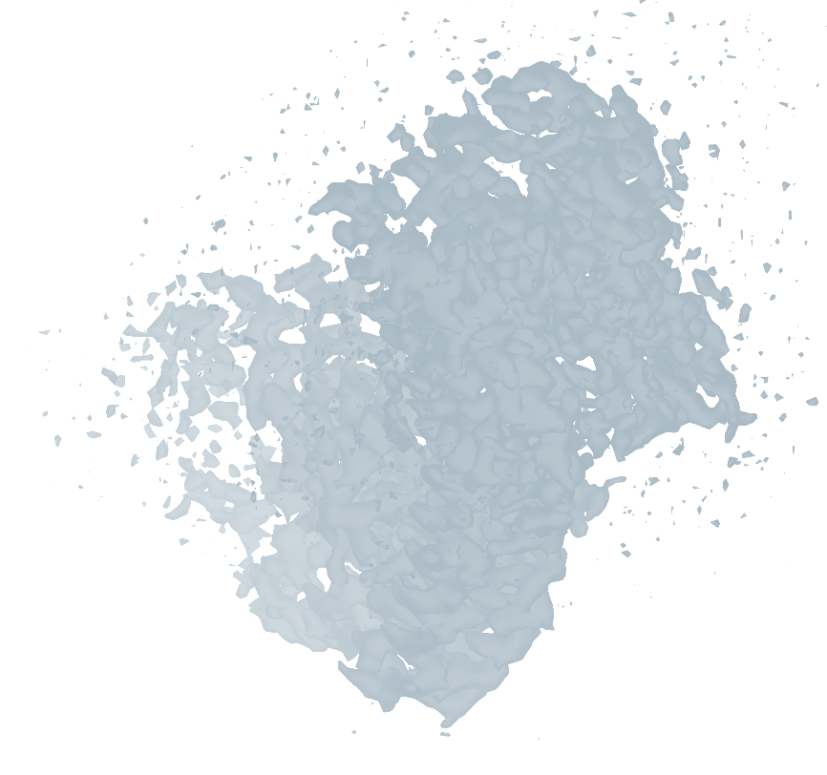
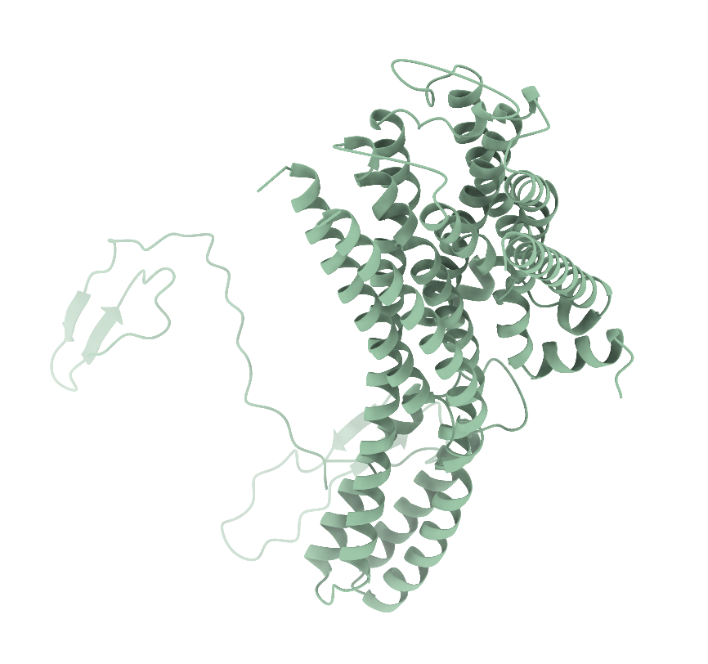
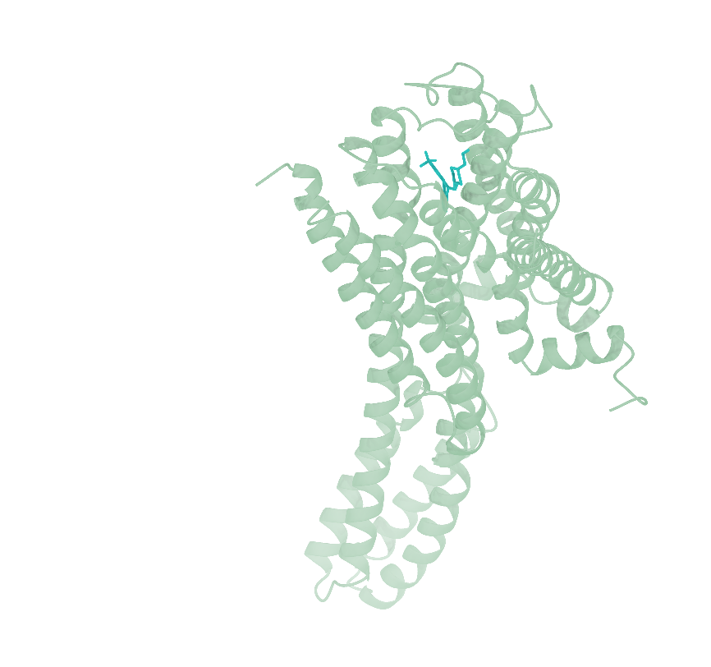
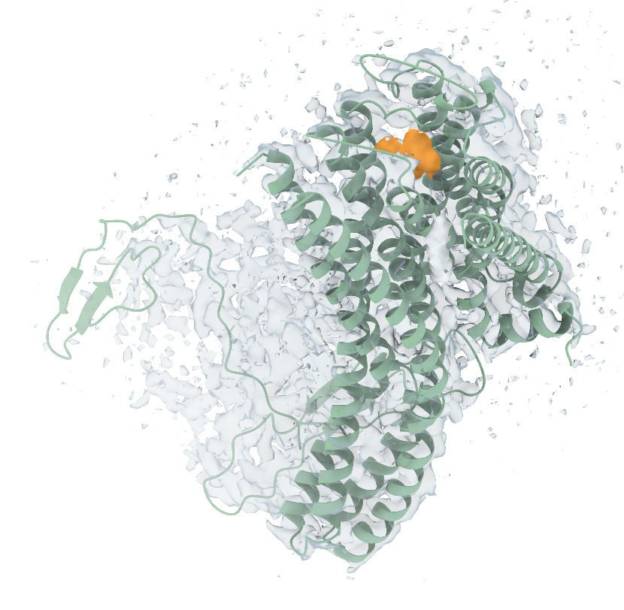
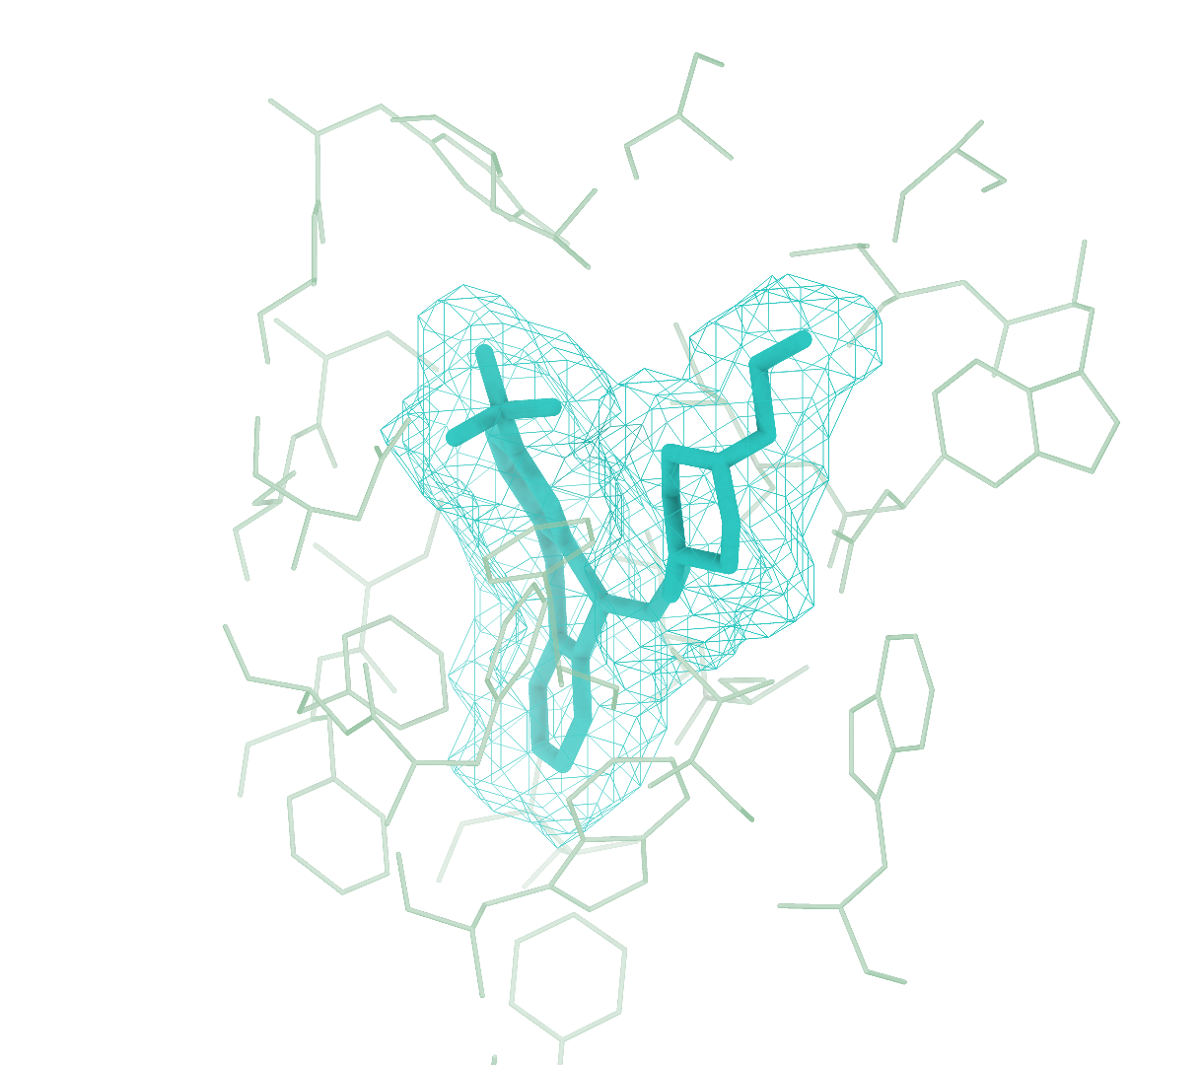
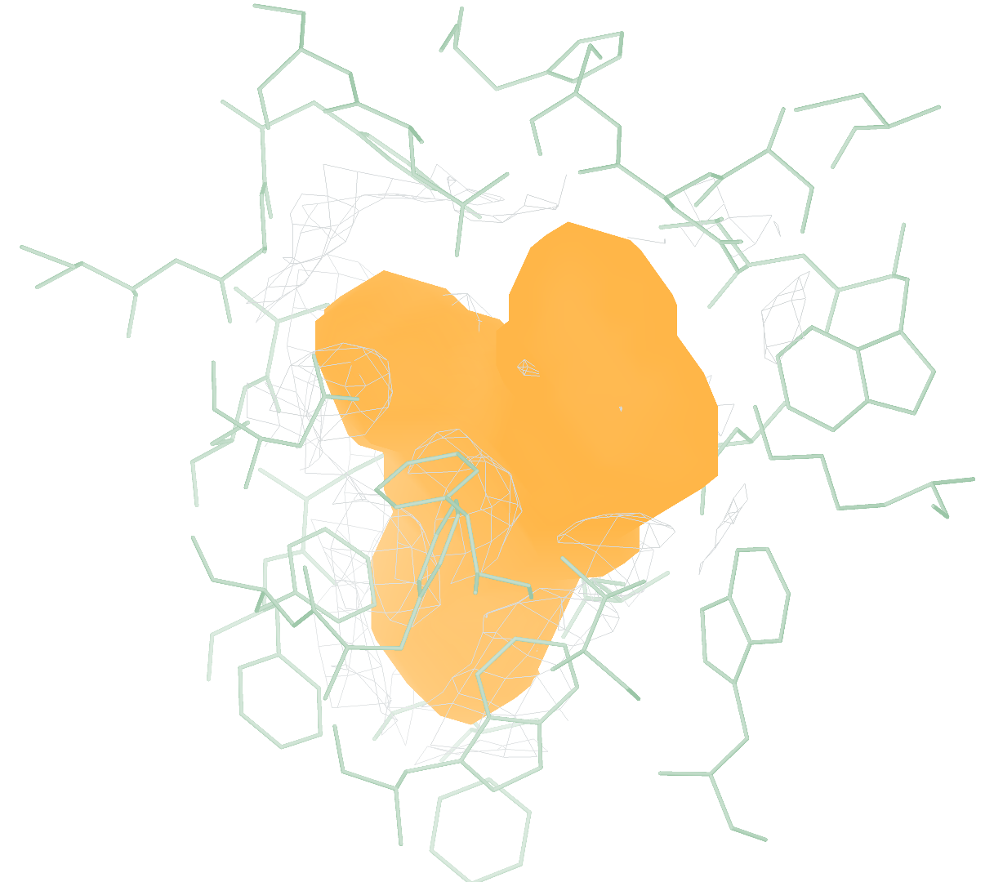
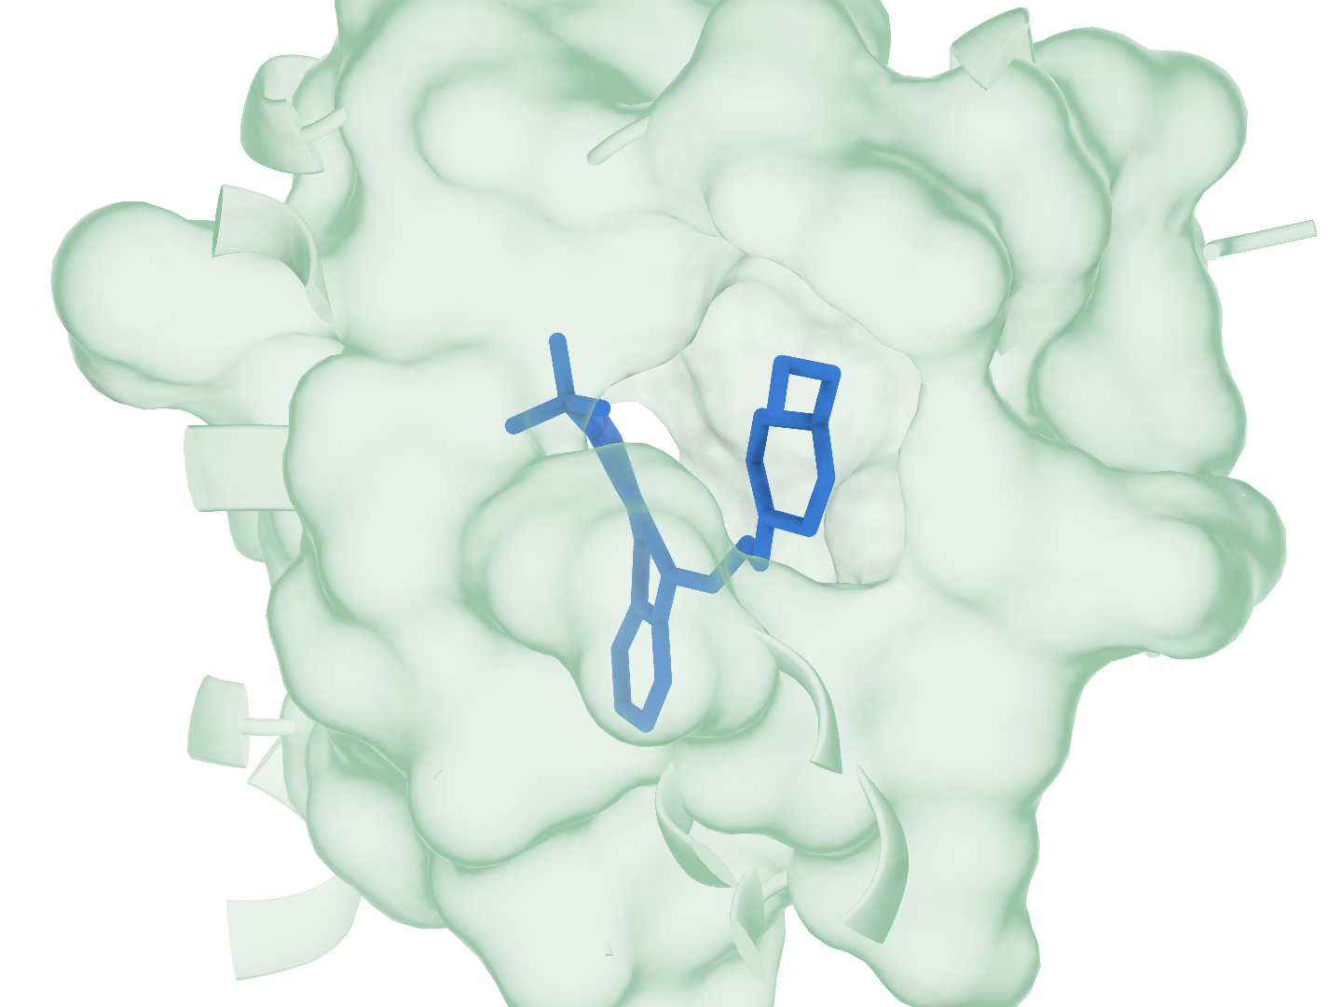
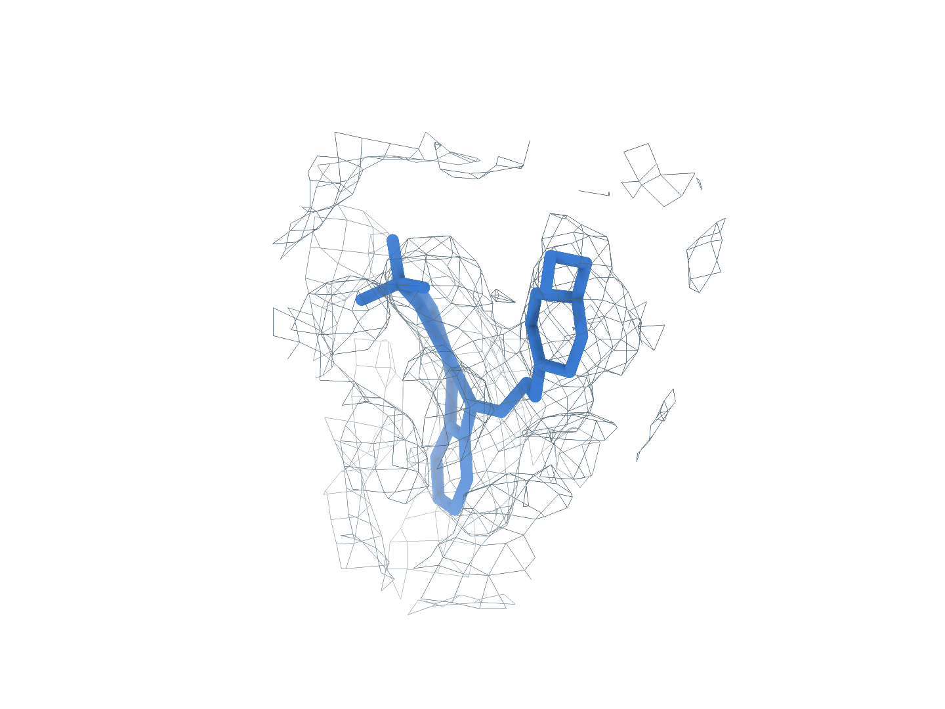
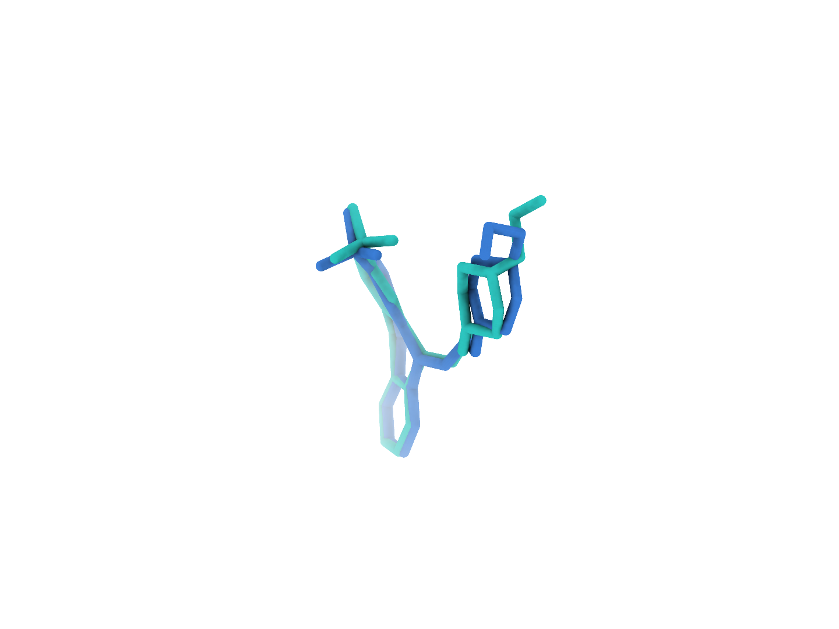
9LLG A1EKL (R:602)
The first-ranked site completes identity matching and pose reconstruction
0
Input
Reconstructing the receptor from the experimental map with CryoAtom2
a
Experimental map
b
CA2 receptor
c
GT receptor (reference)
CryoAtom2
1
Find
Locating candidate ligand regions in the experimental map
d
Global candidates
e
GT neighborhood
f
Find prediction
Rank 1: target ligand
2
Match
Matching candidate regions to ligand SMILES from the same PDB
g
1 Identity1
2 A1EKL
3 Identity3
Matched identity
3
Build
Reconstructing ligand poses with PocketXMol-tuned
h
Receptor surface
i
Experimental density
j
Deposited pose overlay
RMSD 0.88 Å
Receptor
Density
Target blob
Predicted pose
Deposited pose
Notes:
9LLG 中 A1EKL（R:602） 的端到端构象重建。a–c，实验密度、CryoAtom2 重建受体及真实受体（GT）。d，Find 候选区域，图中的框关联着右侧的局部视图；e、f，真实的 ligand area 与 Find 预测的配体区域，它们的朝向和尺度都一致。g，同一 PDB 的全部化学身份，蓝框为 Match 的匹配结果。h–j，PocketXMol-tuned 生成的 top-1 pose 在受体表面、实验密度及沉积构象叠加中的视图。受体绿色，密度灰色，目标区域橙色，预测构象蓝色，沉积构象青绿色。真实受体仅用于参考显示与最终评价，全程均不作为模型的输入。

Slide 2
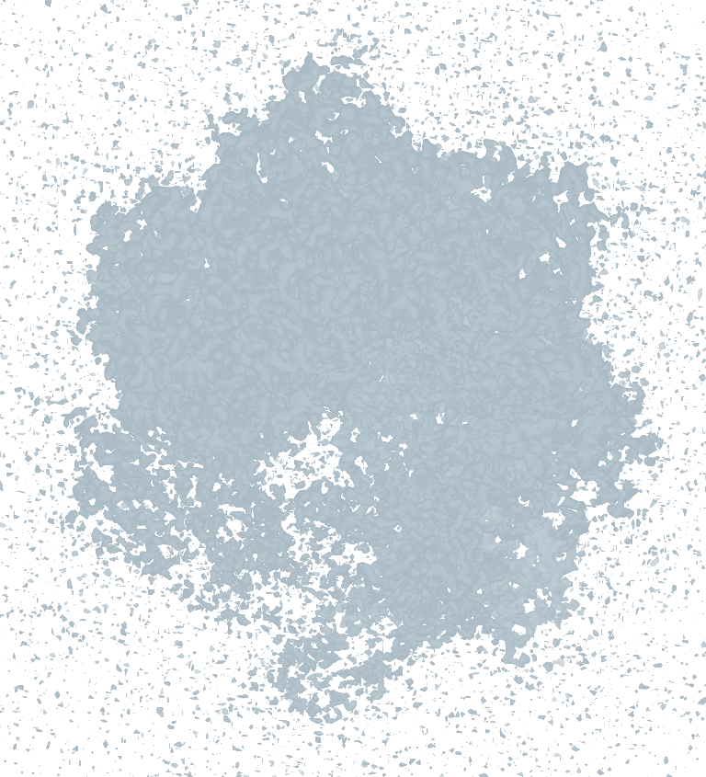
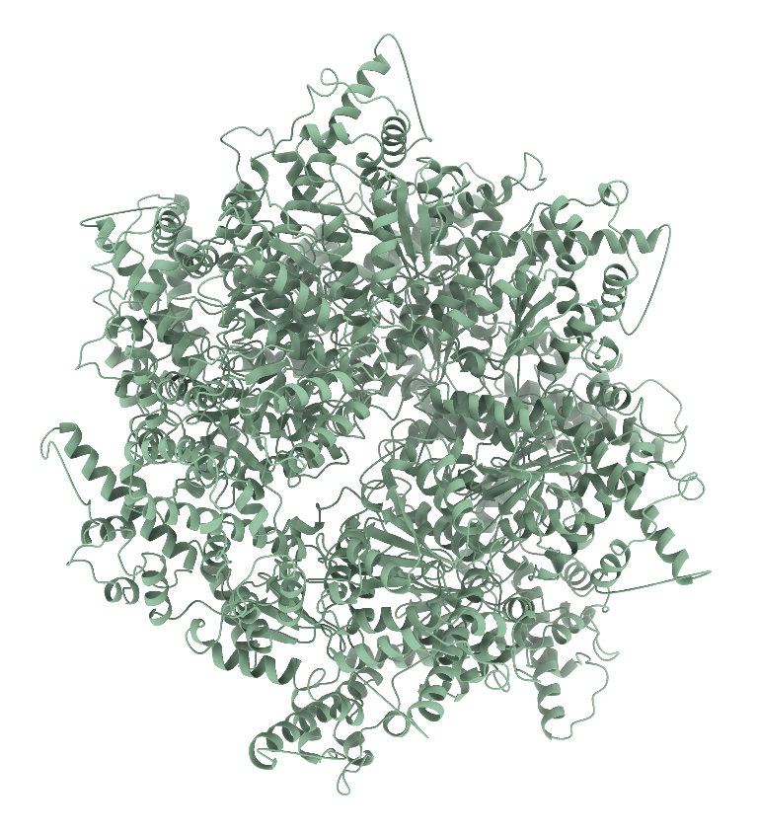
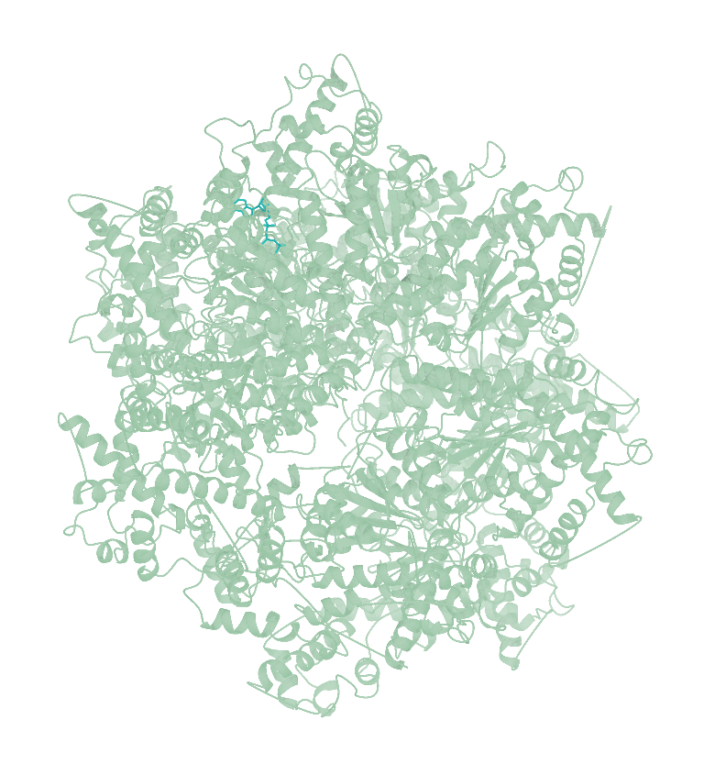
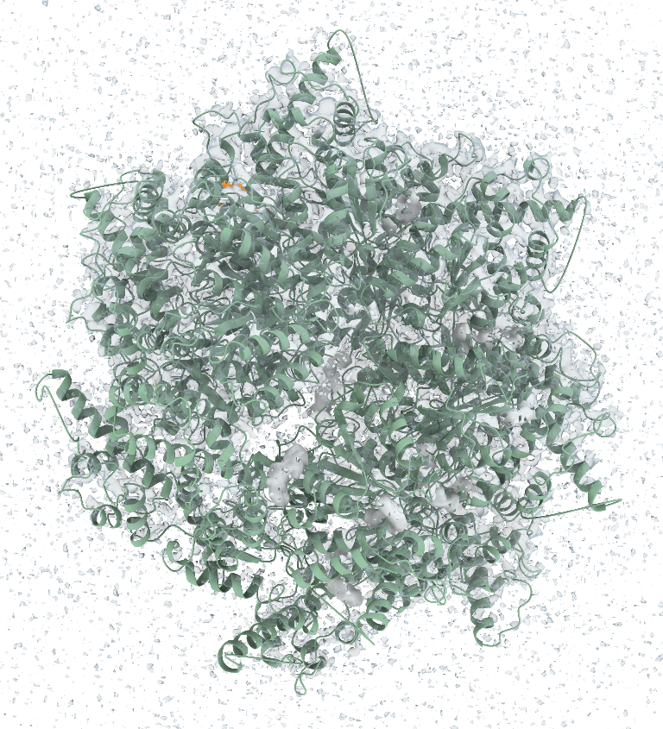
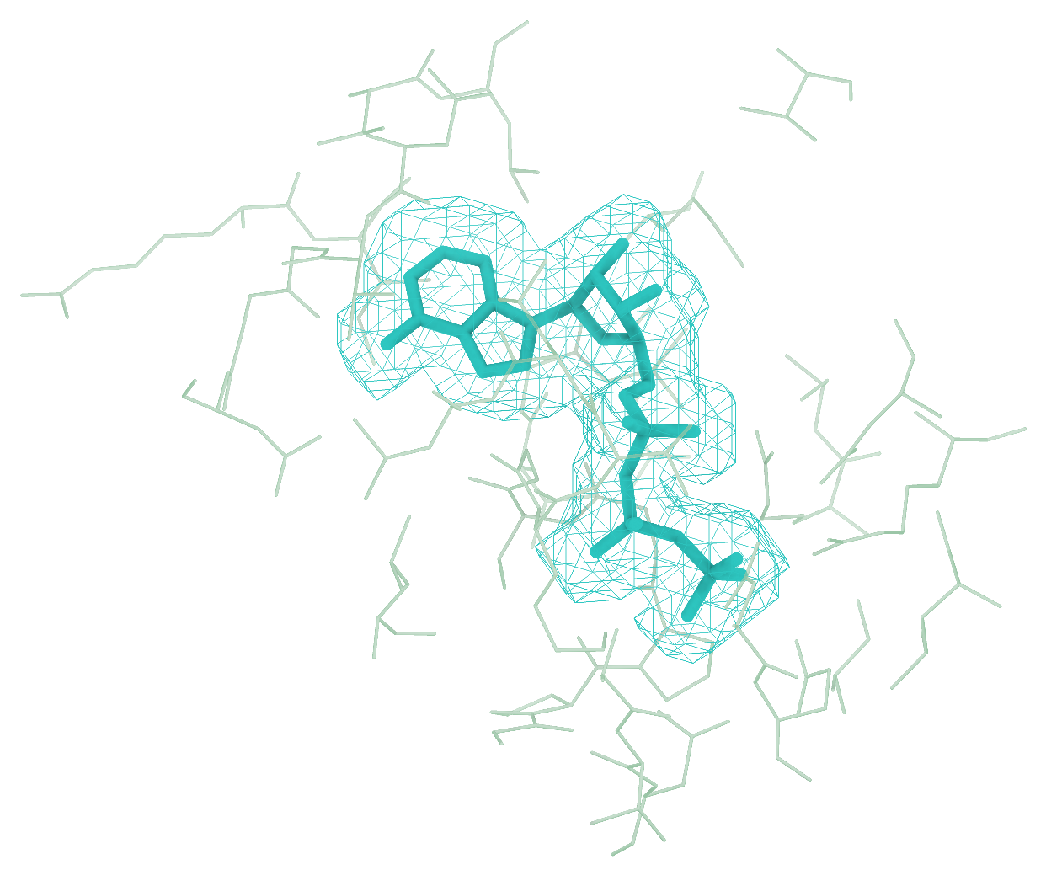
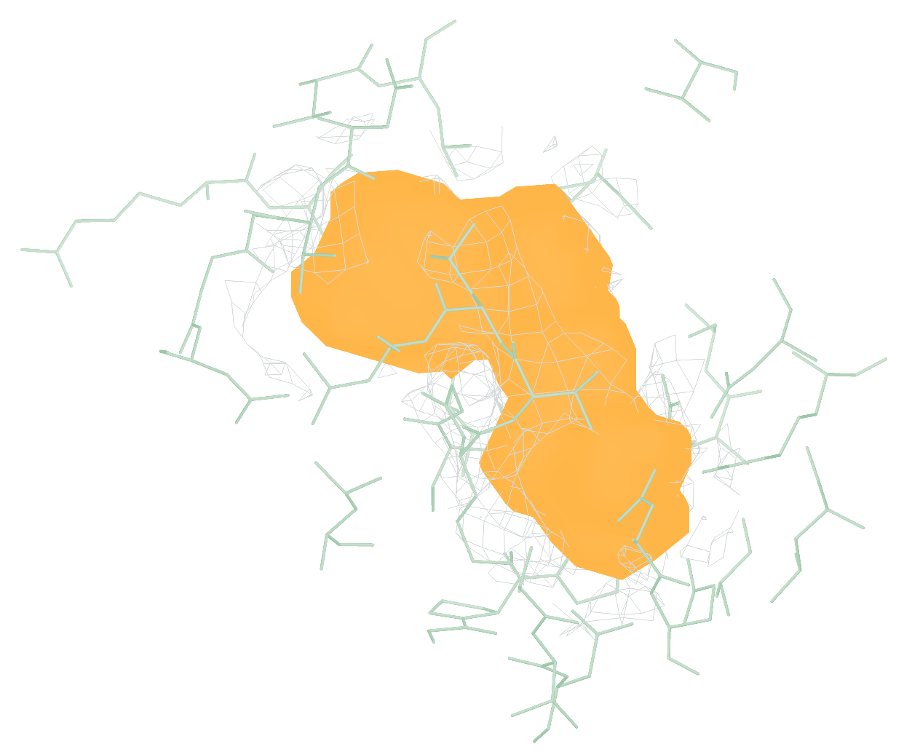
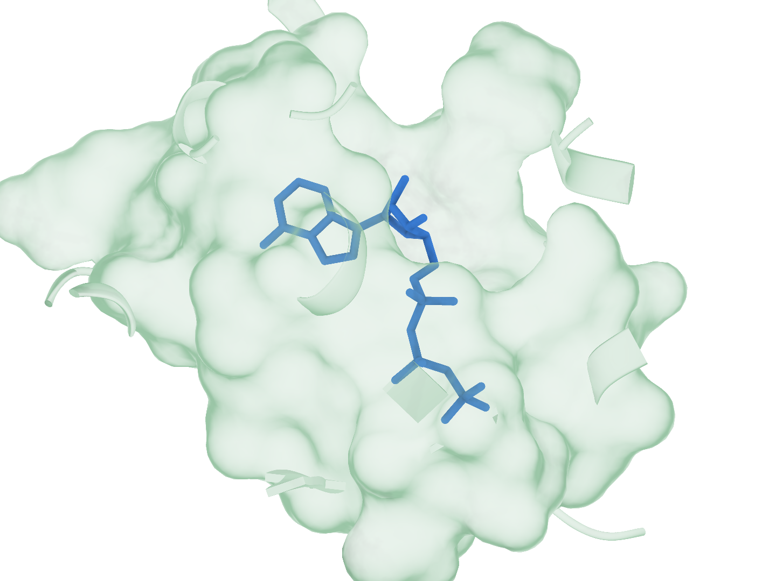
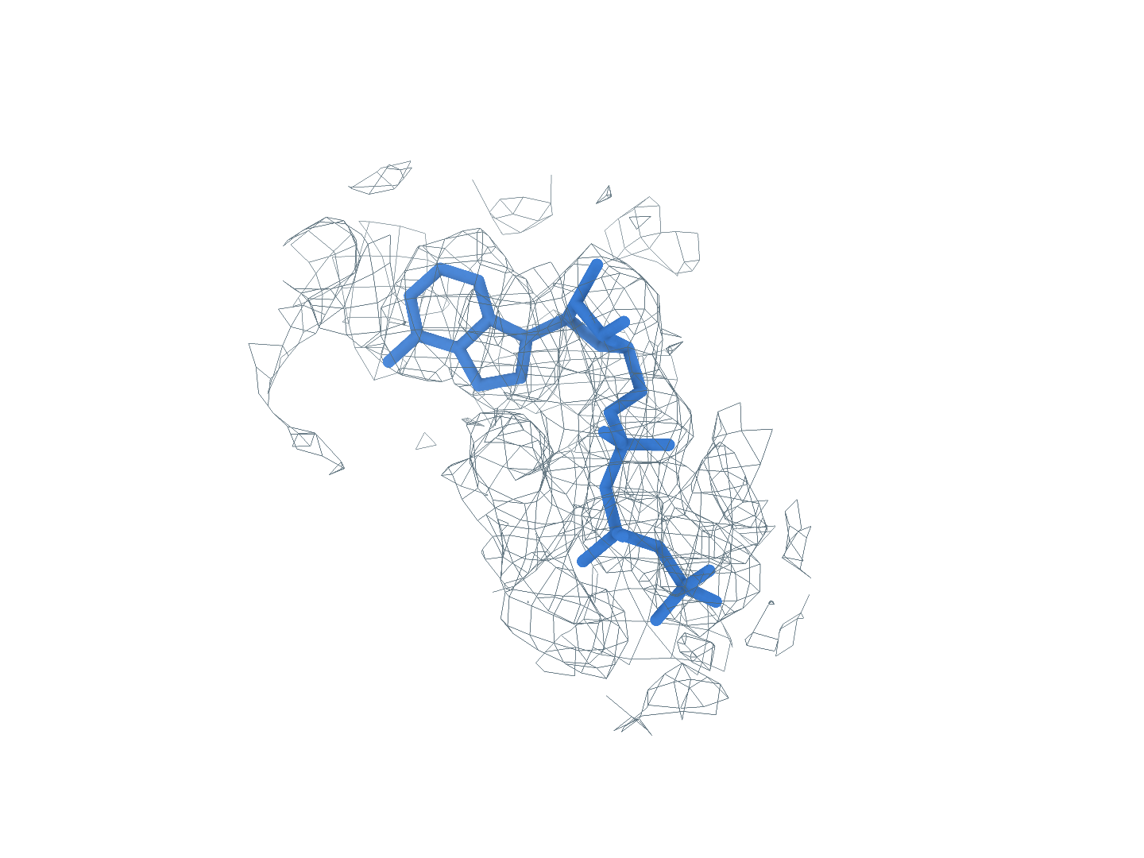
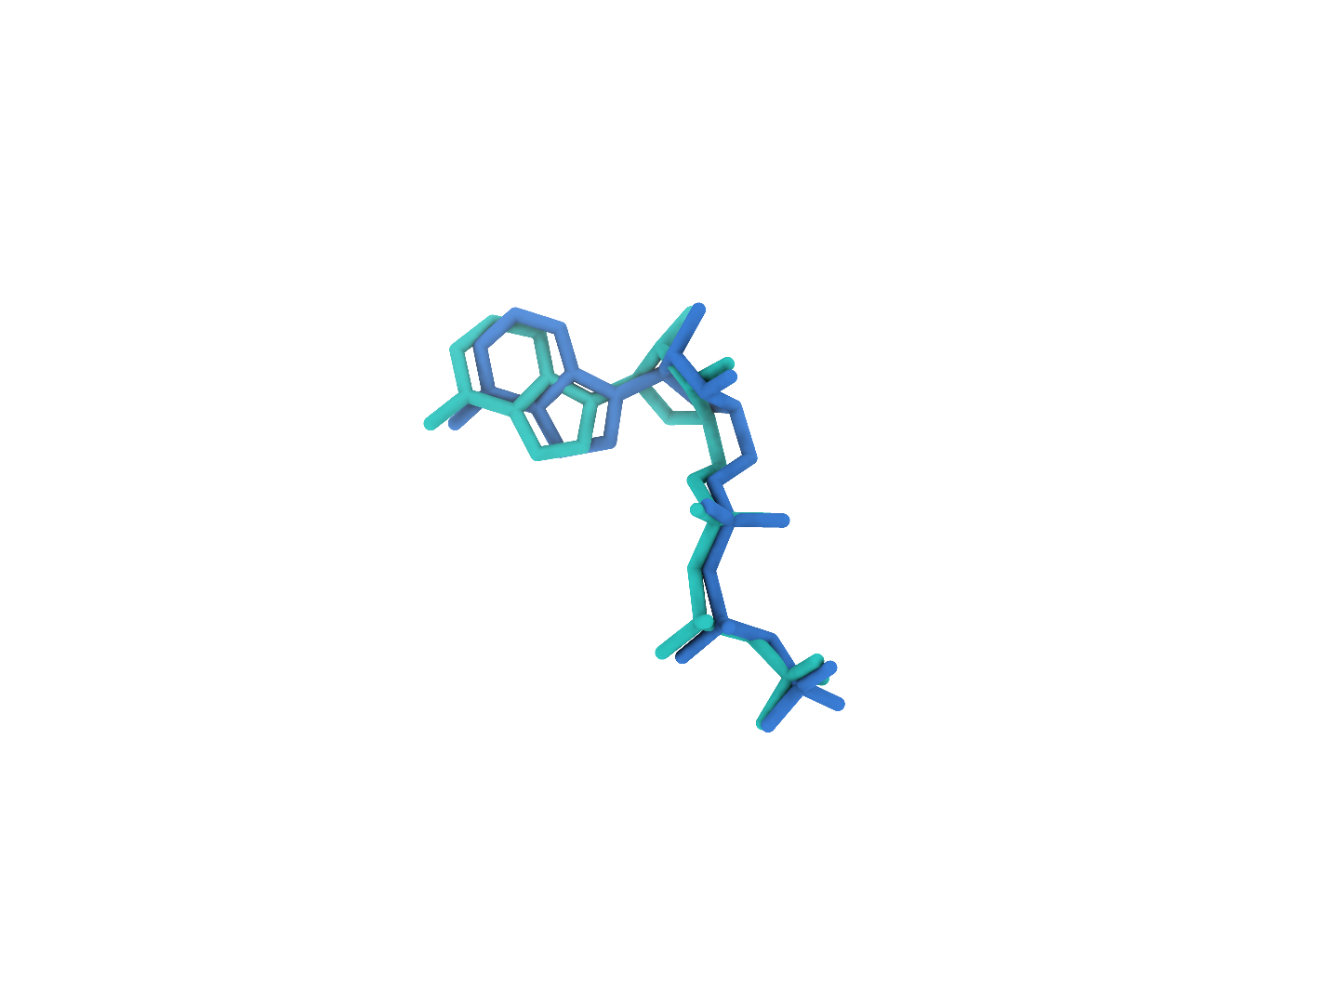
9BJJ ATP (B:901)
The first-ranked site completes identity matching and pose reconstruction
0
Input
Reconstructing the receptor from the experimental map with CryoAtom2
a
Experimental map
b
CA2 receptor
c
GT receptor (reference)
CryoAtom2
1
Find
Locating candidate ligand regions in the experimental map
d
Global candidates
e
GT neighborhood
f
Find prediction
Rank 1: target ligand
2
Match
Matching candidate regions to ligand SMILES from the same PDB
g
1 ATP
2 Identity2
3 Identity3
Matched identity
3
Build
Reconstructing ligand poses with PocketXMol-tuned
h
Receptor surface
i
Experimental density
j
Deposited pose overlay
RMSD 0.80 Å
Receptor
Density
Target blob
Predicted pose
Deposited pose
Notes:
9BJJ 中 ATP（B:901）的端到端构象重建。a–c，实验密度、CryoAtom2 重建受体及真实受体（GT）。d，Find 候选区域，图中的框关联着右侧的局部视图；e、f，真实的 ligand area 与 Find 预测的配体区域，它们的朝向和尺度都一致。g，同一 PDB 的全部化学身份，蓝框为 Match 的匹配结果。h–j，PocketXMol-tuned 生成的 top-1 pose 在受体表面、实验密度及沉积构象叠加中的视图。受体绿色，密度灰色，目标区域橙色，预测构象蓝色，沉积构象青绿色。真实受体仅用于参考显示与最终评价，全程均不作为模型的输入。

Slide 3
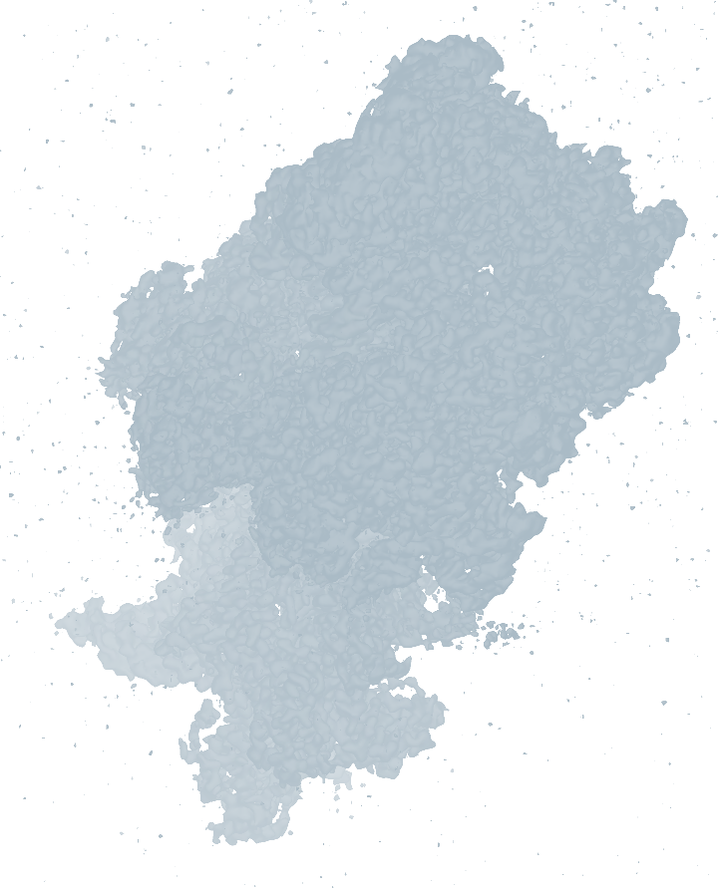
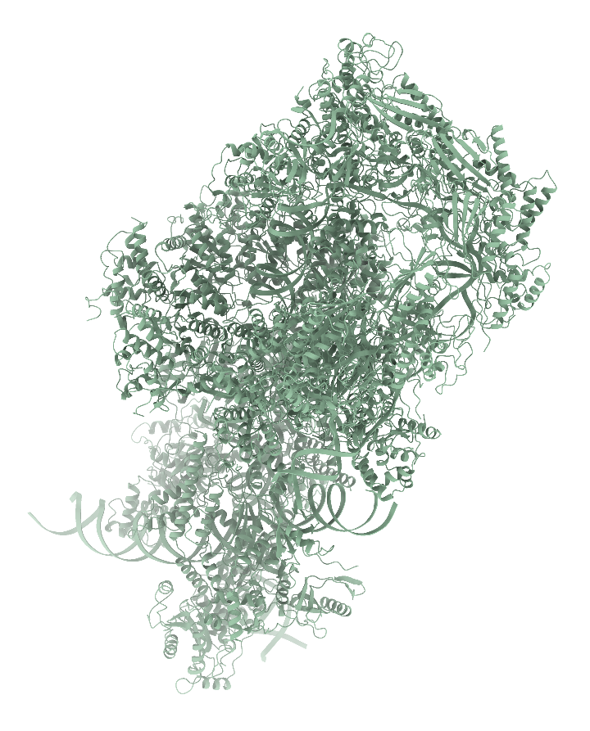
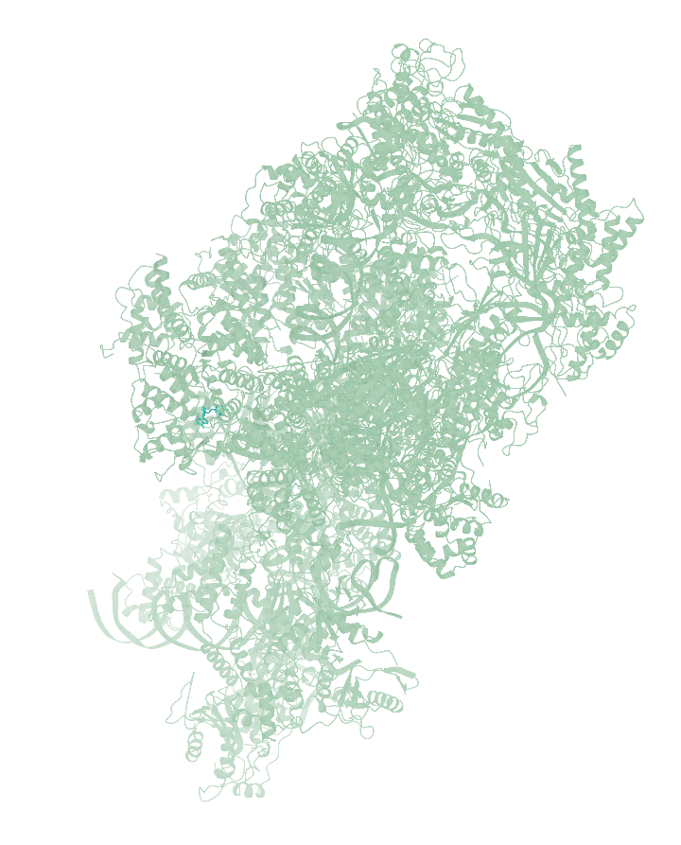
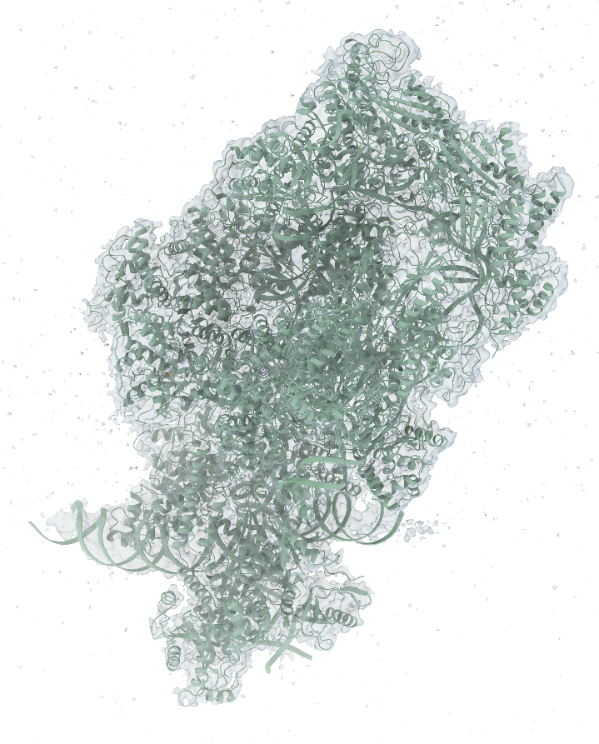
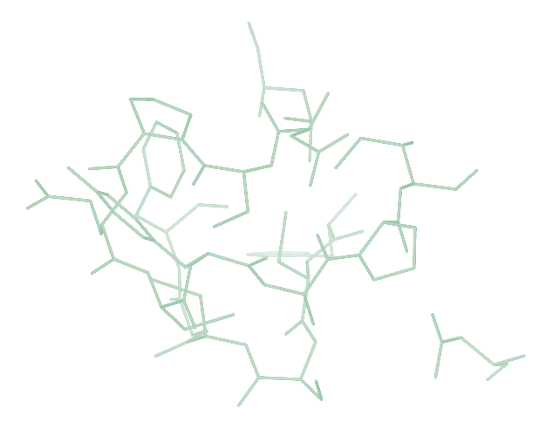
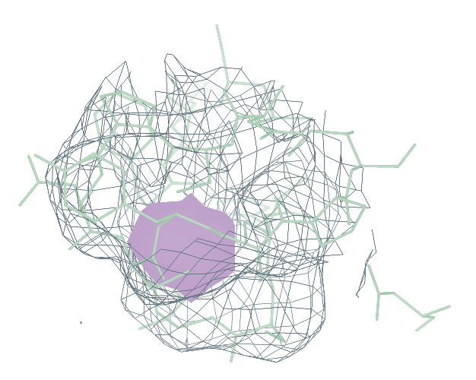
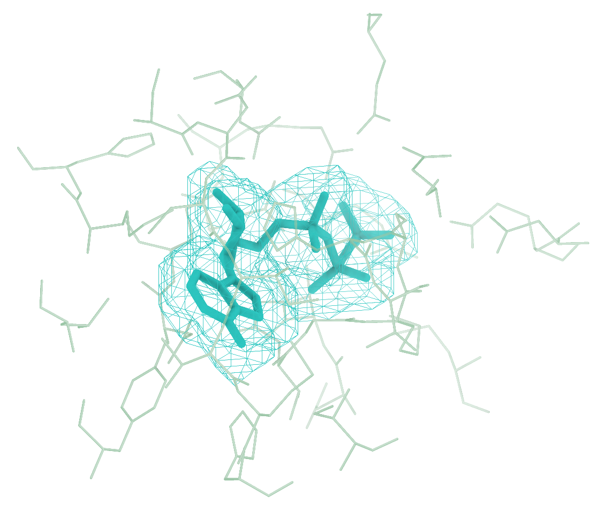
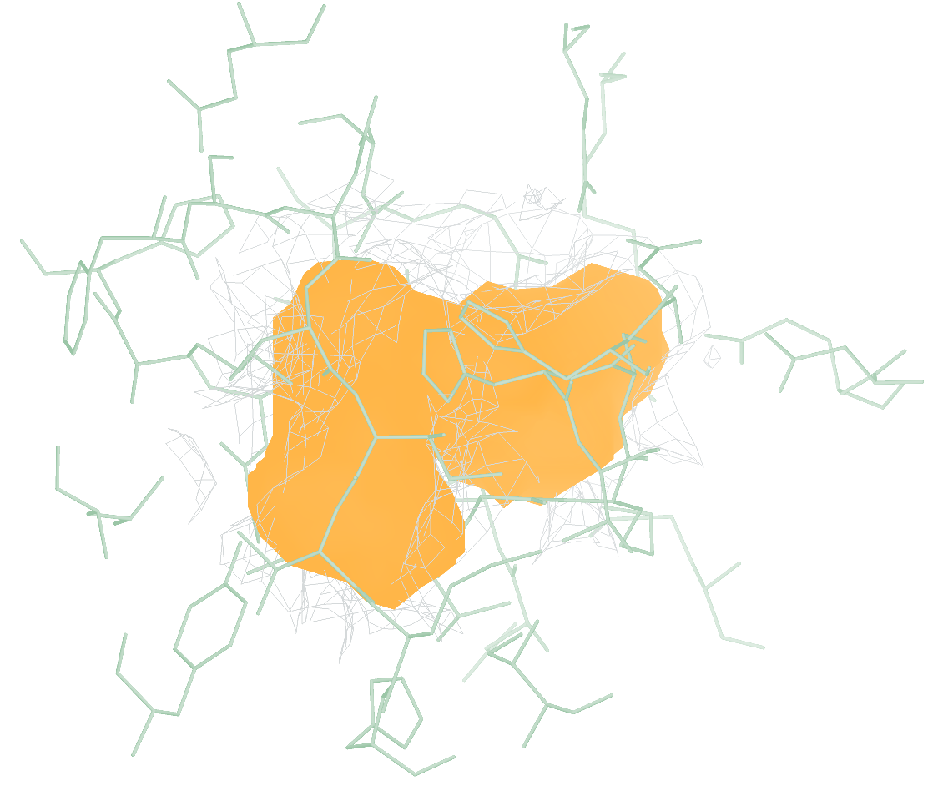
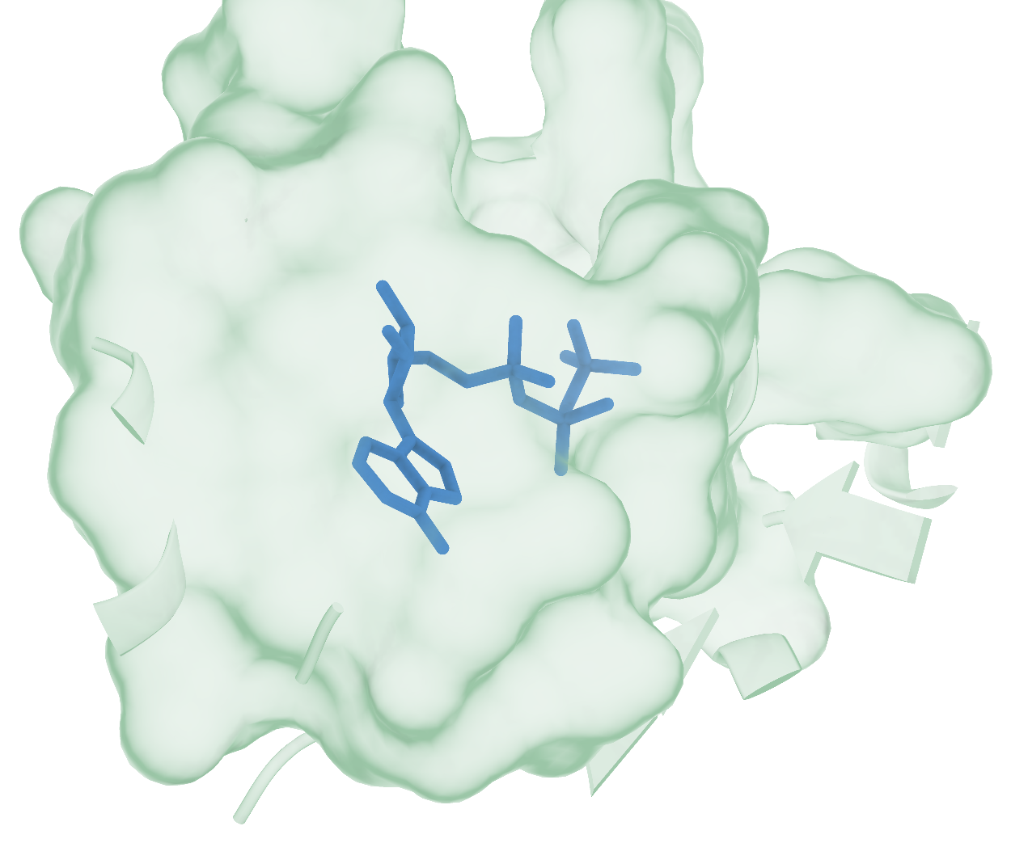
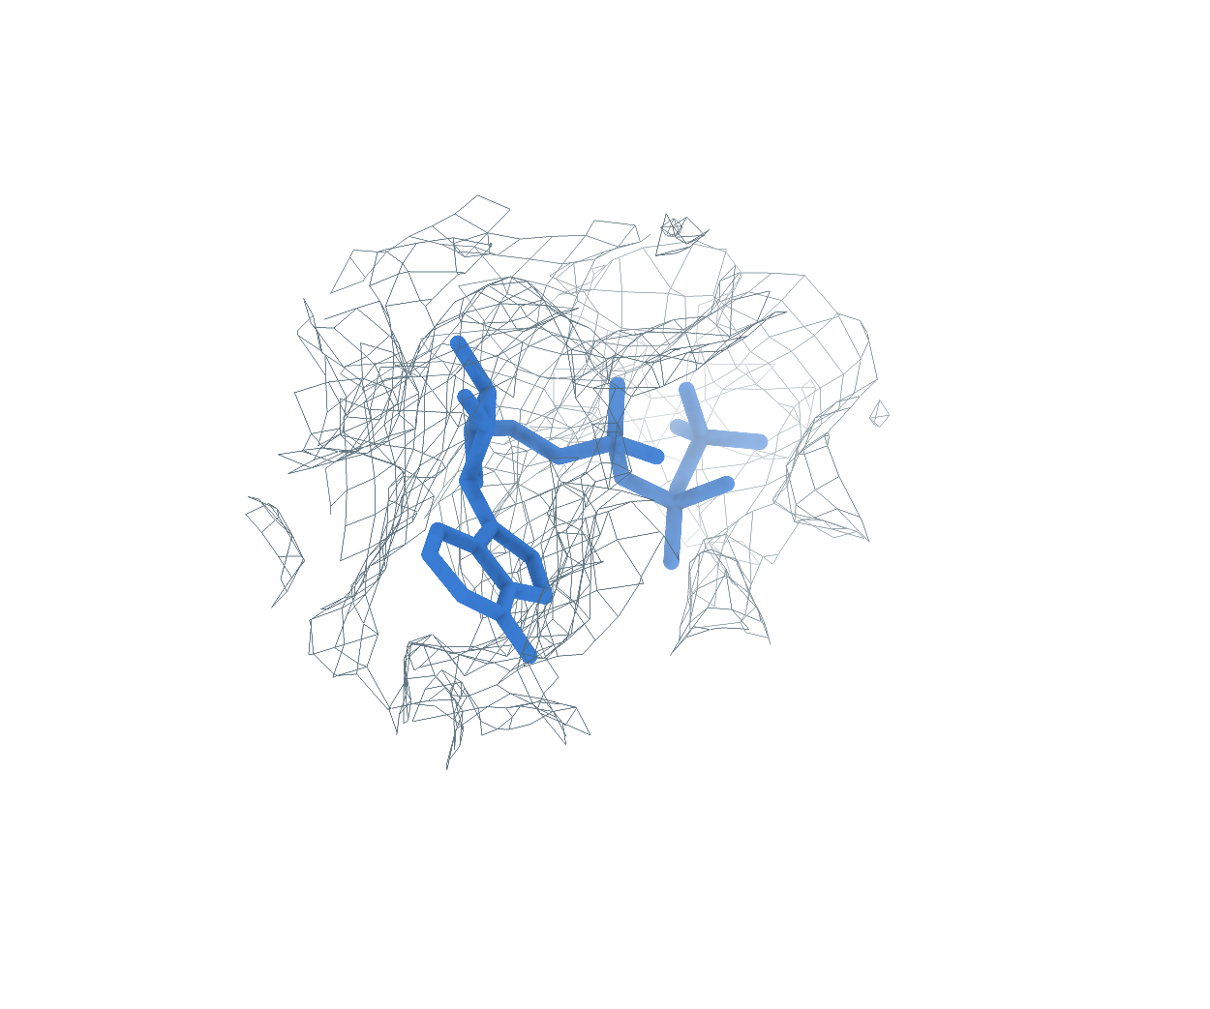
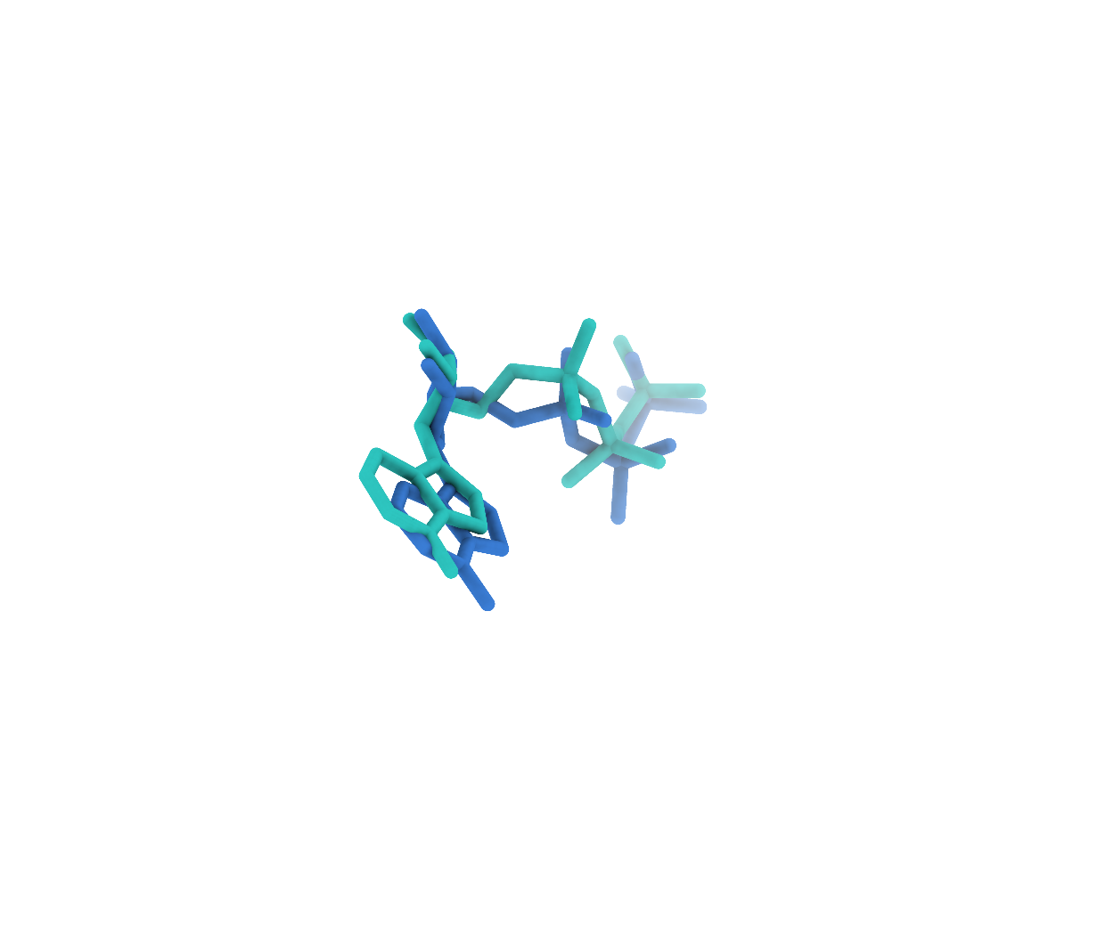
30GA ATP (N:401)
Background at rank 1, successful reconstruction at rank 2
0
Input
Reconstructing the receptor from the experimental map with CryoAtom2
a
Experimental map
b
CA2 receptor
c
GT receptor (reference)
CryoAtom2
1
Find
Locating candidate ligand regions in the experimental map
d
Global candidates
e
GT neighborhood
f
Find prediction
Rank 1: background, one attempt
Rank 2: target ligand, next attempt
2
Match
Matching candidate regions to ligand SMILES from the same PDB
g
1 ATP
2 Identity2
Matched identity
3
Build
Reconstructing ligand poses with PocketXMol-tuned
h
Receptor surface
i
Experimental density
j
Deposited pose overlay
RMSD 1.04 Å
Receptor
Density
Target blob
Predicted pose
Deposited pose
Notes:
30GA 中 ATP（N:401）的端到端构象重建。a–c，实验密度、CryoAtom2 重建受体及真实受体（GT）。d，Find 候选区域，图中的框关联着右侧的局部视图；e、f，真实的 ligand area 与 Find 预测的配体区域，它们的朝向和尺度都一致。g，同一 PDB 的全部化学身份，蓝框为 Match 的匹配结果。h–j，PocketXMol-tuned 生成的 top-1 pose 在受体表面、实验密度及沉积构象叠加中的视图。受体绿色，密度灰色，目标区域橙色，预测构象蓝色，沉积构象青绿色。真实受体仅用于参考显示与最终评价，全程均不作为模型的输入。

Slide 4
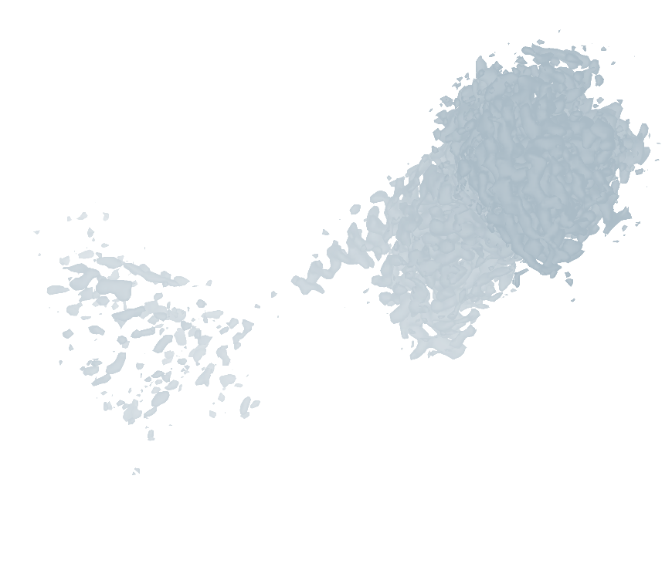
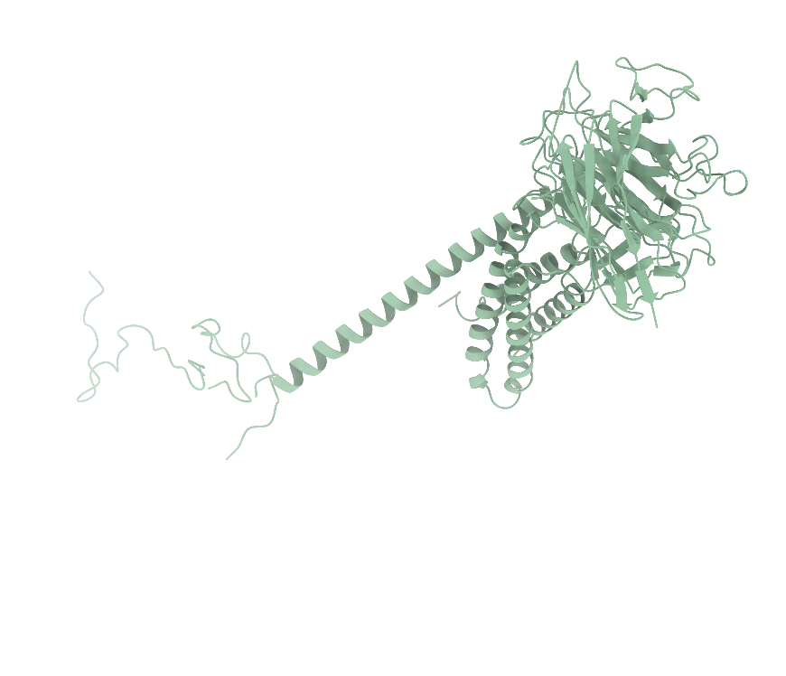
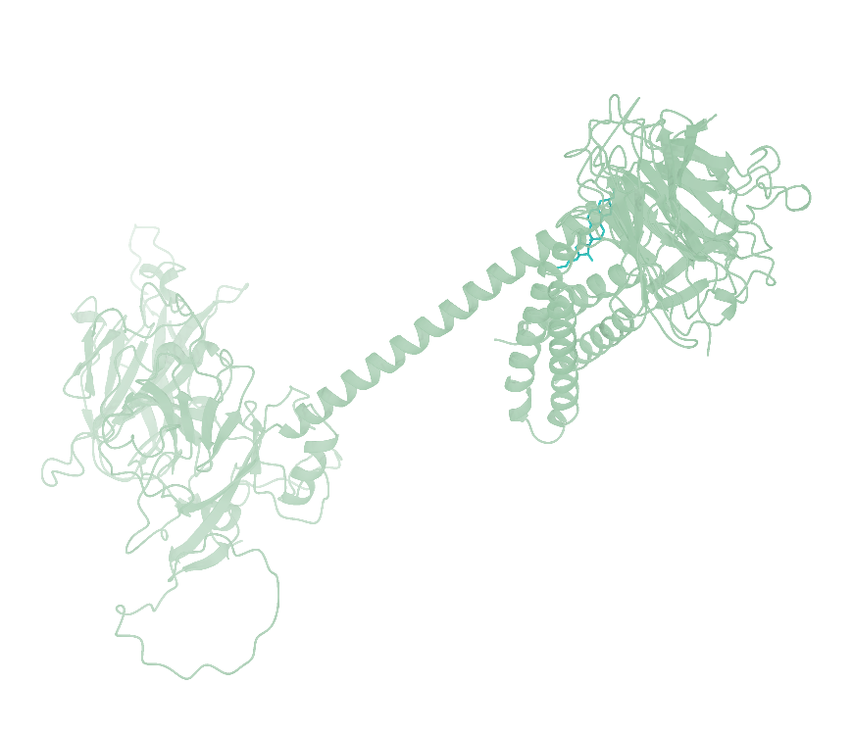
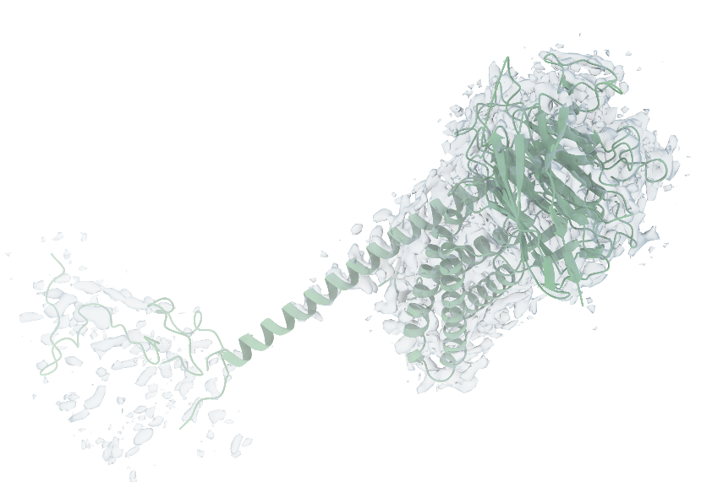
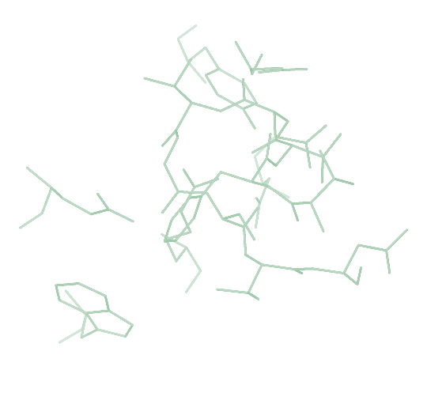
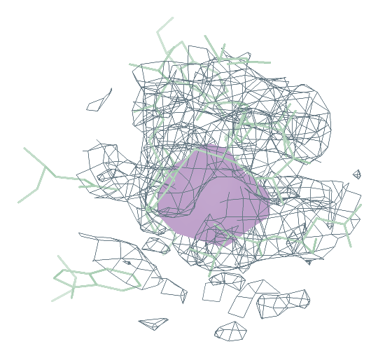
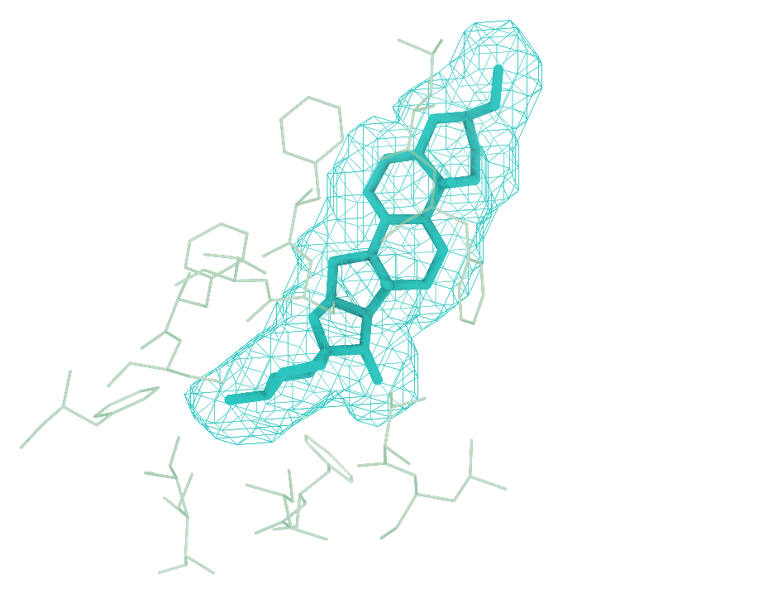
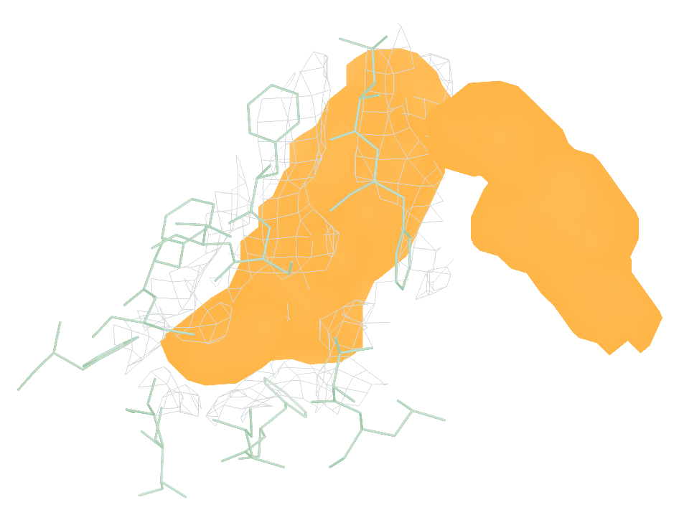
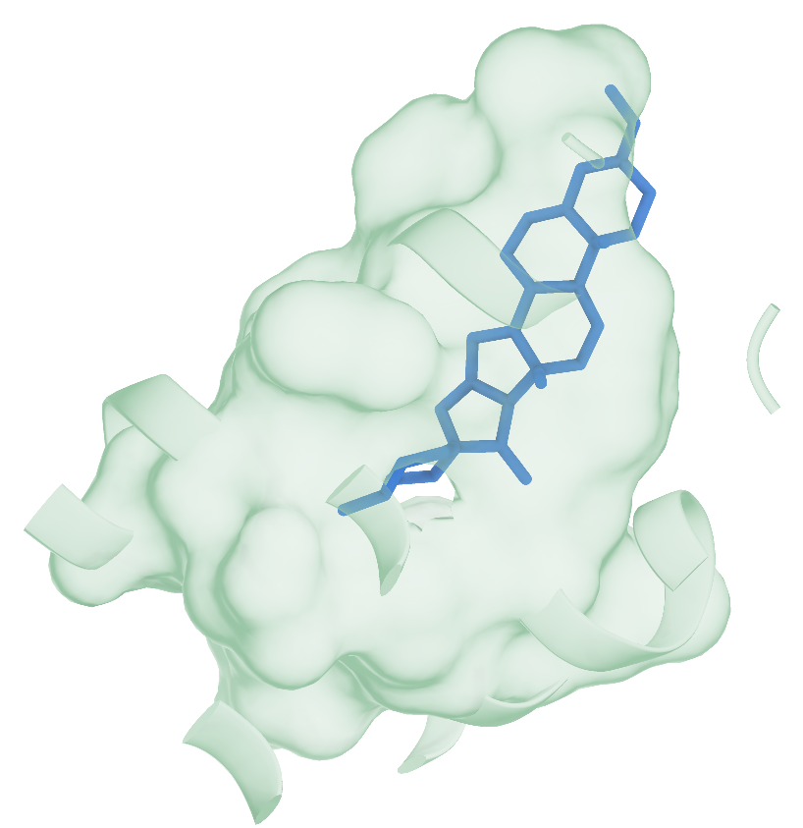
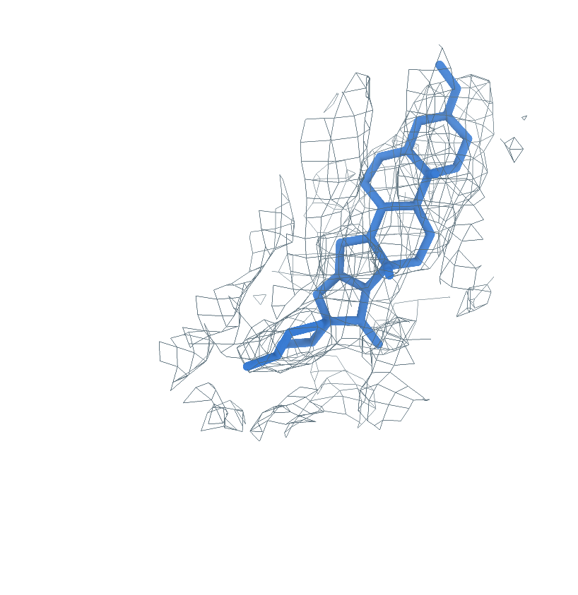
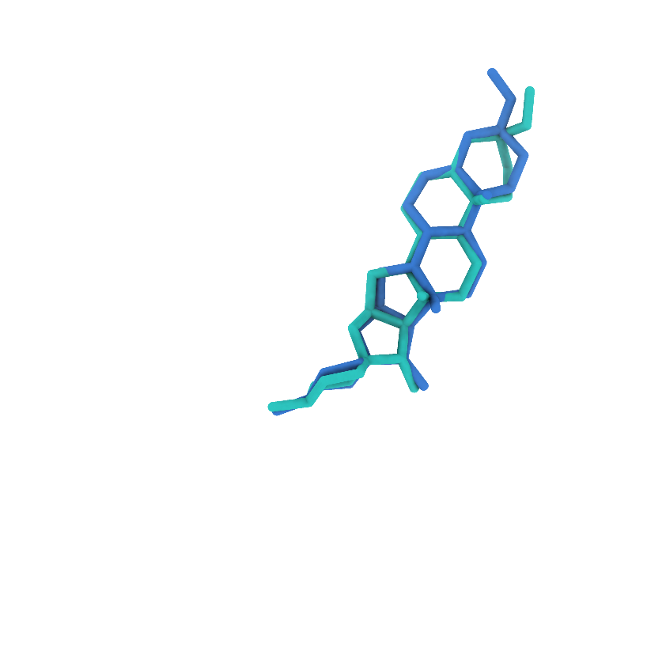
9QRU A1JAX (B:2801)
Background at rank 1, successful reconstruction at rank 2
0
Input
Reconstructing the receptor from the experimental map with CryoAtom2
a
Experimental map
b
CA2 receptor
c
GT receptor (reference)
CryoAtom2
1
Find
Locating candidate ligand regions in the experimental map
d
Global candidates
e
GT neighborhood
f
Find prediction
Rank 1: background, one attempt
Rank 2: target ligand, next attempt
2
Match
Matching candidate regions to ligand SMILES from the same PDB
g
1 A1JAX
2 Identity2
3 Identity3
Matched identity
3
Build
Reconstructing ligand poses with PocketXMol-tuned
h
Receptor surface
i
Experimental density
j
Deposited pose overlay
RMSD 0.63 Å
Receptor
Density
Target blob
Predicted pose
Deposited pose
Notes:
备选图｜9QRU 的完整重建流程。首位背景消耗一次尝试，未进入 Match 或 Build；第二位 A1JAX(B:2801) 完成重建。a–c，实验密度、CryoAtom2 重建受体及隔开的 GT 受体参考。d，预测 blob 的全局分布，彩框关联局部视图；e、f，GT 邻域与 Find 局部对照，同组朝向和尺度一致。g，原顺序的全部 3 个 SMILES 身份，全身份 Match Top-1 的正确项由蓝框标出。h–j，PocketXMol-tuned 自评分首位姿态的受体、密度和沉积构象叠加视图，重原子 RMSD 0.63 Å。受体绿色，密度灰色，目标 blob 橙色，背景灰紫色，预测构象蓝色，沉积构象青绿色。所示目标位点生成 50 个姿态，每姿态 100 步采样；GT 用于参考显示与最终评价。该候选原入选标记为 false，仍按完整顺序评价。

Slide 5
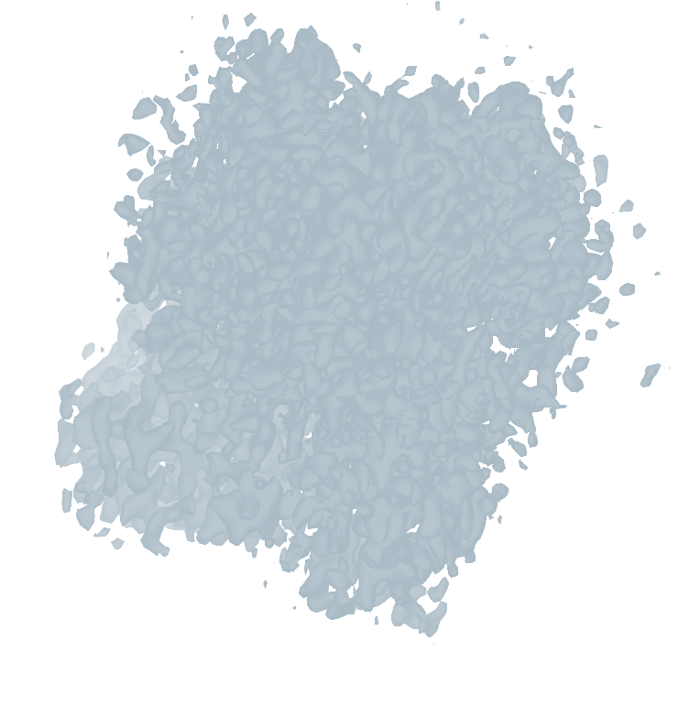
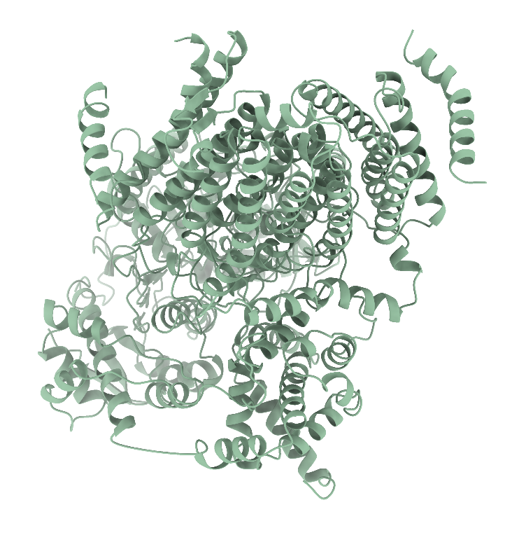
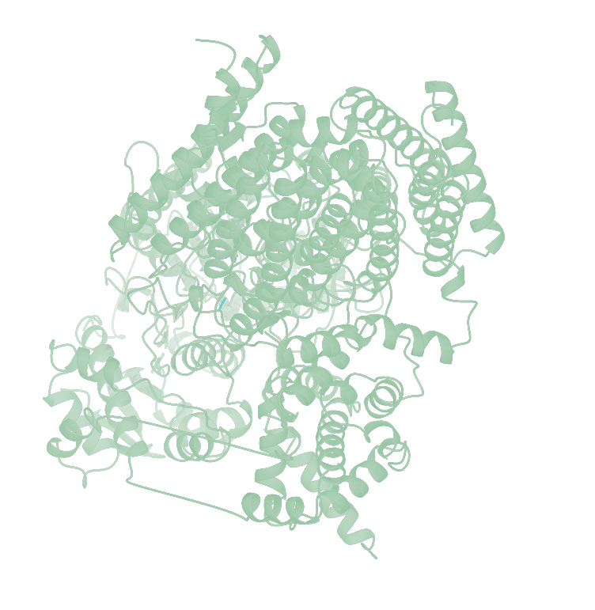
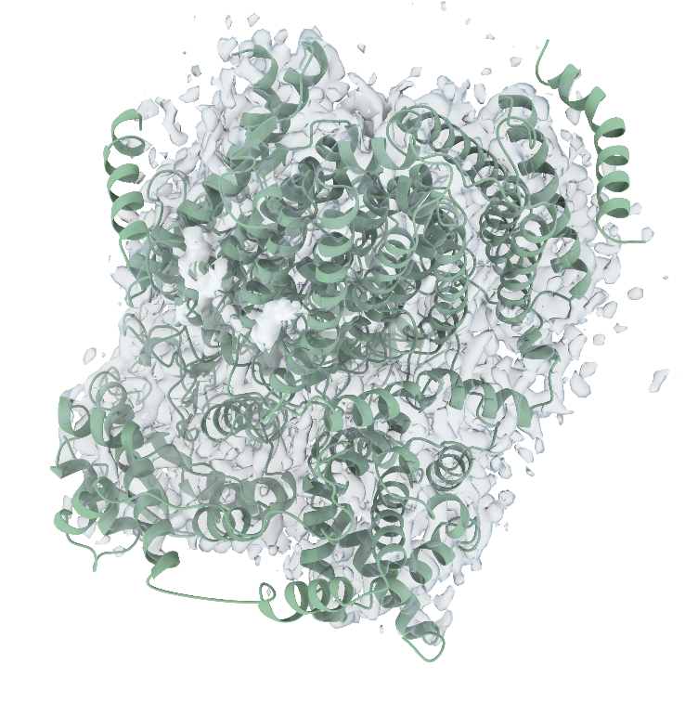
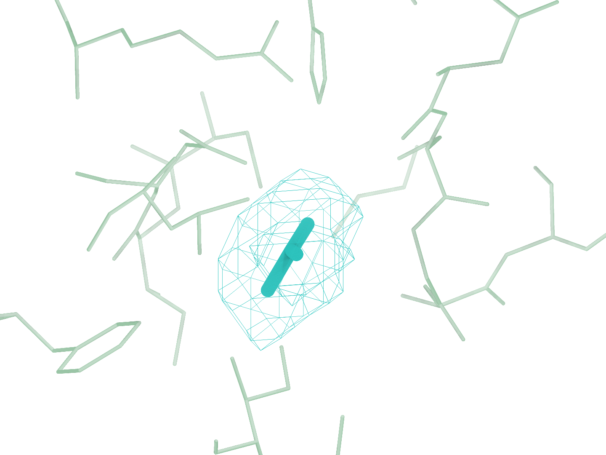
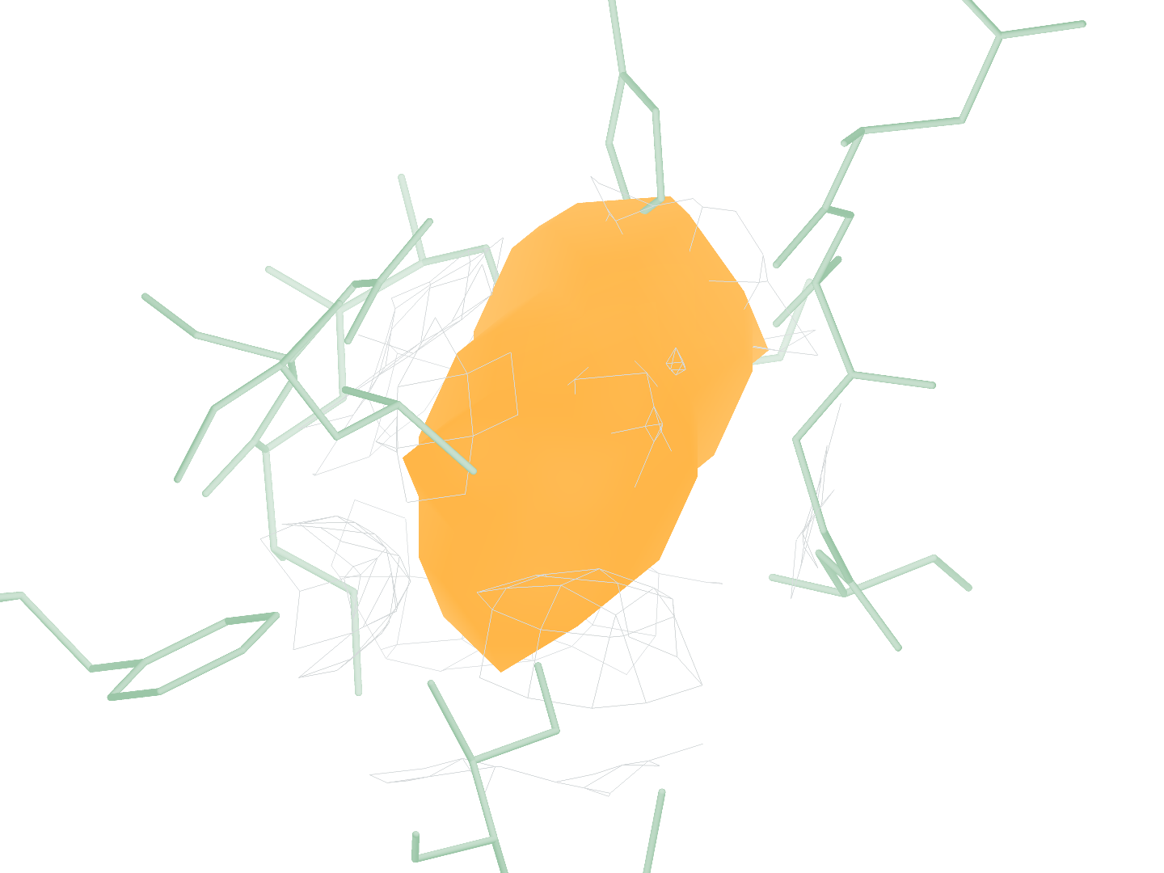
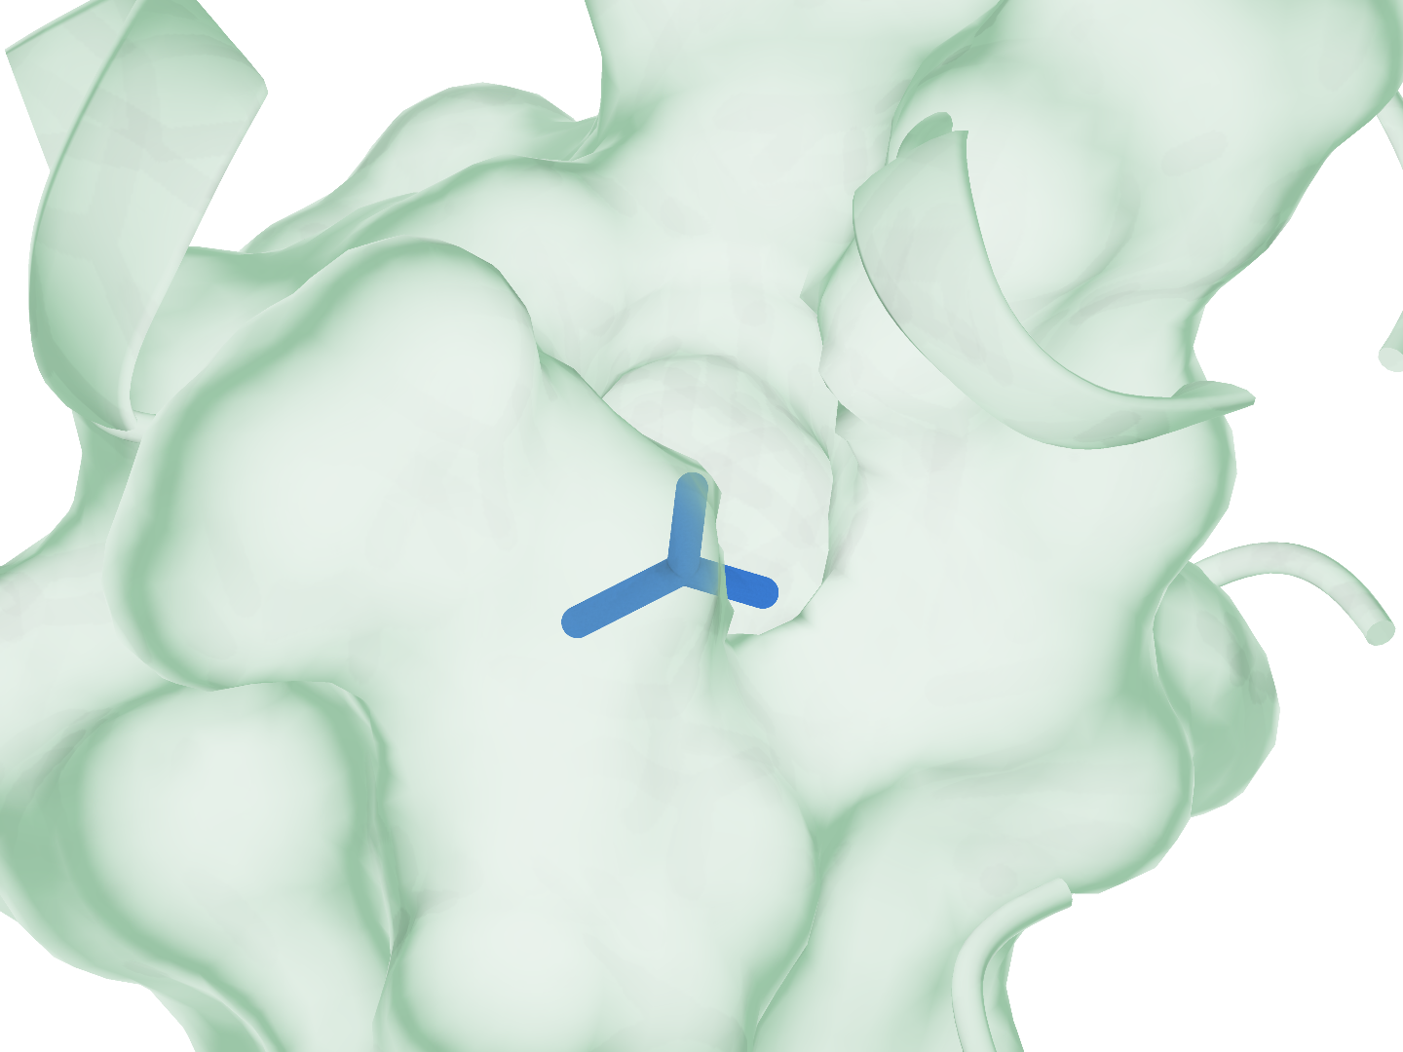
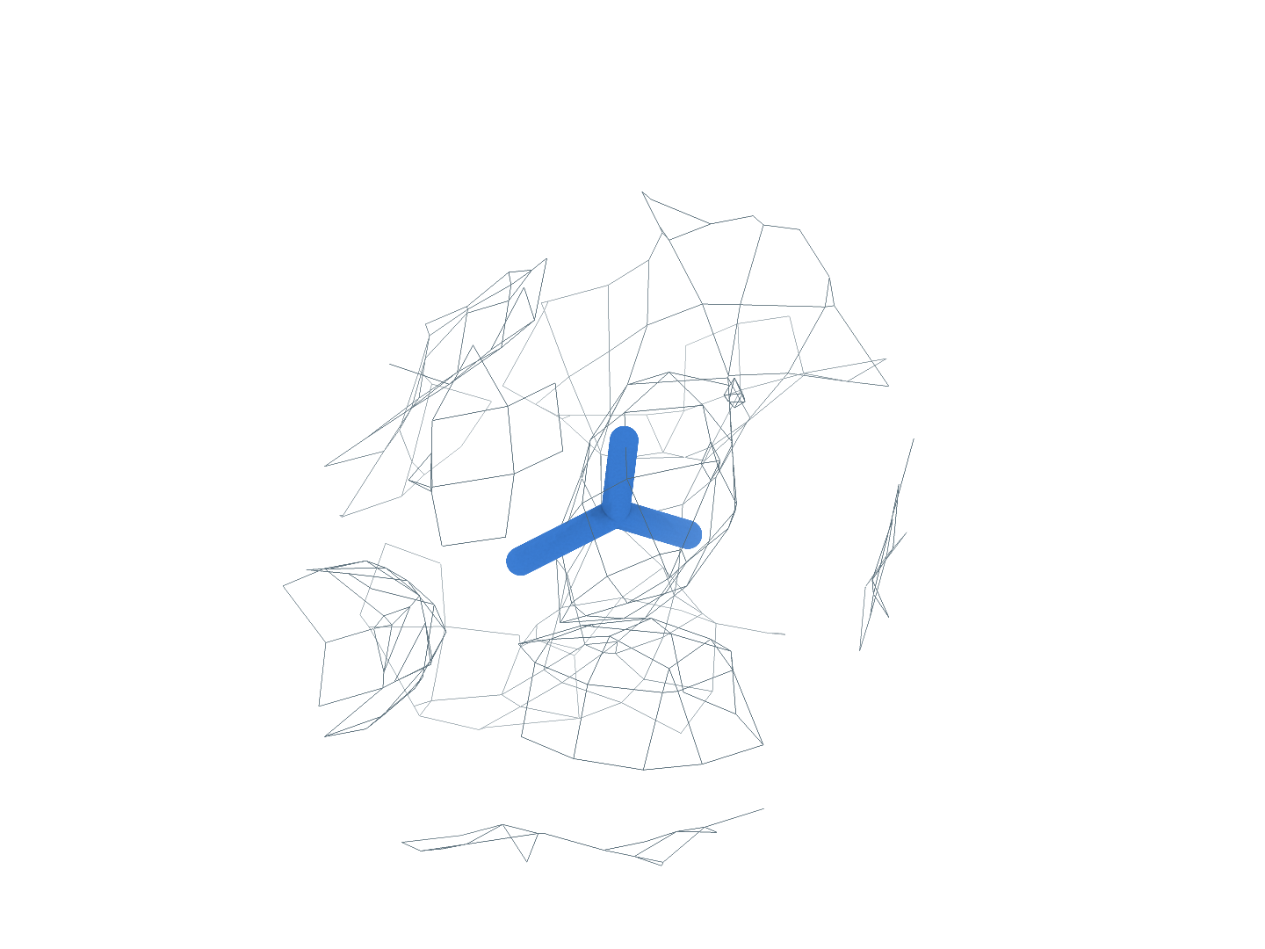

9RD8 BCT (A:902)
The first-ranked site completes identity matching and pose reconstruction
0
Input
Reconstructing the receptor from the experimental map with CryoAtom2
a
Experimental map
b
CA2 receptor
c
GT receptor (reference)
CryoAtom2
1
Find
Locating candidate ligand regions in the experimental map
d
Global candidates
e
GT neighborhood
f
Find prediction
Rank 1: target ligand
2
Match
Matching candidate regions to ligand SMILES from the same PDB
g
1 Identity1
2 BCT
3 Identity3
4 Identity4
Matched identity
3
Build
Reconstructing ligand poses with PocketXMol-tuned
h
Receptor surface
i
Experimental density
j
Deposited pose overlay
RMSD 0.96 Å
Receptor
Density
Target blob
Predicted pose
Deposited pose
Notes:
备选图｜9RD8 的完整重建流程。首位 BCT(A:902) 依次完成区域检出、身份匹配和构象重建。a–c，实验密度、CryoAtom2 重建受体及隔开的 GT 受体参考。d，预测 blob 的全局分布，彩框关联局部视图；e、f，GT 邻域与 Find 局部对照，同组朝向和尺度一致。g，原顺序的全部 4 个 SMILES 身份，全身份 Match Top-1 的正确项由蓝框标出。h–j，PocketXMol-tuned 自评分首位姿态的受体、密度和沉积构象叠加视图，重原子 RMSD 0.96 Å。受体绿色，密度灰色，目标 blob 橙色，背景灰紫色，预测构象蓝色，沉积构象青绿色。所示目标位点生成 50 个姿态，每姿态 100 步采样；GT 用于参考显示与最终评价。

Slide 6
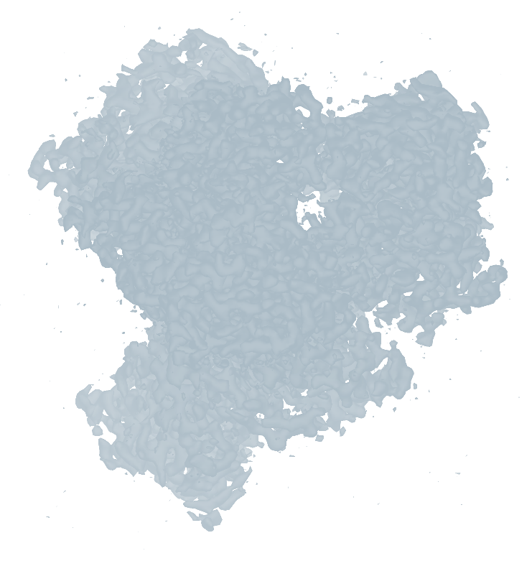
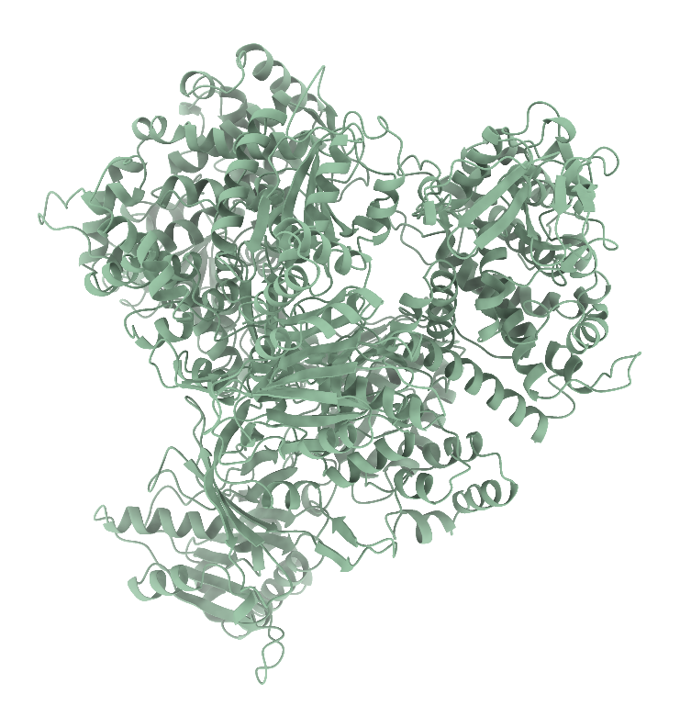







9WUP FMN (B:1103)
Earlier out-of-scope ligands; reconstruction at rank 3
0
Input
Reconstructing the receptor from the experimental map with CryoAtom2
a
Experimental map
b
CA2 receptor
c
GT receptor (reference)
CryoAtom2
1
Find
Locating candidate ligand regions in the experimental map
d
Global candidates
e
GT neighborhood
f
Find prediction
Rank 3: target ligand
Ranks 1–2: free scope skips
2
Match
Matching candidate regions to ligand SMILES from the same PDB
g
1 HEM
2 Identity2
3 FMN
4 Identity4
Matched identity
3
Build
Reconstructing ligand poses with PocketXMol-tuned
h
Receptor surface
i
Experimental density
j
Deposited pose overlay
RMSD 0.52 Å
Receptor
Density
Target blob
Predicted pose
Deposited pose
Notes:
备选图｜9WUP 的完整重建流程。前 2 位范围外小分子身份匹配正确，免费跳过，第 3 位 FMN(B:1103) 为首个计费候选。a–c，实验密度、CryoAtom2 重建受体及隔开的 GT 受体参考。d，预测 blob 的全局分布，彩框关联局部视图；e、f，GT 邻域与 Find 局部对照，同组朝向和尺度一致。g，原顺序的全部 4 个 SMILES 身份，全身份 Match Top-1 的正确项由蓝框标出。h–j，PocketXMol-tuned 自评分首位姿态的受体、密度和沉积构象叠加视图，重原子 RMSD 0.52 Å。受体绿色，密度灰色，目标 blob 橙色，背景灰紫色，预测构象蓝色，沉积构象青绿色。所示目标位点生成 50 个姿态，每姿态 100 步采样；GT 用于参考显示与最终评价。

Slide 7









9XZL AGS (F:1001)
Earlier out-of-scope ligands; reconstruction at rank 2
0
Input
Reconstructing the receptor from the experimental map with CryoAtom2
a
Experimental map
b
CA2 receptor
c
GT receptor (reference)
CryoAtom2
1
Find
Locating candidate ligand regions in the experimental map
d
Global candidates
e
GT neighborhood
f
Find prediction
Rank 2: target ligand
Rank 1: free scope skip
2
Match
Matching candidate regions to ligand SMILES from the same PDB
g
1 AGS
2 Identity2
3 ZN
Matched identity
3
Build
Reconstructing ligand poses with PocketXMol-tuned
h
Receptor surface
i
Experimental density
j
Deposited pose overlay
RMSD 0.91 Å
Receptor
Density
Target blob
Predicted pose
Deposited pose
Notes:
备选图｜9XZL 的完整重建流程。首位非小分子被 Match 正确识别为非小分子，免费跳过，第 2 位 AGS(F:1001) 为首个计费候选。a–c，实验密度、CryoAtom2 重建受体及隔开的 GT 受体参考。d，预测 blob 的全局分布，彩框关联局部视图；e、f，GT 邻域与 Find 局部对照，同组朝向和尺度一致。g，原顺序的全部 3 个 SMILES 身份，全身份 Match Top-1 的正确项由蓝框标出。h–j，PocketXMol-tuned 自评分首位姿态的受体、密度和沉积构象叠加视图，重原子 RMSD 0.91 Å。受体绿色，密度灰色，目标 blob 橙色，背景灰紫色，预测构象蓝色，沉积构象青绿色。所示目标位点生成 50 个姿态，每姿态 100 步采样；GT 用于参考显示与最终评价。

