Slide 1
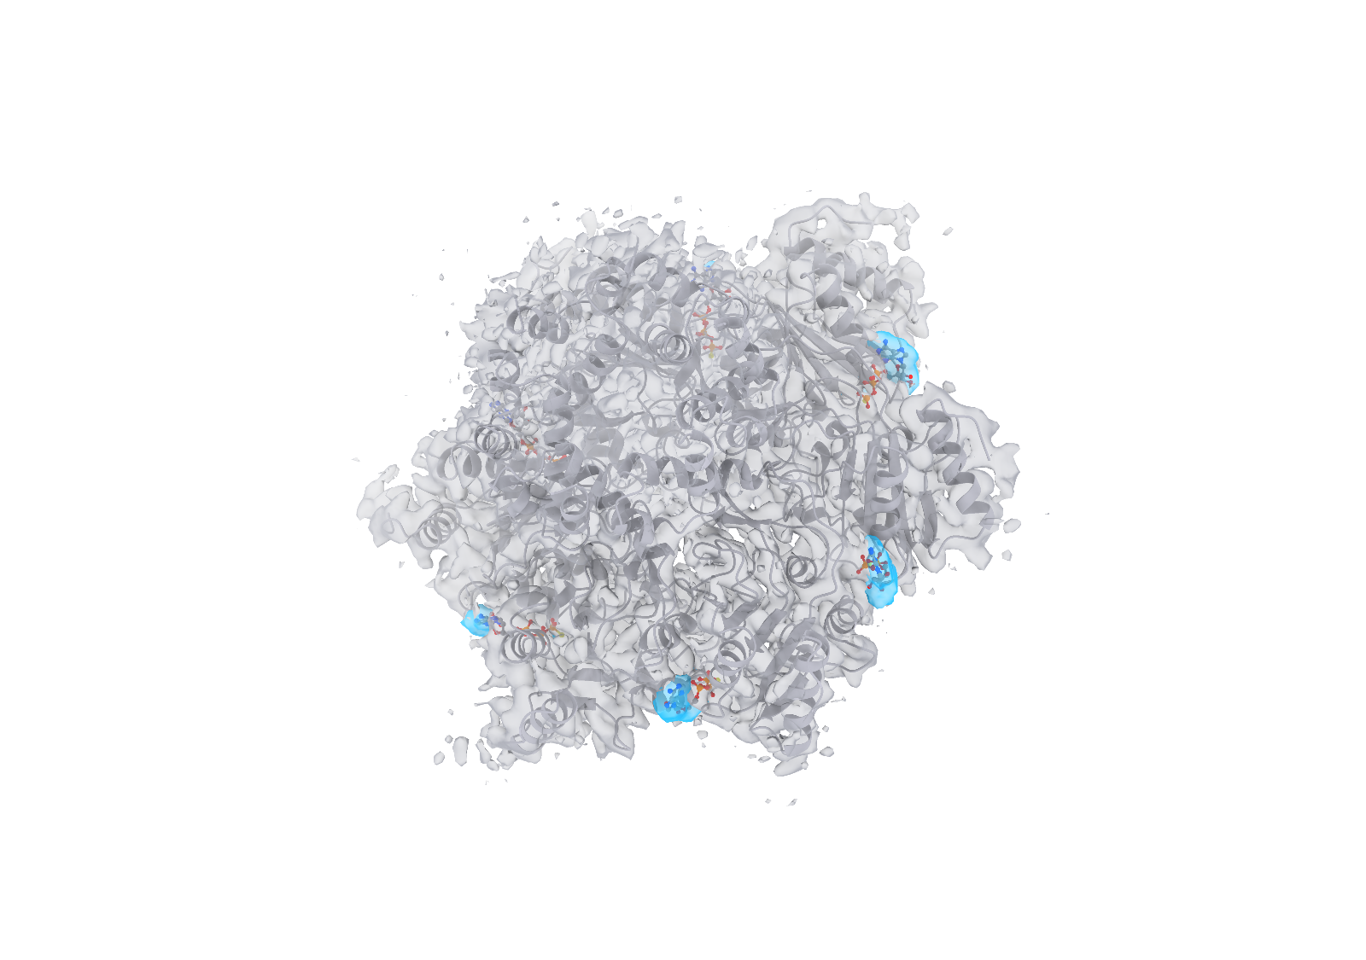
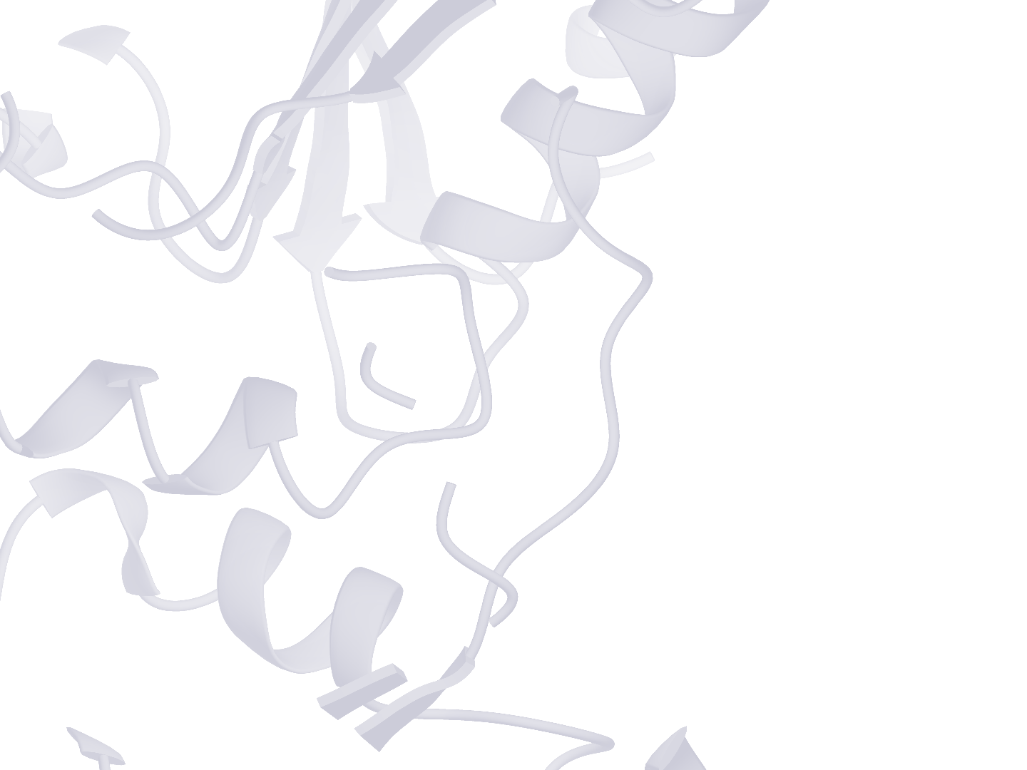
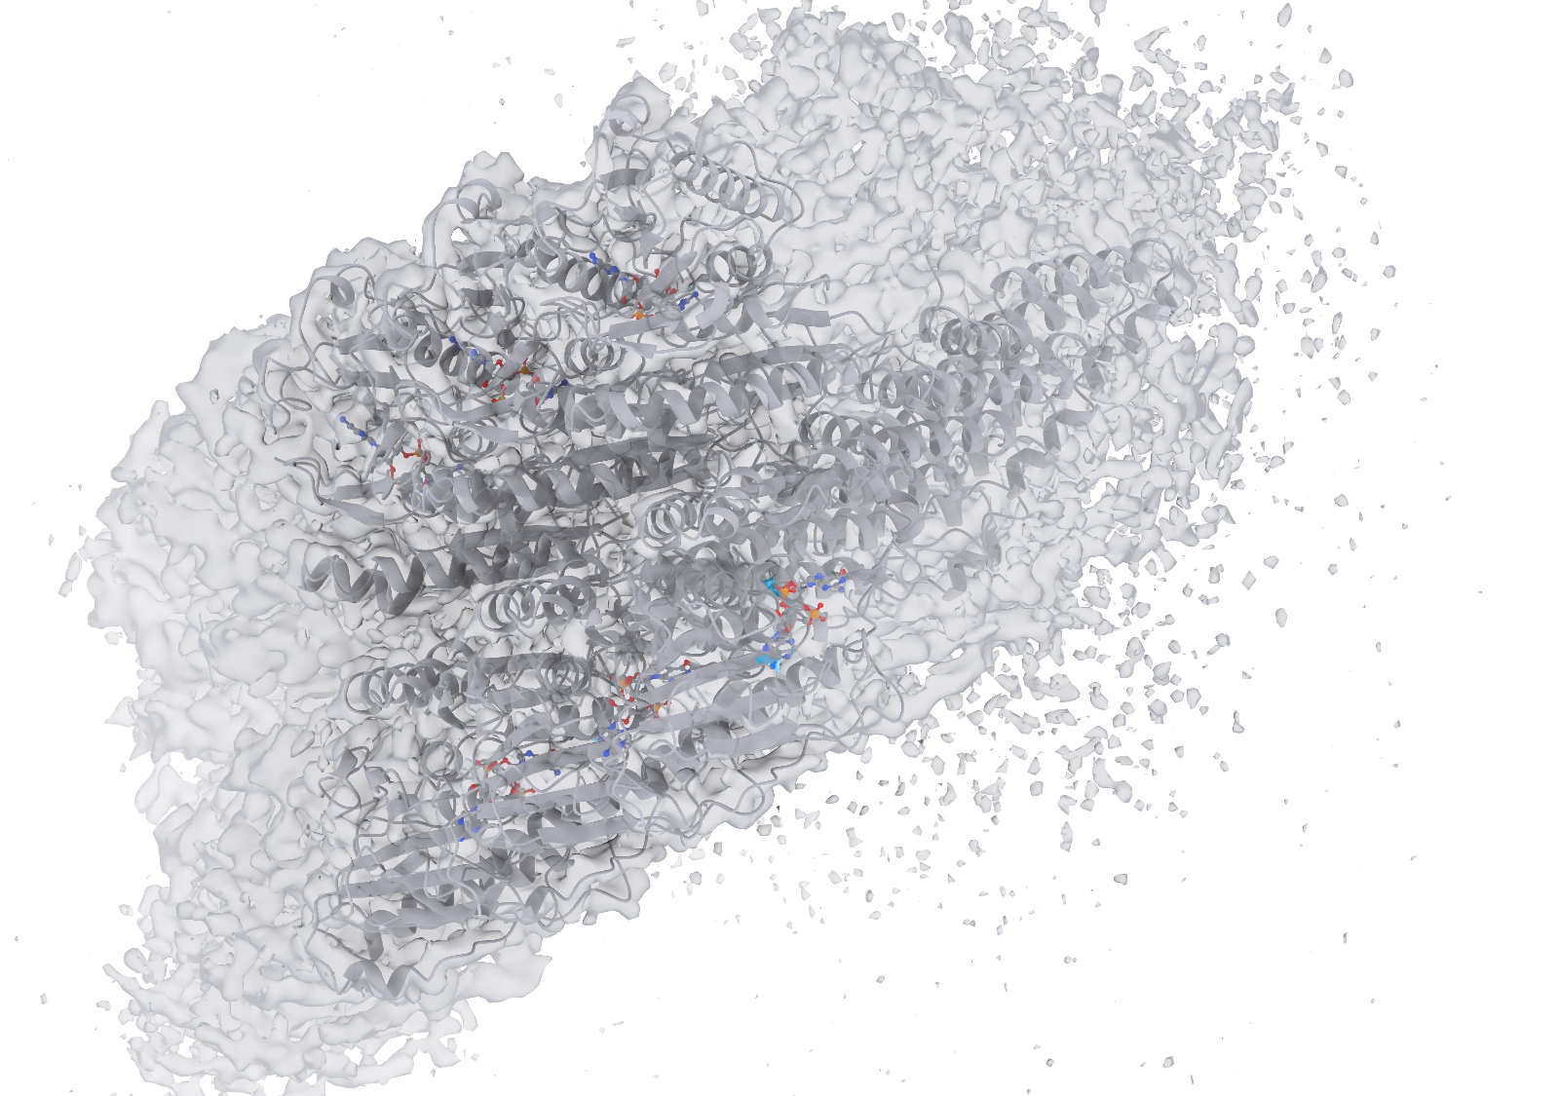
a
b
c
d
Notes:
局部检测实例的风格对照。a–d 依次为 9PQM 的 ATPγS（AGS，A:401）、9WQ3 的 1SY（E:401）、9UWI 的胆固醇（CLR，B:502）和 9X0X 的磷脂酰乙醇胺（PTY，T:801）。每行左侧为复合物整体，框选一个配体结合位点；右侧上排从左至右为真实受体、CryoAtom2 受体、真实配体及其标注区域，下排为使用真实受体的 Find、使用 CryoAtom2 受体的 Find 和 Emap2lig。下排均显示同一真实配体和实验密度，Find 两格另显示相应受体。每例六格共用朝向和尺度。灰白色为受体和实验密度表面，配体按元素着色，蓝色包络为预测区域，浅蓝色为真实标注区域。

Slide 2
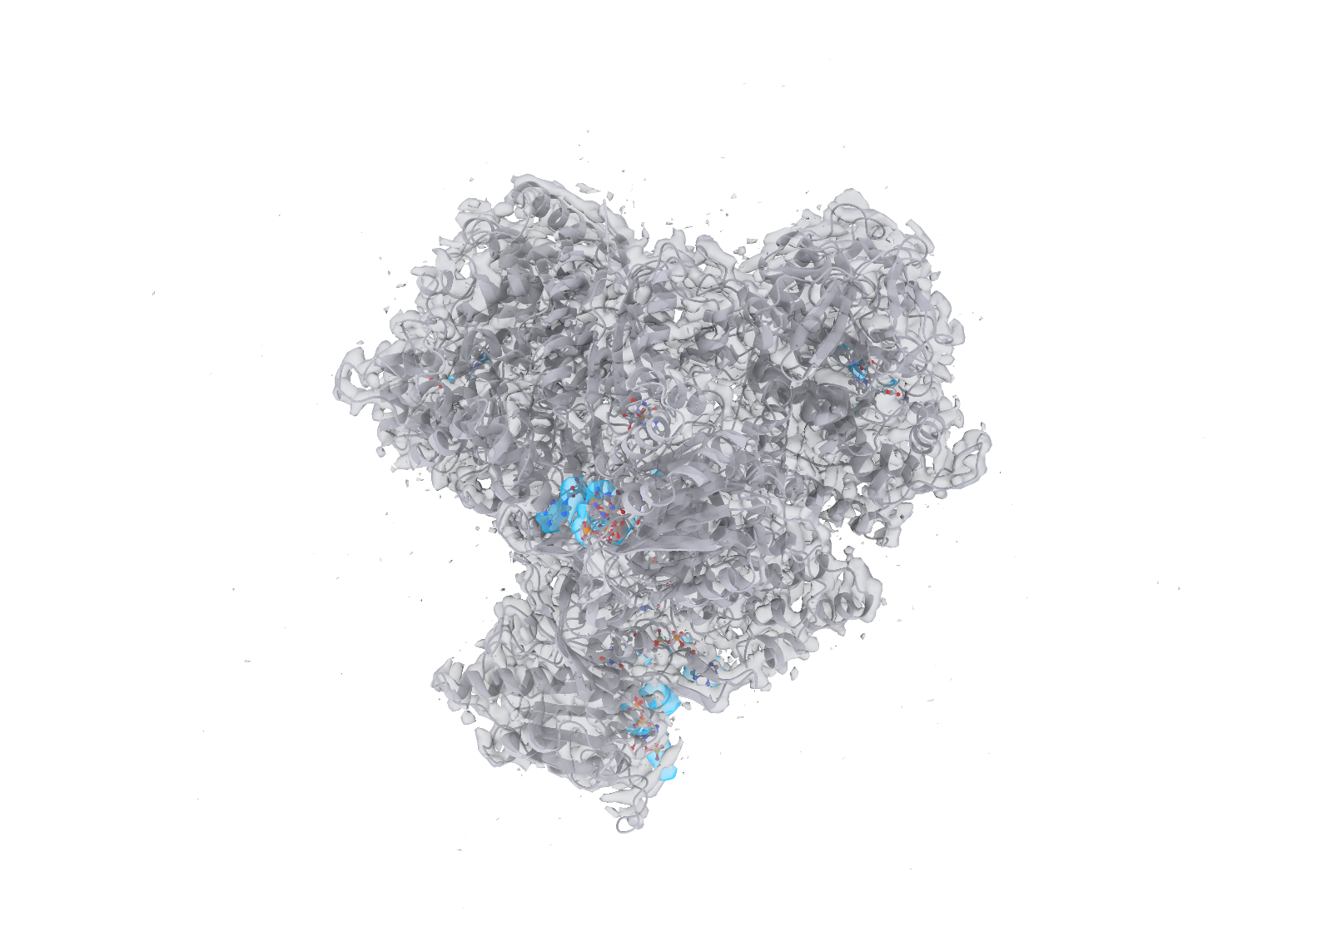


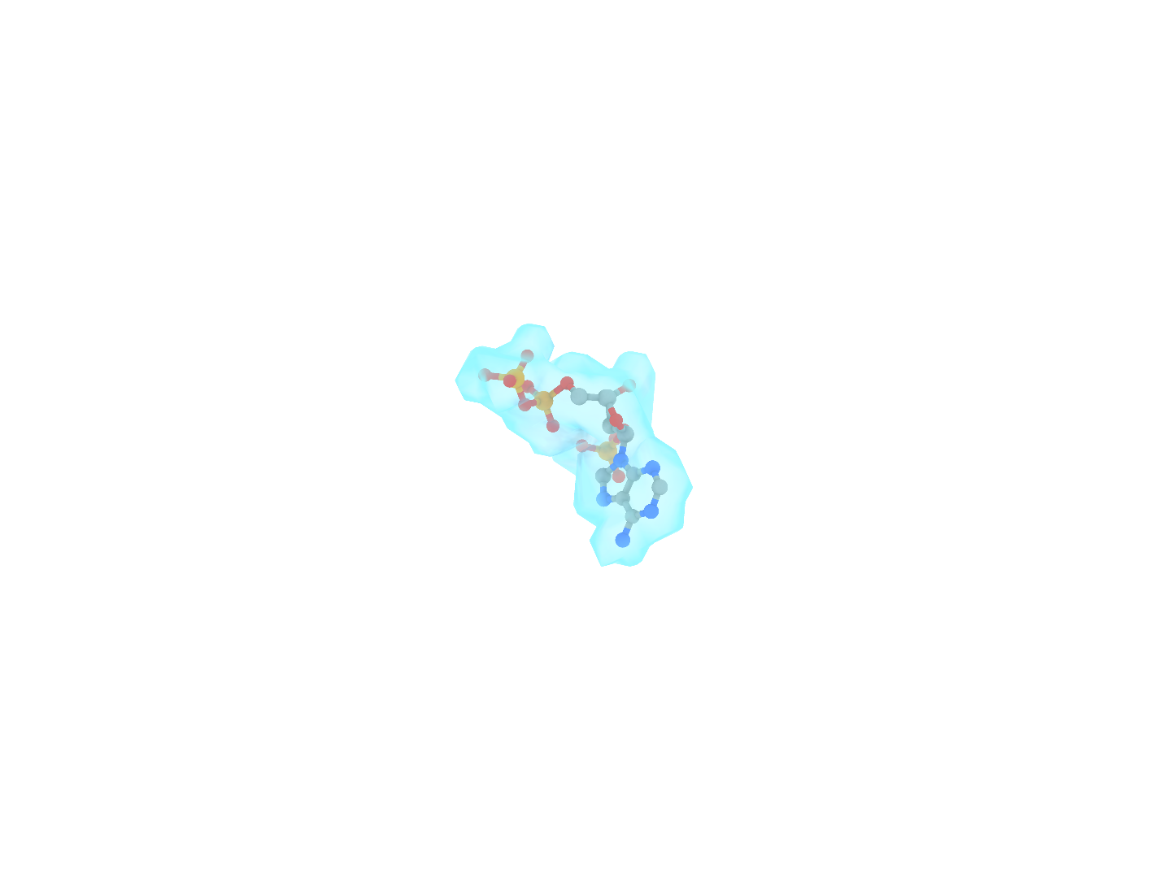
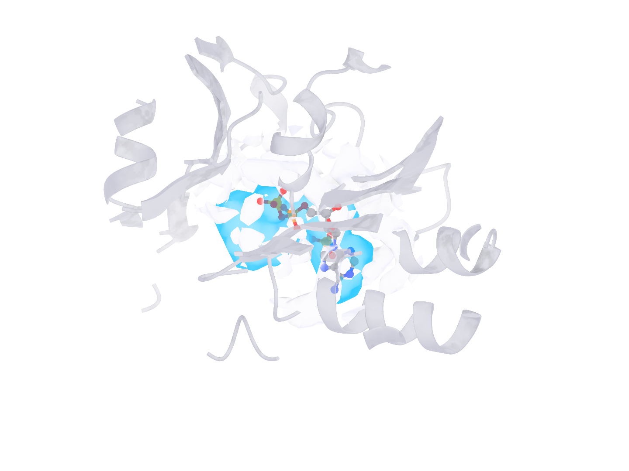
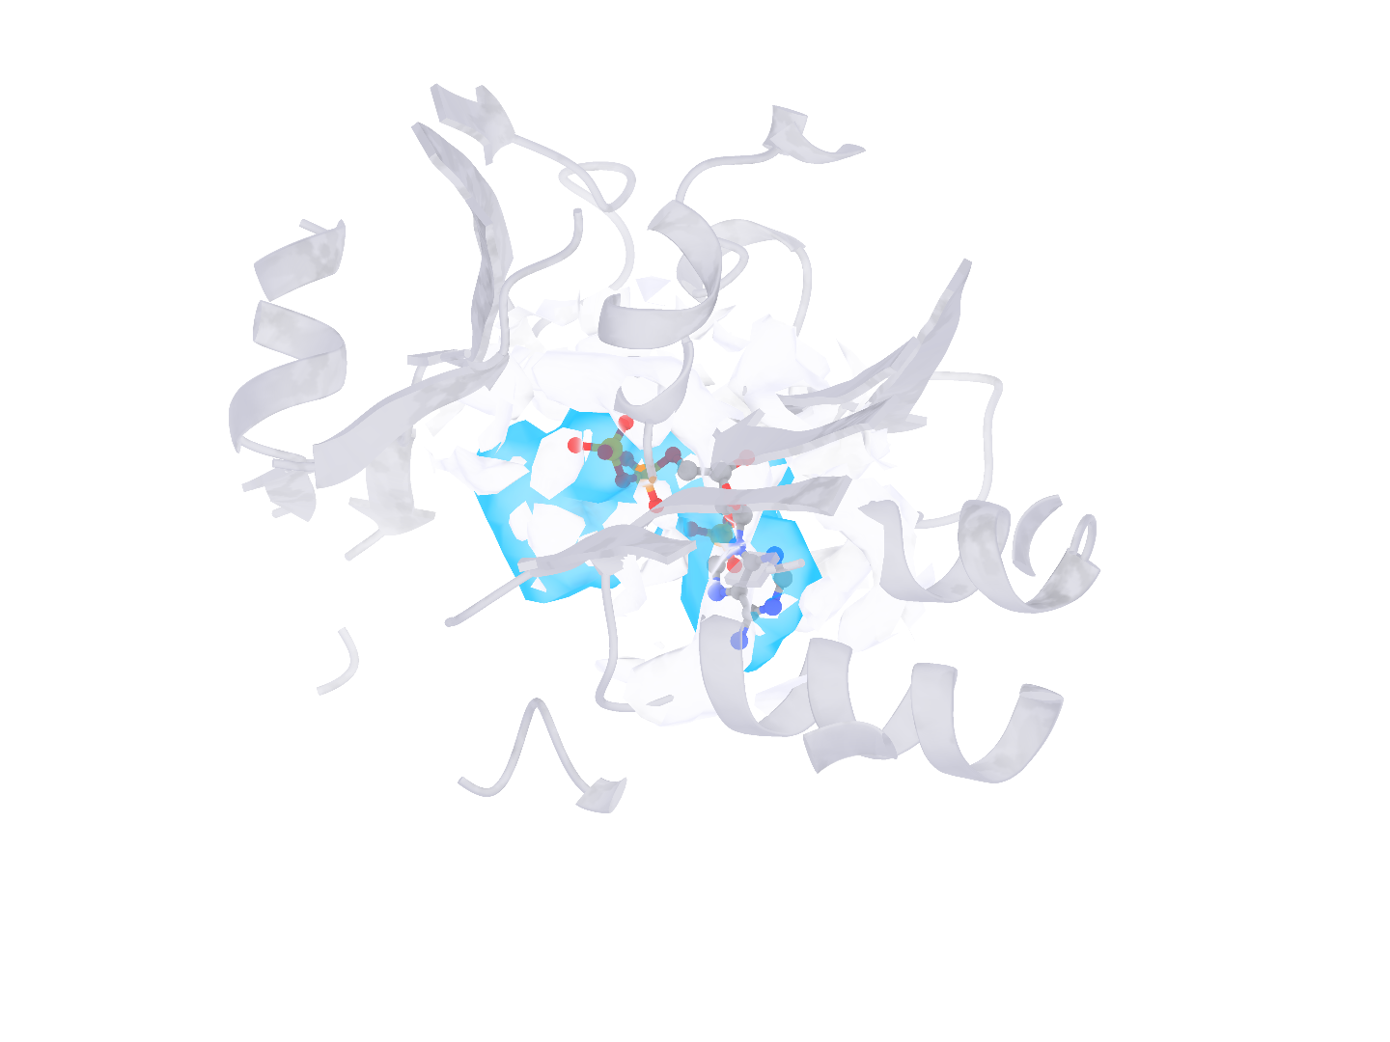
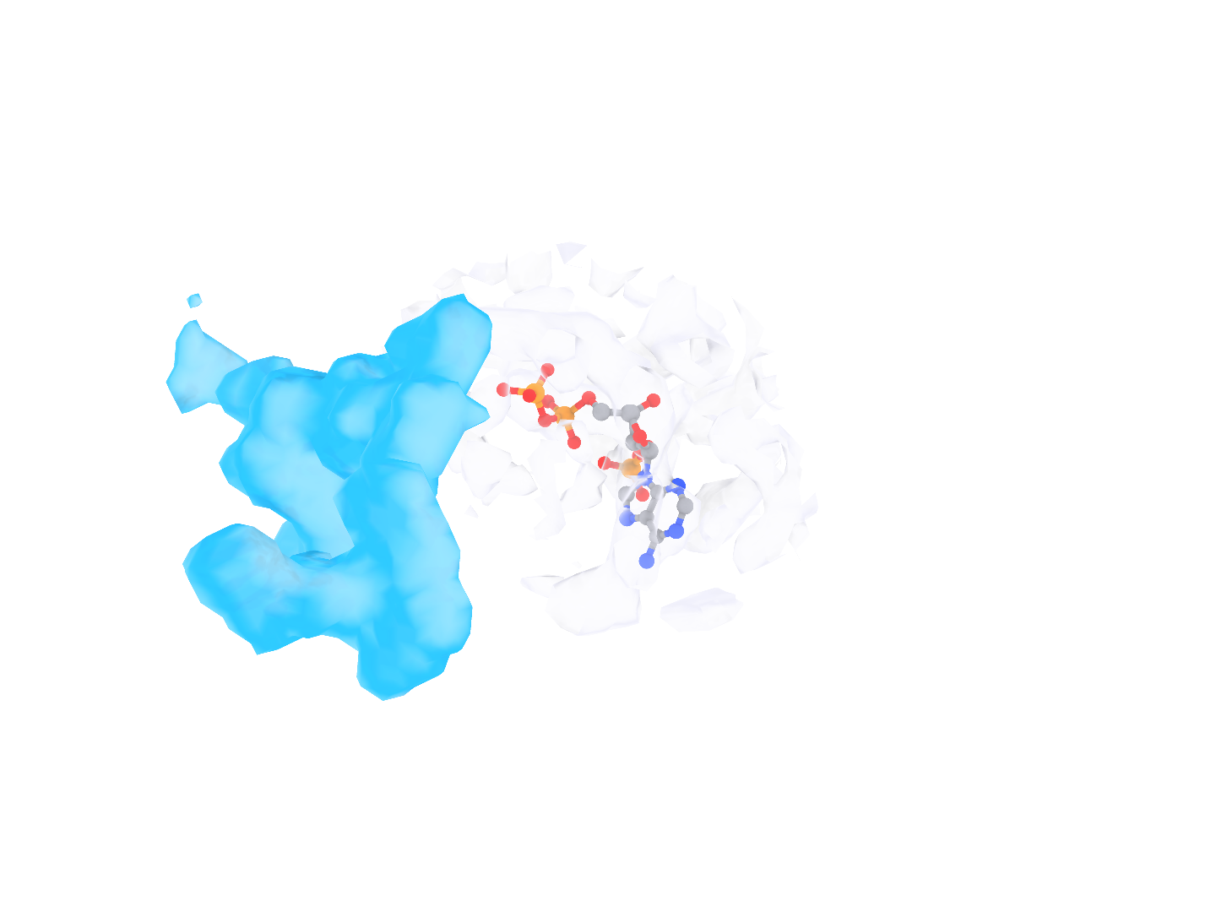
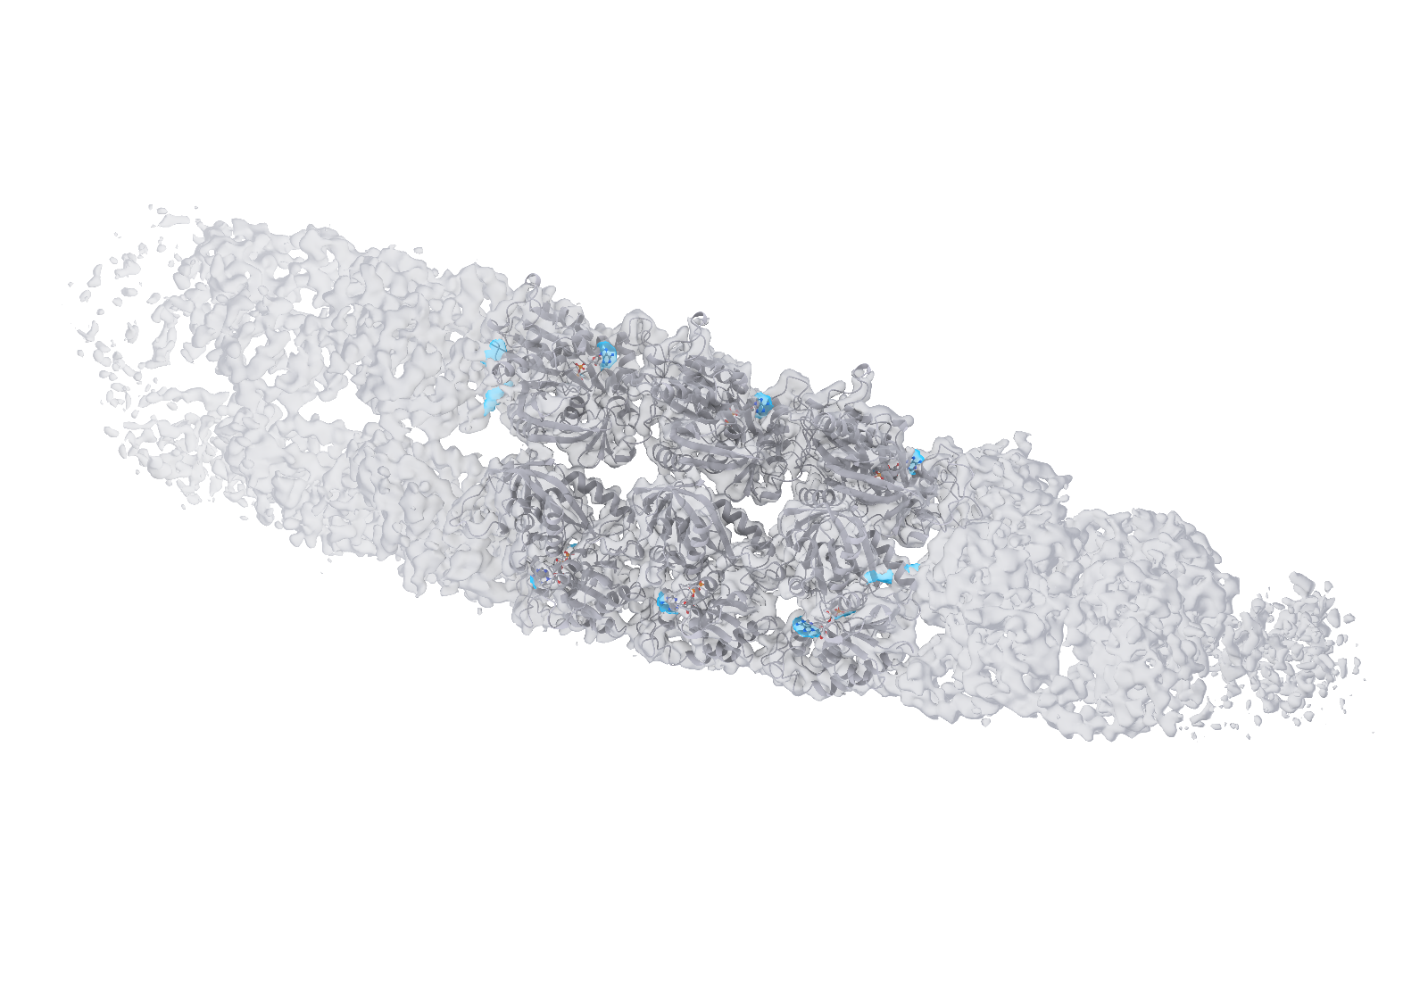
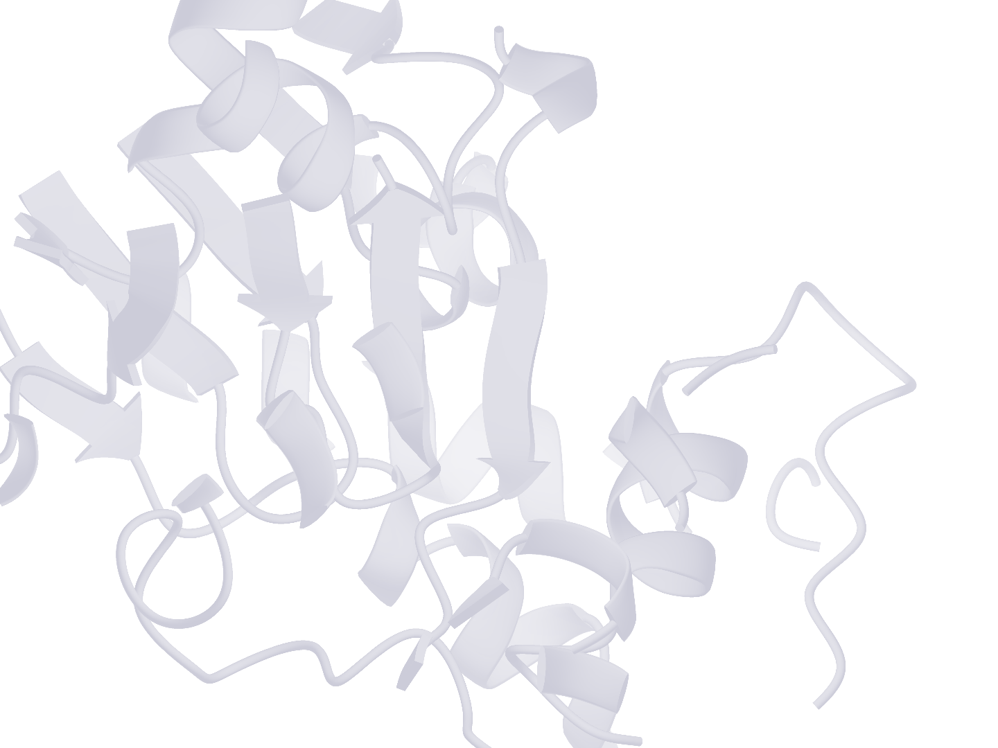
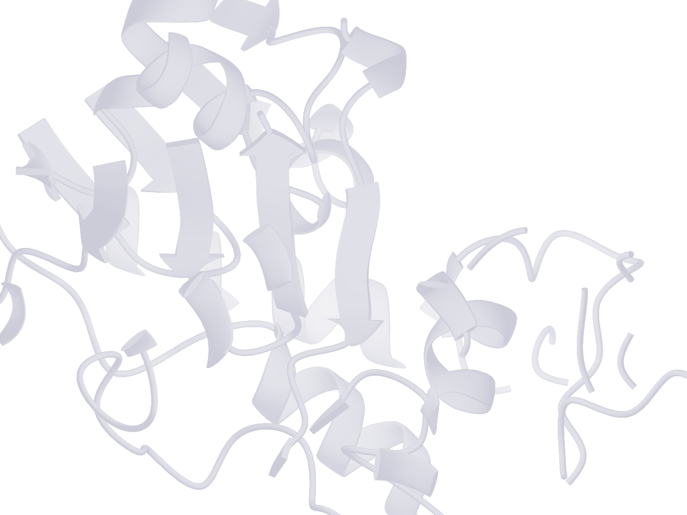
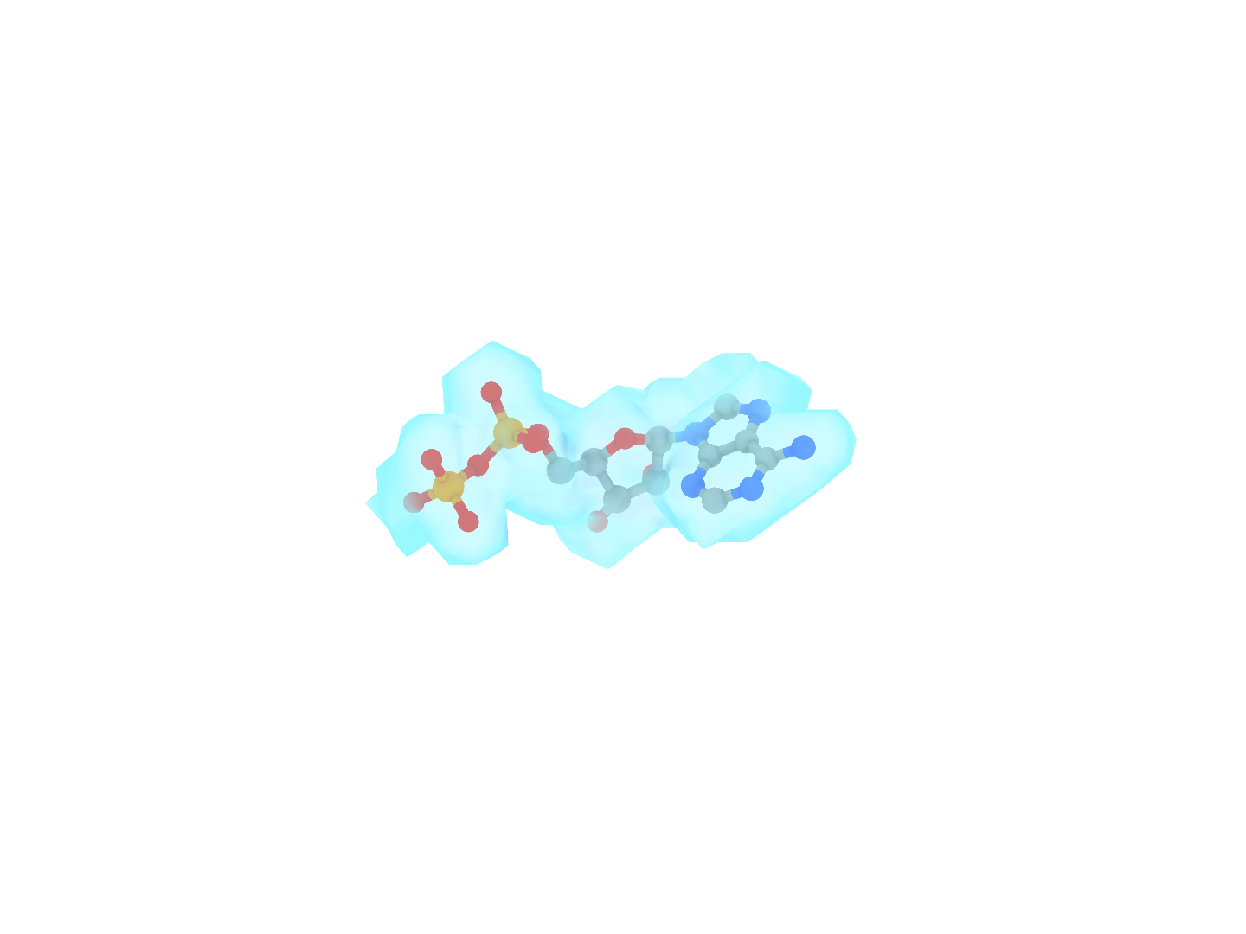
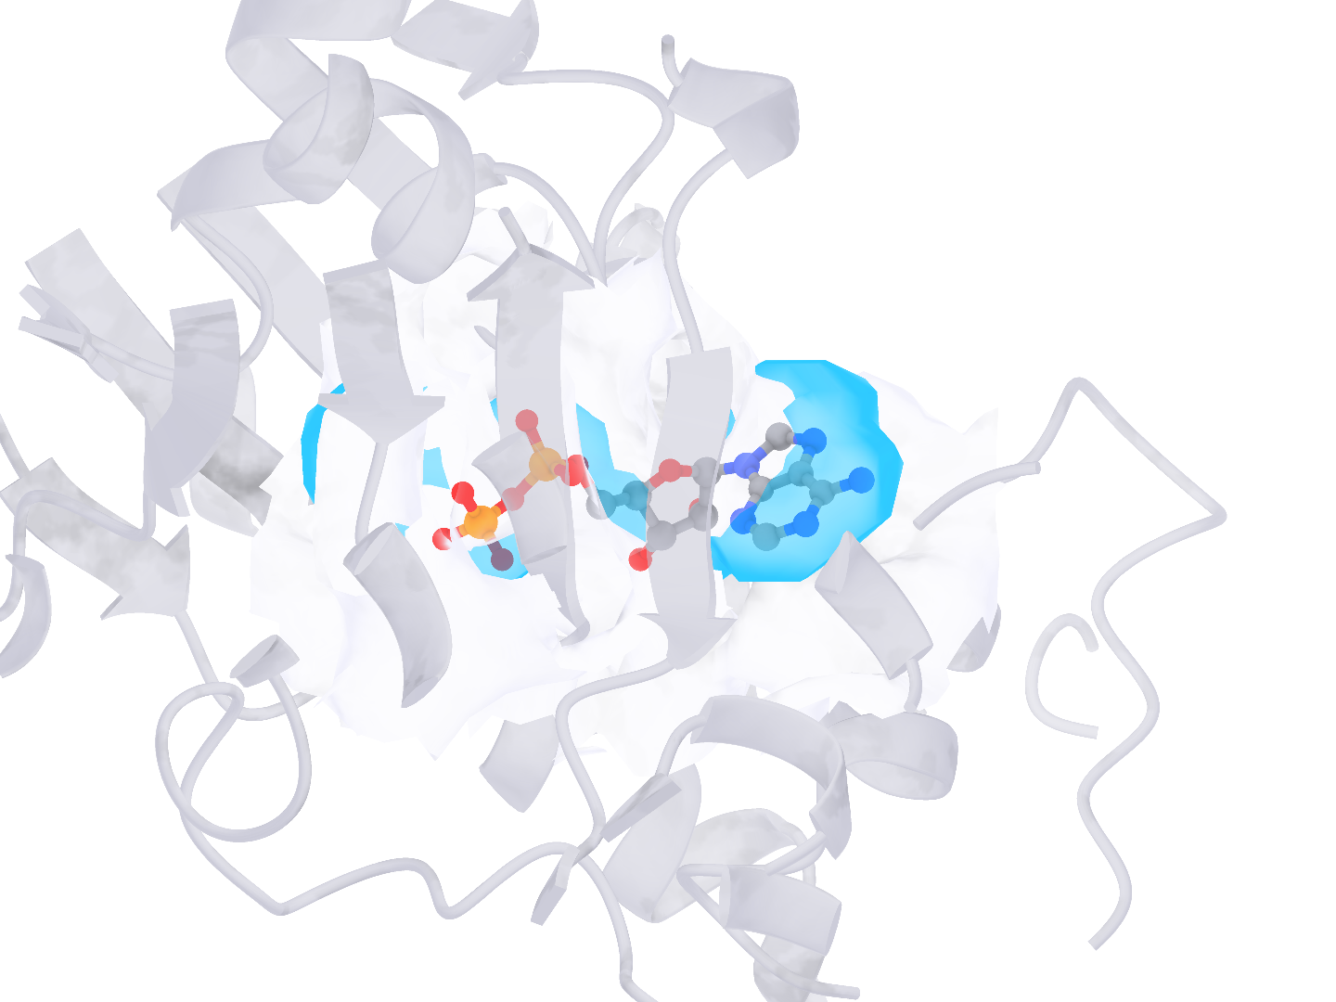
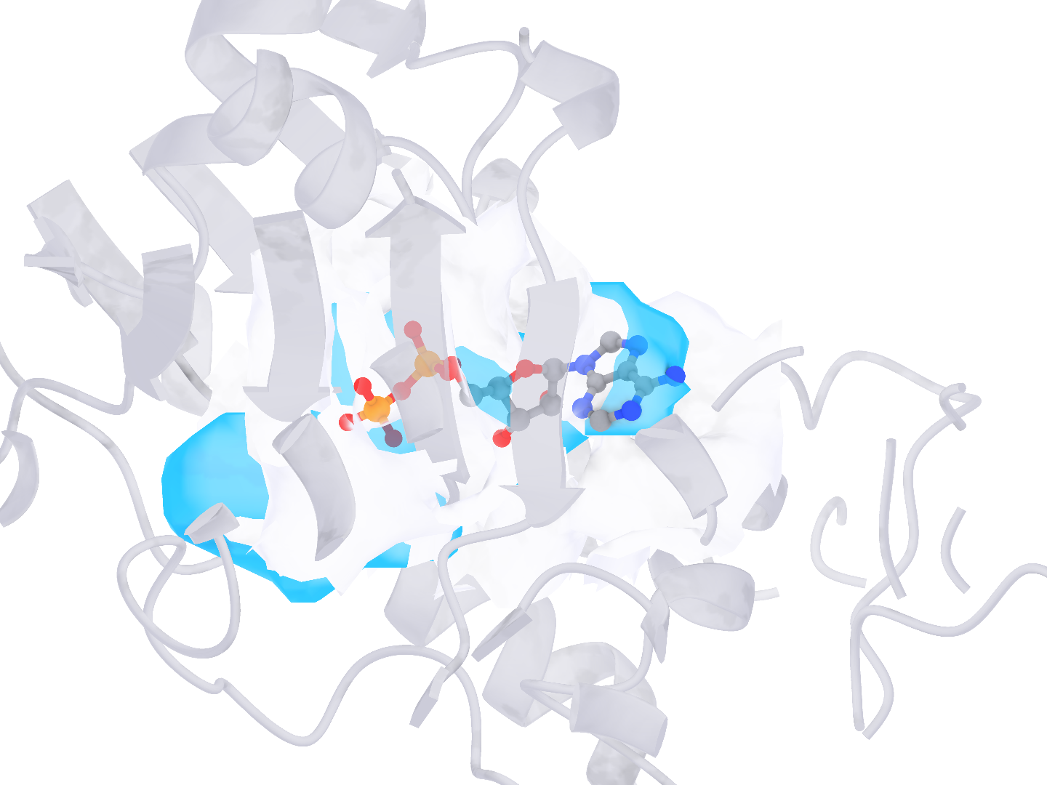
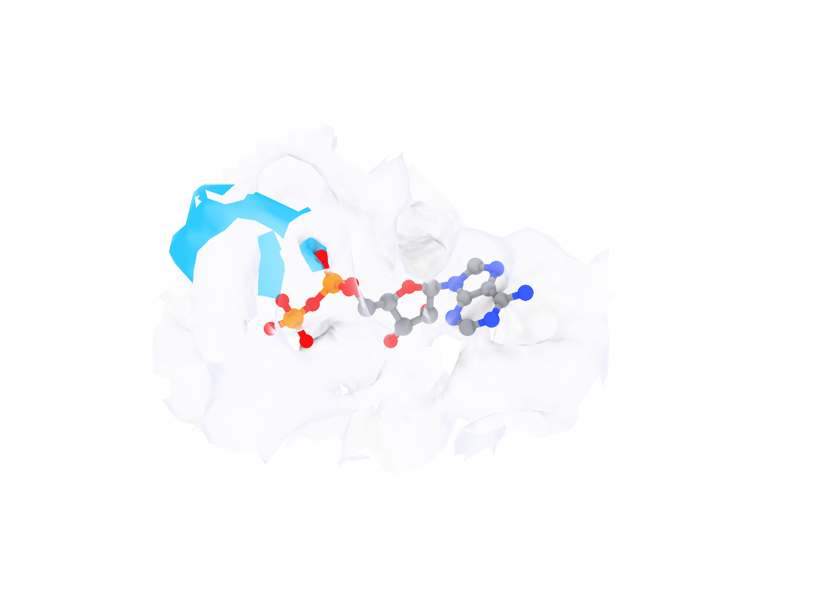
a
b
c
Notes:
局部检测实例的风格对照。a–c 依次为 9BJJ 的 A1AP0（F:1001）、9WUP 的 NADPH（NDP，A:1104）和 9RMI 的 ADP（C:401）。每行左侧为复合物整体，框选一个配体结合位点；右侧上排从左至右为真实受体、CryoAtom2 受体、真实配体及其标注区域，下排为使用真实受体的 Find、使用 CryoAtom2 受体的 Find 和 Emap2lig。下排均显示同一真实配体和实验密度，Find 两格另显示相应受体。每例六格共用朝向和尺度。灰白色为受体和实验密度表面，配体按元素着色，蓝色包络为预测区域，浅蓝色为真实标注区域。

Slide 3

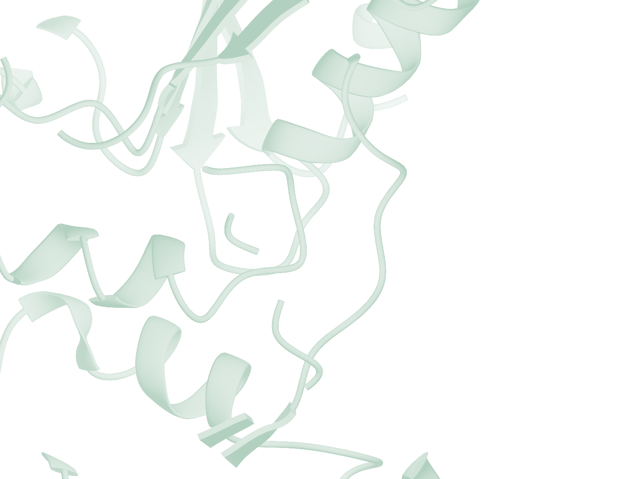
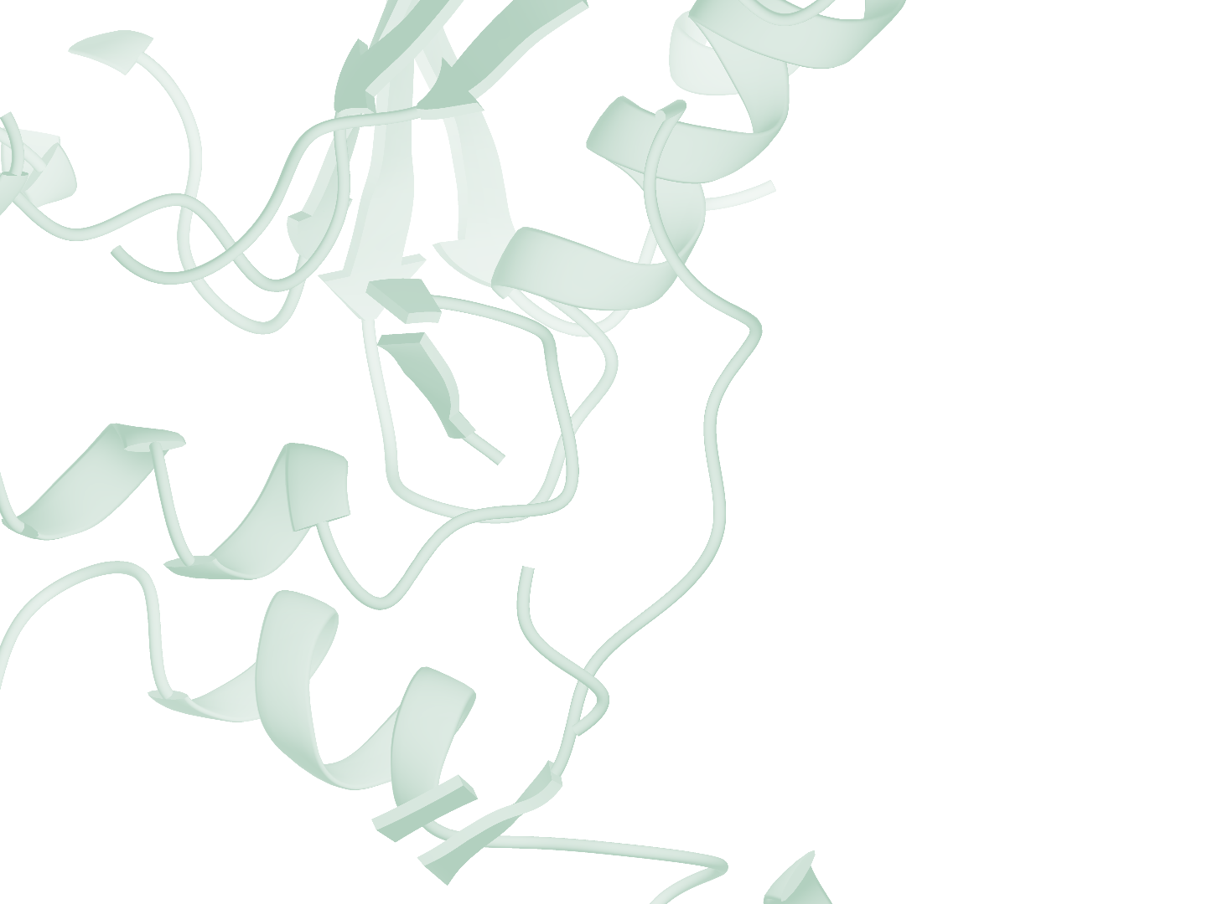
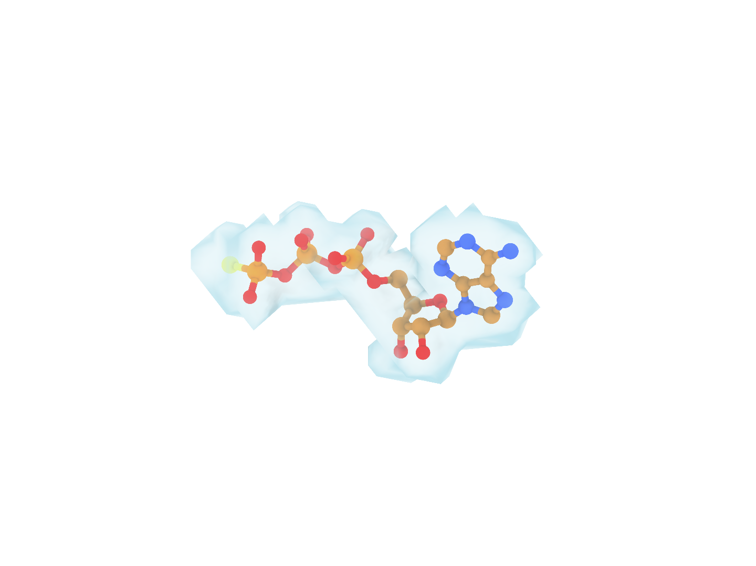
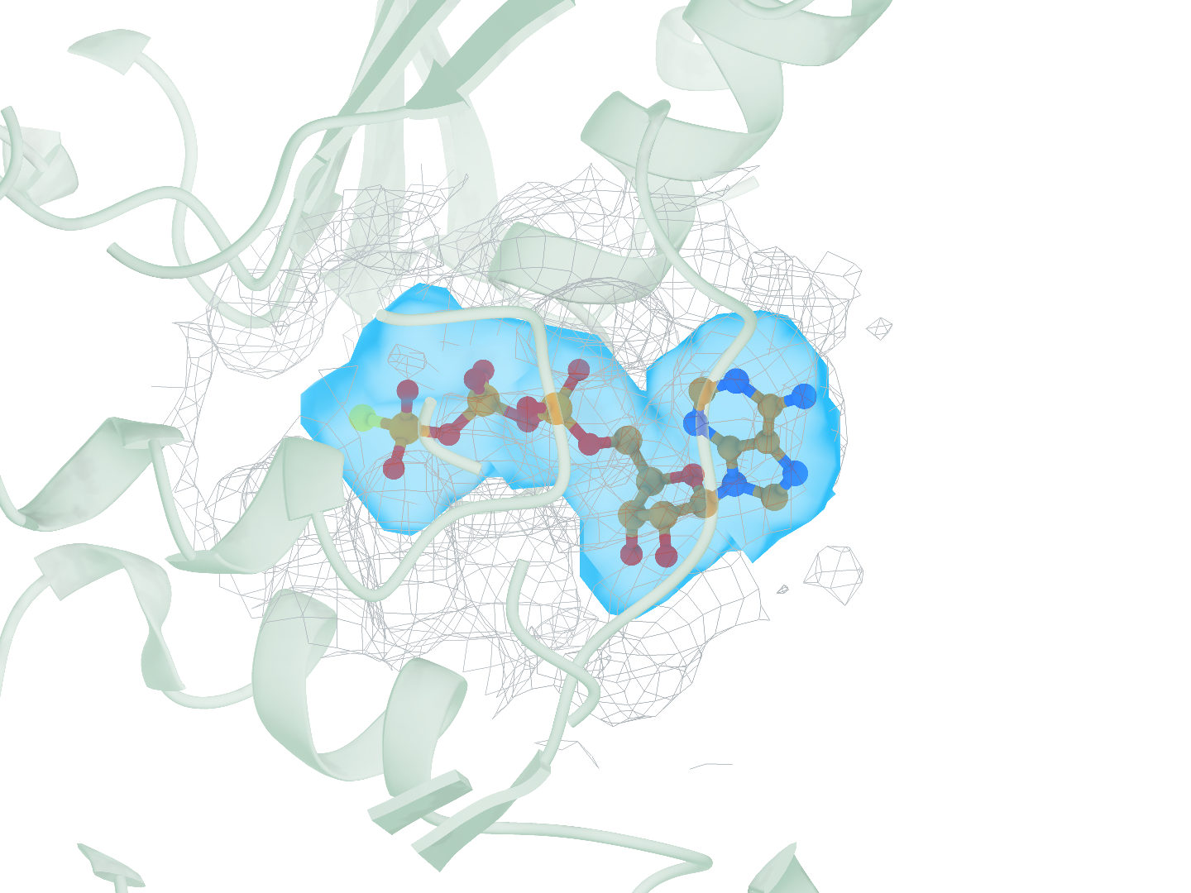
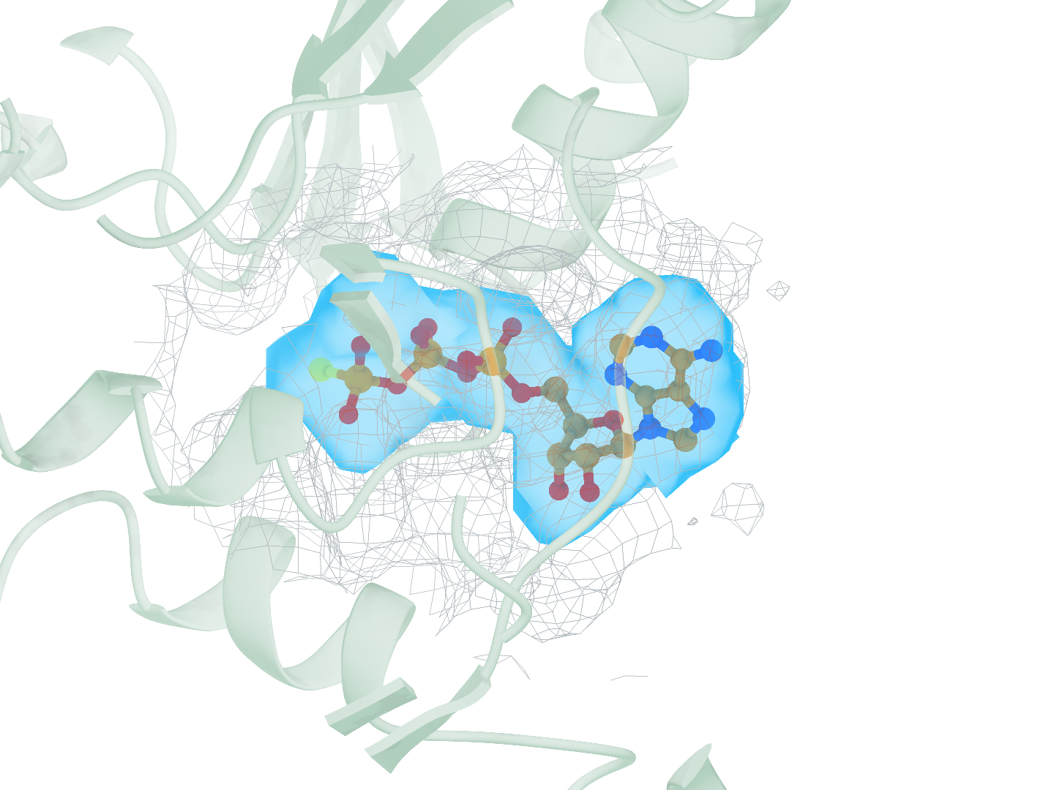
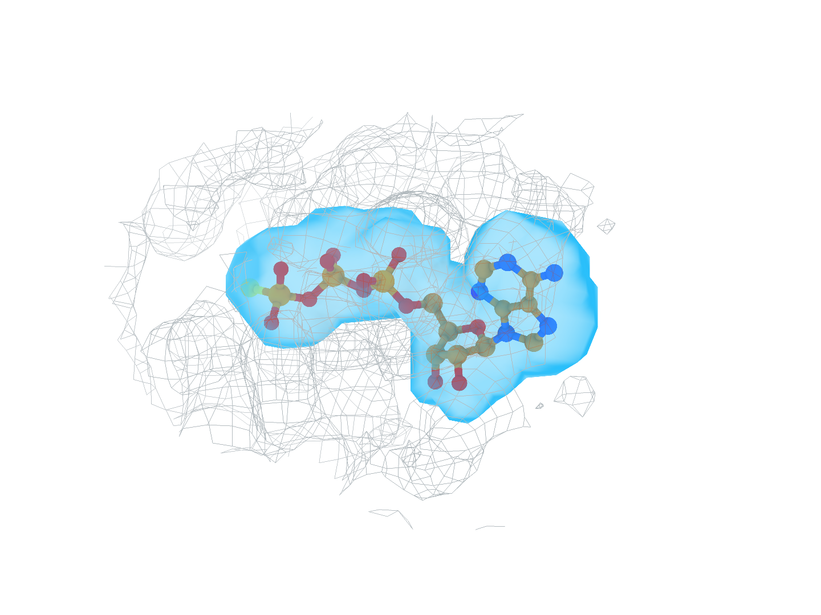
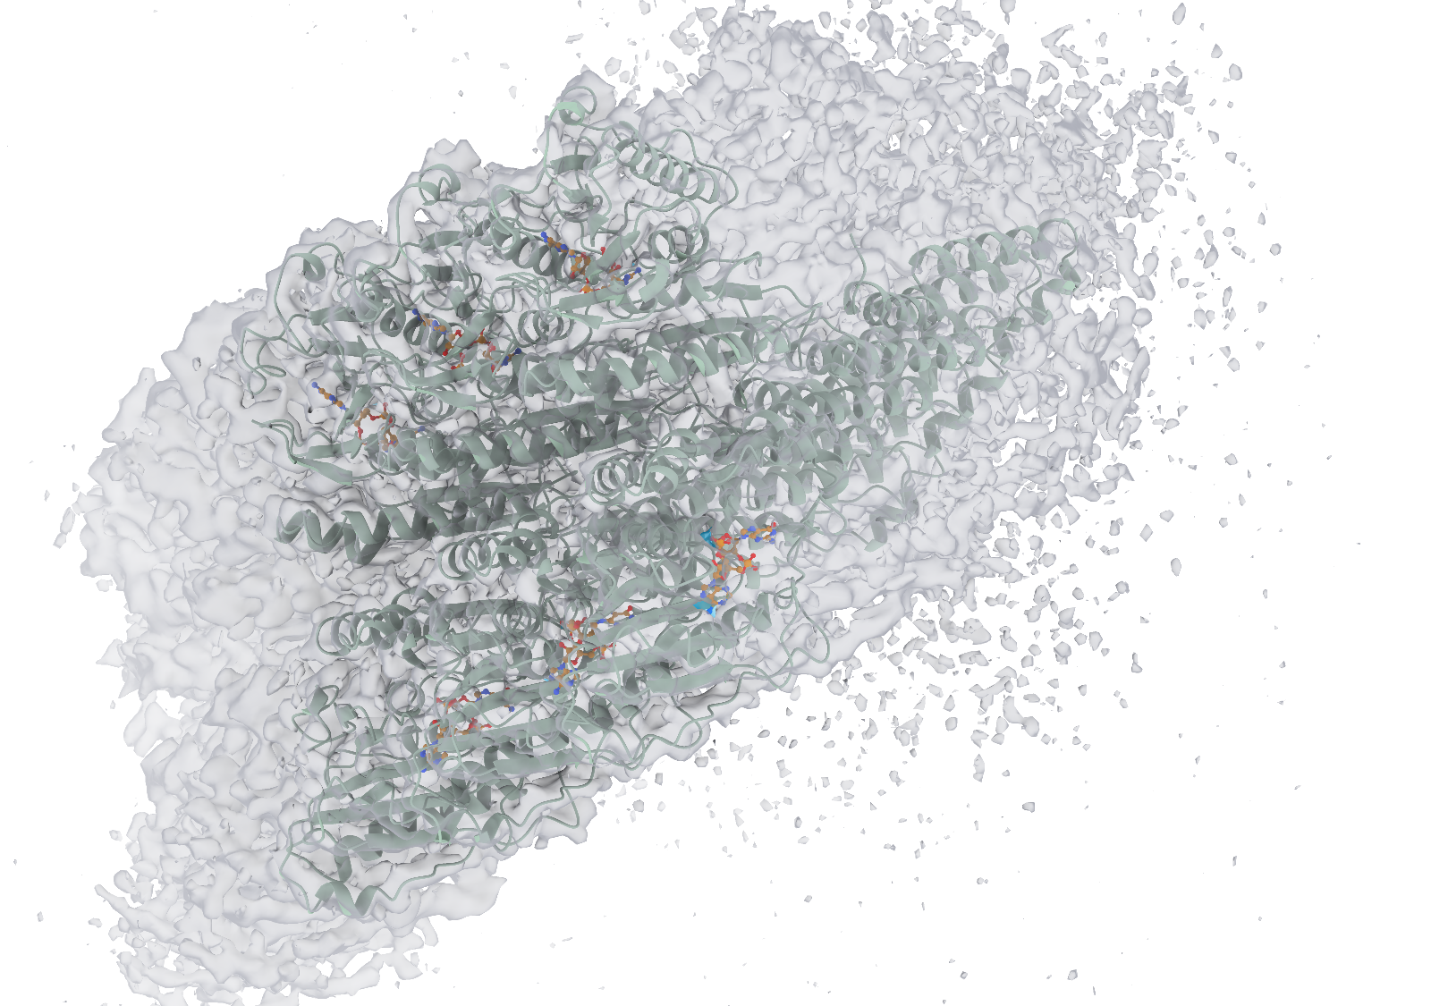
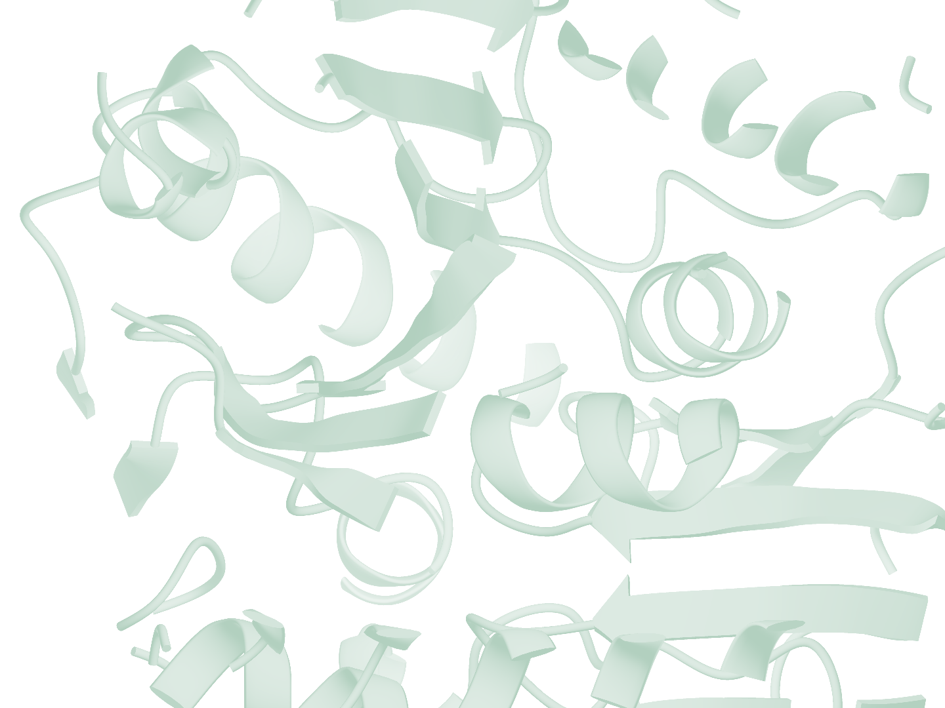
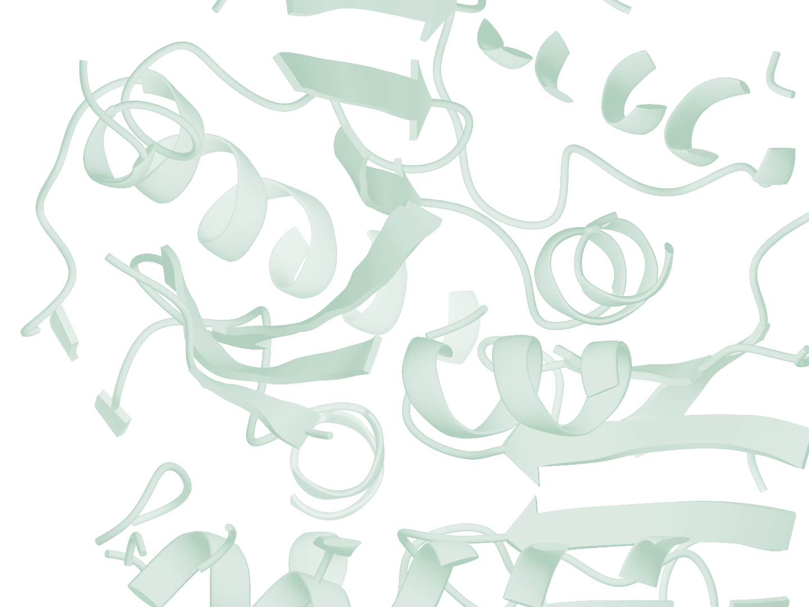
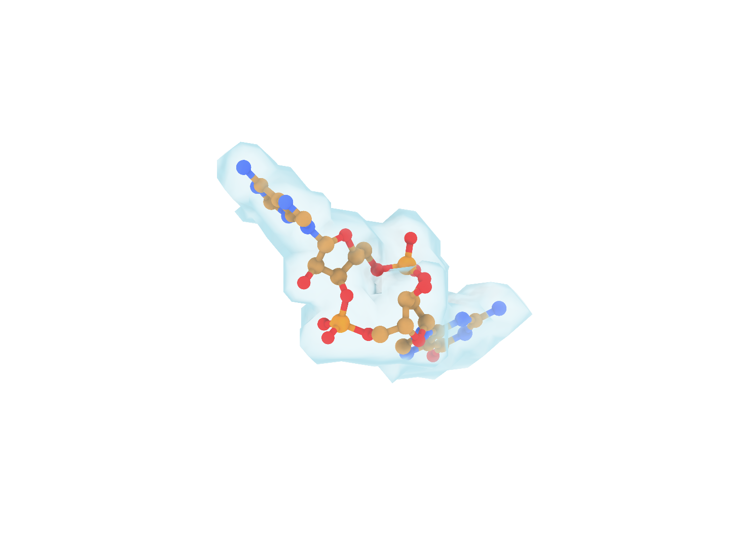
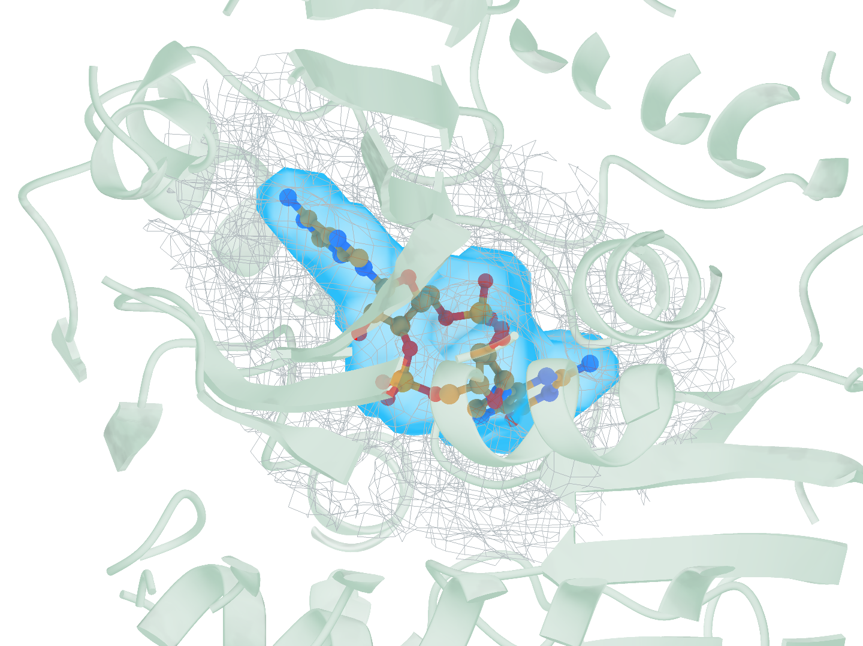
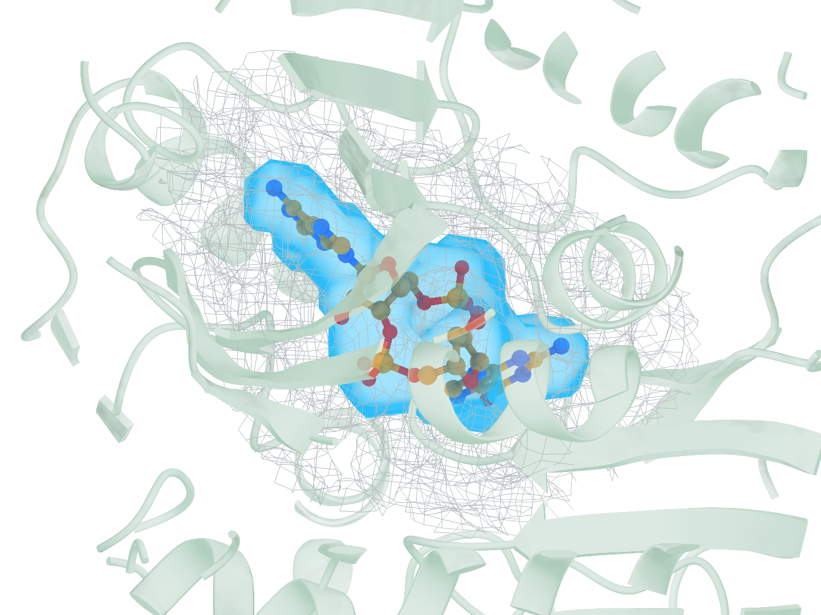
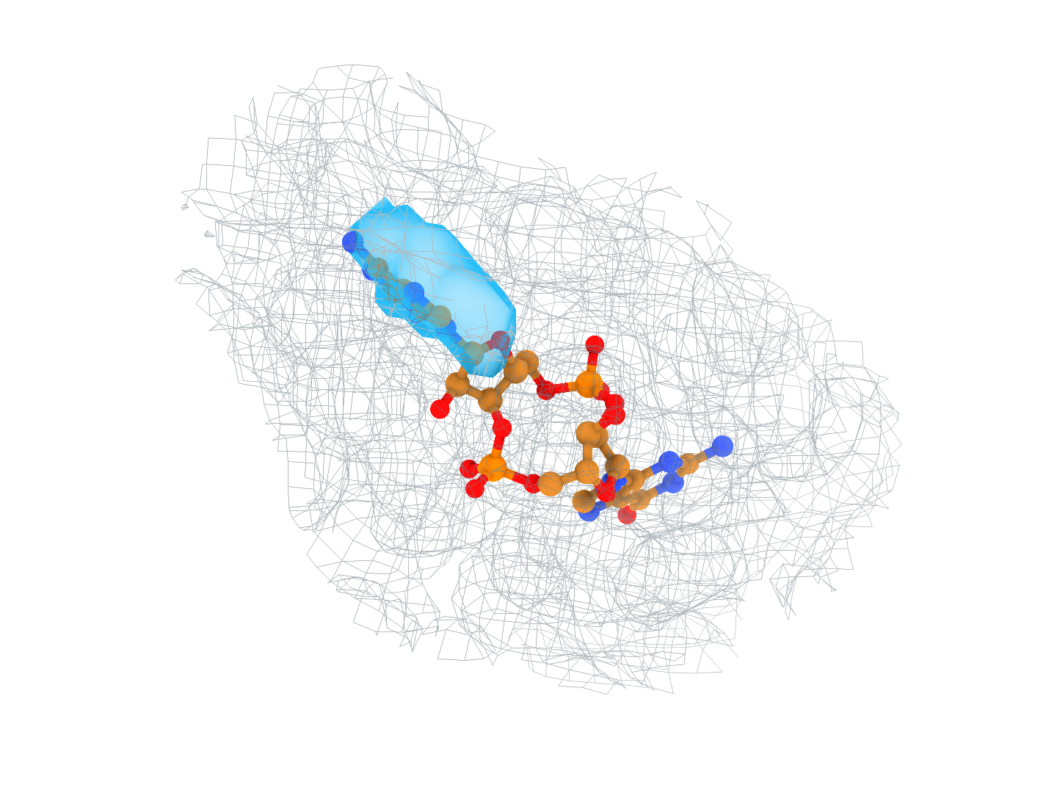
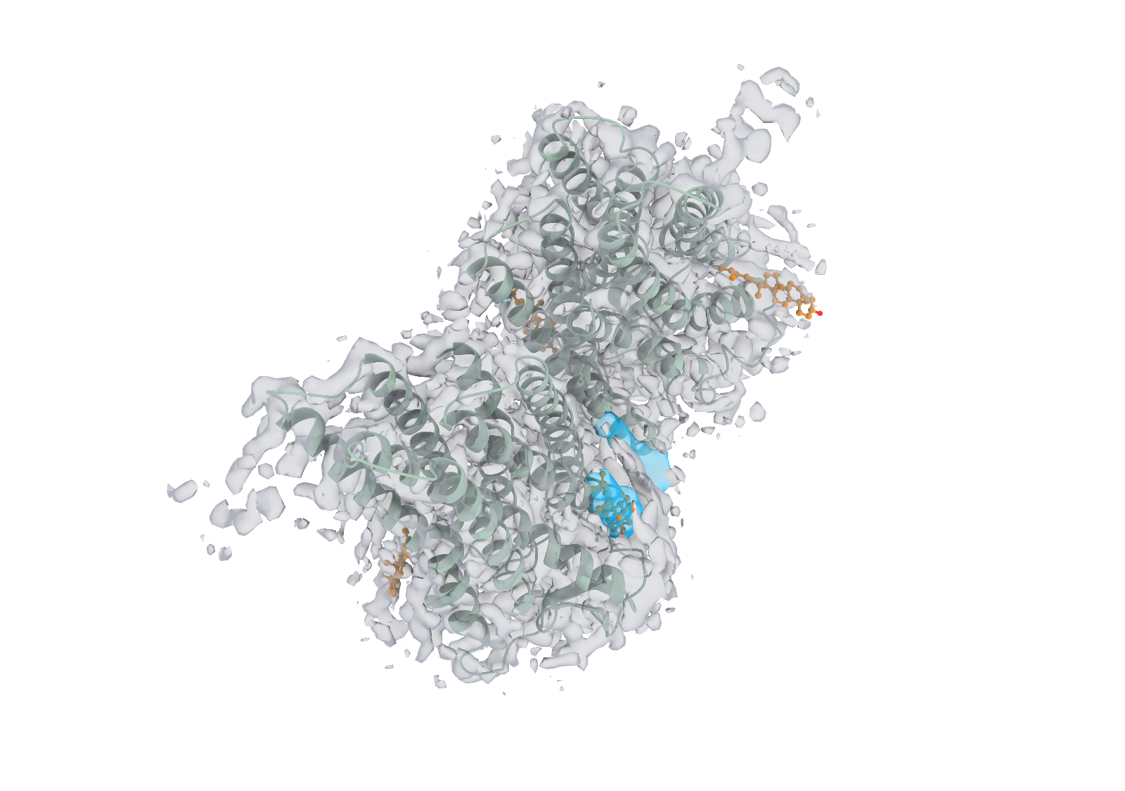
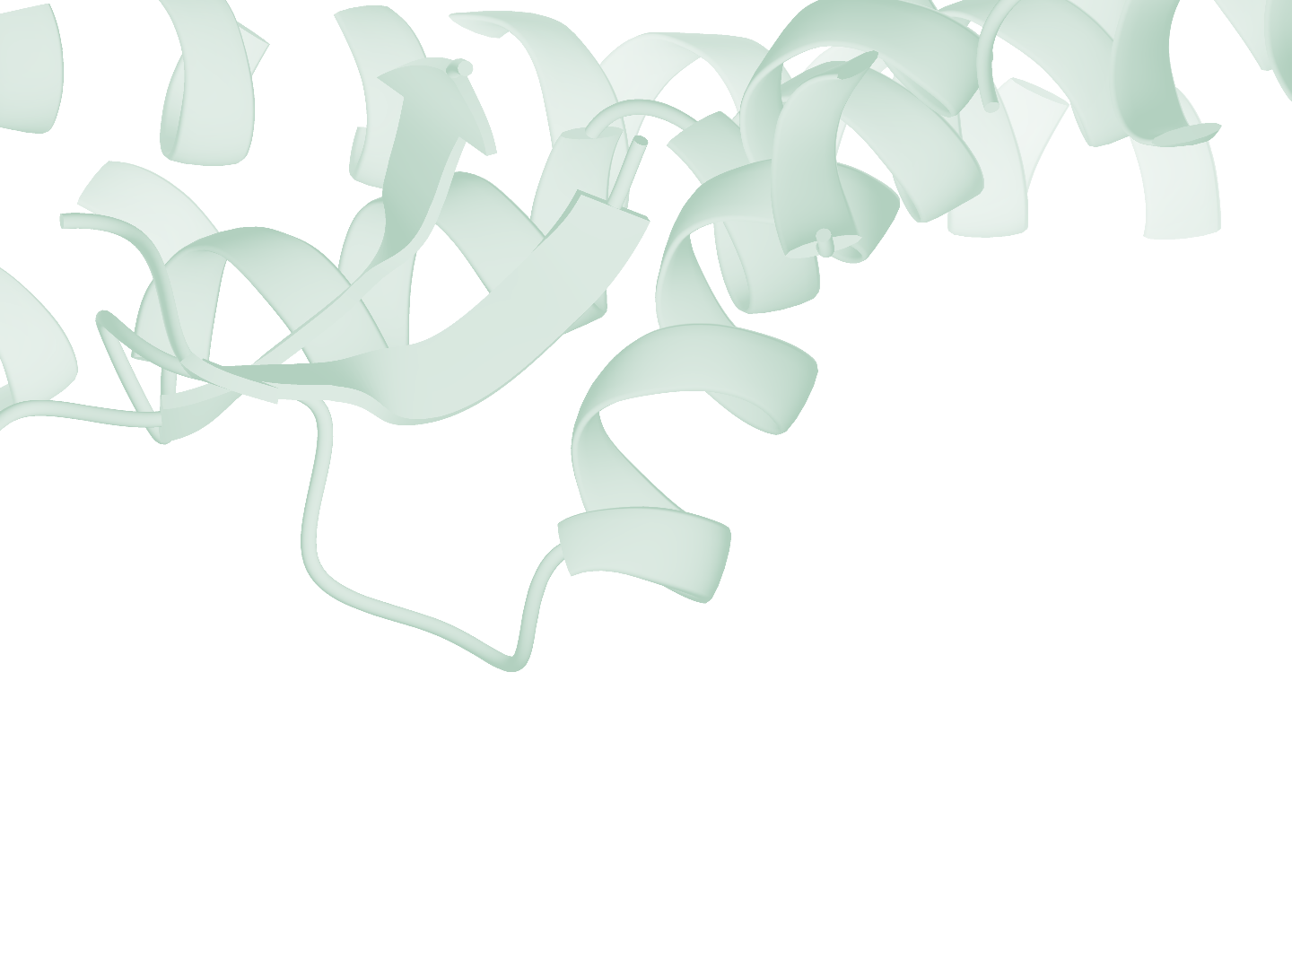
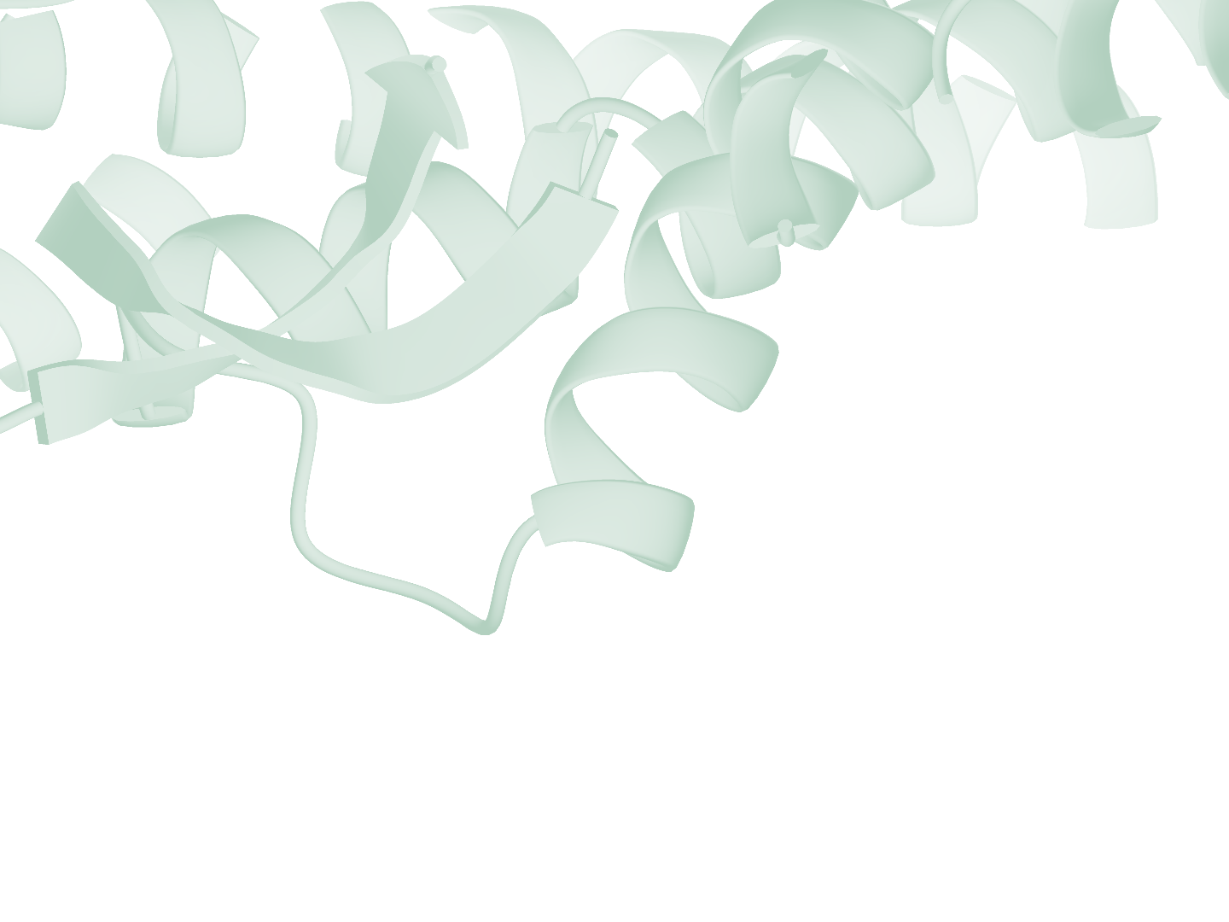
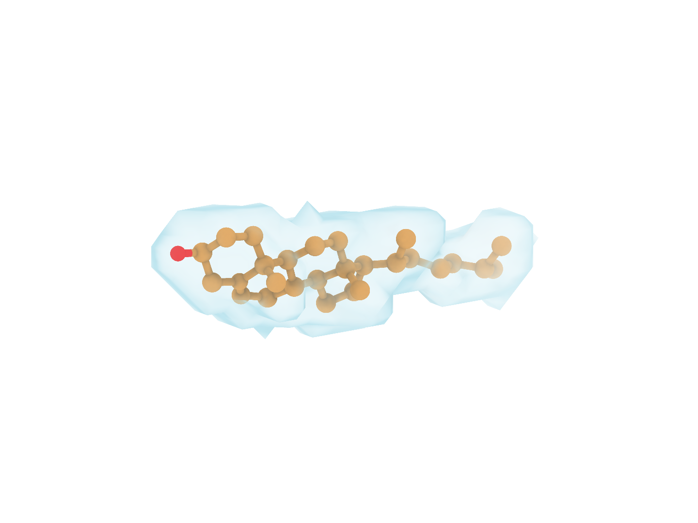
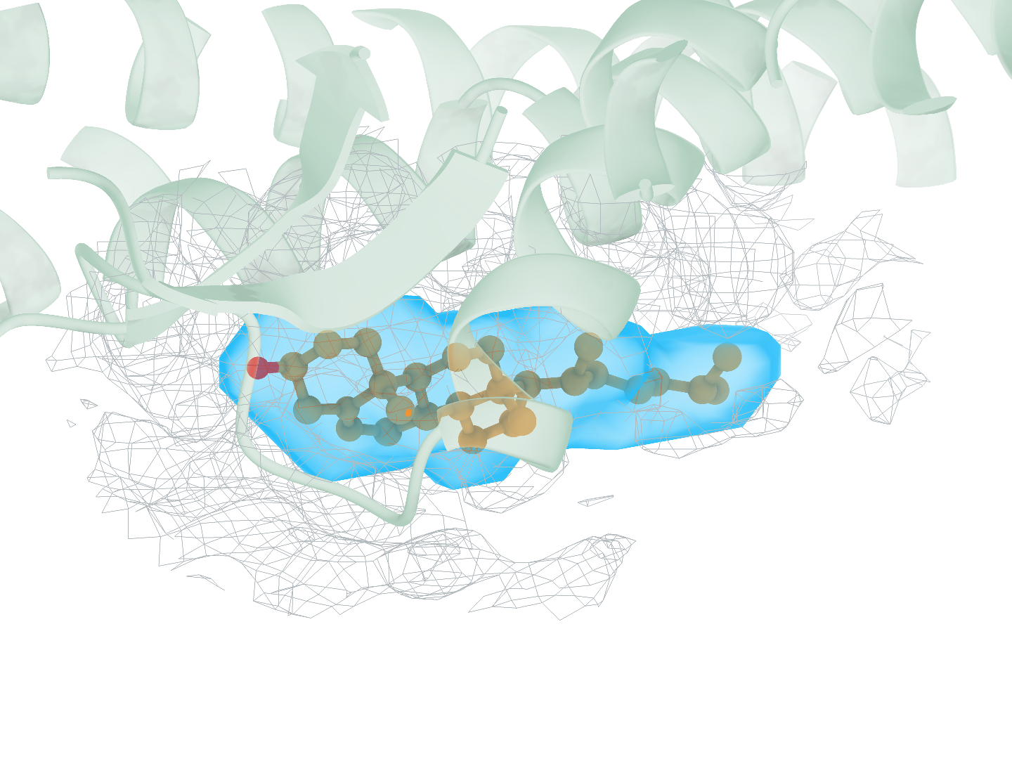
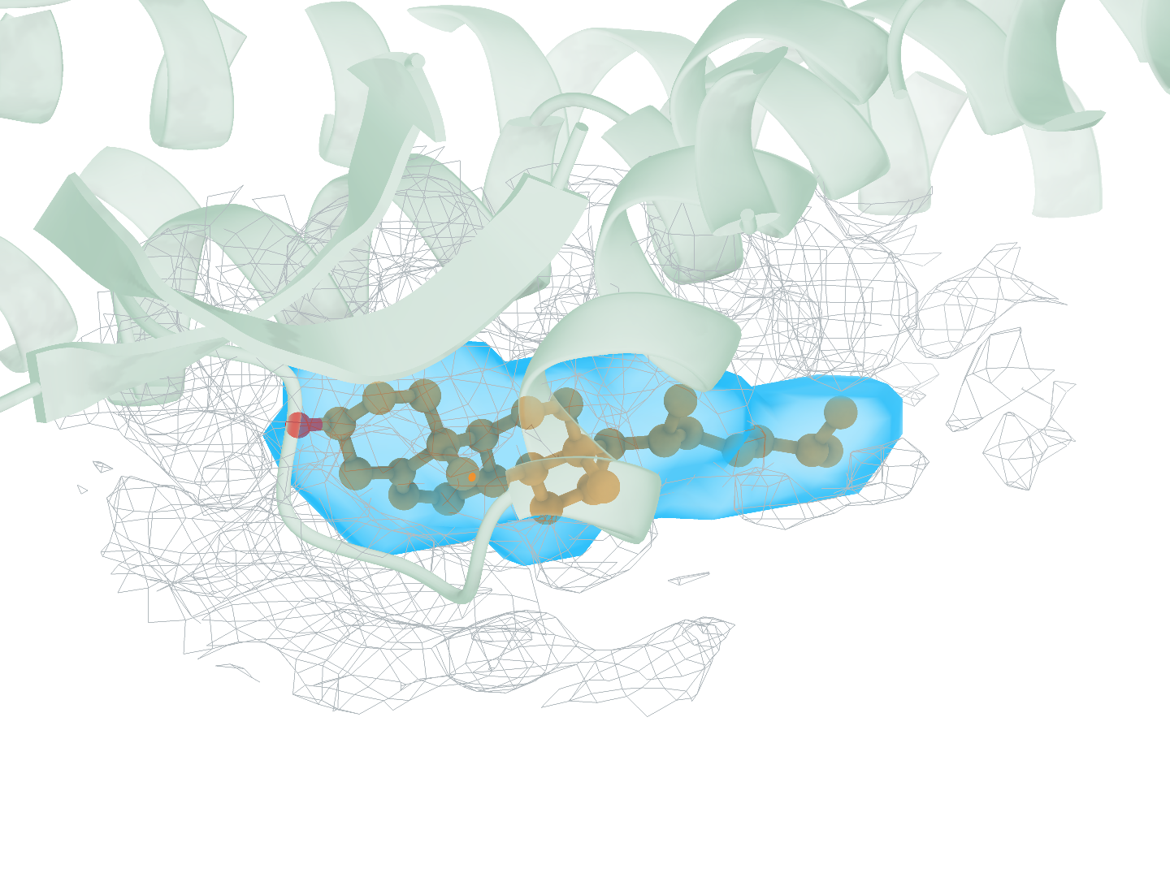
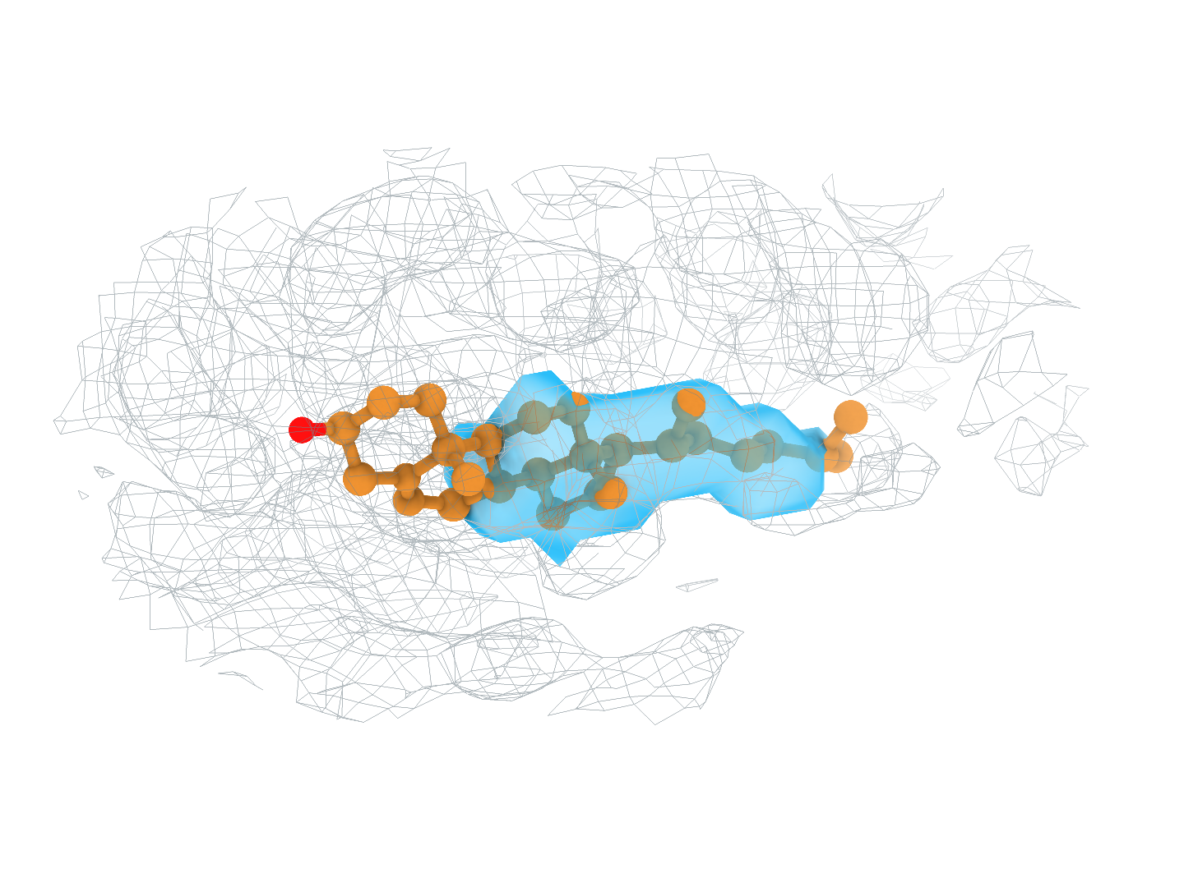
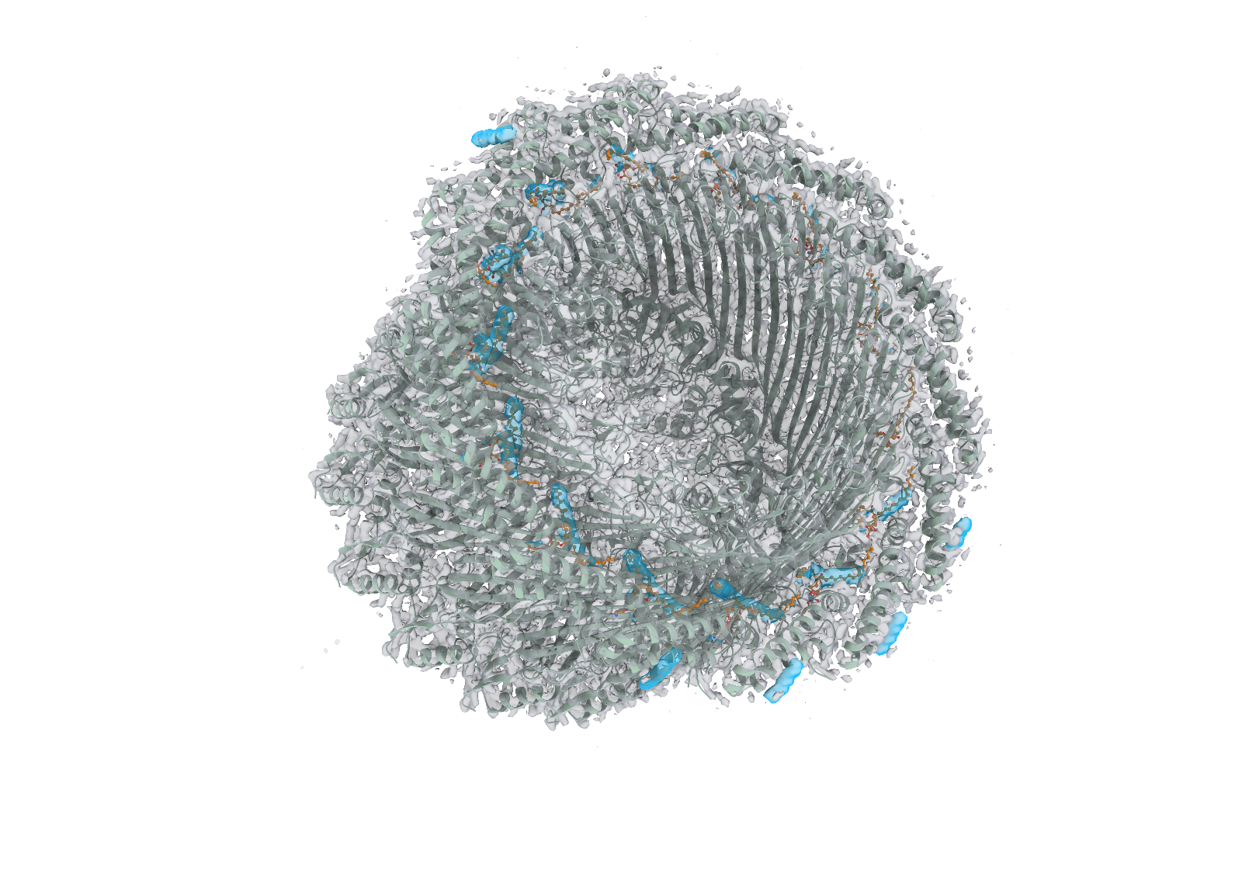
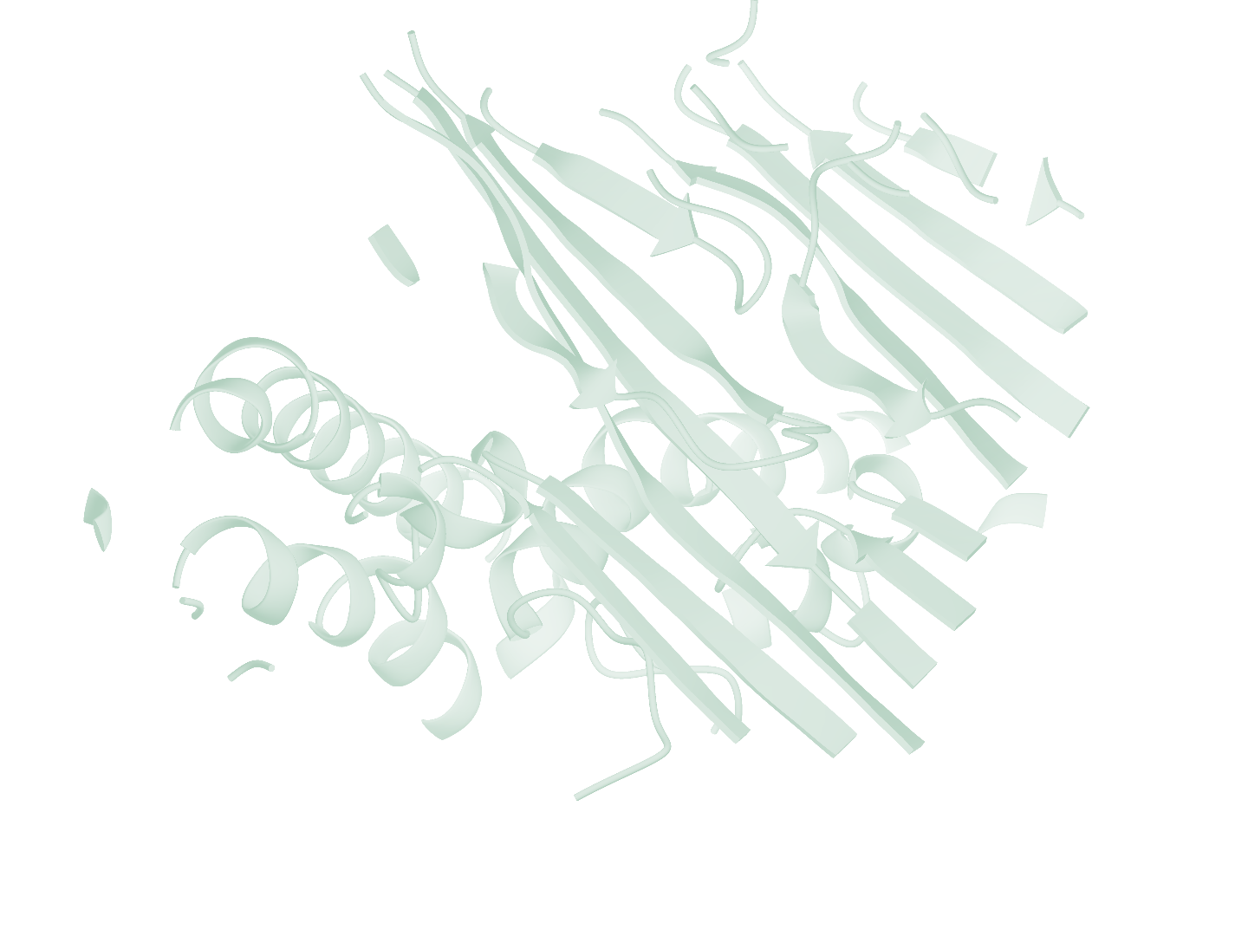
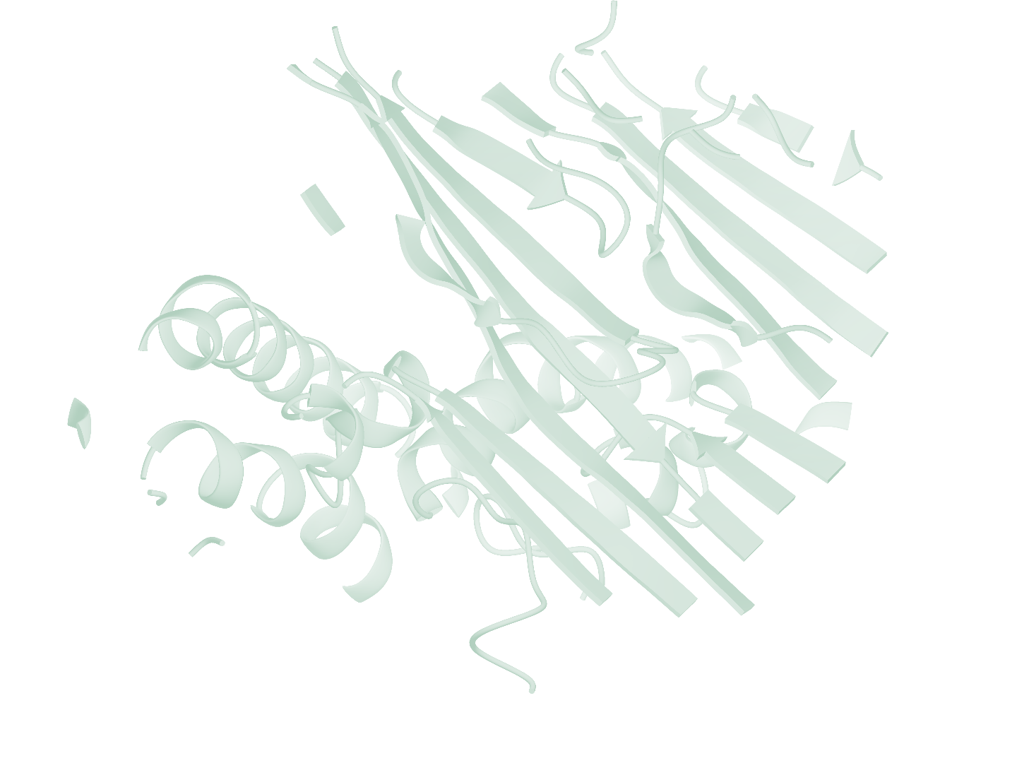
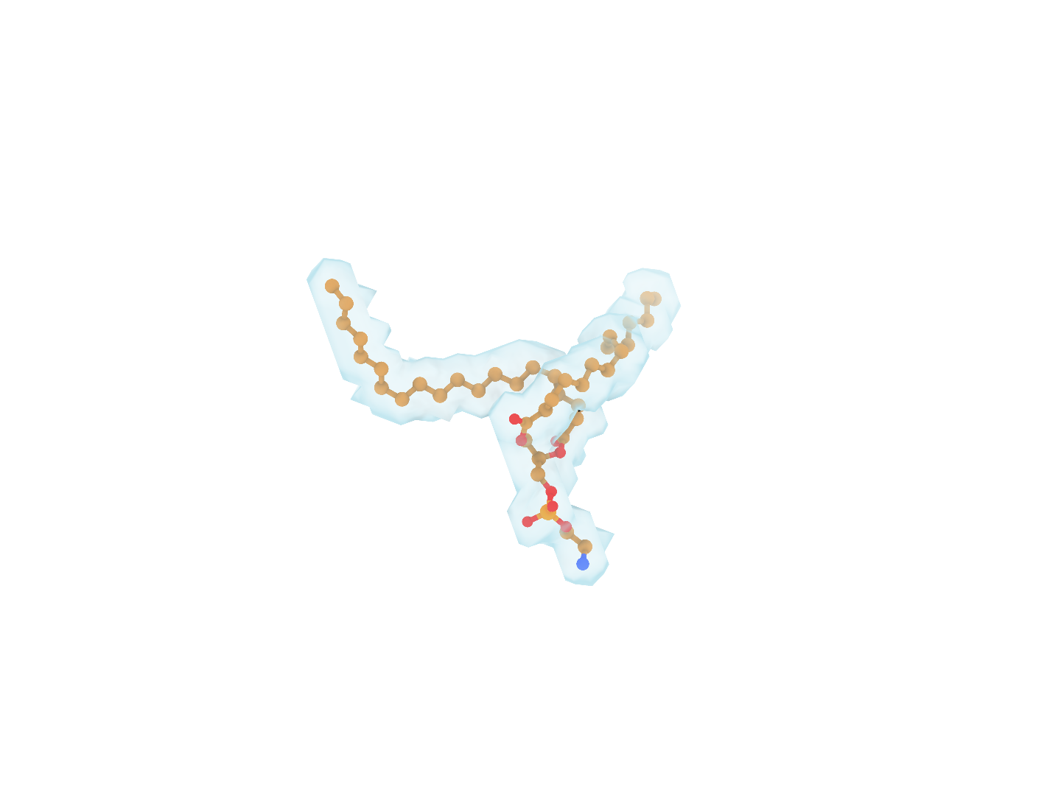
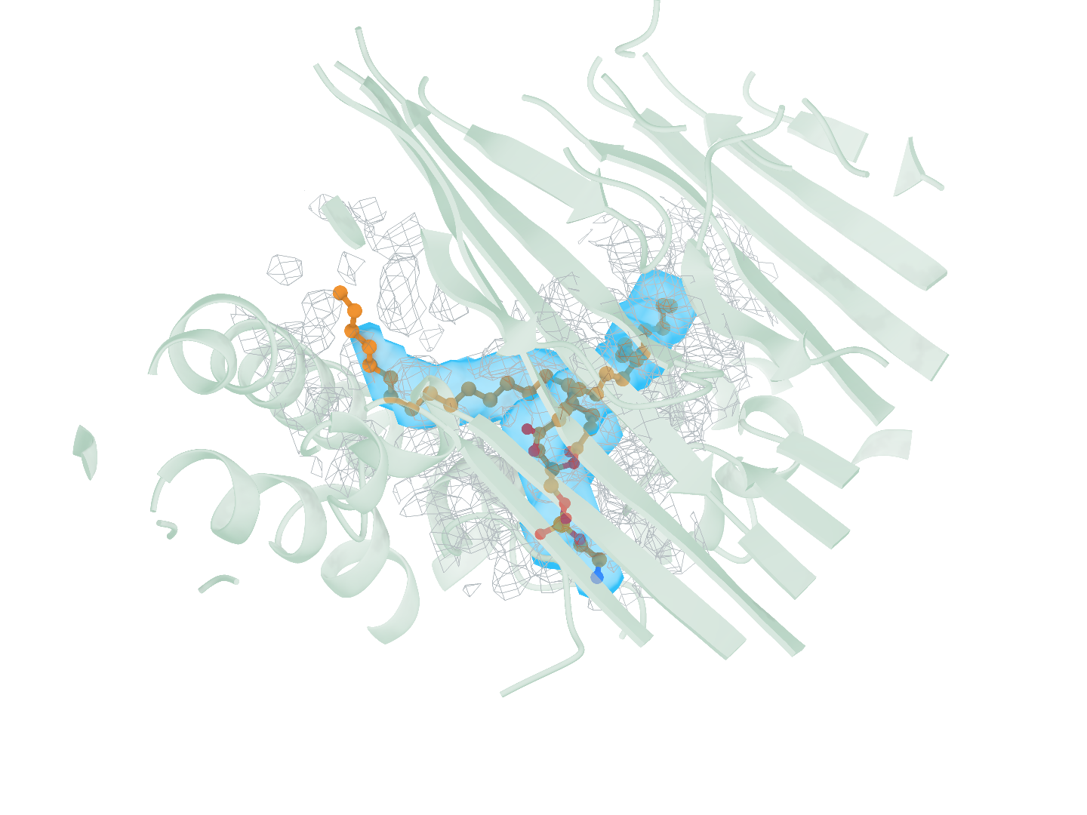
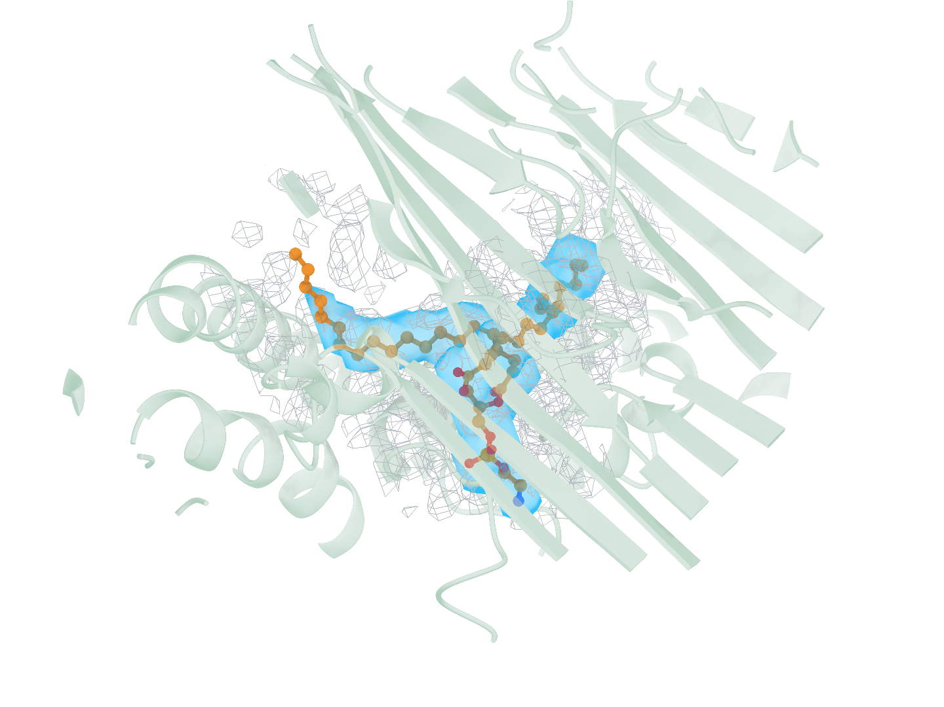
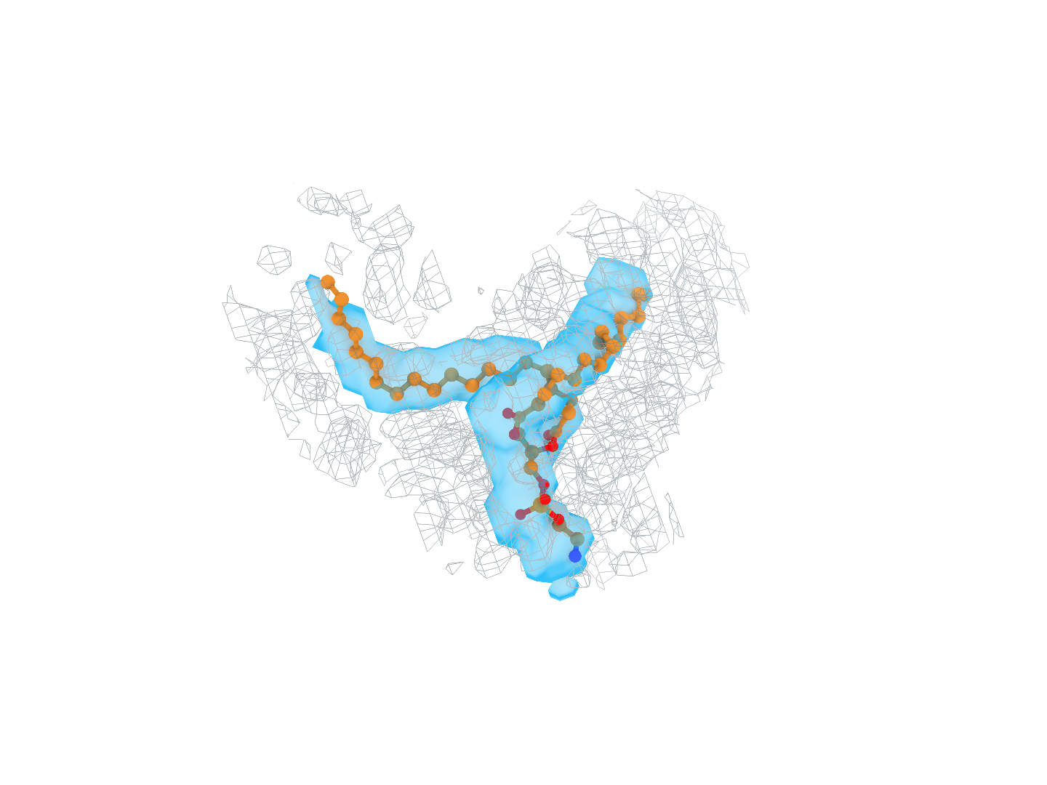
a
b
c
d
Notes:
局部检测实例的风格对照。a–d 依次为 9PQM 的 ATPγS（AGS，A:401）、9WQ3 的 1SY（E:401）、9UWI 的胆固醇（CLR，B:502）和 9X0X 的磷脂酰乙醇胺（PTY，T:801）。每行左侧为复合物整体，框选一个配体结合位点；右侧上排从左至右为真实受体、CryoAtom2 受体、真实配体及其标注区域，下排为使用真实受体的 Find、使用 CryoAtom2 受体的 Find 和 Emap2lig。下排均显示同一真实配体和实验密度，Find 两格另显示相应受体。每例六格共用朝向和尺度。浅绿为受体，灰色网格为实验密度，橙色为配体碳原子，蓝色包络为预测区域，浅灰蓝为真实标注区域。

Slide 4
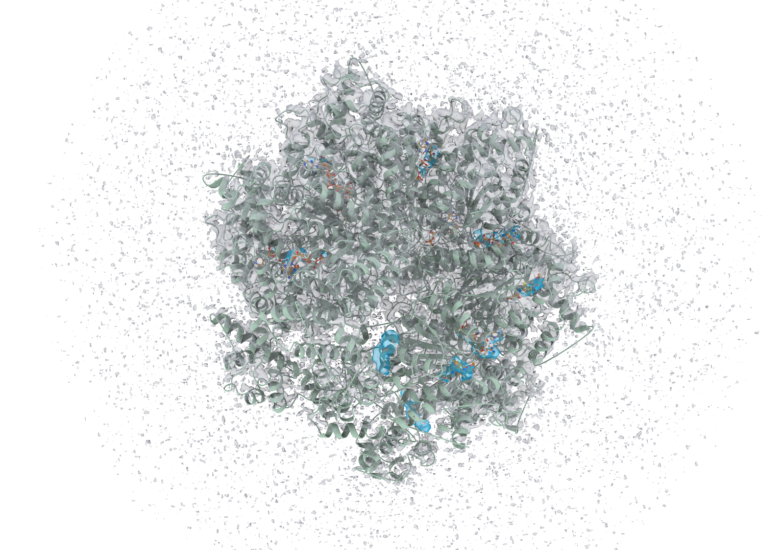
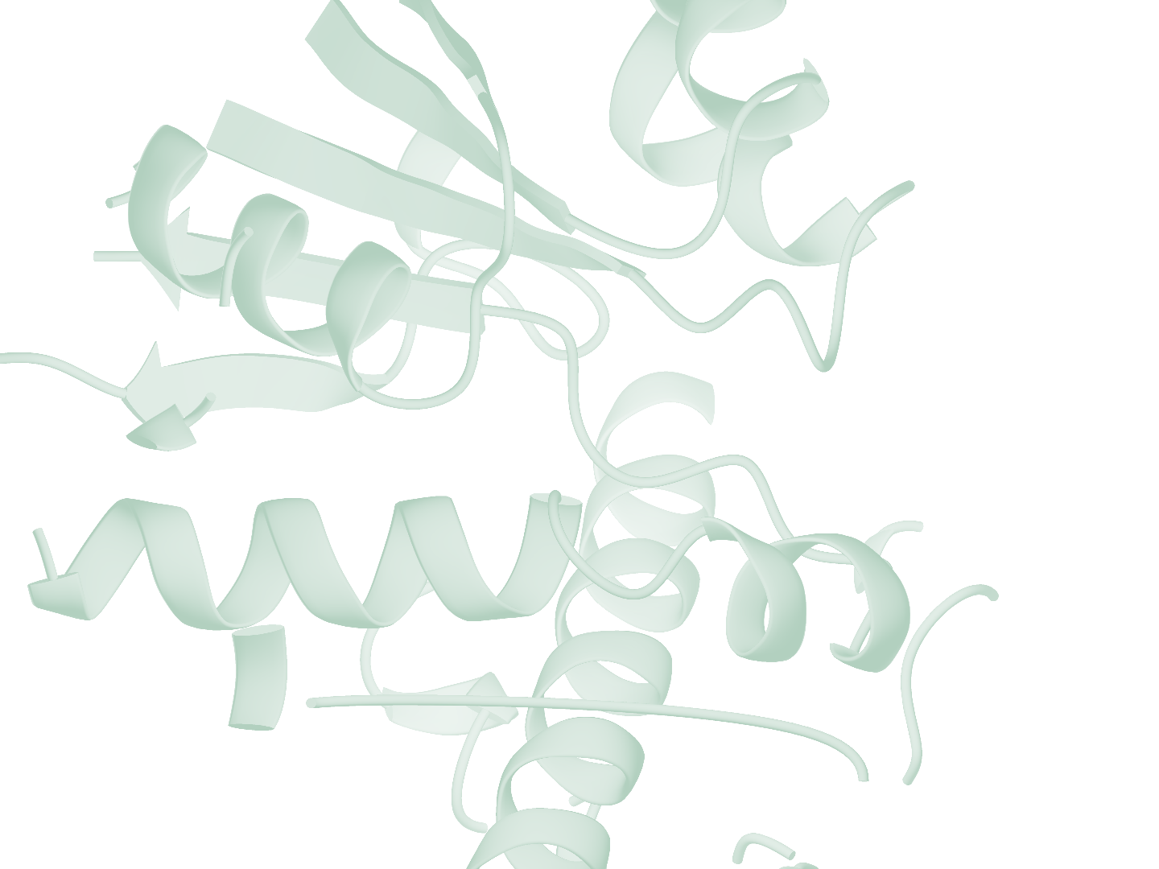
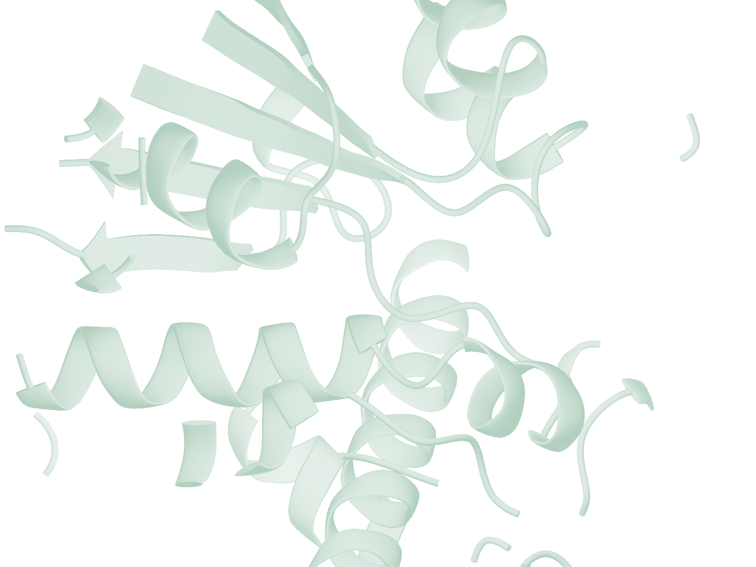
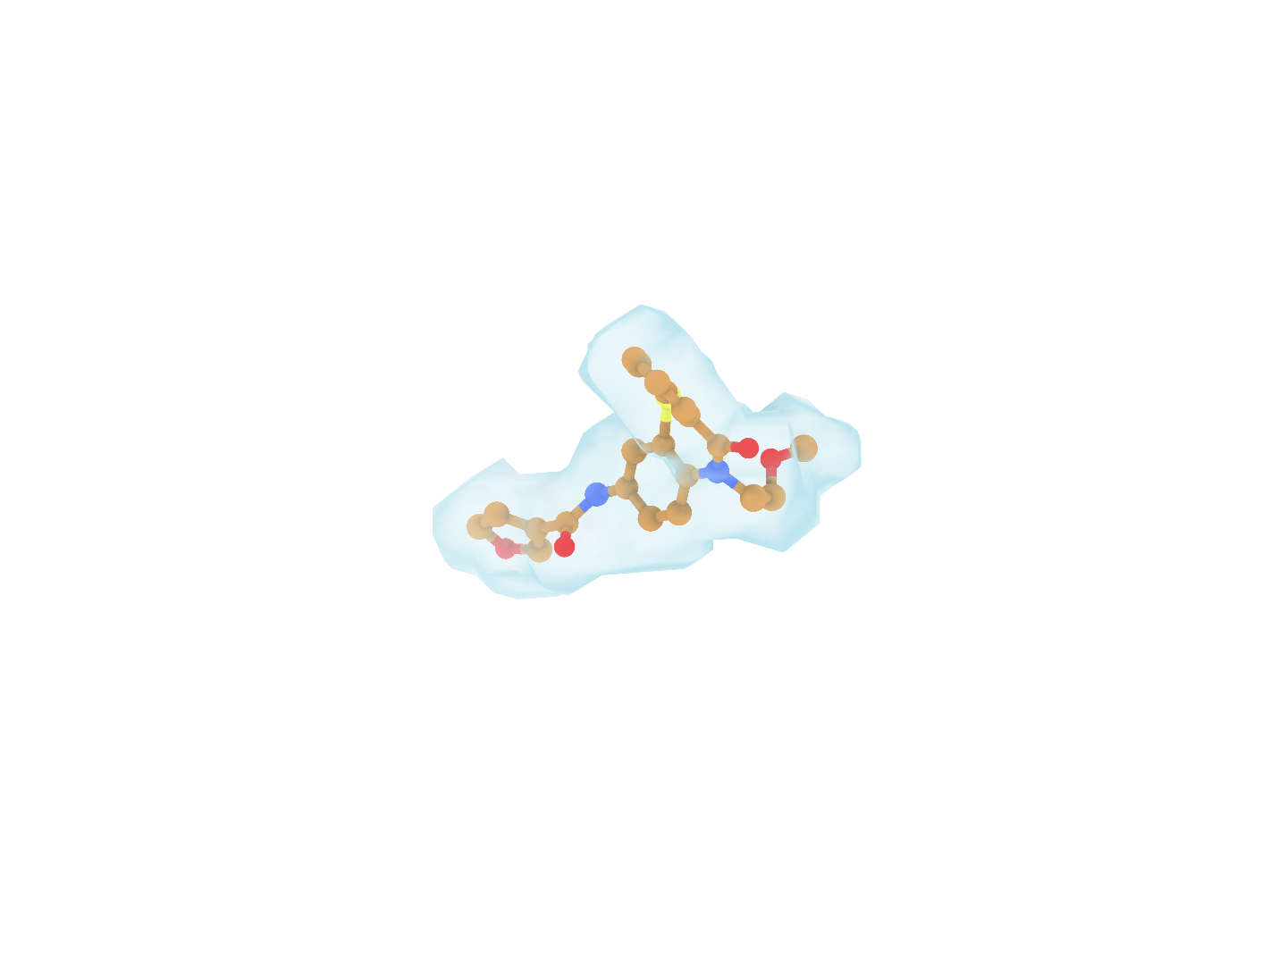
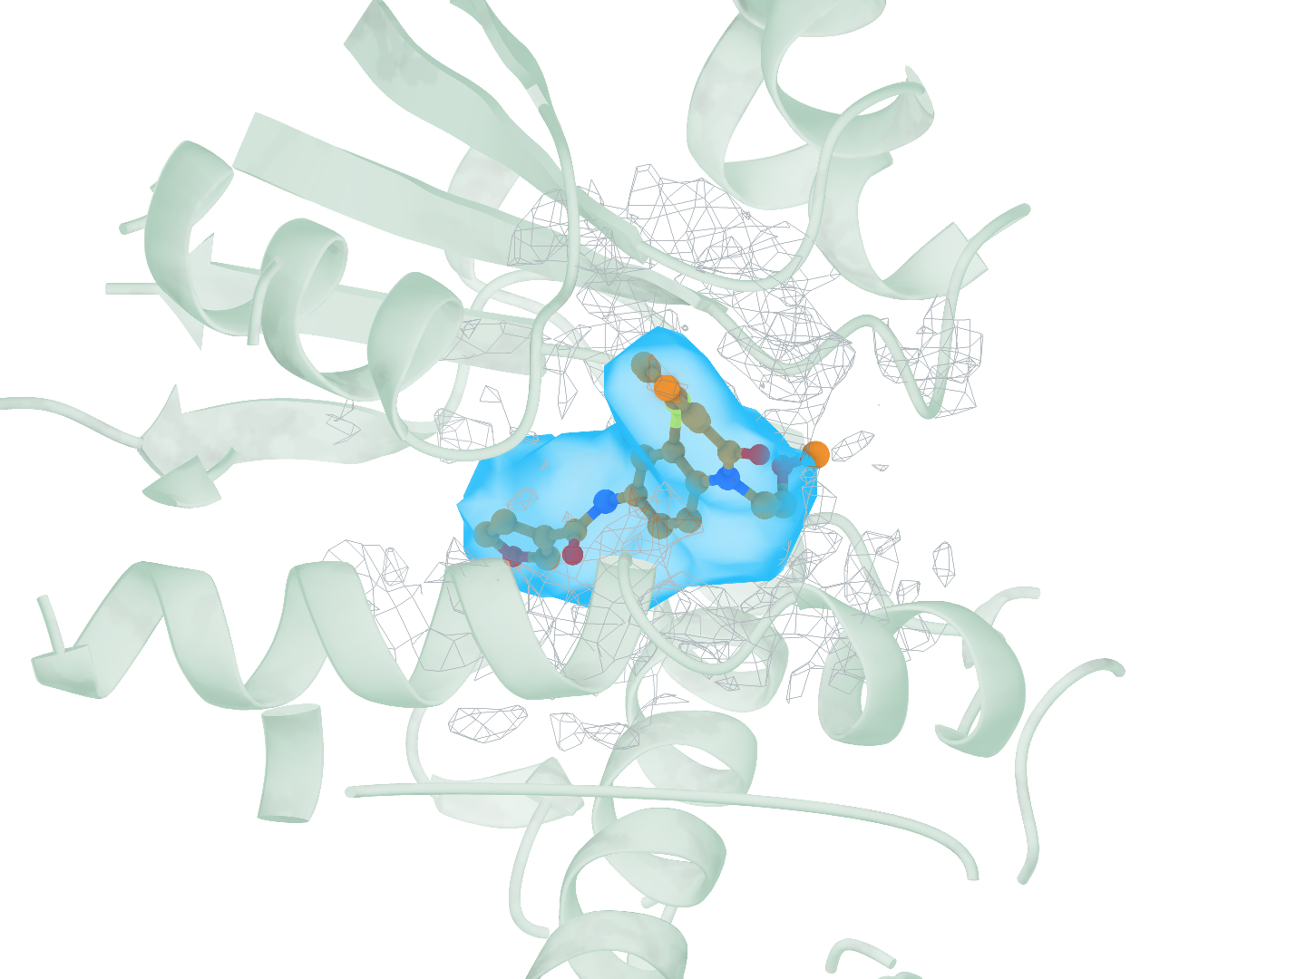
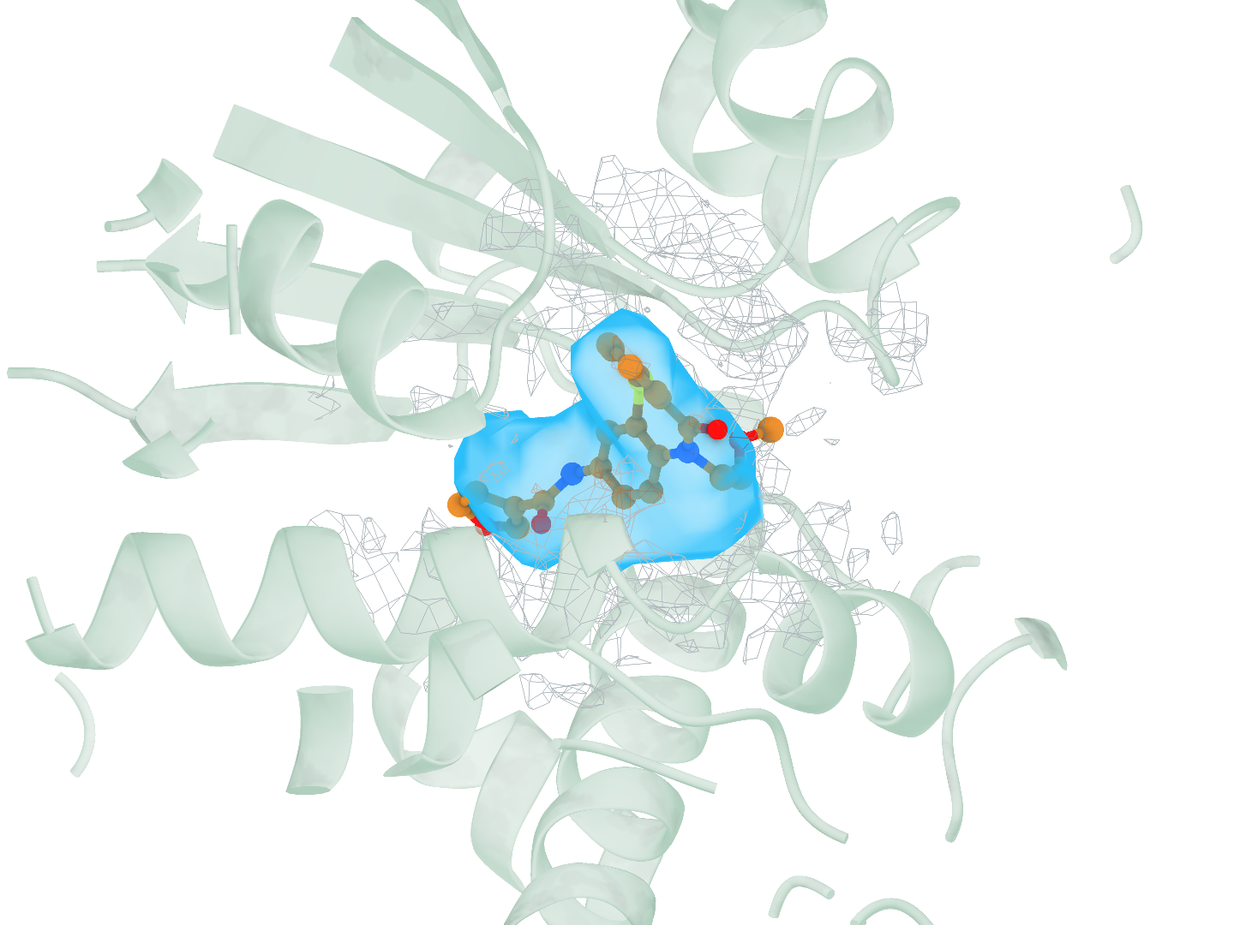
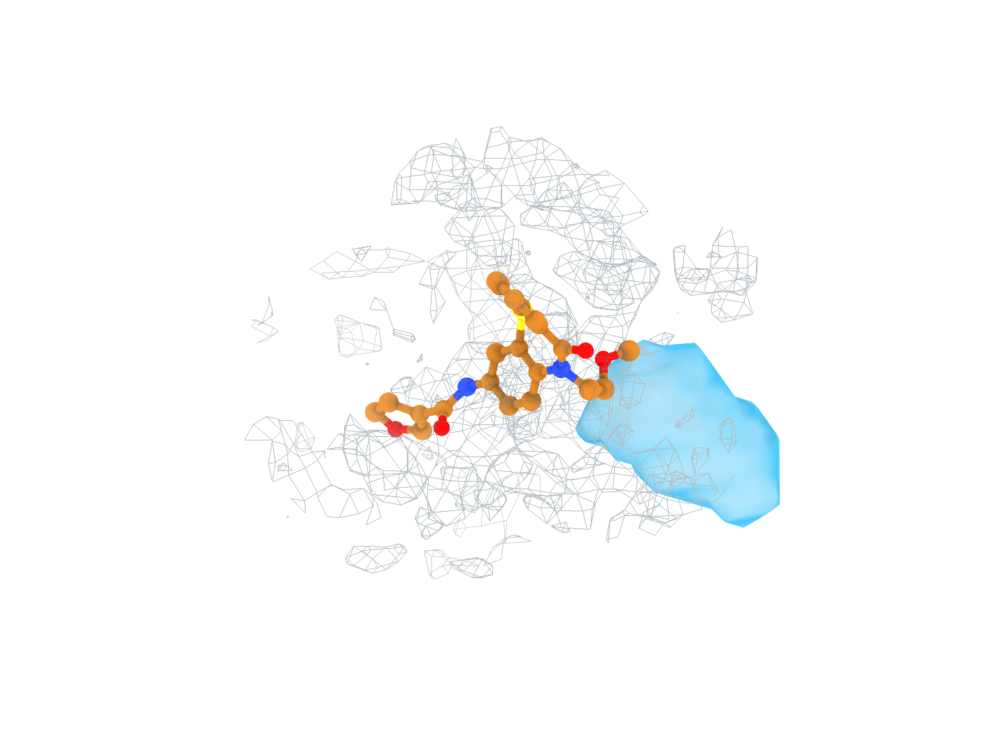
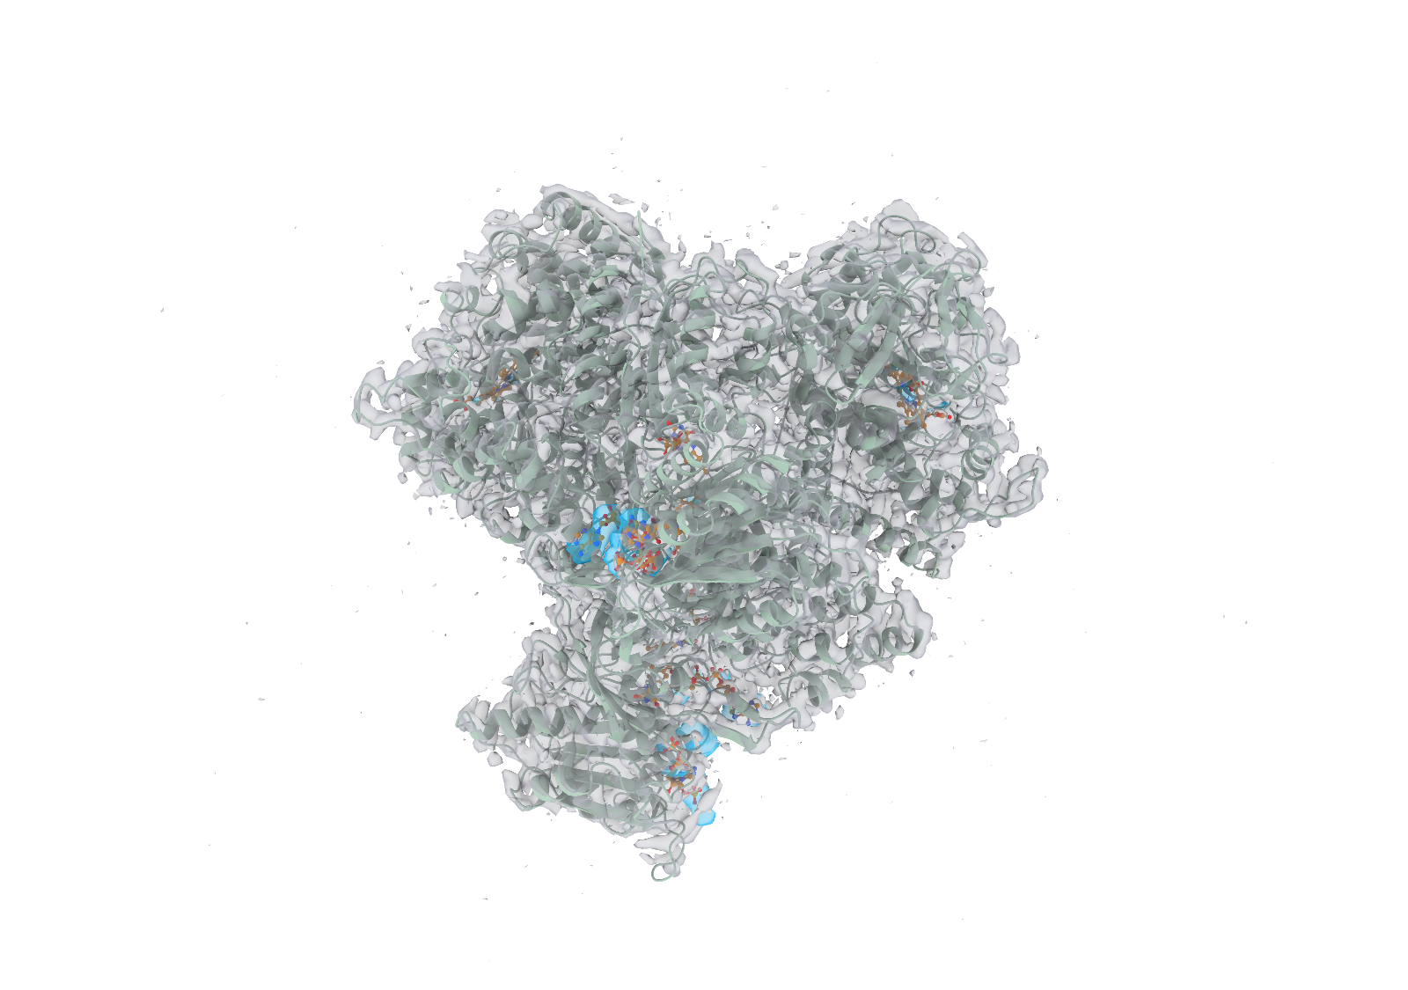













a
b
c
Notes:
局部检测实例的风格对照。a–c 依次为 9BJJ 的 A1AP0（F:1001）、9WUP 的 NADPH（NDP，A:1104）和 9RMI 的 ADP（C:401）。每行左侧为复合物整体，框选一个配体结合位点；右侧上排从左至右为真实受体、CryoAtom2 受体、真实配体及其标注区域，下排为使用真实受体的 Find、使用 CryoAtom2 受体的 Find 和 Emap2lig。下排均显示同一真实配体和实验密度，Find 两格另显示相应受体。每例六格共用朝向和尺度。浅绿为受体，灰色网格为实验密度，橙色为配体碳原子，蓝色包络为预测区域，浅灰蓝为真实标注区域。

Slide 5























a
b
c
d
Notes:
局部检测实例的风格对照。a–d 依次为 9PQM 的 ATPγS（AGS，A:401）、9WQ3 的 1SY（E:401）、9UWI 的胆固醇（CLR，B:502）和 9X0X 的磷脂酰乙醇胺（PTY，T:801）。每行左侧为复合物整体，框选一个配体结合位点；右侧上排从左至右为真实受体、CryoAtom2 受体、真实配体及其标注区域，下排为使用真实受体的 Find、使用 CryoAtom2 受体的 Find 和 Emap2lig。下排均显示同一真实配体和实验密度，Find 两格另显示相应受体。每例六格共用朝向和尺度。浅绿为受体，灰色半透明表面为实验密度，橙色为配体碳原子，蓝色网格为预测边界，浅灰蓝网格为真实标注区域。

Slide 6


















a
b
c
Notes:
局部检测实例的风格对照。a–c 依次为 9BJJ 的 A1AP0（F:1001）、9WUP 的 NADPH（NDP，A:1104）和 9RMI 的 ADP（C:401）。每行左侧为复合物整体，框选一个配体结合位点；右侧上排从左至右为真实受体、CryoAtom2 受体、真实配体及其标注区域，下排为使用真实受体的 Find、使用 CryoAtom2 受体的 Find 和 Emap2lig。下排均显示同一真实配体和实验密度，Find 两格另显示相应受体。每例六格共用朝向和尺度。浅绿为受体，灰色半透明表面为实验密度，橙色为配体碳原子，蓝色网格为预测边界，浅灰蓝网格为真实标注区域。

Slide 7
a
b
c
d
Notes:
不同受体条件下的小分子区域检出。
a–d, 分别为 9PQM 中的 ATPγS（AGS，A:401）、9UWI 中的胆固醇（CLR，B:502）、9WUP 中的 NADPH（NDP，A:1104）和 9RMI 中的 ADP（C:401）。每行左侧展示完整复合物及 LigandSeek-Find 使用真实受体预测的配体区域。方框标出右侧六个局部视图所展示的配体结合位点。上排从左至右展示真实受体、CryoAtom2 受体，以及沉积配体及其真实配体区域。下排从左至右比较使用真实受体的 LigandSeek-Find、使用 CryoAtom2 受体的 LigandSeek-Find，以及 Emap2lig-Find。三个预测视图均展示相同的沉积配体和实验密度，前两个预测视图还分别展示真实受体和 CryoAtom2 重建受体。每个案例的六个局部视图使用相同的方向和尺度。受体为浅绿色，实验密度以灰色网格展示；蓝色包络表示选定的预测区域，浅灰蓝色包络表示真实配体区域。
ENGLISH:
Small-molecule region detection under different receptor conditions.
a–d, ATPγS in 9PQM (AGS, A:401), cholesterol in 9UWI (CLR, B:502), NADPH in 9WUP (NDP, A:1104) and ADP in 9RMI (C:401), respectively. The left view of each row shows the full complex with ligand regions predicted by LigandSeek-Find using the deposited receptor. A box marks the selected ligand binding site for the six close-up views on the right. The top row shows the deposited receptor, the CryoAtom2 receptor, and the deposited ligand with its ground-truth ligand region, from left to right. The bottom row compares LigandSeek-Find with the deposited receptor, LigandSeek-Find with the CryoAtom2 receptor, and Emap2lig-Find, from left to right. All three prediction views show the same deposited ligand and experimental density. The first two prediction views additionally show the deposited and CryoAtom2-reconstructed receptors, respectively. The six close-up views for each case use the same orientation and scale. Receptors are light green, experimental density is shown as a grey mesh; blue envelopes show selected predicted regions, and pale grey-blue envelopes show ground-truth ligand regions.

Slide 8
a
b
c
Notes:
不同受体条件下的小分子区域检出。
a–c, 分别为 9UWI 中的胆固醇（CLR，B:502）、9WUP 中的 NADPH（NDP，A:1104）和 9RMI 中的 ADP（C:401）。每行左侧展示完整复合物及 LigandSeek-Find 使用真实受体预测的配体区域。方框标出右侧六个局部视图所展示的配体结合位点。上排从左至右展示真实受体、CryoAtom2 受体，以及沉积配体及其真实配体区域。下排从左至右比较使用真实受体的 LigandSeek-Find、使用 CryoAtom2 受体的 LigandSeek-Find，以及 Emap2lig-Find。三个预测视图均展示相同的沉积配体和实验密度，前两个预测视图还分别展示真实受体和 CryoAtom2 重建受体。每个案例的六个局部视图使用相同的方向和尺度。受体为浅绿色，实验密度以灰色网格展示；蓝色包络表示选定的预测区域，浅灰蓝色包络表示真实配体区域。
ENGLISH:
Small-molecule region detection under different receptor conditions.
a–c, cholesterol in 9UWI (CLR, B:502), NADPH in 9WUP (NDP, A:1104) and ADP in 9RMI (C:401), respectively. The left view of each row shows the full complex with ligand regions predicted by LigandSeek-Find using the deposited receptor. A box marks the selected ligand binding site for the six close-up views on the right. The top row shows the deposited receptor, the CryoAtom2 receptor, and the deposited ligand with its ground-truth ligand region, from left to right. The bottom row compares LigandSeek-Find with the deposited receptor, LigandSeek-Find with the CryoAtom2 receptor, and Emap2lig-Find, from left to right. All three prediction views show the same deposited ligand and experimental density. The first two prediction views additionally show the deposited and CryoAtom2-reconstructed receptors, respectively. The six close-up views for each case use the same orientation and scale. Receptors are light green, experimental density is shown as a grey mesh; blue envelopes show selected predicted regions, and pale grey-blue envelopes show ground-truth ligand regions.

Slide 9






9NVS · A1B32 (B:1001)
a
Reference
b
Emap2lig-Find
c
LigandSeek-Find (CA2)
ii
ii
i
50 Å
50 Å
50 Å
Reference ligand regions
TP 1 · FP 5
TP 5 · FP 0
d
i · Receptor-associated FP
e
ii · Emap2lig-Find
f
ii · LigandSeek-Find (CA2)
5 Å
5 Å
5 Å
FP · zero overlap with ligand regions
Dice 0.469
Dice 0.792
Notes:
受体背景下配体区域检出的全局与局部比较：9NVS。a–c，真实配体区域（绿色）、Emap2lig-Find 预测（橙色）和 LigandSeek-Find 的 CA2 预测（蓝色）。a、b 使用沉积受体，c 使用 CA2 受体；全部保留预测均显示。d，框 i 对应的受体上假阳性，与全部配体真实区域零交集。e、f，框 ii 对应的同一 A1B32 (B:1001) 实例，两方法均在双向覆盖阈值 0.3 的一对一评价中匹配该实例；Emap2lig 与 LigandSeek 的 Dice 分别为 0.469 和 0.792。绿色网格表示真实区域，棒状原子表示沉积配体和相应受体邻域。a–c 共用全局视角和尺度，e、f 共用局部视角和尺度；掩码为 0.5 等值面，不平滑。比例尺：a–c，50 Å；d–f，5 Å。
ENGLISH:
Global and local comparison of ligand-region detection in 9NVS. a–c, Reference ligand regions (green), Emap2lig-Find predictions (orange), and LigandSeek-Find predictions with CA2 receptors (blue). Deposited receptors are shown in a and b, and the CA2 receptor in c. All retained predictions are displayed. d, The receptor-associated false positive marked by box i has zero overlap with all ground-truth ligand regions. e,f, The same A1B32 (B:1001) instance marked by box ii, matched by both methods under one-to-one evaluation at a bidirectional coverage threshold of 0.3. Dice is 0.469 for Emap2lig-Find and 0.792 for LigandSeek-Find. Green mesh denotes the ground-truth region; sticks show the deposited ligand and the corresponding receptor neighbourhood. Panels a–c share the global view and scale; e and f share the local view and scale. Binary masks are displayed at an isovalue of 0.5 without smoothing. Scale bars, 50 Å (a–c), 5 Å (d–f).

Slide 10
a
b
c
Reference
Emap2lig-Find
LigandSeek-Find (CA2)
ii
ii
i
PDB ID: 9NVS
Semantic Dice: 0.160
Semantic Dice: 0.757
d
e
f
i · Receptor-associated FP
ii · Emap2lig-Find
ii · LigandSeek-Find (CA2)
False positive
IoU: 0.306
IoU: 0.656
Notes:
对 Emap2lig-Find 和 LigandSeek-Find 在 9NVS 上进行配体区域检测的性能进行全局和局部比较。LigandSeek-Find 以 CryoAtom2 重构的受体 (CA2) 作为输入。a–c 分别展示了参考配体区域（绿色）、Emap2lig-Find 预测结果（橙色）以及使用 CA2 受体的 LigandSeek-Find 预测结果（蓝色）。a 和 b 中显示了已提交的受体，c 中显示了 CA2 受体。图中显示了所有保留的预测结果。Emap2lig-Find 和 LigandSeek-Find 的全局语义 Dice 分别为 0.160 和 0.757。d 中，方框 i 标记的受体相关假阳性区域与任何真实配体区域均无重叠。e 和 f 中，对同一 A1B32 (B:1001) 实例（方框 ii 标记）进行了比较（IoU：Emap2lig-Find 为 0.306，LigandSeek-Find 为 0.656）。绿色网格表示真实区域；棒状图表示沉积的配体和相邻的受体残基。图a-c共享全局视图和比例尺；图e和f共享局部视图和比例尺。
ENGLISH:
Global and local comparison of Emap2lig-Find and LigandSeek-Find for ligand-region detection on 9NVS. LigandSeek-Find takes the CryoAtom2-reconstructed receptor (CA2) as input. a–c, Reference ligand regions (green), Emap2lig-Find predictions (orange), and LigandSeek-Find predictions with CA2 receptors (blue). Deposited receptors are shown in a and b, and the CA2 receptor in c. All retained predictions are displayed. Global semantic Dice scores are 0.160 for Emap2lig-Find and 0.757 for LigandSeek-Find. d, The receptor-associated false positive marked by box i shows zero overlap with any ground-truth ligand region. e,f, Comparison on the same A1B32 (B:1001) instance marked by box ii (IoU: 0.306 for Emap2lig-Find vs. 0.656 for LigandSeek-Find). Green mesh denotes the ground-truth region; sticks show the deposited ligand and adjacent receptor residues. Panels a–c share the global view and scale; e and f share the local view and scale.

Slide 11





9NAL · ADP (A:1402)
a
Reference
b
Emap2lig-Find
c
LigandSeek-Find (CA2)
ii
ii
i
Reference ligand regions
TP 2 · FP 11
TP 2 · FP 0
d
i · Receptor-associated FP
e
ii · Emap2lig-Find
f
ii · LigandSeek-Find (CA2)
FP · zero overlap with ligand regions
Dice 0.393
Dice 0.631
Notes:
受体背景下配体区域检出的全局与局部比较：9NAL。a–c，真实配体区域（绿色）、Emap2lig-Find 预测（橙色）和 LigandSeek-Find 的 CA2 预测（蓝色）。a、b 使用沉积受体，c 使用 CA2 受体；全部保留预测均显示。d，框 i 对应的受体上假阳性，与全部配体真实区域零交集。e、f，框 ii 对应的同一 ADP (A:1402) 实例，两方法均在双向覆盖阈值 0.3 的一对一评价中匹配该实例；Emap2lig 与 LigandSeek 的 Dice 分别为 0.393 和 0.631。绿色网格表示真实区域，棒状原子表示沉积配体和相应受体邻域。a–c 共用全局视角和尺度，e、f 共用局部视角和尺度；掩码为 0.5 等值面，不平滑。比例尺：a–c，50 Å；d–f，5 Å。
ENGLISH:
Global and local comparison of ligand-region detection in 9NAL. a–c, Reference ligand regions (green), Emap2lig-Find predictions (orange), and LigandSeek-Find predictions with CA2 receptors (blue). Deposited receptors are shown in a and b, and the CA2 receptor in c. All retained predictions are displayed. d, The receptor-associated false positive marked by box i has zero overlap with all ground-truth ligand regions. e,f, The same ADP (A:1402) instance marked by box ii, matched by both methods under one-to-one evaluation at a bidirectional coverage threshold of 0.3. Dice is 0.393 for Emap2lig-Find and 0.631 for LigandSeek-Find. Green mesh denotes the ground-truth region; sticks show the deposited ligand and the corresponding receptor neighbourhood. Panels a–c share the global view and scale; e and f share the local view and scale. Binary masks are displayed at an isovalue of 0.5 without smoothing. Scale bars, 50 Å (a–c), 5 Å (d–f).

Slide 12






9UJF · GTP (D:201)
a
Reference
b
Emap2lig-Find
c
LigandSeek-Find (CA2)
i
ii
ii
50 Å
50 Å
50 Å
Reference ligand regions
TP 10 · FP 10
TP 10 · FP 0
d
i · Receptor-associated FP
e
ii · Emap2lig-Find
f
ii · LigandSeek-Find (CA2)
5 Å
5 Å
5 Å
FP · zero overlap with ligand regions
Dice 0.560
Dice 0.864
Notes:
受体背景下配体区域检出的全局与局部比较：9UJF。a–c，真实配体区域（绿色）、Emap2lig-Find 预测（橙色）和 LigandSeek-Find 的 CA2 预测（蓝色）。a、b 使用沉积受体，c 使用 CA2 受体；全部保留预测均显示。d，框 i 对应的受体上假阳性，与全部配体真实区域零交集。e、f，框 ii 对应的同一 GTP (D:201) 实例，两方法均在双向覆盖阈值 0.3 的一对一评价中匹配该实例；Emap2lig 与 LigandSeek 的 Dice 分别为 0.560 和 0.864。绿色网格表示真实区域，棒状原子表示沉积配体和相应受体邻域。a–c 共用全局视角和尺度，e、f 共用局部视角和尺度；掩码为 0.5 等值面，不平滑。比例尺：a–c，50 Å；d–f，5 Å。
ENGLISH:
Global and local comparison of ligand-region detection in 9UJF. a–c, Reference ligand regions (green), Emap2lig-Find predictions (orange), and LigandSeek-Find predictions with CA2 receptors (blue). Deposited receptors are shown in a and b, and the CA2 receptor in c. All retained predictions are displayed. d, The receptor-associated false positive marked by box i has zero overlap with all ground-truth ligand regions. e,f, The same GTP (D:201) instance marked by box ii, matched by both methods under one-to-one evaluation at a bidirectional coverage threshold of 0.3. Dice is 0.560 for Emap2lig-Find and 0.864 for LigandSeek-Find. Green mesh denotes the ground-truth region; sticks show the deposited ligand and the corresponding receptor neighbourhood. Panels a–c share the global view and scale; e and f share the local view and scale. Binary masks are displayed at an isovalue of 0.5 without smoothing. Scale bars, 50 Å (a–c), 5 Å (d–f).

Slide 13



9WFU · ATP (A:1401)
a
Reference
b
Emap2lig-Find
c
LigandSeek-Find (CA2)
ii
ii
i
50 Å
50 Å
50 Å
Reference ligand regions
TP 2 · FP 8
TP 2 · FP 0
d
i · Receptor-associated FP
e
ii · Emap2lig-Find
f
ii · LigandSeek-Find (CA2)
5 Å
5 Å
5 Å
FP · zero overlap with ligand regions
Dice 0.655
Dice 0.743
Notes:
受体背景下配体区域检出的全局与局部比较：9WFU。a–c，真实配体区域（绿色）、Emap2lig-Find 预测（橙色）和 LigandSeek-Find 的 CA2 预测（蓝色）。a、b 使用沉积受体，c 使用 CA2 受体；全部保留预测均显示。d，框 i 对应的受体上假阳性，与全部配体真实区域零交集。e、f，框 ii 对应的同一 ATP (A:1401) 实例，两方法均在双向覆盖阈值 0.3 的一对一评价中匹配该实例；Emap2lig 与 LigandSeek 的 Dice 分别为 0.655 和 0.743。绿色网格表示真实区域，棒状原子表示沉积配体和相应受体邻域。a–c 共用全局视角和尺度，e、f 共用局部视角和尺度；掩码为 0.5 等值面，不平滑。比例尺：a–c，50 Å；d–f，5 Å。
ENGLISH:
Global and local comparison of ligand-region detection in 9WFU. a–c, Reference ligand regions (green), Emap2lig-Find predictions (orange), and LigandSeek-Find predictions with CA2 receptors (blue). Deposited receptors are shown in a and b, and the CA2 receptor in c. All retained predictions are displayed. d, The receptor-associated false positive marked by box i has zero overlap with all ground-truth ligand regions. e,f, The same ATP (A:1401) instance marked by box ii, matched by both methods under one-to-one evaluation at a bidirectional coverage threshold of 0.3. Dice is 0.655 for Emap2lig-Find and 0.743 for LigandSeek-Find. Green mesh denotes the ground-truth region; sticks show the deposited ligand and the corresponding receptor neighbourhood. Panels a–c share the global view and scale; e and f share the local view and scale. Binary masks are displayed at an isovalue of 0.5 without smoothing. Scale bars, 50 Å (a–c), 5 Å (d–f).

Slide 14
9X0X · PTY (T:801)
a
Reference
b
Emap2lig-Find
c
LigandSeek-Find (CA2)
ii
ii
i
50 Å
50 Å
50 Å
Reference ligand regions
TP 12 · FP 65
TP 14 · FP 1
d
i · Receptor-associated FP
e
ii · Emap2lig-Find
f
ii · LigandSeek-Find (CA2)
5 Å
5 Å
5 Å
FP · zero overlap with ligand regions
Dice 0.405
Dice 0.830
Notes:
受体背景下配体区域检出的全局与局部比较：9X0X。a–c，真实配体区域（绿色）、Emap2lig-Find 预测（橙色）和 LigandSeek-Find 的 CA2 预测（蓝色）。a、b 使用沉积受体，c 使用 CA2 受体；全部保留预测均显示。d，框 i 对应的受体上假阳性，与全部配体真实区域零交集。e、f，框 ii 对应的同一 PTY (T:801) 实例，两方法均在双向覆盖阈值 0.3 的一对一评价中匹配该实例；Emap2lig 与 LigandSeek 的 Dice 分别为 0.405 和 0.830。绿色网格表示真实区域，棒状原子表示沉积配体和相应受体邻域。a–c 共用全局视角和尺度，e、f 共用局部视角和尺度；掩码为 0.5 等值面，不平滑。比例尺：a–c，50 Å；d–f，5 Å。
ENGLISH:
Global and local comparison of ligand-region detection in 9X0X. a–c, Reference ligand regions (green), Emap2lig-Find predictions (orange), and LigandSeek-Find predictions with CA2 receptors (blue). Deposited receptors are shown in a and b, and the CA2 receptor in c. All retained predictions are displayed. d, The receptor-associated false positive marked by box i has zero overlap with all ground-truth ligand regions. e,f, The same PTY (T:801) instance marked by box ii, matched by both methods under one-to-one evaluation at a bidirectional coverage threshold of 0.3. Dice is 0.405 for Emap2lig-Find and 0.830 for LigandSeek-Find. Green mesh denotes the ground-truth region; sticks show the deposited ligand and the corresponding receptor neighbourhood. Panels a–c share the global view and scale; e and f share the local view and scale. Binary masks are displayed at an isovalue of 0.5 without smoothing. Scale bars, 50 Å (a–c), 5 Å (d–f).

