Slide 1
a
Pocket_Plus: from cryo-EM density to ligand poses
User-provided ligand identities {S_k}
Find
Match
Build
R1 / STRUCTURE RENDER
S1
S2
∅
R3 / STRUCTURE RENDER
Receptor + density
Ligand pose + density
Global view to insert
Local view to insert
Locate ligand regions
Assign identity / reject
Density-guided docking
Receptor A + map M
All-atom reconstruction
AUX from Find
b
Shared input representation
c
Find: coupled voxel and point pathways
Multi-view density bank
3D voxel U-Net
56-channel
density input
Ligand-area
M_exp
M_sim
M_diff
M_diff+
probability
4 base fields
Scatter
Receptor
Multi-scale voxel-to-point fusion
2 normalizations
embedding
Raw / clipped z-score
Point Transformer V3
7 spatial views
Pseudo atoms P
Atom binding
Identity · Gaussian ×2 · DoG ×2
probability q_i
Receptor suppression ×2
Recycle voxel / point states
56 channels
Auxiliary heads: binding area · ligand distance · protein / nucleic mainchain
4 × 2 × 7
d
Match and Build: explicit task boundaries
Match
Build
Receptor atom representation
S1
S2
∅
Site p + SMILES + local receptor pocket
B1
B1 → S2
6 + 25 + 8 + 1 + 9 + 1
B2
B2 → S1
Protein / RNA / DNA
50 features per atom
B3
B3 → ∅ (reject)
With density
Without density
Blobs + AUX + supplied identities
Fine-tuned PocketXmol
Official PocketXmol
Crops: Find 80³; Match / Build 48³
Illustrative assignments, not predictions.
All-atom ligand pose(s)
Shared construction; separate encoders.
Schematic only. R1 / R3 mark reserved structure renders; dimensions and task interfaces follow the manuscript.
Notes:
V1 | 平衡型模型主图
来源：V1_balanced_main_figure.svg。本页保留该 SVG 的内容、文字、颜色和分区，不新增科学结论。
所有 550 个可见基本对象均为 PowerPoint 原生可编辑对象；包括 81 个文本框。无整图图片、SVG 图片或嵌入对象。
编辑：在组合内再次单击可选择子对象；也可使用“取消组合”逐层展开。文本可直接输入；线条、箭头、矩形、圆点可修改格式；自由轮廓可使用“编辑顶点”。使用“选择窗格”可按名称定位分图、结构图预留区和文字。
三页统一为 1200 × 1000 pt 画布，原图等比保留；较矮的版本垂直居中，未拉伸。保持 Arial 字体；不附带任何字体文件。
R1 / R2 / R3 仍为真实结构渲染的预留区。密度小格、原子点集和匹配示例均为原图示意，不是新增实验或预测结果。方法与源码的待确认事项仍以原设计包中的核对说明为准。

Slide 2
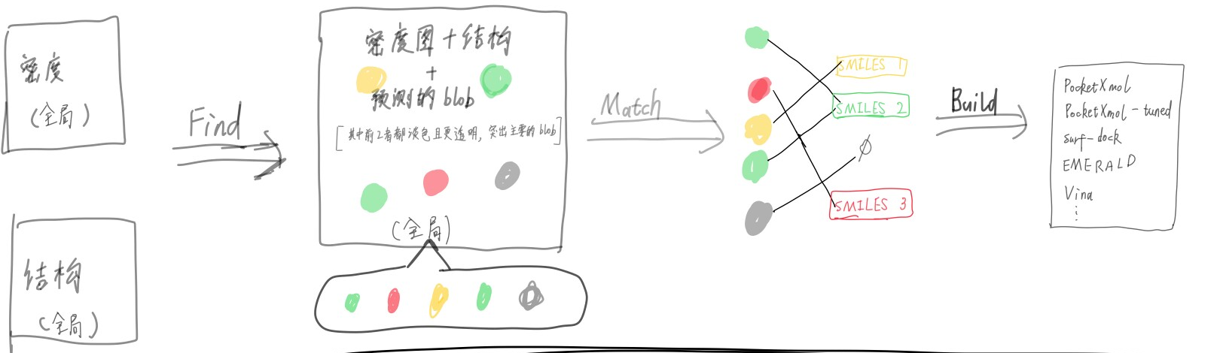
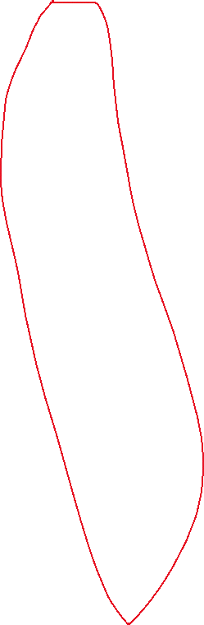
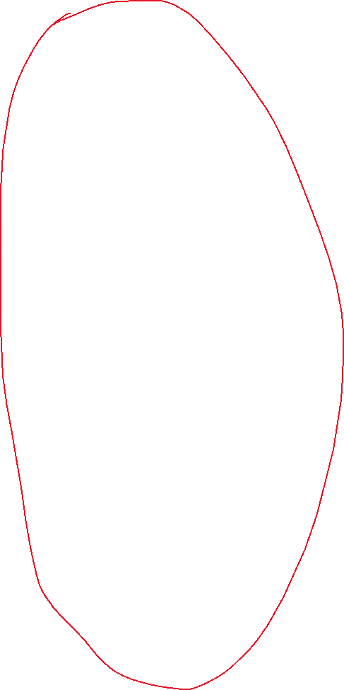
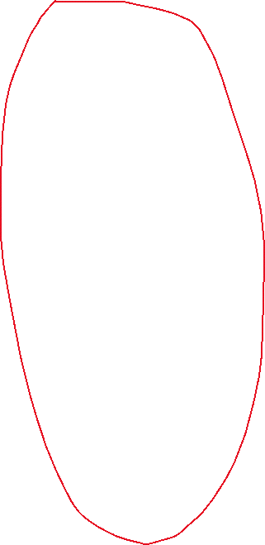

Slide 3
