Slide 1




c
Match: candidate-to-identity assignment
Candidate encoder
Identity encoder
Density + atoms
Base summary
User-provided SMILES · same PDB
$$h_{j}^{vox}$$
1
CCO
U-Net
2
CC(=O)O
k
···
RDKit
Cc1ccccc1
Other
identities
48³ crop
K
···
CC(N)=O
Pocket
Cues from Find
SMI-TED
SMI-TED
Own graph
+ linear
+ linear
Blob
Pseudo
GNN
1
2
K, V
K, V
K
K, V
Mean/max pool
Attention
Q
Graph attention
Q
Q
Context attention
Concat
MLP
FiLM
Fusion
$$h_{j}$$
$$g_{k}$$
Identity scores
$$s_{j,k}$$
k
Foreground head
$$p_{j}^{fg}$$
Cosine score
j
Foreground probability
Learned projections
J × K
Notes:
Match encodes each candidate region and each user-provided ligand identity from the same PDB. The candidate encoder combines a local density–atom voxel representation with pocket, blob and pseudo-atom features through pooling, attention and FiLM modulation. The identity encoder combines the original SMI-TED language representation with attention summaries from its own molecular graph and the other ligand identities. An independent foreground head predicts the foreground probability. Learned projections and cosine scoring relate candidate j to identity k in a J × K score matrix. The highlighted matrix cell identifies the illustrated candidate–identity pair; the grid does not display experimental scores. SMILES strings and molecular graphics are schematic examples. Fusion denotes integration of the identity branches at the level of this overview.

Slide 2
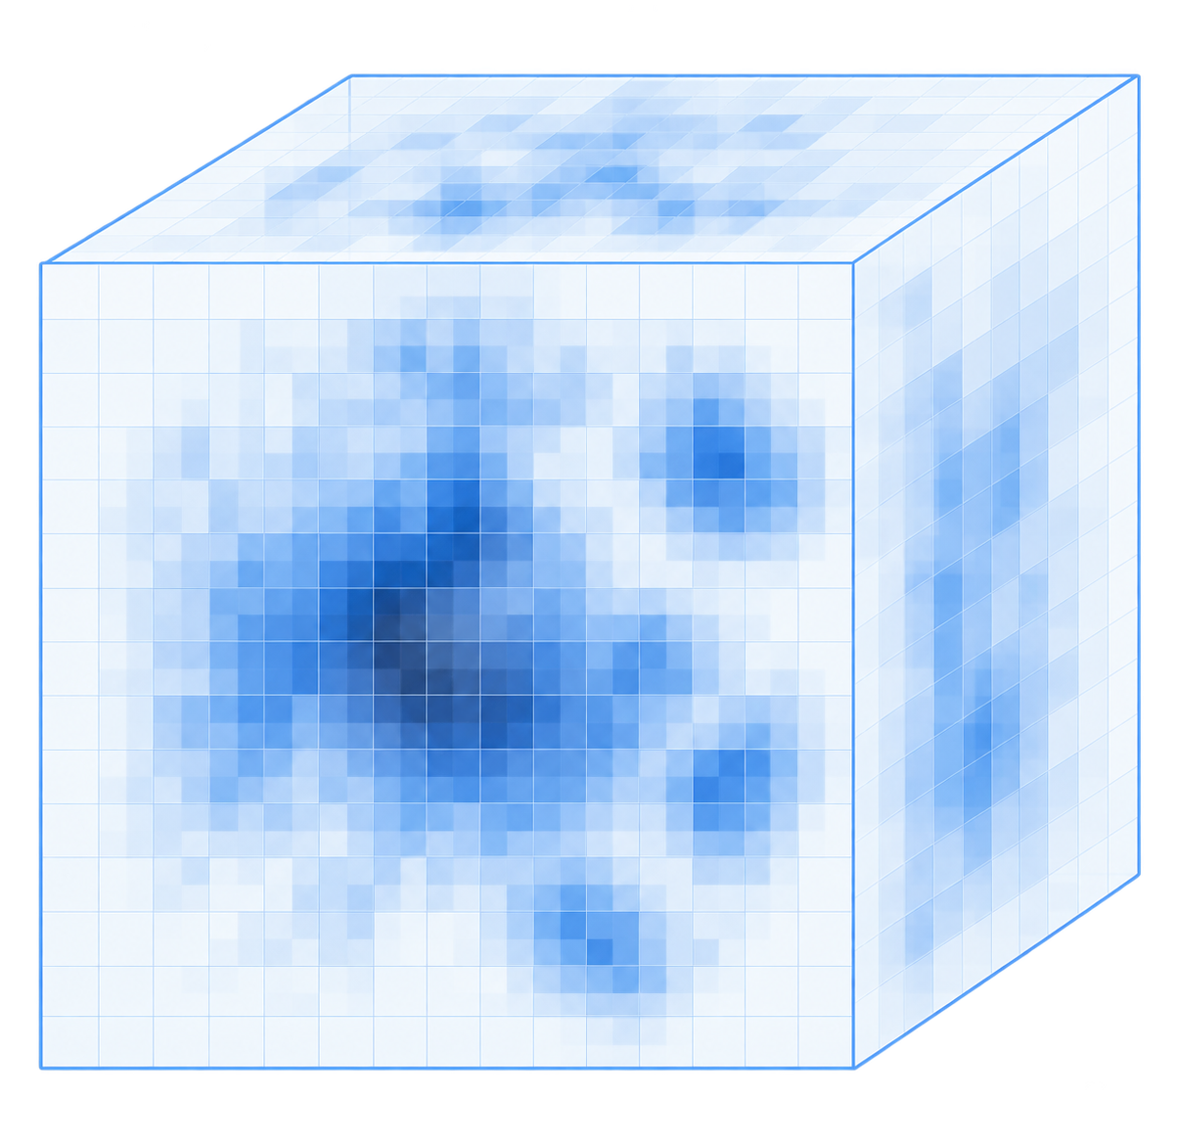
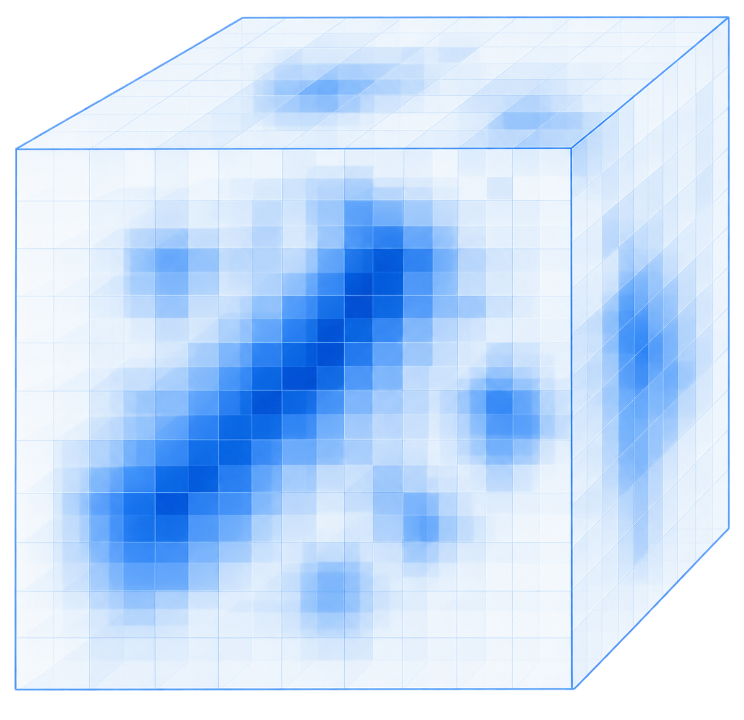
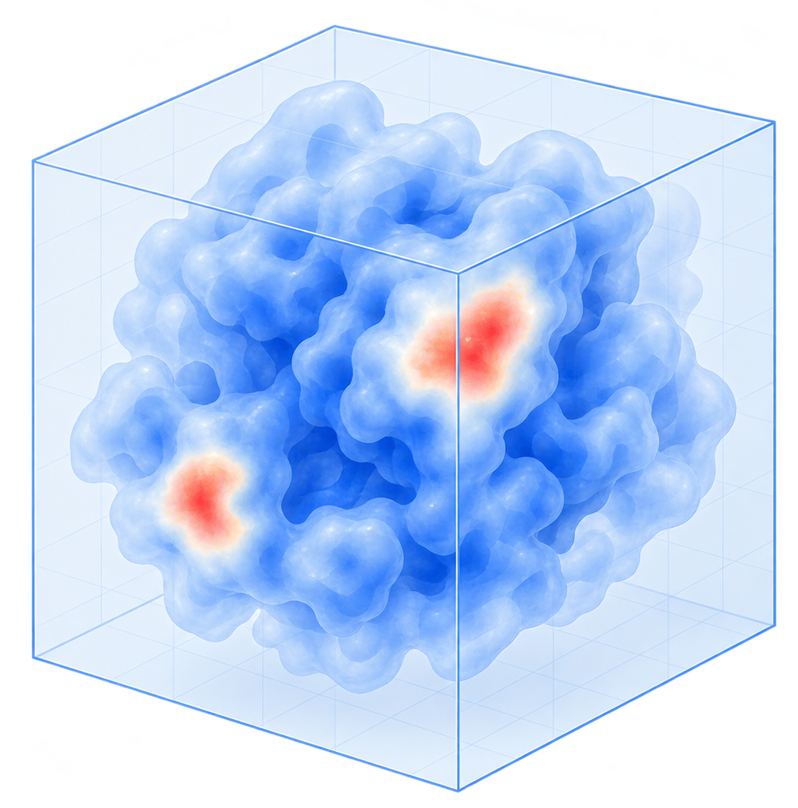
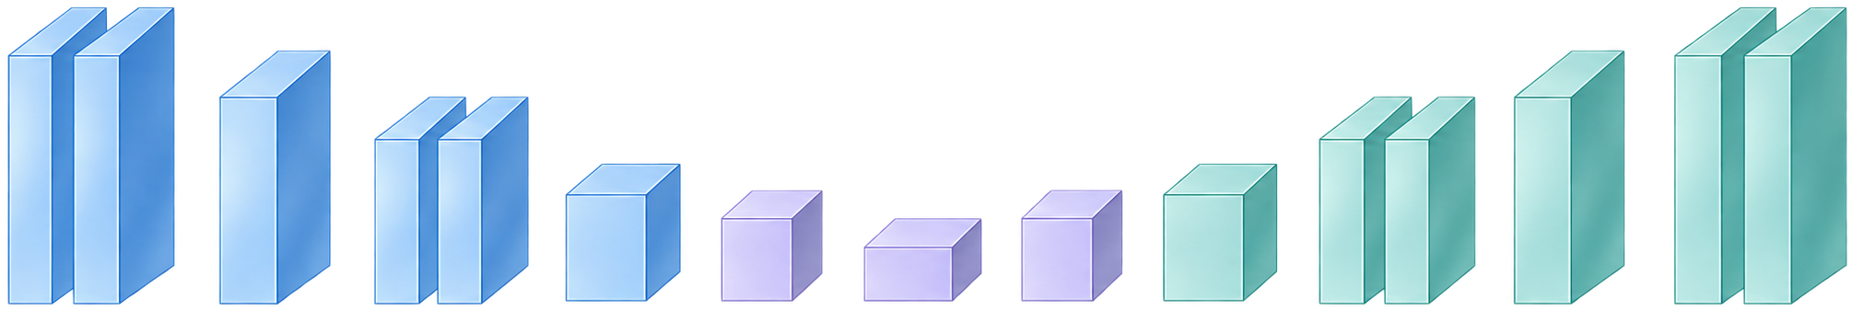
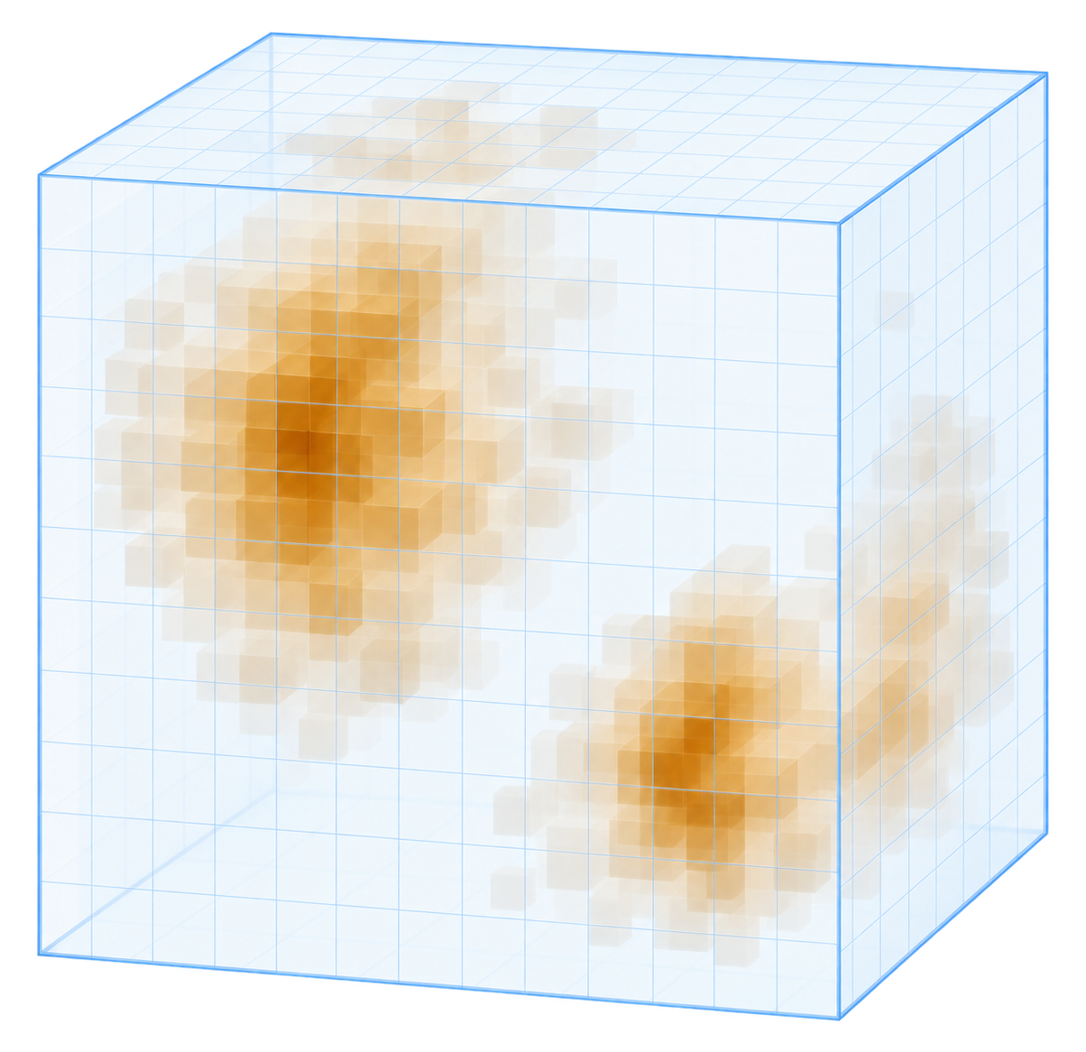
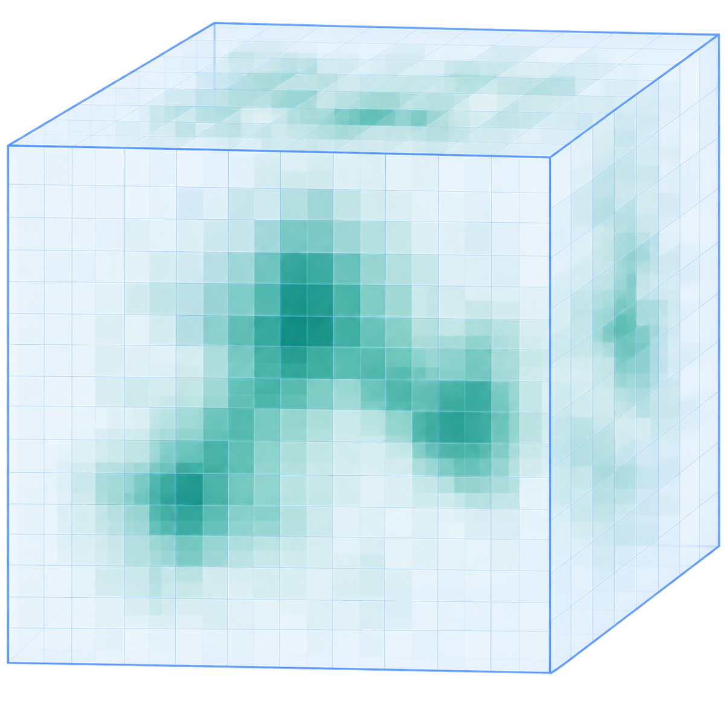
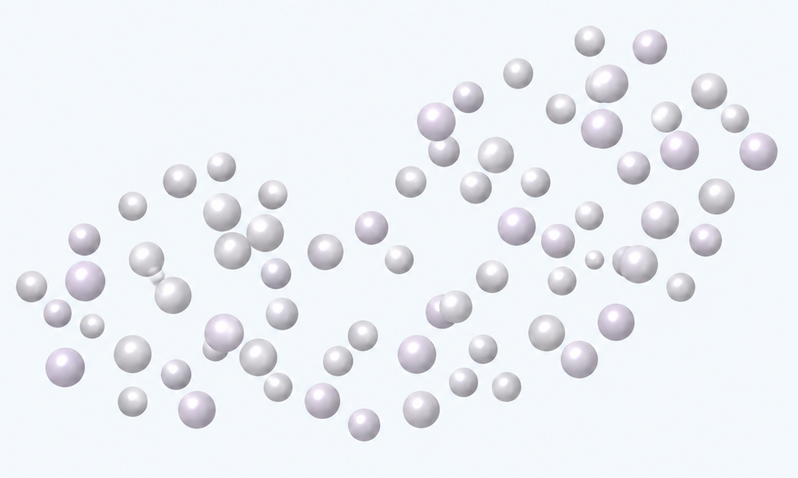
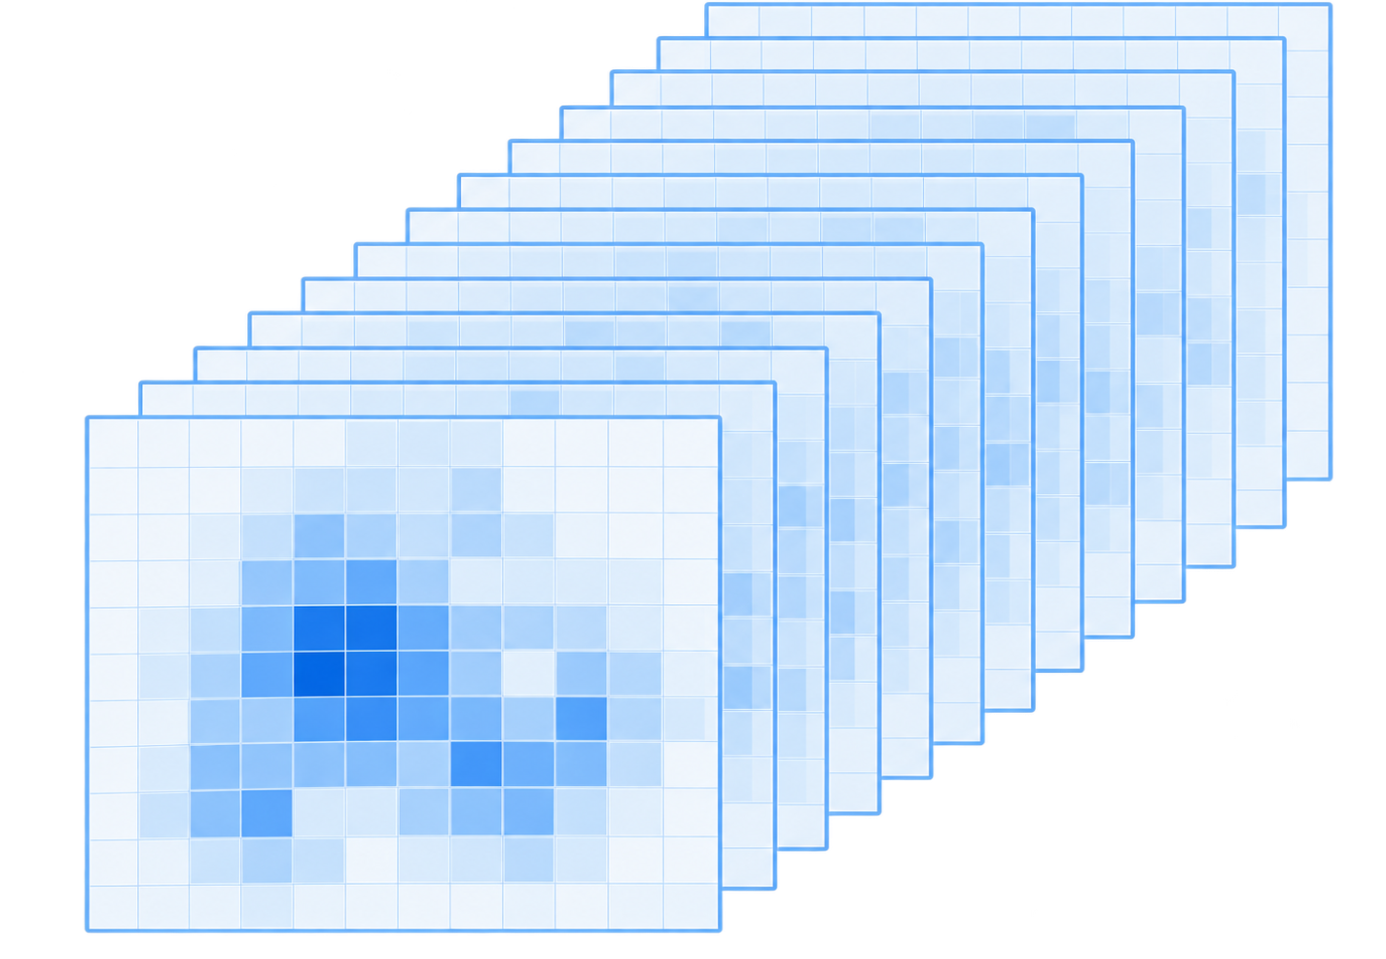

a
Shared input
b
Find: locate ligand area
representation
3D voxel U-Net
Density bank
Density bank
Skip connections
Ligand-area
probability
High
M_{exp}
M_{sim}
Low
Receptor atoms
Encoder
Bottleneck
Decoder
Cues to Match
Atom
encoding
Voxel-to-pointfusion
M_{diff}
M_{diff}⁺
Blob
Pseudo atoms
4 base fields
Atom binding
probability
2 normalizations
Pseudo atoms
High
Raw
Z-score
Recycle
Low
Point Transformer V3
c
Match: candidate-to-identity assignment
7 spatial views
Candidate encoder
Identity encoder
Density + atoms
Base summary
User-provided SMILES · same PDB
$$h_{j}^{vox}$$
1
CCO
Identity
Gaussian ×2
U-Net
2
CC(=O)O
···
48³ crop
RDKit
k
Cc1ccccc1
Other
identities
···
K
CC(N)=O
DoG ×2
Receptor
suppression
×2
Pocket
Cues from Find
SMI-TED
SMI-TED
Own graph
+ linear
+ linear
Blob
Pseudo
GNN
1
2
K, V
K, V
K
K, V
Mean/max pool
Attention
Q
Graph attention
Q
Q
Context attention
56 channels
Concat
4 × 2 × 7
MLP
FiLM
Fusion
Receptor atoms
$$h_{j}$$
$$g_{k}$$
Identity scores
Foreground head
$$p_{j}^{fg}$$
Cosine score
$$s_{j,k}$$
k
j
50 features / atom
Foreground probability
Learned projections
J × K
d
Build: downstream pose reconstruction
Default · PocketXMol
+
O
+
Density-conditioned fine-tuning
Site p
SMILES
Pocket
Docking tools
from Find
Vina · DiffDock · EMERALD
All-atom ligand pose

Slide 3
a
Shared input
b
Find: locate ligand area
representation
3D voxel U-Net
Density bank
Density bank
Skip connections
Ligand-area
probability
High
M_{exp}
M_{sim}
Low
Receptor atoms
Encoder
Bottleneck
Decoder
Cues to Match
Atom
encoding
Voxel-to-pointfusion
M_{diff}
M_{diff}⁺
Blob
Pseudo atoms
4 base fields
Atom binding
probability
2 normalizations
Pseudo atoms
High
Raw
Z-score
Recycle
Low
Point Transformer V3
c
Match: candidate-to-identity assignment
7 spatial views
Candidate encoder
Identity encoder
Density + atoms
Base summary
User-provided SMILES · same PDB
$$h_{j}^{vox}$$
1
CCO
Identity
Gaussian ×2
U-Net
2
CC(=O)O
···
48³ crop
RDKit
k
Cc1ccccc1
Other
identities
···
K
CC(N)=O
DoG ×2
Receptor
suppression
×2
Pocket
Cues from Find
SMI-TED
SMI-TED
Own graph
+ linear
+ linear
Blob
Pseudo
GNN
1
2
K, V
K, V
K
K, V
Mean/max pool
Attention
Q
Graph attention
Q
Q
Context attention
56 channels
Concat
4 × 2 × 7
MLP
FiLM
Fusion
Receptor atoms
$$h_{j}$$
$$g_{k}$$
Identity scores
Foreground head
$$p_{j}^{fg}$$
Cosine score
$$s_{j,k}$$
k
j
50 features / atom
Foreground probability
Learned projections
J × K
d
Build: downstream pose reconstruction
Default · PocketXMol
+
O
+
Density-conditioned fine-tuning
Site p
SMILES
Pocket
Docking tools
from Find
Vina · DiffDock · EMERALD
All-atom ligand pose

