Slide 1
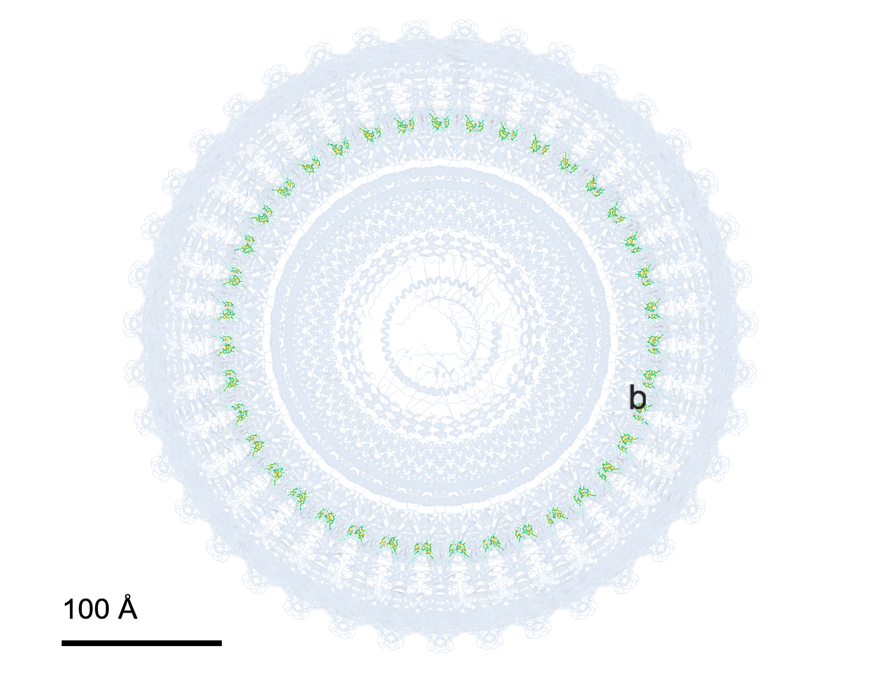
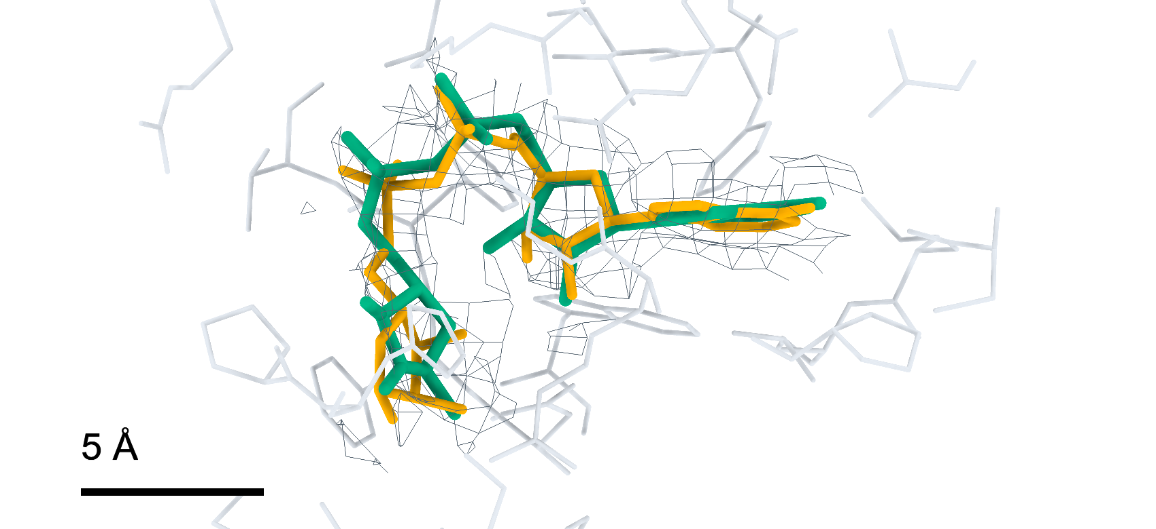
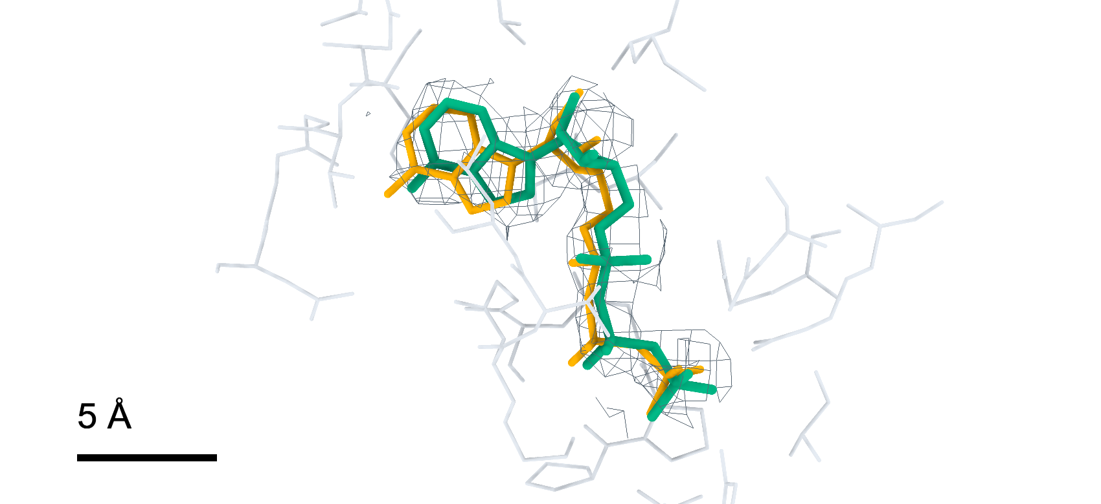
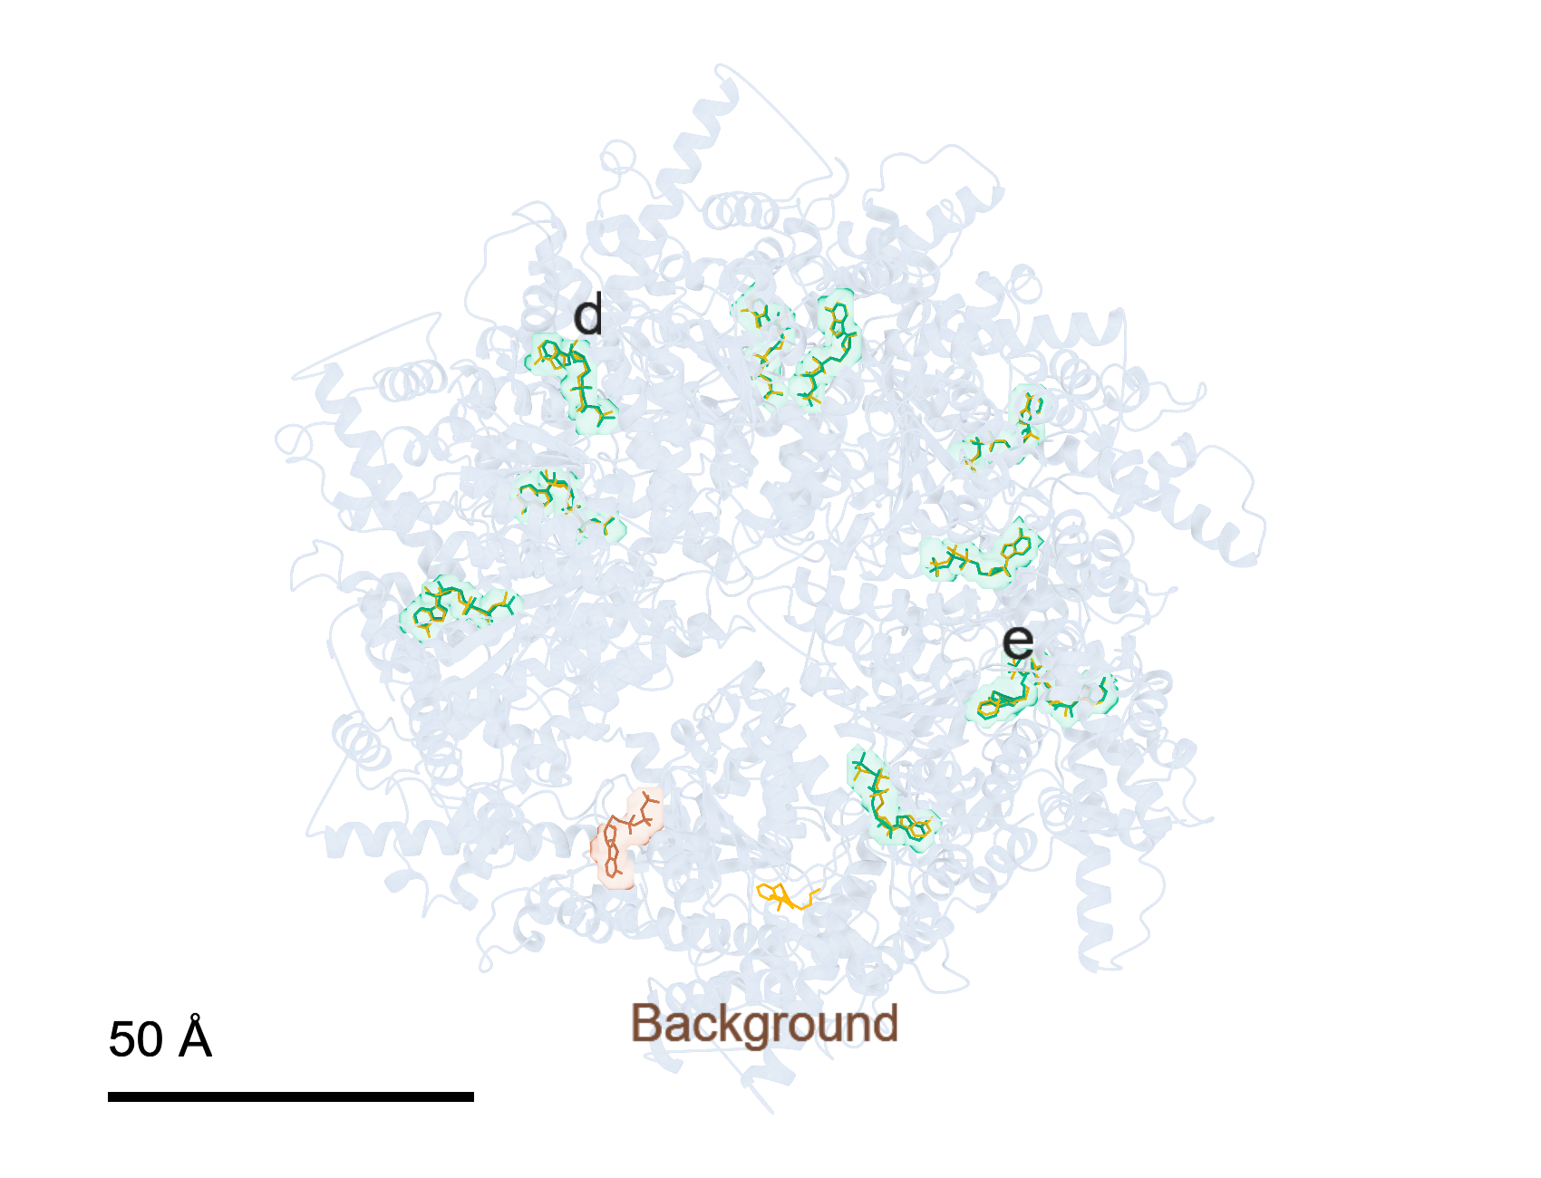
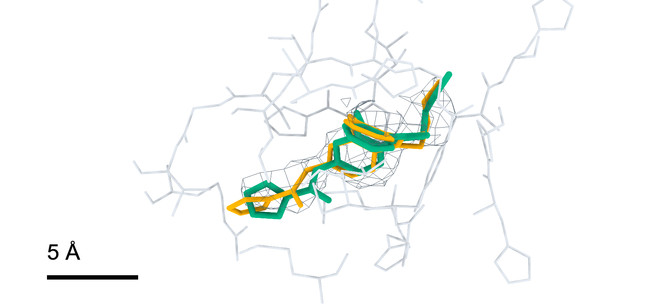
Small-molecule modelling in large complexes
CryoAtom2 receptor | 100% attempt budget | Model top-1
a
11JB | 78 deposited small molecules
b
AR6 (f:2001) | RMSD 1.46 Å
d
ATP (B:901) | RMSD 0.80 Å
c
9BJJ | 11 deposited small molecules
e
A1AP0 (E:1001) | RMSD 1.06 Å
Teal, poses with reference RMSD; brown, poses without reference RMSD; orange, deposited poses.
Notes:
LigandSeek完整流程在大复合物中的小分子建模。a、c，分别展示采用CryoAtom2重建受体和DG-PocketXMol时，11JB与9BJJ的LigandSeek-Find（Find）、LigandSeek-Match（Match）和LigandSeek-Build（Build）实际输出。两例沿用100%尝试预算，分别为78次和11次计费尝试，构象采用模型首选结果。显示Match指派为小分子的候选及其实际输出，包括同一预算内的假阳性区域。橙色为沉积小分子，青绿色为具有既有合法参考重原子RMSD的预测构象，棕色为无合法参考RMSD的新增实际预测构象。全景中的字母标出对应局部位点。b、d、e，分别为AR6（f:2001）、ATP（B:901）和A1AP0（E:1001）的对应局部，展示沉积构象、首选预测构象、实验冷冻电镜密度（灰色网格）及5 Å内受体残基。原首选构象RMSD依次为1.46、0.80、1.06 Å。构象与RMSD均沿实验密度图坐标系，不作刚体叠合。比例尺：a，100 Å；c，50 Å；b、d、e，5 Å。
ENGLISH:
Small-molecule modelling by the complete LigandSeek workflow in large complexes. a,c, Actual outputs of LigandSeek-Find (Find), LigandSeek-Match (Match) and LigandSeek-Build (Build) in 11JB and 9BJJ, respectively, using CryoAtom2-reconstructed receptors and DG-PocketXMol. The 100% attempt budgets are 78 and 11 charged attempts, respectively; model top-1 poses are shown. The display contains candidates assigned small-molecule identities by Match and their actual outputs, including false-positive regions within the same budgets. Deposited small molecules are orange. Predicted poses with a valid reference heavy-atom root-mean-square deviation (RMSD) are teal; outputs without a reference RMSD are brown. Letters in the overview panels mark the sites shown in the local panels. b,d,e, Corresponding local views of AR6 (f:2001), ATP (B:901) and A1AP0 (E:1001), respectively, with deposited poses, top-1 predictions, experimental cryo-EM density (grey mesh) and receptor residues within 5 Å. Their original top-1 RMSDs are 1.46, 0.80, 1.06 Å, respectively. All poses and RMSDs are in the experimental map coordinate system without rigid-body superposition. Scale bars: a, 100 Å; c, 50 Å; b,d,e, 5 Å.

