Slide 1

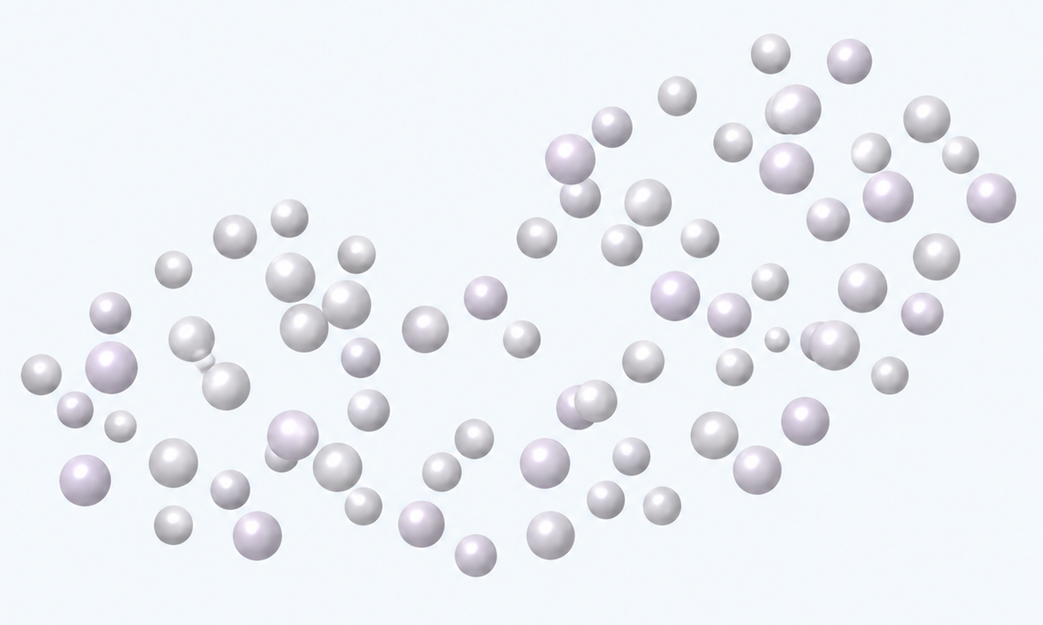
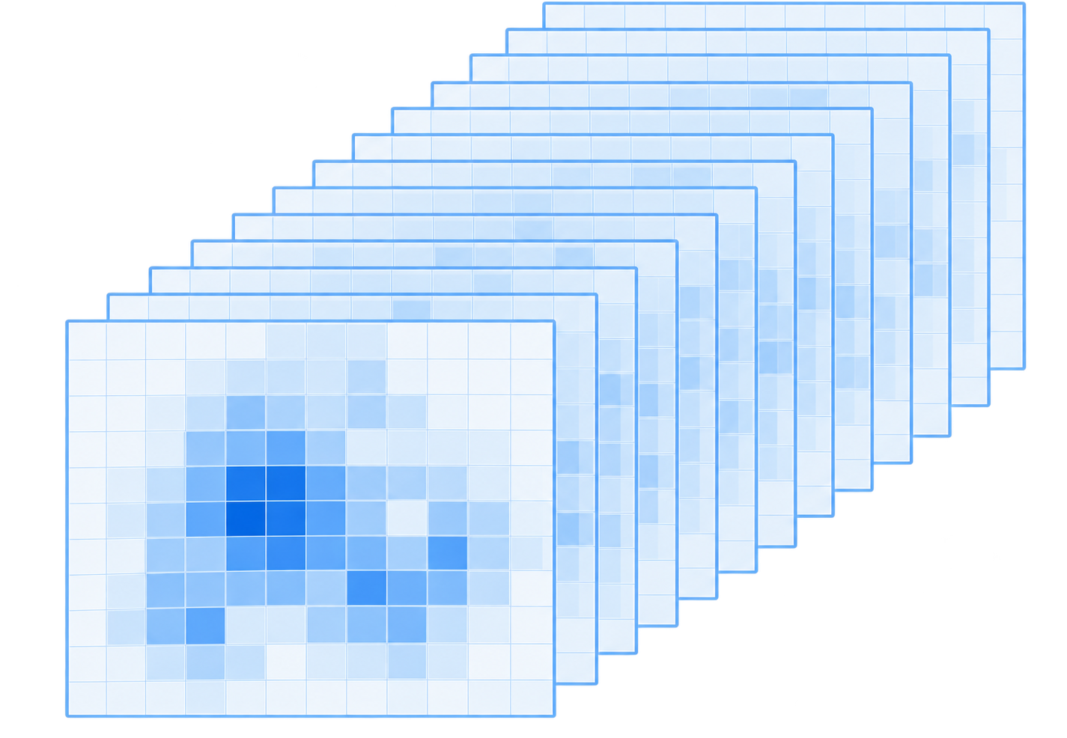

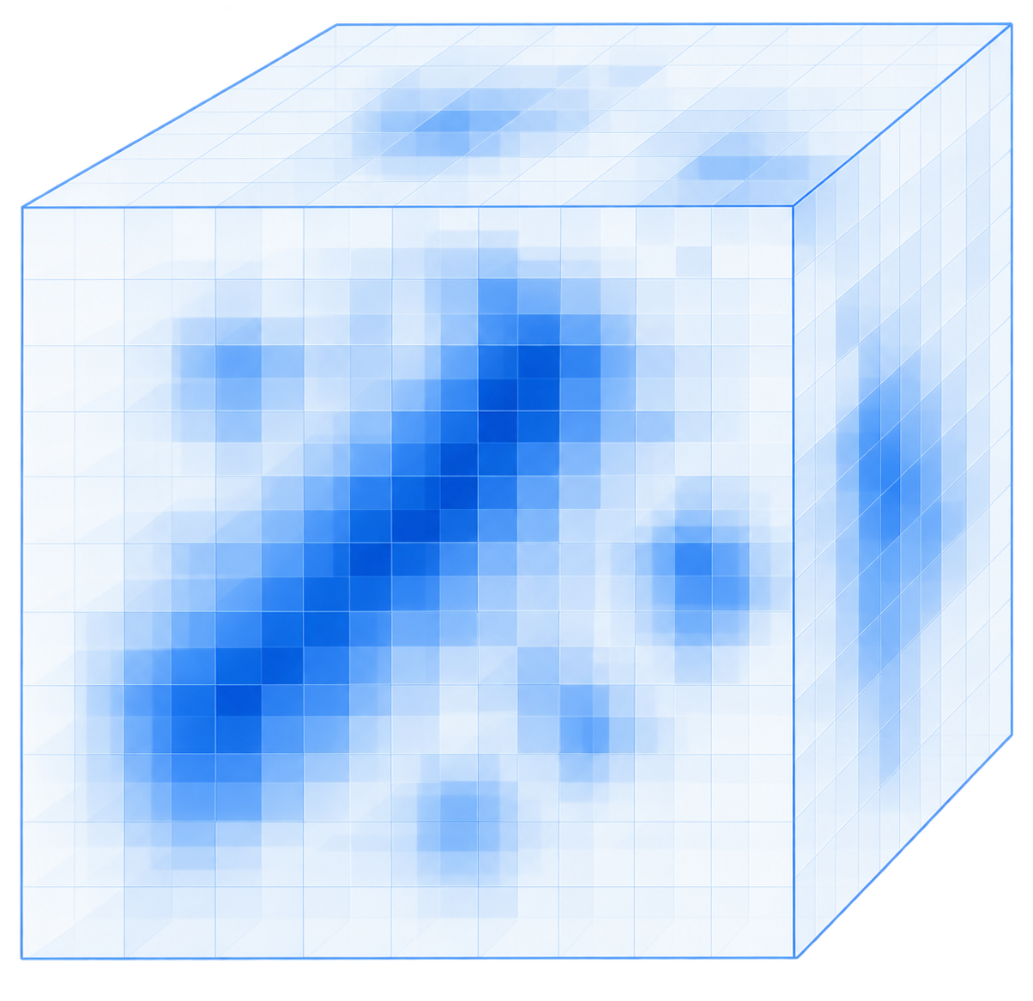
a
Shared input
b
Find: locate ligand regions
representation
3D voxel U-Net
Density bank
Density bank
Skip connections
Ligand-region
probability
High
M_{exp}
M_{sim}
Low
Receptor atoms
Encoder
Bottleneck
Decoder
Cues to Match
Embedding
head
Voxel-to-point fusion
M_{diff}
M_{diff}⁺
Blob
Pseudo atoms
4 base fields
Pseudo atoms
Atom binding
probability
2 normalisations
Recycle
High
Raw
Z-score
Point Transformer V3
Low
c
Match: candidate-to-identity assignment
7 spatial views
Candidate encoder
Identity encoder
Density + atoms
Base summary
User-provided SMILES · same PDB
$$h_{j}^{vox}$$
1
CCO
Identity
Gaussian ×2
U-Net
2
CC(=O)O
···
48³ crop
RDKit
k
Cc1ccccc1
Other
identities
···
K
CC(N)=O
DoG ×2
Receptor
suppression
×2
Pocket
Cues from Find
SMI-TED
SMI-TED
Own graph
+ linear
+ linear
Blob
Pseudo atoms
GNN
1
2
K, V
K, V
K
K, V
Mean/max pool
Cross-attention
Q
Graph attention
Q
Q
Context attention
56 channels
Concat
4 × 2 × 7
MLP
FiLM
Fusion
Receptor atoms
$$h_{j}$$
$$g_{k}$$
Identity scores
Foreground head
$$p_{j}^{fg}$$
Cosine score
$$s_{j,k}$$
k
j
50 features / atom
Foreground probability
Learned projections
J × K
d
Build: downstream pose reconstruction
Default · PocketXMol
+
O
+
Density-conditioned fine-tuning
Site p
SMILES
Pocket
Docking tools
from Find
Vina · DiffDock · EMERALD
All-atom ligand pose
Notes:
LigandSeek 的 Find–Match–Build 框架的网络结构与数据流。
a，共享输入。实验冷冻电镜密度 $M_{\mathrm{exp}}$、受体模拟密度 $M_{\mathrm{sim}}$、差异密度 $M_{\mathrm{diff}}$ 和正差异密度 $M_{\mathrm{diff}}^{+}$ 构成基础密度场。未归一化与 z-score 归一化表示经过七种空间变换，包括高斯平滑、差分高斯（DoG）滤波和受体邻域抑制，形成 56 通道多视角密度库。蛋白质和核酸受体原子的 50 维特征编码其化学与几何信息。
b，Find 的体素–点云联合定位。3D U-Net 融合密度与受体原子特征，预测逐体素的配体区域概率。同时，Point Transformer V3 编码受体原子及从高概率结合区域采样的伪原子，通过多尺度特征采样融入体素信息。AlphaFold3 风格的迭代回收机制逐轮改善两个分支的预测。预测的受体原子结合概率用于在推理时为候选配体区域打分，提取的 blob 与伪原子则为 Match 提供局部线索。
c，Match 的前景判别与身份指派。候选编码器使用 U-Net 处理以各 blob 为中心的 48³ 网格，得到体素摘要 $h_j^{\mathrm{vox}}$。Find 提供的 blob、口袋与伪原子特征通过双重池化、交叉注意力和特征线性调制（FiLM）调制 $h_j^{\mathrm{vox}}$，得到候选表示 $h_j$。身份编码器以 SMI-TED 语言嵌入为查询，通过图注意力读取图神经网络（GNN）编码的分子图特征；上下文注意力融入同一 PDB 中其他配体的信息，得到身份表示 $g_k$。最后，前景头根据 $h_j$ 预测前景概率 $p_j^{\mathrm{fg}}$，$h_j$ 与 $g_k$ 之间的可学习余弦评分生成身份指派分数矩阵 $s_{j,k}$。
d，Build 的构象重建。blob 的几何中心 $p$、Match 指派的配体身份和口袋环境传入对接工具，生成配体构象。默认工具为经过密度引导微调的 PocketXMol，也支持 Vina、DiffDock 和 EMERALD。
ENGLISH：
Network architecture and data flow of LigandSeek’s Find–Match–Build framework.
a, Shared inputs. Experimental cryo-electron microscopy density $M_{\mathrm{exp}}$, simulated receptor density $M_{\mathrm{sim}}$, difference density $M_{\mathrm{diff}}$ and positive difference density $M_{\mathrm{diff}}^{+}$ form the base fields. Unnormalised and z-score-normalised representations undergo seven spatial transformations, including Gaussian smoothing, difference-of-Gaussians (DoG) filtering and receptor-neighbourhood suppression, producing a 56-channel multi-view density bank. Protein and nucleic acid receptor atoms have 50-dimensional features encoding chemical and geometric information.
b, Joint voxel and point-cloud localisation in Find. A 3D U-Net combines density and receptor-atom features to predict voxelwise ligand-region probabilities. In parallel, Point Transformer V3 encodes receptor atoms and pseudo atoms sampled from high-probability binding regions, incorporating voxel information through multiscale feature sampling. An AlphaFold3-style recycling mechanism iteratively refines predictions across both branches. Predicted receptor-atom binding probabilities are used to score candidate ligand regions during inference, while extracted blobs and pseudo atoms provide local cues for Match.
c, Foreground classification and identity assignment in Match. The candidate encoder processes a 48³ grid centred on each blob with a U-Net to generate voxel summary $h_j^{\mathrm{vox}}$. Find-derived blob, pocket and pseudo atom features modulate $h_j^{\mathrm{vox}}$ via dual pooling, cross-attention and FiLM, yielding candidate representation $h_j$. The identity encoder uses SMI-TED language embeddings to query GNN-encoded molecular graph features via graph attention, while context attention incorporates other ligand identities in the same PDB entry, yielding identity representation $g_k$. Finally, a foreground head predicts foreground probability $p_j^{\mathrm{fg}}$ from $h_j$, and learned cosine scoring between $h_j$ and $g_k$ produces the assignment matrix $s_{j,k}$.
d, Pose reconstruction in Build. The blob geometric centre $p$, Match-assigned ligand identity and pocket environment are supplied to docking tools to generate ligand poses. The default tool is PocketXMol fine-tuned with density guidance. Vina, DiffDock and EMERALD are also supported.

Slide 2
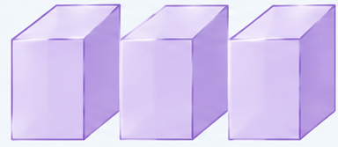
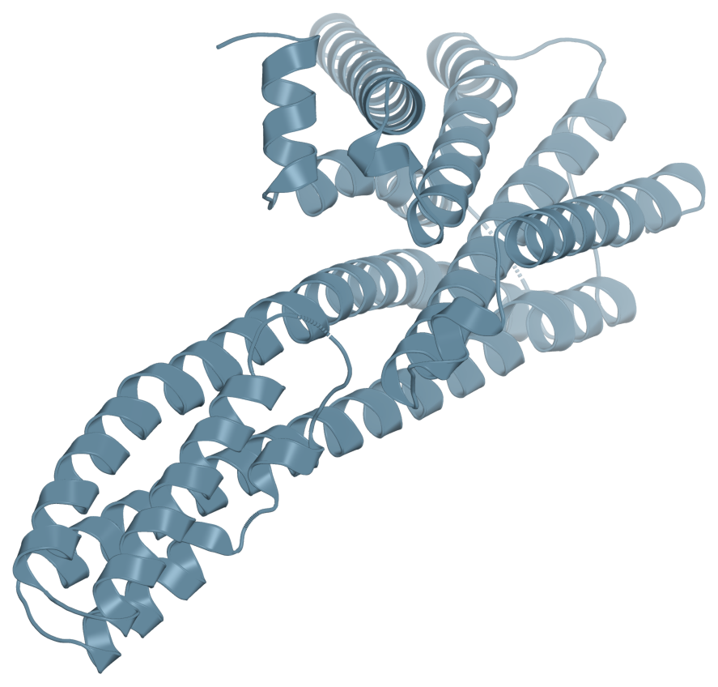
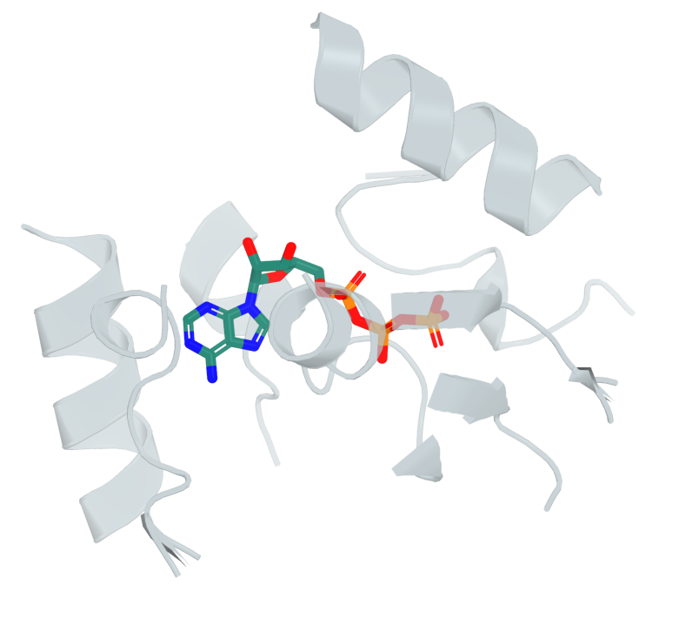
a
Find: locate ligand regions
c
Build: downstream
pose reconstruction
Density
Density
Bank
3D voxel U-Net
Blobs
Skip connections
56 channels
Site
Pocket
Encoder
Bottleneck
Decoder
from Find
Receptor
Embedding
head
Fusion
O
Recycle
Auxiliary
features
SMILES
Density
Point Transformer V3
from Match
b
Match: candidate-to-identity assignment
Downstream docking tools
Candidate encoder
Identity encoder
PocketXMol-tuned
Receptor
Density
48³ crop
User-provided SMILES · same PDB
h_{j}^{vox}
1 CCO
Density-conditioned
fine-tuning
2 CC(=O)O
3D U-Net
Base summary
k Cc1ccccc1
Other
identities
RDKit
K CC(N)=O
Other docking tools
· Vina
· DiffDock
· EMERALD
· · ·
Pocket
Blob
Auxiliary
features
SMI-TED
SMI-TED
Own graph
GNN
1
2
K, V
K, V
K
K, V
Mean/max pool
Cross-attention
Q
Graph attention
Q
Q
Context attention
Concat
MLP
FiLM
Fusion
h_{j}
g_{k}
Identity scores
s_{j,k}
k
Foreground head
p_{j}^{fg}
Cosine score
j
All-atom ligand pose
Foreground probability
Learned projections
J × K
Notes:
LigandSeek 的 Find–Match–Build 框架的网络结构与数据流。
a，Find 将密度与受体信息编码为候选配体区域（blobs）及辅助特征。体素分支和点云分支通过体素到点的特征融合及迭代回收连接。
b，Match 对候选区域进行前景判别和身份指派。3D U-Net 编码局部体素块；口袋与 blob 的辅助特征经池化、交叉注意力和 FiLM 调制候选表示。身份编码器整合分子图、SMI-TED 语言表示及同一 PDB 中的身份上下文。前景头输出前景概率，余弦评分产生候选与身份的匹配分数。
c，Build 结合位点、SMILES 身份、口袋与密度信息，通过下游对接工具重建全原子配体构象。PocketXMol-tuned 为默认选项。
ENGLISH:
Network architecture and data flow of the LigandSeek Find–Match–Build framework.
a, Find encodes density and receptor information to produce candidate ligand regions (blobs) and auxiliary features. Voxel-to-point fusion and recycling connect the voxel and point-cloud branches.
b, Match classifies candidates as foreground or background and assigns ligand identities. A 3D U-Net encodes a local voxel crop. Pooling, cross-attention and FiLM integrate auxiliary features from the pocket and blob into the candidate representation. The identity encoder combines molecular graph features, SMI-TED language representations and identity context within the same PDB entry. A foreground head predicts foreground probability, and cosine scoring produces candidate-to-identity matching scores.
c, Build uses the site, SMILES identity, pocket and density information with downstream docking tools to reconstruct an all-atom ligand pose. PocketXMol-tuned is the default option.

Slide 3
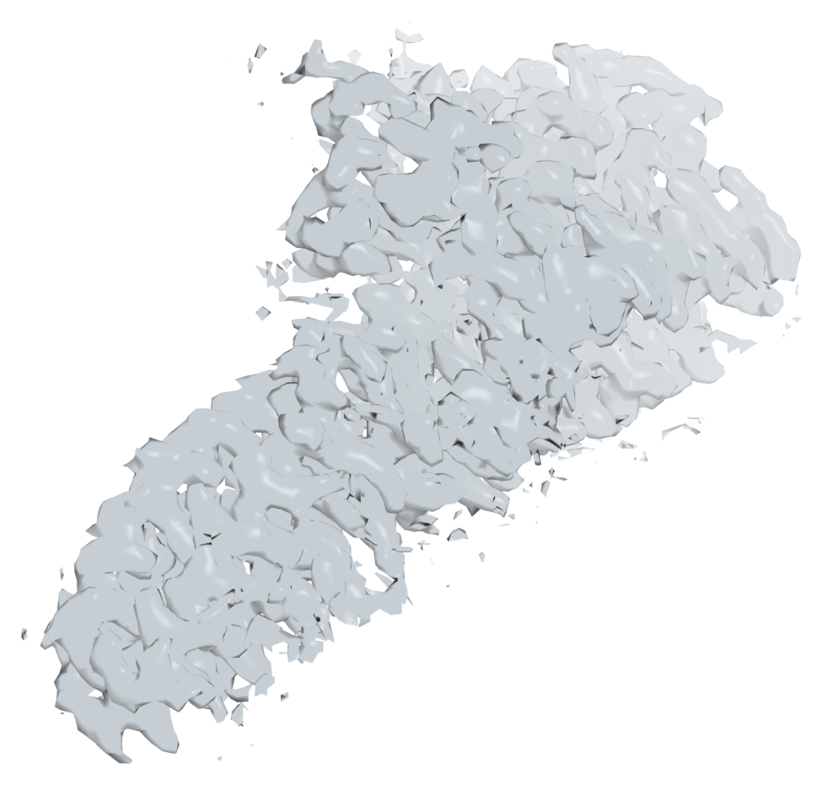
a
Find: locate ligand regions
c
Build: downstream
pose reconstruction
Density
Density
Bank
3D voxel U-Net
Blobs
Skip connections
56 channels
Site
Pocket
Encoder
Bottleneck
Decoder
from Find
Receptor
Embedding
head
Fusion
O
Recycle
Auxiliary
features
SMILES
Density
Point Transformer V3
from Match
b
Match: candidate-to-identity assignment
Downstream docking tools
Candidate encoder
Identity encoder
PocketXMol-tuned
Receptor
Density
48³ crop
User-provided SMILES · same PDB
h_{j}^{vox}
1 CCO
Density-conditioned
fine-tuning
2 CC(=O)O
3D U-Net
Base summary
k Cc1ccccc1
Other
identities
RDKit
K CC(N)=O
Other docking tools
· Vina
· DiffDock
· EMERALD
· · ·
Pocket
Blob
Auxiliary
features
SMI-TED
SMI-TED
Own graph
GNN
1
2
K, V
K, V
K
K, V
Mean/max pool
Cross-attention
Q
Graph attention
Q
Q
Context attention
Concat
MLP
FiLM
Fusion
h_{j}
g_{k}
Identity scores
s_{j,k}
k
Foreground head
p_{j}^{fg}
Cosine score
j
All-atom ligand pose
Foreground probability
Learned projections
J × K
Notes:
LigandSeek Find–Match–Build 框架的网络架构和数据流。
a，Find 部分对密度和受体信息进行编码，生成候选配体区域（$\mathbb{R}^3$ 中的 blob）和辅助特征。受体嵌入头对原子表示进行编码并提供它。3D 体素 U-Net 和 Point Transformer V3 结合密度和受体原子特征，并对其进行进一步编码。AlphaFold3 式的循环机制迭代地优化两个分支的预测结果。
b，Match 部分将候选配体分类为前景或背景，并分配配体身份。3D U-Net 对局部体素区域进行编码。池化、交叉注意力机制和 FiLM 将口袋和 blob 信息与 Find 部分的辅助特征整合到候选配体表示中。身份编码器将分子图特征、SMI-TED 语言表示和身份上下文整合到同一个 PDB 条目中。前景头部预测前景概率，余弦评分生成候选配体与身份匹配分数。
c，构建过程利用结合位点、SMILES 标识符、口袋和密度信息以及下游对接工具，重建全原子配体姿态。默认选项为 PocketXMol-tuned。
ENGLISH:
Network architecture and data flow of the LigandSeek Find–Match–Build framework.
a, Find encodes density and receptor information to produce candidate ligand regions (blobs in $\mathbb{R}^3$) and auxiliary features. The receptor embedding head encodes and supplies atom representations. A 3D voxel U-Net and Point Transformer V3 combine density and receptor-atom features and further encode them. An AlphaFold3-style recycling mechanism iteratively refines predictions across both branches.
b, Match classifies candidates as foreground or background and assigns ligand identities. A 3D U-Net encodes a local voxel crop. Pooling, cross-attention and FiLM integrate pocket and blob information with auxiliary features from Find into the candidate representation. The identity encoder combines molecular graph features, SMI-TED language representations and identity context within the same PDB entry. A foreground head predicts foreground probability, and cosine scoring produces candidate-to-identity matching scores.
c, Build uses the binding site, SMILES identity, pocket and density information with downstream docking tools to reconstruct an all-atom ligand pose. PocketXMol-tuned is the default option.

Slide 4
a
Find: locate ligand regions
c
Build: downstream
pose reconstruction
Density
Density
Bank
3D voxel U-Net
Blobs
Space transform(..?)
Skip connections
56 channels
Site
Pocket
Encoder
Bottleneck
Decoder
from Find
Receptor
Atom embeddings
Fusion
Embedding head(..?)
Recycle
Auxiliary
features
SMILES
Density
Point Transformer V3
from Match
b
Match: candidate-to-identity assignment
Downstream docking tools
Candidate encoder
Identity encoder
PocketXMol-tuned
Receptor
Density
48³ crop
User-provided SMILES · same PDB
h_{j}^{vox}
1 CCO
Density-conditioned
fine-tuning
2 CC(=O)O
3D U-Net
Base summary
k Cc1ccccc1
Other
identities
RDKit
K CC(N)=O
Other docking tools
· Vina
· DiffDock
· EMERALD
· · ·
Pocket
Blob
Auxiliary
features
SMI-TED
SMI-TED
Own graph
GNN
1
2
K, V
K, V
K
K, V
Mean/max pool
Cross-attention
Q
Graph attention
Q
Q
Context attention
Concat
MLP
FiLM
Fusion
h_{j}
g_{k}
Identity scores
s_{j,k}
k
Foreground head
p_{j}^{fg}
Cosine score
j
All-atom ligand pose
Foreground probability
Learned projections
J × K
Notes:
LigandSeek Find–Match–Build 框架的网络架构和数据流。
a，Find 部分对密度和受体信息进行编码，生成候选配体区域（$\mathbb{R}^3$ 中的 blob）和辅助特征。受体嵌入头对原子表示进行编码并提供它。3D 体素 U-Net 和 Point Transformer V3 结合密度和受体原子特征，并对其进行进一步编码。AlphaFold3 式的循环机制迭代地优化两个分支的预测结果。
b，Match 部分将候选配体分类为前景或背景，并分配配体身份。3D U-Net 对局部体素区域进行编码。池化、交叉注意力机制和 FiLM 将口袋和 blob 信息与 Find 部分的辅助特征整合到候选配体表示中。身份编码器将分子图特征、SMI-TED 语言表示和身份上下文整合到同一个 PDB 条目中。前景头部预测前景概率，余弦评分生成候选配体与身份匹配分数。
c，构建过程利用结合位点、SMILES 标识符、口袋和密度信息以及下游对接工具，重建全原子配体姿态。默认选项为 PocketXMol-tuned。
ENGLISH:
Network architecture and data flow of the LigandSeek Find–Match–Build framework.
a, Find encodes density and receptor information to produce candidate ligand regions (blobs in $\mathbb{R}^3$) and auxiliary features. The receptor embedding head encodes and supplies atom representations. A 3D voxel U-Net and Point Transformer V3 combine density and receptor-atom features and further encode them. An AlphaFold3-style recycling mechanism iteratively refines predictions across both branches.
b, Match classifies candidates as foreground or background and assigns ligand identities. A 3D U-Net encodes a local voxel crop. Pooling, cross-attention and FiLM integrate pocket and blob information with auxiliary features from Find into the candidate representation. The identity encoder combines molecular graph features, SMI-TED language representations and identity context within the same PDB entry. A foreground head predicts foreground probability, and cosine scoring produces candidate-to-identity matching scores.
c, Build uses the binding site, SMILES identity, pocket and density information with downstream docking tools to reconstruct an all-atom ligand pose. PocketXMol-tuned is the default option.

