Slide 1




c
Match: candidate-to-identity assignment
Candidate encoder
Identity encoder
Density + atoms
Base summary
User-provided SMILES · same PDB
$$h_{j}^{vox}$$
1
CCO
U-Net
2
CC(=O)O
k
···
RDKit
Cc1ccccc1
Other
identities
48³ crop
K
···
CC(N)=O
Pocket
Cues from Find
SMI-TED
SMI-TED
Own graph
+ linear
+ linear
Blob
Pseudo
GNN
1
2
K, V
K, V
K
K, V
Mean/max pool
Attention
Q
Graph attention
Q
Q
Context attention
Concat
MLP
FiLM
Fusion
$$h_{j}$$
$$g_{k}$$
Identity scores
$$s_{j,k}$$
k
Foreground head
$$p_{j}^{fg}$$
Cosine score
j
Foreground probability
Learned projections
J × K
Notes:
Match encodes each candidate region and each user-provided ligand identity from the same PDB. The candidate encoder combines a local density–atom voxel representation with pocket, blob and pseudo atom features through pooling, attention and FiLM modulation. The identity encoder combines the original SMI-TED language representation with attention summaries from its own molecular graph and the other ligand identities. An independent foreground head predicts the foreground probability. Learned projections and cosine scoring relate candidate j to identity k in a J × K score matrix. The highlighted matrix cell identifies the illustrated candidate–identity pair; the grid does not display experimental scores. SMILES strings and molecular graphics are schematic examples. Fusion denotes integration of the identity branches at the level of this overview.

Slide 2
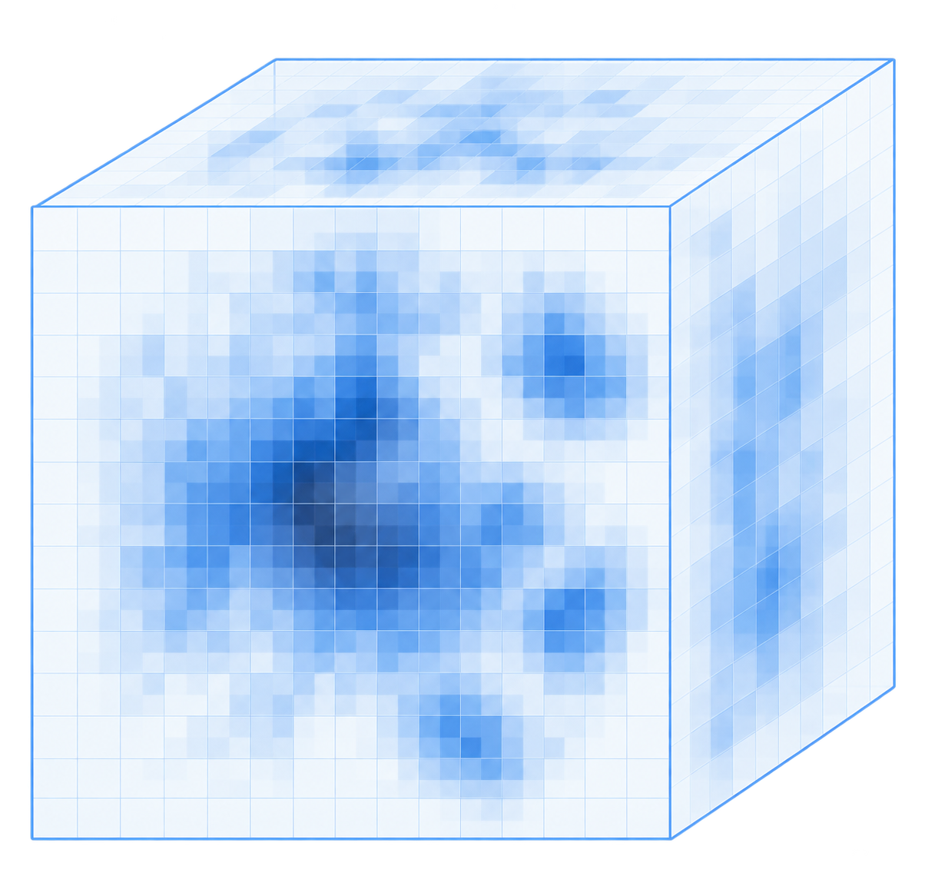
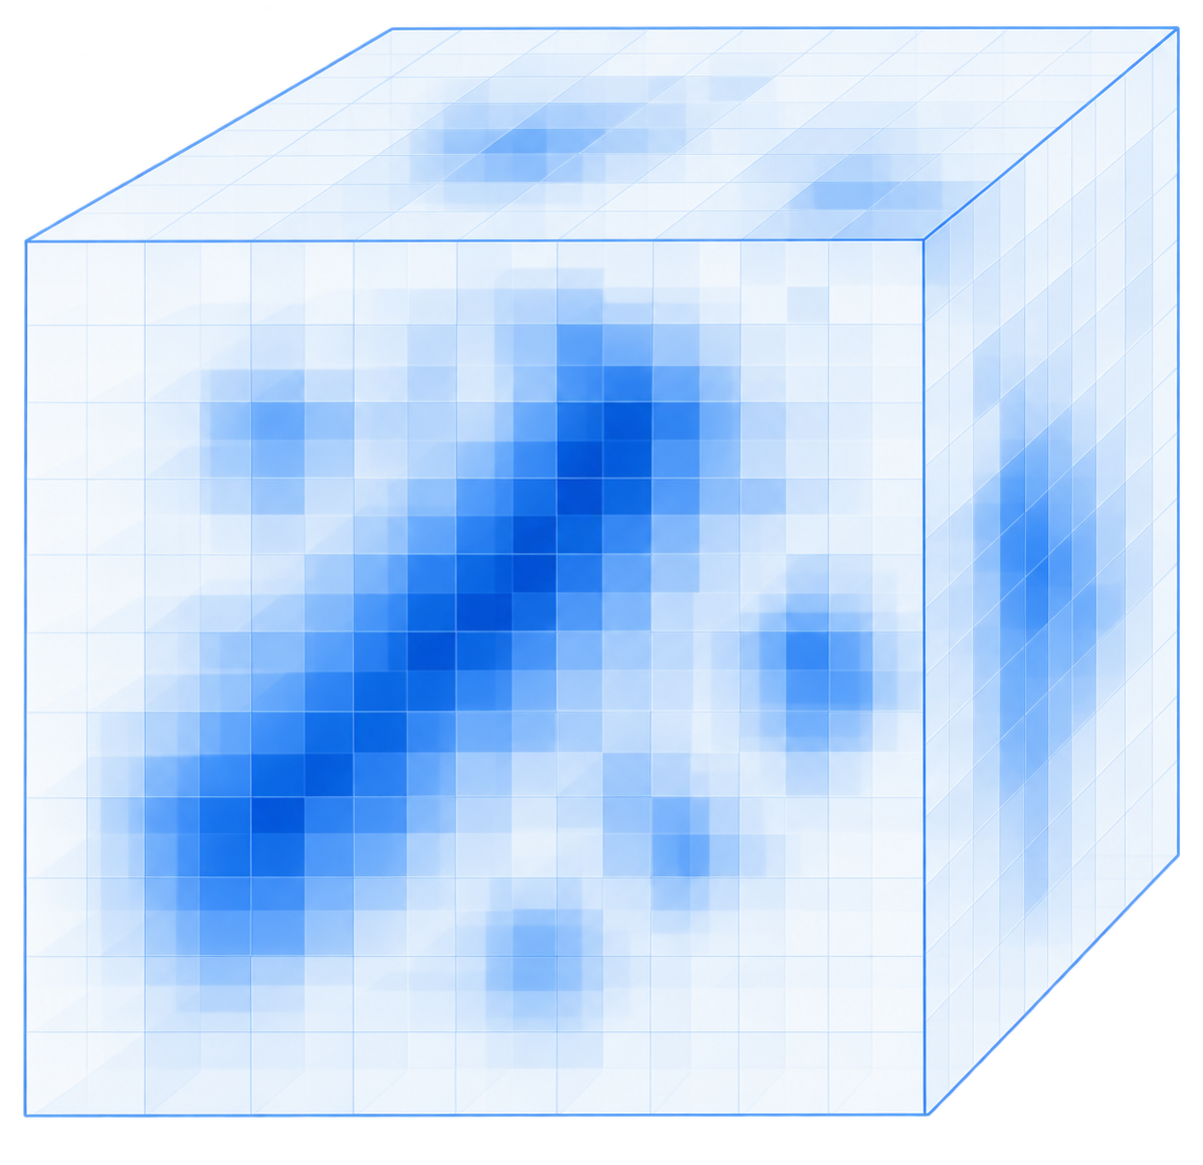
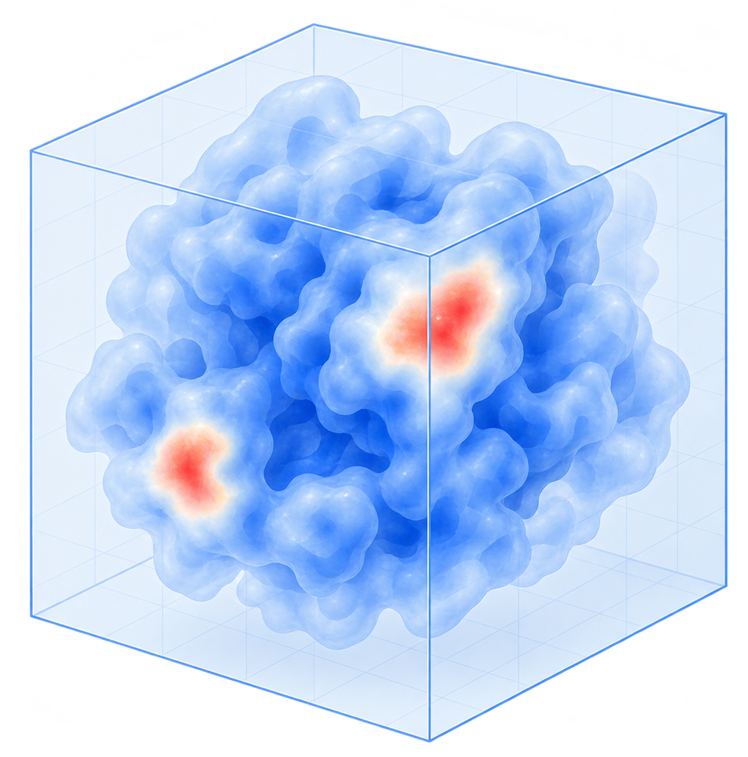
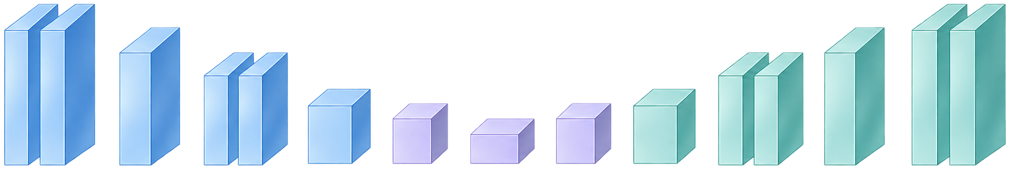
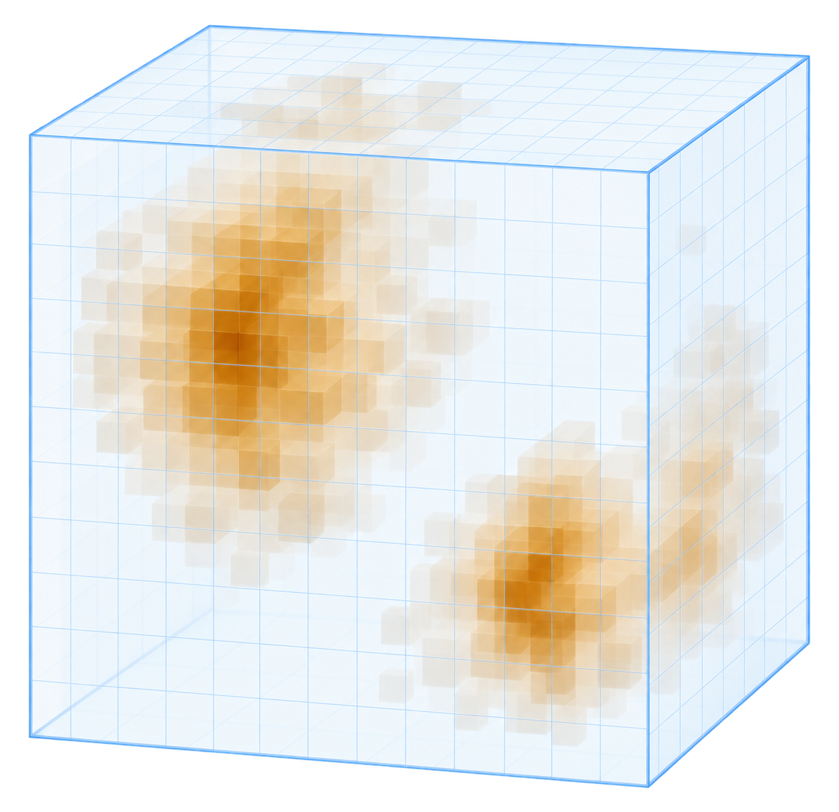
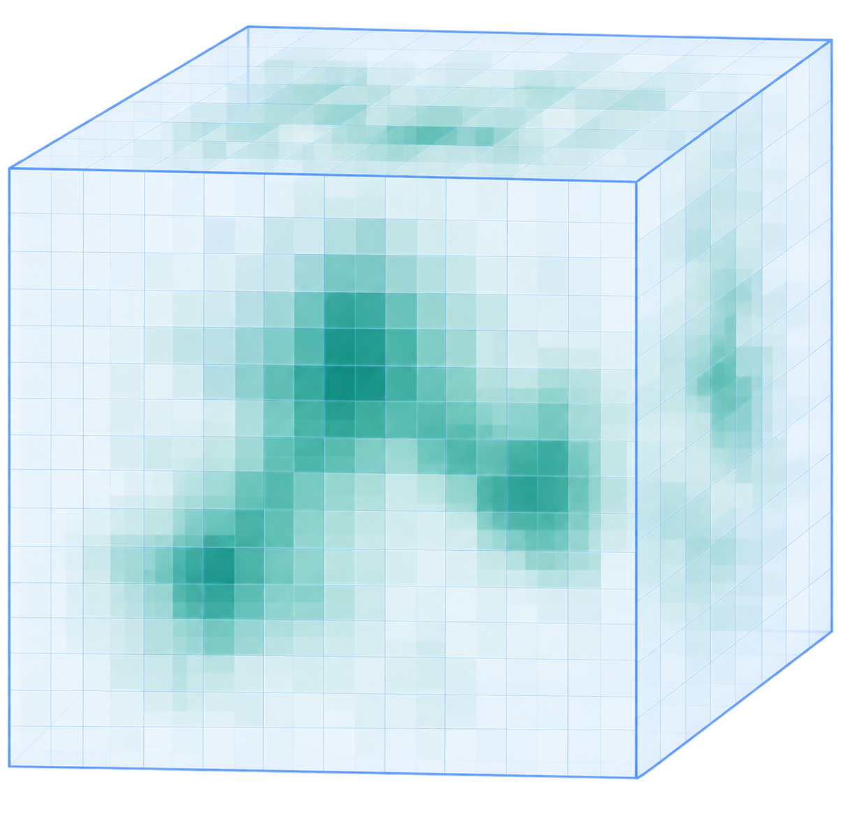
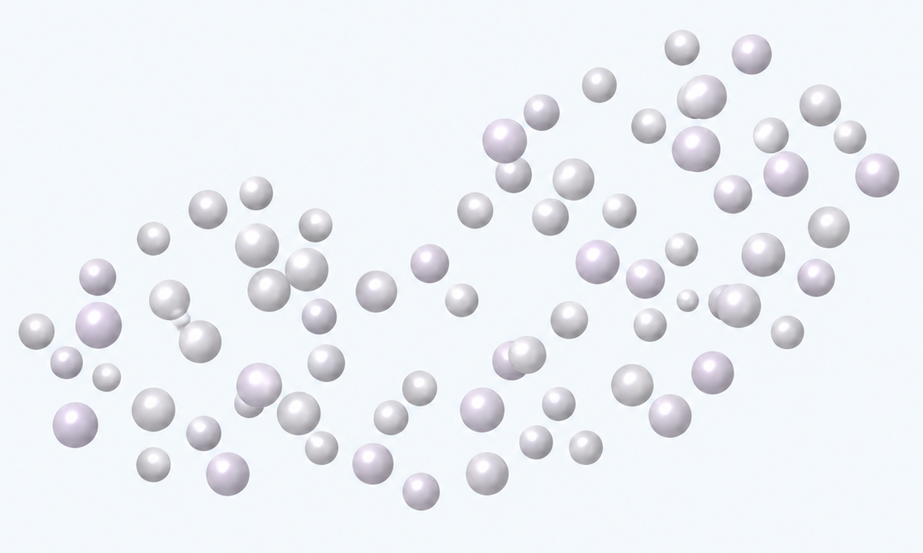
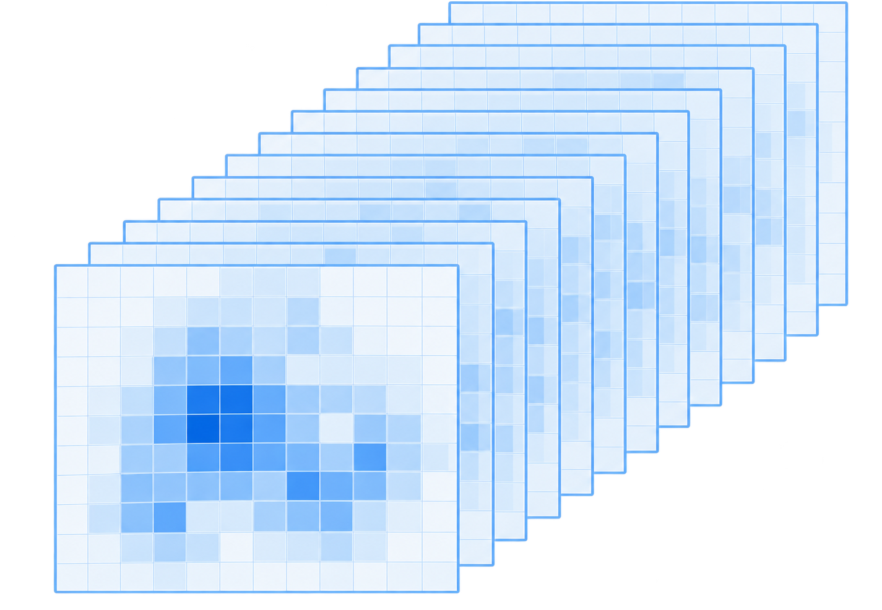

a
Shared input
b
Find: locate ligand area
representation
3D voxel U-Net
Density bank
Density bank
Skip connections
Ligand-area
probability
High
M_{exp}
M_{sim}
Low
Receptor atoms
Encoder
Bottleneck
Decoder
Cues to Match
Atom
encoding
Voxel-to-point fusion
M_{diff}
M_{diff}⁺
Blob
Pseudo atoms
4 base fields
Pseudo atoms
Atom binding
probability
2 normalizations
Recycle
High
Raw
Z-score
Point Transformer V3
Low
c
Match: candidate-to-identity assignment
7 spatial views
Candidate encoder
Identity encoder
Density + atoms
Base summary
User-provided SMILES · same PDB
$$h_{j}^{vox}$$
1
CCO
Identity
Gaussian ×2
U-Net
2
CC(=O)O
···
48³ crop
RDKit
k
Cc1ccccc1
Other
identities
···
K
CC(N)=O
DoG ×2
Receptor
suppression
×2
Pocket
Cues from Find
SMI-TED
SMI-TED
Own graph
+ linear
+ linear
Blob
Pseudo
GNN
1
2
K, V
K, V
K
K, V
Mean/max pool
Cross-attention
Q
Graph attention
Q
Q
Context attention
56 channels
Concat
4 × 2 × 7
MLP
FiLM
Fusion
Receptor atoms
$$h_{j}$$
$$g_{k}$$
Identity scores
Foreground head
$$p_{j}^{fg}$$
Cosine score
$$s_{j,k}$$
k
j
50 features / atom
Foreground probability
Learned projections
J × K
d
Build: downstream pose reconstruction
Default · PocketXMol
+
O
+
Density-conditioned fine-tuning
Site p
SMILES
Pocket
Docking tools
from Find
Vina · DiffDock · EMERALD
All-atom ligand pose
Notes:
Find–Match–Build 的网络结构与信息流。
a，共享输入表示。四个基础密度场分别为实验密度 M_exp、模拟受体密度 M_sim、差密度 M_diff 和正差密度 M_diff⁺。每个密度场采用两种归一化方式和七种空间视图，组成 56 个密度通道；受体原子由 50 维特征表示。
b，Find 的体素–点云网络。3D voxel U-Net 与 Point Transformer V3 通过多尺度体素到点的特征融合协同定位配体区域，并分别输出配体区域概率与原子结合概率。回收连接用于迭代更新点云表示；候选区域（blob）和伪原子为 Match 提供局部线索。
c，Match 的候选–身份匹配。候选区域的密度与原子特征经 U-Net 编码为基础摘要，口袋、blob 和伪原子特征通过池化、交叉注意力与 FiLM 调制候选表示。身份编码器以 SMI-TED 语言表示为查询，分别对自身分子图特征和同一 PDB 中其他身份的语言表示执行图注意力（graph attention）和背景注意力（context attention），再融合为身份表示。候选与身份表示经可学习投影和余弦相似度计算形成 J × K 匹配分数矩阵，独立前景头输出候选的前景概率。J 为候选数，K 为有效身份数；Q、K、V 分别表示注意力中的查询、键和值。
d，Build 的下游构象重建。候选位点、匹配得到的 SMILES 身份和口袋环境输入密度条件微调的 PocketXMol，或满足适用条件的其他对接工具，得到全原子配体构象。blob 内的深蓝点表示几何中心及对接起始位点。密度、原子和配体构象均为示意。

Slide 3
a
Shared input
b
Find: locate ligand regions
representation
3D voxel U-Net
Density bank
Density bank
Skip connections
Ligand-region
probability
High
M_{exp}
M_{sim}
Low
Receptor atoms
Encoder
Bottleneck
Decoder
Cues to Match
Atom
encoding
Voxel-to-point fusion
M_{diff}
M_{diff}⁺
Blob
Pseudo atoms
4 base fields
Pseudo atoms
Atom binding
probability
2 normalisations
Recycle
High
Raw
Z-score
Point Transformer V3
Low
c
Match: candidate-to-identity assignment
7 spatial views
Candidate encoder
Identity encoder
Density + atoms
Base summary
User-provided SMILES · same PDB
$$h_{j}^{vox}$$
1
CCO
Identity
Gaussian ×2
U-Net
2
CC(=O)O
···
48³ crop
RDKit
k
Cc1ccccc1
Other
identities
···
K
CC(N)=O
DoG ×2
Receptor
suppression
×2
Pocket
Cues from Find
SMI-TED
SMI-TED
Own graph
+ linear
+ linear
Blob
Pseudo atoms
GNN
1
2
K, V
K, V
K
K, V
Mean/max pool
Cross-attention
Q
Graph attention
Q
Q
Context attention
56 channels
Concat
4 × 2 × 7
MLP
FiLM
Fusion
Receptor atoms
$$h_{j}$$
$$g_{k}$$
Identity scores
Foreground head
$$p_{j}^{fg}$$
Cosine score
$$s_{j,k}$$
k
j
50 features / atom
Foreground probability
Learned projections
J × K
d
Build: downstream pose reconstruction
Default · PocketXMol
+
O
+
Density-conditioned fine-tuning
Site p
SMILES
Pocket
Docking tools
from Find
Vina · DiffDock · EMERALD
All-atom ligand pose
Notes:
LigandSeek 的 Find–Match–Build 框架的网络结构与数据流。
a，共享输入。实验冷冻电镜密度 $M_{\mathrm{exp}}$、受体模拟密度 $M_{\mathrm{sim}}$、差异密度 $M_{\mathrm{diff}}$ 和正差异密度 $M_{\mathrm{diff}}^{+}$ 构成基础密度场。未归一化与 z-score 归一化表示经过七种空间变换，包括高斯平滑、差分高斯（DoG）滤波和受体邻域抑制，形成 56 通道多视角密度库。蛋白质和核酸受体原子的 50 维特征编码其化学与几何信息。
b，Find 的体素–点云联合定位。3D U-Net 融合密度与受体原子特征，预测逐体素的配体区域概率。同时，Point Transformer V3 编码受体原子及从高概率结合区域采样的伪原子，通过多尺度特征采样融入体素信息。AlphaFold3 风格的迭代回收机制逐轮改善两个分支的预测。预测的受体原子结合概率用于在推理时为候选配体区域打分，提取的 blob 与伪原子则为 Match 提供局部线索。
c，Match 的前景判别与身份指派。候选编码器使用 U-Net 处理以各 blob 为中心的 48³ 网格，得到体素摘要 $h_j^{\mathrm{vox}}$。Find 提供的 blob、口袋与伪原子特征通过双重池化、交叉注意力和特征线性调制（FiLM）调制 $h_j^{\mathrm{vox}}$，得到候选表示 $h_j$。身份编码器以 SMI-TED 语言嵌入为查询，通过图注意力读取图神经网络（GNN）编码的分子图特征；上下文注意力融入同一 PDB 中其他配体的信息，得到身份表示 $g_k$。最后，前景头根据 $h_j$ 预测前景概率 $p_j^{\mathrm{fg}}$，$h_j$ 与 $g_k$ 之间的可学习余弦评分生成身份指派分数矩阵 $s_{j,k}$。
d，Build 的构象重建。blob 的几何中心 $p$、Match 指派的配体身份和口袋环境传入对接工具，生成配体构象。默认工具为经过密度引导微调的 PocketXMol，也支持 Vina、DiffDock 和 EMERALD。
ENGLISH：
Network architecture and data flow of LigandSeek’s Find–Match–Build framework.
a, Shared inputs. Experimental cryo-electron microscopy density $M_{\mathrm{exp}}$, simulated receptor density $M_{\mathrm{sim}}$, difference density $M_{\mathrm{diff}}$ and positive difference density $M_{\mathrm{diff}}^{+}$ form the base fields. Unnormalised and z-score-normalised representations undergo seven spatial transformations, including Gaussian smoothing, difference-of-Gaussians (DoG) filtering and receptor-neighbourhood suppression, producing a 56-channel multi-view density bank. Protein and nucleic acid receptor atoms have 50-dimensional features encoding chemical and geometric information.
b, Joint voxel and point-cloud localisation in Find. A 3D U-Net combines density and receptor-atom features to predict voxelwise ligand-region probabilities. In parallel, Point Transformer V3 encodes receptor atoms and pseudo atoms sampled from high-probability binding regions, incorporating voxel information through multiscale feature sampling. An AlphaFold3-style recycling mechanism iteratively refines predictions across both branches. Predicted receptor-atom binding probabilities are used to score candidate ligand regions during inference, while extracted blobs and pseudo atoms provide local cues for Match.
c, Foreground classification and identity assignment in Match. The candidate encoder processes a 48³ grid centred on each blob with a U-Net to generate voxel summary $h_j^{\mathrm{vox}}$. Find-derived blob, pocket and pseudo atom features modulate $h_j^{\mathrm{vox}}$ via dual pooling, cross-attention and FiLM, yielding candidate representation $h_j$. The identity encoder uses SMI-TED language embeddings to query GNN-encoded molecular graph features via graph attention, while context attention incorporates other ligand identities in the same PDB entry, yielding identity representation $g_k$. Finally, a foreground head predicts foreground probability $p_j^{\mathrm{fg}}$ from $h_j$, and learned cosine scoring between $h_j$ and $g_k$ produces the assignment matrix $s_{j,k}$.
d, Pose reconstruction in Build. The blob geometric centre $p$, Match-assigned ligand identity and pocket environment are supplied to docking tools to generate ligand poses. The default tool is PocketXMol fine-tuned with density guidance. Vina, DiffDock and EMERALD are also supported.

