Slide 1
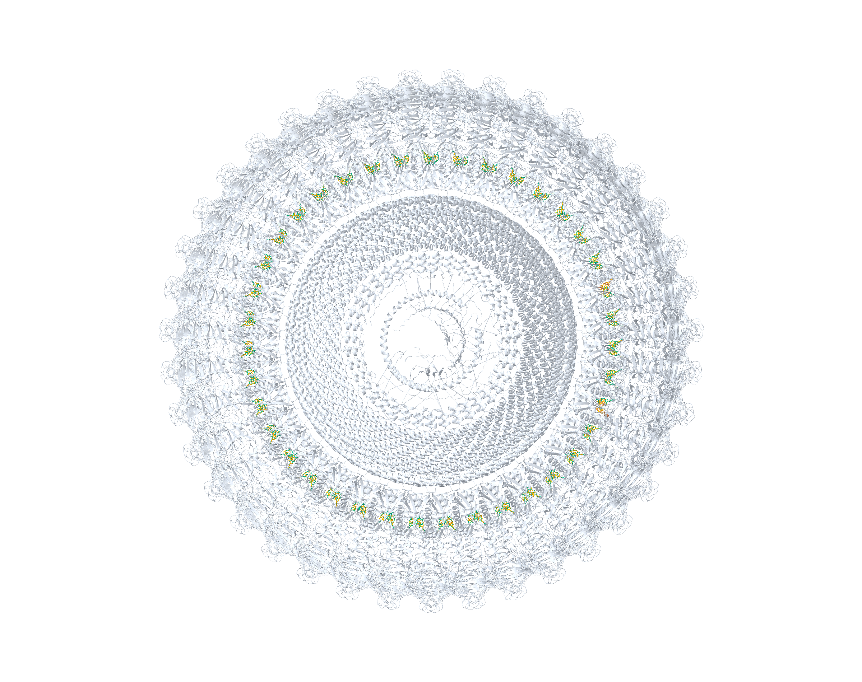
11JB Complete complex
CA2 receptor, 78 charged attempts (100% budget), model Top-1: 76/78 eligible instances at RMSD < 2 Å
CA2 receptor
Deposited ligands
Successful Top-1
Other Top-1
Notes:
11JB完整复合物的端到端建模。浅灰色为CryoAtom2重建受体，橙色为沉积配体，绿色为成功的模型Top-1构象，棕色为其他预测构象。原100%预算为78次计费尝试，恢复76/78个合格小分子实例；成功要求身份正确且重原子RMSD严格低于2 Å。坐标保持实验密度图坐标系，不作刚体叠合。
ENGLISH:
End-to-end modelling of the complete 11JB complex. CryoAtom2 receptor reconstruction is shown in pale grey, deposited ligands in orange, successful model-ranked Top-1 poses in green, and other predicted poses in brown. The original 100% budget of 78 charged attempts recovered 76/78 eligible small-molecule instances, requiring correct identity and heavy-atom RMSD strictly below 2 Å. All coordinates remain in the experimental map frame without rigid-body superposition.

Slide 2
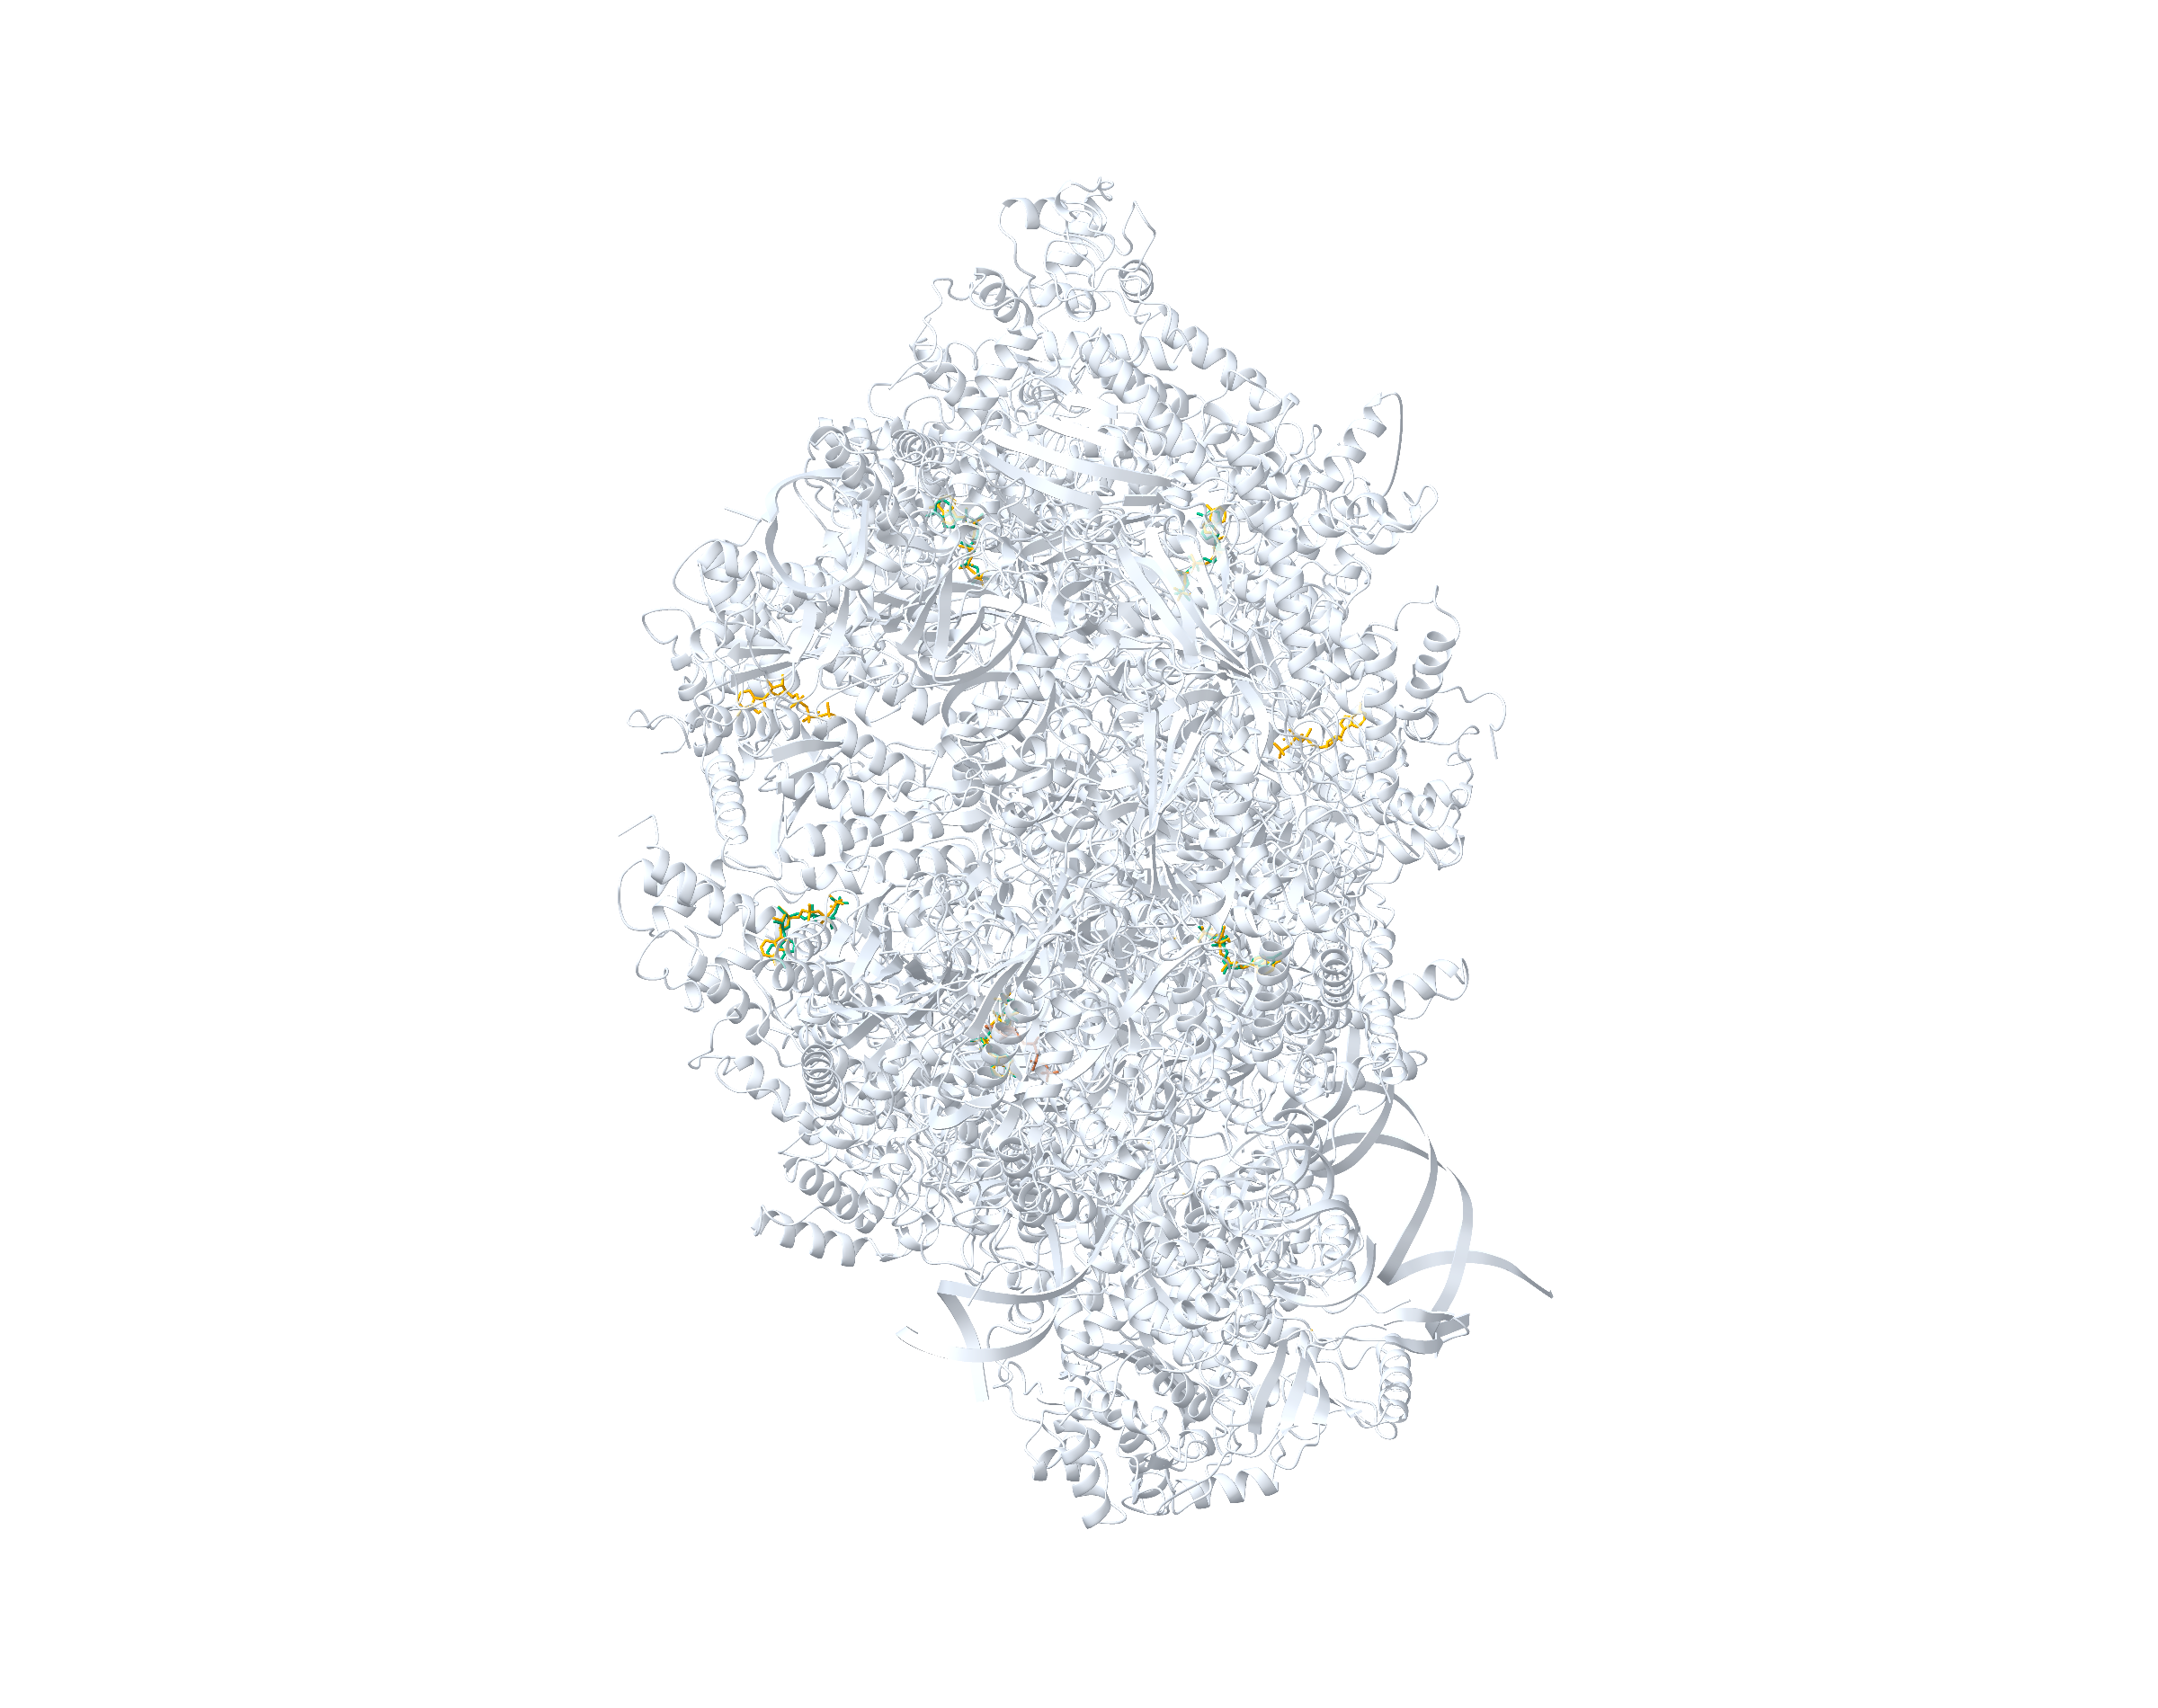
30GA Complete complex
CA2 receptor, 7 charged attempts (100% budget), model Top-1: 5/7 eligible instances at RMSD < 2 Å
CA2 receptor
Deposited ligands
Successful Top-1
Other Top-1
Notes:
30GA完整复合物的端到端建模。浅灰色为CryoAtom2重建受体，橙色为沉积配体，绿色为成功的模型Top-1构象，棕色为其他预测构象。原100%预算为7次计费尝试，恢复5/7个合格小分子实例；成功要求身份正确且重原子RMSD严格低于2 Å。坐标保持实验密度图坐标系，不作刚体叠合。额外背景预测予以保留，不计入成功实例。
ENGLISH:
End-to-end modelling of the complete 30GA complex. CryoAtom2 receptor reconstruction is shown in pale grey, deposited ligands in orange, successful model-ranked Top-1 poses in green, and other predicted poses in brown. The original 100% budget of 7 charged attempts recovered 5/7 eligible small-molecule instances, requiring correct identity and heavy-atom RMSD strictly below 2 Å. All coordinates remain in the experimental map frame without rigid-body superposition. An additional background prediction is shown and is excluded from the recovered-instance count.

Slide 3
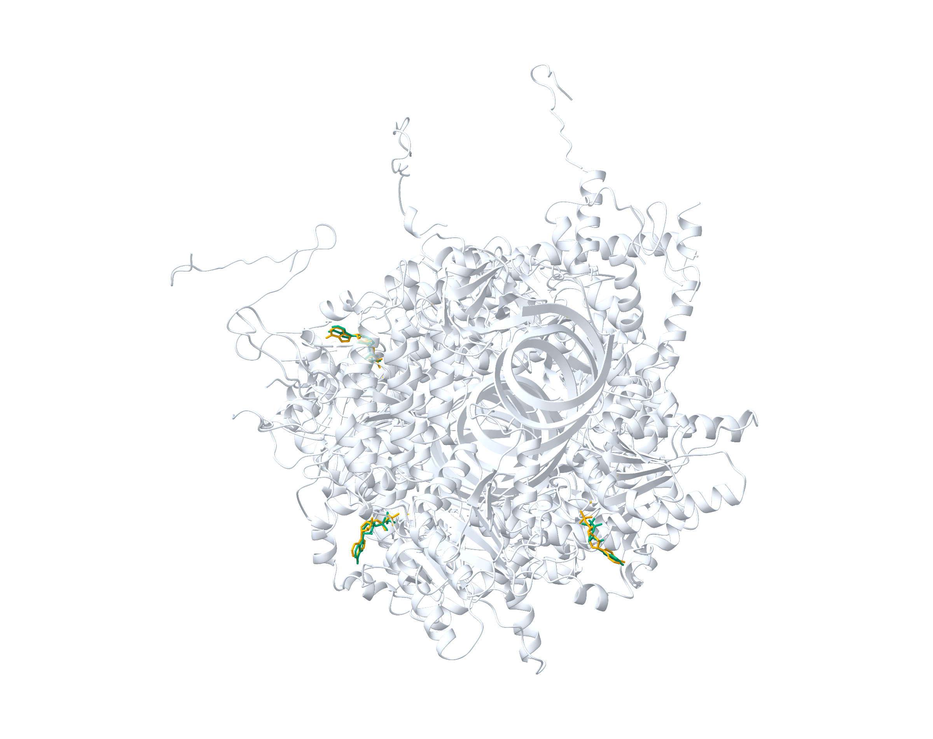
9LOV Complete complex
CA2 receptor, 3 charged attempts (100% budget), model Top-1: 3/3 eligible instances at RMSD < 2 Å
CA2 receptor
Deposited ligands
Successful Top-1
Other Top-1
Notes:
9LOV完整复合物的端到端建模。浅灰色为CryoAtom2重建受体，橙色为沉积配体，绿色为成功的模型Top-1构象，棕色为其他预测构象。原100%预算为3次计费尝试，恢复3/3个合格小分子实例；成功要求身份正确且重原子RMSD严格低于2 Å。坐标保持实验密度图坐标系，不作刚体叠合。
ENGLISH:
End-to-end modelling of the complete 9LOV complex. CryoAtom2 receptor reconstruction is shown in pale grey, deposited ligands in orange, successful model-ranked Top-1 poses in green, and other predicted poses in brown. The original 100% budget of 3 charged attempts recovered 3/3 eligible small-molecule instances, requiring correct identity and heavy-atom RMSD strictly below 2 Å. All coordinates remain in the experimental map frame without rigid-body superposition.

