Slide 1
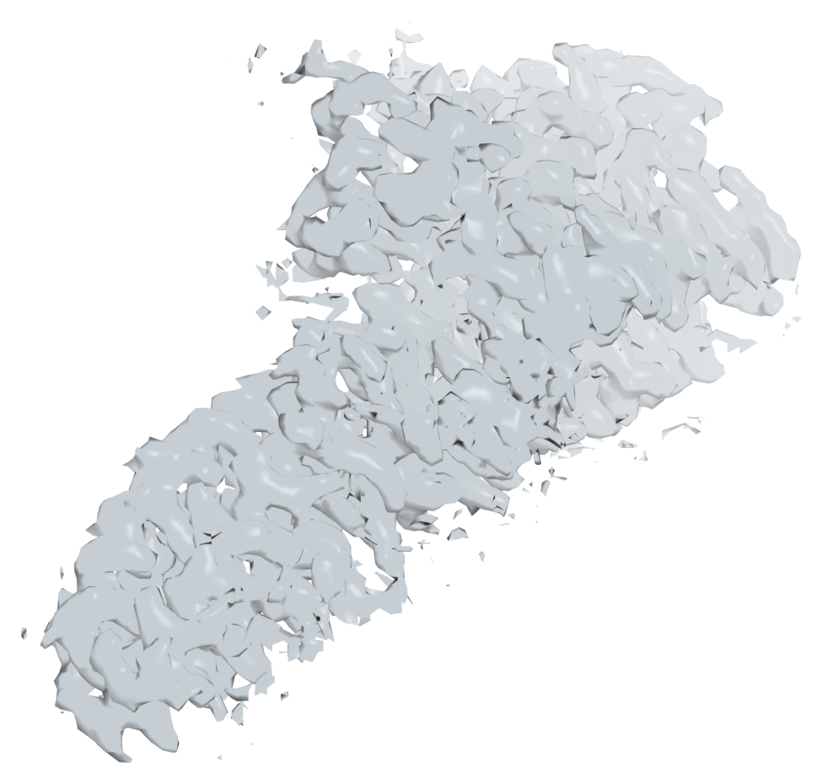
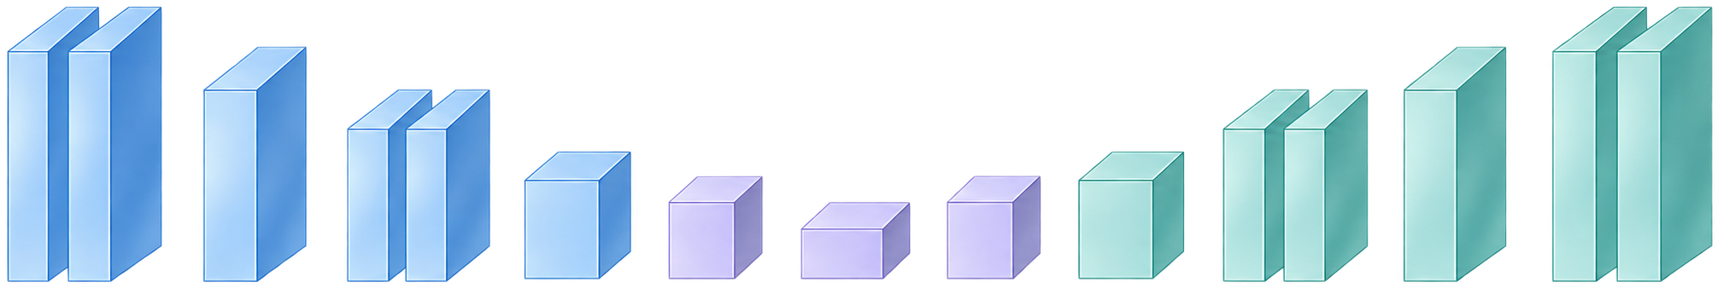
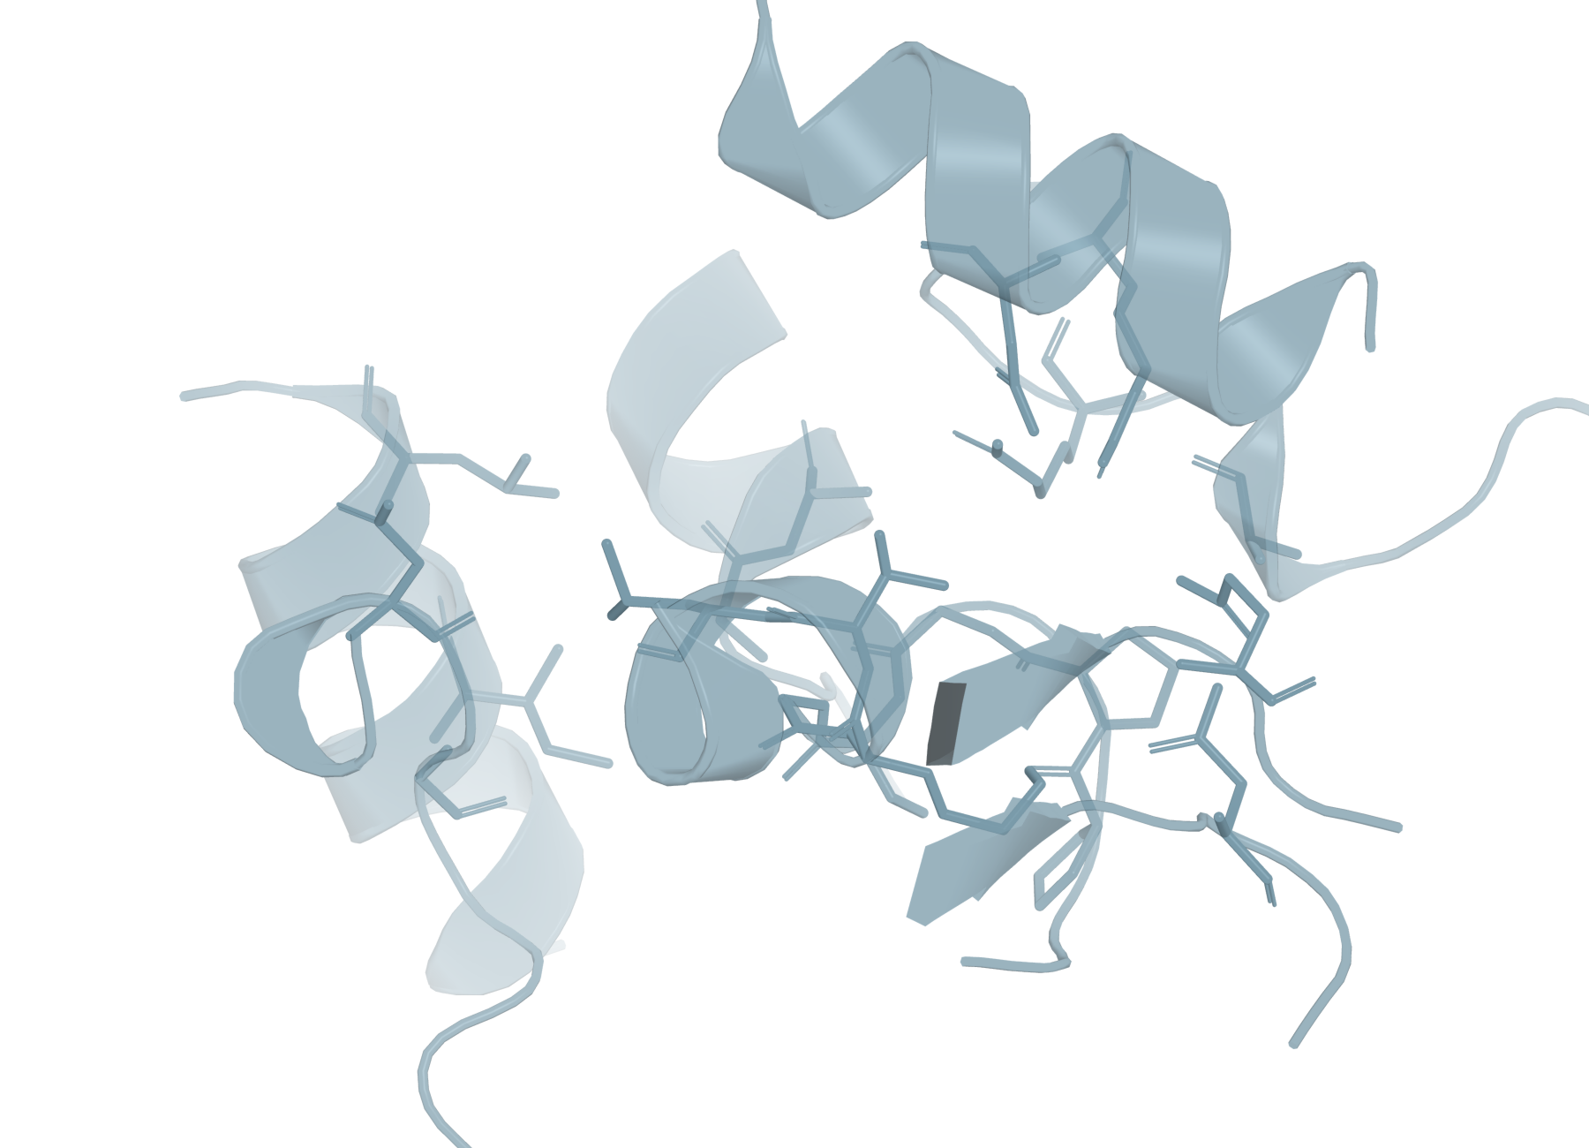
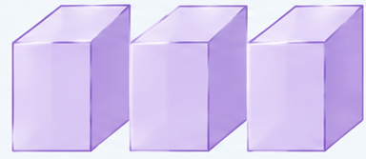
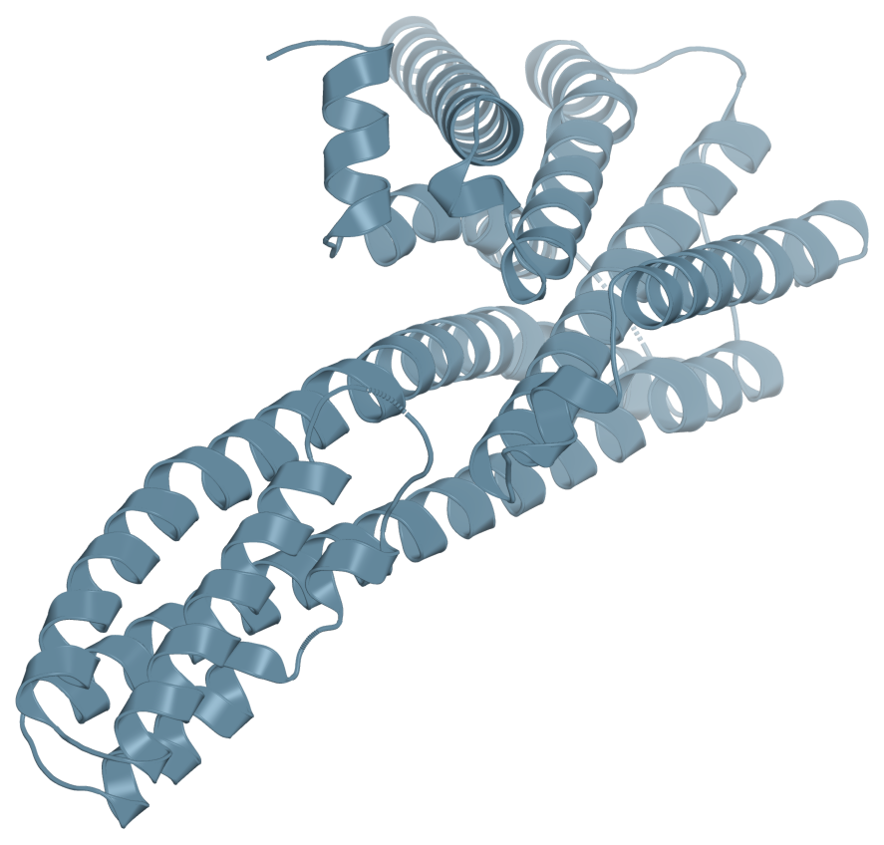
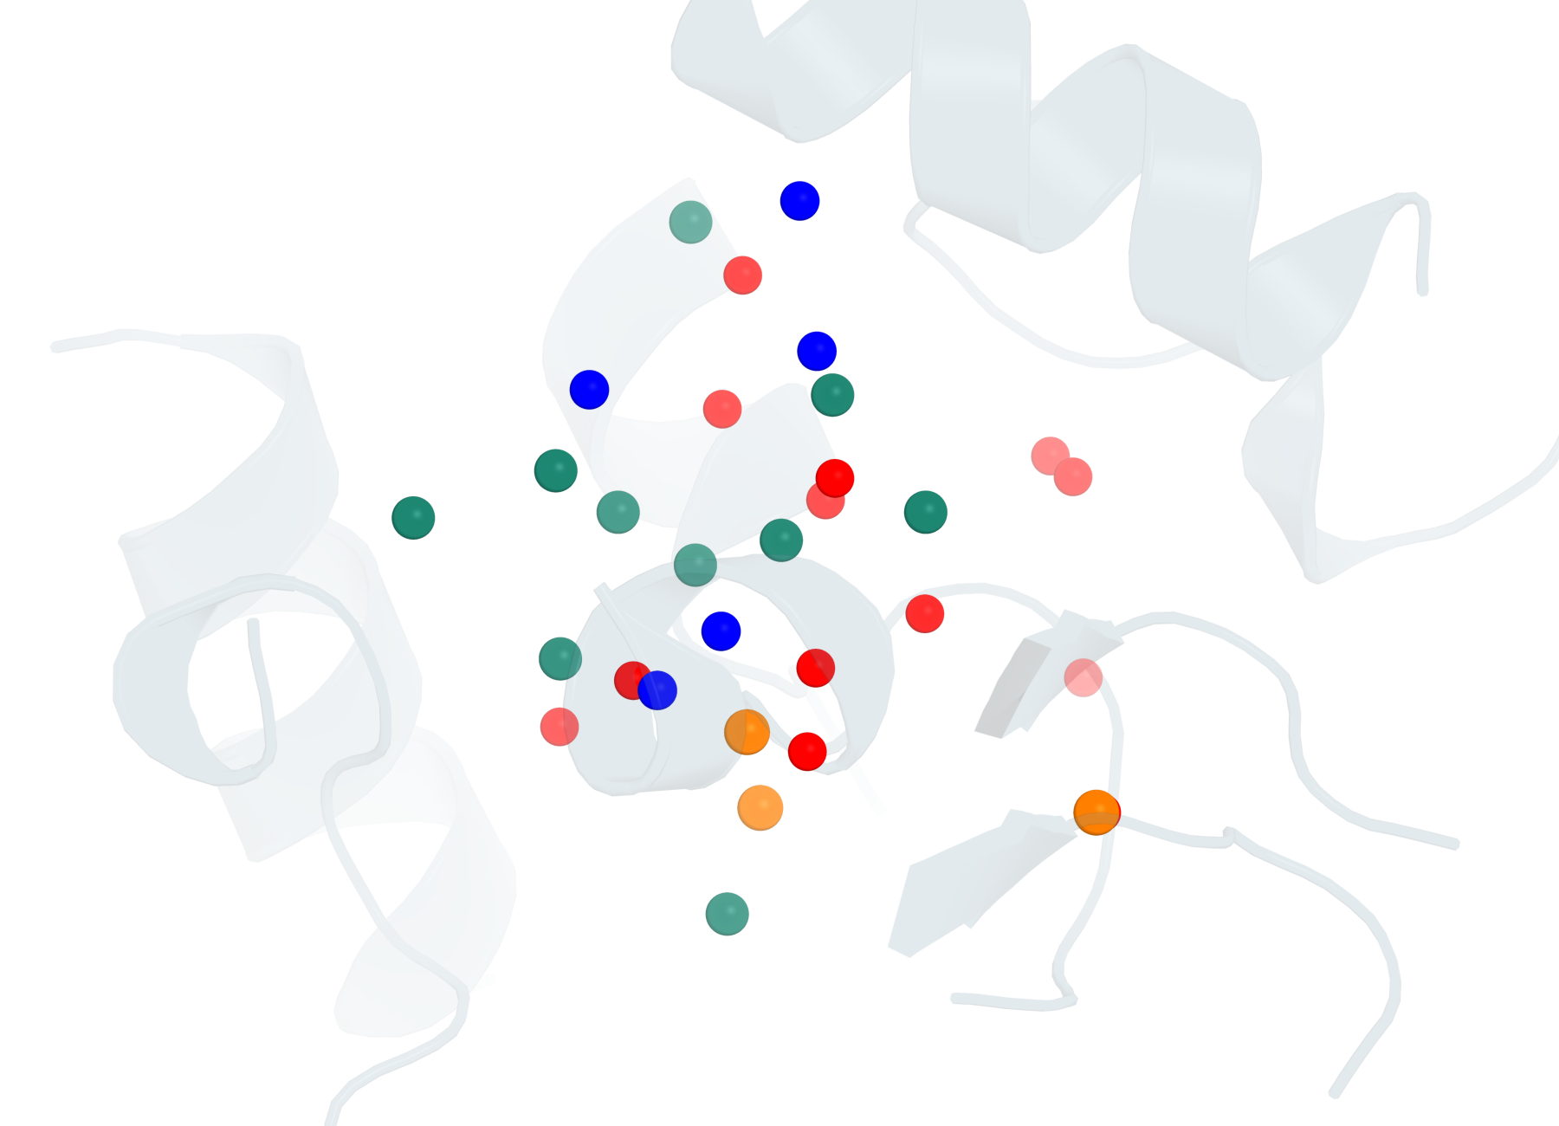
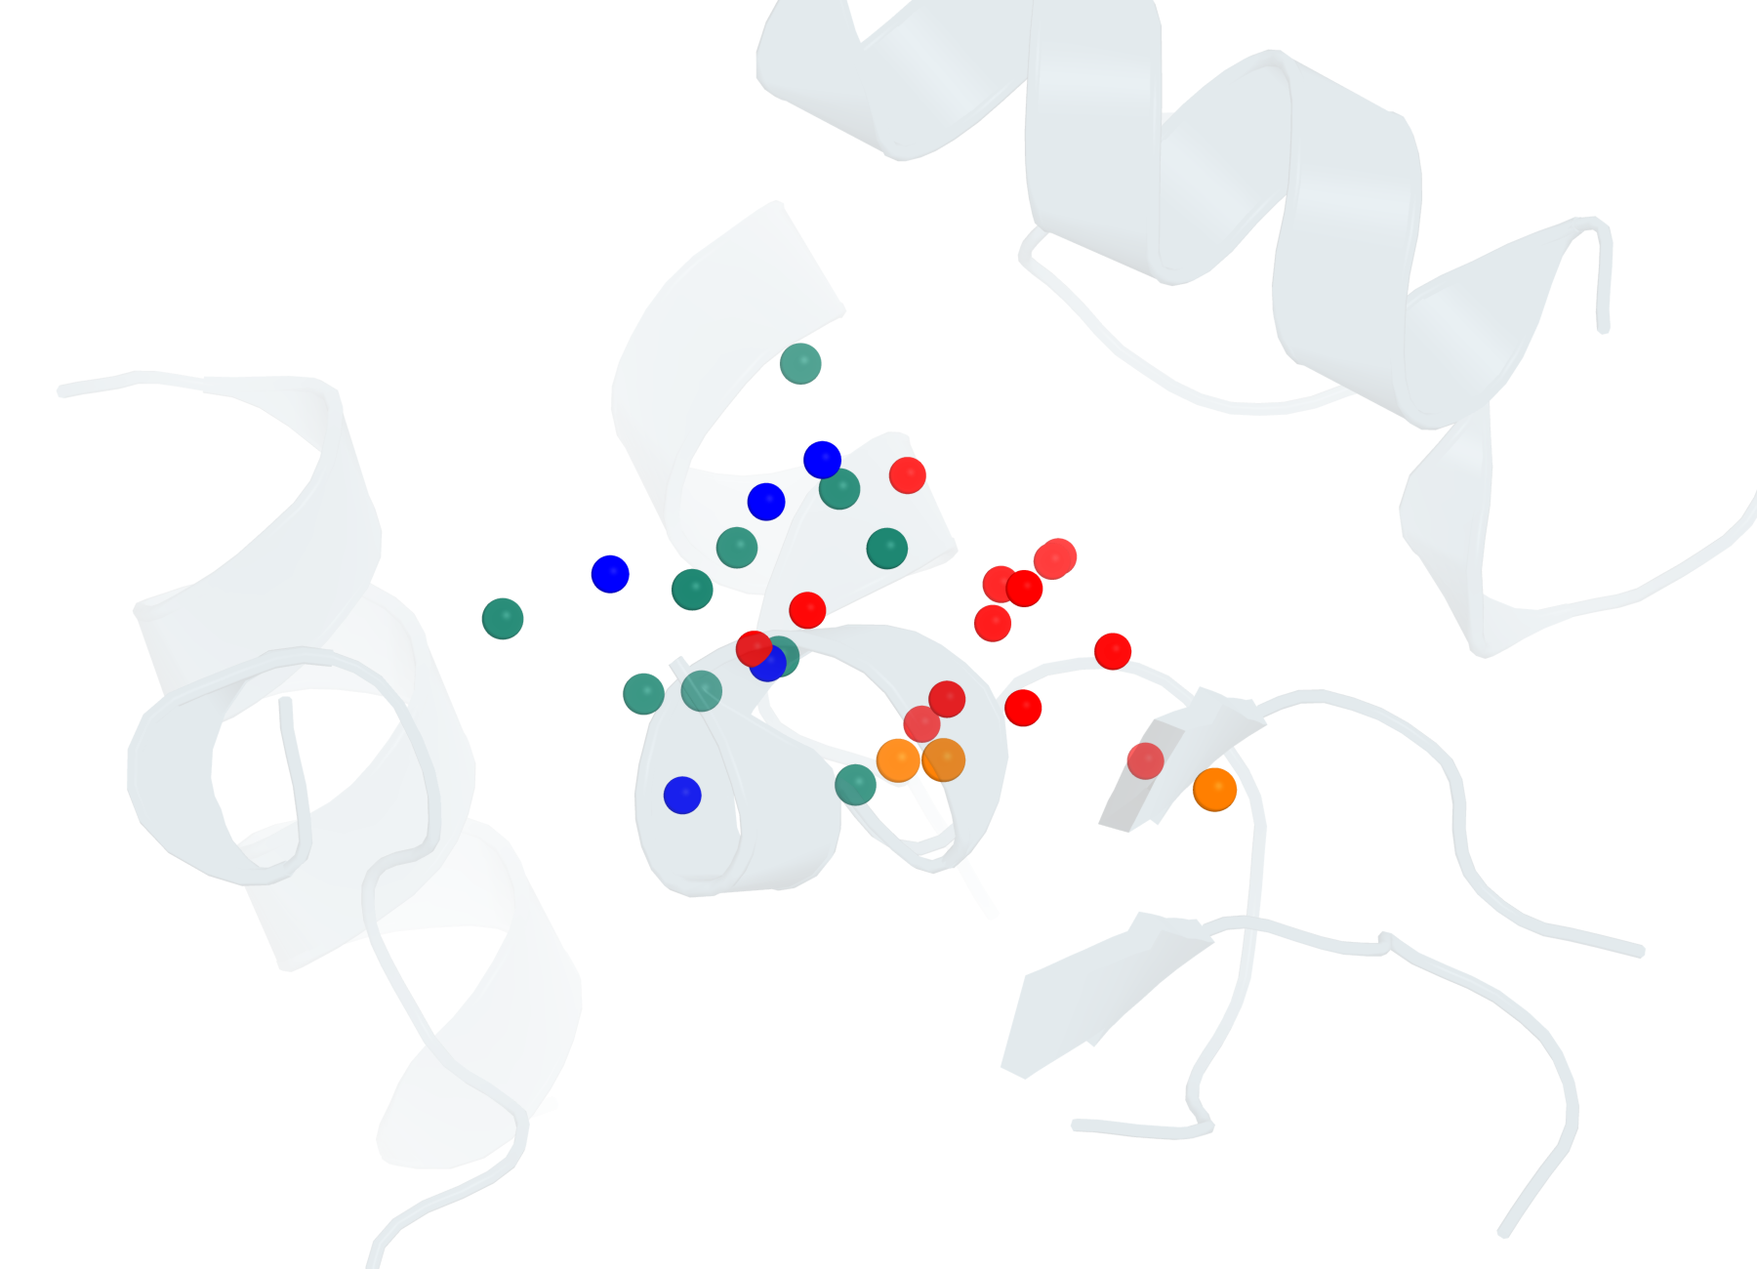
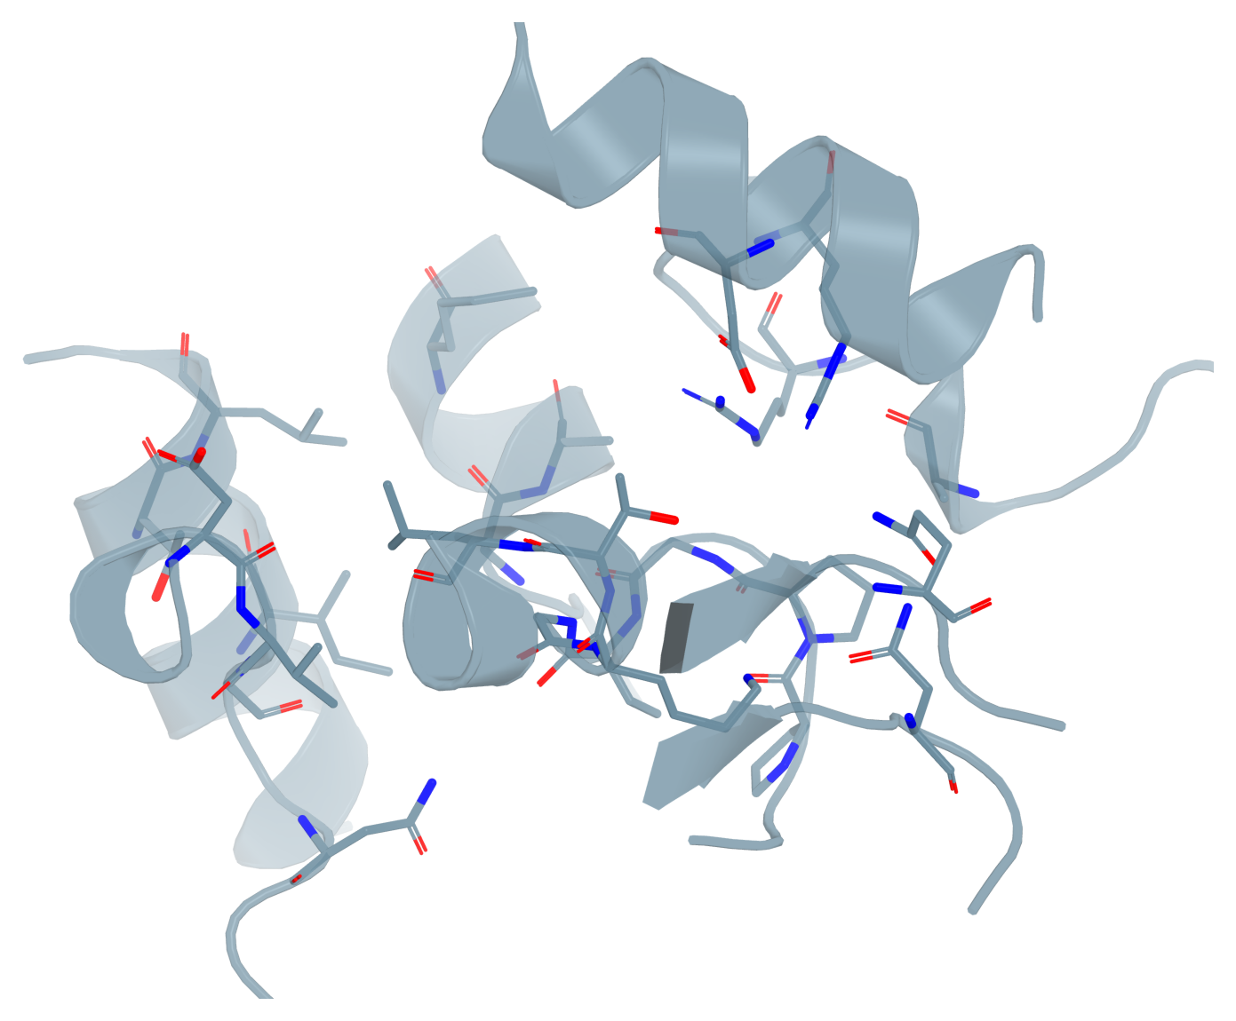

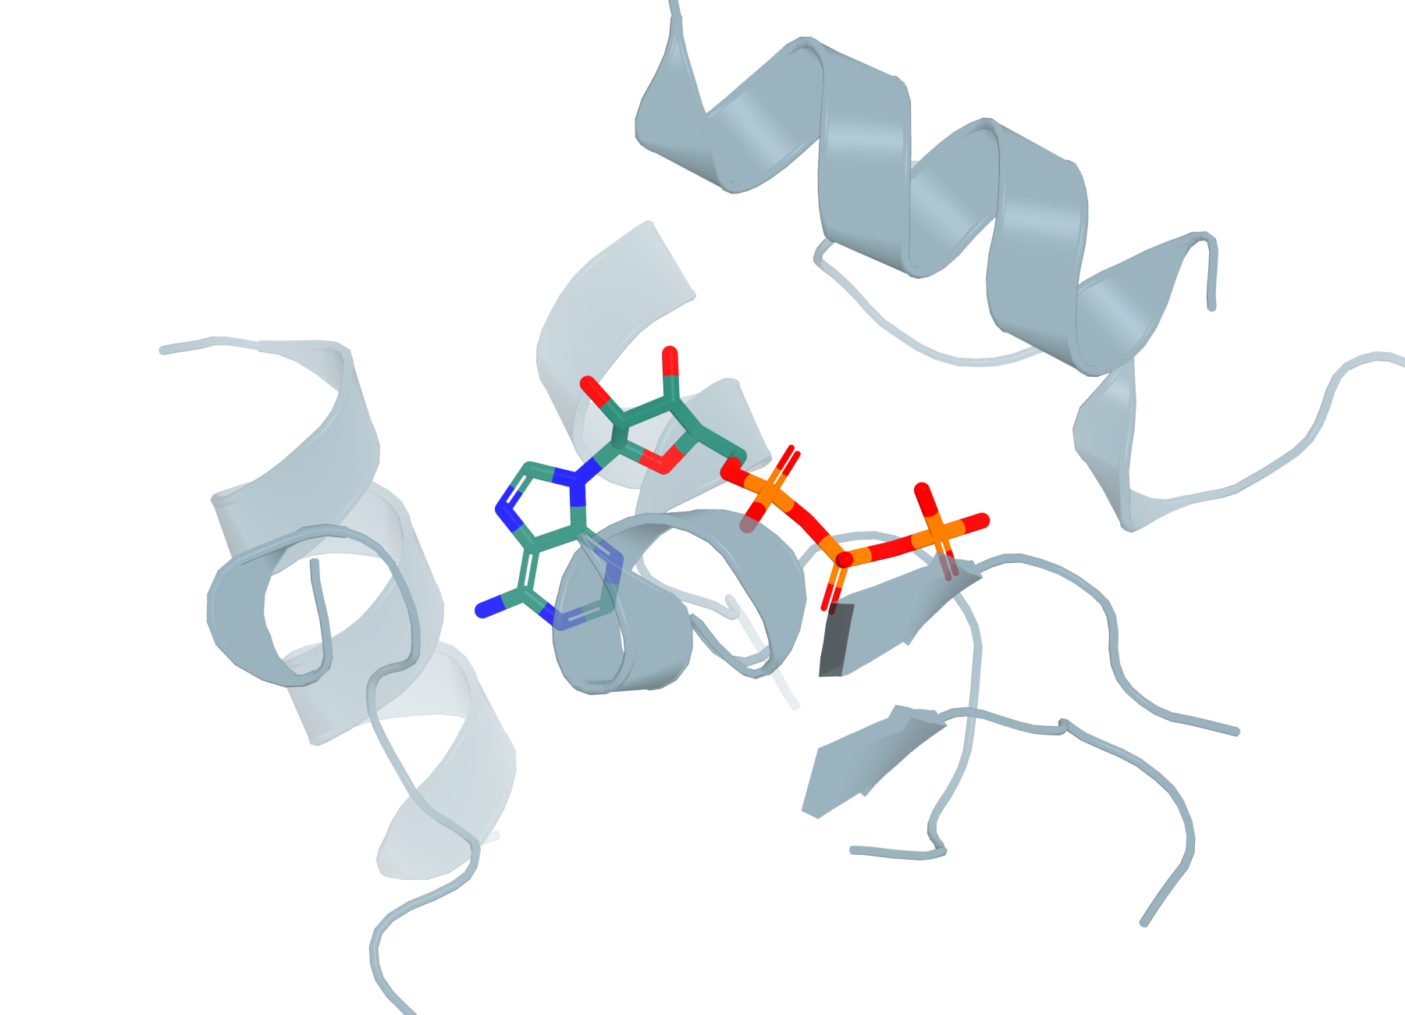
a
Find: locate ligand regions
c
Build: downstream
pose reconstruction
Density
Density
Bank
3D voxel U-Net
Blobs
Skip connections
Spatial
transform
80³
56 channels
Site
Pocket
Encoder
Bottleneck
Decoder
from Find
Receptor
Atom embeddings
Fusion
CCO
CC(=O)O
Embedding
head
Cc1ccccc1
Recycle
CC(N)=O
80³
Auxiliary
features
SMILES
Density
Point Transformer V3
from Match
b
Match: candidate-to-identity assignment
DG-PocketXMol
Candidate encoder
Identity encoder
Density-conditioned
fine-tuning
Receptor
Density
48³ crop
User-provided SMILES · same PDB
h_{j}^{vox}
1 CCO
2 CC(=O)O
Gaussian
noise
3D U-Net
Base summary
k Cc1ccccc1
Other
identities
RDKit
K CC(N)=O
Pocket
Blob
Auxiliary
features
SMI-TED
SMI-TED
Denoising
Own graph
GNN
1
2
K, V
Q
K, V
K
K, V
……
Mean/max pool
Cross-attention
Graph attention
Q
Q
Context attention
Concat
MLP
FiLM
Fusion
h_{j}
g_{k}
Identity scores
s_{j,k}
k
Foreground head
p_{j}^{fg}
Cosine score
j
All-atom ligand pose(s)
Foreground probability
Learned projections
J × K

