Slide 1
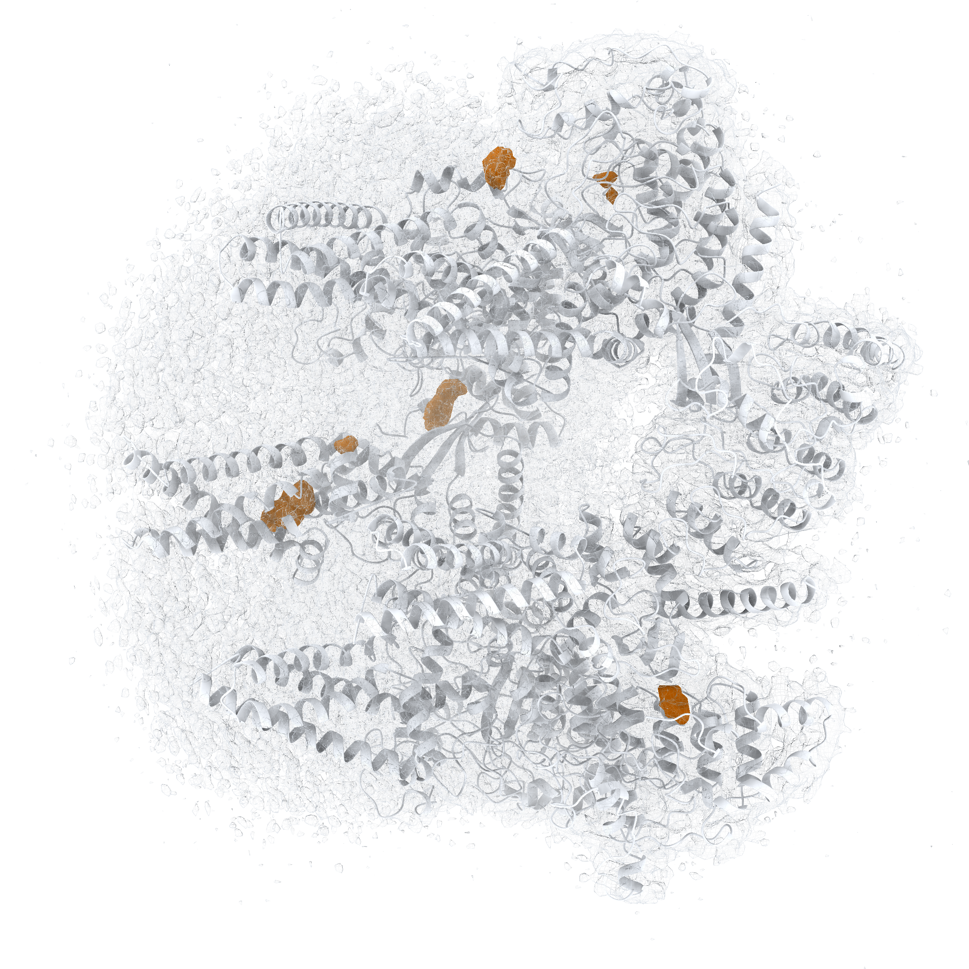
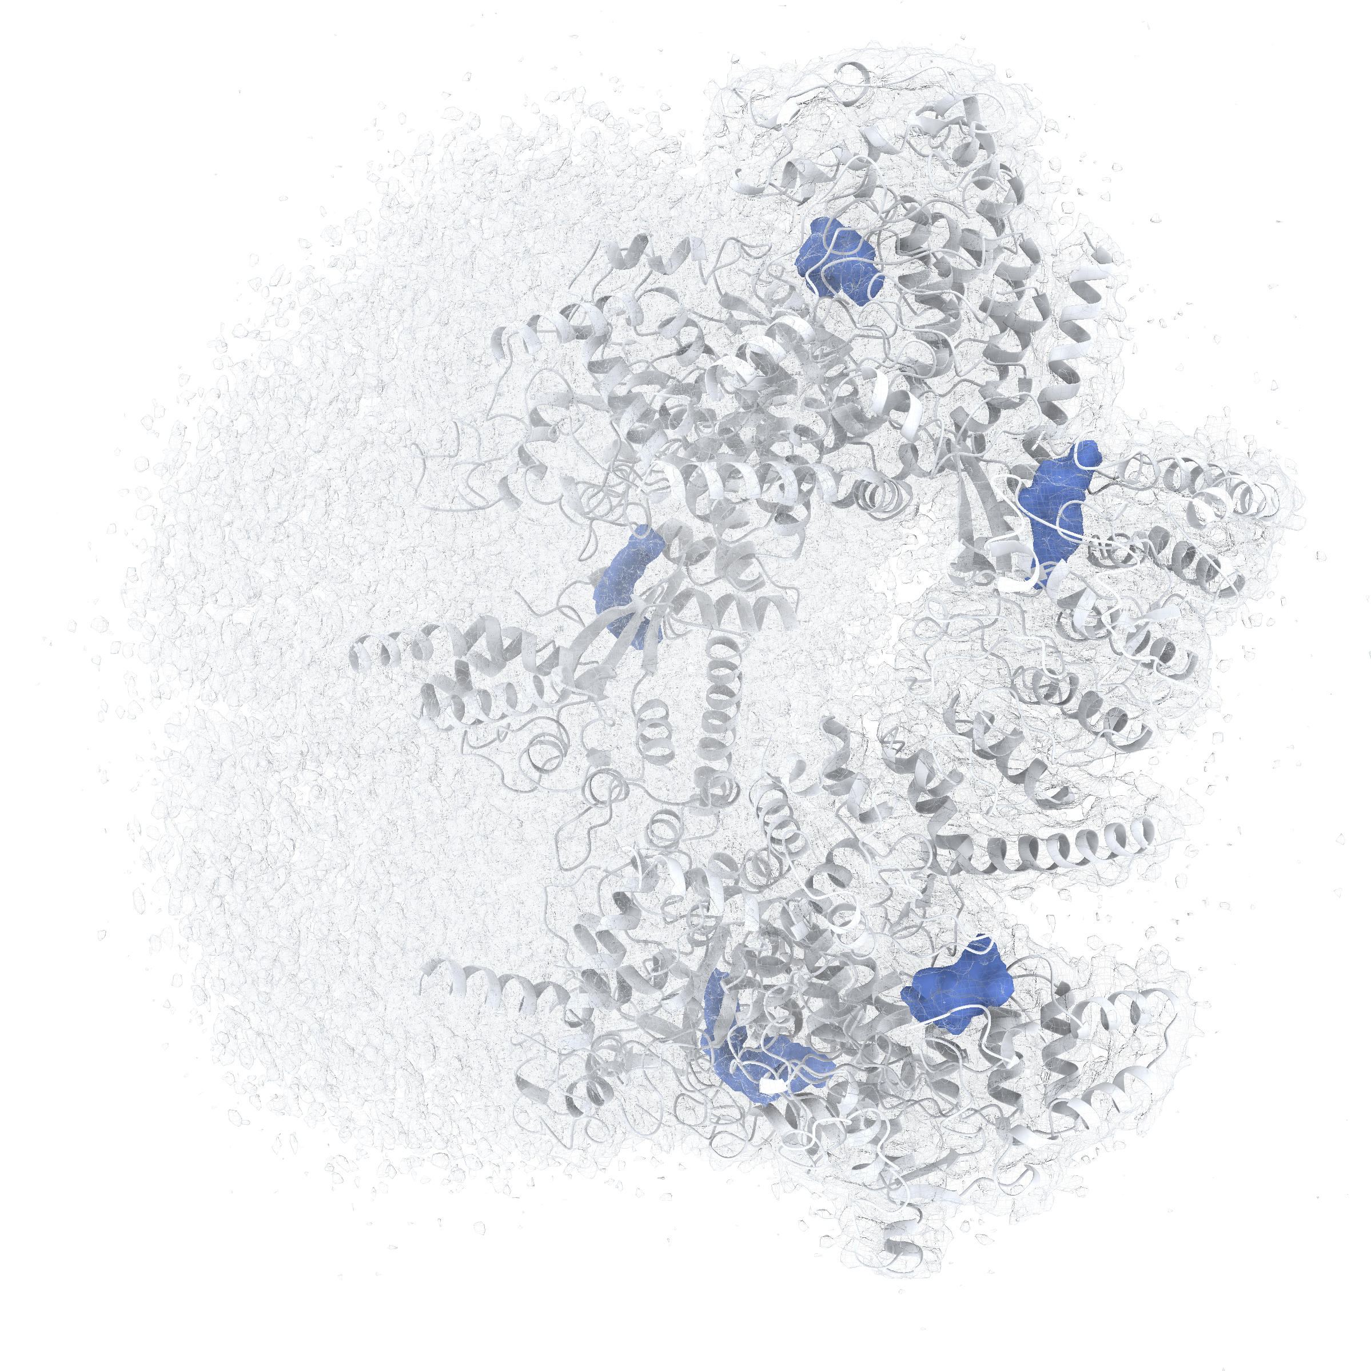
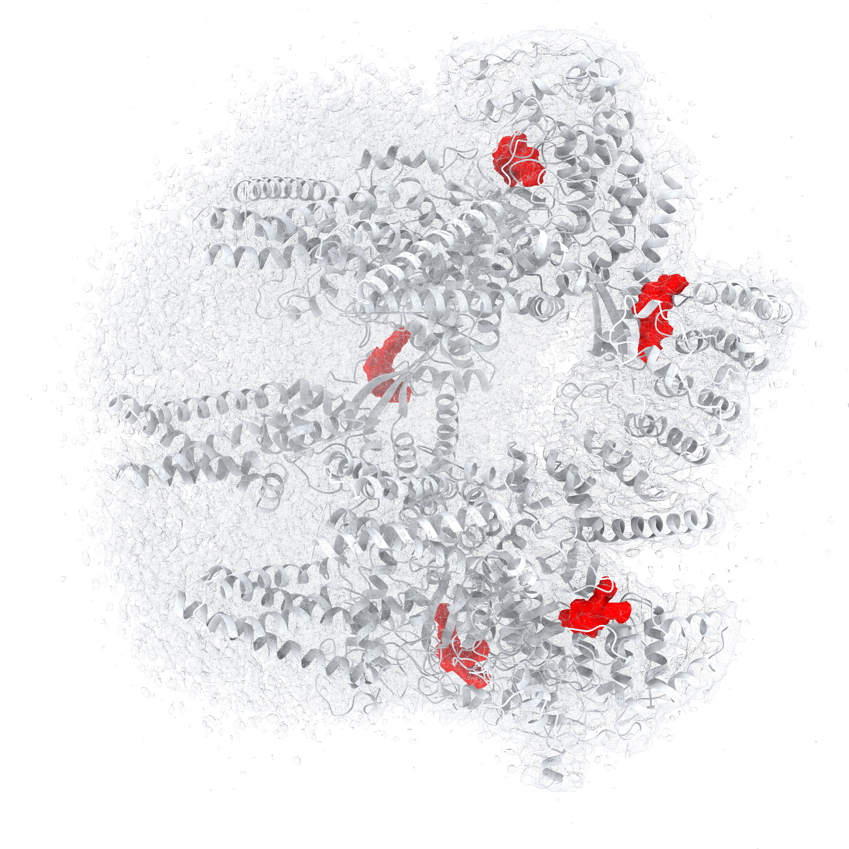
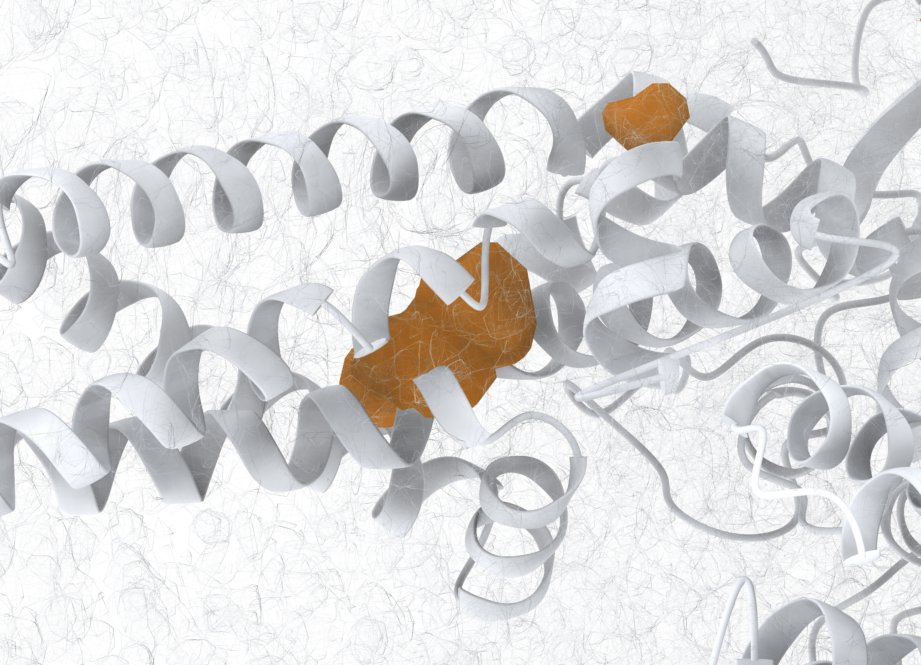
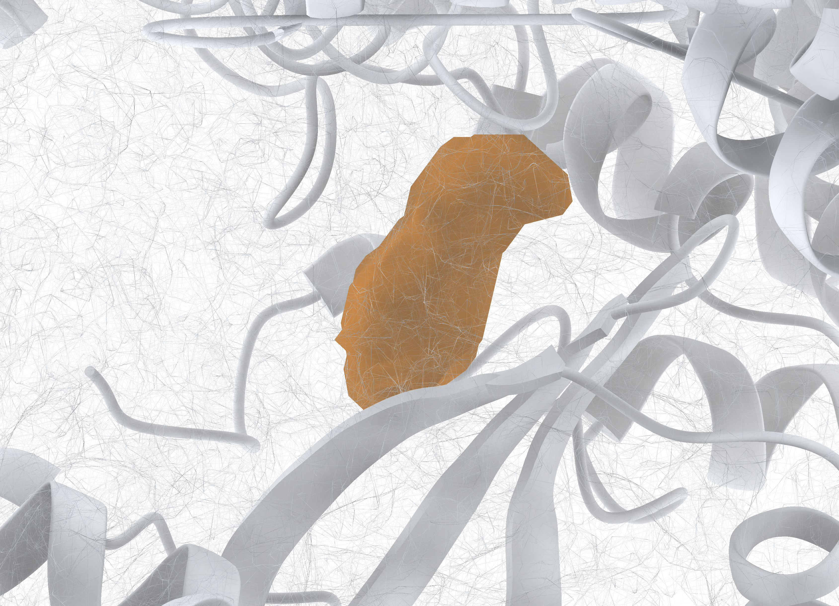
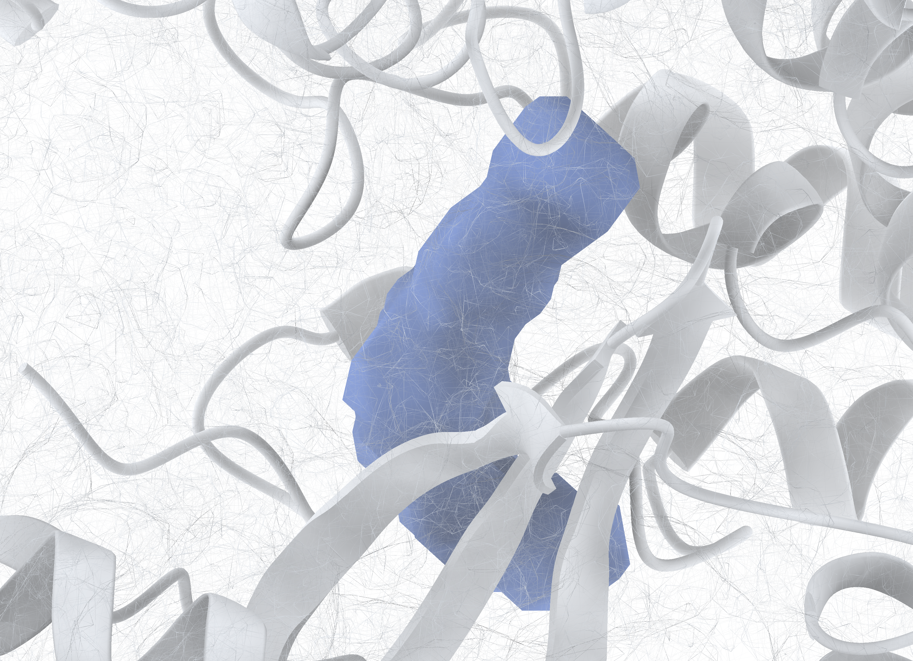
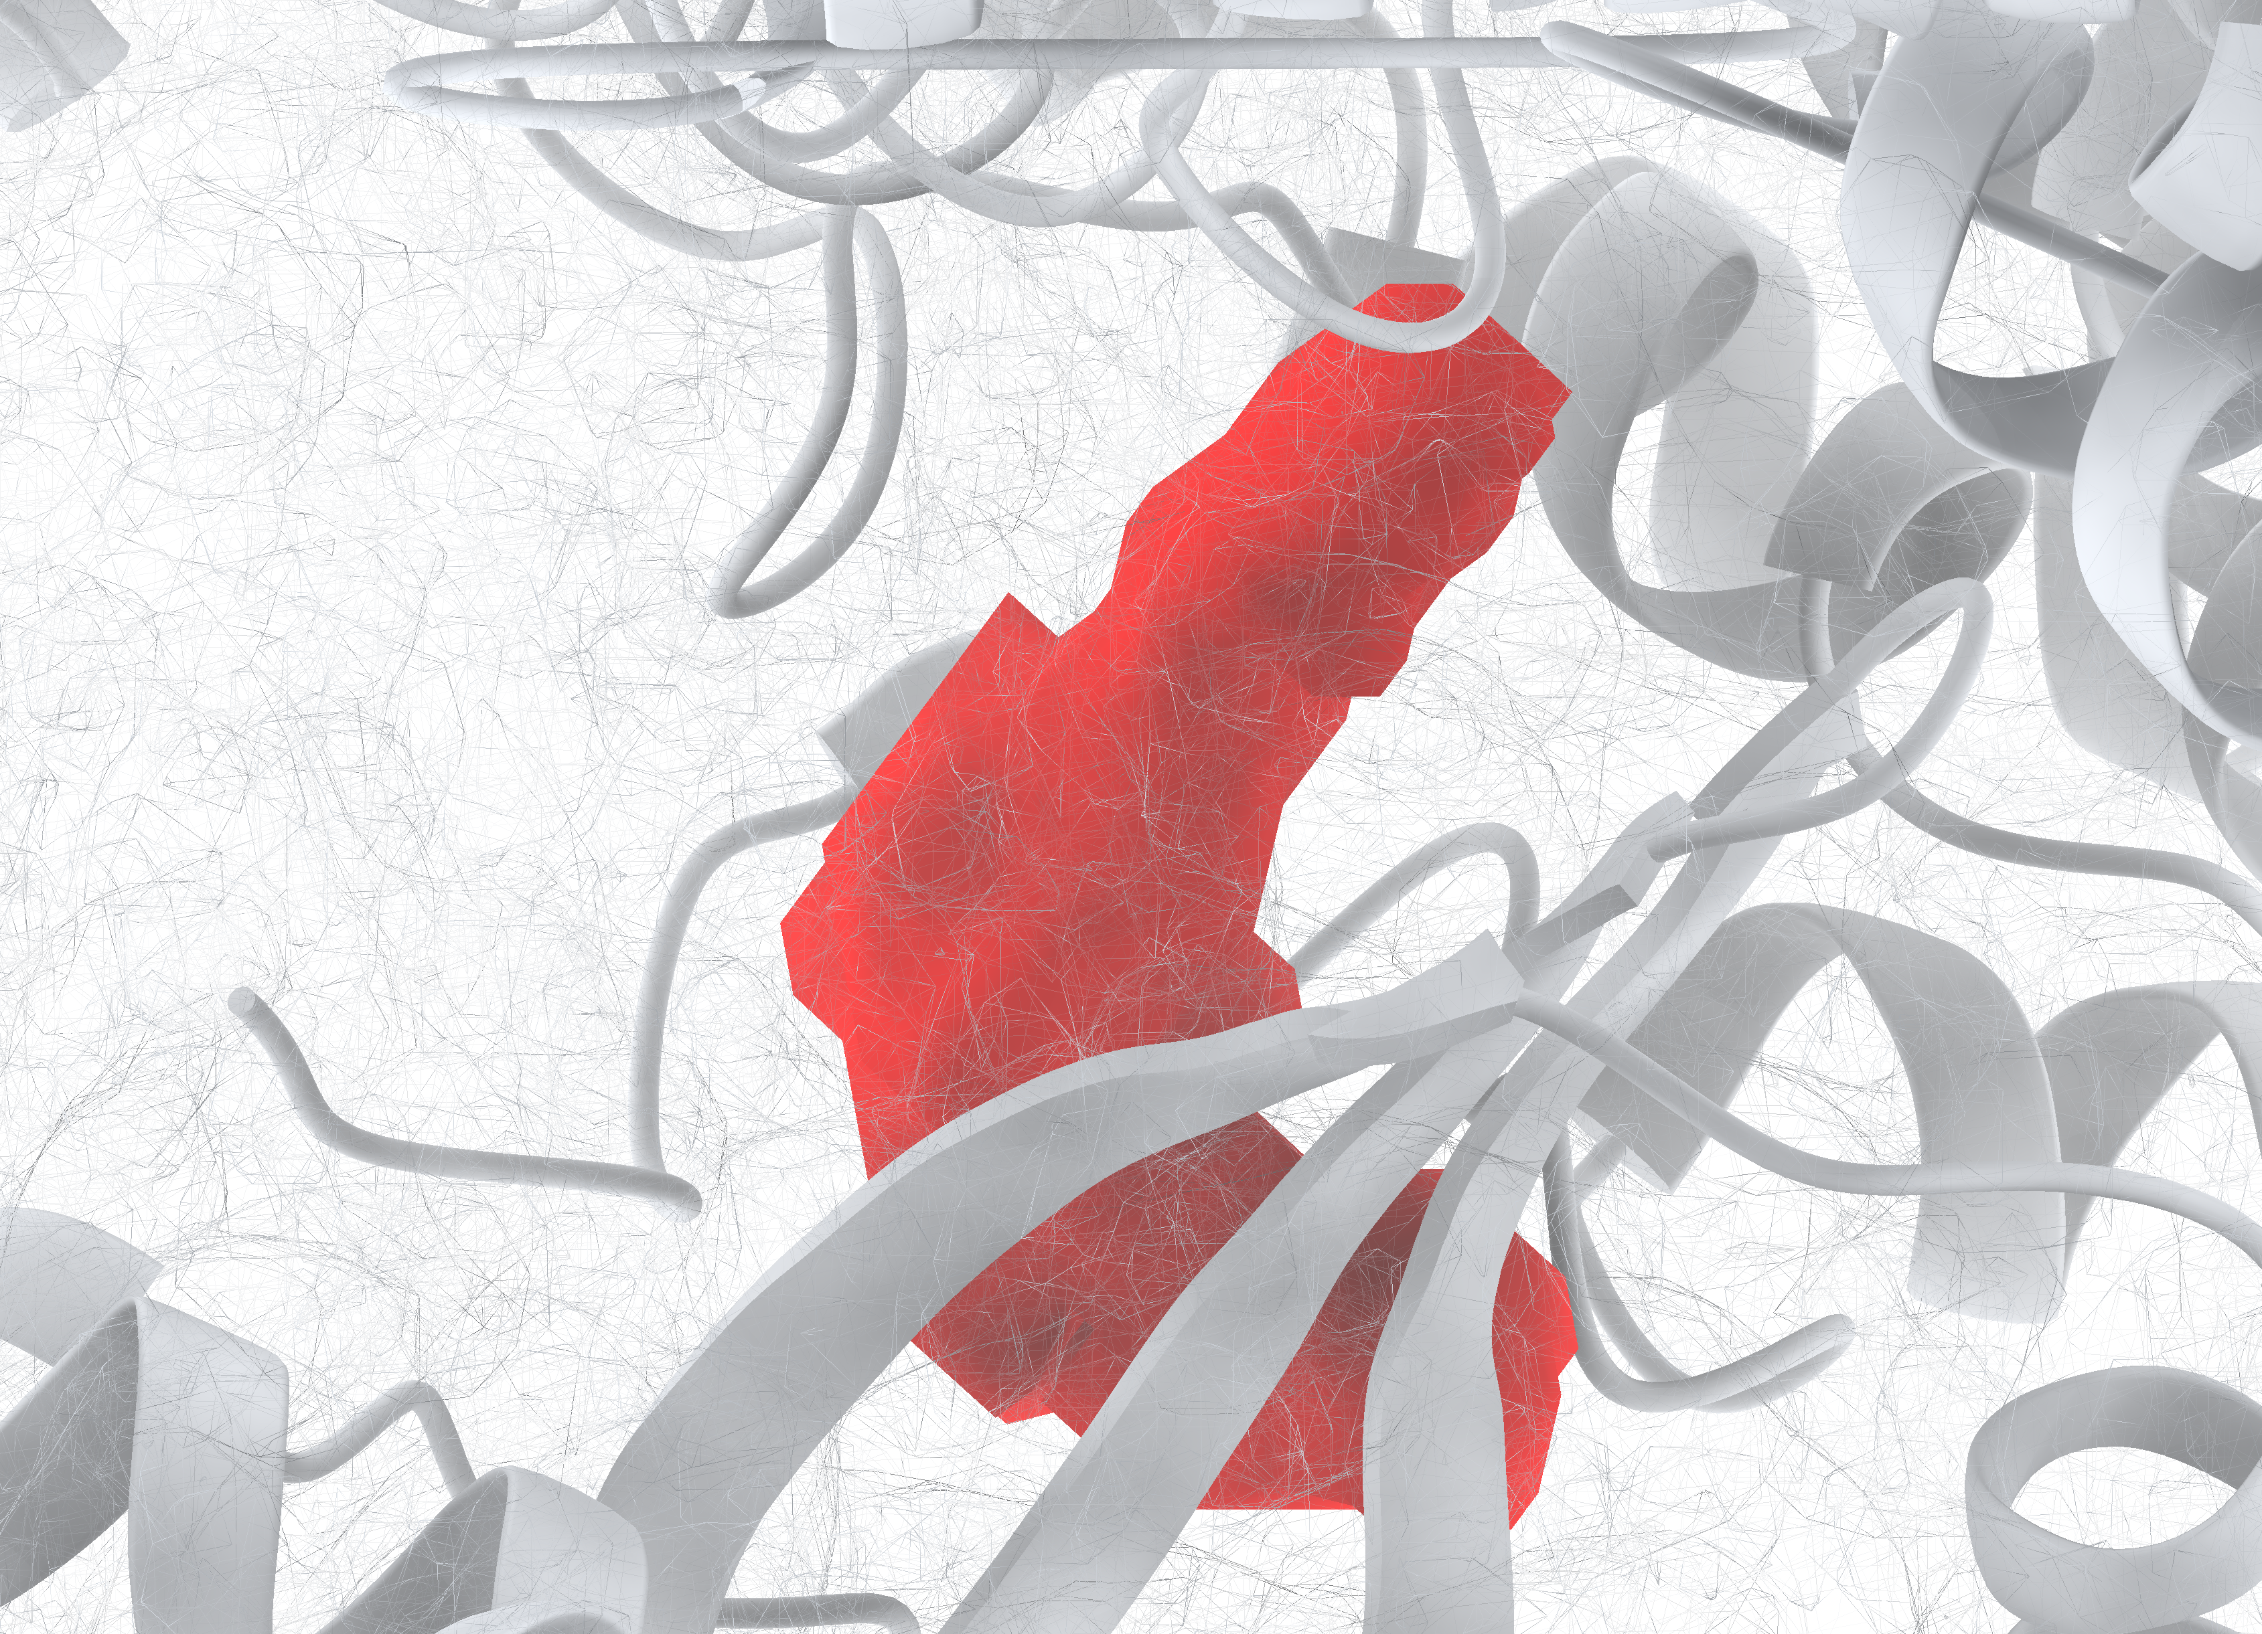
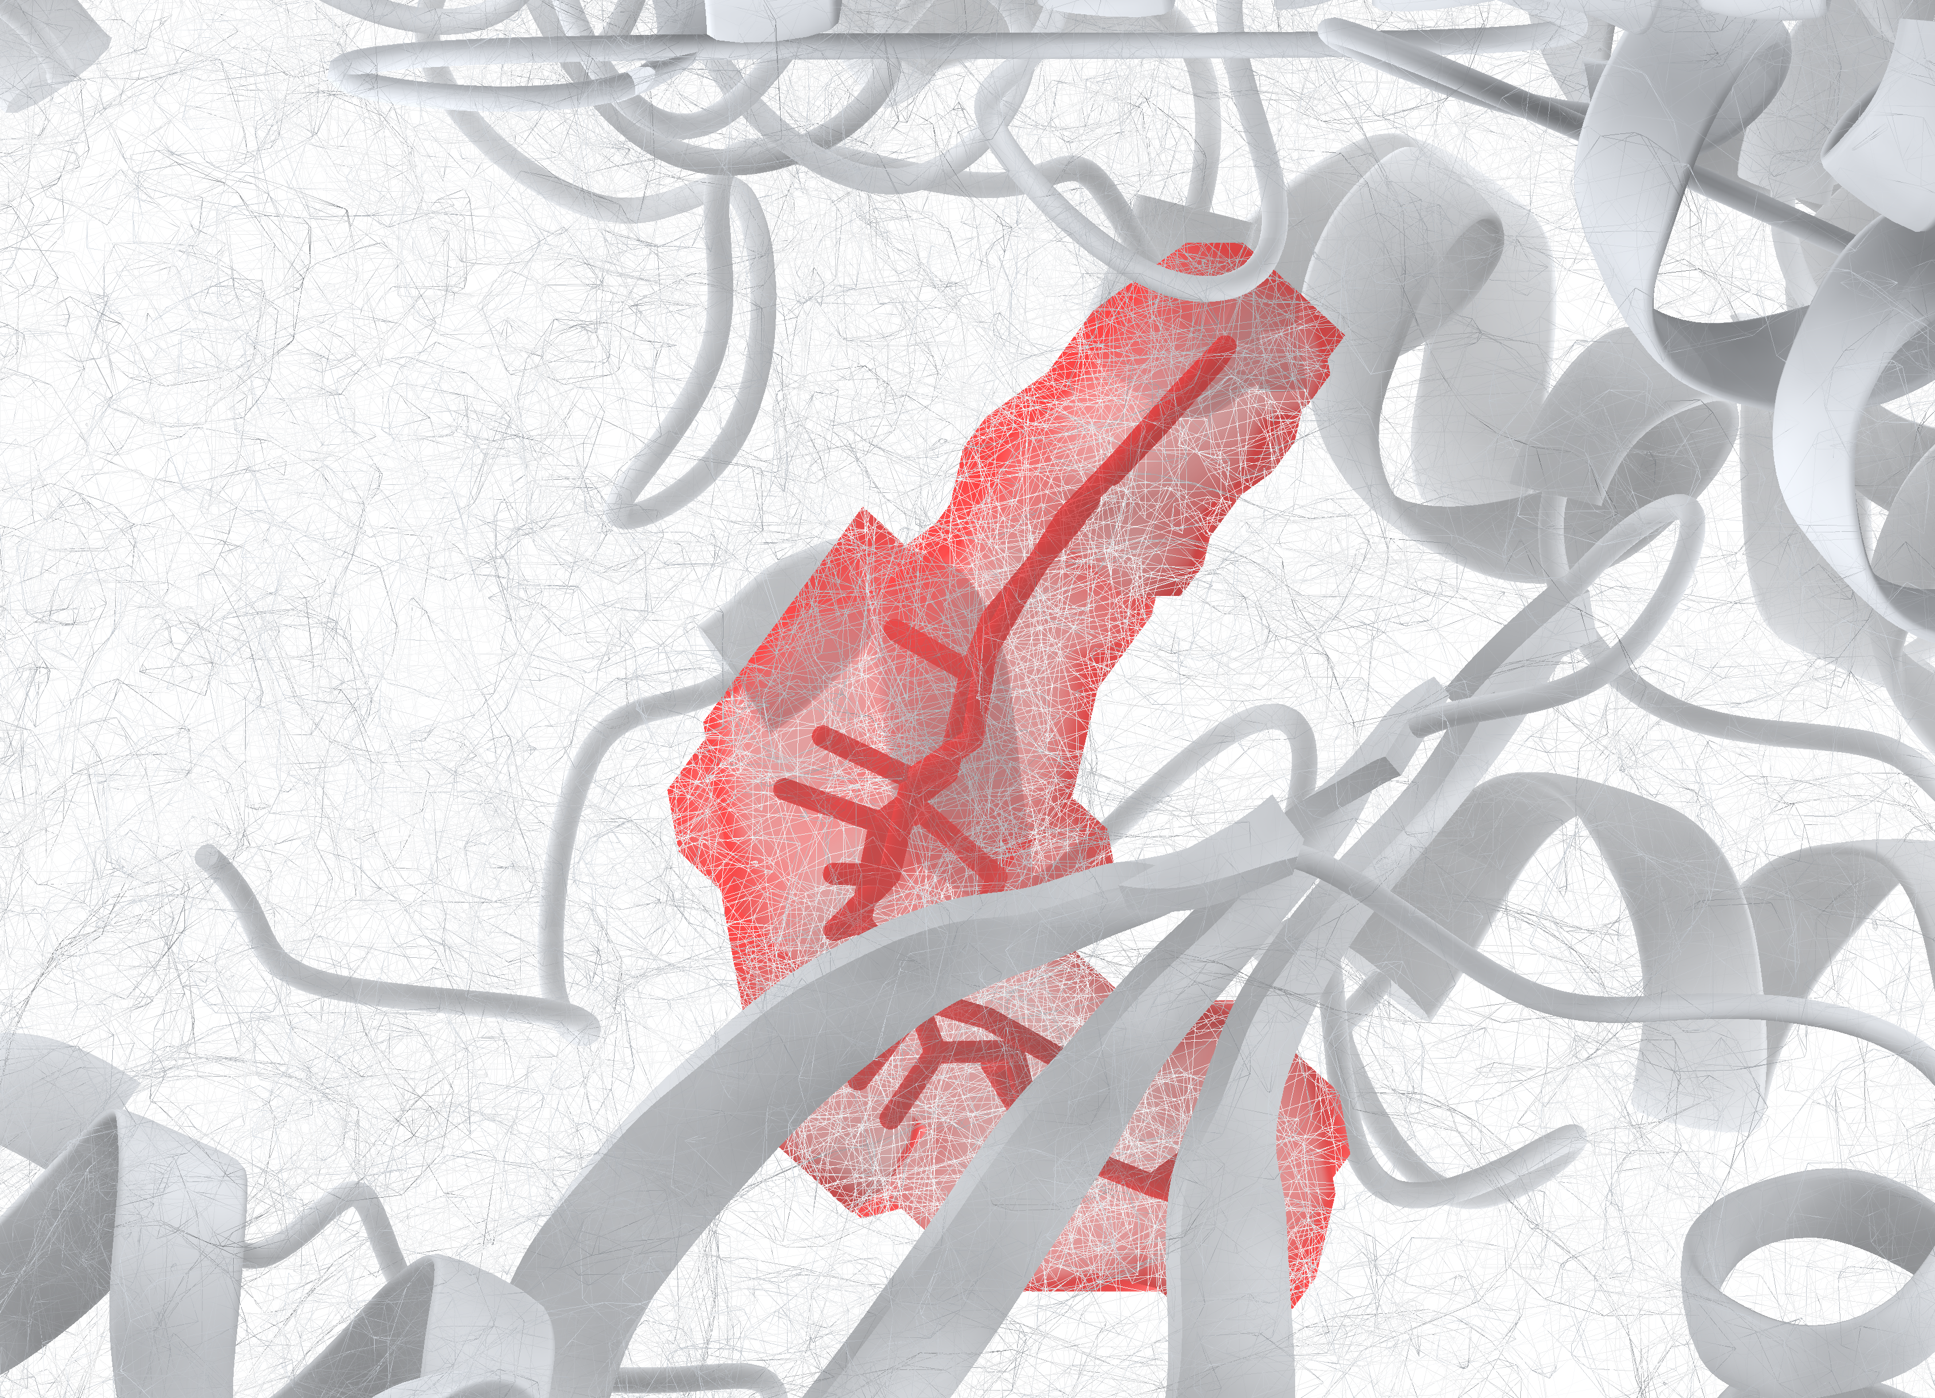
a Emap2lig-Find
b LigandSeek-Find(CA2)
c Reference
Semantic Dice: 0.160
Semantic Dice: 0.757
PDB ID: 9NVS
false positive
IoU: 0.306
IoU: 0.656
Notes:
9NVS中配体区域检测的全局与局部比较。a–c分别为Emap2lig-Find预测（橙色）、使用CryoAtom2受体的LigandSeek-Find预测（CA2；蓝色）及真实配体区域（红色）的整体视图。灰色网格表示实验密度，卡通表示受体；a和c为沉积受体，b为CA2受体。所有保留预测均予以显示。连接线将整体视图的框选区域连接到保持同一观察方向的局部放大图。最左侧局部图中的两块橙色blob均为受体相关假阳性，与任何真实配体区域均无重叠。其余四幅局部图依次展示A1B32（B:1001）位点的Emap2lig-Find预测、LigandSeek-Find预测、真实区域，以及透明显示的真实区域。透明视图显示了区域内的沉积配体。三幅整体视图共用相机与尺度，四幅匹配位点局部图亦然。整体图上方分数为语义Dice，预测局部图下方分数为实例IoU。
ENGLISH:
Global and local ligand-region detection in 9NVS. a–c, Whole-complex views of Emap2lig-Find predictions (orange), LigandSeek-Find predictions using a CryoAtom2 receptor (CA2; blue), and reference ligand regions (red), respectively. Grey mesh shows experimental density, and cartoons show the receptor. The deposited receptor is shown in a and c, and the CA2 receptor in b. All retained predictions are displayed. Lines connect boxed regions to enlarged views with the same viewing direction. Both orange blobs in the leftmost enlargement are receptor-associated false positives with no overlap with any reference ligand region. The remaining enlargements show the A1B32 (B:1001) site, with Emap2lig-Find and LigandSeek-Find predictions followed by the reference region and its transparent view. The transparent view reveals the deposited ligand within the reference region. Whole-complex views share a camera and scale, as do the four matched-site enlargements. Scores above the whole-complex views denote semantic Dice; those below the prediction enlargements denote instance IoU.

