Slide 1
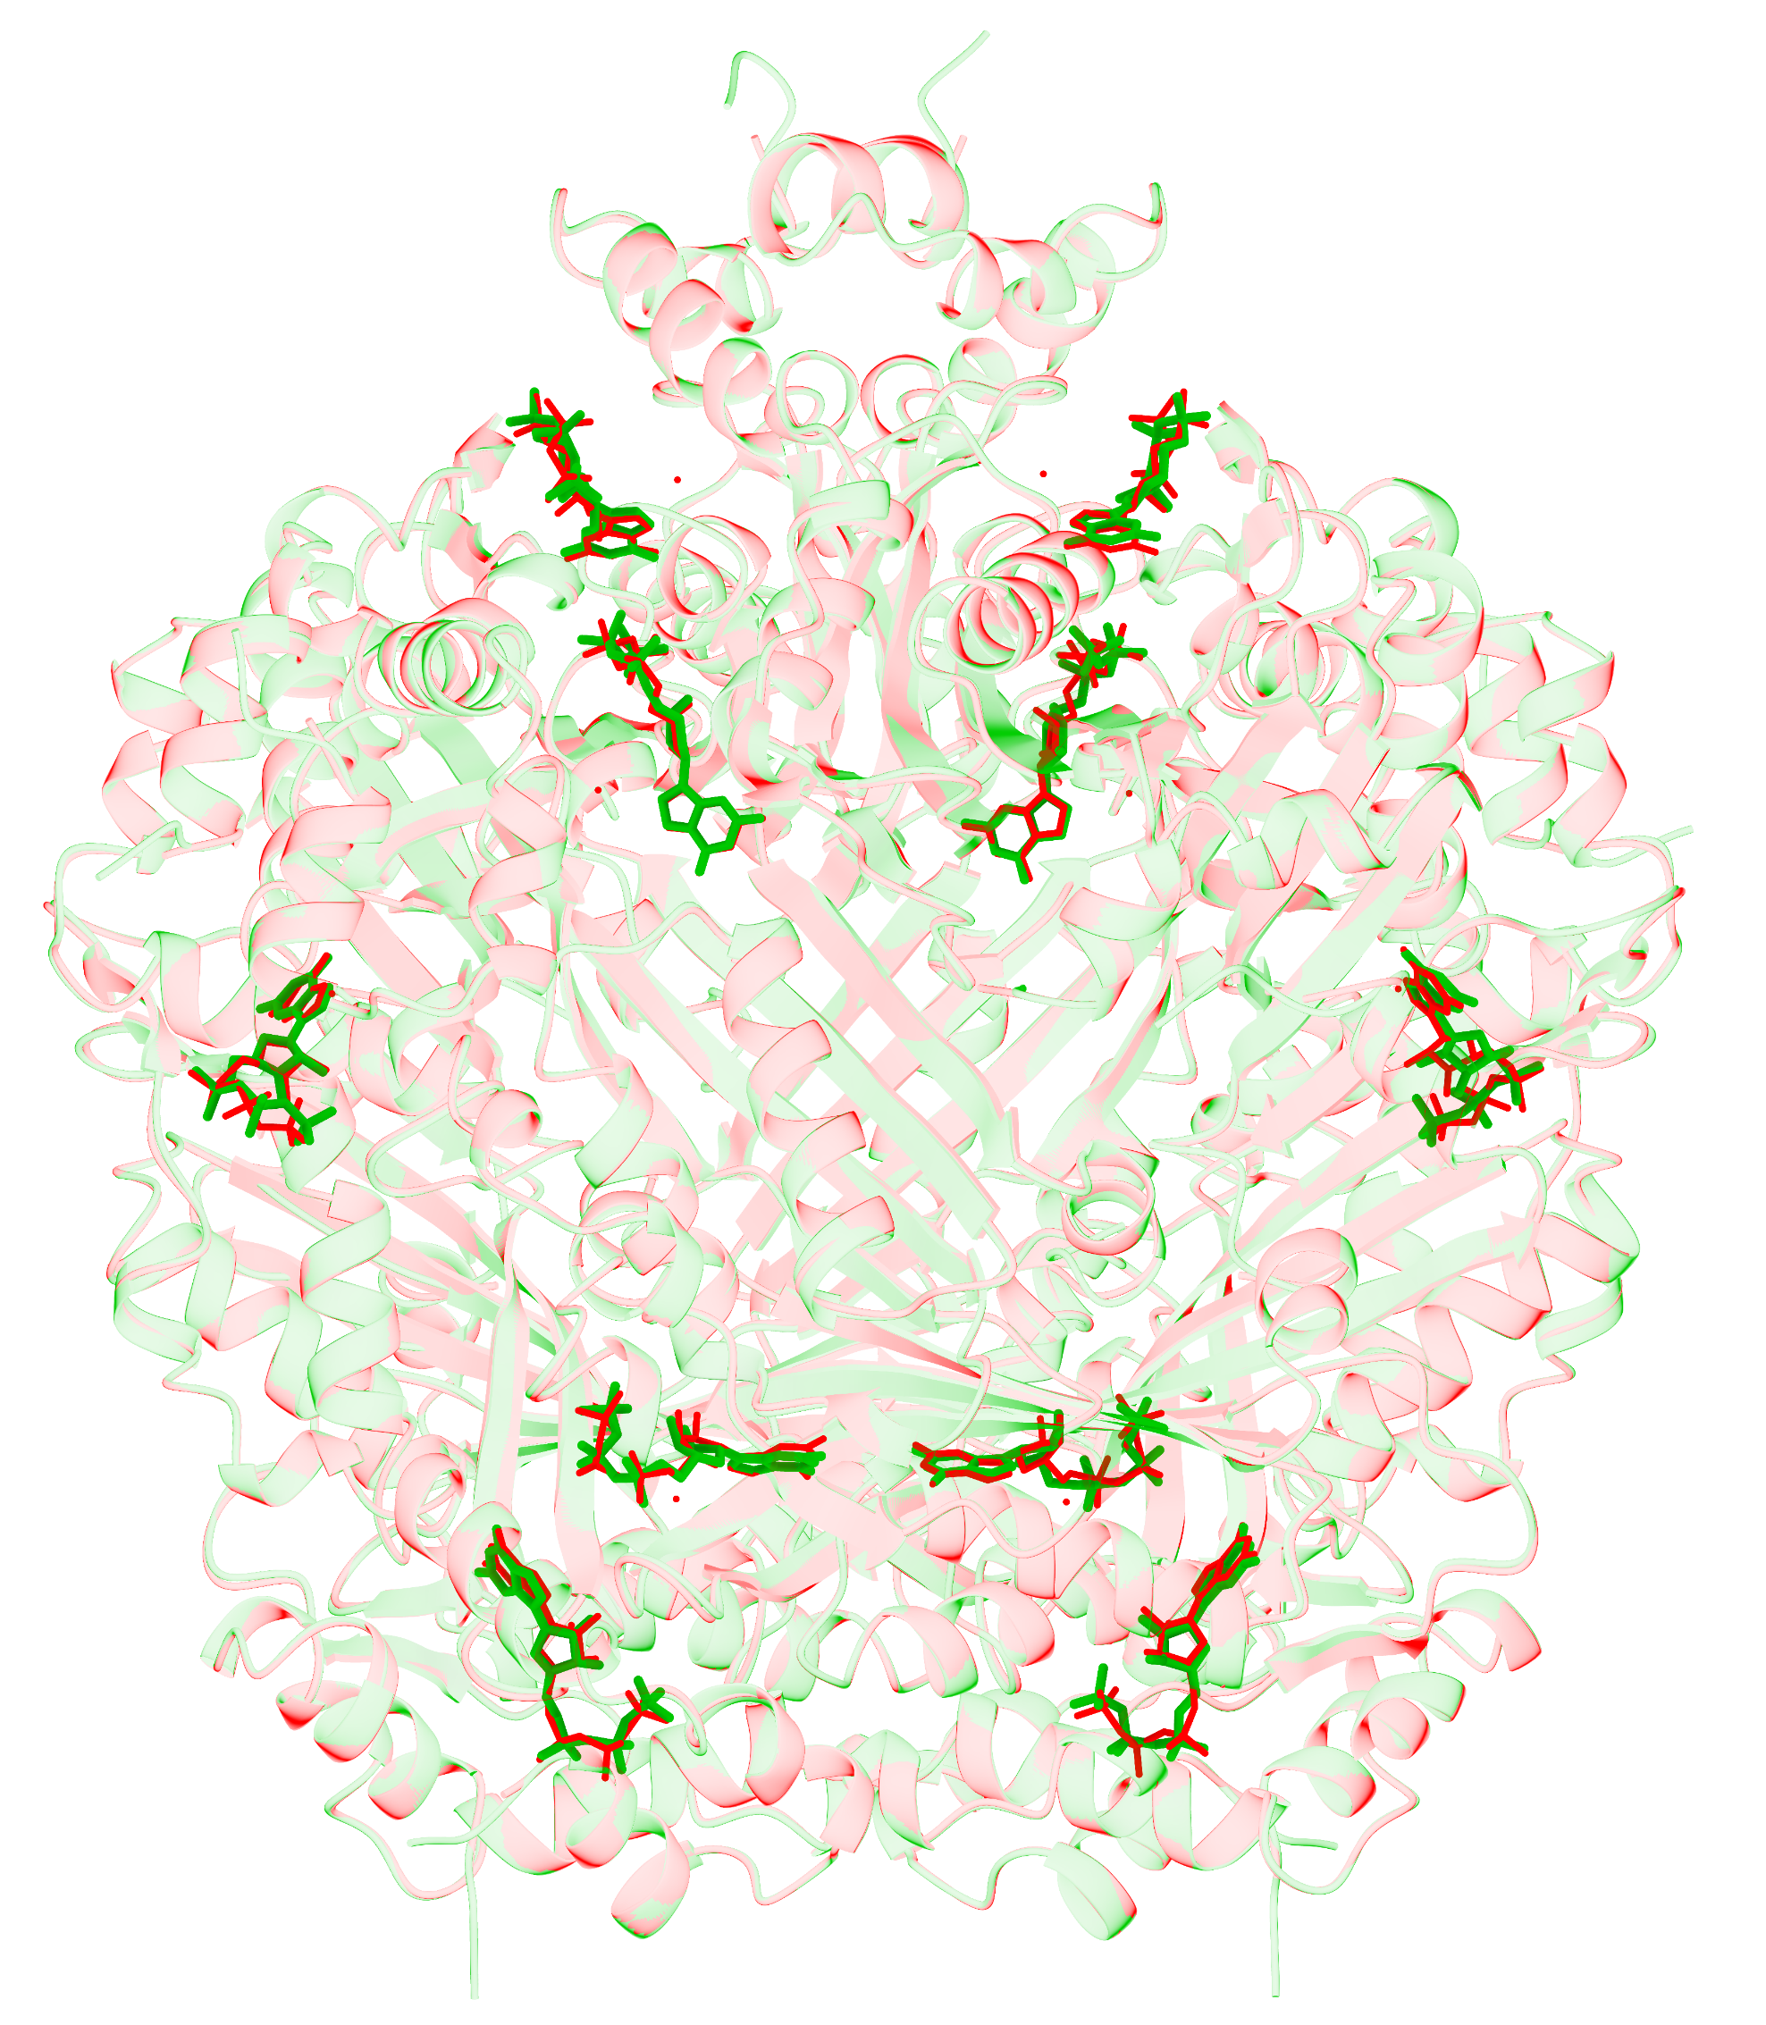
Notes:
9UJF中GTP实例的端到端重建。沉积受体和配体为红色，CryoAtom2重建受体为浅绿色，LigandSeek预测的GTP构象以绿色棒状显示。完整Find–Match–Build流程采用重建受体和DG-PocketXMol。原100%尝试预算对应10次计数尝试，每个建模请求展示一个模型排名首位构象。全部10个GTP实例均满足原重建成功判据，即身份正确且重原子均方根偏差低于2 Å。合格实例为单残基、相对于模板无缺失原子的有机配体。结构位于实验密度图坐标系中，不作刚体叠合。
ENGLISH:
End-to-end reconstruction of GTP instances in 9UJF. The deposited receptor and ligands are shown in red, the CryoAtom2-reconstructed receptor in light green, and LigandSeek-predicted GTP poses in green sticks. The full Find–Match–Build workflow used the reconstructed receptor and DG-PocketXMol. The original 100% attempt budget corresponds to ten counted attempts, with one model-ranked top-1 pose shown for each modelling request. All ten GTP instances meet the original recovery criterion of correct identity and heavy-atom root-mean-square deviation below 2 Å. The eligible instances are single-residue organic ligands with no missing template atoms. Structures are displayed in the experimental map coordinate system without rigid-body superposition.

