Slide 1
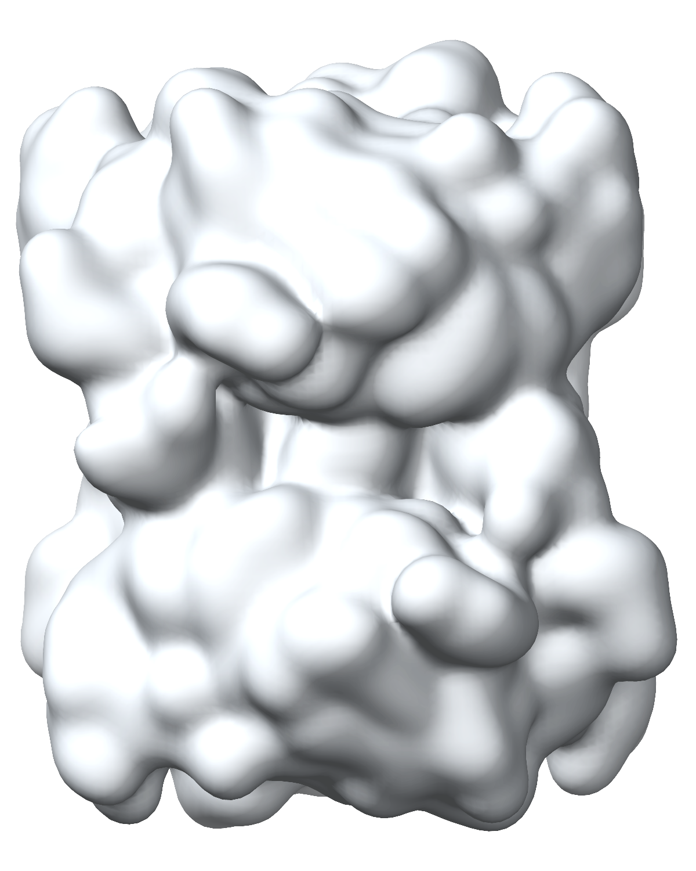
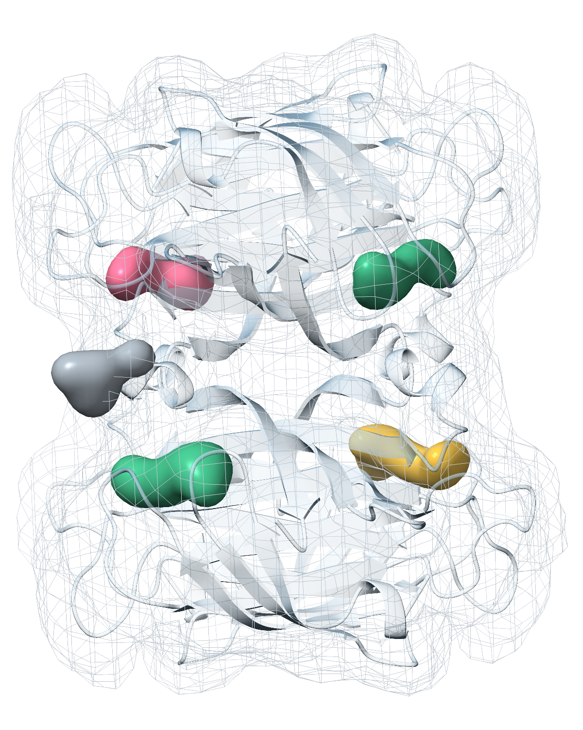
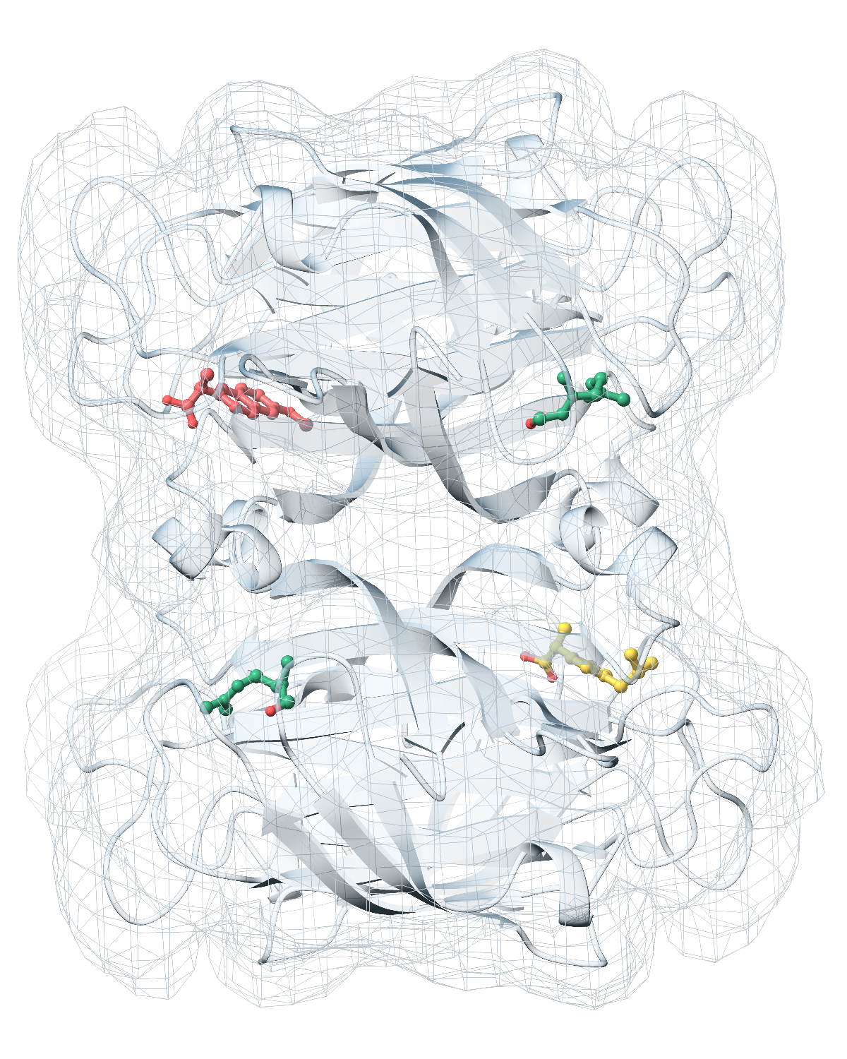
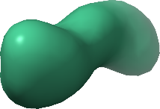
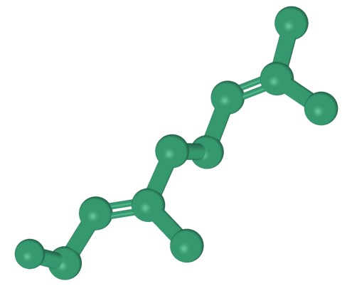
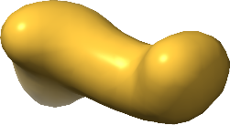
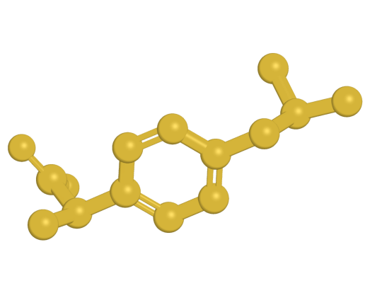
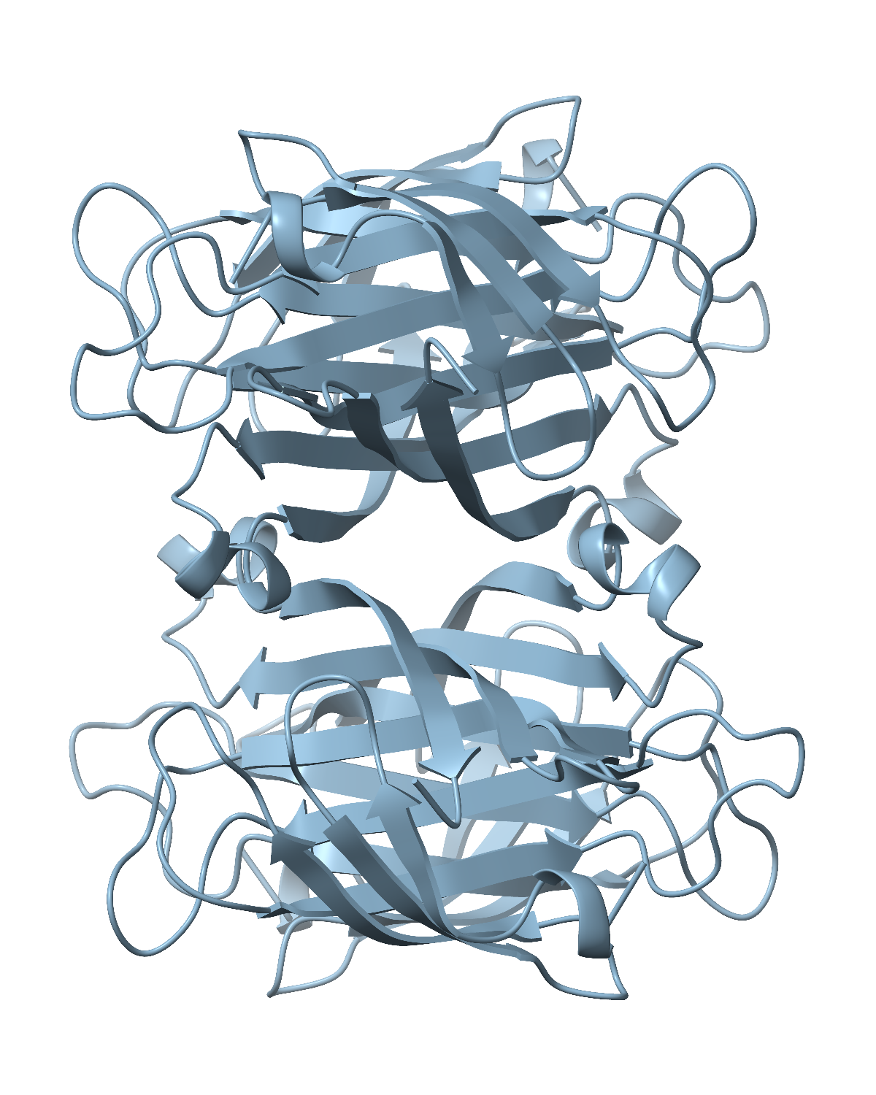
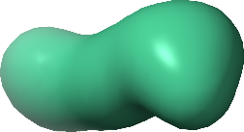
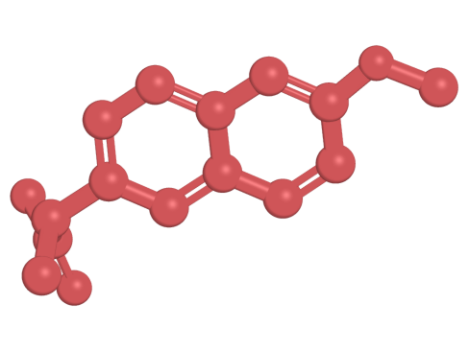
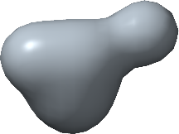
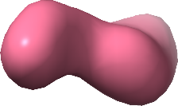
Input
Candidate blob
Ligand identity assignment
Ligand poses
Blobs
Ligand identities
B1
B2
Cryo-EM map
Find
B5
B1
Match
Build
CryoAtom2
B4
B3
B3
B2
B4
Receptor structure
CC(C)=CCC/C(C)=C...
B5
∅ Reject
CC(C)Cc1ccc([C@@...
False positive
Density
Receptor
COc1ccc2cc([C@H]...
RDKit
SMILES
Notes:
基于冷冻电镜数据重建配体构象的 Find–Match–Build 端到端自动化工作流程。输入包括实验冷冻电镜密度图和受体结构，后者可以是 PDB 沉积受体结构，也可以是由 CryoAtom2 自动建模的受体结构。Find 在整张密度图中定位候选配体区域（blobs B1–B5）。Match 过滤假阳性预测，并将有效候选区域指派给同一 PDB 条目中的配体身份（用 SMILES 表示）；B1 和 B3 示意两个不同位点被指派相同的配体身份，B4 示意被剔除的候选区域。Build 结合 Find 预测的区域和 Match 匹配的身份，使用选定的分子对接工具生成三维配体构象。
ENGLISH：
Automated end-to-end Find–Match–Build workflow for reconstructing ligand poses from cryo-EM data. The inputs are an experimental cryo-EM density map and either a deposited receptor structure or a receptor structure automatically modelled by CryoAtom2. Find locates candidate ligand regions (blobs B1–B5) across the density map. Match filters false-positive predictions and assigns valid candidate regions to ligand identities (represented by SMILES) within the same PDB entry; B1 and B3 illustrate two distinct sites assigned the same identity, whereas B4 represents a rejected candidate region. Build combines the predicted regions from Find with the matched identities from Match to generate three-dimensional ligand poses using the selected molecular docking tool.

