Slide 1
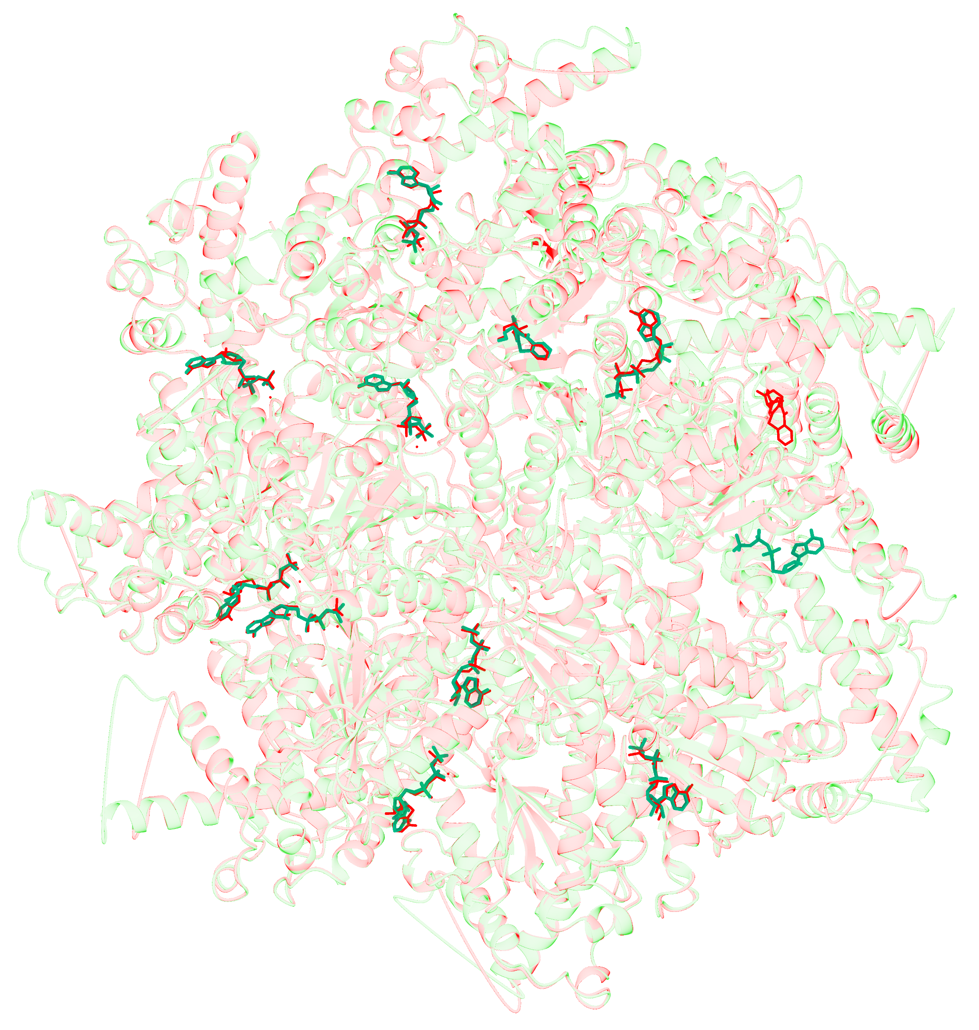
Notes:
9BJJ 结构中的小分子端到端建模。将基于 CryoAtom2 重建受体所获得的 LigandSeek 预测结果与真实结构进行了对比。图中，已存入数据库的受体和配体以红色显示，重建的受体以浅绿色显示，预测出的配体则以绿色棒状模型呈现。此处展示的是模型排序第一（Top-1）的构象。LigandSeek 在该复合物中准确识别并重建了 9 个 ATP 分子和 1 个 A1AP0 分子，所有分子的重原子均方根偏差（RMSD）均低于 2 Å。此外，在未见原始配体记录的位点处，模型还预测出了另一个 ATP 构象。
ENGLISH:
End-to-end small-molecule modelling in 9BJJ. LigandSeek predictions obtained using a CryoAtom2-reconstructed receptor are compared with the deposited structure. The deposited receptor and ligands are shown in red, the reconstructed receptor in light green, and predicted ligands as green sticks. Model-ranked top-1 poses are shown. LigandSeek correctly identified and reconstructed nine ATP molecules and one A1AP0 molecule across the complex, all with heavy-atom RMSDs below 2 Å. An additional ATP pose was predicted at a site without a deposited ligand.

