Slide 1
map.json
quads
oob_points
poly_id #每个poly唯一标志
road_id #
lane_id #
center #中心坐标
vertices #四个角点
direction_angle
s #从本身lane_id的start的距离
curvature#三点法计算，端部特殊处理
prev_w_lane_id # 之前的所有w_lane_id
next_w_lane_id # 之后所有的w_lane_id
x,y,z
w_lanes
w_lane_id #唯一标志
road_id #
lane_id #
center #中心坐标
width #路宽
geometry
road_id #
lane_id #
start_poly_id
end_poly_id
layer #可以区分路类型、区分立交
start #x,y,z
end #x,y,z
length #lane长度

Slide 2
simulator
roadnet
state
params(dynamics\style\reward\goal..)
Done_mask
spacial_hash
pathplanner
startquad
goal_quad
offroadchecker
Valid_mask(path)
Valid_mask(w_lanes)
Δs
traffic
Collisioncheck
Dynamics(with ~done_mask&active)
Worldinit
network
Feature_tensor
Observation(with others)
conditions
dynamics
State t+1
offroadchecker
Collisioncheck
observation
Reward t
Done_mask
reward
Pathplanner

Slide 3
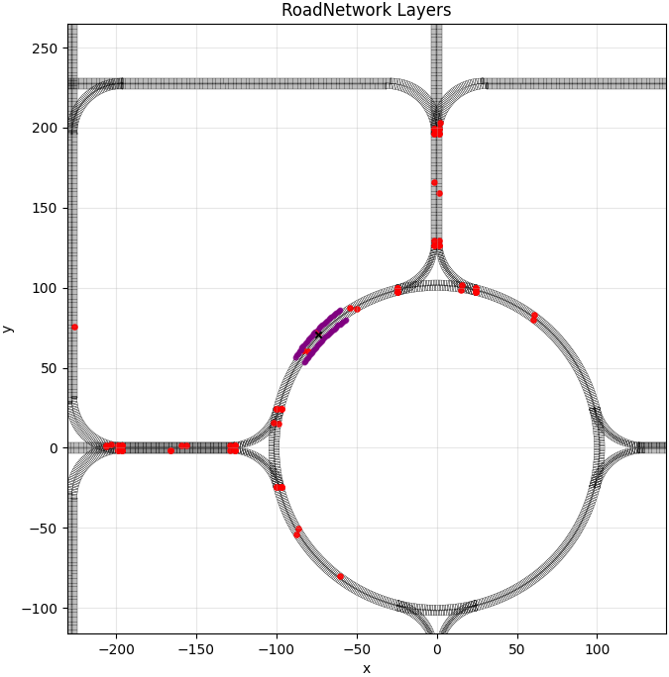
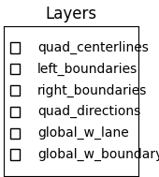
boundaries
w_lanes
variables
quad_vertices\centers\centerlines\direction\curve
Left\right boundaries
w_lane\w_boundary
Quad\lane\road\w_lane\w_boundary idx
polyid👉center

Slide 4
offroad

Slide 5
path

Slide 6
feature
Agent_states
x,y,yaw,speed,w,l,active
valid
0,0,cos(yaw),sin(yaw),speed(-2,20→-1,1),w(0.8,3) →0,1,l (0.8,7) →0,1 | 1
8dim
Other_agents
dx,dy,dvx,dvy,w,l,active
valid
dx(0,200→0,1),dy (0,200→0,1),speed(same), speed same),w,l,1
7x20dim
invalid
1,1,1,1,1,1,0
W_lane
dx,dy,Δs(剩余路径)
valid
dx(0,200→0,1),dy (0,200→0,1),Δs (0,>200→0,1),
3x80dim
对于没有在goal上的w_lane
invalid
1，1，1
全部填充INF（1）
W_boundary
dx,dy
valid
dx(0,200→0,1),dy (0,200→0,1)
2x80dim
invalid
1，1
Stop_line
dx,dy
valid
dx(0,200→0,1),dy (0,200→0,1)
2x10dim
invalid
1，1
Goals
dx,dy
valid
dx(0,200→0,1),dy (0,200→0,1)
128x2dim
invalid
1，1
Conditions
current_road_curvature
valid
-0.077,0.077 →(-1,1)
1dim
Dynamics_params
valid
Cthrottle 范围: [0.900, 1.125]
Csteer 范围: [0.900, 1.125]
Cacc 范围: [0.833, 1.25]
Cvel 范围: [0.833, 1.25]
→(0,1)
4dim
Reward_params
valid
10项目分别归一化
10dim
Wheel_base
[0.48,4.2] →(0,1)
1dim
840dim

Slide 7
Action

