Slide 1
Dynamic Pricing 2.0 – Linking Service Value to Hardware Value
Smarter, Fairer, and Self-Correcting Service Pricing Model

Slide 2
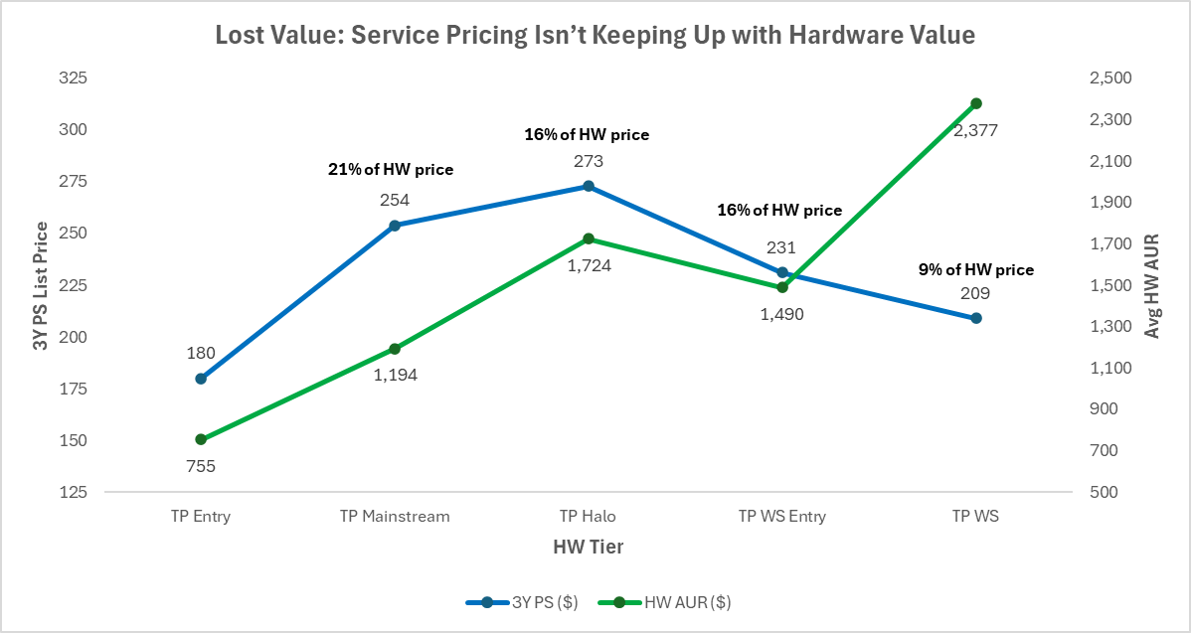
Static Pricing = Broken Value Logic
Our current service pricing does not scale with hardware value
We’re overcharging at the low end and undercharging where customers value protection most
Services are priced in fixed blocks per tier, regardless of HW value
The same 3Y PS costs ~$270 for a $1,700 laptop and $210 for a $2,400 workstation
This flattens the value curve -> price barely changes, but device value does
We’re leaving margin at the top, while discouraging attach at the bottom
24% of HW price
Hardware AUR +214% from Entry → WS
3Y PS price +50% only
Notes:
Static pricing by tier fails to scale with device value. From Entry to WS, hardware AUR nearly triples while service pricing flattens — eroding attach value at the top end

Slide 3
The Pricing Lag
We’re lagging behind the box
TP Halo | HW AUR | Services AUR | SRU | Pen Rate
FY2425 Q3 | $1429 | $120 | $68 | 4.8%
FY2425 Q4 | $1471 | $125 | $74 | 5.1%
FY2526 Q1 | $1726 | $137 (+16% list price increase) | $89 | 5.2%
FY2526 Q2 | $1724 | $134 | $78 | 4.5%
Entry buyers pay a higher protection-to-device ratio, making attach unattractive
Premium buyers, who value uptime, data protection, and experience get discounts by default
This inversion kills both attach rate and perceived fairness
A workstation customer expects to pay more, not less, for premium support! We’re training them not to
Notes:
Pricing bands are now directly indexed to hardware value
Each step adds ~20–25% in service price, mirroring device worth.
PSP maintains a 1.35–1.40× premium consistently across bands, widening slightly for higher-end hardware where support intensity and customer expectation rise

Slide 4
Current Pricing Gaps
Issue | Evidence | Impact
Flat service price by tier | Same price for $1200 and $2000 Carbon | Lost high-end monetization
List-based ceilings | List updates lag hardware shifts | Prices decouple from real AURs
Lifecycle blindness | Newer gens priced same as old | Under-value perception
Term rigidity | Fixed list ratios | Poor elasticity fit
Weak correlation | r ≈ 0.08 between HW AUR and Service AUR | Random pricing outcome

Slide 5
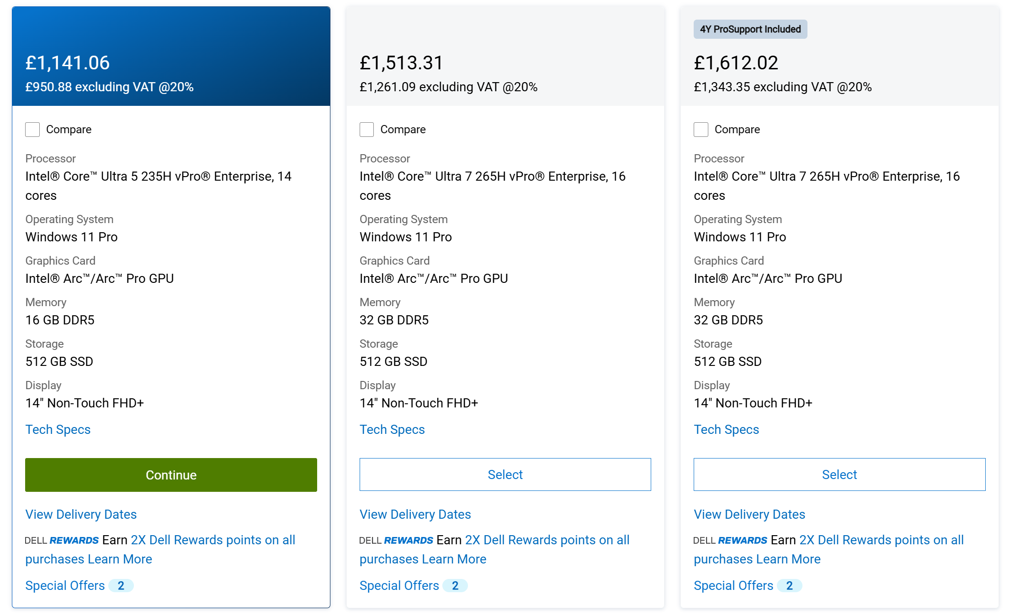
Dell Example
1 Machine – Dell Pro Max 14
3 configs
Config A - £1141.05 (3Y PS->3Y PSP £76.73)
Config B - £1513.31 (3Y PS->3Y PSP £101.77)
Config C - £1612.02 (3Y PS->3Y PSP £147.87)
% Change
Config A to Config B
  HW Price change -> +33%
  Service Price Change -> +33%
Config B to Config C
  HW Price change -> +7%
  Service Price Change -> +45%
Config A to Config C
  HW Price change -> +41%
  Service Price Change -> +92%
Average 3Y PS price in Dell is roughly 14%-15% of HW price
Notes:
Dell is scaling service prices far faster than hardware prices as configuration value increases. Across a single Dell Pro Max 14, moving from base to higher-spec models shows modest hardware jumps but disproportionate jumps in 3-year ProSupport pricing. Hardware rises 33 to 41 percent across tiers while service pricing spikes 33 to 92 percent. Dell is effectively indexing service price to device value, extracting more yield from higher AUR machines and protecting margin. This is the exact pricing discipline we’re missing today.

Slide 6
Summary
Problem
Service pricing today is tier-based, static, and blind to real hardware value
Hardware AURs fluctuate ±25% within the same tier, but service prices don’t move
The current linear correlation between HW AUR and Service AUR ≈ 0.08 → basically random.
Solution
Move to a Value Band Part Number per segment – move away from Tier and offering
Log-Term dynamic model - Price services as a direct function of hardware value and customer time preference
Fully automated, transparent
Expected Outcome
+12-15% service revenue
5+ pts attach through fairer pricing on entry SKUs
Zero risk: stays within existing commercial guardrails.

Slide 7
New Model Overview
Dynamic Pricing v2.0 Components
Value Bands (PNs) - group hardware by actual AUR
Single source input - Base 3Y PS per HW Value Band
Warranty Terms computed algorithmically
Auto-calibration — refresh quarterly using real AUR distribution.
Goal: Price tracks both device value and duration value, automatically.

Slide 8
Key Points
Customers don’t value each extra year the same
The first three years feel valuable. After that, the perceived benefit drops sharply. The curve just translates that human behaviour into a number.
Our support cost moves in the opposite direction
Devices get older, parts fail more, batteries die, ADP claims get heavier. PSP takes the biggest hit. So, while customers value later years less, they actually cost us more.
We bridge that gap with two simple cost modifiers
α adds the steady ageing cost after year three.
γ fixes the year-five spike so we don’t undercharge on long terms.
This creates pricing that feels fair to customers while protecting margin
We price the early years based on psychology and fix the later years based on real risk.
Final outcome
A controlled pricing model where Depot stays flat, Onsite and PS rise modestly, and PSP reflects real volatility. It’s intuitive for customers and stops margin bleed for us.

Slide 9
Hardware Value Banding - SMB
Band segmentation (fixed by hardware AUR)
Band | HW AUR Range | Baseline 3Y PS Price | 3Y PSP Price | PSP/ PS ratio | PS % of mid AUR
A | 0-700 | $110 (introduce floor) | $152 | 1.4 | 16%
B | 700-1000 | $136 | $173 | 1.4 | 16%
C | 1000-1300 | $180 | $255 | 1.4 | 16%
D | 1300-1600 | $230 | $324 | 1.4 | 16%
E | 1600-2000 | $280 | $386 | 1.4 | 16%
F | 2000-2500 | $360 | $469 | 1.4 | 16%
G | 2500-3000 | $440 | $552 | 1.4 | 16%
H | 3000+ | $480 | $621 | 1.4 | 16%
These 3-year prices are the anchor values per band (range of 14% to 18% of HW Price)
Notes:
Pricing bands are now directly indexed to hardware value
Each step adds ~20–25% in service price, mirroring device worth.
PSP maintains a 1.35–1.40× premium consistently across bands, widening slightly for higher-end hardware where support intensity and customer expectation rise

Slide 10
Hardware Value Banding - CONS
Band segmentation (fixed by hardware AUR)
Band | HW AUR Range | Baseline 3Y PC/ LUS Price | 3Y PCP Price | PCP/ PC ratio | PC % of mid AUR
A | 0-400 | $45 | $77 | 1.7 | 15%
B | 400-600 | $75 | $128 | 1.7 | 15%
C | 600-800 | $105 | $179 | 1.7 | 15%
D | 800-1000 | $135 | $230 | 1.7 | 15%
E | 1000-1200 | $165 | $281 | 1.7 | 15%
F | 1200-1400 | $195 | $332 | 1.7 | 15%
G | 1400-1700 | $233 | $395 | 1.7 | 15%
H | 1700-2000 | $278 | $472 | 1.7 | 15%
I | 2000-2500 | $338 | $574 | 1.7 | 15%
J | 2500+ | $375 | $638 | 1.7 | 15%
These 3-year prices are the anchor values per band (range of 14% to 18% of HW Price)
Notes:
Pricing bands are now directly indexed to hardware value
Each step adds ~20–25% in service price, mirroring device worth.
PSP maintains a 1.35–1.40× premium consistently across bands, widening slightly for higher-end hardware where support intensity and customer expectation rise

Slide 11
Behavioural Willingness to Pay
Customer behaviour insight
Extra coverage years yield diminishing perceived value
Represents the relative perceived protection value for each term (based on market research for electronic and PC goods)
Term Factor = 0.55 x ln(Term in Years) + 0.65
Introducing Cost Adjustments (α and γ)
Add realism for PSP and longer terms
FinalTermFactor = (0.55 × ln(Term) + 0.65) × (1 + α × max(0, Term − 3)) × (1 + γ × max(0, Term − 3))
α handles steady cost rise
γ corrects the year-5 tail risk
α represents rising support cost after year three — think labor and parts inflation
γ activates beyond year three, representing failure risk and parts scarcity
Notes:
α represents the steady slope of rising support cost after year three — think labor and parts inflation.
γ is a small kicker that activates beyond year four, representing end-of-life failure risk and parts scarcity.
Together, they make the PSP curve behave like our actual service cost profile — smooth early, steep at the tail.”
Factor:α (steady cost rise)
What it captures: The gradual, predictable increase in service cost after year 3 — labor inflation, small parts attrition, more frequent claims
Why it matters: Applies broadly to all higher-touch services (Onsite, PS, PSP)
Factor:γ (tail risk bump)
What it captures: The nonlinear jump in risk that happens beyond year 4 — aging hardware, sealed-battery replacements, EOL parts scarcity, higher logistics cost
Why : Mostly affects PSP (especially ADP and battery coverage)

Slide 12
Behavioural Willingness to Pay
Tier (SMB) | α | γ | Rationale
Depot | 0 | 0 | No age sensitivity
Onsite | 0.02 | 0
PS | 0.03-0.04 | 0.03-0.05 | Predictable support cost
PSP | 0.07-0.09 | 0.08-0.1 | ADP + sealed battery tail risk (can be adjusted for EMEA)
Tier (CONS) | α | γ | Rationale
Depot | 0 | 0 | No age sensitivity
Onsite | 0.02 | 0
PC | 0.03-0.04 | 0.03-0.05 | Predictable support cost
PCP | 0.08-1.1 | 0.09-0.12 | ADP + sealed battery tail risk (can be adjusted for EMEA)
Notes:
α represents the steady slope of rising support cost after year three — think labor and parts inflation.
γ is a small kicker that activates beyond year four, representing end-of-life failure risk and parts scarcity.
Together, they make the PSP curve behave like our actual service cost profile — smooth early, steep at the tail.”
Factor:α (steady cost rise)
What it captures: The gradual, predictable increase in service cost after year 3 — labor inflation, small parts attrition, more frequent claims
Why it matters: Applies broadly to all higher-touch services (Onsite, PS, PSP)
Factor:γ (tail risk bump)
What it captures: The nonlinear jump in risk that happens beyond year 4 — aging hardware, sealed-battery replacements, EOL parts scarcity, higher logistics cost
Why it matters: Mostly affects PSP (especially ADP and battery coverage)

Slide 13
Term Factors and Multipliers (SMB)
Years 4–5 see mild uplift for PSP to preserve margin
Term | Base (log) | Depot | Onsite | PS | PSP
1Y | 0.65 | 0.65 | 0.65 | 0.65 | 0.65
2Y | 1.03 | 1.03 | 1.03 | 1.03 | 1.03
3Y | 1.25 | 1.25 | 1.25 | 1.25 | 1.25
4Y | 1.41 | 1.41 | 1.44 | 1.53 | 1.69
5Y | 1.54 | 1.54 | 1.60 | 1.80 | 2.18
Normalized Multipliers
Term | Depot | Onsite | PS | PSP
1Y | 0.52 | 0.52 | 0.52 | 0.52
2Y | 0.82 | 0.82 | 0.82 | 0.82
3Y | 1.00 | 1.00 | 1.00 | 1.00
4Y | 1.13 | 1.15 | 1.22 | 1.35
5Y | 1.23 | 1.28 | 1.44 | 1.74
Notes:
For PSP (and to some extent PS with onsite labor), the cost to serve does rise non-linearly:
Failure rates grow with age (especially for batteries, displays, hinges, motherboards).
Part costs rise due to EOL inventory and logistics.
Labor time often increases for older SKUs.
So,
The base logarithmic function models customer price sensitivity.
For high-cost services like PSP that bundle ADP and sealed battery, we apply a small cost-adjustment multiplier beyond 3 years to protect margin against rising claim rates

Slide 14
Term Factors and Multipliers
Years 4–5 see mild uplift for PSP to preserve margin
Term | Base (log) | Depot | Onsite | PS | PSP
1Y | 0.65 | 0.65 | 0.65 | 0.65 | 0.65
2Y | 1.03 | 1.03 | 1.03 | 1.03 | 1.03
3Y | 1.25 | 1.25 | 1.25 | 1.25 | 1.25
4Y | 1.39 | 1.39 | 1.42 | 1.48 | 1.56
5Y | 1.50 | 1.50 | 1.56 | 1.69 | 1.88
Normalized Multipliers
Term | Depot | Onsite | PS | PSP
1Y | 0.52 | 0.52 | 0.52 | 0.52
2Y | 0.82 | 0.82 | 0.82 | 0.82
3Y | 1.00 | 1.00 | 1.00 | 1.00
4Y | 1.11 | 1.14 | 1.18 | 1.25
5Y | 1.20 | 1.27 | 1.35 | 1.5
Notes:
For PSP (and to some extent PS with onsite labor), the cost to serve does rise non-linearly:
Failure rates grow with age (especially for batteries, displays, hinges, motherboards).
Part costs rise due to EOL inventory and logistics.
Labor time often increases for older SKUs.
So,
The base logarithmic function models customer price sensitivity.
For high-cost services like PSP that bundle ADP and sealed battery, we apply a small cost-adjustment multiplier beyond 3 years to protect margin against rising claim rates

Slide 15
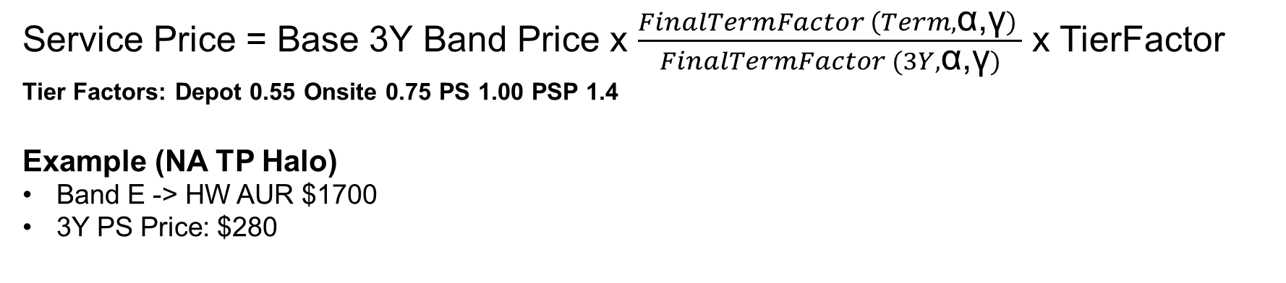
Example Calculations
Service Price = Base 3Y Band Price x $\frac{FinalTermFactor \left(Term,\text{α}\text{,}\text{γ}\right) }{FinalTermFactor (3Y,\text{α}\text{,}\text{γ})}$ x TierFactor
Tier Factors: Depot 0.55 Onsite 0.75 PS 1.00 PSP 1.4
Example (NA TP Halo)
Band E -> HW AUR $1700
3Y PS Price: $280
Term (Years) | Depot (0.55x) | Onsite (0.75x) | Premier Support | Premier Support Plus (+40%) | PS today as % of list | PSP today as % of list
1Y |  | $109 (6%) | $146 (9%) | $204 (12%) | 3% | 7%
2Y | $127 (5%) | $173 (10%) | $231 (14%) | $323 (19%) | 9% | 15%
3Y | $155 (7%) | $210 (12%) | $280 (16%) | $392 (23%) | 16% | 22%
4Y | $174 (9%) | $242 (14%) | $343 (20%) | $530 (31%) | 26% | 36%
5Y | $188 (11%) | $269 (16%) | $404 (24%) | $684 (40%) | 34% | 45%
Prices scale smoothly with both device value and term length - no dependence on list price cables

Slide 16
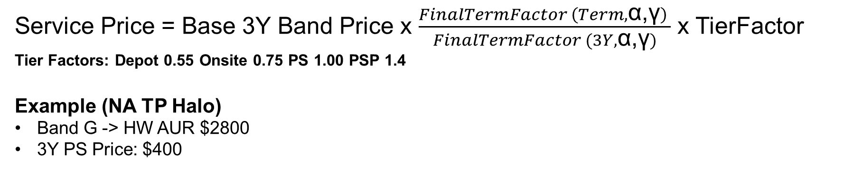
Example Calculations
Service Price = Base 3Y Band Price x $\frac{FinalTermFactor \left(Term,\text{α}\text{,}\text{γ}\right) }{FinalTermFactor (3Y,\text{α}\text{,}\text{γ})}$ x TierFactor
Tier Factors: Depot 0.55 Onsite 0.75 PS 1.00 PSP 1.4
Example (NA TP Halo)
Band G -> HW AUR $2800
3Y PS Price: $400
Term (Years) | Depot (0.55x) | Onsite (0.75x) | Premier Support | Premier Support Plus (1.4x) | PS today as % of list | PS today as % of list
1Y |  | $156 (6%) | $208 (7%) | $291 (10%) | 2% | 5%
2Y | $181 (6%) | $247 (9%) | $330 (12%) | $461 (16%) | 6% | 9%
3Y | $221 (8%) | $300 (11%) | $400 (14%) | $560 (20%) | 10% | 14%
4Y | $249 (9%) | $346 (12%) | $490 (17%) | $757 (27%) | 16% | 22%
5Y | $270 (10%) | $384 (14%) | $576 (21%) | $977 (35%) | 21% | 27%

Slide 17
Business Incremental
Financial impact of dynamic pricing across SMB and Consumer over the last four quarters, using current run-rate volumes as the base.
SMB (Last 4 quarters) | Bookings | Services Qty | HW Bookings | HW Qty | HW AUR | AUR | AR | $CA | PR | AUR as % of HW |  | New AUR | δAUR | AR | δAR | $CA | δ$CA | New Bookings | Incremental
SMB Entry Total | $1.8m | 76350 | $48.0m | 117794 | 408 | 24 | 64.8% | 15.29 | 3.8% | 6% |  | 27 | 16% | 57% | -7% | 15.74 | 3% | $1.9m | $0.1m
TP Entry Total | $21.1m | 574728 | $391.4m | 518532 | 755 | 37 | 110.8% | 40.73 | 5.4% | 5% |  | 58 | 58% | 77% | -34% | 44.37 | 9% | $23.0m | $1.9m
TP Halo Total | $21.4m | 281154 | $372.1m | 237367 | 1568 | 76 | 118.4% | 90.35 | 5.8% | 5% |  | 155 | 103% | 68% | -51% | 104.63 | 16% | $24.8m | $3.4m
TP Mainstream Total | $26.9m | 363691 | $389.5m | 344586 | 1130 | 74 | 105.5% | 77.96 | 6.9% | 7% |  | 130 | 76% | 66% | -40% | 85.80 | 10% | $29.5m | $2.6m
TP WorkStation Total | $5.0m | 40425 | $144.1m | 58738 | 2453 | 123 | 68.8% | 84.57 | 3.4% | 5% |  | 276 | 125% | 38% | -31% | 104.88 | 23% | $6.1m | $1.1m
TP WorkStation Entry Total | $11.6m | 123621 | $240.7m | 172758 | 1393 | 94 | 71.6% | 67.41 | 4.8% | 7% |  | 197 | 109% | 38% | -34% | 74.86 | 11% | $12.9m | $1.3m
Grand Total | $87.8m | 1459969 | $1585.8m | 1449775 | 1094 | 60 | 100.7% | 60.59 | 5.5% | 6% |  | 115 | 91% | 65% | -36% | 74.55 | 21% | $98.2m | $10.3m
CONS (Last 4 quarters) | Bookings | Services Qty | HW Bookings | HW Qty | HW AUR | AUR | AR | $CA | PR | AUR as % of HW |  | New AUR | δAUR | AR | δAR | $CA | δ$CA | New Bookings | Incremental
Idea AIO Total | $0.4m | 16146 | $34.5m | 49118 | 702 | 27 | 32.9% | 8.81 | 1.3% | 4% |  | 36 | 34% | 32.9% | 0.0% | 11.81 | 34% | $0.6m | $0.1m
Idea Desktop Total | $0.6m | 15335 | $63.8m | 59558 | 1071 | 42 | 25.7% | 10.84 | 1.0% | 4% |  | 56 | 34% | 25.8% | 0.1% | 14.48 | 34% | $0.9m | $0.2m
Idea NB Entry Total | $2.4m | 194754 | $187.5m | 418806 | 448 | 13 | 46.5% | 5.83 | 1.3% | 3% |  | 24 | 88% | 36.5% | -10.0% | 8.60 | 48% | $3.6m | $1.2m
Idea NB Halo Total | $7.1m | 129240 | $317.6m | 255974 | 1241 | 55 | 50.5% | 27.72 | 2.2% | 4% |  | 67 | 23% | 47.0% | -3.5% | 31.64 | 14% | $8.1m | $1.0m
Idea NB Mainstream Total | $3.7m | 105481 | $248.3m | 276438 | 898 | 35 | 38.2% | 13.23 | 1.5% | 4% |  | 45 | 30% | 35.2% | -3.0% | 15.92 | 20% | $4.4m | $0.7m
Grand Total | $14.3m | 460956 | $851.6m | 1059894 | 804 | 31 | 43.5% | 13.47 | 1.7% | 4% |  | 42 | 37% | 37.9% | -5.6% | 16.44 | 22% | $17.4m | $3.2m
Dynamic pricing delivers $10.3M (+12%) incremental in SMB and $3.2M (+22%) in Consumer
Upside is driven by AUR expansion, incremental revenue offsets AR decline materially
AR decline (primarily SMB) due to assumptions on
  Higher price effect: normal elasticity trade-off.
  1Y PN (Premier and OS) either ESS or reclass have low AUR value

Slide 18
Auto-Calibration Logic
Quarterly Process
Pull latest HW AUR distribution by sub-series
Re-bucket into Bands A to H
Update 3Y anchor values based on band medians
Apply log term curve to re-generate all SKUs
Governance (if needed)
Floor = 8* % of HW AUR (PS 1Y)
Cap = 22* % of HW AUR (PSP 5Y)
Finance review each qtr to validate margin
Add AI tuning (optional but very good to have)
Auto feed attach data back into the model
If attach rate in Band D drops > 2 pts QoQ, lower the band’s service coefficient by 5%
If Band A attach surges, nudge price upward
* The percentage values are indicative and can change

Slide 19
Potential Issues
Reclass and the mechanism around it (both for PSD and ESS)
Instances where price may be lower than channel (rare but possible)
Introduction of floor and ceilings to make sure price erosion doesn’t happen (no hit on GP)

Slide 21
Behavioural Willingness to Pay
What is Term Factor = 0.55 x ln(Term in Years) + 0.65
The Problem
How much more a customer is willing to pay as term increases
This increase is not linear
Why the log function
Perfectly matches the behavioural curve of “willingness to pay”
Adjust it to make commercial sense
The Constraints
Two anchor points, based on 1Y and 5Y
Based on customer behavior and actual historical sales data
Notes:
We fitted a simple logarithmic curve between two empirical anchor points: at 1 year, customers value protection at roughly 65% of the 3-year level; by 5 years, the perceived value rises to about 1.5×.
The constants 0.55 and 0.65 are simply the slope and intercept that make the function hit those anchors.
The rest of the curve flows naturally and matches observed attach and pricing behavior

Slide 22
PFV Analysis
Cost – out of the window
Channel vs Web

Slide 23
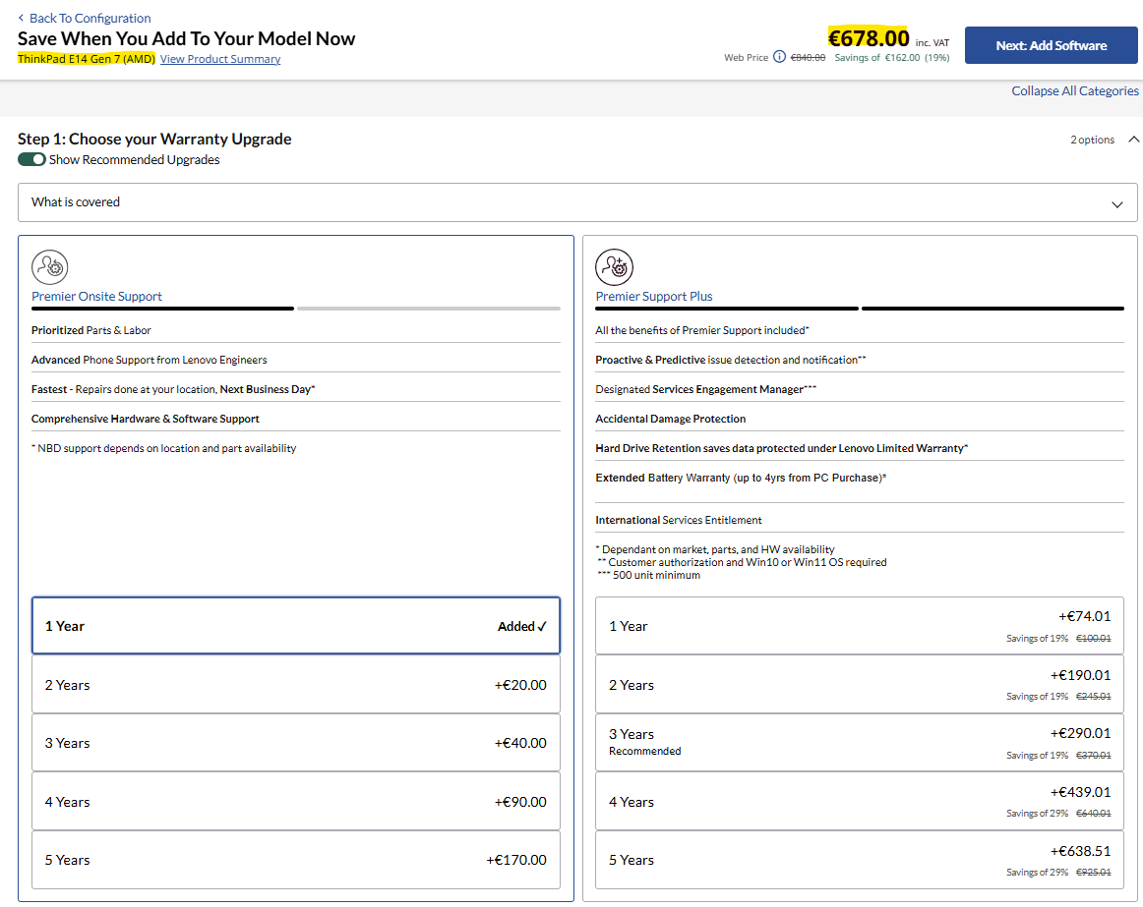
HLS - POS
POS: Customer Selects HW and proceeds to PB
Price table & PN lookup based on tier and price band
Return Dynamic Price (and 1 PN per offering)
to customer
REDPORT Pricing Engine
Band | Avg HW AUR | New 3Y PS
C | 1008 | $144
D | 1534 | $184
E | 1865 | $224
E | 1872 | $224
Term | Band E Depot (0.55x) | Band E Onsite (0.75x) | Band E Premier Support | Band E Premier Support Plus (+38%)
12M |  | $156 | $208 | $287
24M | $180 | $246 | $328 | $453
36M | $220 | $300 | $400 | $552
48M | $244 | $342 | $460 | $651
60M | $264 | $381 | $516 | $773

Slide 24
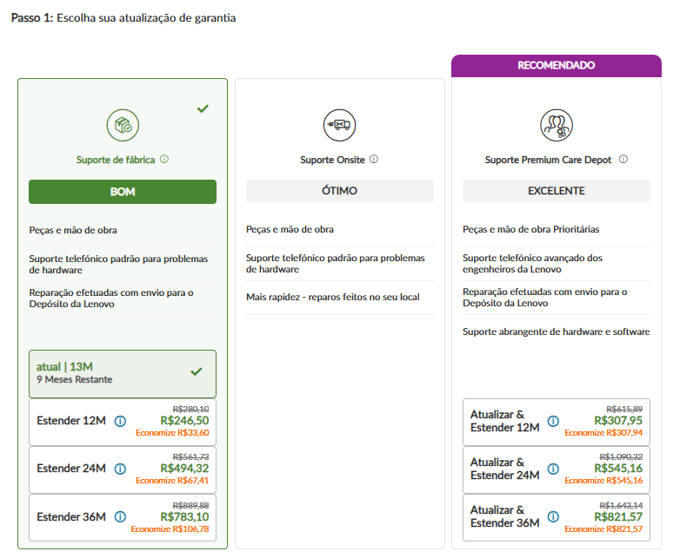
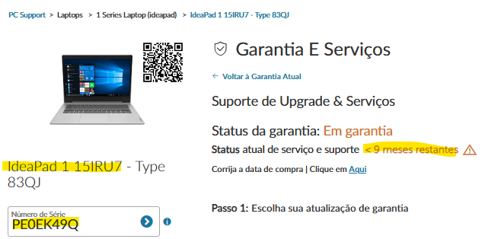
HLS - APOS
APOS: Customer Enters SN on eSupport
Price table & PN lookup based on tier and price band
Return Dynamic Price (and 1 PN per offering)
to customer
REDPORT Pricing Engine
Band | Avg HW AUR | New 3Y PS
C | 1008 | $144
D | 1534 | $184
E | 1865 | $224
E | 1872 | $224
Term | Band E Depot (0.55x) | Band E Onsite (0.75x) | Band E Premier Support | Band E Premier Support Plus (+38%)
12M |  | $156 | $208 | $287
24M | $180 | $246 | $328 | $453
36M | $220 | $300 | $400 | $552
48M | $244 | $342 | $460 | $651
60M | $264 | $381 | $516 | $773
Unique APOS Factors:
Moment in Time
Starting Point

