Slide 1
Sensor Fusion Systems
Overview and Mathematics
Bjoern Griesbach
griesbac@in.tum.de

Slide 2
Sensor Fusion Systems
[Content]
Introduction
  Motivation
  Different tracking options
Existing Multi Sensor Fusion Systems
  Fusion of head mounted and fixed sensor data
  Fusion of magnetic & optical sensor data
  Fusion of gyroscope & optical sensor data
  Open Tracker – an open source AR software
Mathematics of Sensor Fusion
  Kalman Filter
  Particle Filter

Slide 3
Motivation
Each sensor has its strengths and weaknesses
One sensor is never sufficient for reliable tracking
Optimal tracking = use multiple sensors
Precise Estimation
Data Fusion Component
Noisy
Data
Noisy
Data
Noisy
Data
Sensor
Sensor
Sensor

Slide 4
Motivation
Multi Sensor Fusion used in various fields of research:
Augmented Reality
Virtual Reality
Mobile Robots
Notes:
Air traffic control

Slide 5
Different Tracking Options
Technology
Location
Magnetic Tracking
  reliable
  stable
  fast
Optical Tracking
  precise
  time consuming
Gyroscope
  precise
  drift error
Fixed Trackers
  no limit in size, weight
  highly precise (e.g. stereo vision) in tracking objects
  bad for head orientation
Mobile Trackers (i.e. Head Mounted Tracker)
  good for head orientation
  limited in size & weight
  less precise in tracking objects

Slide 6
Content
Introduction
  Motivation
  Different tracking options
Existing Multi Sensor Fusion Systems
  Fusion of head mounted and fixed sensor data
  Fusion of magnetic & optical sensor data
  Fusion of gyroscope & optical sensor data
  Open Tracker – an open source AR software
Mathematics of Sensor Fusion
  Kalman Filter
  Particle Filter

Slide 7
Fusion of Data from Head Mounted and Fixed Sensors
Two optical trackers:
  Mobile (Head Mounted)
  Fixed
Wanted: Fusing data of fixed and mobile tracker: Hybrid inside-out & outside-in approach in order to
Estimate pose of a certain object (for example a head’s pose)
→ How to realize?
Notes:
= kalman simple!

Slide 8




Fusion of Data from Head-Mounted and Fixed Sensors
Pose of an object is represented as a vector
=(x,y,z,α,β,γ);
By transforming poses of two different sensors into the same coordinate system, one will get two (noisy) measurements and for the same object
Each measurement is weighted differently → depends on the variance of the measurement
Each measurement has its own variance σ_{i}² represented by a matrix P_{i}
Notes:
Random variable z, x

Slide 9
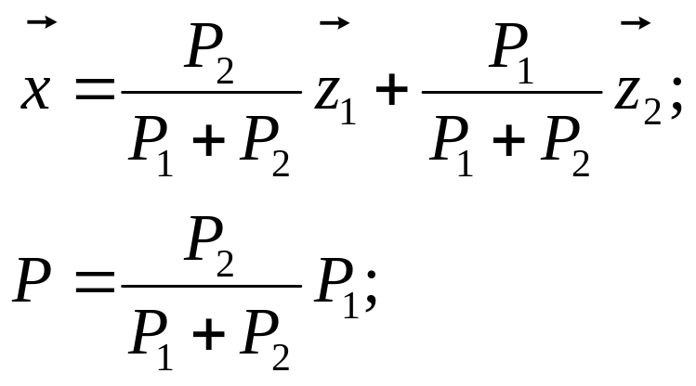
Fusion of Data from Head-Mounted and Fixed Sensors
Given: pose measurements: z₁ z₂ with covariance matrices P₁ P₂ from two different sensors
Wanted: optimal weights to get optimal estimate
Solution: Optimal estimate x with minimal combined covariance matrix P:
Already a simple form of the Kalman Filter - Remember!
Notes:
In the experiment the following equation was used:
Beispiel: z1 hat kleiner varianz als z2 -> genauer -> groesseres gewicht!

Slide 10
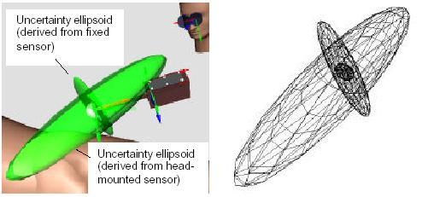
Fusion of Data from Head-Mounted and Fixed Sensors
Result: max. translational error was reduced by 90%
Experiment by W. Hoff,
First International Workshop on AR
San Francisco

Slide 11
Content
Introduction
  Motivation
  Different tracking options
Existing Multi Sensor Fusion Systems
  Fusion of head mounted and fixed sensor data
  Fusion of magnetic & optical sensor data
  Fusion of gyroscope & optical sensor data
  Open Tracker – an open source AR software
Mathematics of Sensor Fusion
  Kalman Filter
  Particle Filter

Slide 12
Fusion of Magnetic and Optical Trackers
E.g. Studierstube in Vienna:
  HMD with magnetic tracker & stereo camera system
  estimating pose by Landmark Tracking
  pose estimation from magnetic tracker is used to predict feature locations in the image
  optical tracking system can thus work with small search areas
Result: Features of the entire system
  more precise than an magnetic tracker
  faster and more reliable than an optical tracker
Notes:
Flipchart: Pose estimation from magnetic tracker is used to predict feature locations in the image

Slide 13
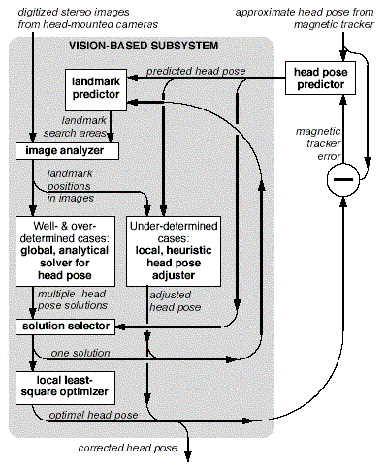
Fusion of Magnetic and Optical Trackers
Landmark Predictor:
  keeps track of potentially detectable landmarks and sorts them
  improves head pose after each newly found landmark
  tells IA where to search for landmarks
Image Analyzer:
  inspects search area defined by LP

Slide 14
Content
Introduction
  Motivation
  Different tracking options
Existing Multi Sensor Fusion Systems
  Fusion of head mounted and fixed sensor data
  Fusion of magnetic & optical sensor data
  Fusion of gyroscope & optical sensor data
  Open Tracker – an open source AR software
Mathematics of Sensor Fusion
  Kalman Filter
  Particle Filter

Slide 15
Fusion of Gyroscope and Optical Tracker data
Situation:
  Gyroscope (head mounted)
  Optical tracker (head mounted)
Problem to solve: Gyroscope serves highly precise head orientation data but with a drift error
Solution:
Vision based drift compensation algorithm

Slide 16
Content
Introduction
  Motivation
  Different tracking options
Existing Multi Sensor Fusion Systems
  Fusion of head mounted and fixed sensor data
  Fusion of magnetic & optical sensor data
  Fusion of gyroscope & optical sensor data
  Open Tracker – an open source AR software
Mathematics of Sensor Fusion
  Kalman Filter
  Particle Filter

Slide 17
Open Tracker: An open Software Framework for AR
Most implementations of AR Systems were not portable solutions.
Reason: data flow in AR Systems is each time implemented specifically for this solution
Need for a standard which handles data flow in AR Systems
→Open Tracker
Open source framework
Configurable via XML
Object oriented
Uses a directional graph to describe data flow
Eases setting up an AR environment
(e.g. distributed, several trackers, etc.)

Slide 18
Open Tracker: Example
Multicast Information to multiple users on a network
Console
Fusion
Filter
Sink node
Transformation
Filter
Noise
Filter
Filter
node
Source node
Optical Tracker
[Mobile]
Optical Tracker
[Fixed]
Magnetic Tracker
[Mobile]

Slide 19
Content
Introduction
  Motivation
  Different tracking options
Existing Multi Sensor Fusion Systems
  Fusion of head mounted and fixed sensor data
  Fusion of magnetic & optical sensor data
  Fusion of gyroscope & optical sensor data
  Open Tracker – an open source AR software
Mathematics of Sensor Fusion
  Kalman Filter
  Particle Filter
Notes:
Not only kalman and particle filter but also other tools, kalman and particle filter not primarily for sensor fusion but extensions

Slide 20
Kalman Filter
  Step by step introduction:
  Static KF
  Basic KF
  Extended KF
  Sensor Fusion with the KF
Notes:
First steps do not hav somethng in common with sensor fusion, but necessary to understand the kalman filter

Slide 21
Kalman Filter
Optimal data processing algorithm
Major use: filter out noise of measurement data (but can also be applied to other fields, e.g. Sensor Fusion)
Result: Computes an optimal estimation of the state of an observed system based on measurements
Recursive
Optimal: incorporates all information (i.e. measurement data) that can be provided to it
Does not need to keep all previous measurement data in storage!

Slide 22

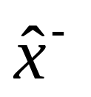
Kalman Filter
Conventions:
→ We observe a system with:
  x : state of the system
  z : measurement (approximates x)
  σ² : variance of a measurement
  : vector
  P : covariance matrix
  : best estimate of state
  : best estimate before measurement was taken

Slide 23
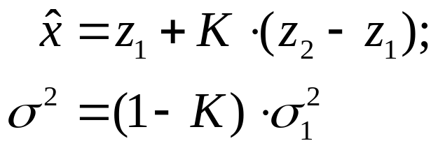
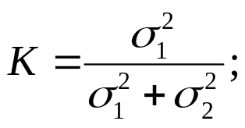
Introduction Kalman Filter
Assumptions:
Two scalar sensor measurements z₁ and z₂
Gaussian noise, i.e. z_{i} ~ N(0, σ_{i}² )
→ Optimal state estimate:
Kalman Gain
Notes:
Example: 1D location of an object (e.g. tree at the horizon with binoculars, distance to a house)
Derivation on flipchart
x=wz₁+(1-w)z₂ & σ² =w²σ₁² +(1-w)² σ₂² because of Gaussian noise i.e. z_{i}~N(0, σ_{i}² )
find optimal w: derivation of σ² (w) → minimum
Transform equations of 1.) into x=z₂+w(z₁-z₂) and σ² =(1-w)σ₂²
Compare result to fusion of fixed and mobile sensors
flip 1 and 2, K=w
Voila static kalman

Slide 24
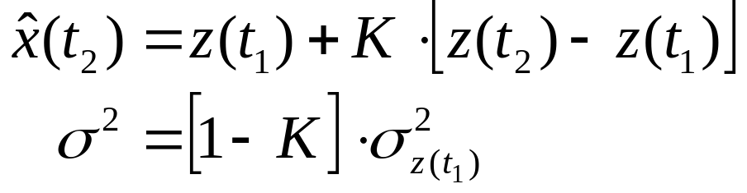
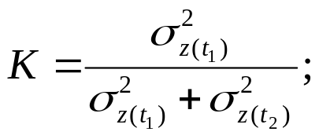
Introduction Kalman Filter
Let’s incorporate time!
Measurements z₁ and z₂ were taken sequentially → z(t₁), z(t₂)
→ Optimal state estimate at time t₂ :
Kalman Gain
Notes:
What happens if we take another measurement z(t3)?

Slide 25
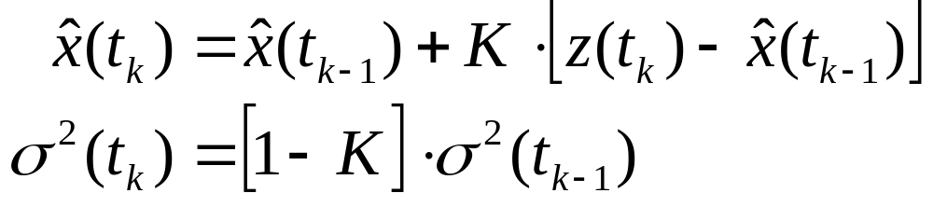
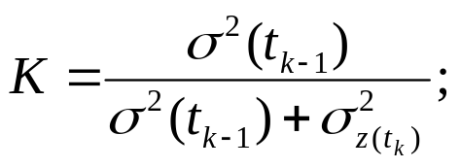
Introduction Kalman Filter
Let’s take more measurements (time continues)
Incorporate previous knowledge (last estimate)
→ Optimal state estimate at time t_{k} :
Kalman Gain
Notes:
New view of the equation: old estimate + difference (old estimate, new measurement) times Kalman gain

Slide 26
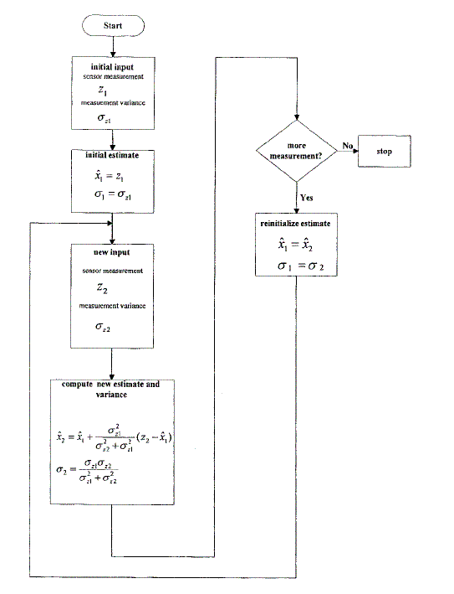
Introduction Kalman Filter
Static Kalman Filter:

Slide 27
Introduction Kalman Filter
Previous slides: static state
Now: Dynamic state x (stochastic process)
Idea: Use knowledge about process x in addition to measurements to obtain best estimate:
Notes:
Example: car instead of tree

Slide 28
Introduction Kalman Filter
Previous slides: static state
Now: Dynamic state x (stochastic process)
Idea: Use knowledge about process x in addition to measurements to obtain best estimate:
Process Model: (example)
x(t_{k})=x(t_{k-1})+u+w Noise: w ~ N(0, σ_{w}² )
Measurement Model:
z(t_{k})=x(t_{k})+v Noise: v ~ N(0, σ_{z}² )
Notes:
No hat on x! why?
U is 100m each time step for example!
State transition equation!

Slide 29
Introduction Kalman Filter
Process & Measurement Model
z(t_{k-1})
z(t_{k})
z(t_{k+1})
Measurements
(observed)
Measurement Model
(measurement equation)
States of the system
(cannot be observed)
x(t_{k-1})
x(t_{k})
x(t_{k+1)}
Process Model
(state transition equation)

Slide 30
Introduction Kalman Filter
Process & Measurement Model
z(t_{k-1})
z(t_{k})
z(t_{k+1})
Measurements
(observed)
Measurement Model
(measurement equation)
States of the system
(cannot be observed)
x(t_{k-1})
x(t_{k})
x(t_{k+1)}
Process Model
(state transition equation)
Kalman Filter evolves→ two step algorithm:
Predict: via process model
Correct: via measurement model

Slide 31
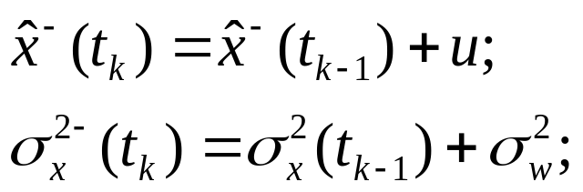
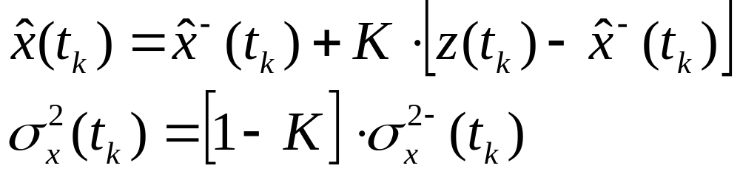
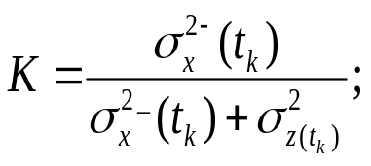
Introduction Kalman Filter
Kalman Filter Algorithm (simplified):
t_{k} := t_{k+1}
Start with init values
Kalman Gain
1. Predict: (superminus!)
with Process Model
Measurement not yet taken!
2. Correct:
with measurement

Slide 32
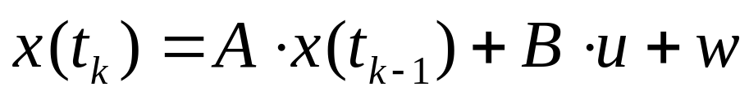
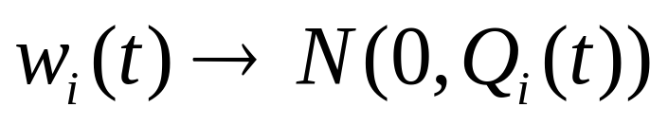
Kalman Filter: Possible Extensions
Extending to Vector World:
Previous scalar state x becomes vector which contains all relevant information of a state in a certain system. For example:
  State vector: =(x,y,z,α,β,γ)
  Process Model:
  Covariance Matrix:
Matrices are time dependent e.g. A(t), B(t)
Using a non linear process model
→ Extended Kalman Filter (EKF)
Notes:
State transition matrix A
Input transformation matrix B (→ u can be of different dimension than x)
Omitting variables also can!

Slide 33




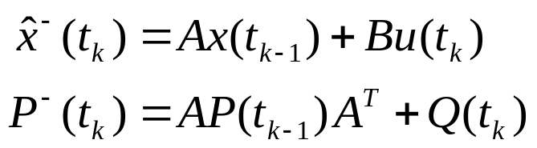
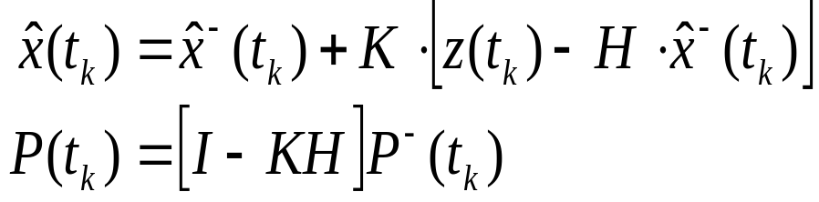
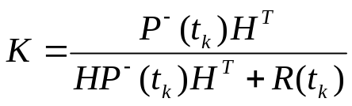
Basic Kalman Filter
Process Model:
Measurement Model:
Algorithm: (vector arrows omitted!)
1. Predict
2. Correct
Kalman Gain

Slide 34



Basic Kalman Filter [abstract]
Process Model:
Measurement Model:
Algorithm:
Predict
via process model
Correct
via measurement model
→ Idea of the Kalman Filter
Notes:
Every small letter implicitly is a vector!

Slide 35
How to use a Kalman Filter
Find a state representation
Find a process model
Find a measurement model
→ Many ways to apply a Kalman Filter, i.e. depends on the chosen models!
How to apply KF for Sensor Fusion?

Slide 36

Kalman Filter: Sensor Fusion
Examples:
Static KF: As seen before (not a real KF!)
Basic KF:
  Measurement vector incorporates data of
  all sensors.
  Covariance Matrix R weights data of different sensors according to their strength
“Advanced” KF of G. Welch / G. Bishop:
  Asynchronous algorithm
  Uses multiple measurement models

Slide 37

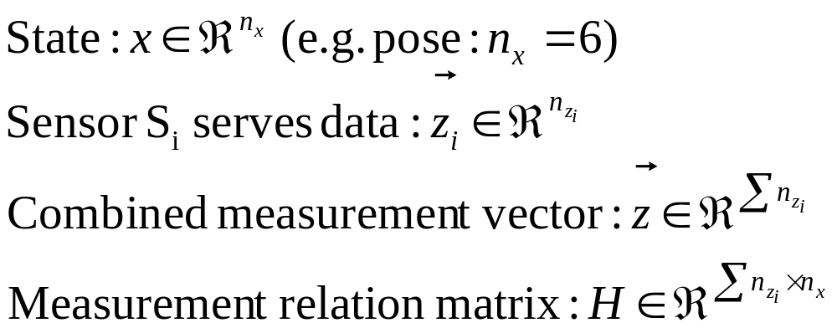

Kalman Filter: Sensor Fusion
[with Basic Kalman Filter]
Process Model:
Measurement Model:
Measurement Vector incorporates all measurements:
Covariance matrix R reflects variances of different sensors!
→ Then use “normal” Basic KF algorithm
Notes:
Each time step, data of all the sensors has to be available.
What if this is not the case?

Slide 38
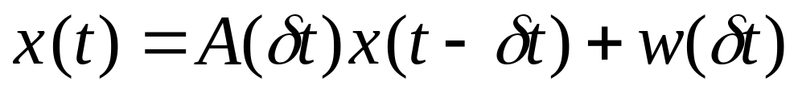
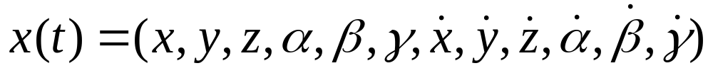
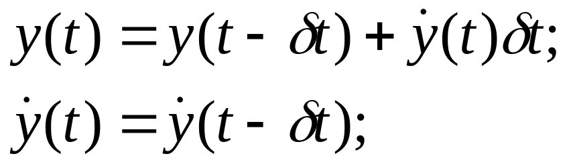
Kalman Filter: Sensor Fusion
[Advanced approach Welch/Bishop]
Process model:
State Representation:
State transition via A:
→ A relates for example:
System noise: w with covariance matrix Q
Notes:
No discrete time steps

Slide 39
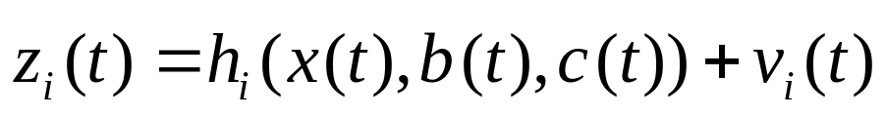
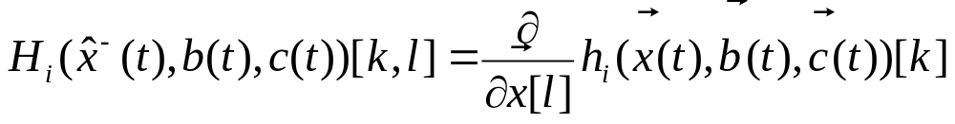

Kalman Filter: Sensor Fusion
[Advanced approach Welch/Bishop]
Individual measurement model for Sensor i:
Measurement Function: h_{i}(●) with corresponding Jacobian H_{i}:
Measurement noise: v with covariance matrix R
Notes:
Wie funktioniert h(), was sind b() und c() und was sind die corresponding jacobians?

Slide 40
Kalman Filter: Sensor Fusion
[Advanced approach Welch/Bishop]
Asynchronous algorithm
Each time a new measurement z becomes available, a new estimate x will be computed
Sensor 2
Sensor 3
Kalman Fusion
Filter
Sensor 1

Slide 41
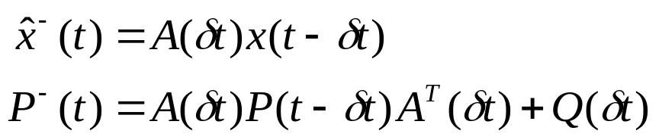
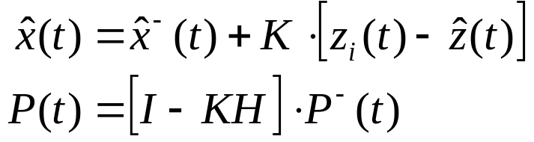
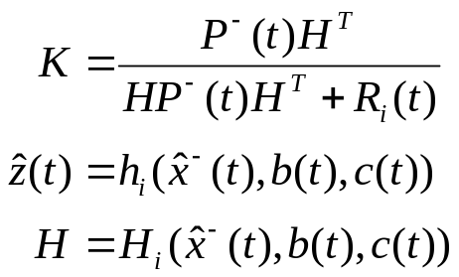
Kalman Filter: Sensor Fusion
[Advanced approach Welch/Bishop]
Algorithm:
1. Predict
2. Correct
Kalman Gain
Predicted measurement i
Corresponding Jacobian

Slide 42
Content
Introduction
  Motivation
  Different tracking options
Existing Multi Sensor Fusion Systems
  Fusion of head mounted and fixed sensor data
  Fusion of magnetic & optical sensor data
  Fusion of gyroscope & optical sensor data
  Open Tracker – an open source AR software
Mathematics of Sensor Fusion
  Kalman Filter
  Particle Filter

Slide 43
Particle Filters
To handle non linear processes
To handle non Gaussian Noise
Process and measurement models but different algorithm → slower
Refer to: ”Particle Filters: an overview”, M. Muehlich
Extensions:
  e.g. Decentralized Sensor Fusion with Distributed Particle Filters
Notes:
Based on Bayes Filter (like Kalman)

Slide 44
Conclusion
Multi Sensor Fusion
Sensor Fusion is of increasing interest due to higher tracking demands in AR
Sensor Fusion can be complex and therefore has greater computational requirements
Future work: standardizing AR fusion systems
Notes:
Open Tracker

Slide 45
Questions
?

