Slide 1






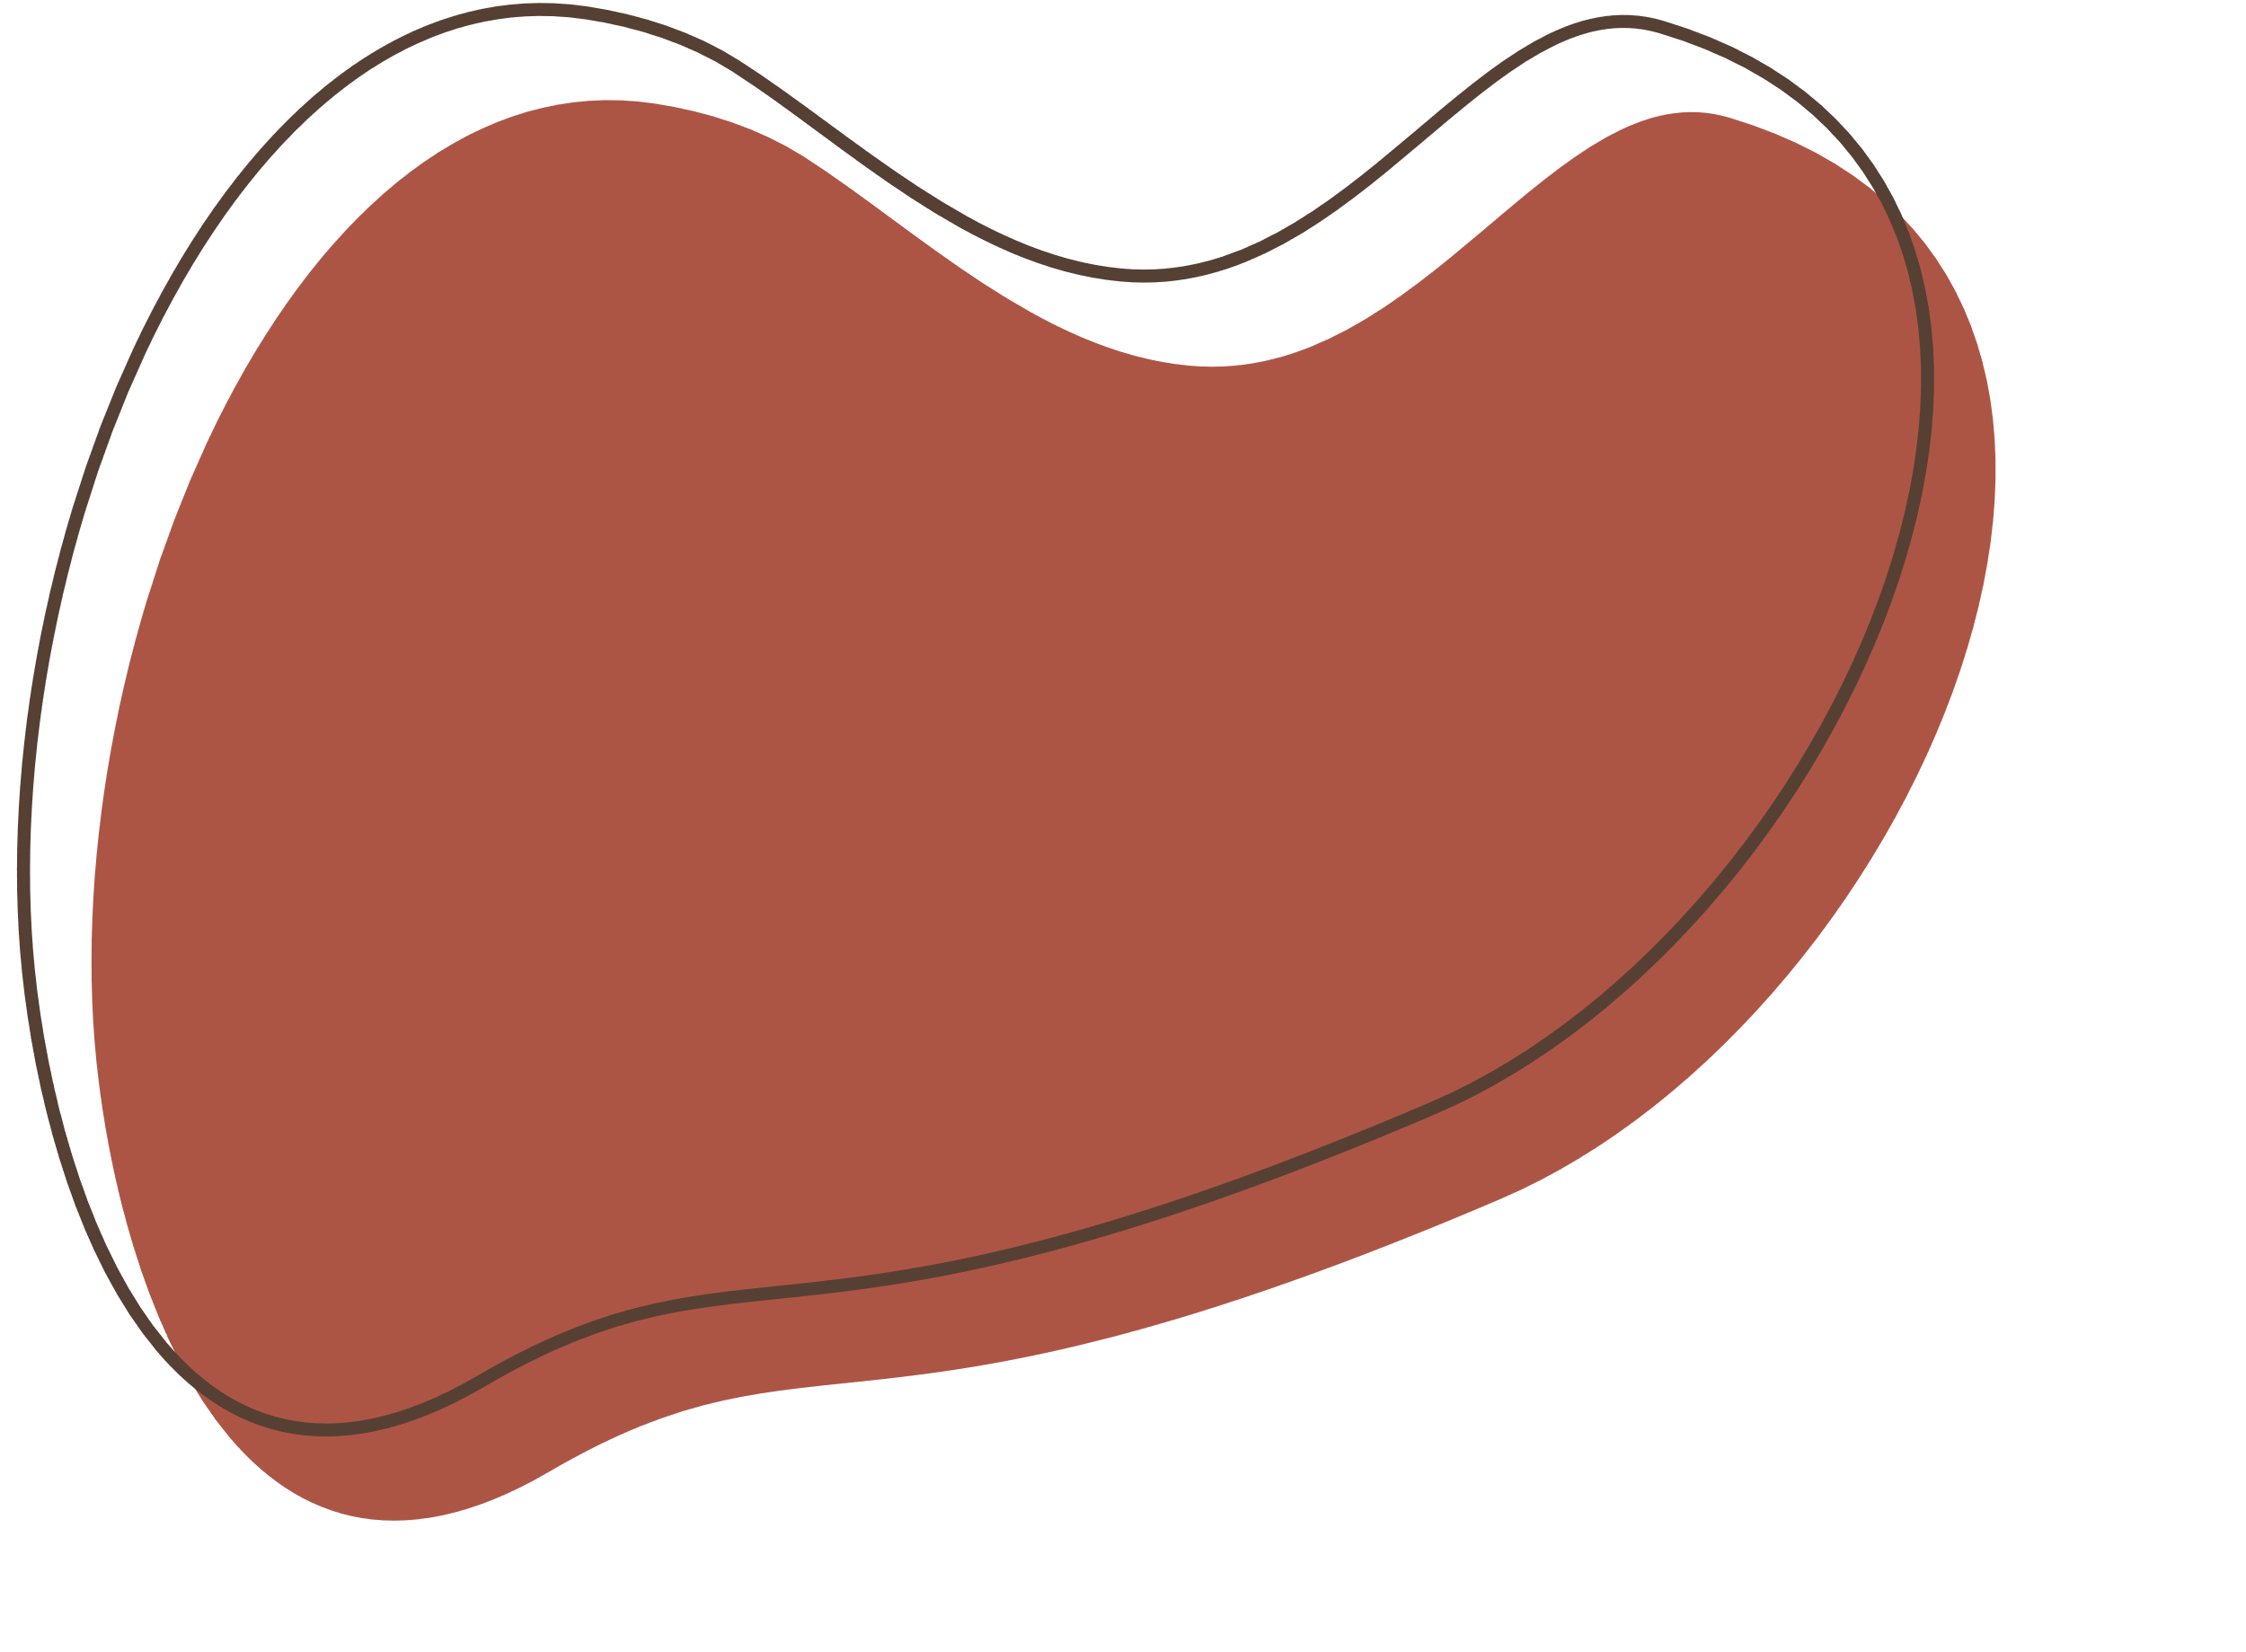
Nonlinear Model Predictive Control for Growth Robots
Presented by Lowell Lobo

Slide 2
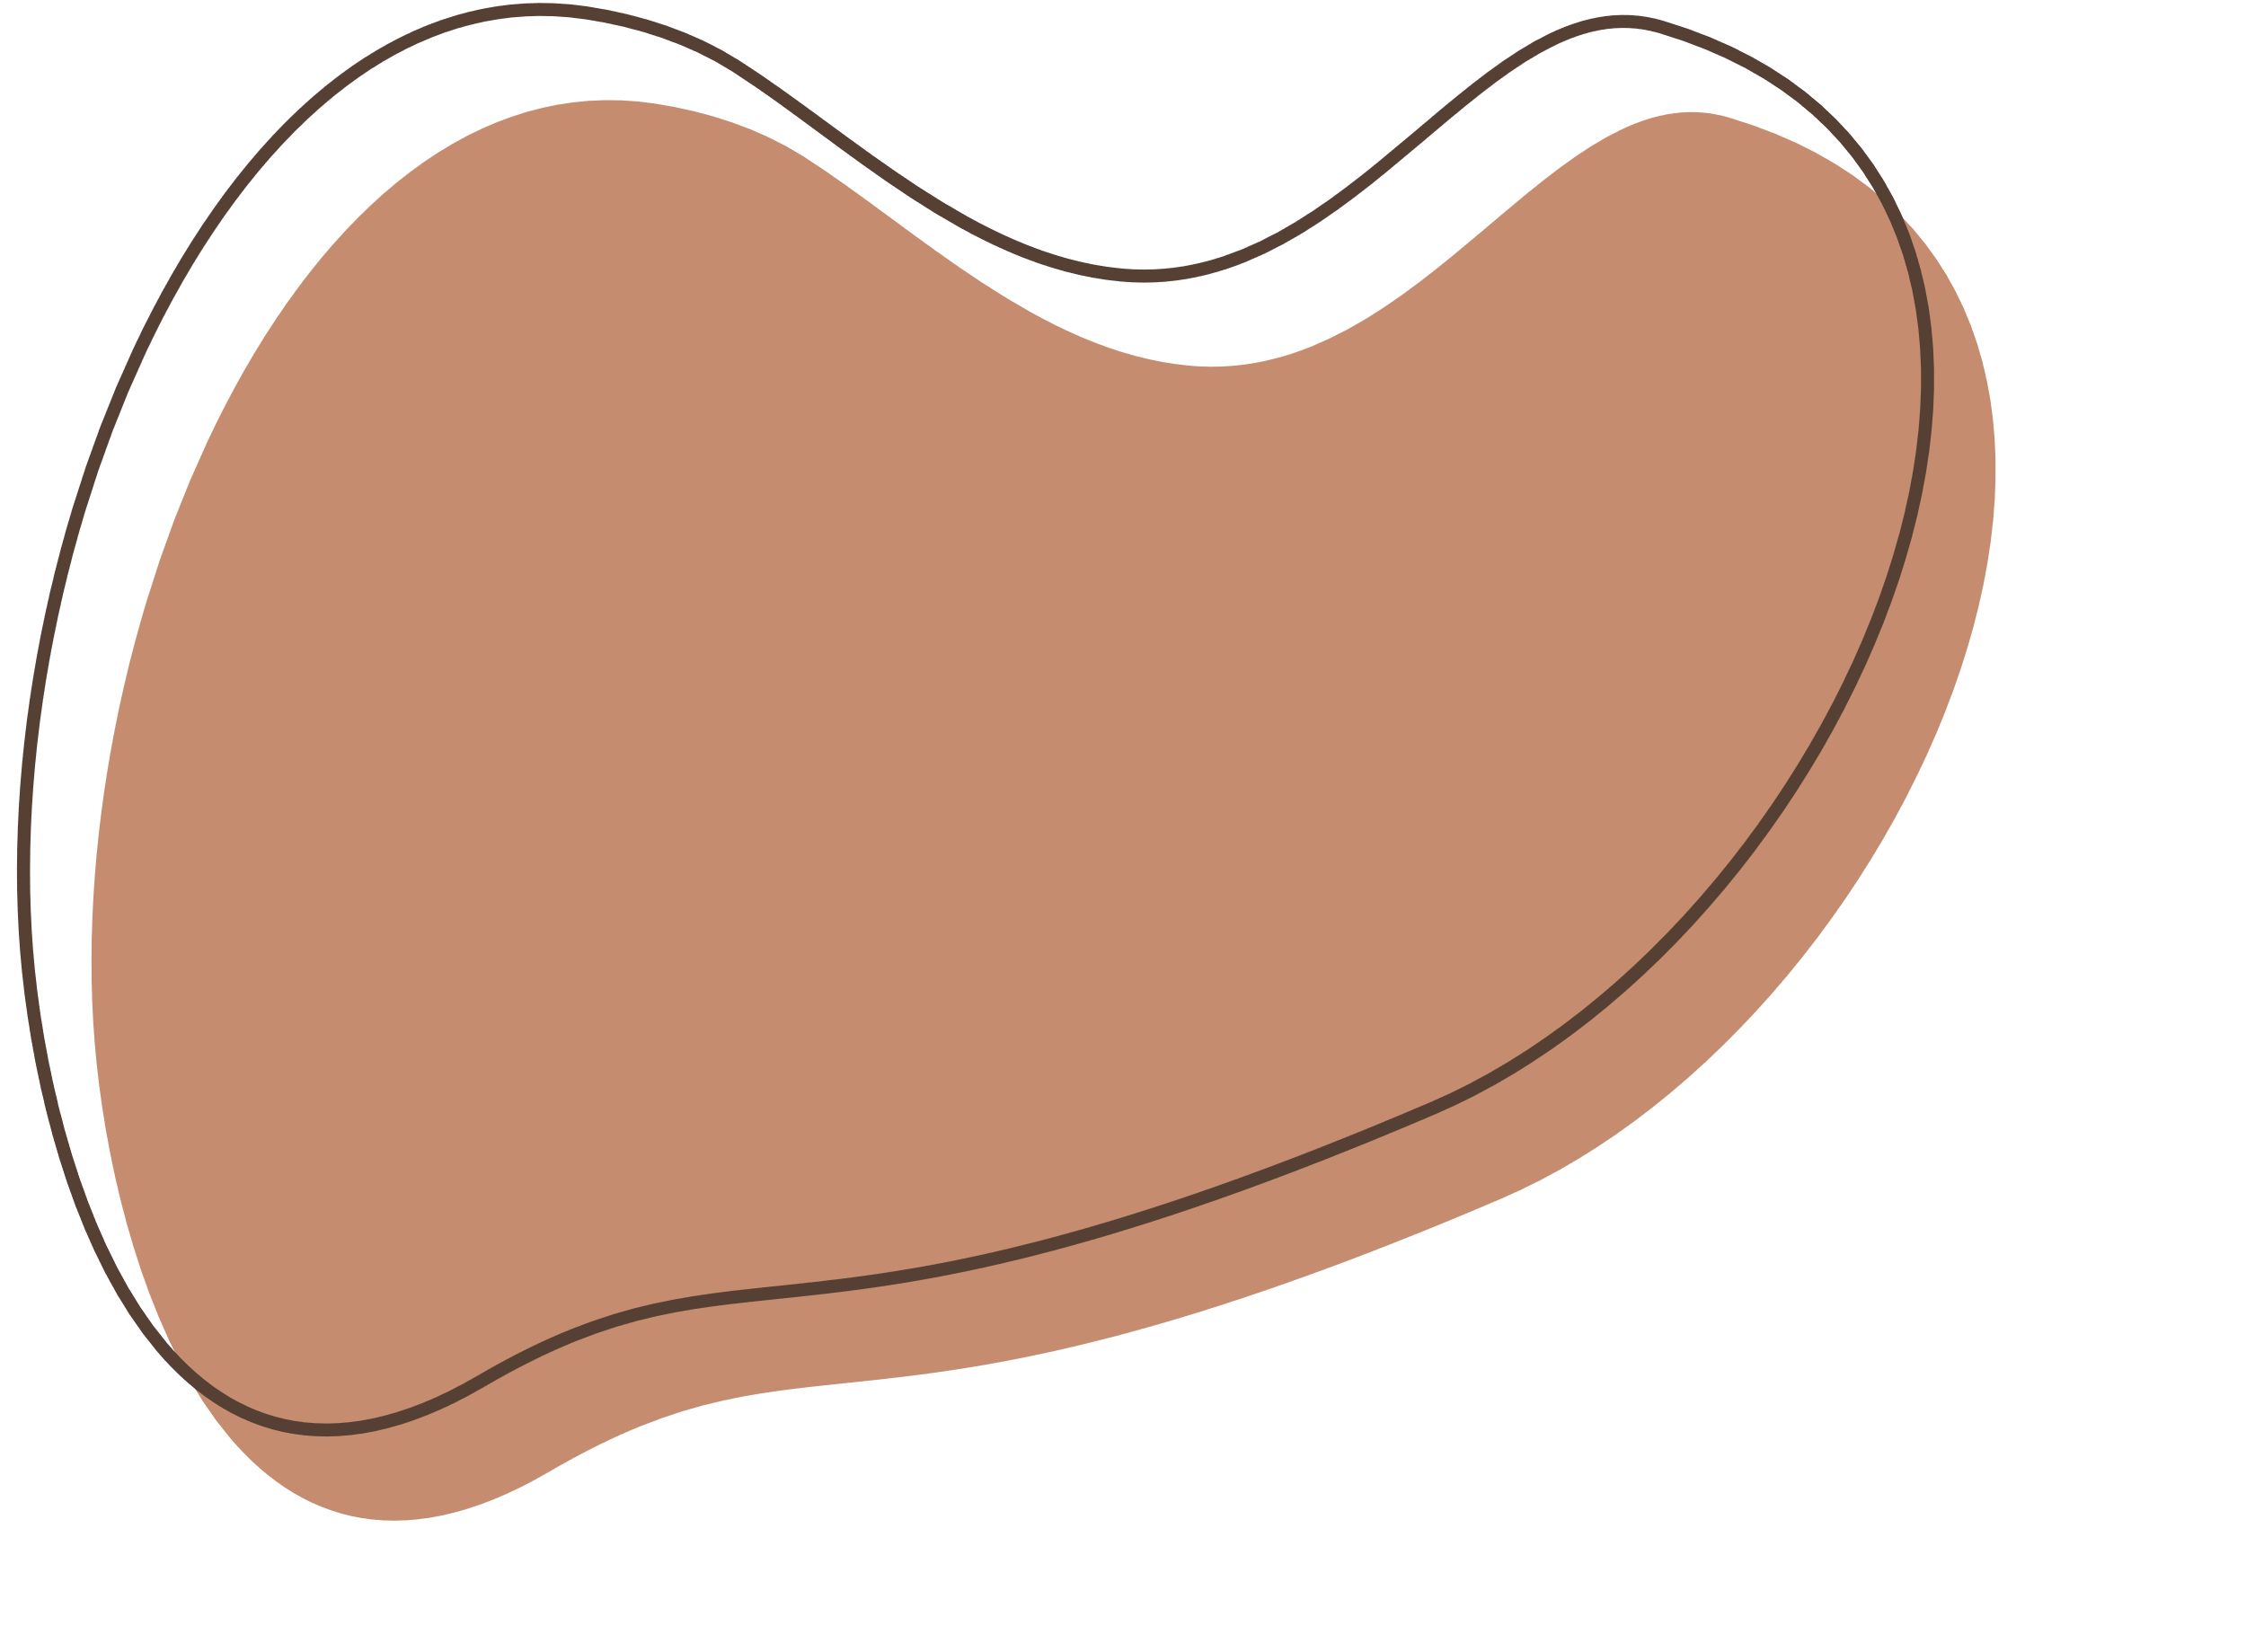


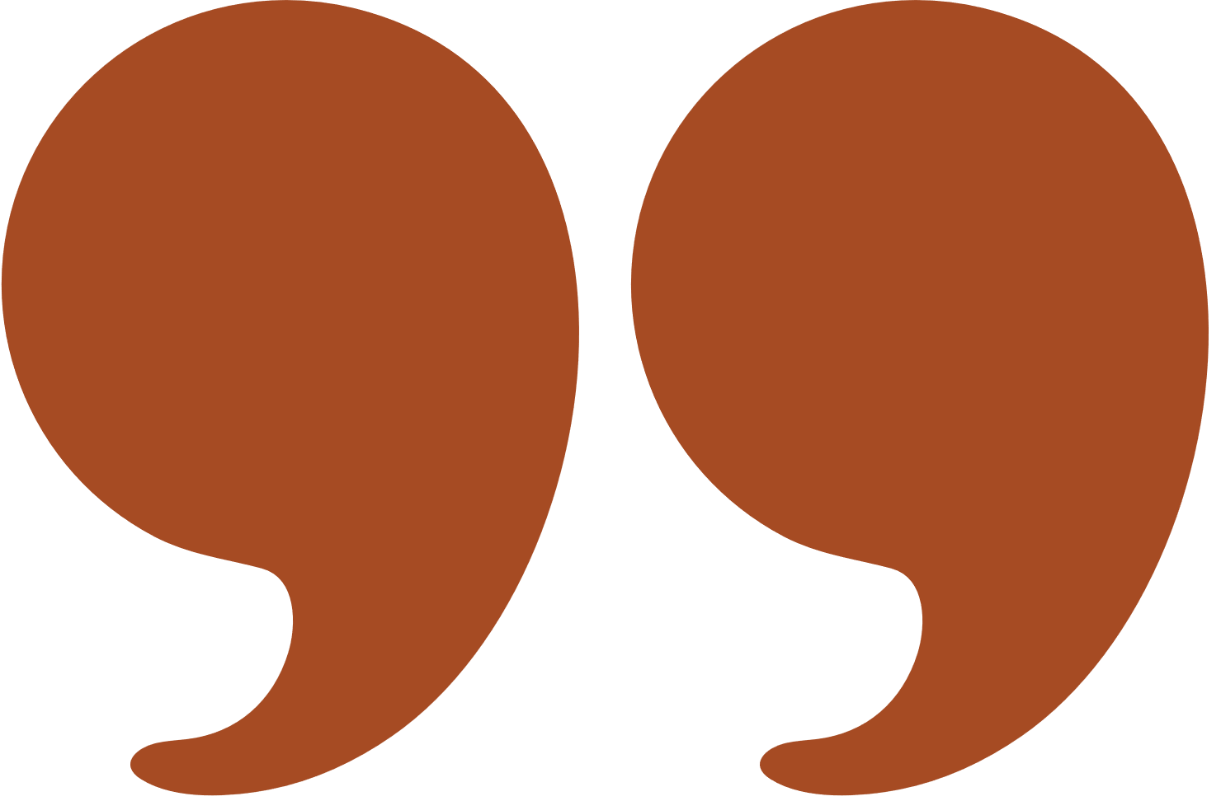
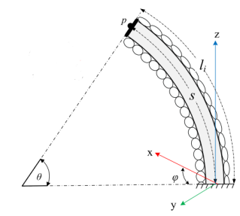
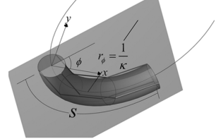




Growth / Continuum Robots
- No rigid links
- Continuous in appearance
Notes:
Report Page1 and Page2

Slide 3


Derivation Process
Modeling
State Space Model
NMPC Design
Notes:
Title Headings

Slide 4
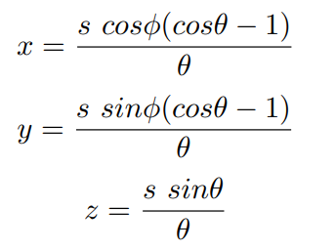

Modeling
Position Kinematics
Velocity Kinematics
Notes:
Report pages 3, 4 and 5

Slide 5

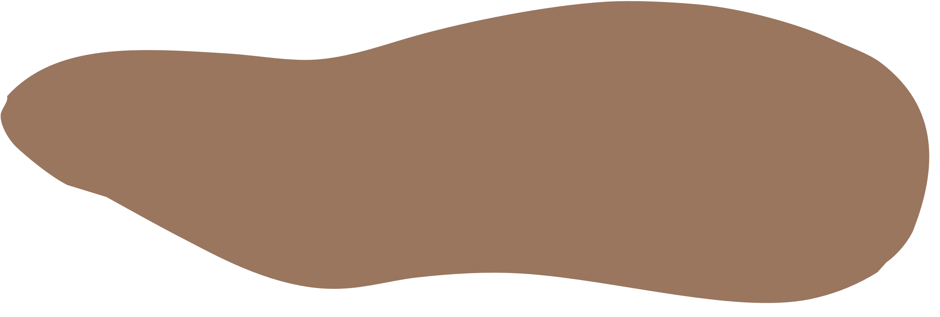

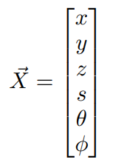
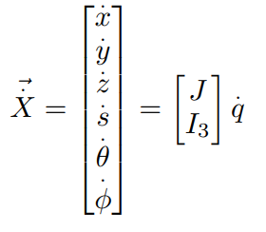
State Space Model
- Irreversible slow growth
- Dependant purely on control input
Notes:
Report page 5

Slide 6



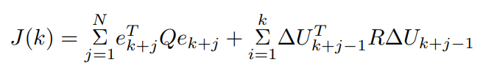
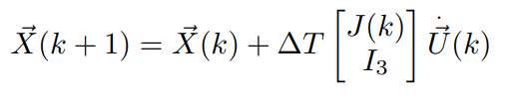
NMPC Design
Cost Function
Discrete Linear Model
Notes:
Report page 5 and 6

Slide 7
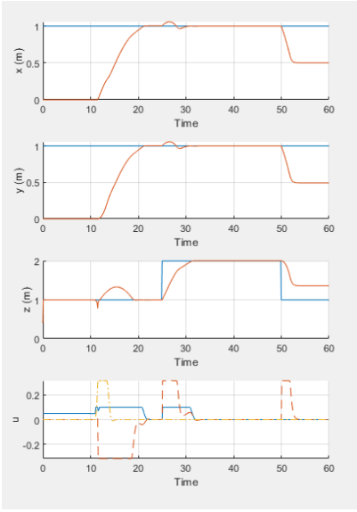
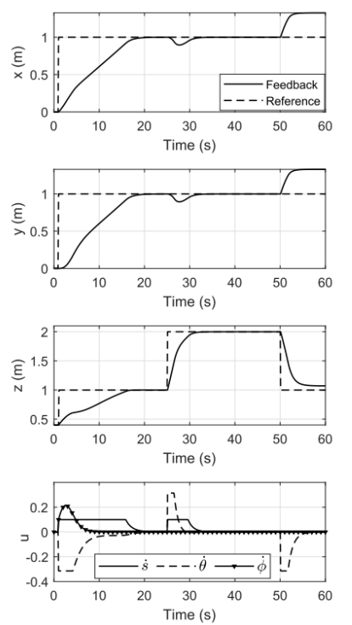
Point Stabilization
Personal Simulation
Paper Simulation
z shoots to 1, instead of slow increments
x and y increments delayed by 10 sec
Opposite x, y and s’ values after 50 sec
Almost similar graphs
Notes:
Report pages 7 and 8

Slide 8
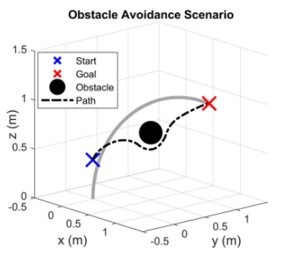
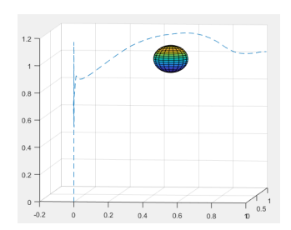
Obstacle Avoidance
Paper Simulation
z shoots to 1, instead of slow increments
Robot trajectory moves above instead of below
Successfully avoids object
Personal Simulation
Notes:
Report pages 8 and 9

Slide 9
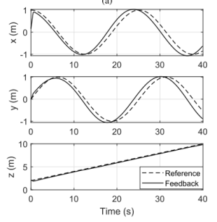
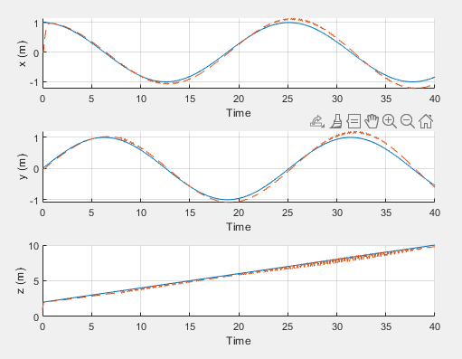
Trajectory Tracking
Paper Simulation
Unconstrained NMPC
Good trajectory
Bad zero tracking error
Personal Simulation
Notes:
Report pages 10, 11 and 12

Slide 10
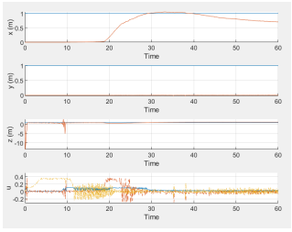
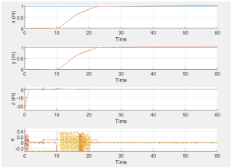
Robustness Analysis
Simulation 1
Simulation 2
Notes:
Report page 12

Slide 11
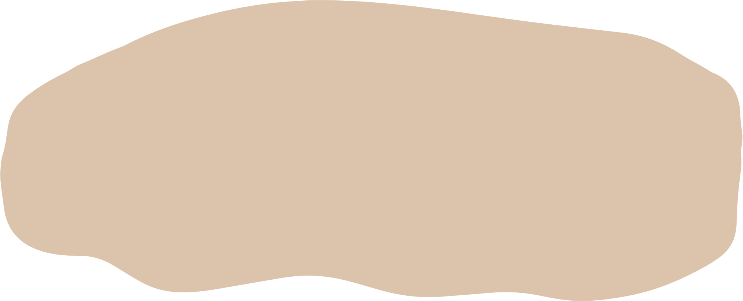
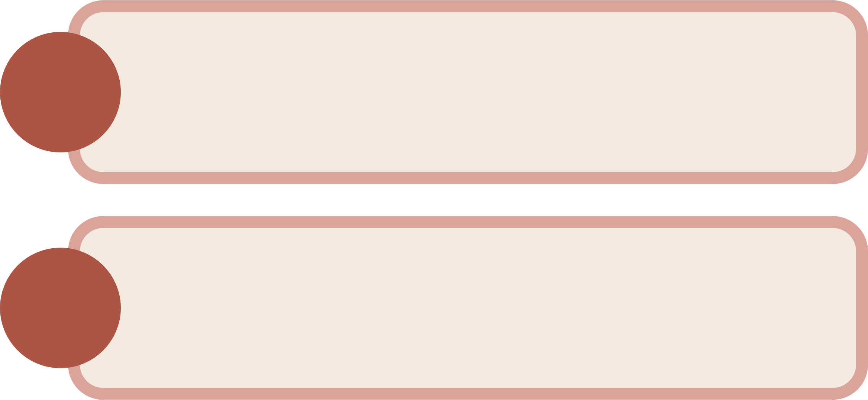
Discrepancies
1.
Model Design Inaccuracy
2.
Multi-Shooting Algorithm Implementation
Notes:
Title Headings

Slide 12
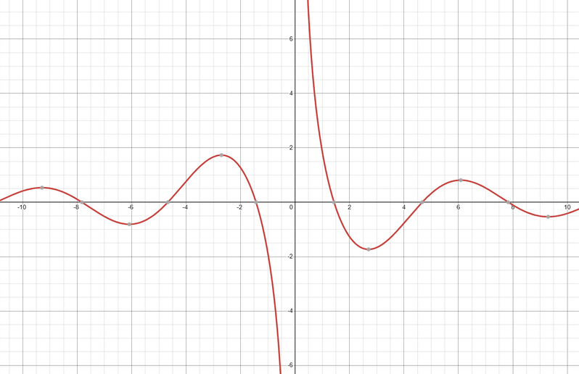

Model Design Inaccuracy
Edited Model used in Paper
z is undefined at initial condition
Small θ value leads to large z value
Notes:
Report page 13 under limitations in design first part

Slide 13

Multi-Shooting Algorithm
Uses all state variables
Prioritises z - z_r = 0
Prioritises minimization on θ
Notes:
Report page 12 last paragraph and page 13 under limitations in design last part

Slide 14


Conclusion
NMPC Algorithm designed
Results compared
Results vary due to lack of information
Model Reduction
Algorithm Employed

Slide 15

