Slide 1
Fig. 1
Start and initialize x_{i}, m_{i}, and η_{i}
User input
nelx, nely, volfrac, er, options
1. Problem definition and FE preparation
Design domain, materials, loads, boundary conditions,
FE mesh, and filters
get_option(), prepare_fem(), prepare_filter()
Examples/Direct function call
2. Initial multi-material FE analysis and response recovery
Self-weight
→ Step 2 & 7
Displacement, compliance, principal stresses, and von Mises stress
FE_displacement(), FE_vectorized(), element_compliance()
3. Material-utilization evaluation
Extended solver
Standard solver
Stress-state classification and element-wise utilization $ηᵢ$
mbeso_fixed_solid.m
mbeso.m
update_material_utilization()
Options:
fixed_solid_mask
non_design_mask
include_self_weight
4. Spatial filtering and history averaging
Filtered stress-state and utilization fields
apply_filter()
5. Target-volume and solid–void update
Design masks
→ Step 5
Rank history-averaged scores and select the elements retained in the next design
select_keep_mask(), optional even_keep_count adjustment
6. Material reassignment
Update mᵢ using the filtered stress state and obtain a new design
Returned result structure
7. FE analysis of the updated design
Design variable, response,
history, settings
Update stiffness and loads; compute the updated response
FE_vectorized(), element_compliance()
No
8. Stopping criteria satisfied?
Visualization/Export
Plots, history, reports, MAT-files
Yes
9. Final-response evaluation and result assembly
Runtime call/data return
Final material layout, displacement, stresses, utilization, and histories
Extended-solver interaction
build_design_response_from_analysis()

Slide 2
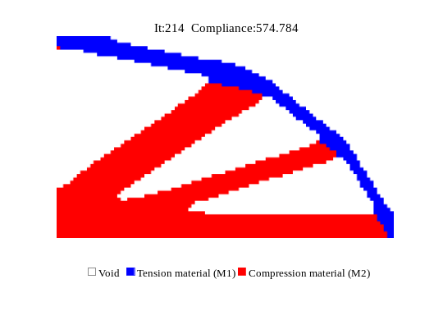
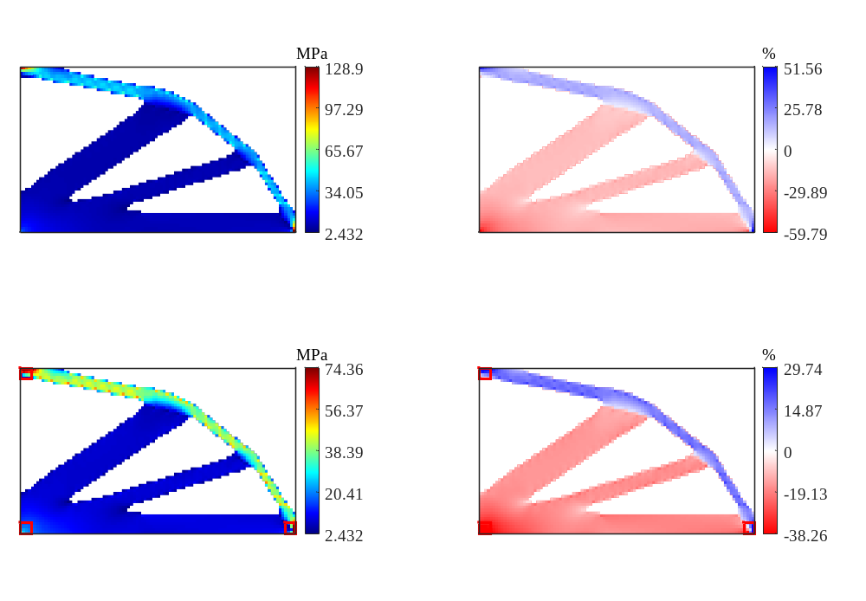
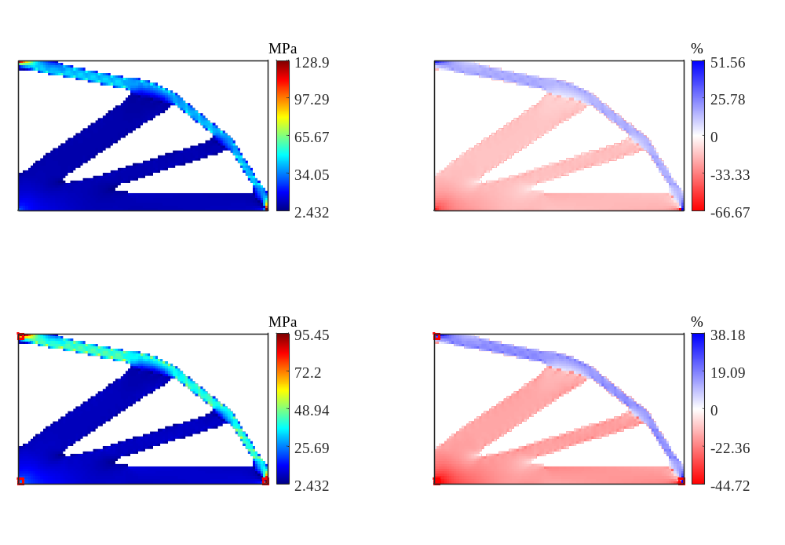
Fig. 2
40 mm
1,000 mm
Compression
Cantilever
S₁
Tension
40 mm
600 mm
40×40 mm evaluation-exclusion region
S₂
L
Problem definition
1,000 N
Optimized material layout
von Mises stress
Unfiltered signed material utilization

Slide 3
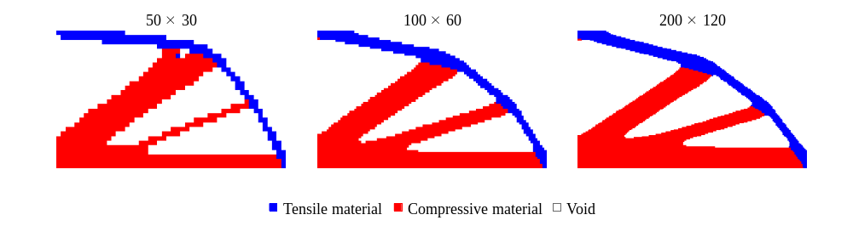
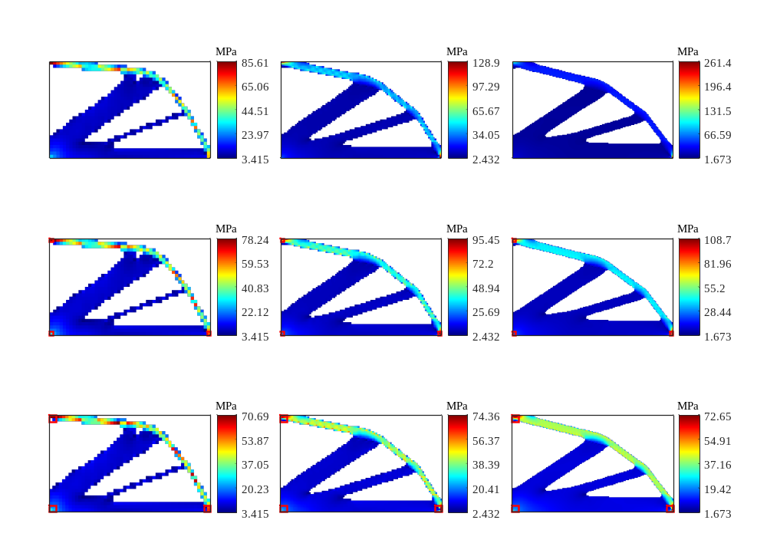
Fig. 3a
Optimized material layout
von Mises stress
von Mises stress
(40×40 mm exclusion)

Slide 4
Fig. 3b
Optimized material layout
von Mises stress
von Mises stress
(40×40 mm exclusion)

Slide 5
Fig. 3c
Optimized material layout
von Mises stress
von Mises stress
(40×40 mm exclusion)

Slide 6
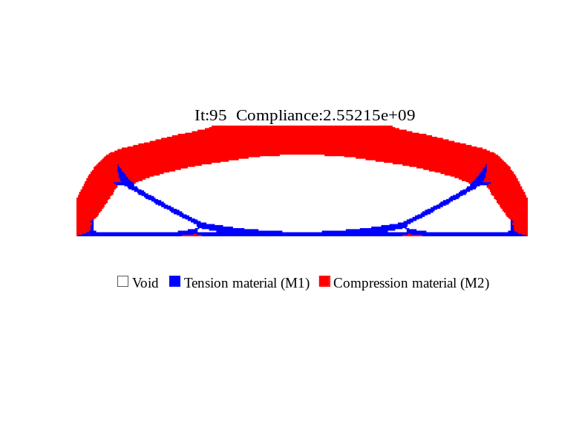
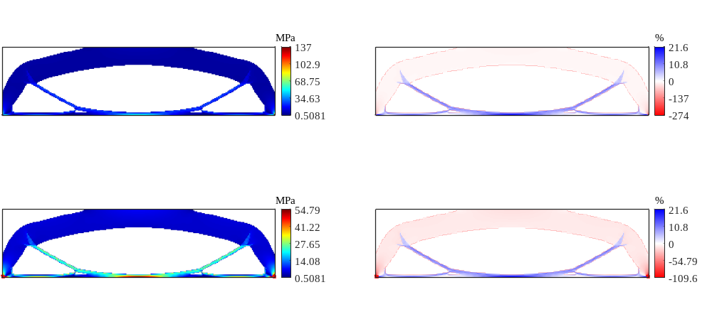
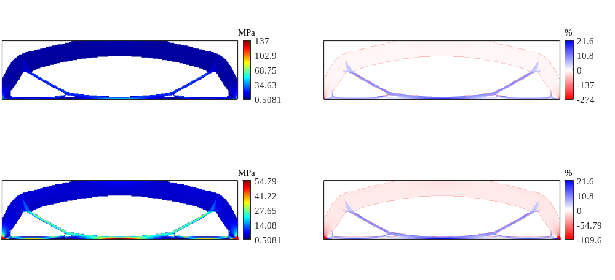
Non-design domain
q = 1.0×10⁵ N/m
40 m
1.5 m
160 m
Problem definition
Optimized material layout
von Mises stress
Unfiltered signed material utilization
Fig. 4a

Slide 7
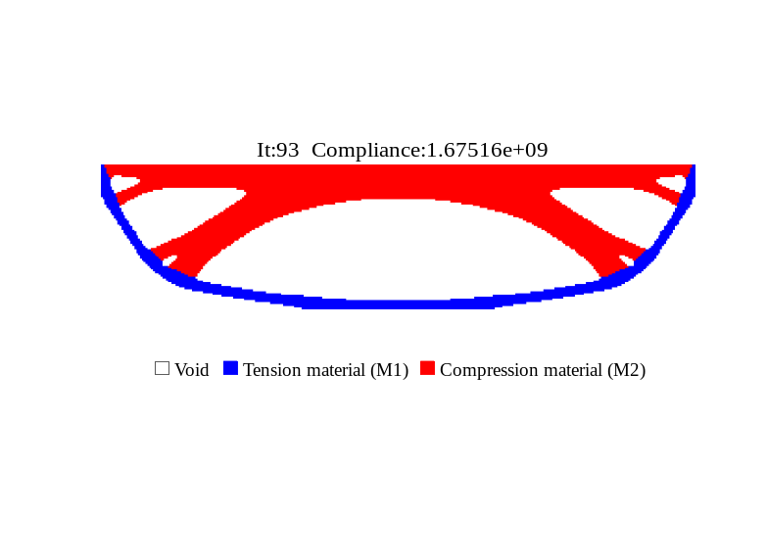
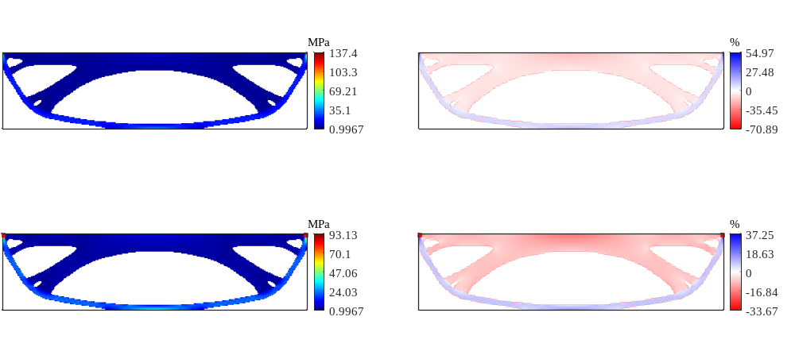
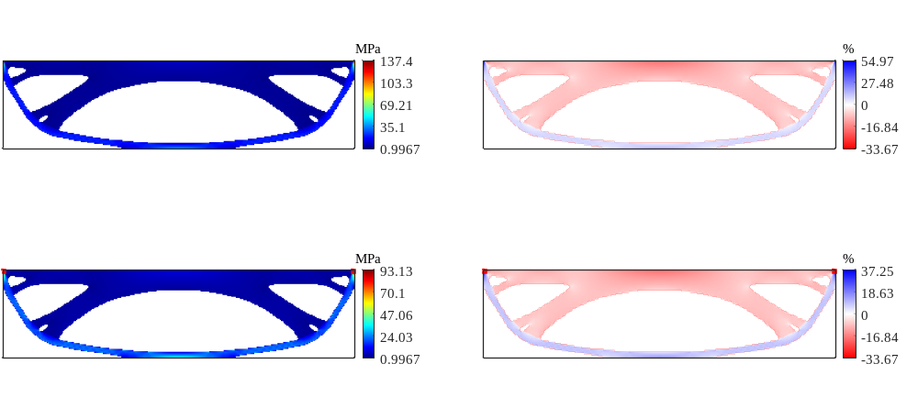
q = 1.0×10⁵ N/m
1.5 m
40 m
160 m
Problem definition
Optimized material layout
von Mises stress
Unfiltered signed material utilization
Fig. 4b

Slide 8
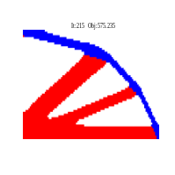

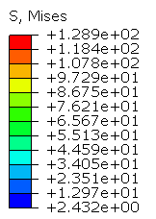



$${\text{P}}_{\text{I}}$$
$${\text{u}}_{\text{x}}$$
$${\text{u}}_{\text{y}}$$
Abaqus/Standard 2024
MBESO2D
Fig. 5a

Slide 9
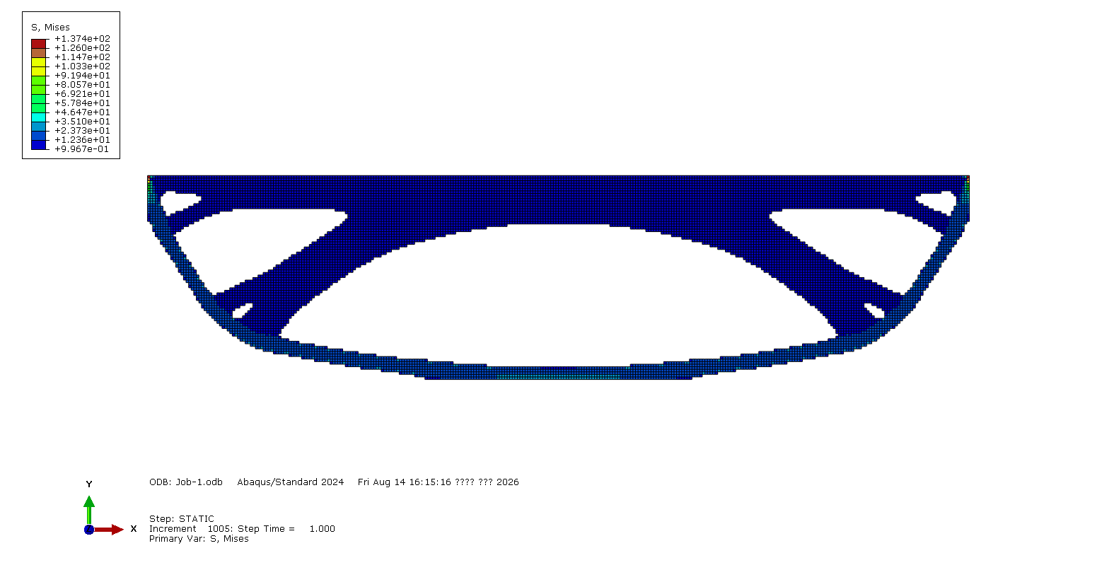


$${\text{P}}_{\text{III}}$$
$${\text{u}}_{\text{x}}$$
$${\text{u}}_{\text{y}}$$
Abaqus/Standard 2024
MBESO2D
Fig. 5b

Slide 10
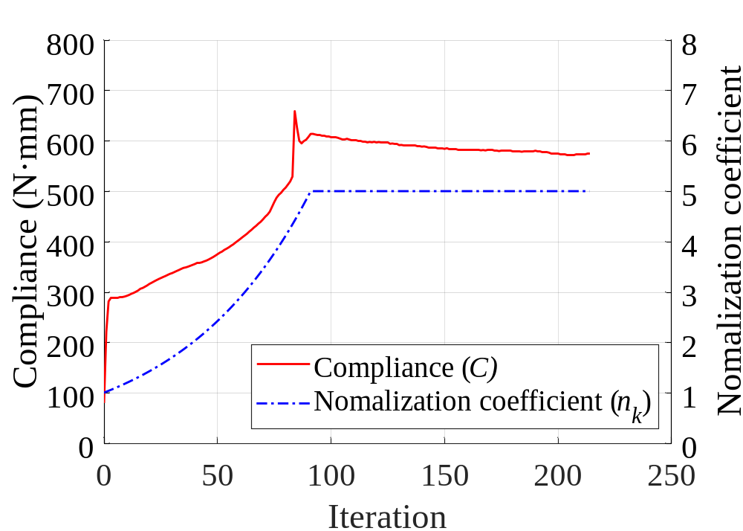
Fig. 6a
Notes:
Fig. 7. All four original solid-selection curves refer to element 974. The added ochre history-averaged score refers to element 5829. Its iteration-2 score 0.0096311054 lies below the retention threshold 0.026230446 and the saved output is void. The first response history stops at iteration 214. Added annotations are purple. The actual material maps and chart series remain editable. Source: initial10/cantilever/representative_trajectories.csv and archived state10 material layout.

Slide 11
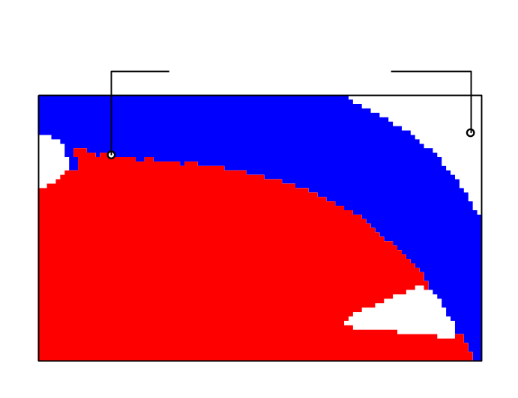
Fig. 6b
 | Iteration
Element | 1 | 2 | 3 | 4 | 5 | 6 | 7 | 8 | 9 | 10
974
5829
974
5829
Tension material
Compression material
Void
Material assignment
at iteration 10
Tensile material
Compressive material
Void
Notes:
Fig. 7. All four original solid-selection curves refer to element 974. The added ochre history-averaged score refers to element 5829. Its iteration-2 score 0.0096311054 lies below the retention threshold 0.026230446 and the saved output is void. The first response history stops at iteration 214. Added annotations are purple. The actual material maps and chart series remain editable. Source: initial10/cantilever/representative_trajectories.csv and archived state10 material layout.

Slide 12
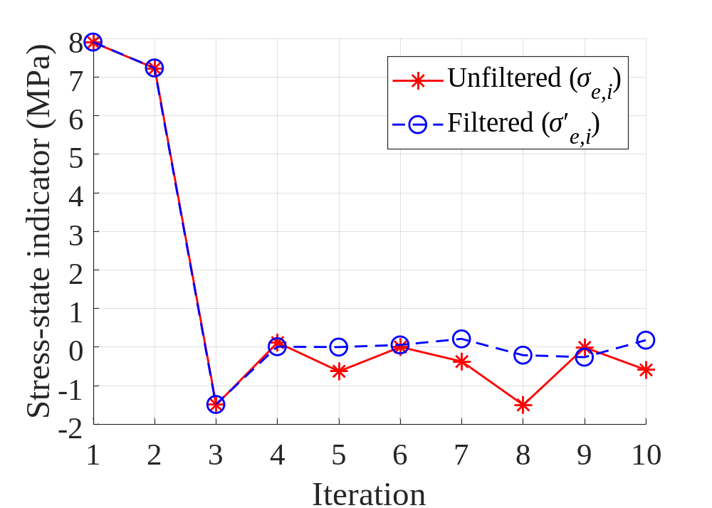
Fig. 6c
0.2056
–0.2166
–0.3732
Notes:
Fig. 7. All four original solid-selection curves refer to element 974. The added ochre history-averaged score refers to element 5829. Its iteration-2 score 0.0096311054 lies below the retention threshold 0.026230446 and the saved output is void. The first response history stops at iteration 214. Added annotations are purple. The actual material maps and chart series remain editable. Source: initial10/cantilever/representative_trajectories.csv and archived state10 material layout.

Slide 13
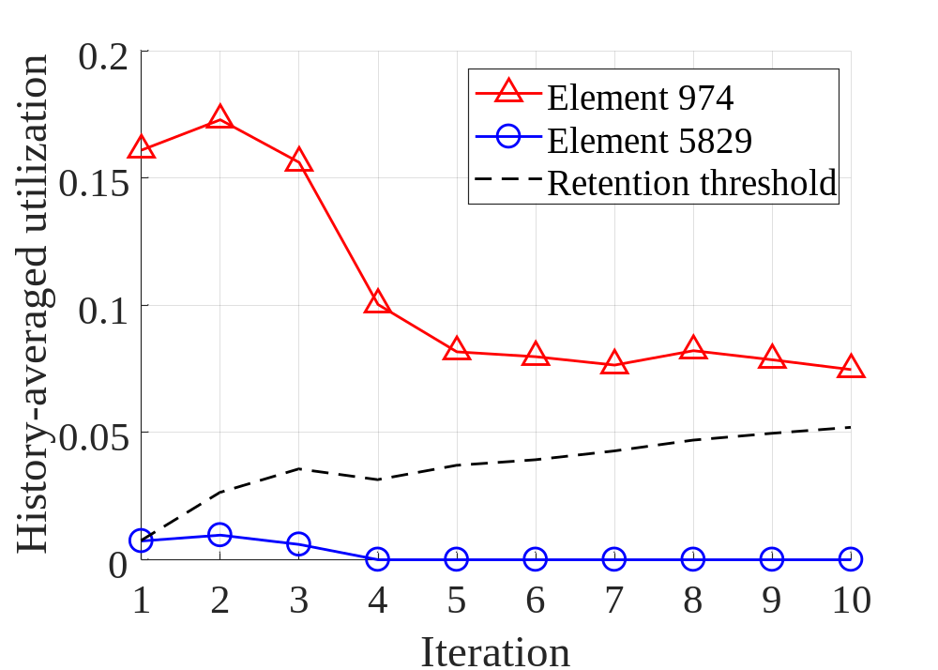
Fig. 6d
0.0262
0.0096
Notes:
Fig. 7. All four original solid-selection curves refer to element 974. The added ochre history-averaged score refers to element 5829. Its iteration-2 score 0.0096311054 lies below the retention threshold 0.026230446 and the saved output is void. The first response history stops at iteration 214. Added annotations are purple. The actual material maps and chart series remain editable. Source: initial10/cantilever/representative_trajectories.csv and archived state10 material layout.

Slide 14
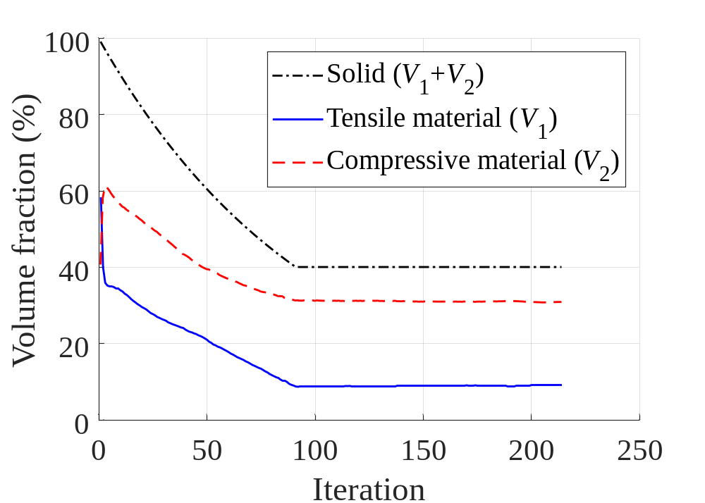
Fig. 7a
Notes:
Fig. 7. All four original solid-selection curves refer to element 974. The added ochre history-averaged score refers to element 5829. Its iteration-2 score 0.0096311054 lies below the retention threshold 0.026230446 and the saved output is void. The first response history stops at iteration 214. Added annotations are purple. The actual material maps and chart series remain editable. Source: initial10/cantilever/representative_trajectories.csv and archived state10 material layout.

Slide 15
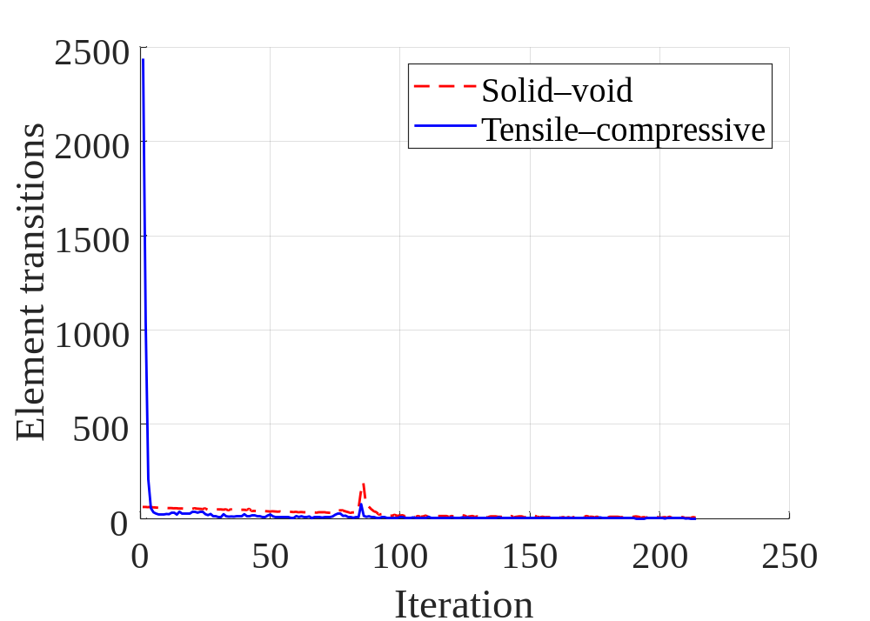
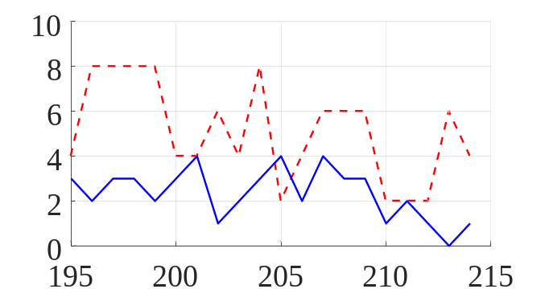
Fig. 7b
Notes:
Fig. 7. All four original solid-selection curves refer to element 974. The added ochre history-averaged score refers to element 5829. Its iteration-2 score 0.0096311054 lies below the retention threshold 0.026230446 and the saved output is void. The first response history stops at iteration 214. Added annotations are purple. The actual material maps and chart series remain editable. Source: initial10/cantilever/representative_trajectories.csv and archived state10 material layout.

Slide 16
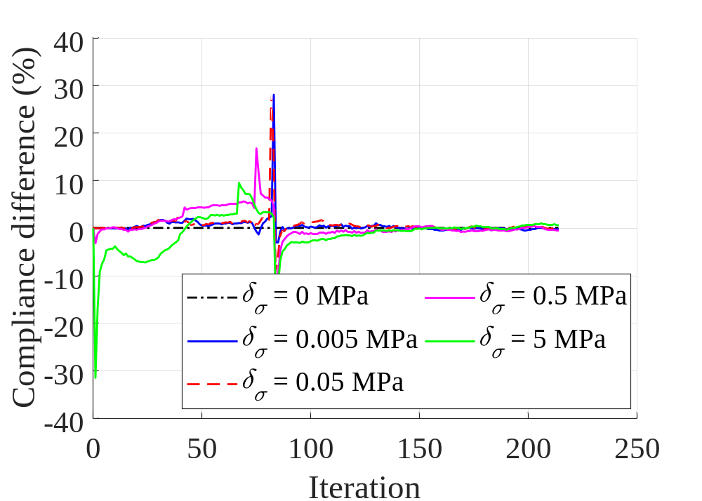
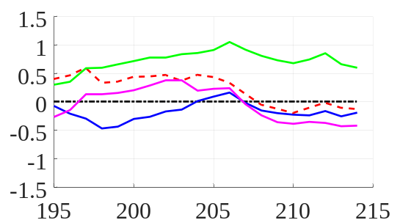
Fig. 7c
Notes:
Fig. 7. All four original solid-selection curves refer to element 974. The added ochre history-averaged score refers to element 5829. Its iteration-2 score 0.0096311054 lies below the retention threshold 0.026230446 and the saved output is void. The first response history stops at iteration 214. Added annotations are purple. The actual material maps and chart series remain editable. Source: initial10/cantilever/representative_trajectories.csv and archived state10 material layout.

Slide 17
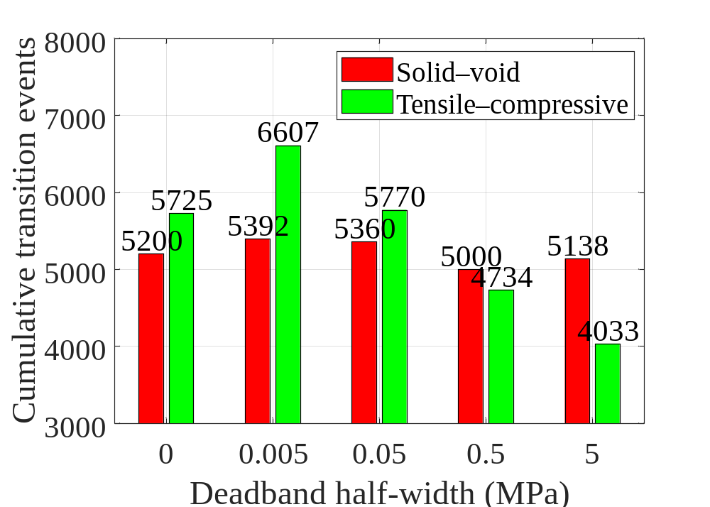
Fig. 7d
Notes:
Fig. 7. All four original solid-selection curves refer to element 974. The added ochre history-averaged score refers to element 5829. Its iteration-2 score 0.0096311054 lies below the retention threshold 0.026230446 and the saved output is void. The first response history stops at iteration 214. Added annotations are purple. The actual material maps and chart series remain editable. Source: initial10/cantilever/representative_trajectories.csv and archived state10 material layout.

Slide 18
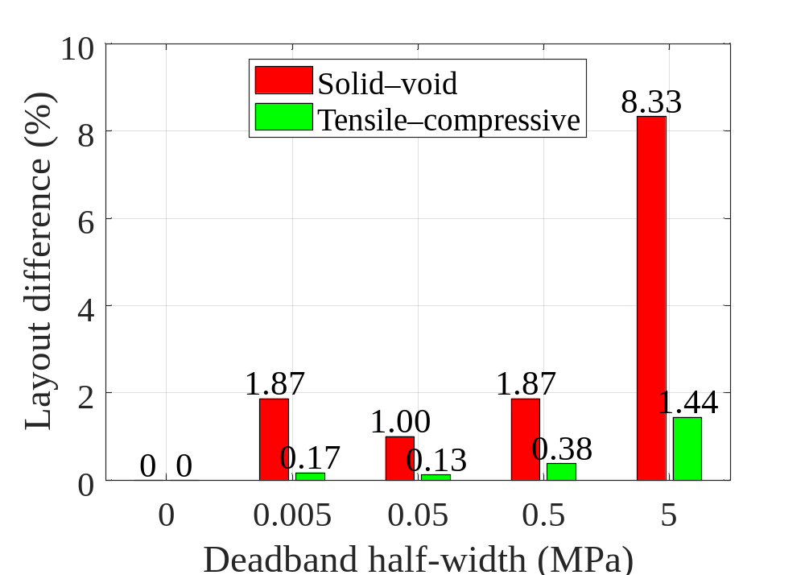
Fig. 7e
Notes:
Fig. 7. All four original solid-selection curves refer to element 974. The added ochre history-averaged score refers to element 5829. Its iteration-2 score 0.0096311054 lies below the retention threshold 0.026230446 and the saved output is void. The first response history stops at iteration 214. Added annotations are purple. The actual material maps and chart series remain editable. Source: initial10/cantilever/representative_trajectories.csv and archived state10 material layout.

Slide 19
q = 1.0×10⁵ N/m
40 m

Slide 20
1,000 mm
Compression
Cantilever
Tension
600 mm
Problem definition
1,000 N
Optimized material layout
von Mises stress
Unfiltered signed material utilization

Slide 21
1,000 mm
40 mm
Cantilever
S₁
40 mm
600 mm
S₂
L
40×40 mm evaluation-exclusion region
1,000 N

