Slide 1








Stack Overflow Developer Survey 2019
Hongjian Xiao
24/03/2024
Email: hx1918@ic.ac.uk

Slide 2



OUTLINE
Executive Summary
Introduction
Methodology
Results
Visualization – Charts
Dashboard
Discussion
Findings & Implications
Conclusion
Appendix

Slide 3

EXECUTIVE SUMMARY
Trends of programming languages and database
Trends of platforms and web frames.
Demographics survey
Discrepancy across country
Trend by age
Difference by Education level and gender

Slide 4

INTRODUCTION
Analyze trends of skills and tools of programmer based on the survey in 2019 over 9000 respondents globally.
Predict the programming language and database mostly needed in the future.
The respondents are not evenly in age and gender
Male is the majority
Most respondents are in young and middle age

Slide 5

METHODOLOGY
Data Collection
API
Web scraping
Data Wrangling
Exploratory Data Analysis
Data distribution
Correlation between data
Check statistics information
Data Visualization - Dashboard

Slide 6

RESULTS
Programming language trends
Database trends

Slide 7
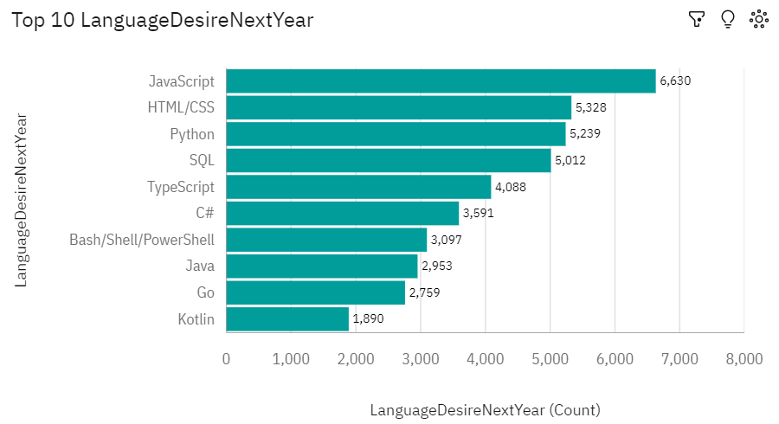
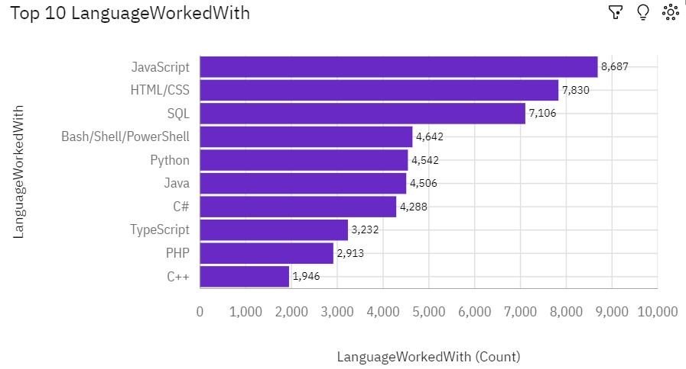
PROGRAMMING LANGUAGE TRENDS
Current Year
Next Year

Slide 8
PROGRAMMING LANGUAGE TRENDS - FINDINGS & IMPLICATIONS
Findings
JavaScript and HTML/CSS keep the leading positions.
A fast growth in Python
An increase in TypeScript
A drop in Java and C#
Implications
An increasing need of Python programming in the industry
A possible switch of programming from Java and C# to TypeScript
JavaScript is still the most popular.

Slide 9
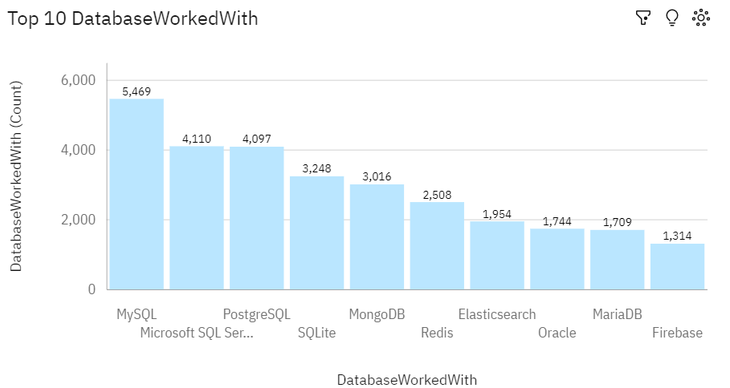
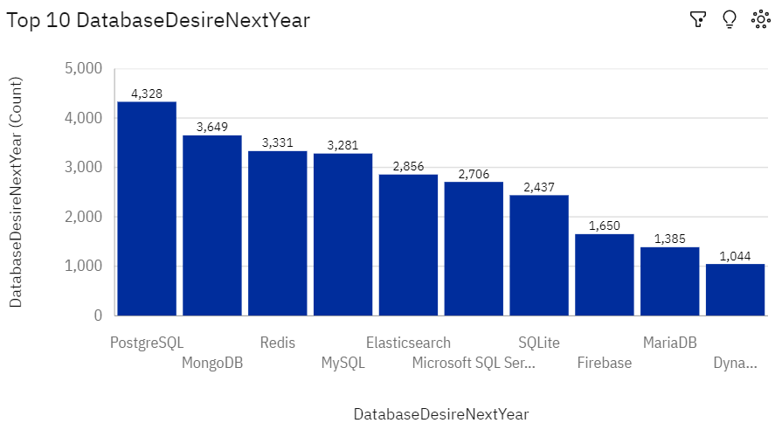
DATABASE TRENDS
Current Year
Next Year

Slide 10
DATABASE TRENDS - FINDINGS & IMPLICATIONS
Findings
Increasing interest in PostgreSQL
Decreasing interest in MicrosoftSQL and MySQL
Moderate drop in SQLite
Implications
SQL based database is the majority
A potential shift from MicrosoftSQL and MySQL to PostgreSQL for SQL programmers

Slide 11
DASHBOARD
https://us3.ca.analytics.ibm.com/bi/?perspective=dashboard&pathRef=.my_folders%2Fcapstone%2Bproject&action=view&mode=dashboard&subView=model0000018e5d5fc026_00000000

Slide 12
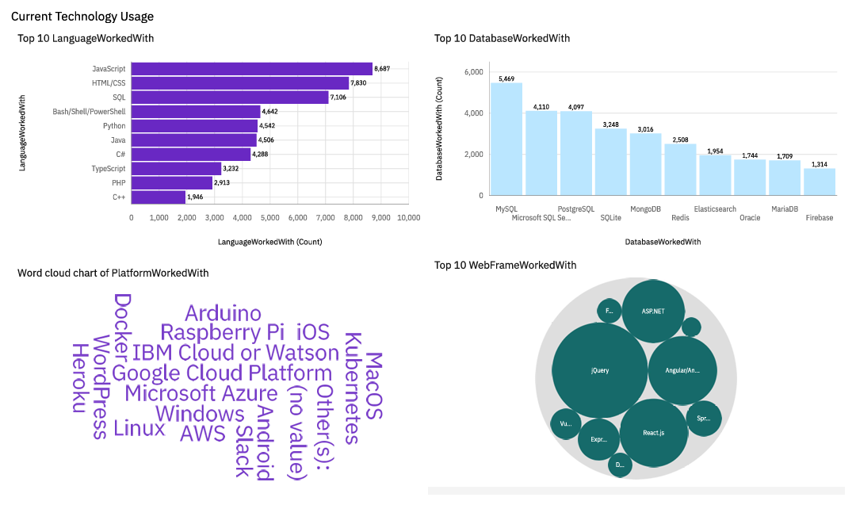
DASHBOARD TAB 1

Slide 13
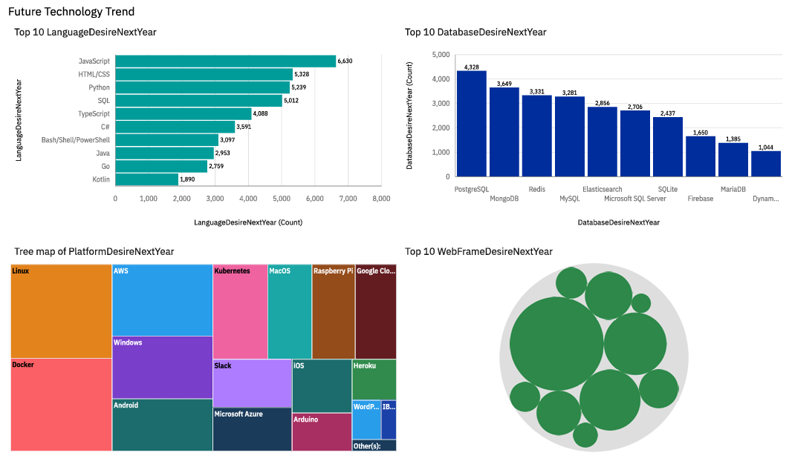
DASHBOARD TAB 2

Slide 14
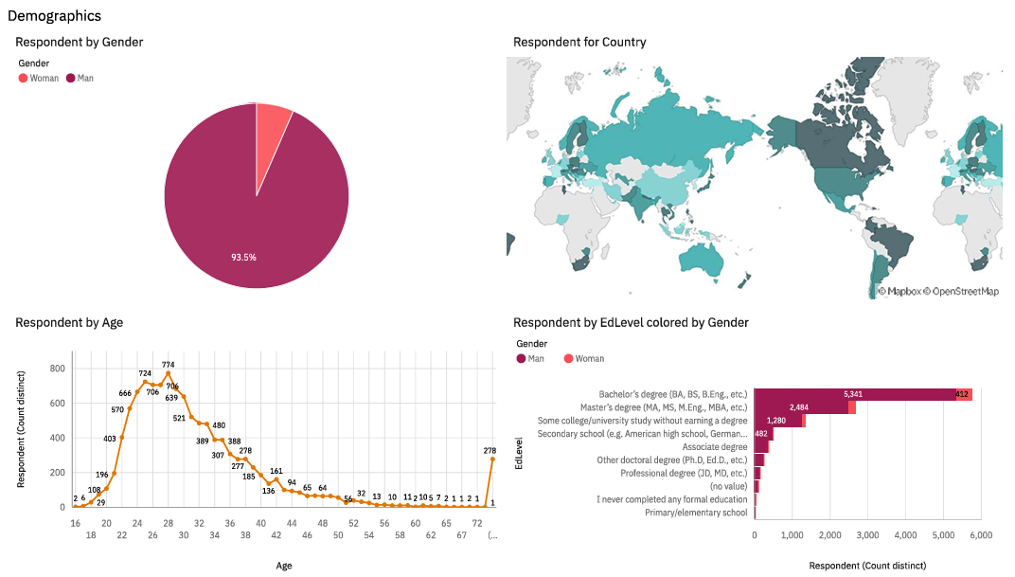
DASHBOARD TAB 3

Slide 15
DISCUSSION
Huge gender difference in technology industry
Discrepancy of technology gap across countries.
Discrimination of education level and age in employment.

Slide 16
OVERALL FINDINGS & IMPLICATIONS
Findings
For programming language, a fast growth in Python and TypeScript can be observed.
For database, there is an increasing interest in PostgreSQL.
Young males occupy the majority of the technology industry.
Most developers are from developed countries.
Implications
Python and TypeScript programmers will be largely needed.
Pay attention to gender and age discrimination in employment
Technologies need to spread out to developing countries.

Slide 17

CONCLUSION
The trends of the skills and characters of developers can be observed.
The difference among employers in the technology industries is shown based on gender, age, education level and country.

Slide 18

APPENDIX
Number of job posting on Github.
Average salaries based on different programming languages.

Slide 19
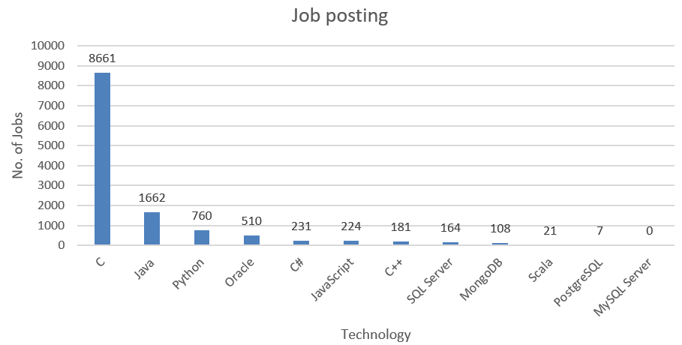
JOB POSTINGS

Slide 20
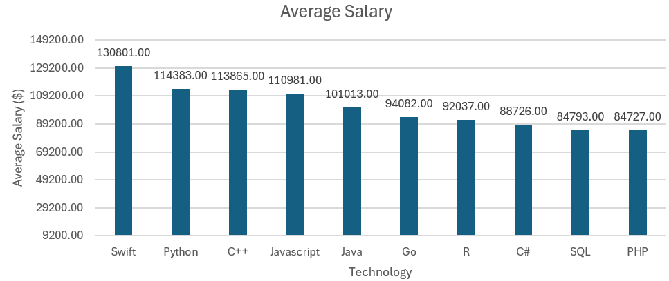
POPULAR LANGUAGES

