Slide 1
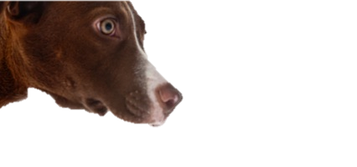

DOG OR CAT?
Neural Networks
FALL 2017 ADS PROJ5 GRP7

Slide 2
Neural Network- Image Classification
FALL 2017, PROJ5, GRP 7
1
INTRODUCTION
2
CIFAR10
3
VGG-16
4
INCEPTION - V3
5
CONCLUSION

Slide 3
PART 1
INTRODUCTION
Brief Intro

Slide 4
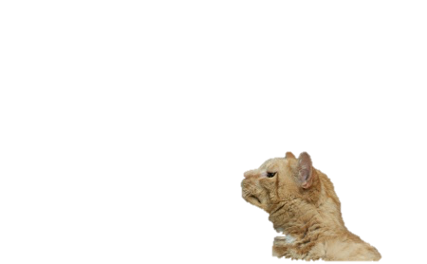
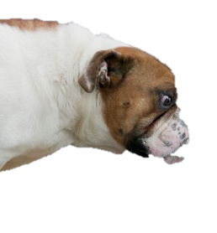
Neural Network- Image Classification
FALL 2017, PROJ5, GRP 7
KAGGLE Competition:
Play Ground Competition
https://www.kaggle.com/c/dogs-vs-cats-redux-kernels-edition
INTRODUCTION
Dataset:
Overall 25,000 Train images with labels
Overall 12,500 Test images without labels
CIFAR10
VGG16
INCEPTION - V3
Model Implemented:
Cifar 10
VGG-16
Inception-V3
CONCLUSION

Slide 5
PART 2
CIFAR10
The Structure of CIFAR10
Train Process

Slide 6
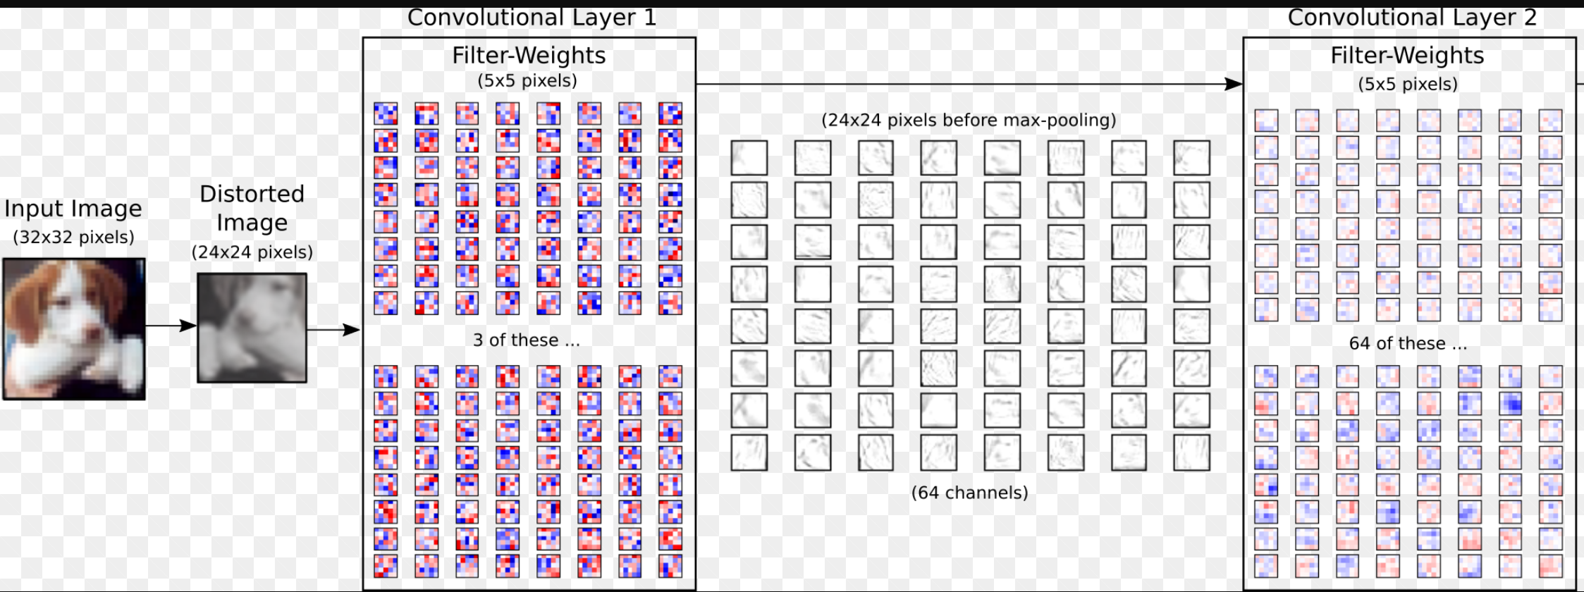
Neural Network- Image Classification
FALL 2017, PROJ5, GRP 7
INTRODUCTION
CIFAR10
VGG16
INCEPTION - V3
CONCLUSION
About CIFAR-10:
A common benchmark in machine learning for image recognition.
Very conventional CNN for visual recognition
7 layers: 2 convolutional layers + 2 pooling + 2 fully-connected + softmax
Notes:
123123123

Slide 7
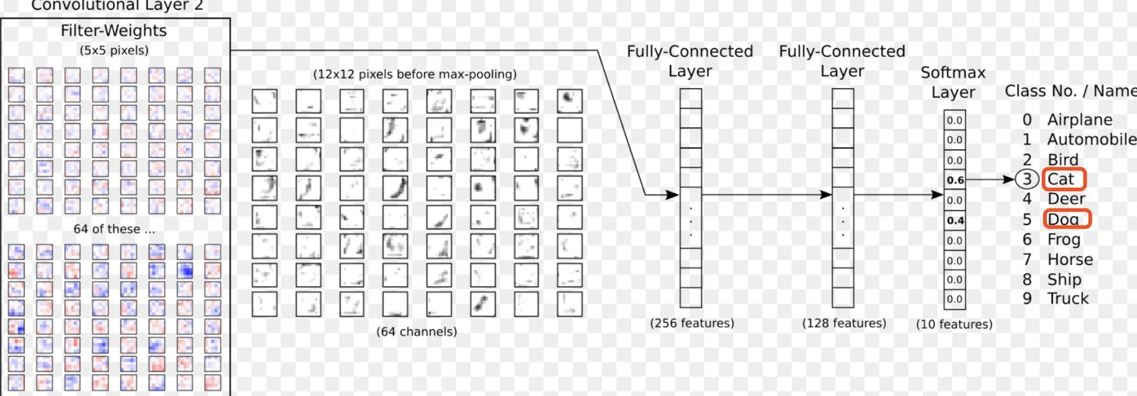
Neural Network- Image Classification
FALL 2017, PROJ5, GRP 7
INTRODUCTION
CIFAR10
VGG16
INCEPTION - V3
CONCLUSION

Slide 8
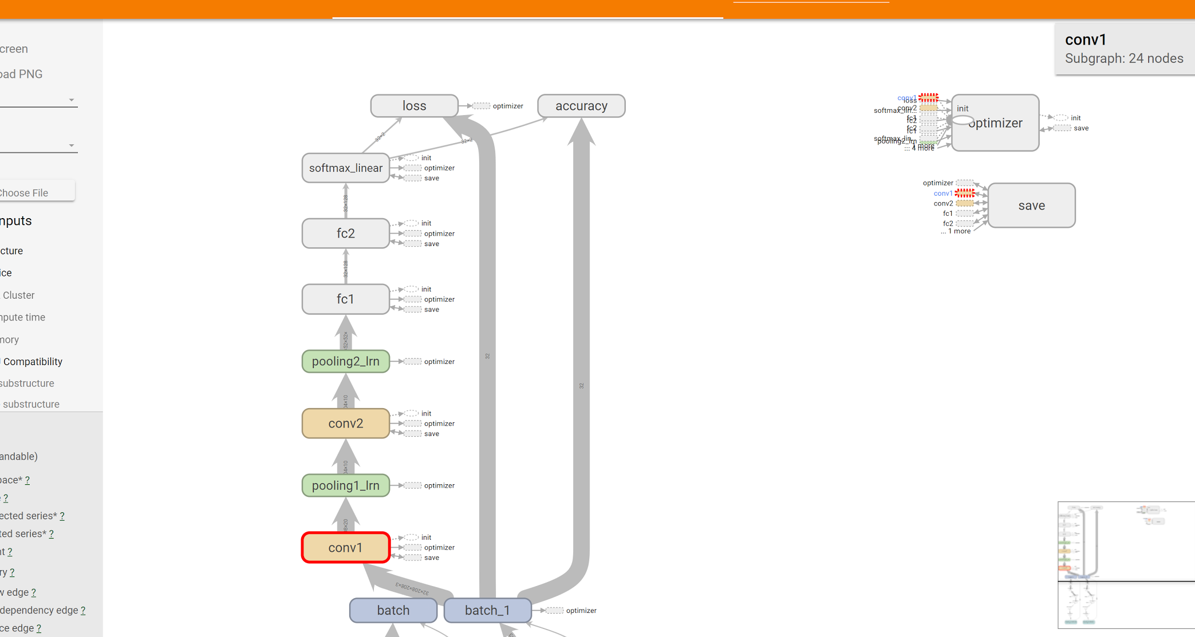
Neural Network- Image Classification
FALL 2017, PROJ5, GRP 7
Here is the structure of our model:
INTRODUCTION
CIFAR10
VGG16
INCEPTION - V3
CONCLUSION

Slide 9
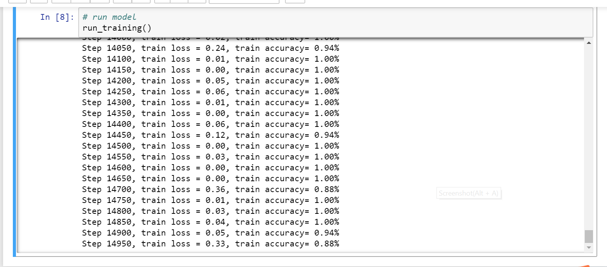
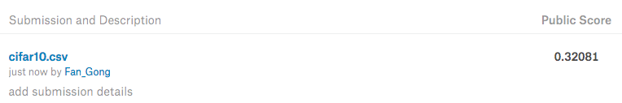
Neural Network- Image Classification
FALL 2017, PROJ5, GRP 7
Training Error:
INTRODUCTION
CIFAR10
VGG16
INCEPTION - V3
CONCLUSION
LOG LOSS: 0.32081
Notes:
123123123

Slide 10
PART 3
VGG-16
The Structure of VGG-16
Transfer Learning
Results

Slide 11
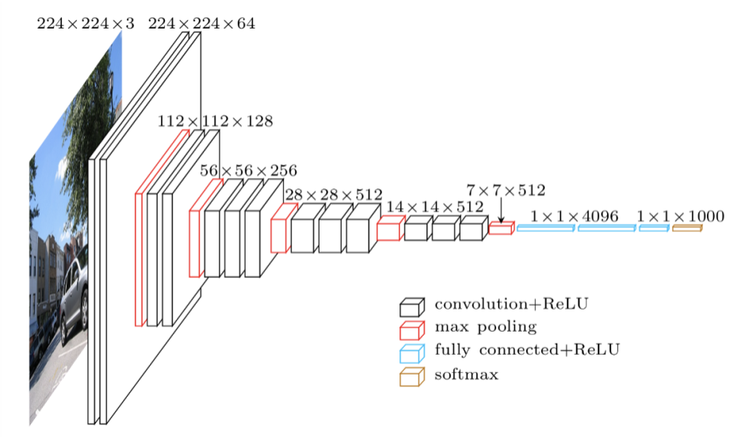
The structure of VGG16
INTRODUCTION
CIFAR10
VGG16
Pros:
Smaller kernel size in sequence emulate larger kernels (multiple 3×3 kernels)
Increase the depth to compensate the width
Enlight more recent network architectures such as Inception model
Cons:
Training of these network was difficult (160M parameters)
INCEPTION-V3
CONCLUSION

Slide 12
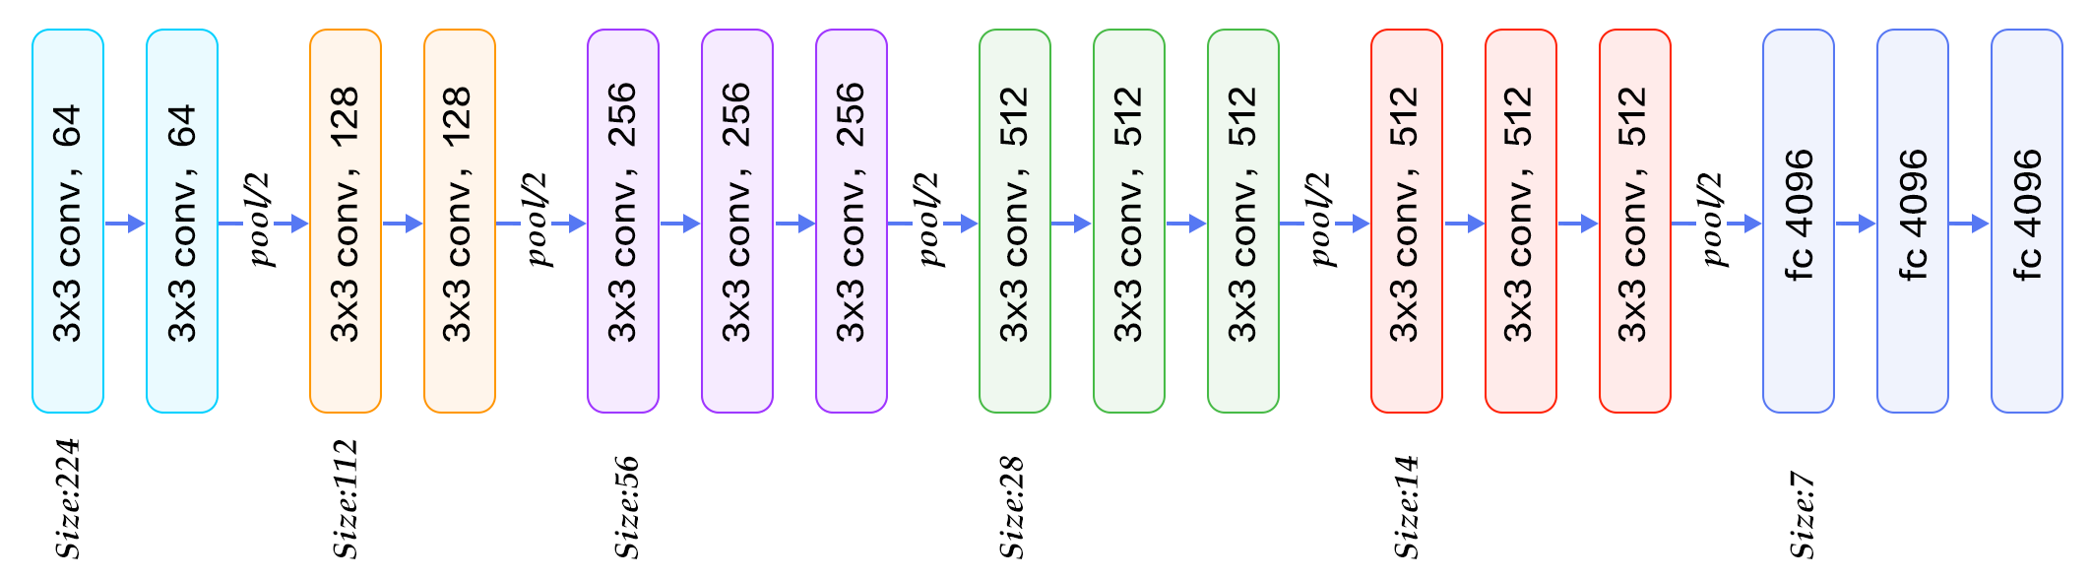
Transfer Learning
INTRODUCTION
CIFAR10
VGG16
INCEPTION-V3
Pipeline:
Resize Image to the Required Size (224*224*3)
Package Images into Batches
Transfer learning--train the last layer(fc-8)
CONCLUSION

Slide 13
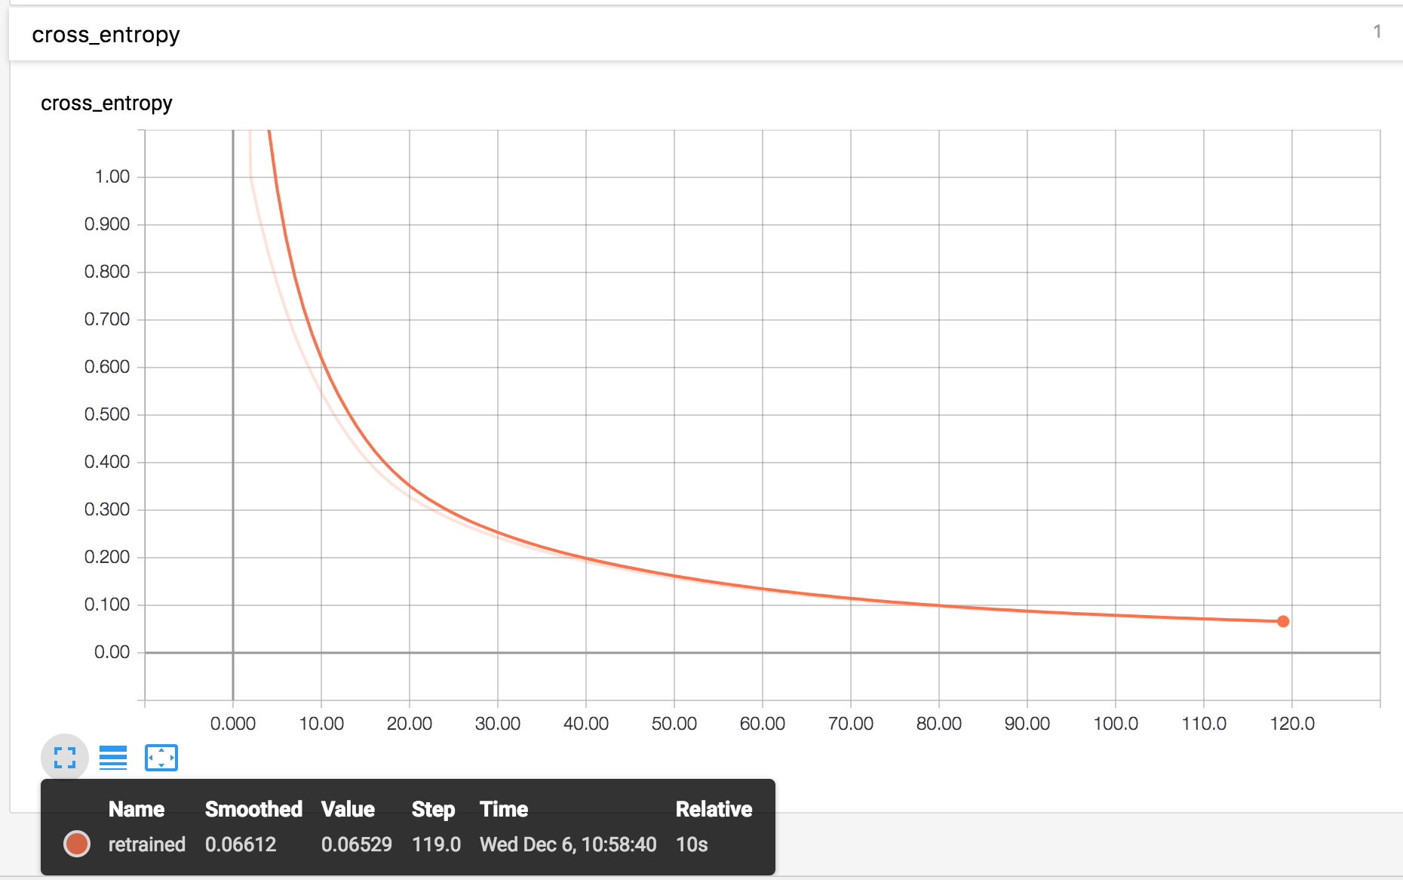
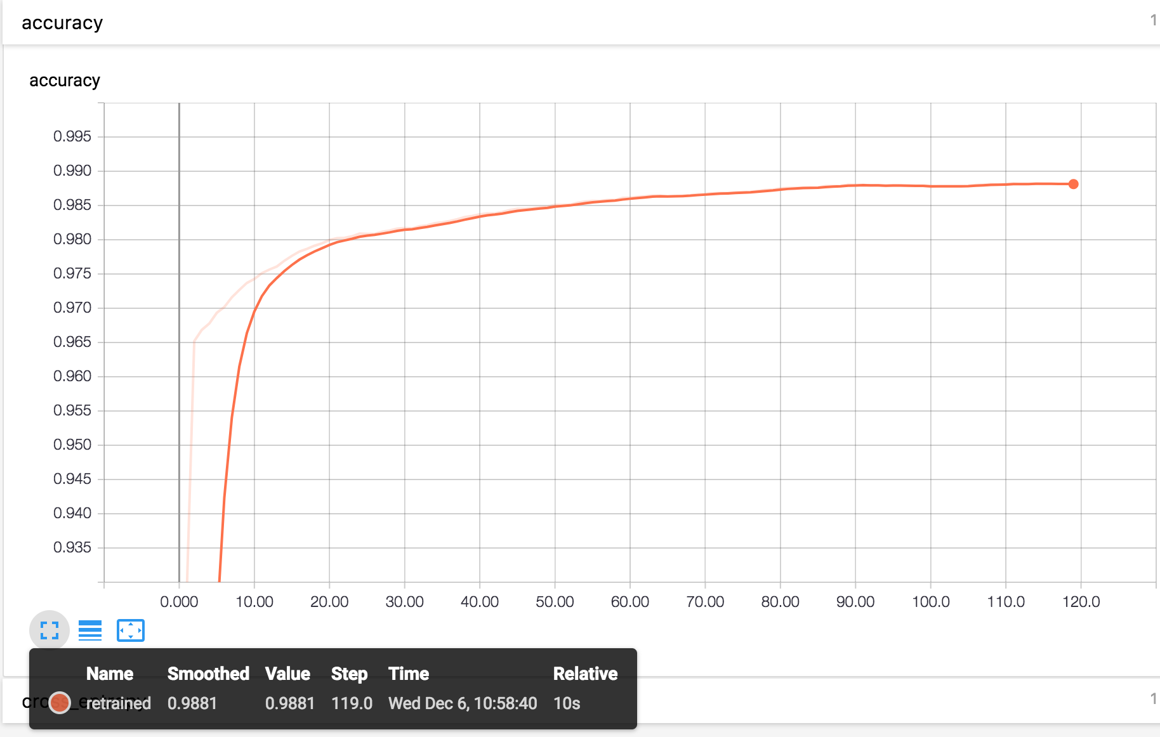
Results
FALL 2017, PROJ5, GRP 7
Training Loss:
Accuracy:
INTRODUCTION
CIFAR10
VGG16
INCEPTION-V3
CONCLUSION
The training process took us about 6 hour.
The reason that we only use 10s is that we have already saved all the features of each image before last layer. So we only spent 22s on optimization and evaluation process.

Slide 14
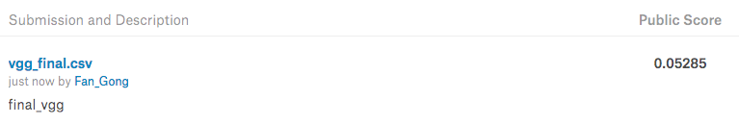
Results
FALL 2017, PROJ5, GRP 7
Result
Prediction Log Loss
INTRODUCTION
CIFAR10
VGG16
2. Ranking (87 / 1314 = top 6.6%)
INCEPTION-V3
CONCLUSION

Slide 15
PART 4
Inception-V3
Introduction to inception model
Transfer Learning
Result

Slide 16
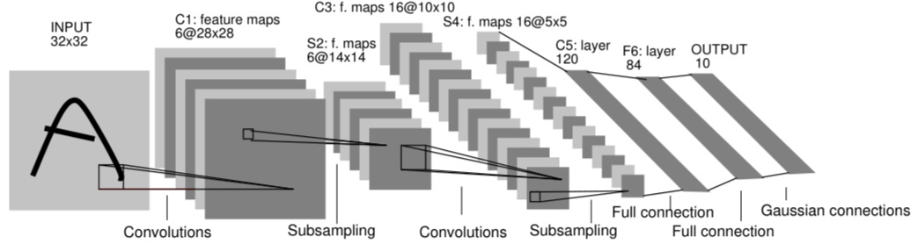
Neural Network- Image Classification
FALL 2017, PROJ5, GRP 7
Before Inception model, the neural networks are mostly like this:
INTRODUCTION
CIFAR10
VGG16
INCEPTION-V3
CONCLUSION
Increase the depth of NNs
To improve the accuracy:
Increase the width of CLs
Notes:
What they care about most is the order of convolution layer and pooling layer. So if you want to improve the accuracy, you need to increase the depth of your NN and also increase your width of each layer. But what inception model does is a little bit different.

Slide 17
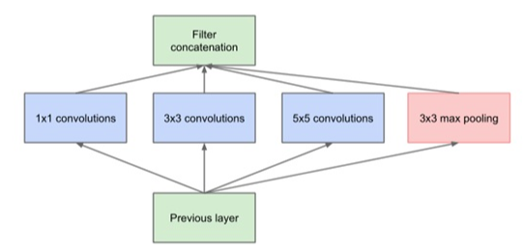
Neural Network- Image Classification
FALL 2017, PROJ5, GRP 7
What Inception model does:
INTRODUCTION
CIFAR10
VGG16
INCEPTION-V3
CONCLUSION
Create bottleneck layer (or mixed layer): One layer contains different type of filtering. So each time we can learn both sparse feature and dense feature.
Use batch normalization, decrease the internal covariate shift

Slide 18
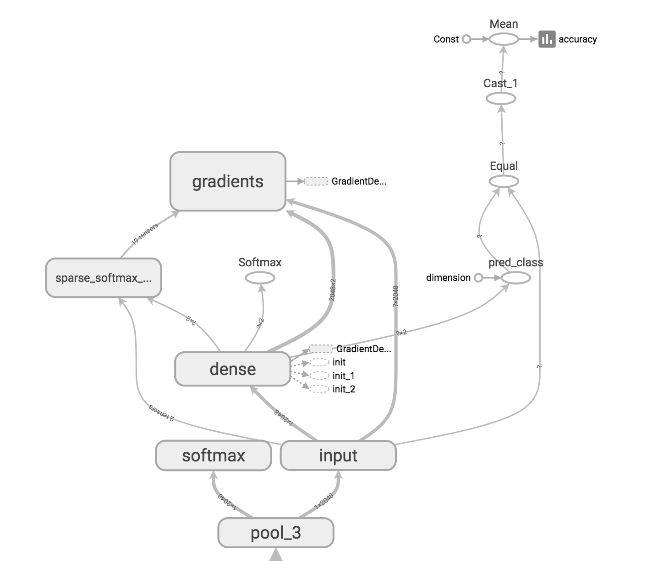
Neural Network- Image Classification
FALL 2017, PROJ5, GRP 7
Tensorboard:
Add a dense layer
Minimize cross entropy
Output softmax
Calculate Accuracy
INTRODUCTION
CIFAR10
VGG16
INCEPTION-V3
CONCLUSION

Slide 19
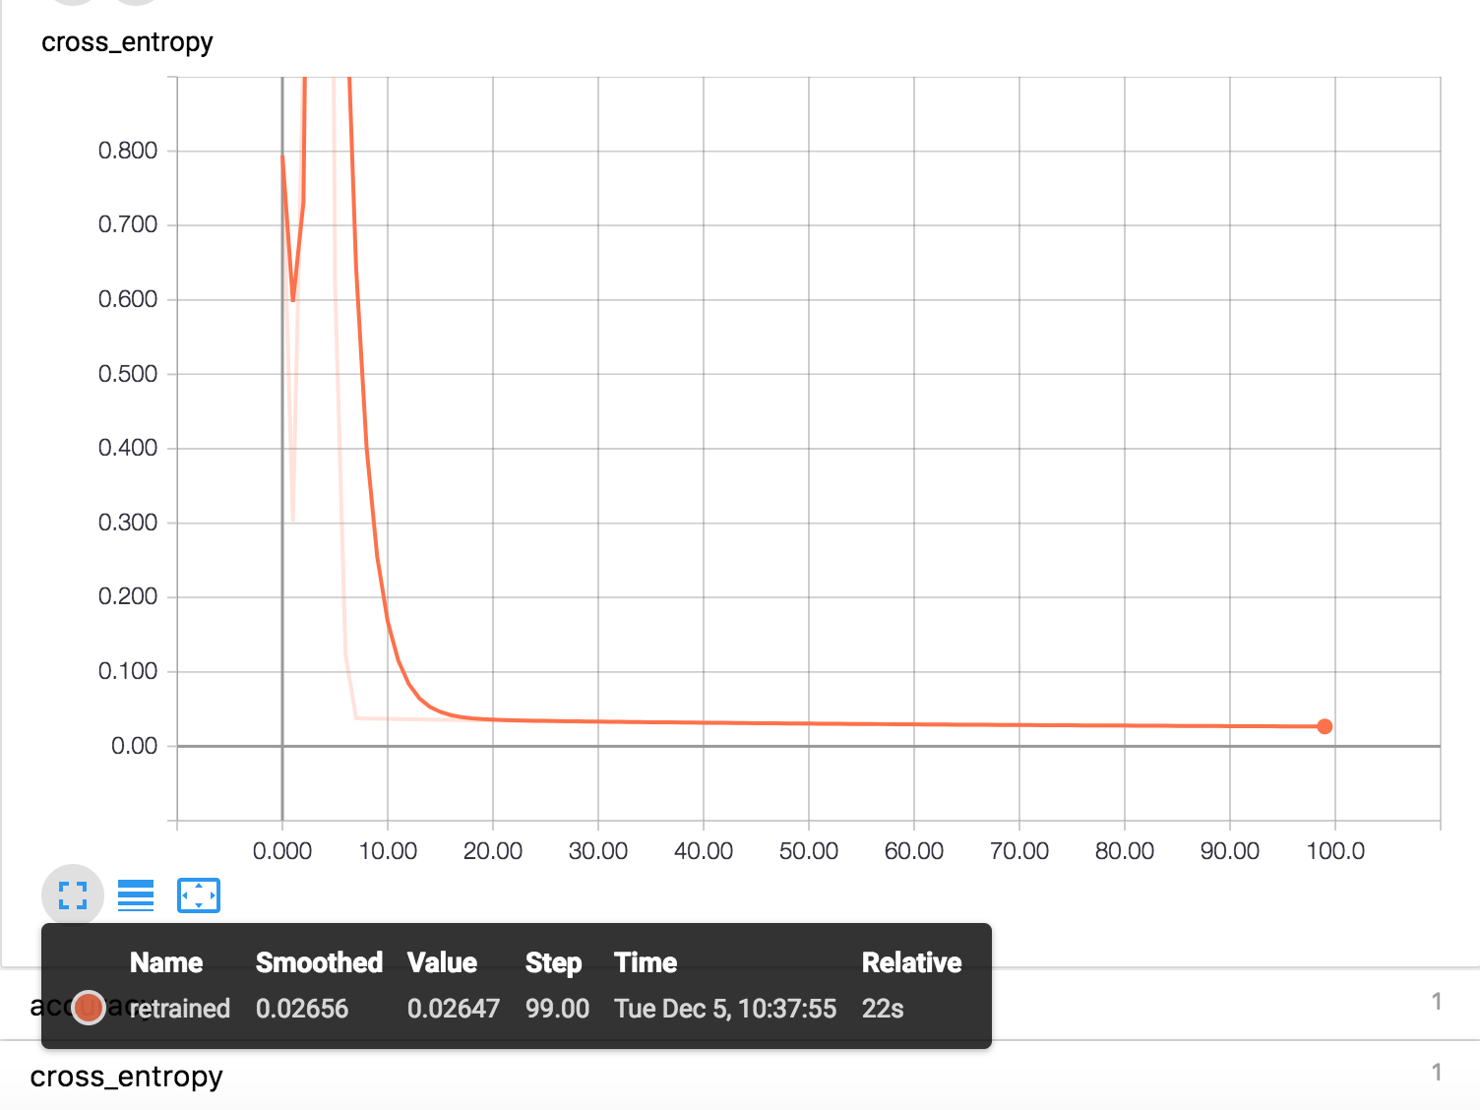
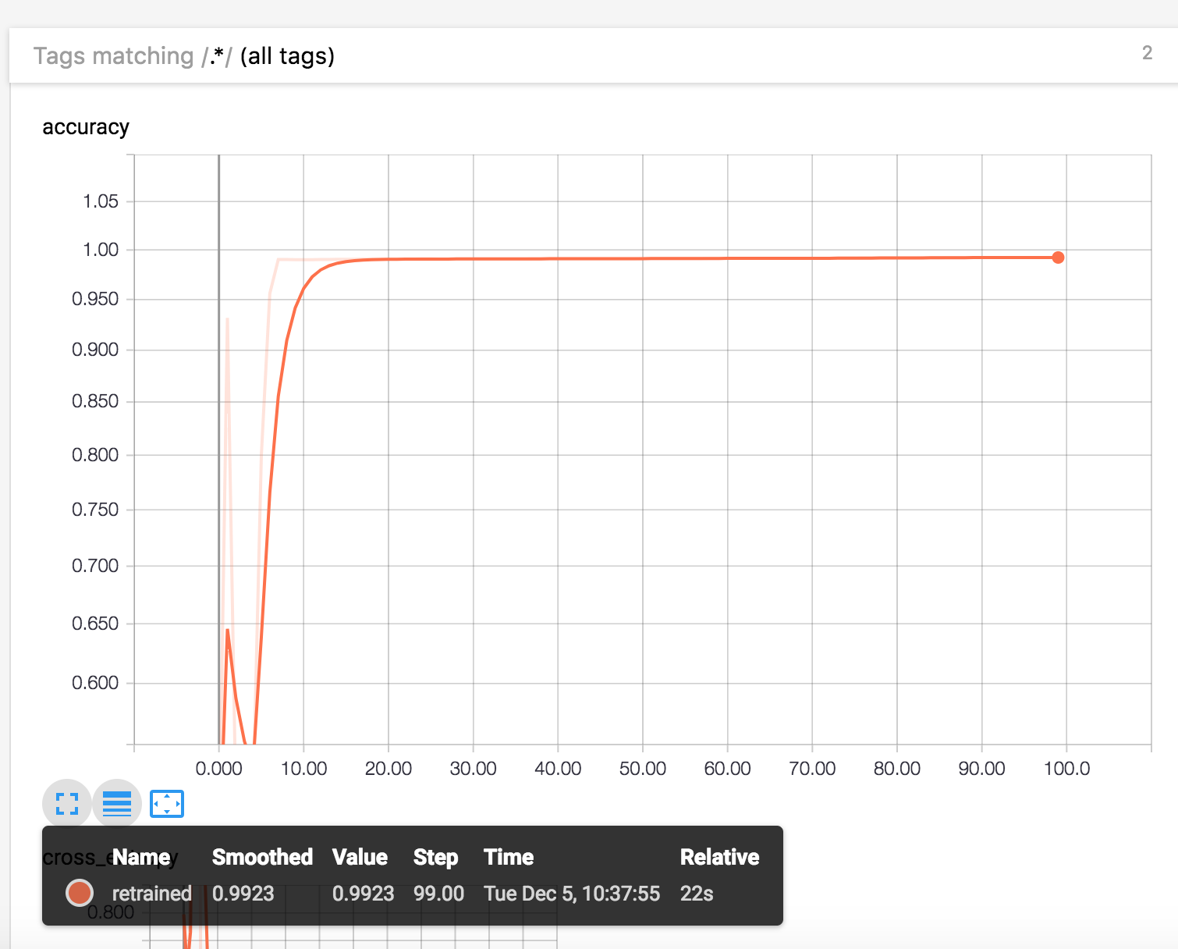
Neural Network- Image Classification
FALL 2017, PROJ5, GRP 7
Training Loss:
Accuracy:
INTRODUCTION
CIFAR10
VGG16
INCEPTION-V3
CONCLUSION
The training process took place for about 2 hour.
The reason that we only use 22s is that we have already saved all the features before last layer. So we only spent 22s on optimization and evaluation process.
Notes:
The reason that we only use 22s is that we have already saved all the features before last layer.

Slide 20
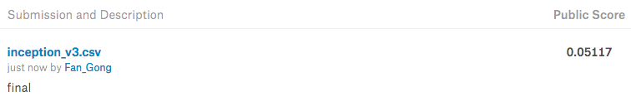
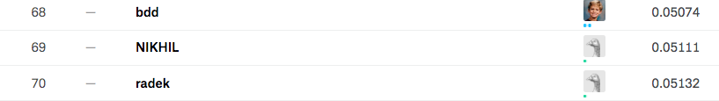
Neural Network- Image Classification
FALL 2017, PROJ5, GRP 7
Result
Prediction Log Loss
INTRODUCTION
CIFAR10
VGG16
2. Ranking (70 / 1314 = top 5.3%)
INCEPTION-V3
CONCLUSION

Slide 21
PART 5
Conclusion
Network Comparison & Result Display

Slide 22
Neural Network- Image Classification
FALL 2017, PROJ5, GRP 7
Conclusion
 | CIFAR10(2004) | VGG-16(2014) | INCEPTION-V3(2015)
Kernel Size | 5 x 5 | 3 x 3 | 1 x1 / 3 x 3 / 5 x 5
Number of Layers | 7 | 16 | 48
Training Time | 3 hrs | 6 hrs | 2 hrs
Kaggle Score (Log Loss) | 0.32081 | 0.05285 | 0.05117
Kaggle Rank | 65% | 6% | 5%
INTRODUCTION
CIFAR10
VGG16
INCEPTION-V3
CONCLUSION

Slide 23
THANKS
PLEASE ENJOY
PRESENTED BY GROUP7
Chenyun Wu
Fan Gong
Hongjie Ren
Qihang Li
Yingbin Jiang

