Slide 1
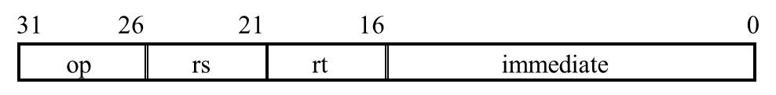
Beq指令的Single Cycle Datapath（示例）
if (Reg[rs]-Reg[rt] == 0)
PC = PC + 4 + Imm<<2
else
PC = PC + 4
Inst
Memory
Instruction<31:0>
<21:25>
<16:20>
<11:15>
<0:15>
Addr
Control Unit
<26:31>, etc.
Rs
Rt
Rd
imm16
Inst Address
Rd
Rt
Mux
RegDst=X
4
32
Rs
Rt
ALUSrc=0
ALUConf=Sub
RegWr=0
Adder
5
5
5
0
busA
PC
Rw
Ra
Rb
PC
busW
32 32-bit
Registers
32
Zero
Mux
ALU
Result
32
32
1
busB
Adder
0
MemtoReg
=X
Clk
32
Mux
<< 2
PCSrc=
Branch and Zero
MemWr=0
Clk
imm16
ImmExt
16
1
WrEn
Addr
Data In
Data Out
32
Mux
ExtOp=1
(Signed)
32
Data
Memory
Clk
32

Slide 2
流水线（示例）
PCSrc
1
0
ID/EX
EX/MEM
IF/ID
Control
Branch
Add
MEM/WB
4
RegWr
Add
<<2
Zero
Instruction
Memory
Read
Addr 1
Read
Data 1
Read
Addr 2
A
Data
Memory
MemtoReg
PC
Read
Address
Regs
Read
Data
ALU
Address
1
0
Write Addr
Read
Data 2
1
0
Write Data
B
Write Data
ALUOp
Imm
Extend
RegDst
MemRead
MemWr
16
32
0
1
ID/EX.Rt
Forwarding
Unit
EX/MEM.RegWrAddr
ID/EX.Rs
MEM/WB.RegWrAddr

