Slide 4
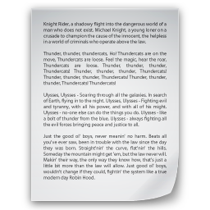
Is the comment below relevant to the article?
Is the comment below relevant to the article?
Are comments below relevant to the article?
“This idea looks cool. What do you think?”
☒ “Indeed.”
“This idea looks cool. What do you think?”
“Indeed.”
Annotated by Worker #1
Annotated by Worker #2
Annotated by Worker #3

Slide 5
Is the comment below relevant to the article?
Is the comment below relevant to the article?
Are comments below relevant to the article?
“This idea is cool. Isn’t it?”
☒ “Indeed.”
“This idea is cool. Isn’t it?”
“Indeed.”
Annotated by Worker #1
Annotated by Worker #2
Annotated by Worker #3

