Slide 4
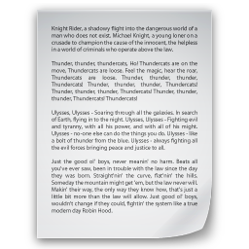
Is the comment below relevant to the article?
Is the comment below relevant to the article?
Are comments below relevant to the article?
“This idea looks cool. What do you think?”
☒ “Indeed.”
“This idea looks cool. What do you think?”
“Indeed.”
Annotated by Worker #1
Annotated by Worker #2
Annotated by Worker #3

Slide 5
Is the comment below relevant to the article?
Is the comment below relevant to the article?
Are comments below relevant to the article?
“This idea is cool. Isn’t it?”
☒ “Indeed.”
“This idea is cool. Isn’t it?”
“Indeed.”
Annotated by Worker #1
Annotated by Worker #2
Annotated by Worker #3

Slide 6

Label positive reviews on the movie “The Imitation Game”
☒ Stack of Lies

Slide 7
Label positive reviews on the movie “The Imitation Game”
☒ Average In The Extreme

Slide 8
Label positive reviews on the movie “The Imitation Game”
☑ Good enough but historically sketchy

Slide 9
Label positive reviews on the movie “The Imitation Game”
☑ Great movie, worth a watch

Slide 10
Label positive reviews on the movie “The Imitation Game”
☒ Stack of Lies
☑ Average In The Extreme

Slide 11
Label positive reviews on the movie “The Imitation Game”
☒ Good enough but historically sketchy
☑ Great movie, worth a watch

