Slide 1

Dual (XG + Cat) Boost +
MLP 6-Fold OOF model
黄之杰 2023200251
Highlights & Innovations
Advanced Hybrid Modeling Architecture
Strong nonlinear interaction modeling of tree ensembles & the representation learning capability of deep neural networks
Robust and Reproducible Data Preprocessing Pipeline
Mitigate outliers, standardized scaling of numerical features, and consistent feature transformations
Professional Training and Validation Strategy
K-Fold cross-validation and out-of-fold (OOF) predictions to obtain reliable generalization estimates
Metrics | In sample rmse | Out of sample rmse | Cross-validation rmse | Kaggle Score
OLS (Midterm) | 808210 | 837201 | 862298 | 64.8
Xgboost | 373133 | 582679 | 597596.94 | 72.8
Xgboost + MLP | 351135 | 499390 | 498842.67 | 75.5
Dual boost + MLP | 3394496.56 | 475270.36 | 524329.70 | 77.8

Slide 2
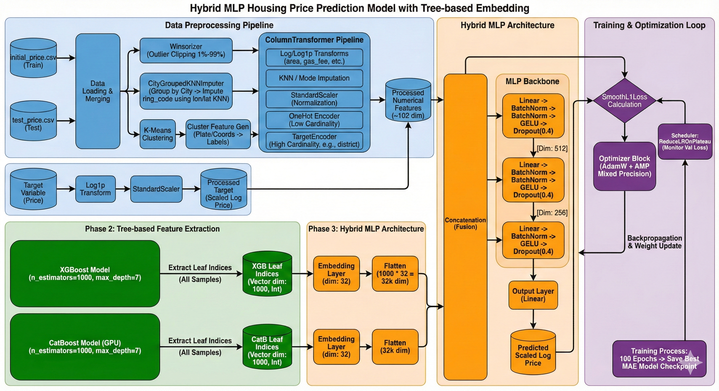

Slide 3
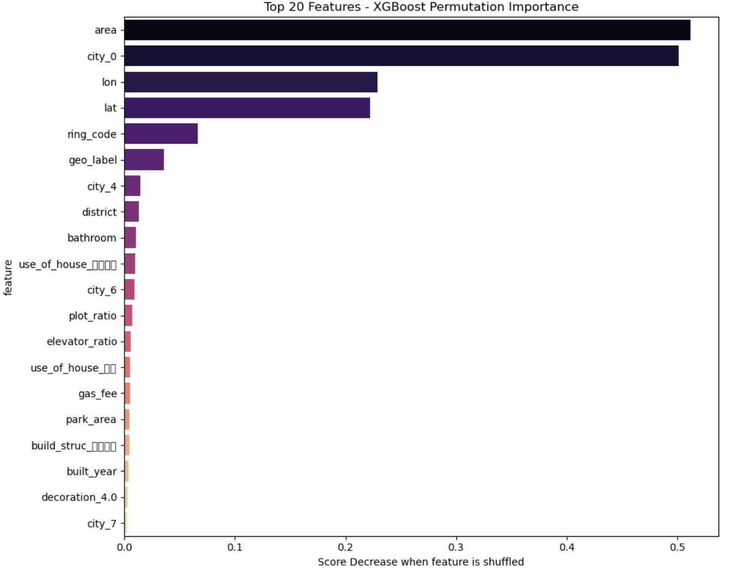
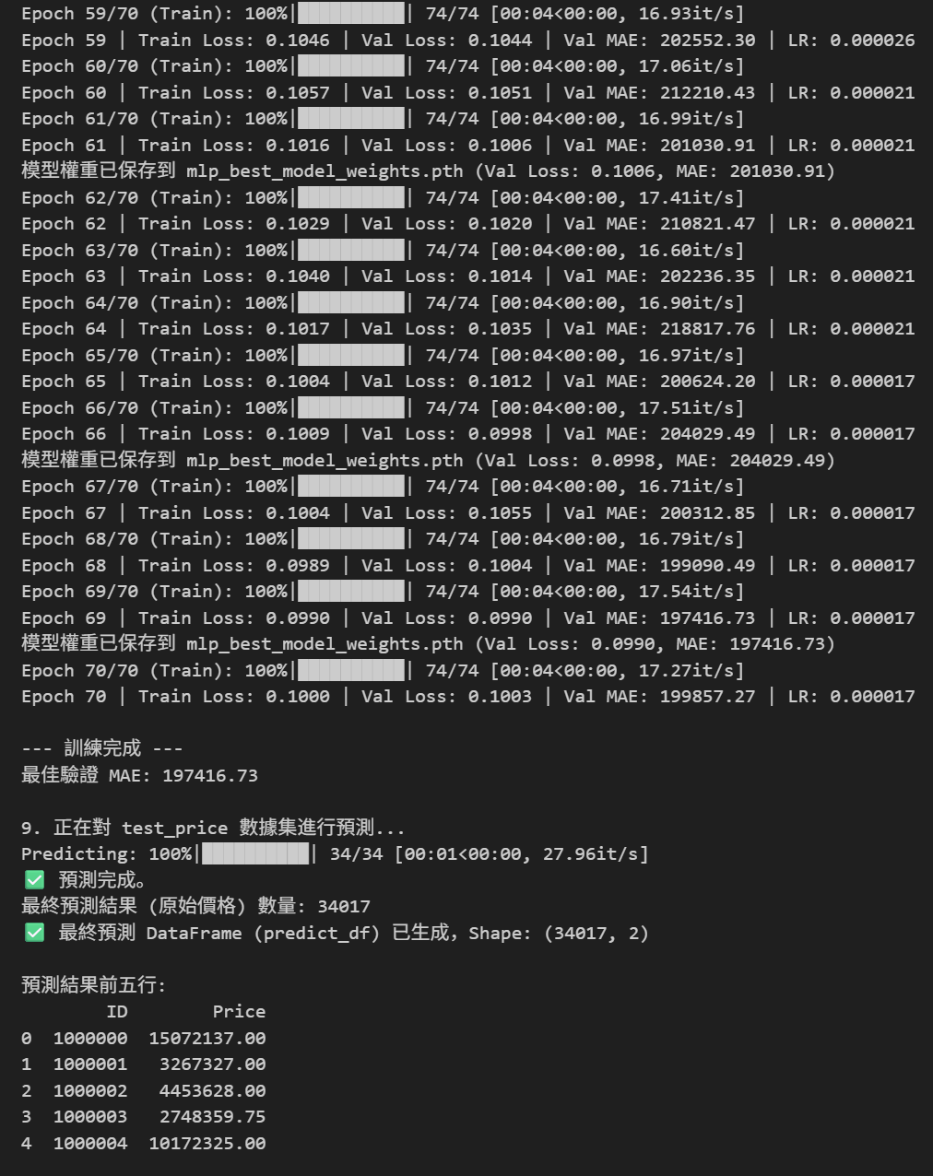
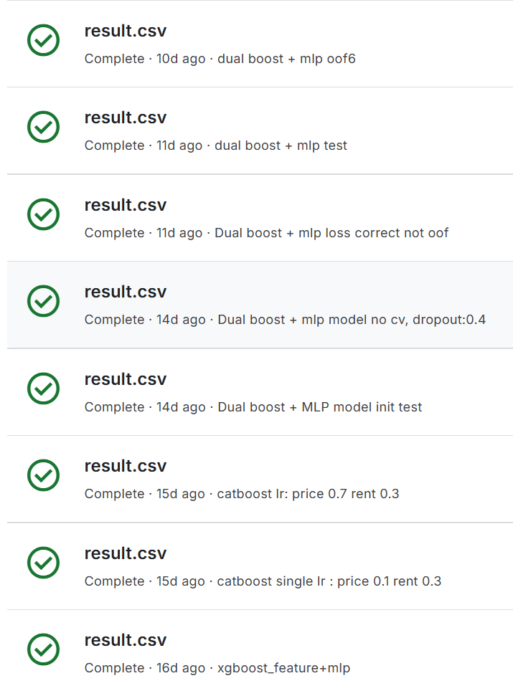
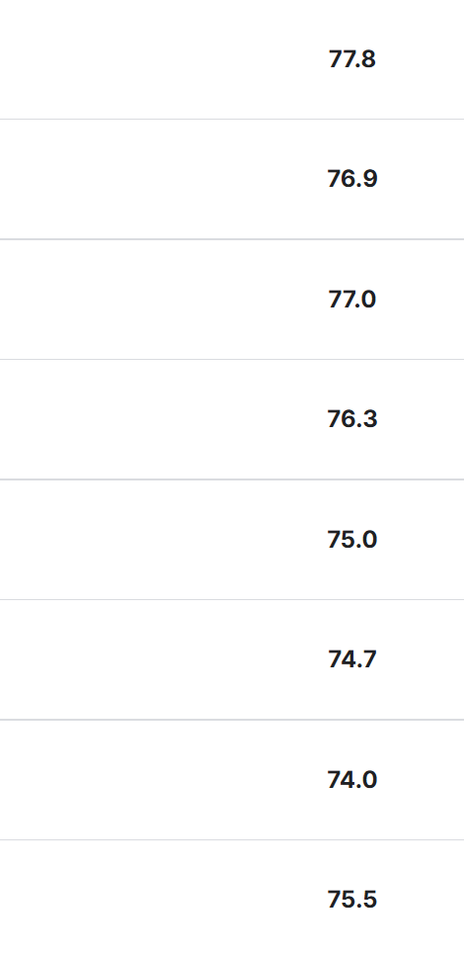
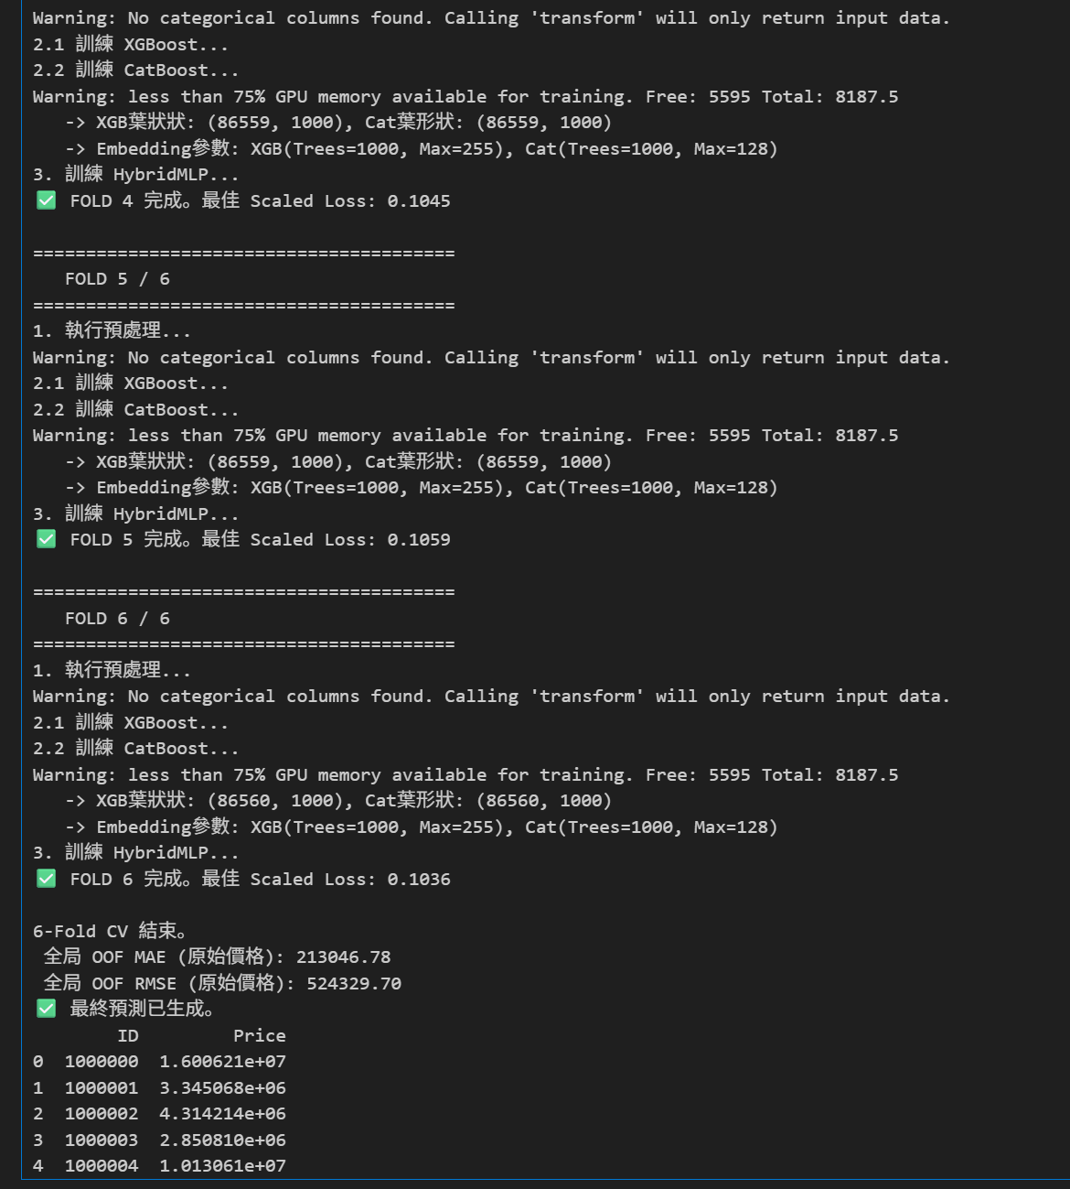

Reflection
Feature Significance & Interpretability
Lack of feature importance analysis, which prevents informed feature selection and the pruning of redundant decision paths
Parameter & Hyperparameter Optimization
Limited by heuristic-based hyperparameter settings (e.g., fixed embedding dimensions and hidden layers)
Advanced Feature Engineering: Reverse Modeling
MLP’s internal hidden states can be used as high-level, non-linear feature representations to augment a final gradient boosting regressor
Welcome to questions ~

