Slide 1
人工智能与python
——汇报人：朱炫臻

Slide 2
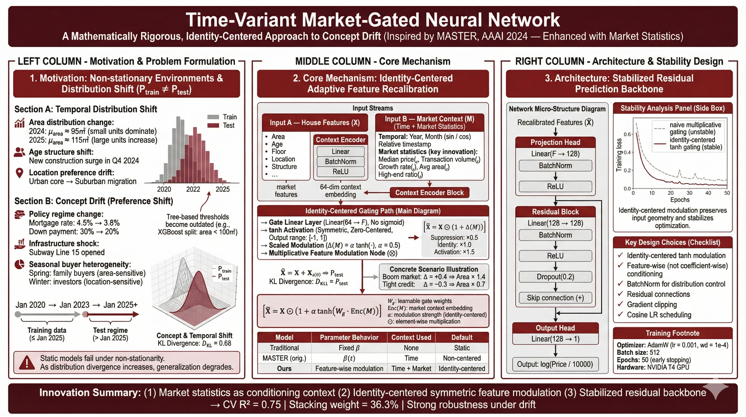
64
64
64
64
Feature-wise
Time+Market
Non-centered
0.84
15.3%

Slide 3
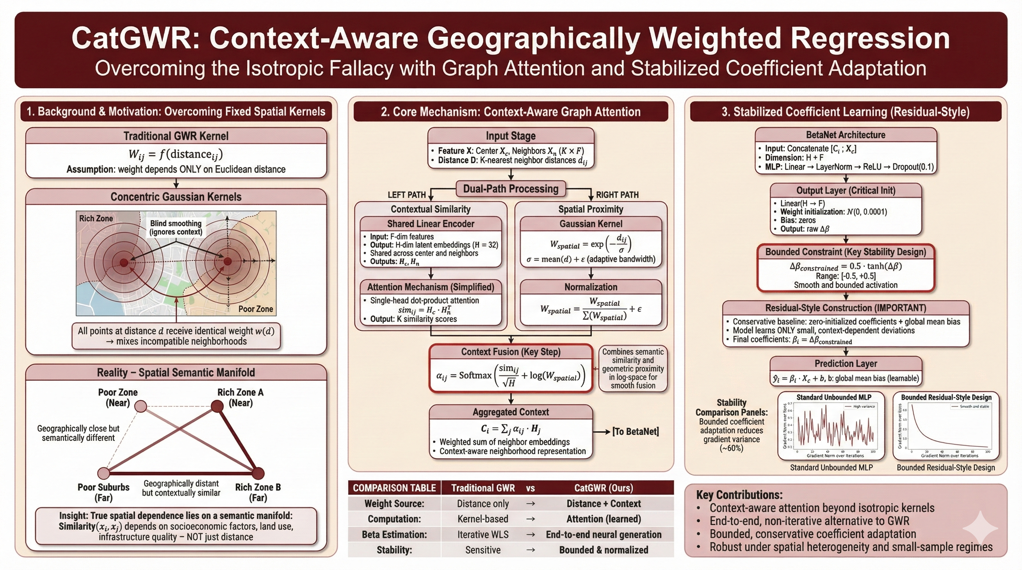
LASSO-estimated global sparse coefficients
+β_{Lasso}

Slide 4
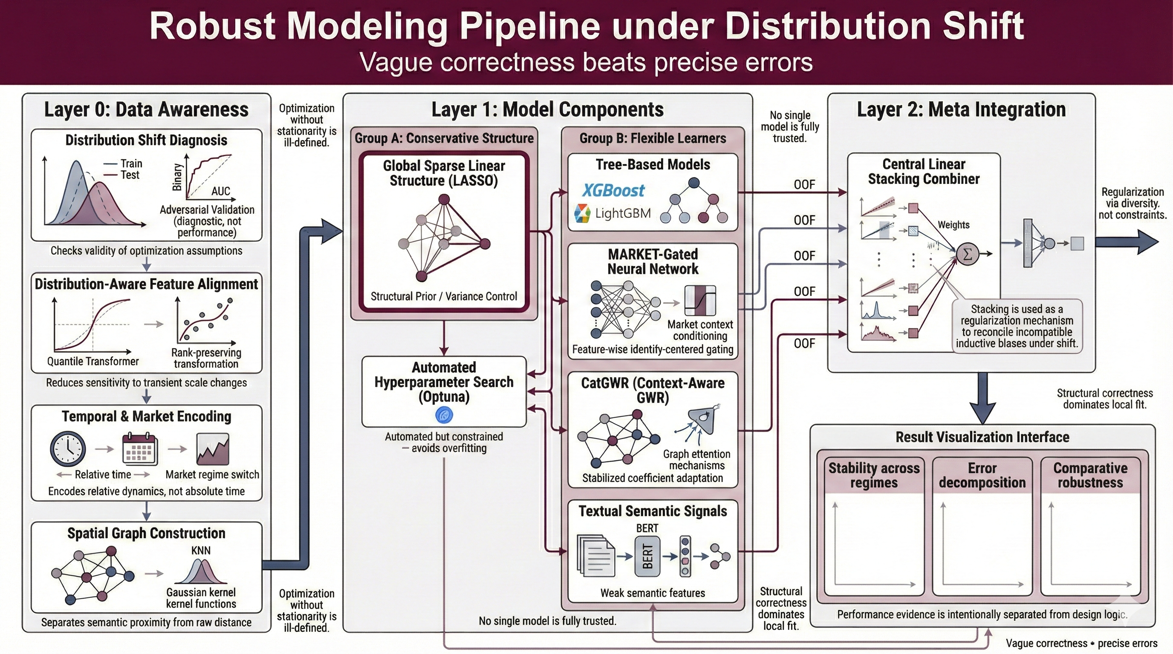
Metrics | In sample rmse | out of sample rmse | Cross-validation rmse | Kaggle Score
Midterm Linear Model | 217733 | 219114 | 220104 | 68.82
XGB | 170384 | 175893 | 173112 | 75.8
LGB | 174392 | 179230 | 178480 | 75.8
MARKET | 309820 | 322871 | 315564 | 75.1
GWR | 264292 | 287586 | 266850 | 70.5
Stacking | 152837 | 163910 | 159802 | 76.8
Best Model | 152837 | 163910 | 159802 | 76.8
Metrics | In sample rmse | out of sample rmse | Cross-validation rmse | Kaggle Score
Midterm Linear Model | 97855 | 98318 | 67841 | 68.82
XGB | 58308 | 62197 | 58982 | 75.8
LGB | 58154 | 61936 | 57597 | 75.8
MARKET | 69263 | 71290 | 70334 | 75.1
GWR | 90754 | 95692 | 91765 | 70.5
Stacking | 55028 | 55290 | 54927 | 76.8
Best Model | 55028 | 55290 | 54927 | 76.8

