Slide 1
Housing Price and Rent Prediction Final Exam： Quant Modeling
白瑞睿 2023200753
Renmin University of China
2023 Dual Bachelor’s Degree Program in Econ and Math

Slide 2
Data Processing
清洗：统一数值格式，Winsorize(5%/15%)处理异常值
编码：分类特征转为哑变量
列删减：移除无关冗余列
创新点1：HDBSCAN 地理聚类
→ 其他条件不变时，kaggle分数由63.9提升至71.9

Slide 3
Data Processing
创新点2：Knowledge Ditillation(小样本蒸馏)
随机抽取300条数据用LLM读取
TF-IDF+逻辑回归训练模型，高效预测剩余数据
Column | Positive | Negative | Neutral
核心卖点 | 80.66% | 0.00% | 19.34%
户型介绍 | 28.13% | 0.00% | 71.87%
周边配套 | 53.61% | 0.00% | 46.39%
交通出行 | 44.84% | 0.00% | 55.16%
客户反馈_Price | 44.59% | 54.96% | 0.45%
客户反馈_Rent | 53.44% | 44.93% | 1.63%

Slide 4
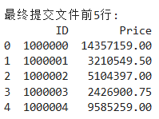
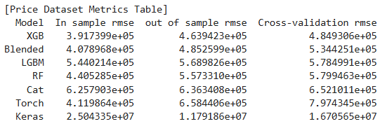
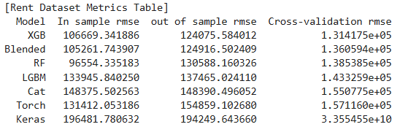
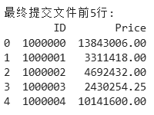
Model Performances
Model | In | OOS | CV | KS
XGB_price | 391.7k | 463.9k | 484.9k | 75.9
XGB_rent | 106.6k | 124.0k | 131.4k | 75.9
XGB_price* | 392.9k | 464.7k | 485.8k | 75.9
XGB_rent* | 106.3k | 124.8k | 131.6k | 75.9
In = In-sample RMSE
OOS = Out-of-sample RMSE
CV = Cross-validation RMSE
KS = Kaggle Score
All values in thousands(k)

