Slide 1


Slide 5
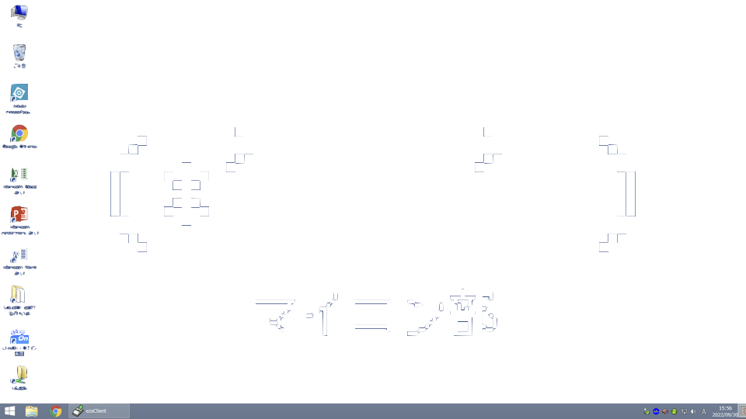

Hongo Micro Controller Club

Slide 6
Hongo Micro Computer Club

Slide 7
Hongo Mind Control Club

Slide 8
省エネモード中

Slide 9
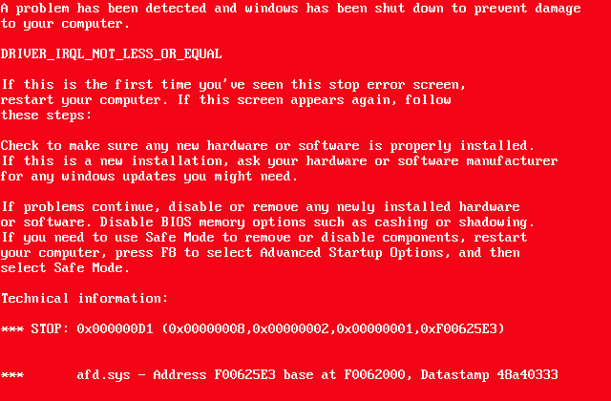
Fatal Error

