Slide 1
课程项目2
PostgreSQL上的Similarity Join实现

Slide 2
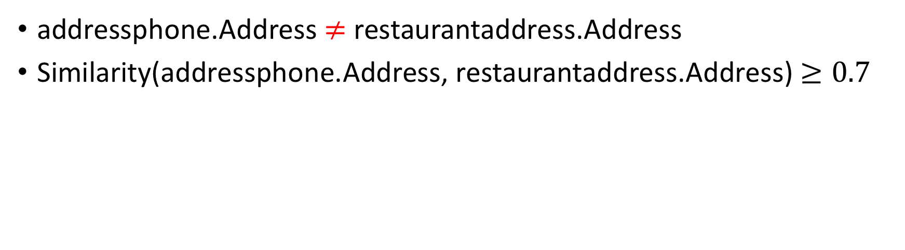
相似性查询
addressphone
Address | Phone
11 North Michigan Avenue Chicago | (312) 521-7275
restaurantaddress
Name | Address
Par; Grill restaurant | 11 N Michigan Avenue Chicago

Slide 3
两种相似性度量方式
Levenshtein Distance
Jaccard Index

Slide 4
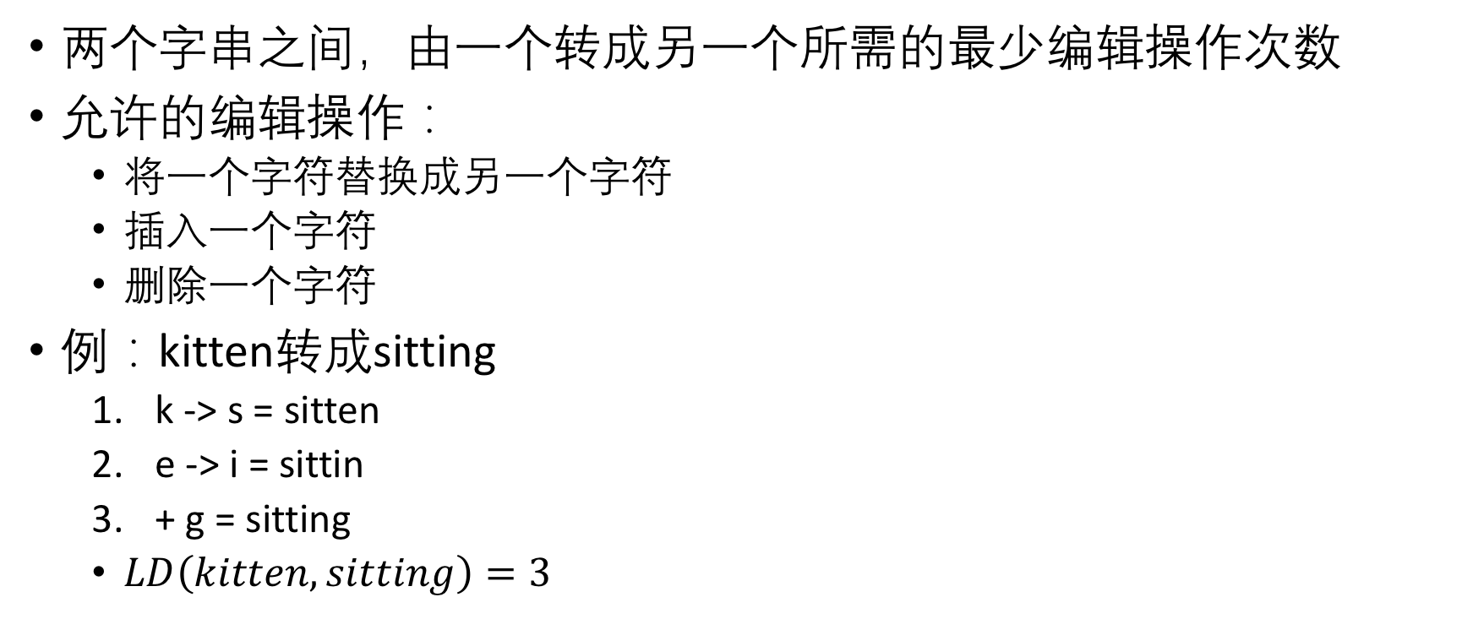
Levenshtein Distance

Slide 5
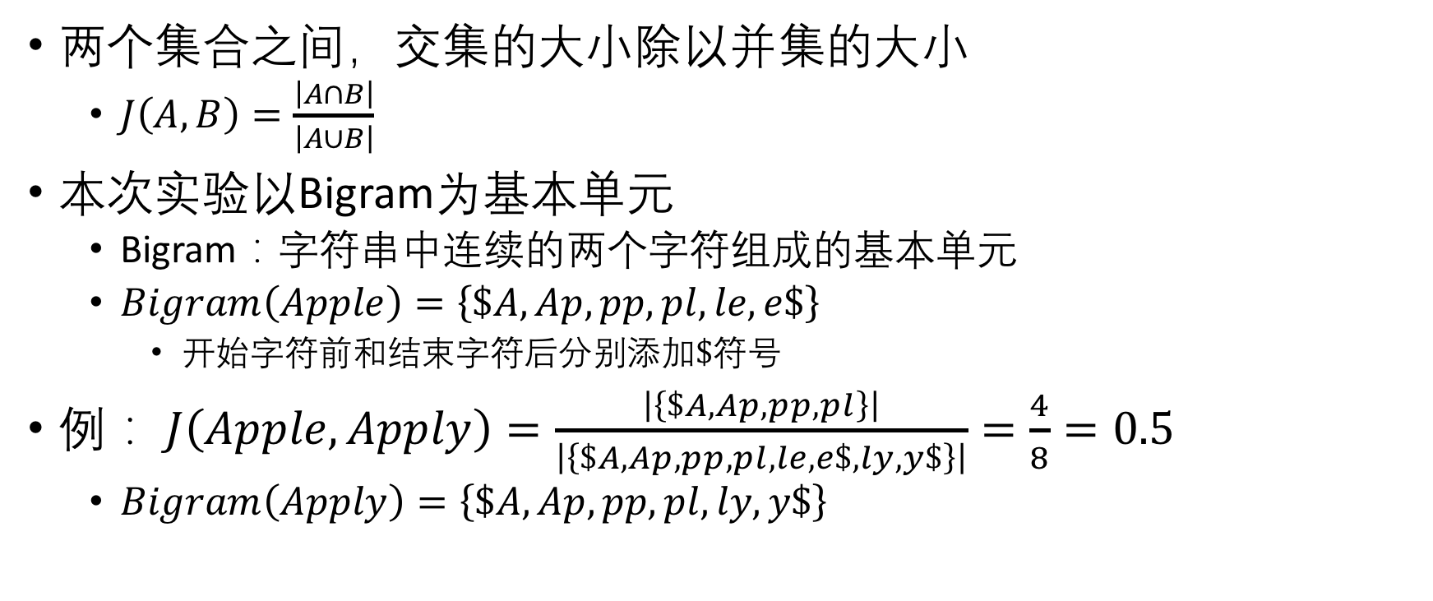
Jaccard Index

Slide 6
测试查询
Levenshtein Distance
select count(*)
from restaurantaddress ra, addressphone ap
where levenshtein_distance(ra.address, ap.address) < 4;
Correct:2592
Jaccard Index
select count(*)
from restaurantphone rp, addressphone ap
where jaccard_index(rp.phone, ap.phone) > 0.6;
Correct:1653

Slide 7
结果验证（依次增大）
select count(*) from restaurantphone rp, addressphone ap where levenshtein_distance(rp.phone, ap.phone) < 4;
select count(*) from restaurantaddress ra, restaurantphone rp where levenshtein_distance(ra.name, rp.name) < 3;
select count(*) from restaurantaddress ra, addressphone ap where levenshtein_distance(ra.address, ap.address) < 4;
select count(*) from restaurantphone rp, addressphone ap where jaccard_index(rp.phone, ap.phone) > 0.6;
select count(*) from restaurantaddress ra, restaurantphone rp where jaccard_index(ra.name, rp.name) > 0.65;
select count(*) from restaurantaddress ra, addressphone ap where jaccard_index(ra.address, ap.address) > 0.8;

Slide 8
实验流程
准备开发环境，推荐使用Linux Ubuntu 发行版
https://www.ubuntu.com/download/desktop
Windows下可使用VirtualBox配置虚拟环境
https://www.virtualbox.org/wiki/Downloads
下载PostgreSQL源码
https://ftp.postgresql.org/pub/source/v10.4/postgresql-10.4.tar.gz
阅读PostgreSQL文档，进行编译、安装
https://www.postgresql.org/docs/10/static/installation.html
阅读文档、源码，修改源码，并调试
https://www.postgresql.org/docs/10/static/index.html

Slide 9
实验流程
导入数据，运行实验测试样例，记录返回结果、运行时间等
撰写实验报告
系统与源码理解
设计思路与实现方案
关键代码说明
实验与结果
性能优化

Slide 10
验收方式
2人一组
6月26日23:55前通过elearning提交(期末考后一周）
本次Project不用Pre
压缩包命名方式：学号_姓名
内容
实验报告
源代码
评分依据
实验报告
代码质量
实现与优化情况

Slide 11
参考文献
Levenshtein Distance
https://en.wikipedia.org/wiki/Levenshtein_distance
Jaccard Index
https://en.wikipedia.org/wiki/Jaccard_index
Bigram
https://en.wikipedia.org/wiki/Bigram
PostgreSQL Documents
https://www.postgresql.org/files/documentation/pdf/10/postgresql-10-A4.pdf

