Slide 1
Duke University
Project Week02
January 14, 2022
Hongren Jiang

Slide 2
Problem 1
Compare the conditional distribution of the Multivariate Normal, to the OLS equations. Are these values the same? Why? Use the data in problem1.csv to prove your answer empirically.
Hongren Jiang
Project Week02

Slide 3
Answer 1
The following are the conditional expected value and variance for the multivariate distribution:
12
22
Var[P(X1|X2 = x2] = σ 11 −
σ
E[P(X1|X2 = x2 )] = µ 1 + (x2 − µ2 )
^{σ} 2
σ22 The following are the expected value and variance for the OLS regression:
E[Y |X = x] = E[βX + c + e|X = x] = βx + c Var[Y |X = x] = Var[βX + c + e|X = x] = Var[e]
σ
2
1
Hongren Jiang
Project Week02

Slide 4
Answer 1
Therefore, we only need to calculate the above values and compare them. Through the algorithm provided by problem1.ipynb, we can get:
Var[P(X1|X2 = x₂ )] ≈ 0.657956
Var[Y |X = x] ≈ 0.651377
They are almost the same.
We use images to visually represent the difference between two expectation vectors
Hongren Jiang
Project Week02

Slide 5

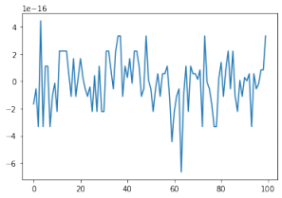
Answer 1
As you can see, the difference between the two is very small. Therefore, they can be considered equal.
Hongren Jiang
Project Week02

Slide 6
Problem 2
Fit the data in problem2.csv using OLS and calculate the error vector. Look at it’s distribution. How well does it fit the assumption of normally distributed errors?
Fit the data using MLE given the assumption of normality. Then fit the MLE using the assumption of a T distribution of the errors. Which is the best fit?
What are the fitted parameters of each parameters of each and how do they compare? What does this tell us about the breaking of the normality assumption in regards to expected values in this case?
Hongren Jiang
Project Week02

Slide 7
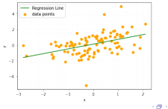
Answer 2
The following are the OLS equation and fitting result:
= ^{βˆ}x + c
βˆ ≈ 0.605205
c ≈ 0.119836
= 0.605205x + 0.119836
Here are the picture of regression line and data point:
Hongren Jiang
Project Week02

Slide 8
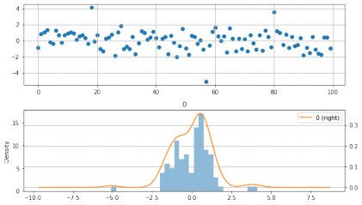
The residual equation is as follows
error = y −
Here are the graphs:
Hongren Jiang
Project Week02

Slide 9
Answer 2
They do not look like they follow a normal distribution. Therefore, I do the K-S test:
Pvalue ≈ 0 < 0.05
The errors do not follow a normal distribution. Then, I use MLE method estimate the regression parameters, and get the following answers: Based on the assumption of normality:
= 0.605190x + 0.119836
Based on the assumption of t-distribution:
= 0.594180x + 0.119835
These results are very similar.
Hongren Jiang
Project Week02

Slide 10
Problem 3
Simulate AR(1) through AR(3) and MA(1) through MA(3) processes. Compare their ACF and PACF graphs. How do the graphs help us to identify the type and order of each process?
Hongren Jiang
Project Week02

Slide 11

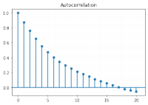
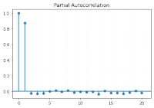
Answer 3
Hongren Jiang
Project Week02

Slide 12
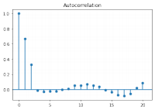
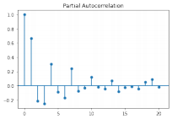
Answer 3
Hongren Jiang
Project Week02

