Slide 1
Weekly Report w142
紀宏勳
MMFAA1
Date 2021.10.14

Slide 2
Retrain Milestones in October
Main Work Item | Schedule |  |  |  | Sub Work Item
 | W141 | W142 | W143 | W144
Issue handle |  |  |  |  | 檔名路徑太長複製問題 資料每類保留固定張數 每對 TF CLS Job 需同生共死 模型對應多組產品
Deploy API |  |  |  |  | Upload file to 中繼PC Download file from 中繼PC View file in 中繼PC
Linux Environment |  |  |  |  | Retrain Requirement for 3090
Docker Image Automation |  |  |  |  | Run retrain Job in image automatically
Wylee、HS
HS
HS
HS

Slide 3





Deploy API
weight
weight
Call API
ADT PC
AI PC
Weight先丟這
API
Auto Depoly
D$
L$
網路磁碟機
D$
Weight所在地
中繼 PC
ADT PC
AI PC
weight
只看的到對應EQ

Slide 4

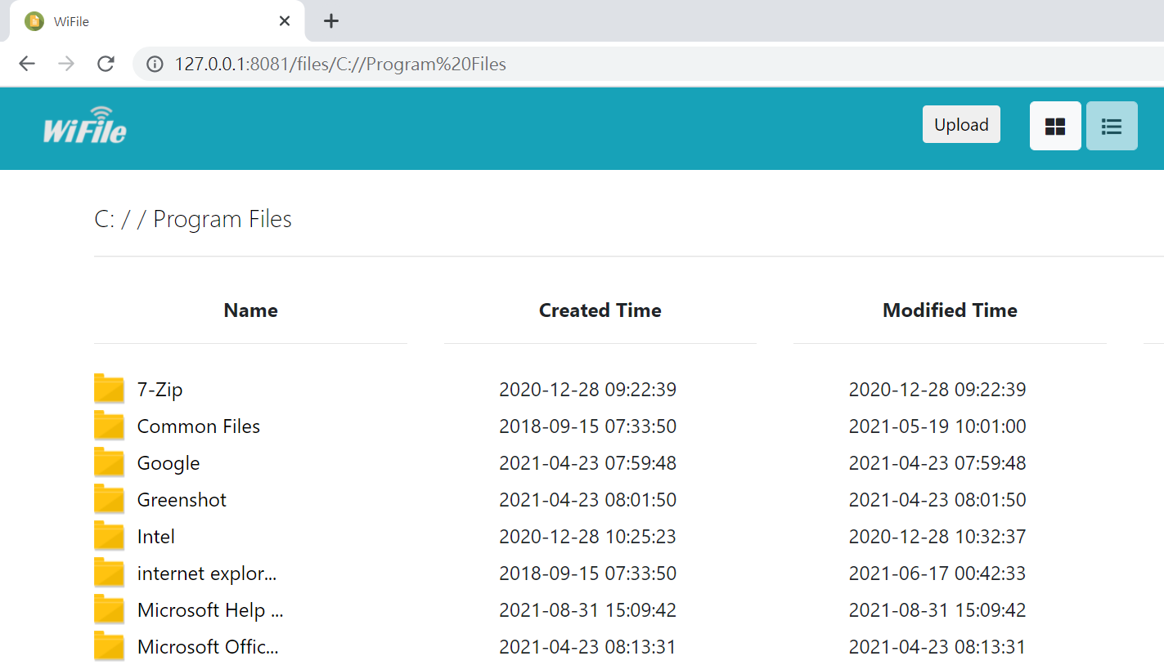
API Function
Upload file to 中繼 PC
Download file from 中繼 PC
View file from 中繼 PC (需調整)
API
中繼 PC

Slide 5
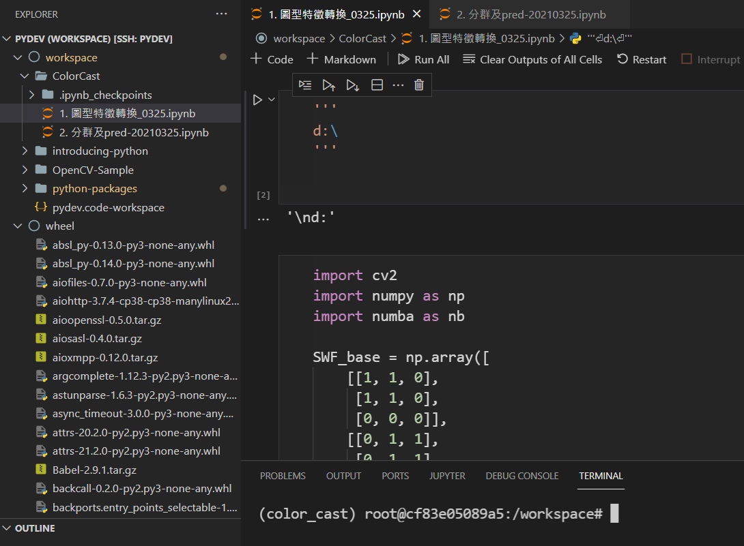
色偏預警協助
Phase
開發環境用jupyter執行
架設 color_casr環境
等待作者移除多餘的程式碼
轉單檔 python
DLL 串接

Slide 6
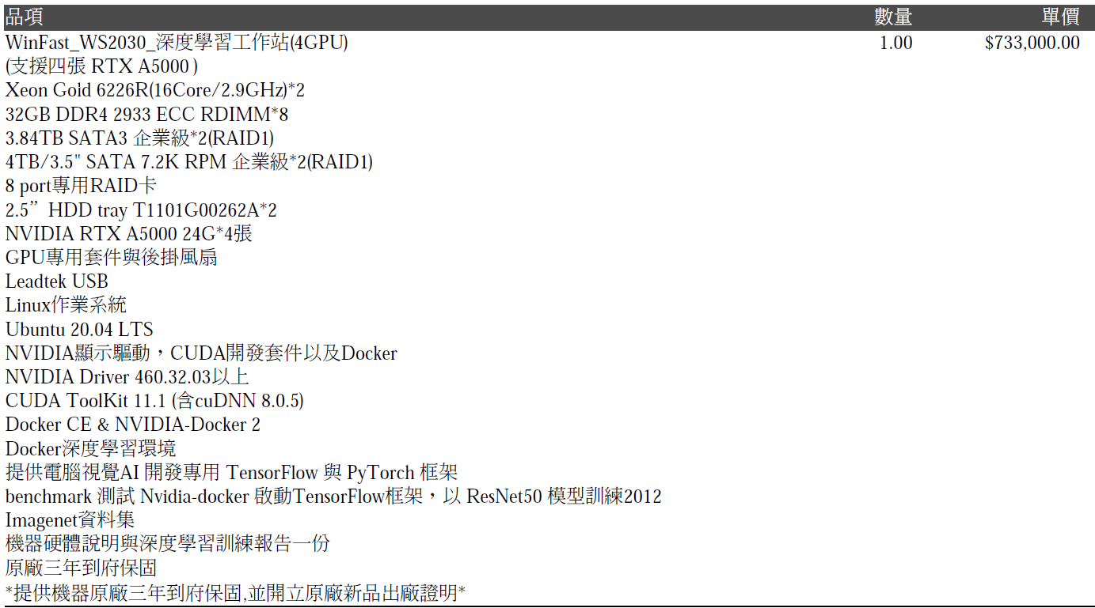
設備採買 -- 深度學習工作站 with GPU A5000*4
Phase
取得報價單
開FlowER 108表單
?
?

Slide 7
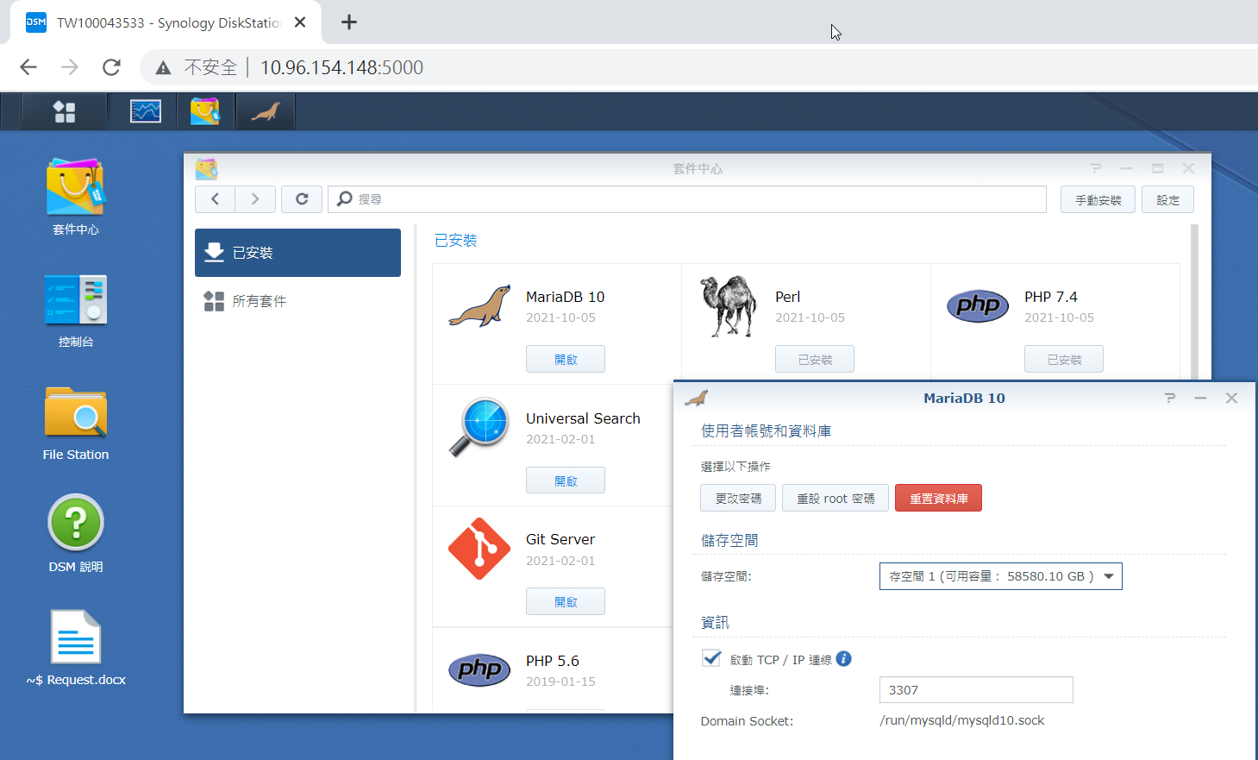
Install MySQL DB on NAS
有望成為共用資料庫!?

Slide 8
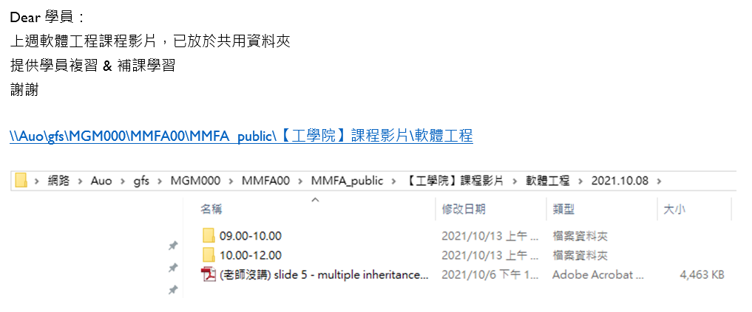
軟體工程概論
恩…工學院

Slide 9
Doing & Next
Repair Retrain
Depoly API 開發
Run in Linux
Other
軟工課程 work with 鄭老師
GPU 設備洽談與購買
色偏需求協助DLL包裝

Slide 11




Retrain System 關卡地圖1I
ReJudge UI
weight
weight
Data Manager
NAS (RetrainData)
Retrain
NAS (RetrainResult)
NAS (RejudgeData)
MySQL Database
Auto Order

Slide 12



Retrain System 關卡地圖1
爬蟲程式
NAS (RejudgeData)
Log Parser
MySQL Database
AI
Tool
MMFA Inference Code
MySQL Database
Web API
NAS (RejudgeData)

Slide 13


Retrain System 關卡地圖III
AI
weight
weight
EQ電腦
AI電腦
Retrain UI
FAB User/MMFA
weight
weight
AI
Web Uploader
Model API
EQ電腦
AI電腦
NAS (RetrainResult)
Depoly Server
weight
weight
Auto Depoly
Depoly Server
AI
EQ電腦
AI電腦

