Slide 1
WikiQuery
By Lisheng Wu, Hongtao Lin

Slide 2
Outline
Wikidata Overview
Database Design
Natural Language Query
Web Demo

Slide 3
Outline
Wikidata Overview
Database Design
Natural Language Query
Web Demo

Slide 4
Wikidata Overview
- 32% of entities have no labels (names).
- 25% of entities have no subclass/instance as a property.
- 80% of properties are used by <5k statements (aka. usage).
Why shall we store all the information?

Slide 5
Outline
Wikidata Overview
Database Design
Natural Language Query
Web Demo

Slide 6
DATABASE DESIGN
DESIGN
SPEED
DATA
QUERY

Slide 7
DATABASE DESIGN
Data & Query as consideration:
- Filter out properties with usage <4k OR with type of ‘external-id’. (12% left)
- Store only English labels.
- Discard ‘Reference’.
- Simplify ‘datavalue’ structure as a single value in statement.
- e.g. The datavalue of type ‘Time’ -> a Date-like string in SQL.
…

Slide 8
DATABASE DESIGN
Query & Speed as consideration:
- Build index.
- [Query2 only] Use preorder tree for faster traversal.
- [NLQ only] Add ‘popularity’ as a derived value for entity linking. (more later)
…

Slide 9
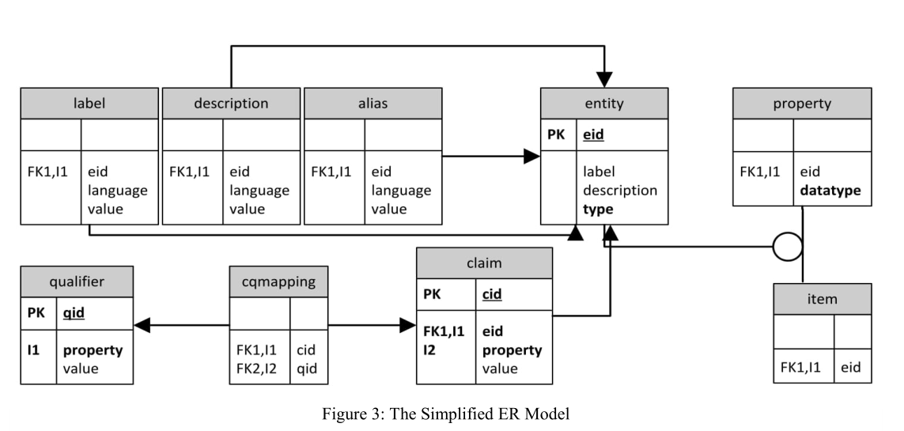
DATABASE DESIGN

Slide 10
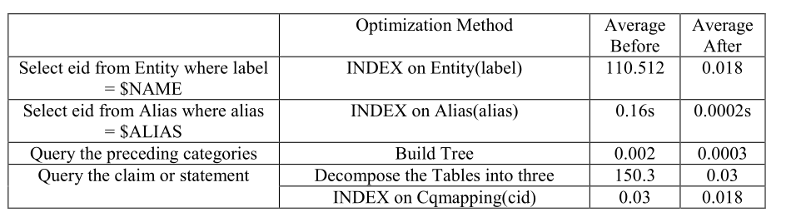
DATABASE DESIGN
Result shown below:

Slide 11
Outline
Wikidata Overview
Database Design
Natural Language Query
Web Demo

Slide 12
Natural language query
Parsing:
- Natural Language -> Structural information
- Return ‘property’, ‘value’
Entity Linking:
- Select the most probable entity given matched ones.
- Define ‘popularity’ as #statements associated with it.
Querying:
- Define a list of query APIs.
Notes:
e.g.
Parsing: Who did Obama married? Use regex: Who did $item married? -> property: spouse, value: Obama
Linking: Obama -> ?
Querying: (‘Obama’, ‘spouse’, ‘?’)

Slide 13
Outline
Wikidata Overview
Database Design
Natural Language Query
Web Demo

Slide 14

WEB DEMO
Web Interface
React
Flask
Database

Slide 15
Thanks for watching :)

