Slide 1
MOVIER
A DATA SCIENCE PROJECT ABOUT TOPIC MODELING AND TREND ANALYSIS OF US FEATURE movies
BY Wei CHEN
Movier.space

Slide 2
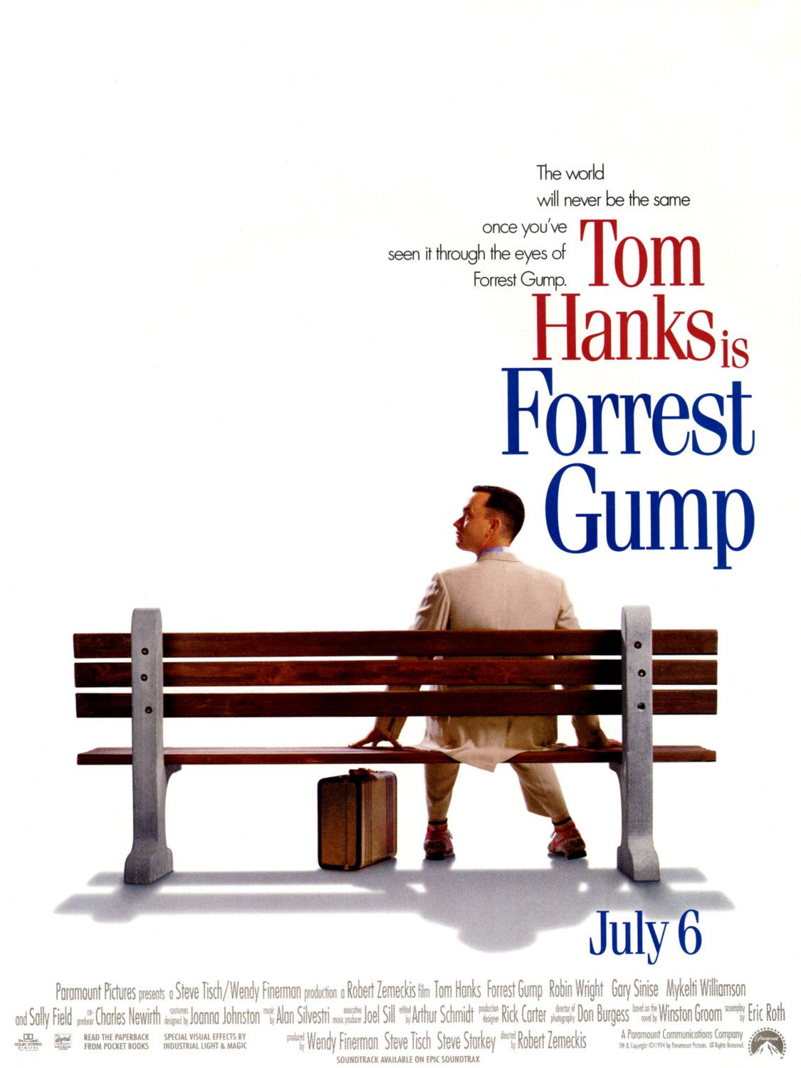

Slide 3
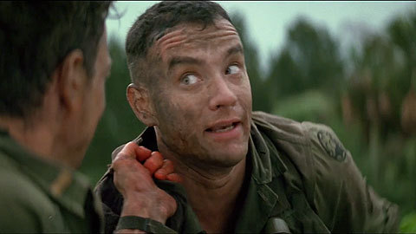
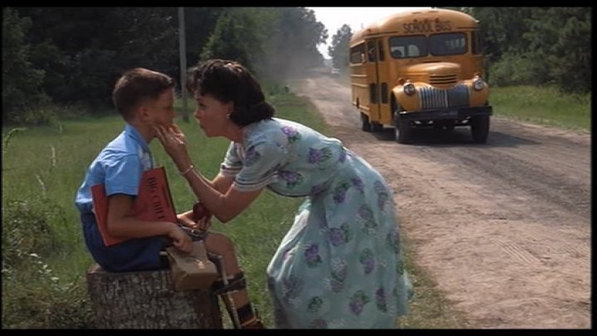

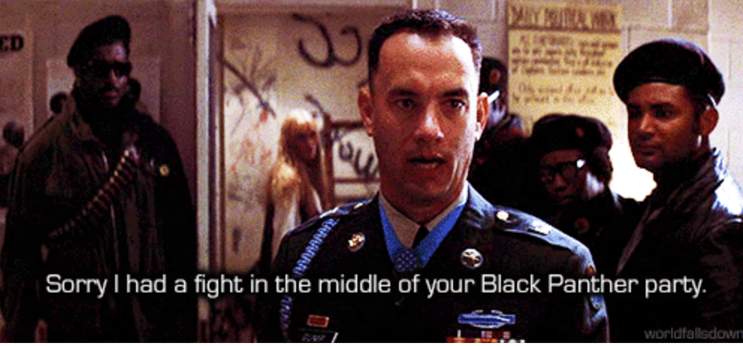

Slide 4
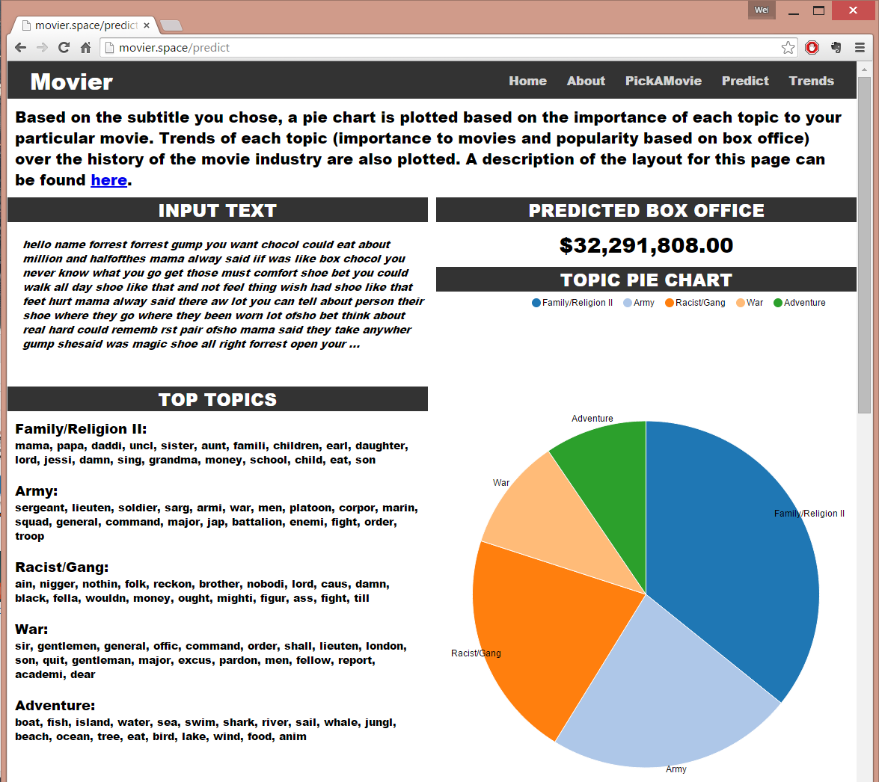
Forrest Gump

Slide 5
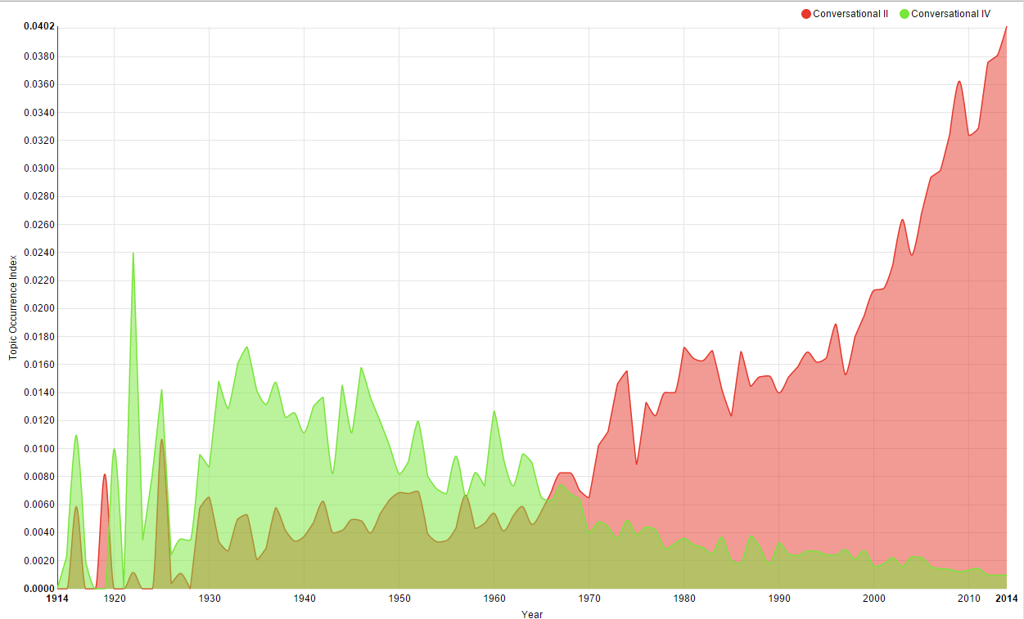
Topic Trend
okay, gotta, actual, wanna, wow, hmm, phone, huh, bye, mom
mrs, darling, dear, mother, marry, husband, goodbye, shall, lady, wonder

Slide 6
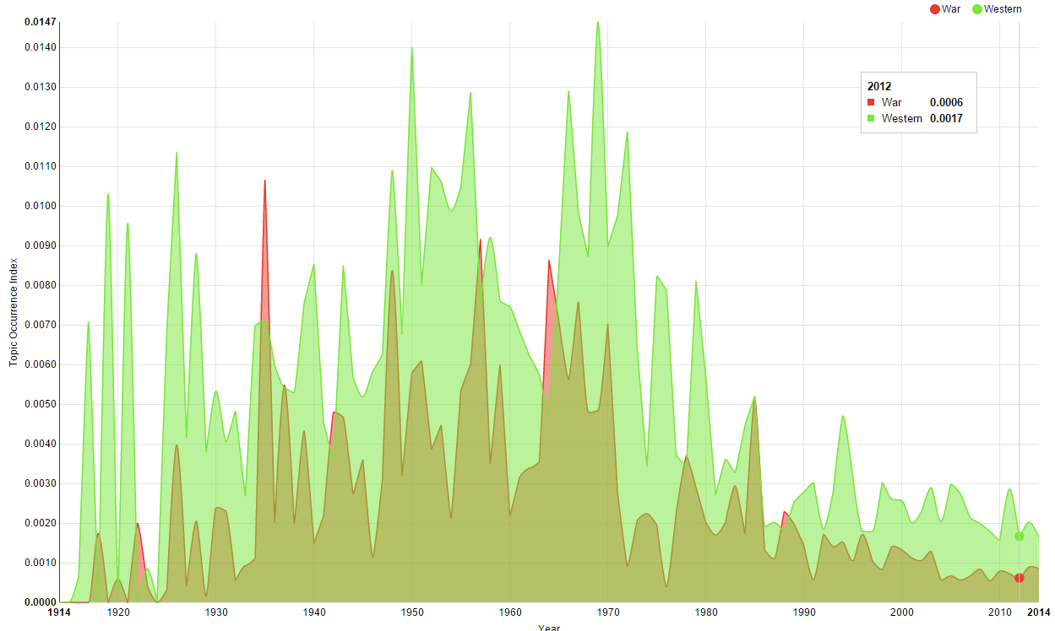
Topic Trend
colonel, general, major, men, army, command, war, sir, order, soldier
Horse , indian, ride, gold, wagon, gun, ranch, race, cattle, men

Slide 7
Random Forest Regressor Topic Occurrence Index (PREDICT?) Box Office
R² ~ 27%

Slide 8
Forrest Gump

Slide 9
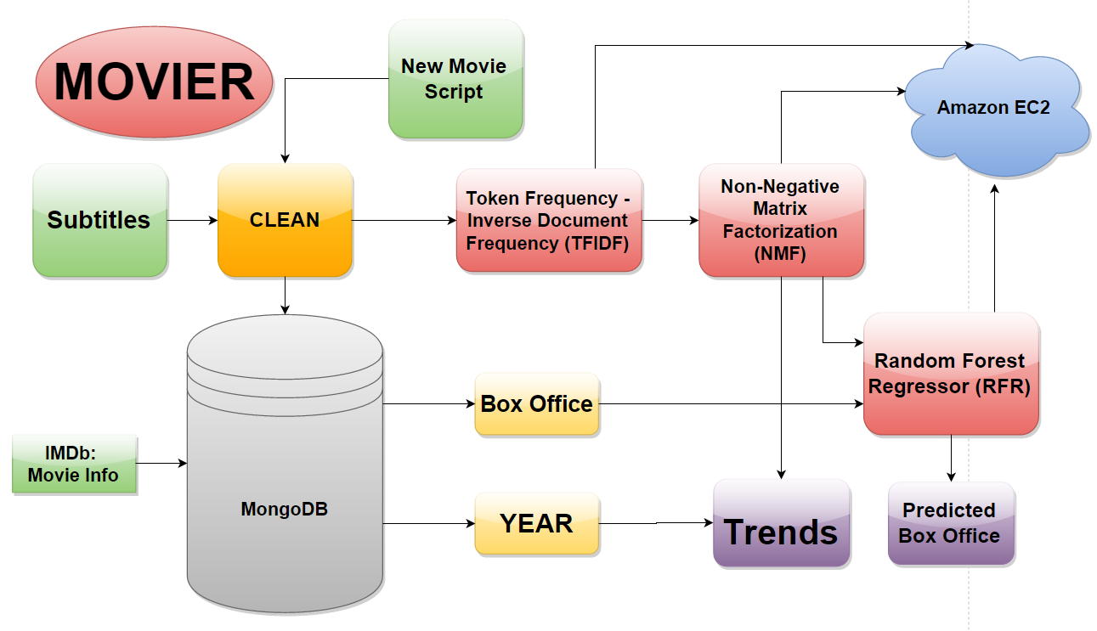
Mind Map

Slide 10
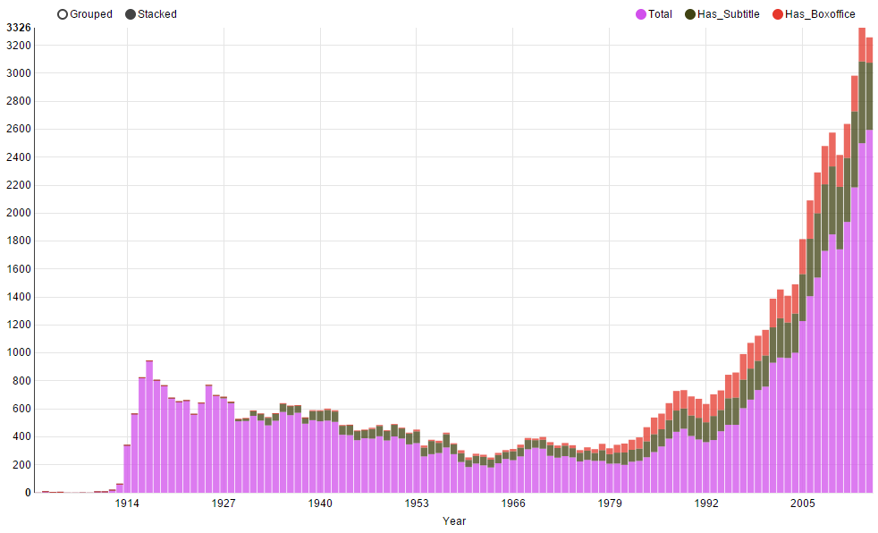
Data Scope

Slide 11
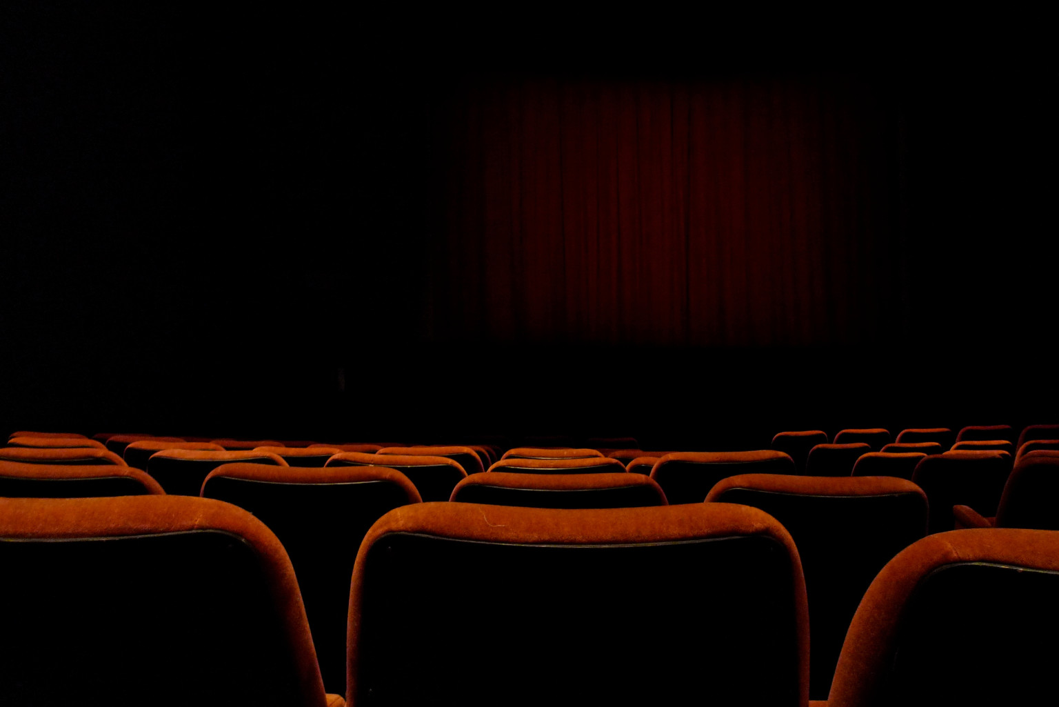
Movier
By Wei Chen
url: movier.space
repo: github.com/weichen1984/Movier
About Me:
Wei.chen.riceu@gmail.com
weichen1984@LinkedIn/github/twitter
Acknowledgements:
Zipfian fellow students/instructors
Opensubtitles.org

