Slide 1
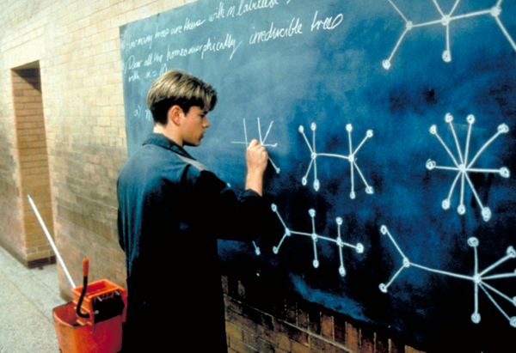
DS5010 Codewalk
Team members:
Naseem Alfaqeh,
Hongyan Yang,
Evan Chan

Slide 2
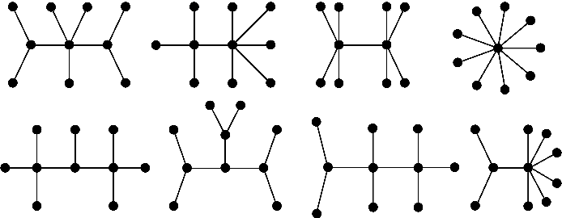
Purpose of package Graph
1. Check and format user's inputs
2. Find all CONNECTED sub_graphs
3. Find all Cycles in a connected graph
4. Find the Shortest Path between two nodes

Slide 3
1. Check and format user's inputs
edges = ['Ab', 'ca', 'Cb']
edge_lens = [1, 2, 3, 2]
# Should return ValueError because edges and lens not one on one.
graph = Graph(edges, edge_lens)
edges = ['Ab', 'ca', 'Cb', 'AC']
edge_lens = [1, 2, 3, 1]
# Should return ValueError "conflict lens input for edge AC"
graph = Graph(edges, edge_lens)

Slide 4
1. Check and format user's inputs
edges = ['Ab', 'ca', 'Cb', 'AC']
edge_lens = [1, 2, 3, 2]
# Create a Graph instance
graph = Graph(edges, edge_lens)
graph.get_edges() # Should return ['AB', 'AC', 'BC']
graph.get_edge_lens() # Should return [1, 2, 3]

Slide 5
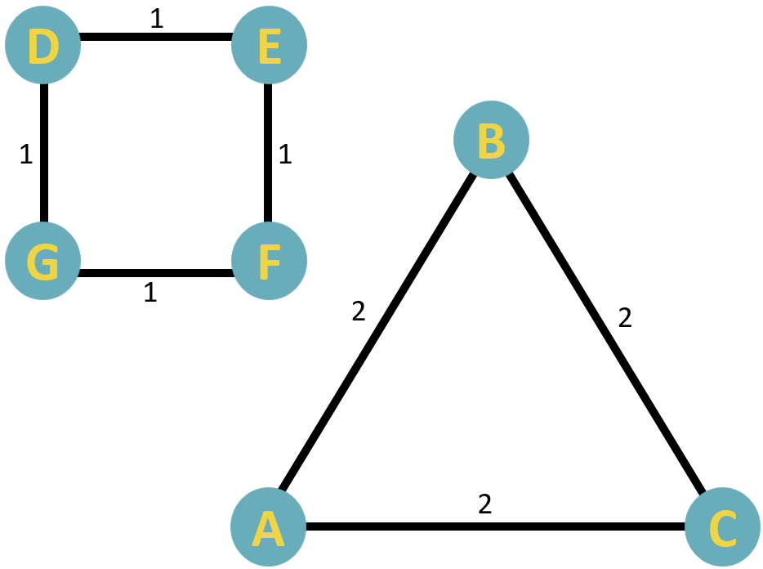
2. Find all CONNECTED sub_graphs
edges = ['AB', 'AC', 'BC', 'DE', 'EF', 'FG', 'DG']
edge_lens = [2, 2, 2, 1, 1, 1, 1]
# Reset .edges and .edge_lens attribute
graph.set_edges_and_lens(edges, edge_lens)
# Should return two sets of sub_graphs
graph.get_connected_subgraphs()

Slide 6
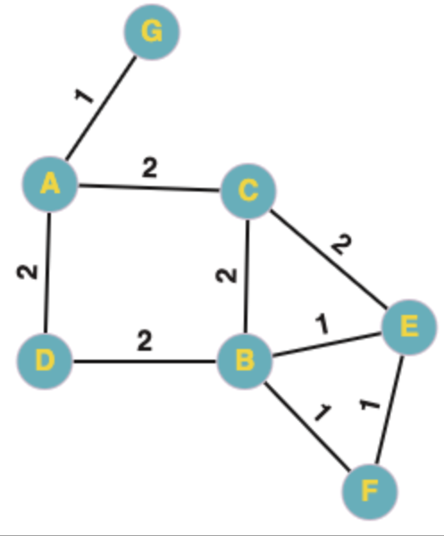
3. Find all Cycles in a connected graph
edges = ['AC', 'AD', 'BC', 'BD', 'BE', 'CE', 'EF', 'BF', 'AG']
edge_lens = [2, 2, 2, 2, 1, 2, 1, 1, 1]
# Reset .edges and .edge_lens attribute
graph.set_edges_and_lens(edges, edge_lens)
# Should return a dictionary with key as the size of
# cycle and value as a list of same-size cycles
graph.cycles()

Slide 7
4. Find the Shortest Path between two nodes
# Set start and end nodes
path_tuple = ("A", "F")
# Should return a list consisting all shortest paths,
# and return the shortest length
graph.get_shortest_path(path_tuple)

Slide 8
Next steps:
Classification algorithms to cut a graph into groups
Topics related to tree graph

