Slide 1

Project 03
Dogs, Fried Chicken, or Blueberry Muffins?
Team 8:
Hongyu Li
Jia Zheng
Jiaqi Dong
Xiaochen Fan

Slide 2
Feature extraction:
SIFT, RGB
HOG (histogram of oriented gradients)—similar with RGB, extract features as black and white
ORB (Oriented FAST and rotated BRIEF)—similar with SIFT, a fast and efficient alternative to SIFT
SURF (speeded up robust features)—classic method of feature extraction

Slide 3
Model:
GBM
Xgboost—similar with GBM, a boosting algorithm
Random Forest—decision tree algorithm, not additive model
SVM (supporting vector machine)—when feature extraction is done, seems like supporting vector; therefore, try SVM

Slide 4

Model | Feature extraction | CV error | Test error | Time
GBM | SIFT | 0.2658 | 0.2716 | 252
GBM | SIFT+PCA | 0.2725 | 0.2883 | 102
GBM | SIFT+TSNE | 0.43 | 0.7033 | 22
GBM | SIFT+LLE | 0.4821 | 0.6467 | 32
GBM | SIFT+ISOMAP | 0.3912 | 0.755 | 32
GBM | RGB | 0.1279 | 0.13 | 68
GBM | RGB+TSNE | 0.3667 | 0.6 | 18
GBM | RGB+PCA | 0.2625 | 0.3933 | 27

Slide 5
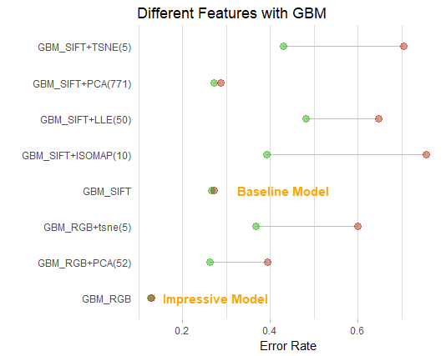
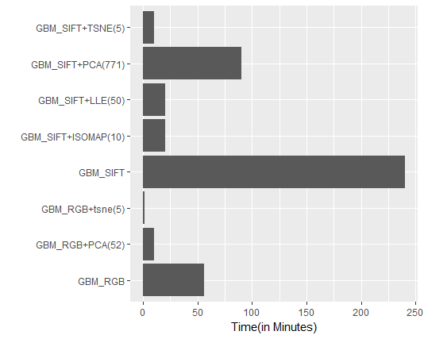

Slide 6
Model | Feature extraction | CV error | Test error | Time
Xgboost | RGB | 0.117 | 0.1683 | 18
Xgboost | HOG | 0.216 | 0.295 | 5
Xgboost | ORB(500) | 0.256 | 0.3533 | 6
Xgboost | ORB(50) | 0.243 | 0.325 | 6
Xgboost | SURF | 0.278 | 0.36 | 11

Slide 7
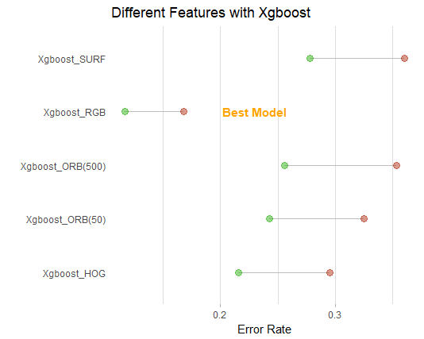
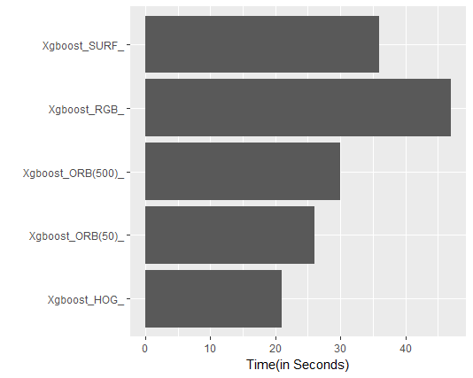

Slide 8
Model | Feature extraction | CV error | Test error | Time
RF | SIFT | 0.279167 | 0.298333 | 55
RF | RGB | 0.108333 | 0.145 | 24
RF | HOG | 0.19375 | 0.248333 | 5
RF | ORB | 0.26875 | 0.31 | 9

Slide 9
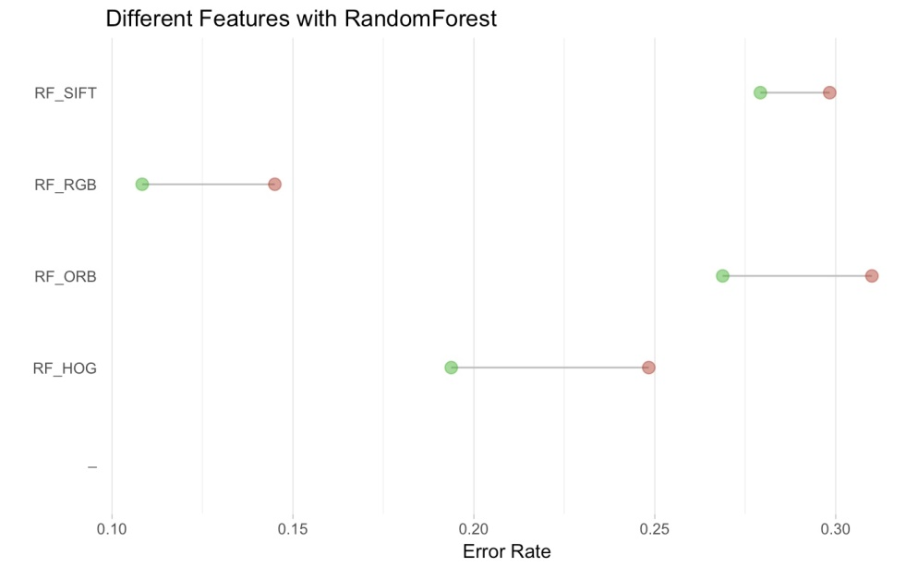
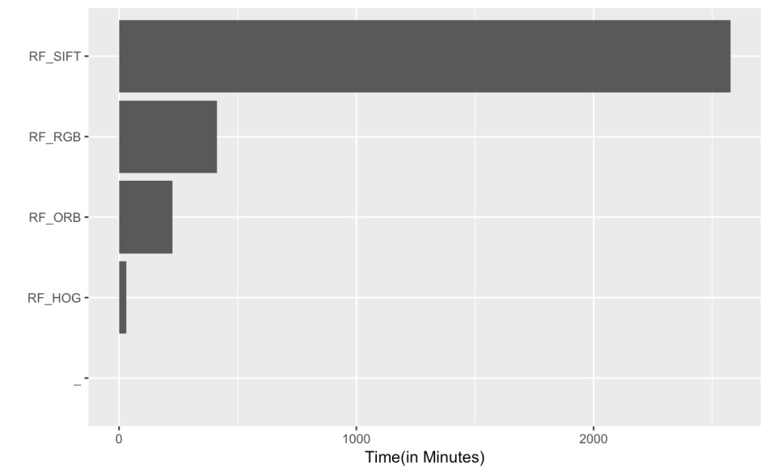

Slide 10
Model | Feature extraction | CV error | Test error | Time
SVM | SIFT | 0.4546 | 0.4917 | 25
SVM | SURF | 0.3208 | 0.325 | 18
SVM | ORB | 0.2167 | 0.225 | 11
SVM | RGB | 0.2579 | 0.2367 | 91
SVM | HOG | 0.1867 | 0.205 | 21

Slide 11
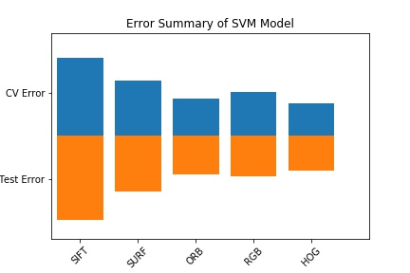

Slide 12
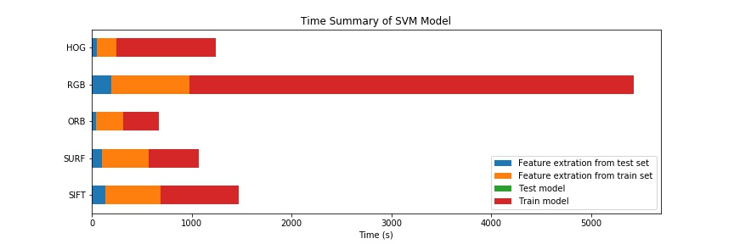

Slide 13
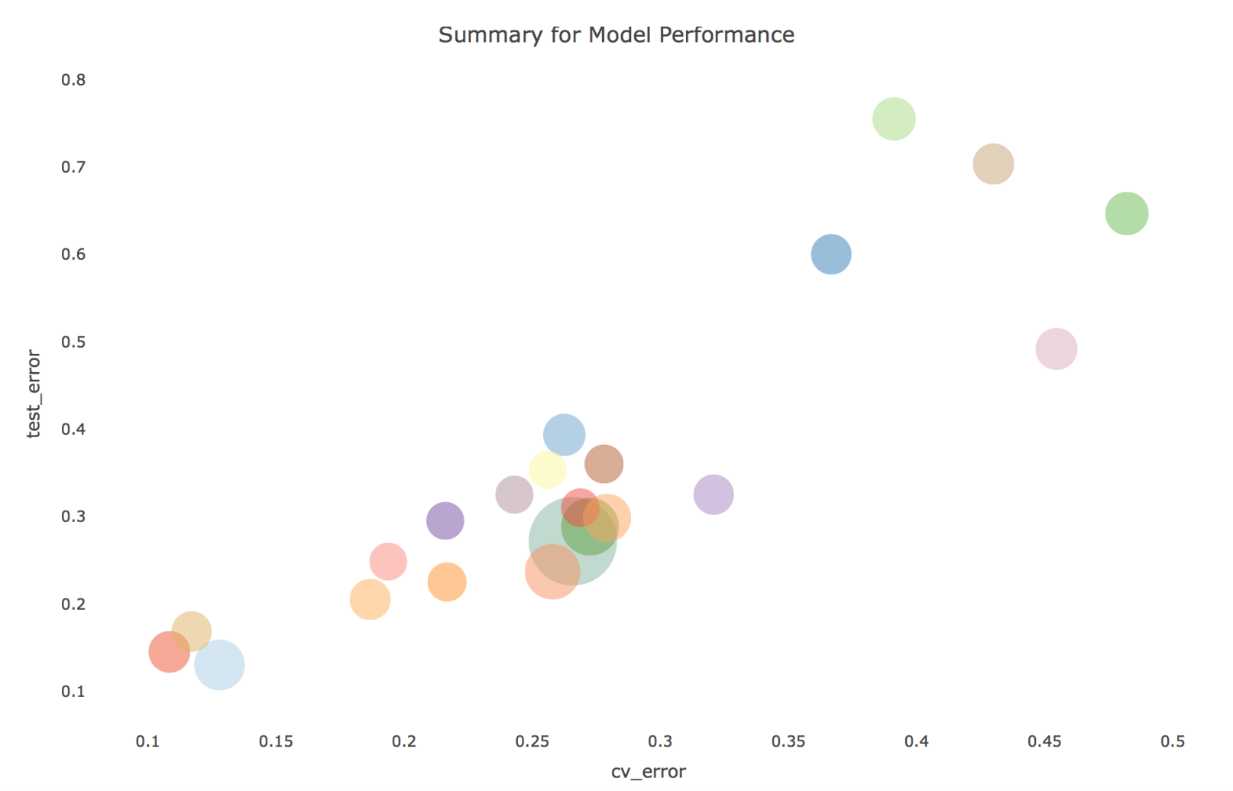

Slide 14
Model | Feature extraction | CV error | Test error | Time
GBM | SIFT | 0.2658 | 0.2716 | 252
GBM | RGB | 0.1279 | 0.13 | 68
Xgboost | RGB | 0.117 | 0.1683 | 18
RF | RGB | 0.108333 | 0.145 | 24
SVM | HOG | 0.1867 | 0.205 | 21
Compared to baseline (GBM+SIFT), Xgboost+RGB is better in each aspects.

