Slide 1
A Historical Look At Climate Change Impact Upon Atlantic Hurricanes
By Hongyu Zhu, Cyrus Chen, and Noah Manning

Slide 2
Welcome
Everyone has heard of the existence of climate changes affected by global warming on the news. But do you know how climate change impacts Hurricanes ?
Our goal is to show how hurricanes changed overtime. In order to help people be aware of how the climate change is affecting our world through hurricanes.

Slide 3
How it works

Slide 4
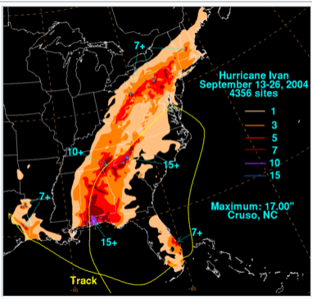
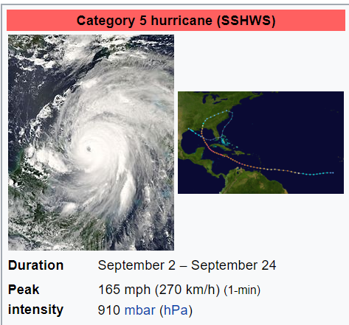
A Story to Share
If you read the news frequently, you must know there are many hurricanes happening each year. And there are some major hurricanes that brought huge damage to our society.
One of the craziest hurricanes is the hurricane Ivan happened back in 2004.
This category 5 hurricane left 54 fatalities and $20.5 billion in damage throughout the US. And thousands of other houses were damaged or destroyed in many counties. Ivan produced a record tornado outbreak, with at least 119 twisters spawned collectively in nine states.

Slide 5
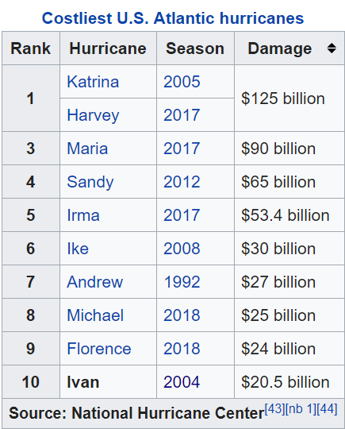
There are way more crazier Hurricanes!!
As you can see from the left table, Ivan is not even the most deadly hurricane ever happened to us.
There are more destructive hurricanes happened in recent years.
You might think only south area like Florida get affected. But many of them went further in land in recent years.
When you travel to coast, be aware of the hurricane season!!!

Slide 6
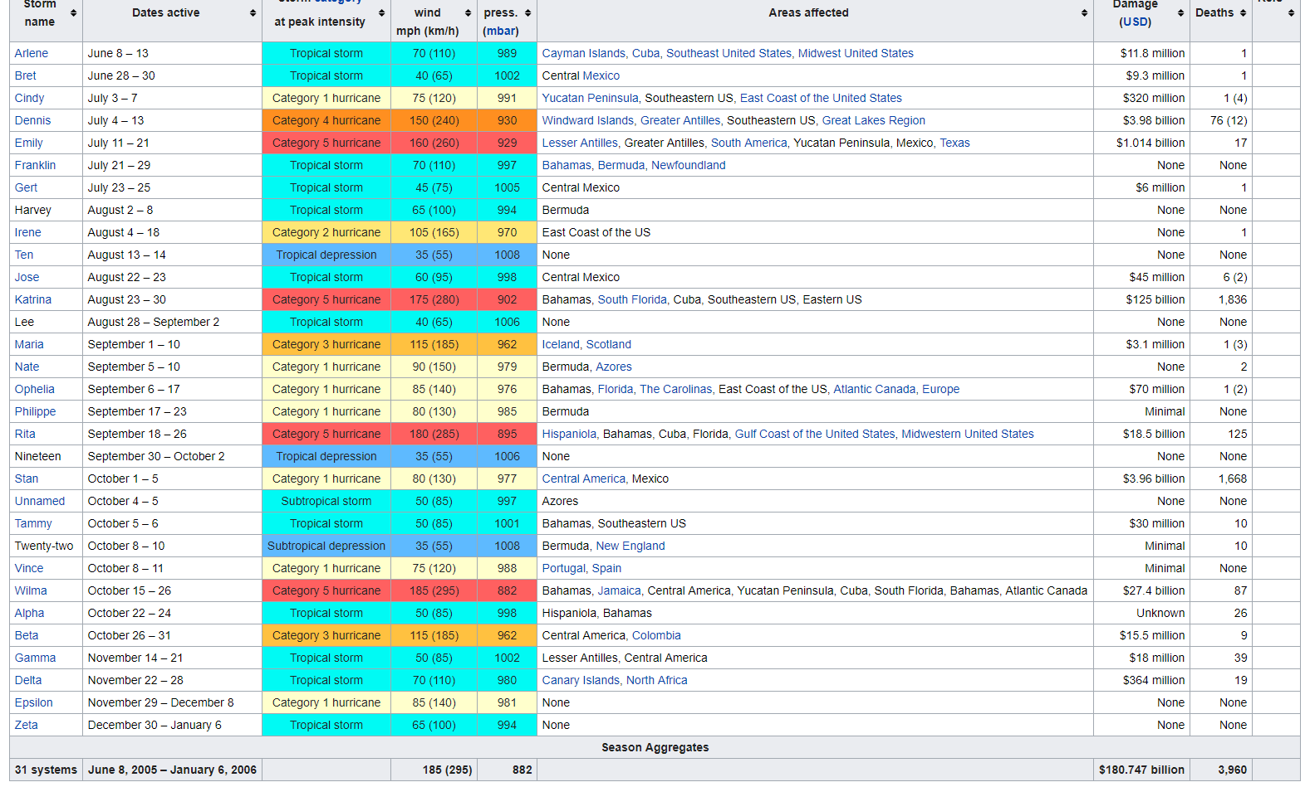
2005

Slide 7
A Little Challenge for Y'all
-Can you find in which years did hurricane increase significantly after 2000?
-Would you be able to identify some major hurricanes through their tracks?

Slide 8
Hurricanes went inland
1900 Galveston hurricane 1915 New Orleans hurricane 1928 Okeechobee hurricane 1929 Bahamas hurricane 1935 Labor Day hurricane The 1949 Florida hurricane
1961 Hurricane Carla 1971 Hurricane Edith
1979 Hurricane David (5) 1979 Hurricane Frederic (4)
1988 Hurricane Gilbert
1989 Hurricane Hugo
1992 Hurricane Andrew 1995 Hurricane Opal 1998 Hurricane Mitch
2004 Hurricane Ivan
2005 all 4 of them
2017 Hurricane Harvey 2017 Hurricane Irma

Slide 9
Contributions:
Code -- Cyrus and Hongyu
Slide – Hongyu and Cyrus
Poster -- Noah

Slide 10
References:
[1] http://www.aoml.noaa.gov/hrd/data_sub/hurr.html
[2]https://coast.noaa.gov/states/fast-facts/hurricane-costs.html
[3]https://www.iii.org/fact-statistic/facts-statistics-hurricanes

