Slide 1


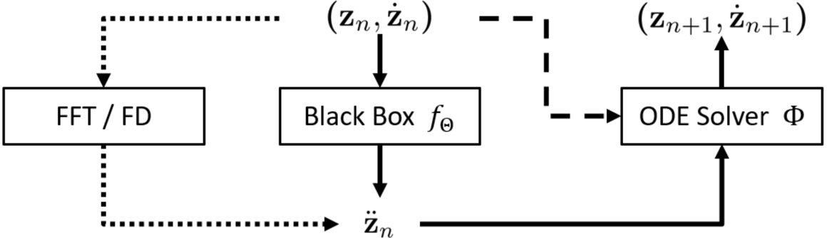
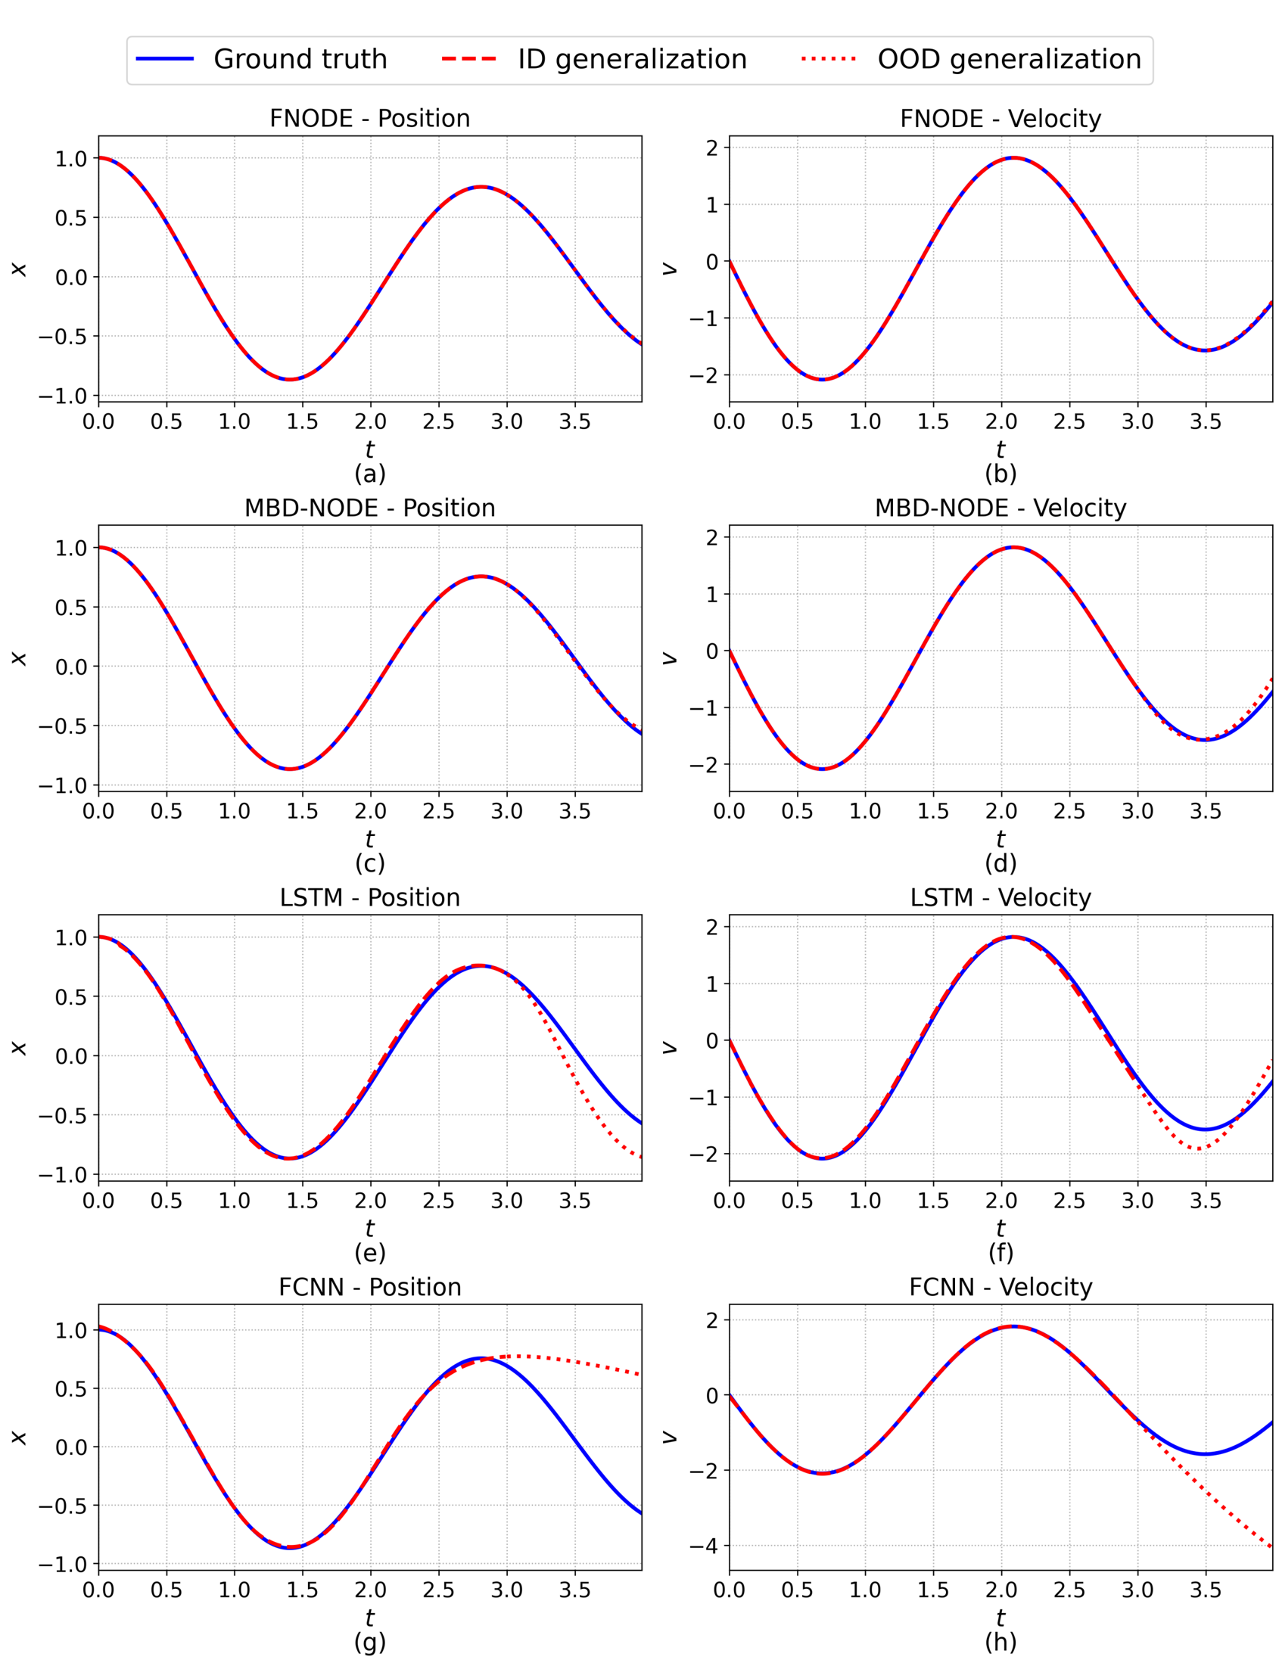
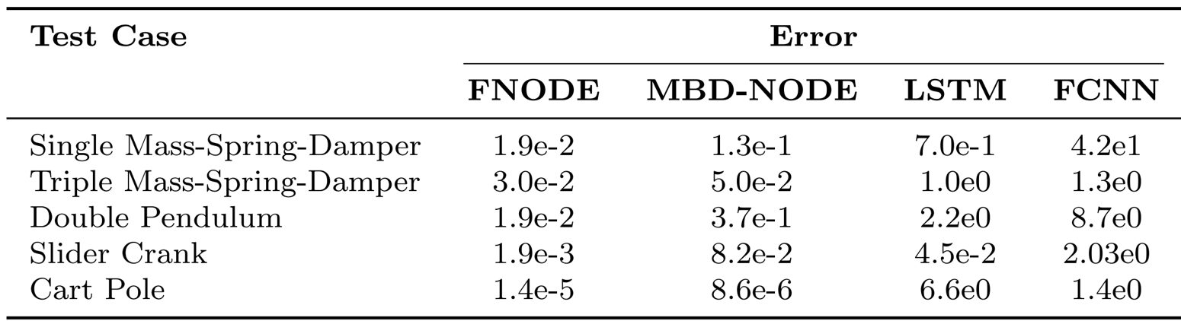
FNODE: Flow-Matching for data-driven simulation of constrained multibody systems
Hongyu Wang¹, Jingquan Wang¹, Dan Negrut¹
¹University of Wisconsin-Madison
Introduction
Methodology
•Multibody dynamics is key in engineering and science.
•Used in robotics, vehicle dynamics, and biomechanics.
•Traditional methods face challenges with complex dynamics.
•Machine learning offers data-driven potential.
•Early methods struggled with long-term prediction.
•Neural ODEs use neural vector fields with ODE solvers.
•Flow-matching algorithms supervise derivatives.
•FNODE approximates accelerations directly.
•FNODE uses multibody dynamics.
•Predicts acceleration directly.
•Uses Lagrange multipliers.
•Enhances accuracy.
•Reduces computational load.
•Efficient with FFT.
•Handles non-periodic data.
•Minimizes prediction error.
•Adam ensures fast training.
Experiments
Discussion
•FNODE tested on mass-spring-damper, pendulum, slider-crank, and cartpole.
•Outperformed others in single-mass-spring-damper.
•Best in triple-mass-spring-damper for multiscale dynamics.
•Reproduced chaotic patterns in double pendulum.
•Accurate long-term in slider-crank.
•Matched ground truth in cart-pole, efficient training.
•FNODE trains faster than MBD-NODE.
•Lower prediction error than baselines.
•Efficient physics-informed formulation.
•Outperforms in chaotic systems.
•Accuracy relies on precise targets.
•Balances efficiency and accuracy.
•FNODE avoids adjoint sensitivity.
•Matches MBD-NODE performance.
•No significant overhead.
•Stable long-term predictions.
•Uses FFT and FD for accuracy.
•Scalable simulation framework.
Conclusions
•FNODE models dynamics by learning accelerations.
•Removes Neural ODEs' adjoint bottleneck for faster training.
•Beats LSTM and FCNN in accuracy and efficiency.
•Open-source for reproducibility.
•Relies on accurate acceleration targets with FFT and FD.
•Future: noise-resilient methods and less error growth.
•Extend to higher-dimensional and PDE systems.
•Benchmarks: mass-spring-damper, pendulum, slider-crank, cartpole.
•FNODE excelled in single-mass-spring-damper.
•Top performance in triple-mass-spring-damper.
•Outperformed in double pendulum.
•Surpassed others in slider-crank.
•Competitive in cart-pole, efficient training.

