Slide 1
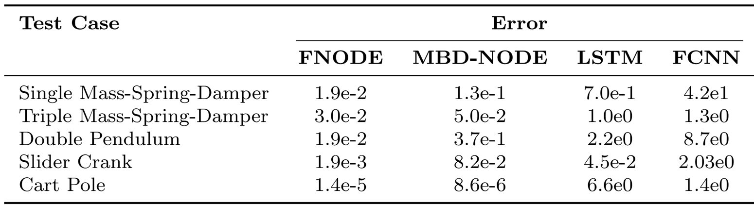
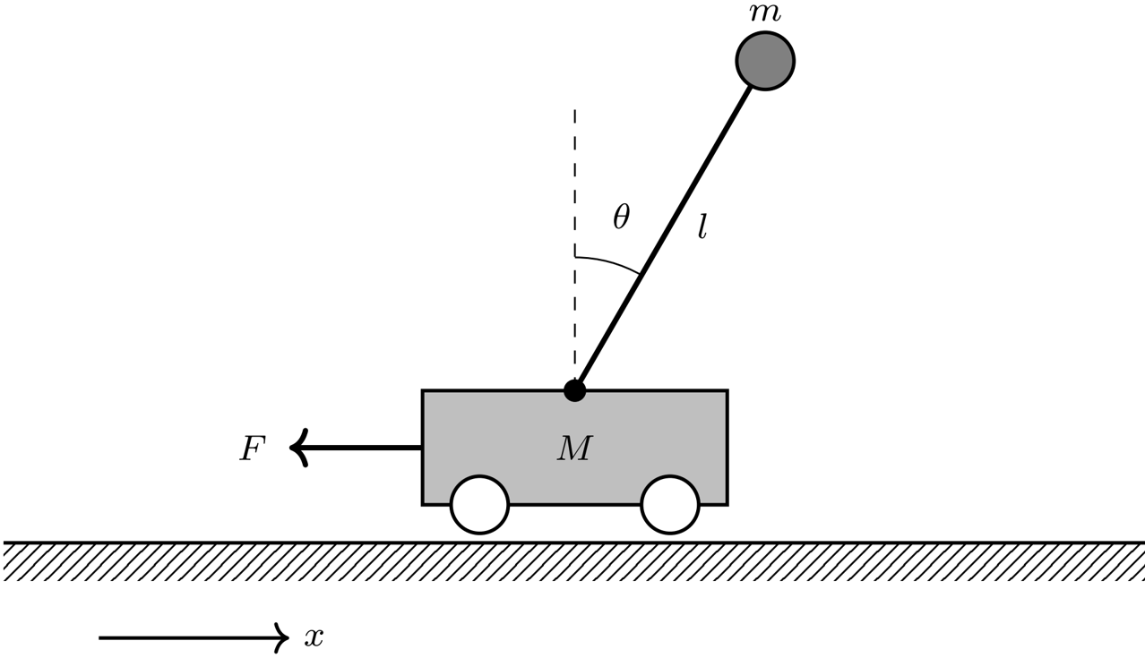
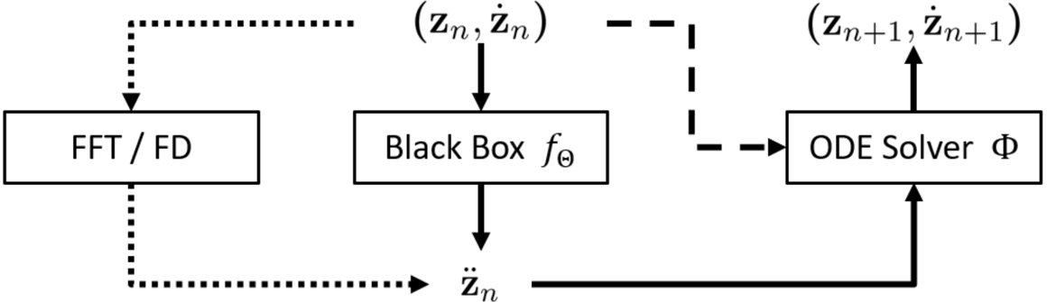
FNODE: Flow-Matching for Data-Driven Simulation of Constrained Multibody Systems
Hongyu Wang¹, Jingquan Wang¹, Dan Negrut¹
¹University of Wisconsin-Madison
Abstract
Numerical Experiments
Conclusions
•Introduces Flow-Matching Neural Ordinary Differential Equation (FNODE).
•Aims to improve computational cost and long-term prediction accuracy.
•Models constrained multibody systems effectively.
•Learns acceleration vector fields directly from trajectory data.
•Explored systems: mass-spring-damper, double pendulum, slider-crank.
•FNODE shows enhanced accuracy over traditional methods.
•Better generalization capability demonstrated through varied tests.
•FNODE advances data-driven modeling of dynamical systems.
•Identifies efficient and accurate modeling methods.
•Points out limitations in current approaches.
Introduction
•Multibody dynamics key in engineering/science.
•Traditional models struggle with complexity.
•Machine learning, especially NODEs, advances modeling.
•FNODEs improve on NODE bottlenecks.
•Comparative analysis highlights computational efficiency.
•Baseline methods benchmarked against FNODE’s novel approach.
•Insights suggest potential for wide applicability in physics-based modeling.
Methodology
•Introduces FNODE's framework for learning acceleration vector fields.
•Details numerical differentiation techniques for deriving acceleration.
•Suggests development of noise-resilient techniques.
•Emphasizes need for acceleration estimation improvements.
•Recommends extensions for long-term accuracy and complex systems handling.
Discussion
•FNODE shows faster training, enhancing efficiency.
•Lower prediction errors through improved accuracy.
•Efficient multiscale dynamics handling.
•Notable data efficiency and robustness.
•Aims for a balance between noise robustness and accuracy in acceleration data.
•Highlights the importance of accurate acceleration targets.
•Provides insights into model structure and training methodologies.
Acknowledgements
•Grant supported by the National Science Foundation.
•Project number: CMMI2153855.

