Slide 1
The Koopman operator: strong prediction, non-inferior control
Four multi-turn tasks; the evidence is hard on the prediction side, and only non-inferiority on the control side.
Hongyu Cao · CLAIM Lab · 2026-09-17
Numbers from autoencoder_koopman_core @ 2d2718c / 6304abc / e8ac78d
1 / 7

Slide 2
New task: one rewrite instruction per turn, to a target difficulty level
Task 4 · tsar_cefr · added this week
One rewrite instruction per turn pushes the paragraph toward A2 or B1.
The scoring is done by the official difficulty classifier, not by the model being rewritten.
We picked it because the instruction enters the next turn's input, and overshooting costs.
One rewrite instruction
down one / down half / paraphrase / keep
Model rewrites
the paragraph
Difficulty classifier scores
expected CEFR level
Compare with target
issue the next instruction
Repeated every turn, 4 steps in all
199 source paragraphs × 4 randomised steps · Qwen3-4B-Instruct · readout = TSAR official CEFR classifier (published F1 0.89)
2 / 7

Slide 3
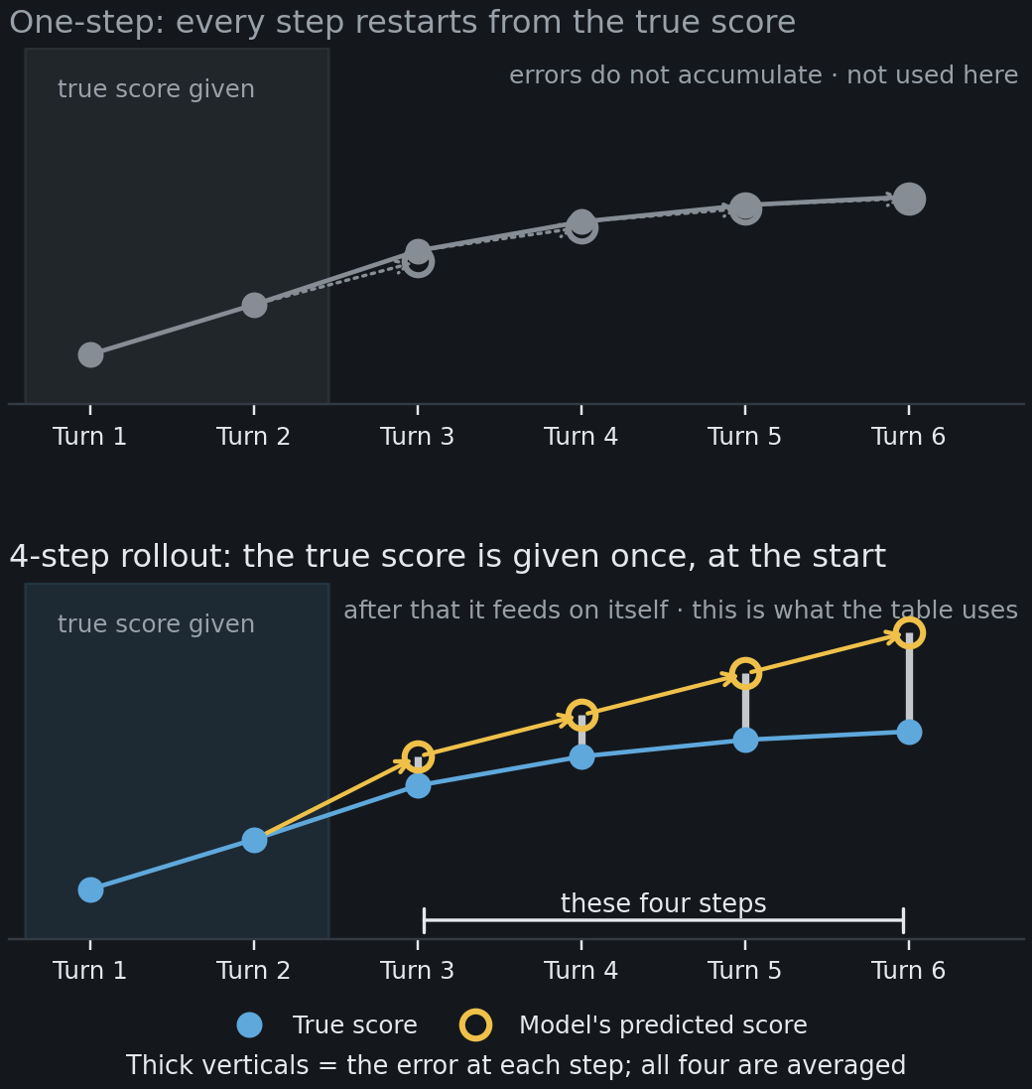
What the next table measures: 4-step rollout error
Perception
The true score is given once at the start; after that the model feeds on itself
Why measure it this way
Handing over the true score at every step is too easy — the score has inertia of its own.
How to read it
Errors accumulate, so this tests understanding of the dynamics rather than of one step.
Four steps is exactly what the controller plans over; the control results are on the last page.
Schematic, not measured data. Rollout (free-running) H-step prediction: the model is seeded with the observed prefix once, then re-ingests its own output. MSE_H averages the squared error over all H steps of every window; H = 6 (t10) / 3 (t5) / 4 (behavioural, = the MPC planning horizon). One-step error is barred as a headline number (ruling 2, 2026-09-12) and reported only in the appendix.
3 / 7

Slide 4
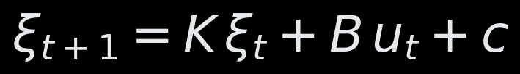
Main table: 4-step rollout error, 11 tasks × 6 model classes
Perception
Cells hold the error itself, in the unit of that column's own score — lower is better
Core tasks · 10 turns
Core tasks · 5 turns
Multi-turn dialogue tasks
4-step rollout error ↓
unit = that column's score
10-turn
sentence len.
10-turn
count Ⅱ
10-turn
count Ⅰ
5-turn
char. len.
5-turn
formality
5-turn
sentiment
5-turn
word len.
Task 1
safety
Task 2
sharded math
Task 3
constraints
Task 4
CEFR level
sentence_length_t10
vector_count_stage2_t10
vector_count_stage1_t10
character_length_t5
formality_t5
sentiment_t5
average_word_length_t5
defense
gsm8k_sharded
constraint
tsar_cefr
×10⁻³ ↓
×10⁻² ↓
×10⁻² ↓
×10⁻³ ↓
×10⁻³ ↓
×10⁻³ ↓
×10⁻³ ↓
×10⁻² ↓
×10⁻¹ ↓
×10⁻² ↓
×10⁻¹ ↓
History-blind guess
3.81
3.84
1.60
4.84
8.08
9.51
2.59
7.36
2.64
3.84
2.08
Last turn only
3.17
1.86
0.966
4.67
4.74
6.89
2.64
6.86
0.960
2.75
1.00
History, no action
0.899
0.674
0.615
3.43
5.20
4.47
4.35
7.19
3.13
1.85
0.912
LSTM
0.951
0.736
0.585
3.38
5.07
5.49
2.78
7.76
4.74
1.75
2.29
Nonlinear version
0.944
0.686
0.596
3.68
4.97
5.75
3.63
7.21
2.99
2.03
2.14
Ours
0.880
0.668
0.574
3.53
5.02
4.79
3.70
7.10
2.98
1.85
0.899
Next state = part of the past scores carried over (K) + a push from this turn's action (B) + a constant.
Page 5 plots how much of that guess's error is removed.
Bold = smallest in column, underline = second; Ours is smallest in 4 of 11, second in 3.
Rollout MSE over H steps, seeds averaged before scoring; reported on held-out folds disjoint from selection folds. H = 6 (t10) / 3 (t5) / 4 (behavioural). even_odd_t5 omitted (degenerate null). defense: judge = self, n_seed = 2; gsm8k_sharded: 64 eval rows, n_seed = 2.
Three reading rules: (1) each column is only compared with itself — the score units differ, so no cross-column mean, rank or best-of; (2) this table prints no intervals — the resampling is built on the relative quantity; (3) whether two rows differ is judged only by paired resampling, reported per column on page 5. Bold / underline are within-column ranks only, and are descriptive.
4 / 7

Slide 5
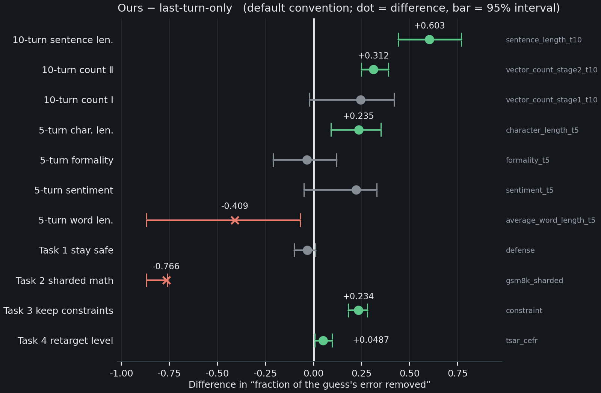
Claim A: one turn of history is not enough — you need several
Perception
Memory is measured to be necessary, not assumed
Purpose
Ask whether predicting the next turn needs several turns of history.
How to read it
The five green columns are better, and none of their bars touches the zero line.
Two red crosses run the other way: on the two smallest columns, more history hurts.
Paired bootstrap, 95% CI, default training-window convention. Under the matched-window convention: sentence_length_t10 +0.603→+0.109★, vector_count_stage2_t10 +0.312→+0.229★, character_length_t5 +0.235→−0.035★ (sign flip); constraint unchanged (+0.234→+0.231★). Grey = CI includes 0.
5 / 7

Slide 6
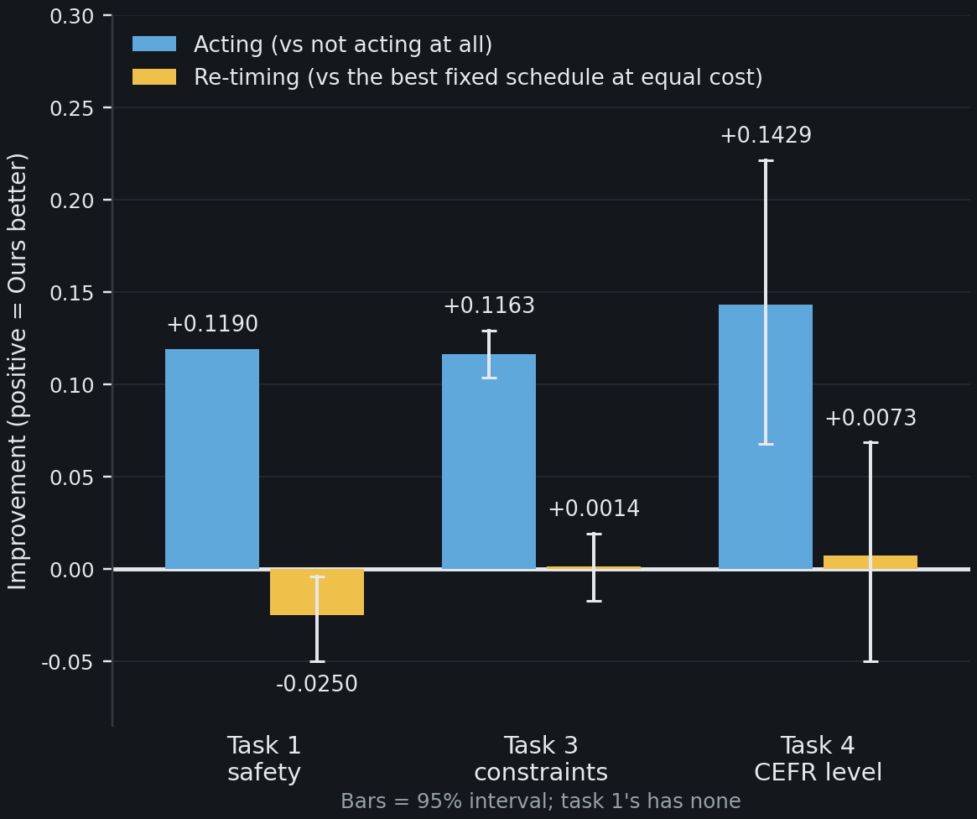
Claim C: it moves the target, but only matches a fixed schedule
Control
“Re-timing” = issuing the same actions on different turns
Purpose
Ask what acting buys, and what re-timing buys.
How to read it
Acting buys about ten times what re-timing buys.
It matches the schedule on all three tasks, and the hand-written rules on all three too.
Table 2 (closed-loop), paired bootstrap, 95% CI. Sign convention: positive = ours better; task 4 is an endpoint-RMSE difference, so a reduction is plotted as a gain (-0.1429 and -0.0073 in native sign). effect/MDE = 1.87 / 0.05 / 0.09, n = 3 seeds; defense judge = self, gain has no interval (late window). Hand-written if-else rules: +0.0042 / +0.0012 / +0.0096, all CI include 0.
6 / 7

Slide 7
Two things that count against us, stated up front
Cost · four columns too small
Cost
Four columns too small
322 vs 100 tokens
10 / 14 / 30 / 64
Task 4, per trajectory: 3.37 steps vs 1.03.
3.2× the tokens buys no measurable gain.
Under the pre-agreed equal-cost comparison, it loses to the simplest fixed schedule.
Sentiment: 10 trajectories; word length: 14.
Task 1: 30 attacks, and self-scored.
Task 2 has only 64 rows to score; the richer models overfit on them.
All four stay in the table, but carry no conclusion.
Both go into Limitations; the cost one is the likeliest to be pressed at review.
Cost axis is per-trajectory and deterministic (no interval); the RMSE side ties (CI includes 0). Resampling units: 10 / 14 trajectories (core), 30 attacks × 2 data seeds (task 1, judge = self), 64 eval rows (task 2).
7 / 7

