Slide 1
Recurrent Chunking Mechanisms for Long-Text Machine Reading Comprehension
Hongyu Gong¹, Yelong Shen², Dian Yu³, Jianshu Chen³, Dong Yu³
¹University of Illinois at Urbana-Champaign
²Microsoft Dynamics 365 AI
³Tencent AI Lab

Slide 2
Machine Reading Comprehension (MRC)
Document
Once upon a time, in a barn near a farm house, there lived a little white kitten named Cotton. Cotton lived high up in a nice warm place above the barn where all of the farmer's horses slept. But Cotton wasn't alone in her little home above the barn, oh no. She shared her hay bed with her mommy and 5 other sisters. All of her sisters were cute and fluffy, like Cotton. But she was the only white one in the bunch.
MRC: provided with one piece of evidence (e.g., a document), extract an answer to a questions
Q: Who lived with Cotton?
A: Her mommy and 5 other sisters.

Slide 3
Previous Works: BERT with Simple Chunking
Pre-trained model BERT achieves strong performance on MRC
Sequence length limit: BERT can process 512 tokens at most
Simple chunking: documents are chunked into equally-spaced segments
Limitations: bad segments from simple chunking
The answer is not fully covered in both segment 1 and 2
Answer
Document
Segment 1
Segment 2
Stride size

Slide 4
Previous Works: Sentence Selection
Sentence Selector
Keep a subset of sentences to which are likely to contain the answer
Downsize the long documents to meet the length constraint
Loss of contextual information
Answer
Question
Downsized Document
Full Document

Slide 5
Long-Text Machine Reading Comprehension
Chunking Scorer
Final Answer
Answer 1
Answer 2
Answer
Extractor
Policy
Network
Answer
Extractor
Policy
Network
Recurrence
BERT
BERT
Chunking Action
Question | Segment 1
Question | Segment 2
Segment 1
Document
Segment 2

Slide 6
Recurrent Chunking Mechanism
Chunking Scorer
Final Answer
Answer 1
Answer 2
Answer
Extractor
Policy
Network
Answer
Extractor
Policy
Network
Recurrence
BERT
BERT
Chunking Action
Question | Segment 1
Question | Segment 2
Segment 1
Document
Segment 2

Slide 7
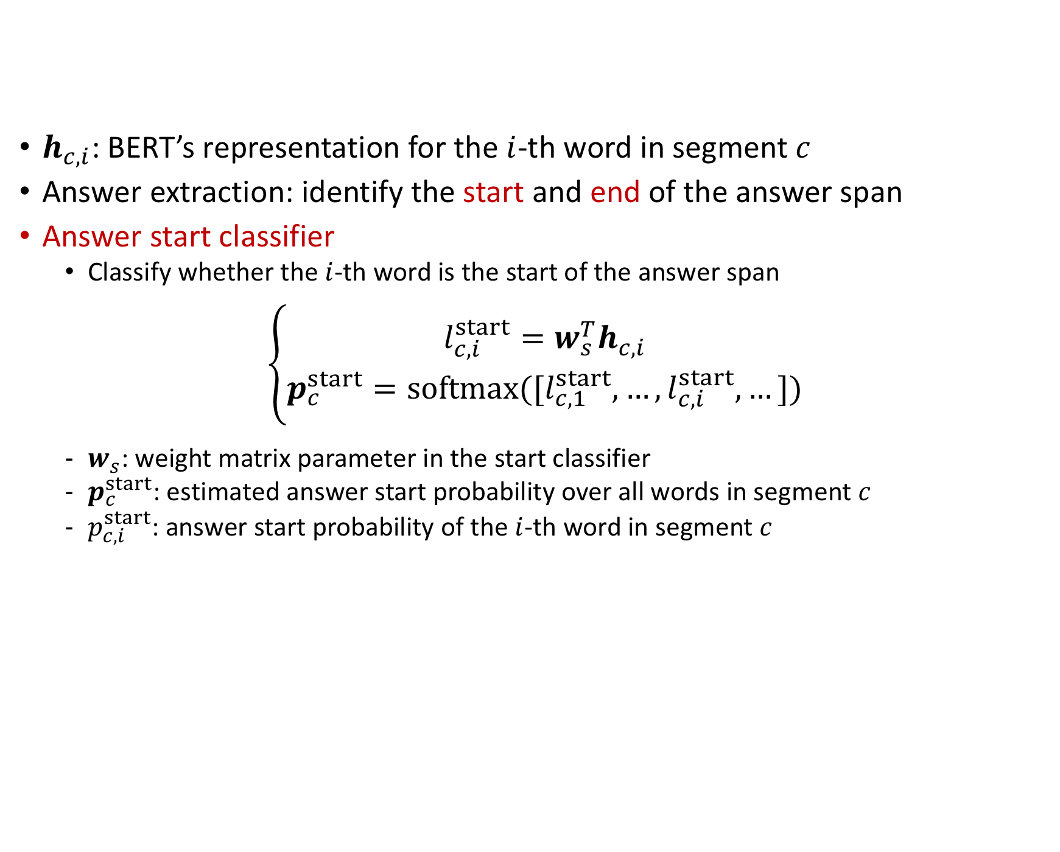
Answer Extractor: Answer Start Classifier
$h_{c,i}$: BERT’s representation for the $i$-th word in segment $c$
Answer extraction: identify the start and end of the answer span
Answer start classifier
Classify whether the $i$-th word is the start of the answer span
$$\left\{\begin{matrix}l_{c,i}^{start}=w_{s}^{T}h_{c,i} \\ p_{c}^{start}=softmax([l_{c,1}^{start}, …,l_{c,i}^{start},…])\end{matrix}\right.$$
$w_{s}$: weight matrix parameter in the start classifier
$p_{c}^{start}$: estimated answer start probability over all words in segment $c$
$p_{c,i}^{start}$: answer start probability of the $i$-th word in segment $c$

Slide 8
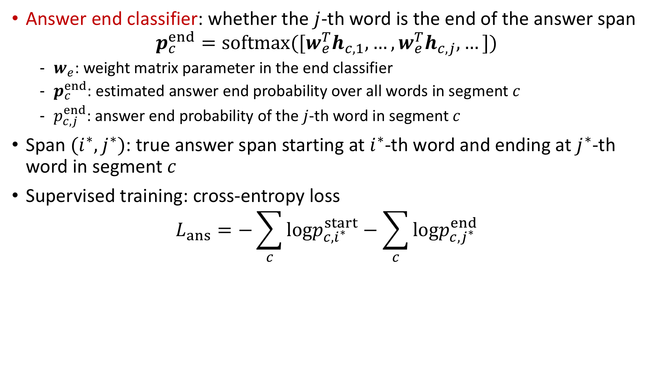
Answer Extractor: Answer End Classifier
Answer end classifier: whether the $j$-th word is the end of the answer span
$$p_{c}^{end}=softmax([w_{e}^{T}h_{c,1}, …,w_{e}^{T}h_{c,j},…])$$
$w_{e}$: weight matrix parameter in the end classifier
$p_{c}^{end}$: estimated answer end probability over all words in segment $c$
$p_{c,j}^{end}$: answer end probability of the $j$-th word in segment $c$
Span ${(i}^{∗},j^{∗})$: true answer span starting at $i^{∗}$-th word and ending at $j^{∗}$-th word in segment $c$
Supervised training: cross-entropy loss
$$L_{ans}=−\sum_{c}{logp_{c,i^{∗}}^{start}}−\sum_{c}{logp_{c,j^{∗}}^{end}}$$

Slide 9
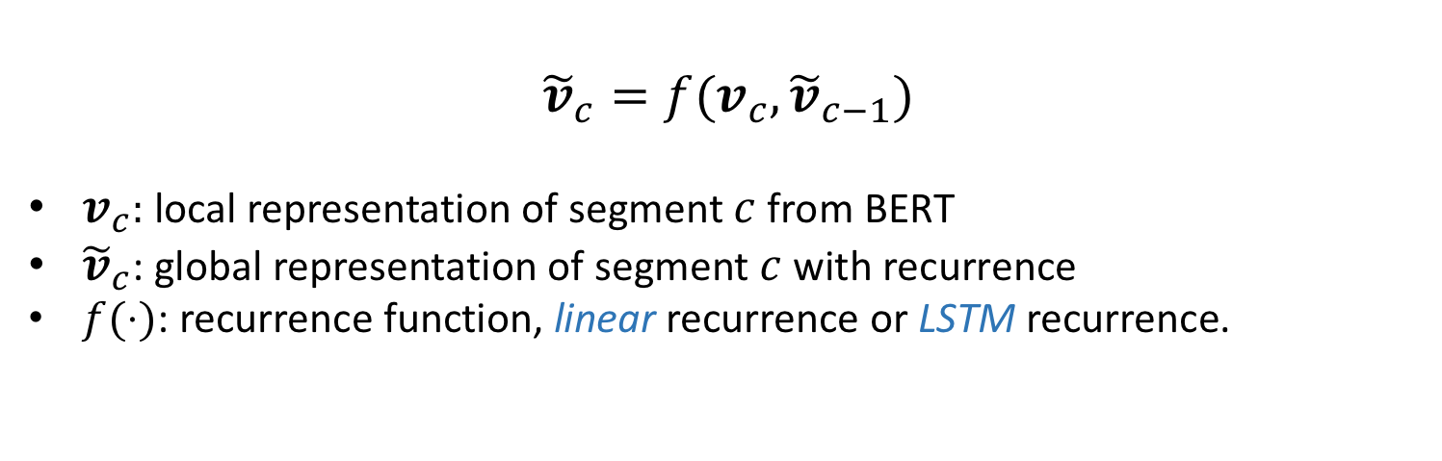
Recurrence
Capture global information via recurrence mechanism
Recurrence
Recurrence
Segment 1
Segment 2
Segment 3
$${\tilde{v}}_{c}=f(v_{c},{\tilde{v}}_{c−1})$$
$v_{c}:$ local representation of segment $c$ from BERT
${\tilde{v}}_{c}$: global representation of segment $c$ with recurrence
$f(⋅)$: recurrence function, linear recurrence or LSTM recurrence.

Slide 10
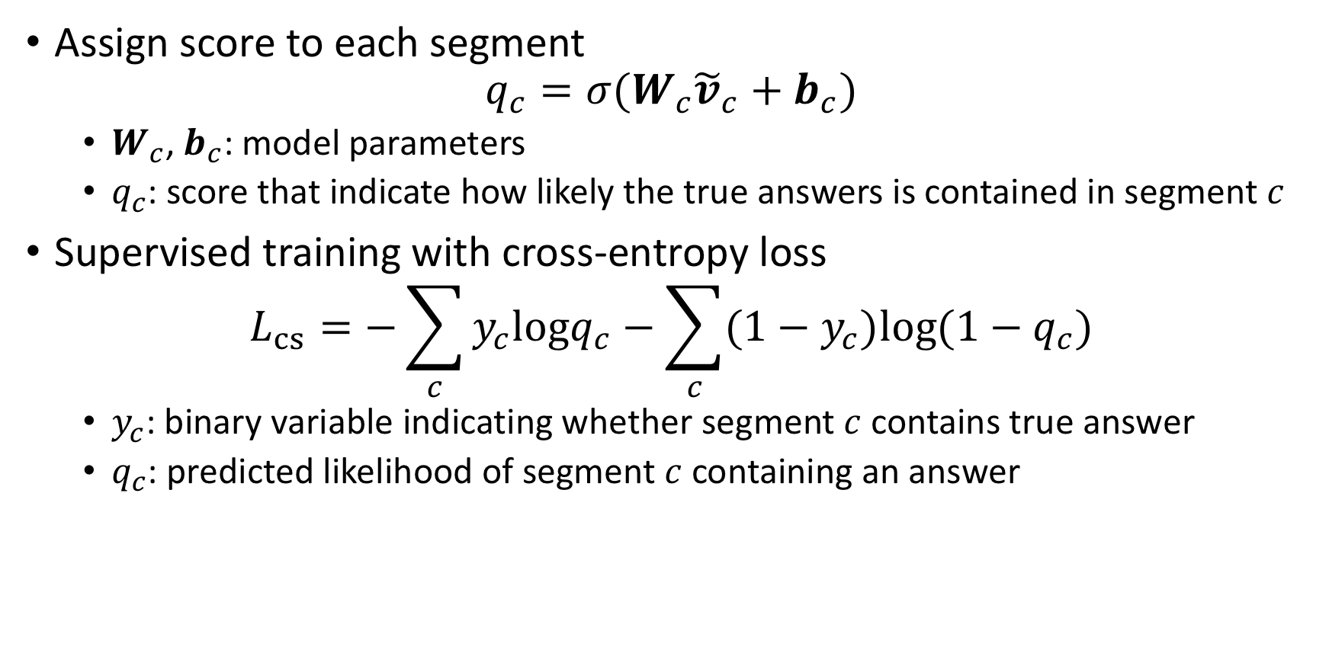
Chunking Scorer: Score Segments
Assign score to each segment
$$q_{c}={σ(W}_{c}{\tilde{v}}_{c}+b_{c})$$
$W_{c}$, $b_{c}$: model parameters
$q_{c}$: score that indicate how likely the true answers is contained in segment $c$
Supervised training with cross-entropy loss
$$L_{cs}=−\sum_{c}{y_{c}logq_{c}−\sum_{c}{{(1−y}_{c})log(1−q_{c})}}$$
$y_{c}$: binary variable indicating whether segment $c$ contains true answer
$q_{c}$: predicted likelihood of segment $c$ containing an answer

Slide 11
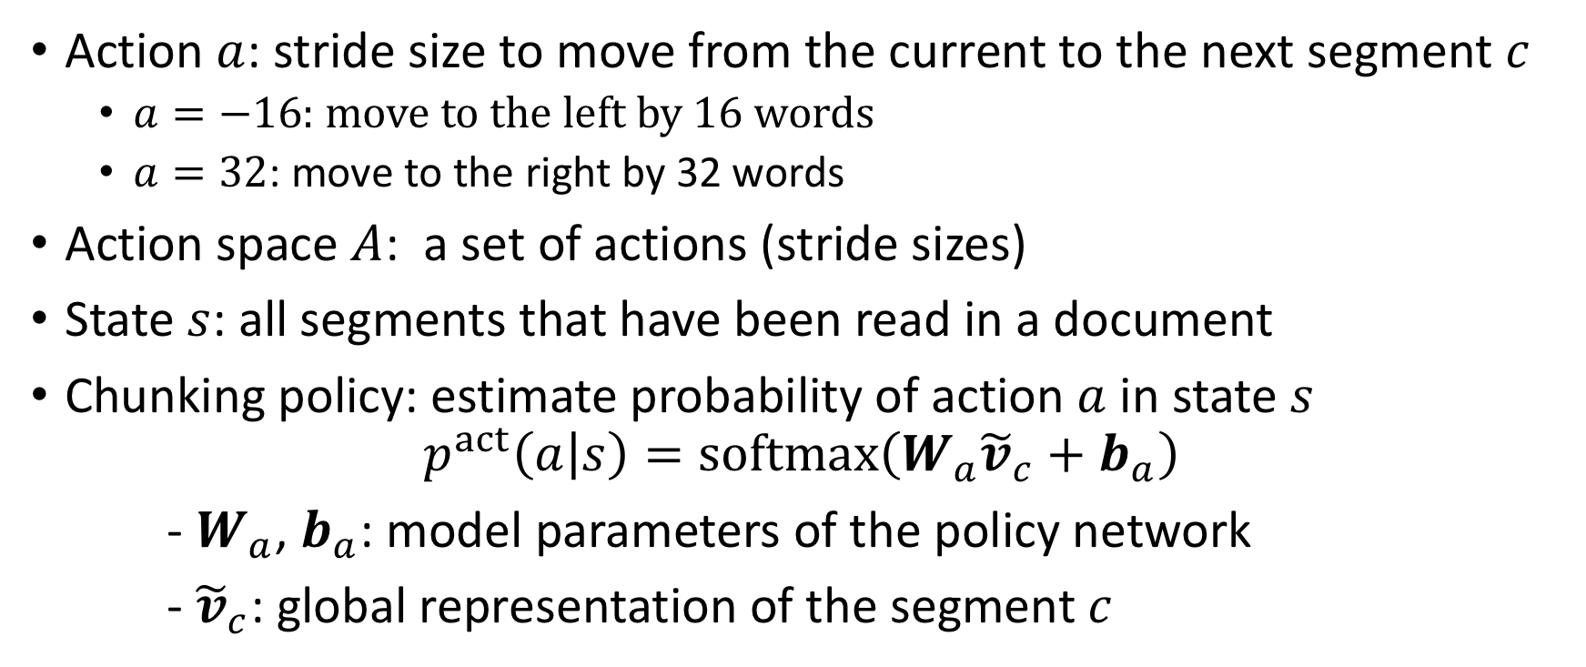
Policy Network
Action $a$: stride size to move from the current to the next segment $c$
$a=−16$: move to the left by 16 words
$a=32$: move to the right by 32 words
Action space $A$: a set of actions (stride sizes)
State $s$: all segments that have been read in a document
Chunking policy: estimate probability of action $a$ in state $s$
$$p^{act}\left(a | s\right)=softmax\left(W_{a}{\tilde{v}}_{c}+b_{a}\right)$$
- $W_{a}$, $b_{a}$: model parameters of the policy network
- ${\tilde{v}}_{c}$: global representation of the segment $c$

Slide 12
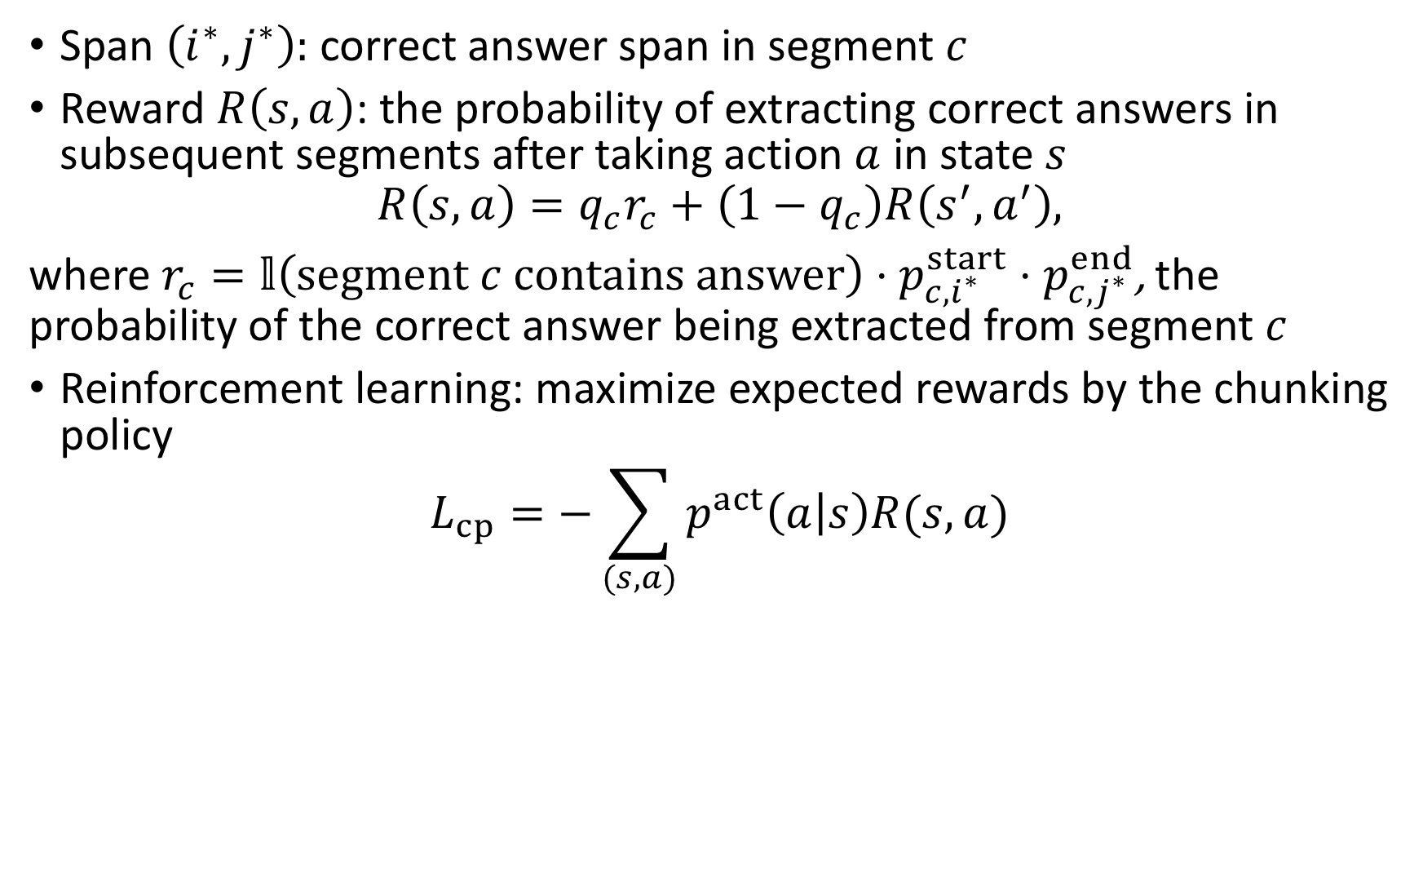
Policy Network: Reward
Span $\left(i^{∗},j^{∗}\right):$ correct answer span in segment $c$
Reward $R\left(s,a\right)$: the probability of extracting correct answers in subsequent segments after taking action $a$ in state $s$
$$R\left(s,a\right)=q_{c}r_{c}+\left(1−q_{c}\right)R\left(s^{′},a^{′}\right),$$
where $r_{c}=𝕝\left(segment c contains answer\right)⋅p_{c,i^{∗}}^{start}⋅p_{c,j^{∗}}^{end}$, the probability of the correct answer being extracted from segment $c$
Reinforcement learning: maximize expected rewards by the chunking policy
$$L_{cp}=−\sum_{(s,a)}{p^{act}\left(a | s\right)R(s,a)}$$

Slide 13
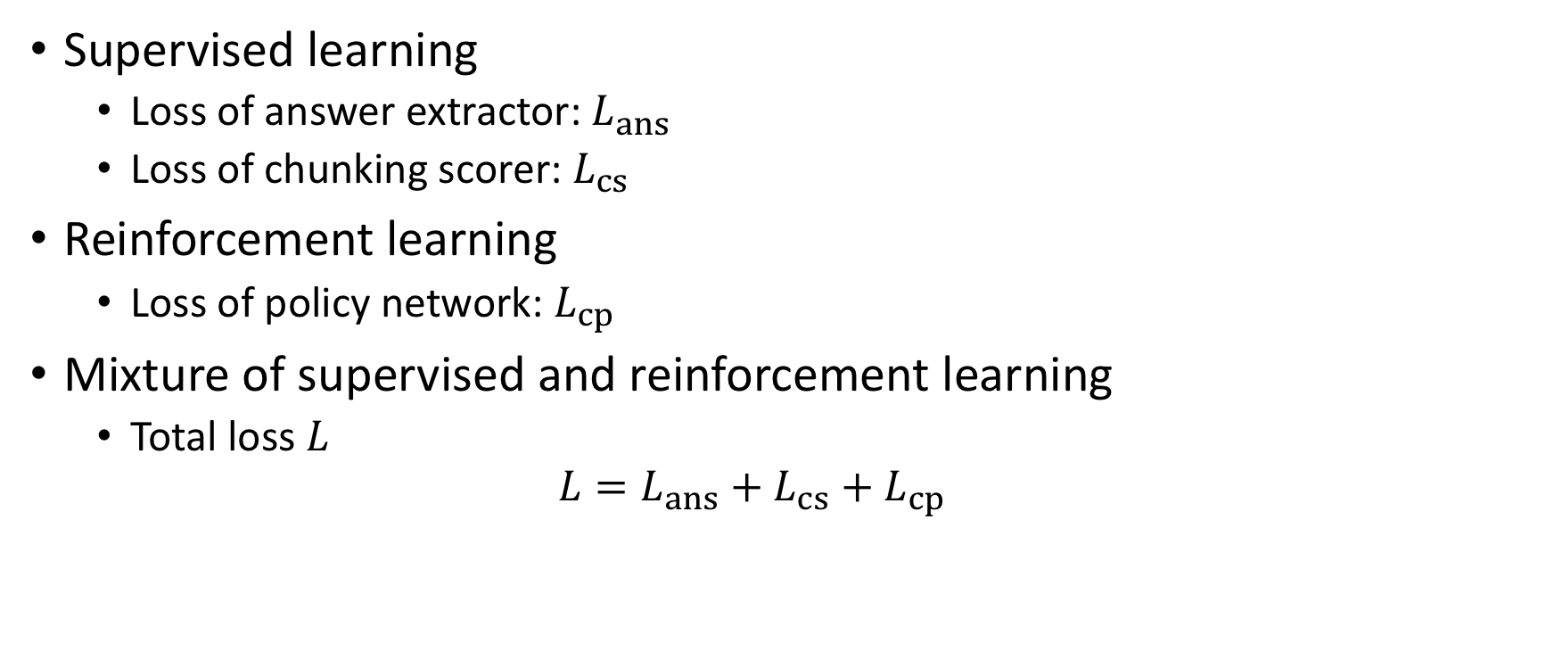
Model Training
Supervised learning
Loss of answer extractor: $L_{ans}$
Loss of chunking scorer: $L_{cs}$
Reinforcement learning
Loss of policy network: $L_{cp}$
Mixture of supervised and reinforcement learning
Total loss $L$
$$L=L_{ans}+L_{cs}+L_{cp}$$

Slide 14
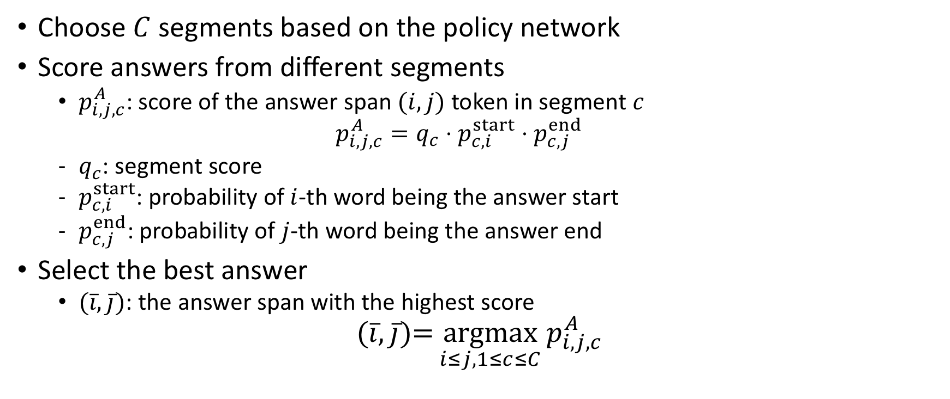
Prediction
Choose $C$ segments based on the policy network
Score answers from different segments
$p_{i,j,c}^{A}$: score of the answer span $(i,j)$ token in segment $c$
$$p_{i,j,c}^{A}=q_{c}⋅p_{c,i}^{start}⋅p_{c,j}^{end}$$
$q_{c}$: segment score
$p_{c,i}^{start}$: probability of $i$-th word being the answer start
$p_{c,j}^{end}$: probability of $j$-th word being the answer end
Select the best answer
$(\overline{i},\overline{j})$: the answer span with the highest score
$$(\overline{i},\overline{j})\text{=}\underset{i≤j, 1≤c≤C}{argmax}{p_{i,j,c}^{A}}$$

Slide 15
Dataset
Conversational Question Answering (CoQA)
Documents with a series of interconnected questions
Average tokens: 352, Maximum tokens: 1323
Question Answering in Context (QuAC)
Dialogues of interactive question answering based on given texts
Average tokens: 516, Maximum tokens: 2310
TriviaQA (wiki)
Question-answer pairs and evidence documents from Wikipedia
Average tokens: 2,622, Maximum tokens: 5,839

Slide 16
Baselines & Evaluation
BERT-Large
Pre-trained model tuned on the datasets of machine reading comprehension
Long documents are chunked into equally-spaced segments
Sent-Selector
Select a subset of sentences from documents
BERT-Large model tuned to extract answers from the downsized documents
Maximum segment length is 512 for all models
Evaluation Metric
F1 score: measure the overlap between the predicted answer and the ground truth

Slide 17
Overall Results
Table 1: F1 Scores of Different Algorithms on CoQA, QuAC and TriviaQA
Algorithms | CoQA | QuAC | TriviaQA
BERT-Large | 81.4 | 61.5 | 61.3
Sent-Selector | 79.5 | 56.4 | 59.8
BERT-RCM (ours) | 81.8 | 62.0 | 62.9

Slide 18
Results on CoQA and QuAC
Table 2: F1 Score of Different Algorithms on CoQA and QuAC datasets
Dataset | CoQA |  |  |  | QuAC
# of doc tokens | <=200 | (200, 300] | (300, 400] | >400 | <=300 | (300, 450] | (450, 600] | >600
Percentage | 15.3 | 63.3 | 18.9 | 2.5 | 20.5 | 52.0 | 19.7 | 7.8
BERT-Large | 81.0 | 81.9 | 81.8 | 67.2 | 66.2 | 62.8 | 62.2 | 38.7
BERT-RCM (ours) | 81.1 | 82.1 | 82.3 | 74.5 | 66.1 | 62.6 | 63.6 | 43.2

Slide 19
Conclusion
The performance gain comes from
Flexible chunking to generate good segments
Information flow across segments
Leverage answers from multiple segments properly
Code release
https://github.com/HongyuGong/RCM-Question-Answering

Slide 20
Thank You!

