Slide 1
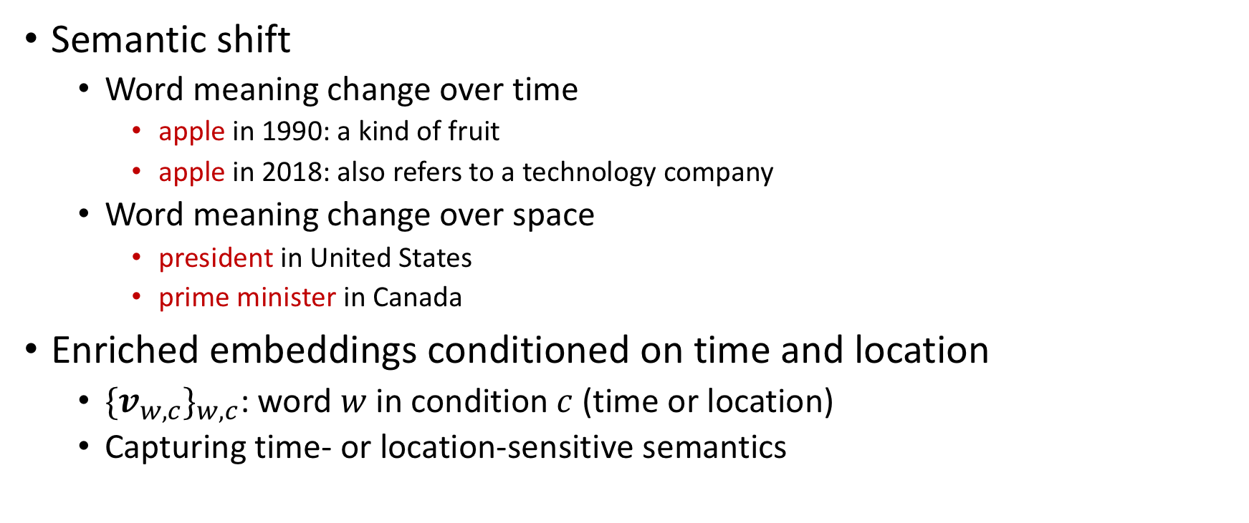
Motivation
CoNLL2020
Semantic shift
Word meaning change over time
apple in 1990: a kind of fruit
apple in 2018: also refers to a technology company
Word meaning change over space
president in United States
prime minister in Canada
Enriched embeddings conditioned on time and location
${{\{v}_{w,c}\}}_{w,c}$: word $w$ in condition $c$ (time or location)
Capturing time- or location-sensitive semantics

Slide 2
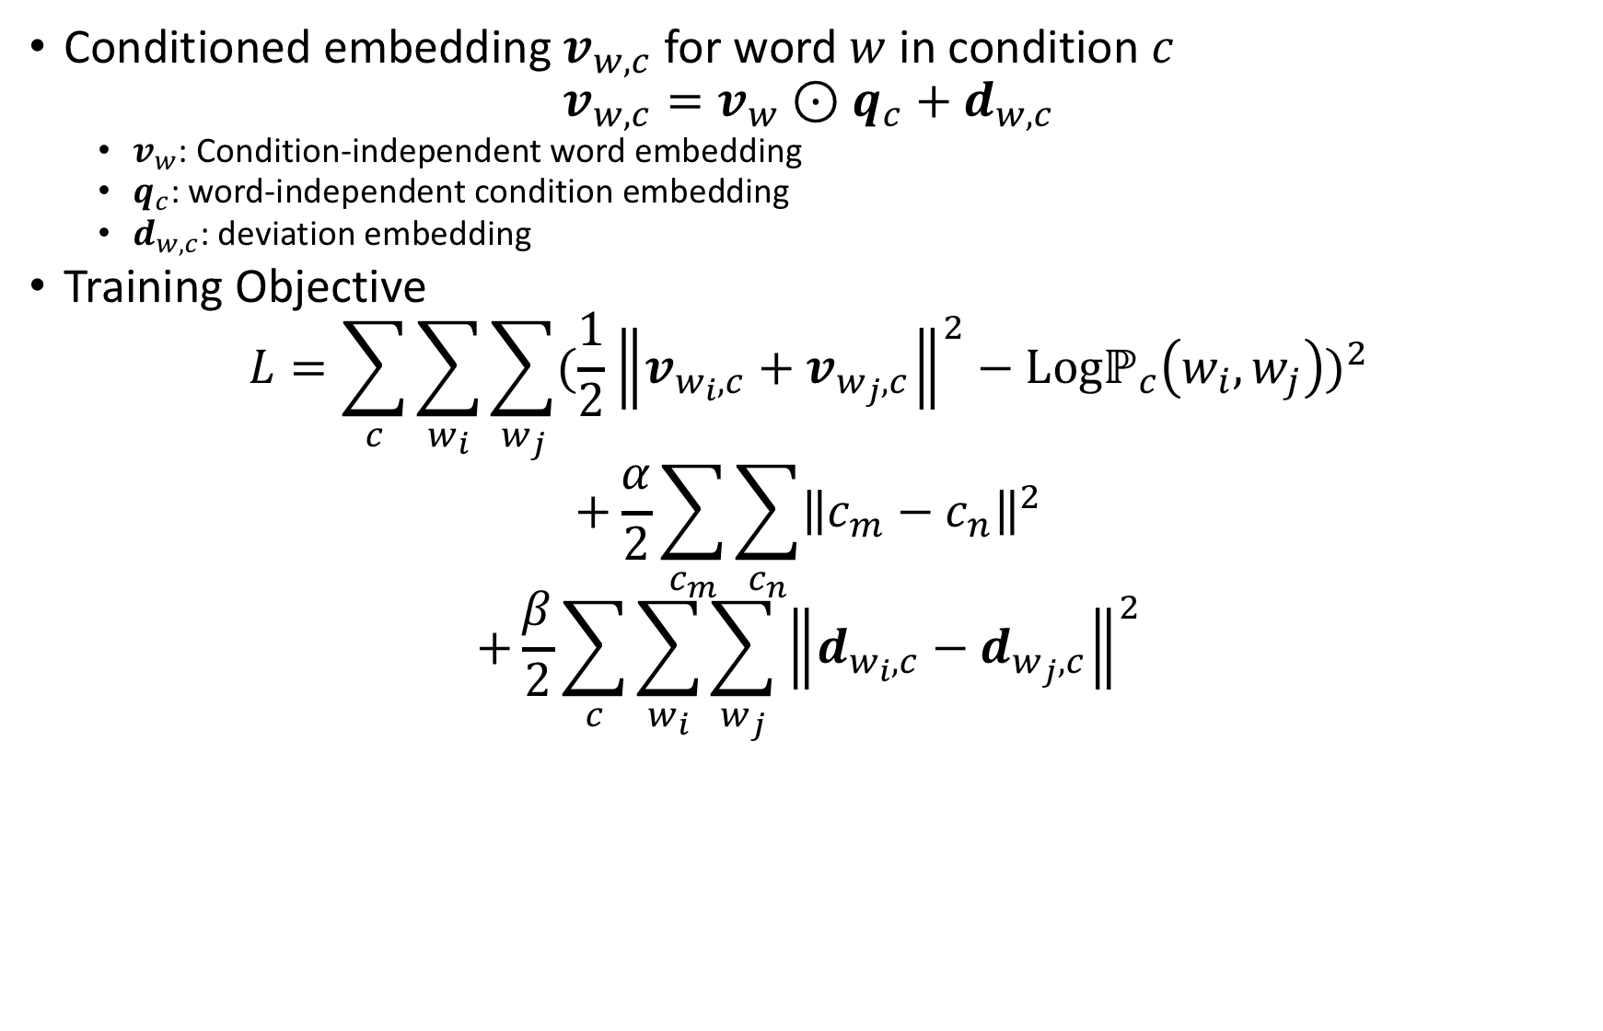
Representation Model
CoNLL2020
Conditioned embedding $v_{w,c}$ for word $w$ in condition $c$
$$v_{w,c}=v_{w}⊙q_{c}+d_{w,c}$$
$v_{w}$: Condition-independent word embedding
$q_{c}$: word-independent condition embedding
$d_{w,c}$: deviation embedding
Training Objective
$$L=\sum_{c}{\sum_{w_{i}}{\sum_{w_{j}}{{(\frac{1}{2}{\left\|v_{w_{i},c}+v_{w_{j},c}\right\|}^{2}−Logℙ_{c}\left(w_{i},w_{j}\right))}^{2}}}}$$
$$+\frac{α}{2}\sum_{c_{m}}{\sum_{c_{n}}{{\left\|c_{m}−c_{n}\right\|}^{2}}}$$
$$+\frac{β}{2}\sum_{c}{\sum_{w_{i}}{\sum_{w_{j}}{{\left\|d_{w_{i},c}−d_{w_{j},c}\right\|}^{2}}}}$$
Property 1: Condition-specific semantics
Property 2: Consistency over conditions
Property 3: Different degrees of semantic changes.

Slide 3
Stable Words
CoNLL2020
Words stability
measured by the cosine similarity between embeddings in different conditions
Temporally stable words
the, in, to, a, of, it, by, with, at, was, are, and, on, who, for, not, they, but, he, is, from, have, as, has, their, about, her, been, there, or, will, this, said, would
Spatially stable words
in, from, at, could, its, which, out, but, on, all, has, so, is, are, had, he, been, by, an, it, as, for, was, this, his, be, they, we, her, that, and, with, a, of, the
Frequent words (e.g., function words) are most stable

Slide 4
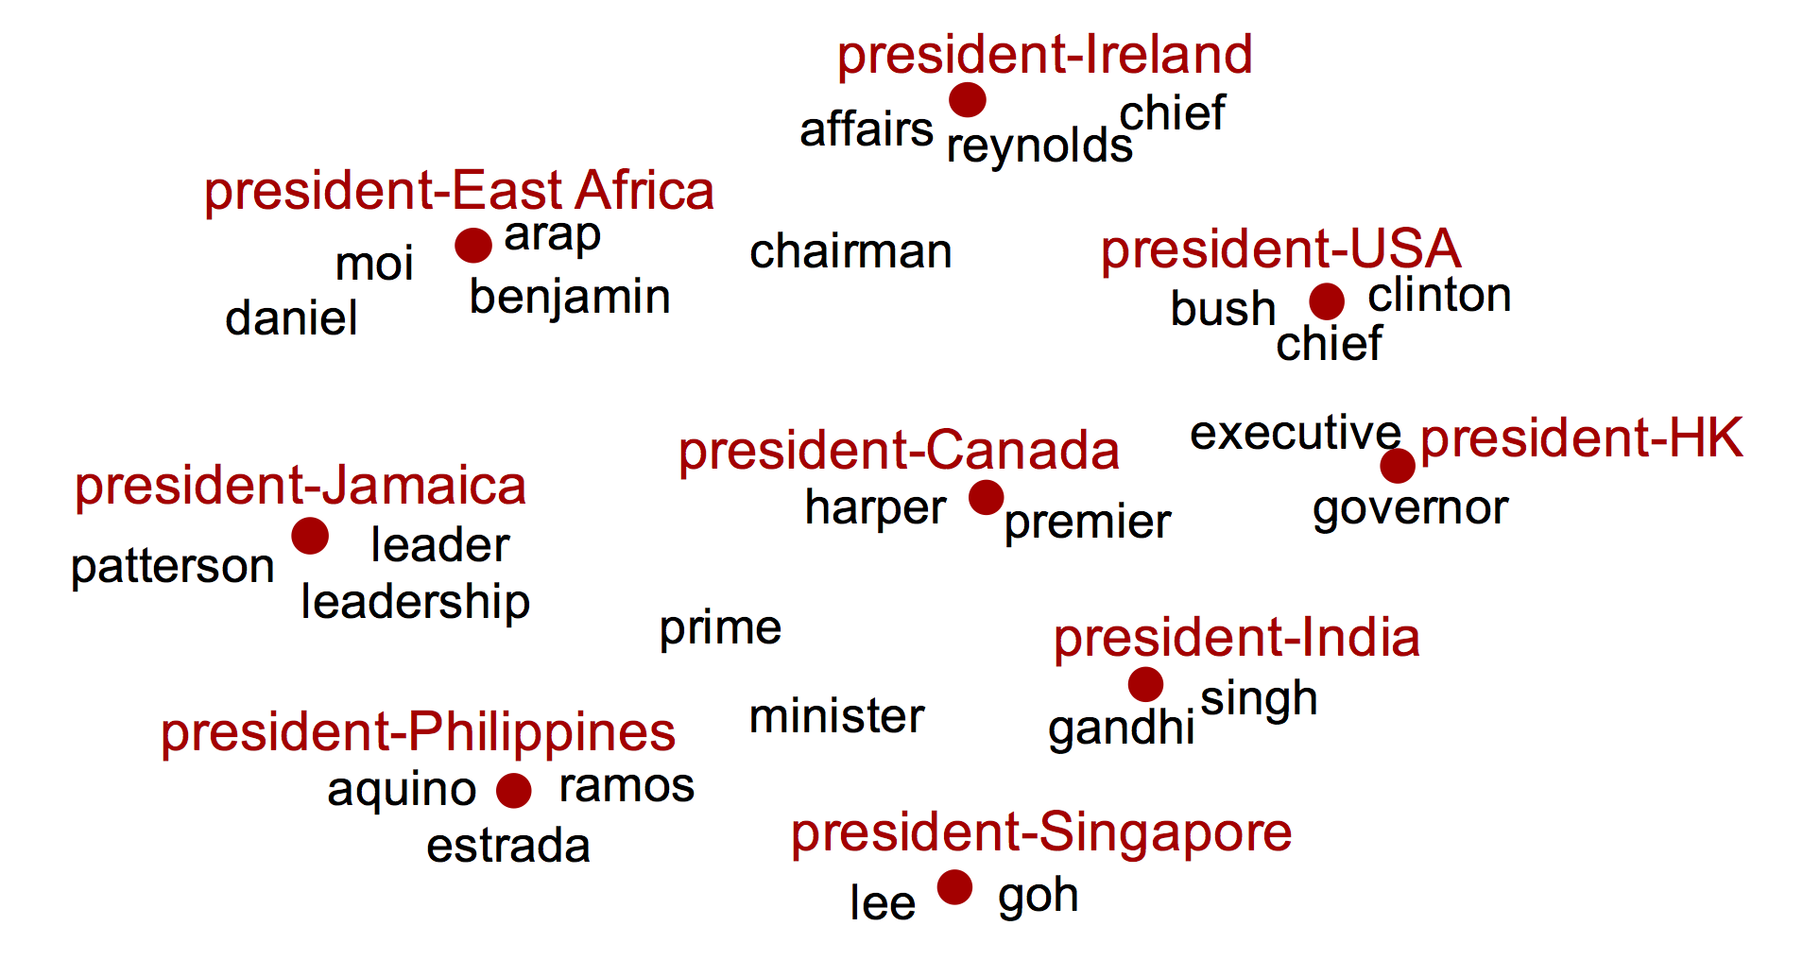
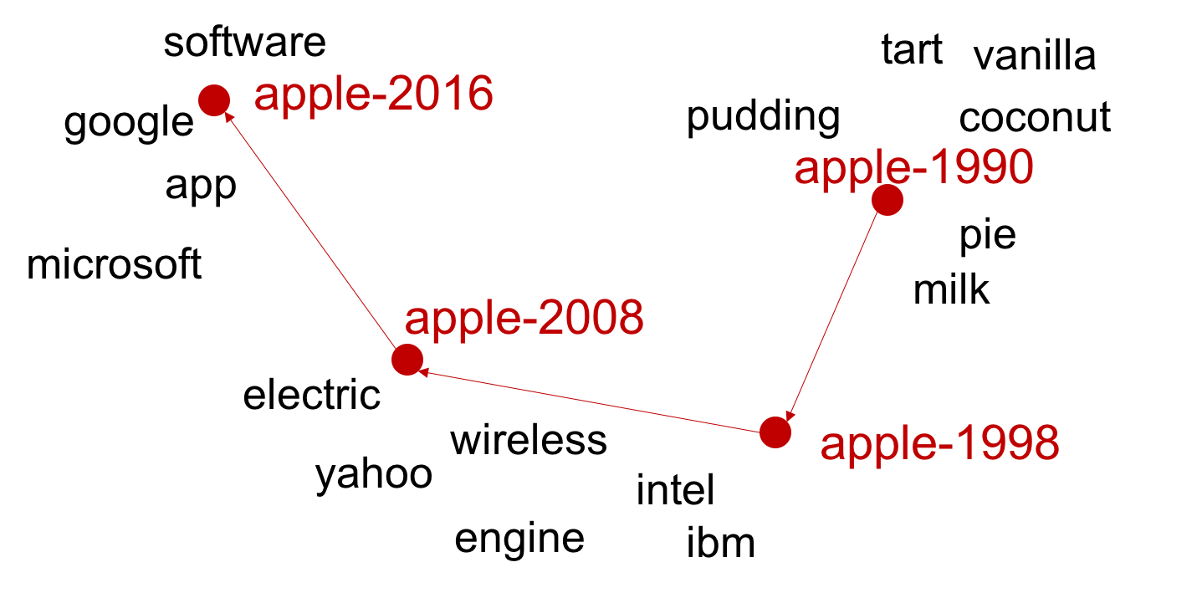
Changing Words
CoNLL2020
Fig. 1: Temporally changing words
Fig. 2: Spatially changing words

