Slide 1
Reinforcement Learning Based Text Style Transfer without Parallel Training Corpus
Hongyu Gong*, Suma Bhat*, Lingfei Wu†, Jinjun Xiong†, Wen-mei Hwu*
*University of Illinois at Urbana-Champaign, USA
†T.J. Watson Research Center, IBM

Slide 2
Language Styles
Simple English Wiki
Hanami means "flower viewing" in Japanese. Enjoying beautiful flowers is an old Japanese custom. Cherry blossoms are the most popular. The custom of hanami is more than a thousand years old. It is still very popular in Japan. Hanami takes place in the spring. Cherry blossoms are there for only a week or two. The cherry trees flower in late March and early April. The blossoms do not stay fresh very long. After a little time, the blooming is over. Then the blossoms fall from the trees.
English Wiki
Hanami ( "flower viewing") is the Japanese traditional custom of enjoying the transient beauty of flowers; flowers ("hana") are in this case almost always referring to those of the cherry or, less frequently, plum ("ume") trees. From the end of March to early May, cherry trees bloom all over Japan, and around the first of February on the island of Okinawa. The blossom forecast "cherry blossom front" is announced each year by the weather bureau, and is watched carefully by those planning hanami as the blossoms only last a week or two.
Notes:
Different styles in writing: fiction novels

Slide 3
Motivation of Style Transfer
Language style transfer
Rewrite a source sentence in a different style and preserve its original semantic content
Applications
Personalized response in dialogue system
News/books for different audience
English Wikipedia and Simple English Wikipedia
Stylistic Text Generation

Slide 4
Transfer via Parallel Translation
Monolingual machine translation^{[1]}
Sequence-to-sequence model
I
really
like
it
I
really
hate
it
[1] Harsh Jhamtani, Varun Gangal, Eduard Hovy, and Eric Nyberg. 2017. Shakespearizing modern language using copy-enriched sequence-to-sequence models. Proceedings of the Workshop on Stylistic Variation, EMNLP 2017 pages 10–19.

Slide 5
Challenges
Parallel data may not be available or costly to collect
A lot of non-parallel data
Corpora collected in different styles
Goal of language style transfer
Preserve content
Change style
Achieve fluency

Slide 6
Transfer via Non-parallel Corpus
Word substitutions^{[1]}
Delete words associated with the source style and replace them with similar phrases associated with the target style
Limited to lexical level transfer
Neural model with cycle consistency^{[2]}
Source style
Source sentence
Source sentence
Source semantics
Target sentence
Target style
[1] Juncen Li, Robin Jia, He He, and Percy Liang. 2018. Delete, retrieve, generate: a simple approach to sentiment and style transfer. NAACL-HLT 2018, Volume 1 (Long Papers), volume 1, pages 1865–1874.
[2] Cicero Nogueira dos Santos, Igor Melnyk, and Inkit Padhi. 2018. Fighting offensive language on social media with unsupervised text style transfer. arXiv preprint arXiv:1805.07685.

Slide 7
Limitations
Previous models rely on differentiable training objective to train the style transfer model
Implicit constraints on generated sentences
Cycle consistency constraint for content preservation
No guarantee of transfer quality beyond the content and style of generated sentences

Slide 8
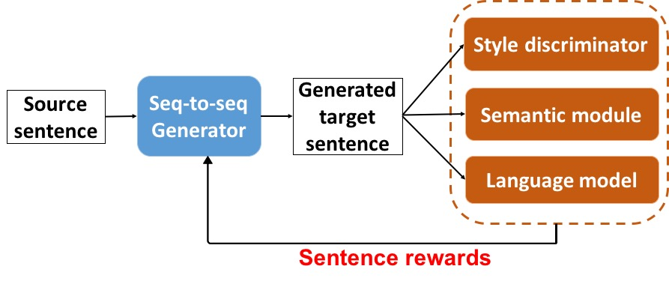
Model Overview
Target evaluation
Target generation
Style
Content
Fluency

Slide 9
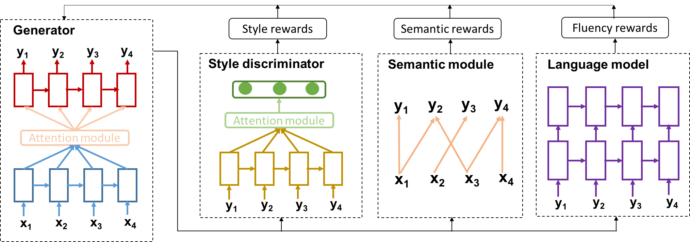
Model

Slide 10
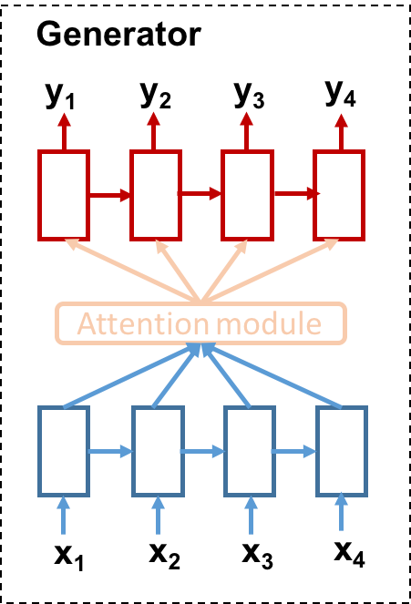
Generator
Model: Sequence-to-sequence RNN with attention
Input: source sentence
Output: target sentence

Slide 11
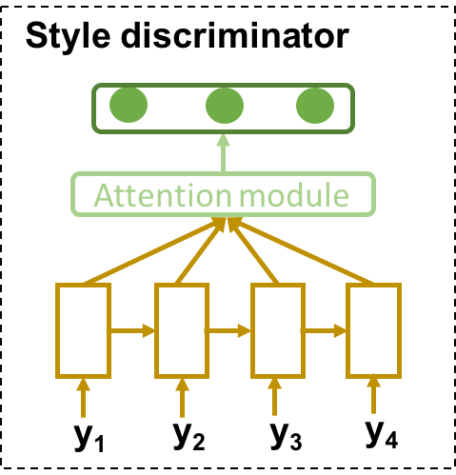
Style Discriminator
Style classifier built upon bidirectional RNN with attention
Pre-trained on source and target corpus in style classification
Adversarially trained on target sentences generated by the generator

Slide 12
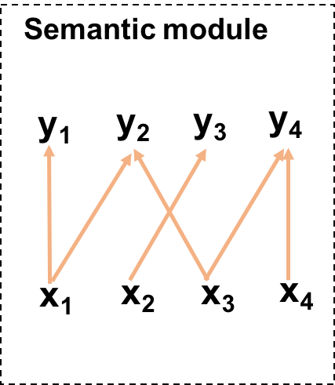
Semantic Module
Word mover’s distance (WMD)^{[1]}
Embedding-based similarity metric for sentence pairs
Word alignment between two sentences
Sentence distance is a sum of distances between words
[1] Kusner M, Sun Y, Kolkin N, Weinberger K. From word embeddings to document distances. InInternational Conference on Machine Learning 2015 Jun 1 (pp. 957-966).

Slide 13
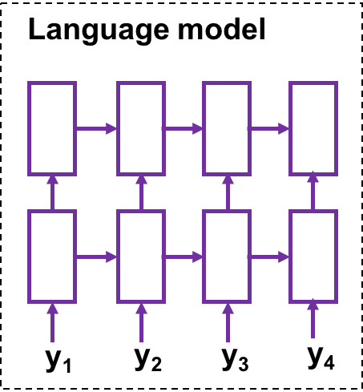
Language Model
RNN-based language model
Predict probability of the next token given previous tokens in the input sentence
Efficient measure of sentence fluency

Slide 14
Reinforcement Learning
Non-differentiable training losses in the evaluation module
Supervised training is not applicable
Reinforcement learning is used instead
Reinforcement learning: update model parameters according to the rewards assigned by the evaluation modules
Reinforcement learning for style transfer
State: Source sentence and tokens already generated in the target sentence
Action: The next token to be generated
Reward: How good an action is
Policy: Prediction of the next token, i.e., probability over the whole vocabulary

Slide 15
RL: Reward Estimation
The services is bad
The servants are friendly
The waiters are nice
0.2
0.5
0.5
sample
score
Evaluators
Target:
The
service
is
good
score
The service is wonderful
The service is excellent
The service is alright
0.8
0.8
0.6
Generator
sample
Source:
The
service
is
bad

Slide 16
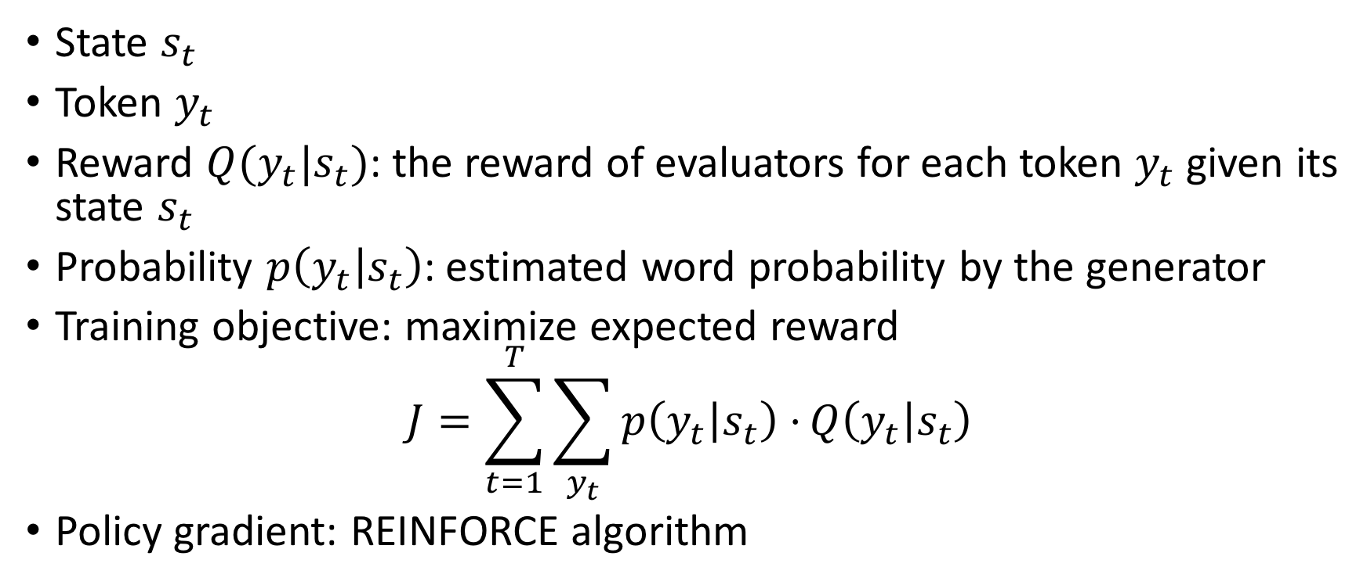
RL: Loss Function
State $s_{t}$
Token $y_{t}$
Reward $Q(y_{t}|s_{t})$: the reward of evaluators for each token $y_{t}$ given its state $s_{t}$
Probability $p\left(y_{t} | s_{t}\right)$: estimated word probability by the generator
Training objective: maximize expected reward
$$J=\sum_{t=1}^{T}{\sum_{y_{t}}{p\left(y_{t} | s_{t}\right)⋅}}Q\left(y_{t} | s_{t}\right)$$
Policy gradient: REINFORCE algorithm

Slide 17
Evaluation
Datasets
Sentiment dataset: consisting of restaurant reviewers on Yelp website, which are classified as either negative or positive.
Formality dataset: Yahoo Answers Formality Corpus (GYAFC) where sentences written in informal style and rewritten formally by annotators
Evaluation
Content preservation: sentence similarity metric
Transfer strength: style classifier
Content-style tradeoff: compromise between content and style score
Fluency: sentence perplexity by language model

Slide 18
Experiment
Baselines
Aligned Auto-Encoder (CA^{)[1]:} assuming that texts in source and target styles share the same latent content space. Encoder generates style-independent content representation which is then combined with style information for target sentences.
Multi-decoder seq2seq model (MDS^{)[2]:} consisting of one encoder and multiple decoders. Style specific decoder takes content representation of a source sentence and generates the target sentence.
[1] Tianxiao Shen, Tao Lei, Regina Barzilay, and Tommi Jaakkola. 2017. Style transfer from non-parallel text by cross-alignment. In Advances in Neural Informa- tion Processing Systems, pages 6830–6841
[2] Zhenxin Fu, Xiaoye Tan, Nanyun Peng, Dongyan Zhao, and Rui Yan. 2018. Style transfer in text: Exploration and evaluation. In Proceedings of the Thirty-Second AAAI Conference on Artificial Intel- ligence, (AAAI-18), New Orleans, Louisiana, USA, February 2-7, 2018, pages 663–670.

Slide 19
Results
Table 1: Evaluation of text style transfer on sentiment and formality transfer.
Sentiment | Negative-to-Positive |  |  |  | Positive-to-Negative
Metric | Content | Style | C-S Tradeoff | Perplexity | Content | Style | C-S Tradeoff | Perplexity
CA | 0.894 | 0.836 | 0.432 | 103.11 | 0.905 | 0.836 | 0.435 | 185.35
MDS | 0.783 | 0.988 | 0.437 | 98.89 | 0.756 | 0.860 | 0.402 | 156.98
RLS (Ours) | 0.868 | 0.980 | 0.460 | 119.24 | 0.856 | 0.992 | 0.459 | 174.02
Formality | Informal-to-Formal |  |  |  | Formal-to-Informal
Metric | Content | Style | C-S Tradeoff | Perplexity | Content | Style | C-S Tradeoff | Perplexity
CA | 0.865 | 0.558 | 0.339 | 238.05 | 0.789 | 0.956 | 0.432 | 317.40
MDS | 0.519 | 0.435 | 0.237 | 278.65 | 0.546 | 0.998 | 0.353 | 352.86
RLS (Ours) | 0.885 | 0.601 | 0.358 | 208.33 | 0.873 | 0.982 | 0.462 | 267.78

Slide 20
Conclusion
Reinforcement learning for language style transfer
Explicit constraints such as fluency on generated sentences
Flexible to incorporate any metrics into training objective
Future direction: other constraints to improve text quality?

Slide 21
Q & A

