Slide 1
Decoding Miniature Asymmetric Visual Evoked Potentials with EEGNet-Based Methods
[Your Name]
Supervisor: [Supervisor Name]
[Date]
Notes:
~10 s. Greet the committee and state the thesis title.

Slide 2
Research Background and Objectives
Research Progress and Stage Achievements
Next-stage Research Plan
Project Schedule
Notes:
~5 s. Four parts: background and objectives, progress, next-stage plan, schedule.

Slide 3
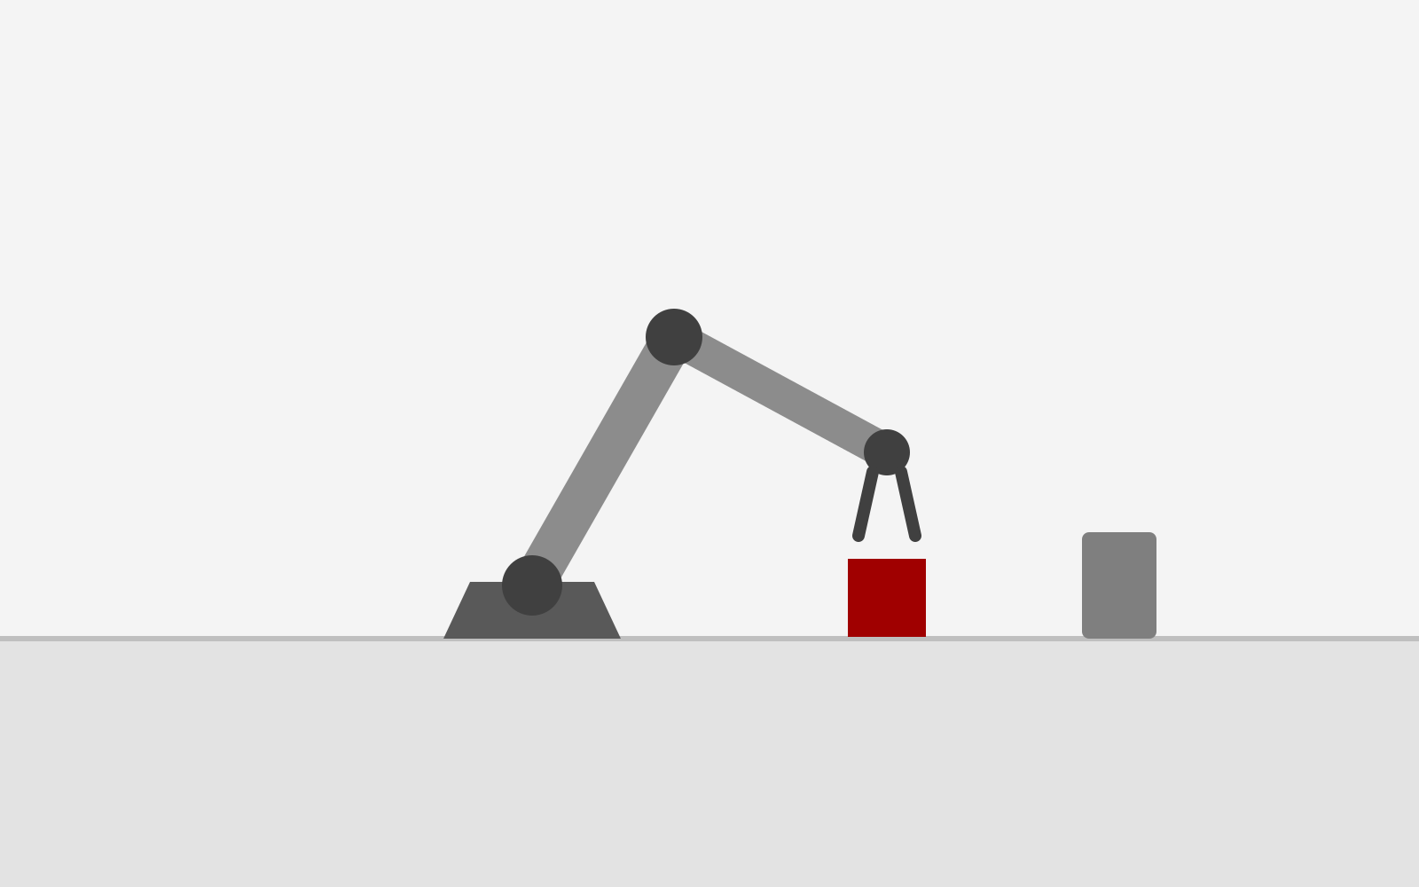
1 Research Background and Objectives
(a) SSVEP [1]
(b) Oddball (P300) [2]
(c) aVEP [3]
8.0 Hz
8.5 Hz
9.0 Hz
9.5 Hz
A
B
C
D
E
F
G
H
I
J
K
L
10.0 Hz
10.5 Hz
11.0 Hz
11.5 Hz
M
N
O
P
Q
R
S
T
U
V
W
X
12.0 Hz
12.5 Hz
13.0 Hz
13.5 Hz
Y
Z
1
2
3
4
5
6
7
8
9
_
↑
↓
←
→
Grasp
Large flickering targets, one frequency each
High visual burden: view largely occluded
Flashing rows / columns of a symbol matrix
High visual burden: view largely occluded
Miniature stimuli beside each command
Low visual burden: environment stays visible
aVEP coding [3]: stimulus order = code
Application
Robotic arms, unmanned vehicles: the user must keep watching the environment while issuing commands
→ Chapter 3: online aVEP-based robotic arm
+
+
= code 0
+
+
= code 1
Task: decode each pair (one every 200 ms) from single-trial EEG
[1] X. Chen et al., PNAS, 2015. [2] L. A. Farwell, E. Donchin, Electroencephalogr. Clin. Neurophysiol., 1988.
[3] M. Xu et al., IEEE Trans. Biomed. Eng., 2018. Panels (a)–(c) are schematic illustrations.
Notes:
~50 s. Traditional visual BCIs use large stimuli: SSVEP needs big flickering targets, the P300 speller a flashing symbol matrix. Both cover most of the view, so the user cannot watch the robot or the road. aVEP uses tiny stimuli beside each command: a left→right pair is code 0, right→left code 1. The scene stays visible, which is what device control needs; this is the goal of Chapter 3. The cost is a very weak signal, shown next.

Slide 4
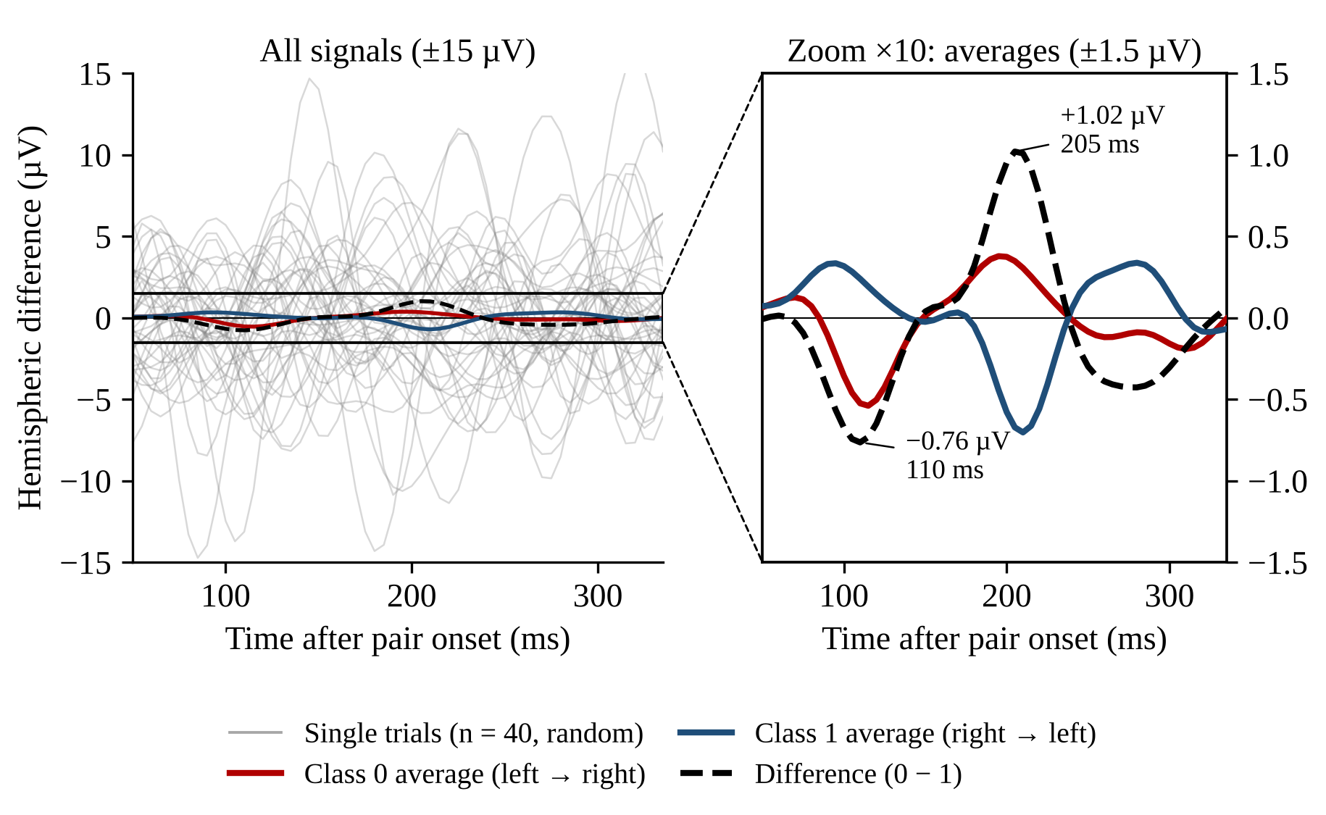
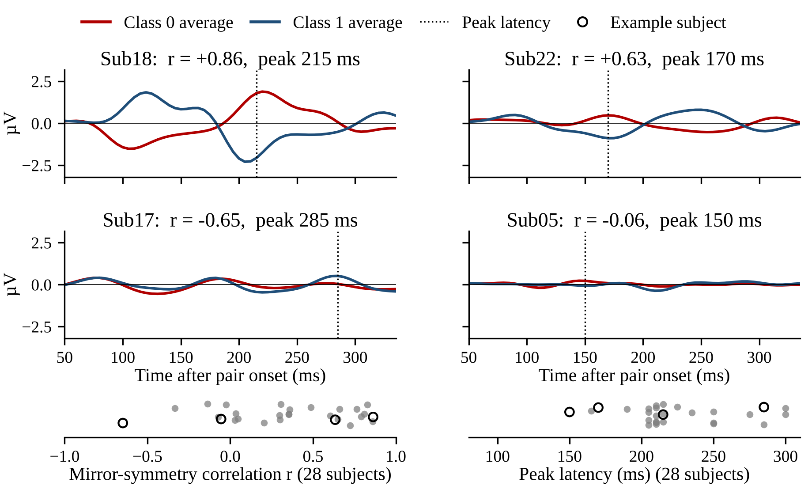
1 Research Background and Objectives
Challenge 1: Low single-trial SNR
Challenge 2: High inter-subject variability
Single trials fluctuate by about ±10 µV (SD 3.3 µV), while the class difference peaks at only ≈ 1 µV
→ The task-related ERP is buried in background EEG
Mirror-symmetry r: −0.65 to 0.86; peak latency: 150–300 ms; peak amplitude: 0.3–3.9 µV
→ Waveform, timing and lateralization differ across subjects
All waveforms are measured data (28 subjects; 1–30 Hz, common average reference). Signal: left − right hemisphere, mean of 9 mirror channel pairs. r: correlation of the class-0 pattern with the sign-flipped class-1 pattern (9 pairs × time; mirror rule gives r = 1). Peak latency: largest class difference within 80–300 ms.
Notes:
~45 s. Left: grey lines are real single trials; red and blue are the class averages, black dashed their difference. Single trials swing by about ten microvolts, the class difference is about one, so a single trial carries very little of the signal. Responses to neighbouring pairs also overlap, since pairs come every 200 ms. Right: four real subjects. Sub18 follows the mirror rule, Sub22 peaks early, Sub17 is inverted, Sub05 barely responds. Across 28 subjects r ranges from −0.65 to 0.86 and the peak from 150 to 300 ms, so a model trained on some subjects transfers poorly to others.

Slide 5
1 Research Background and Objectives
 | Current limitation | Research focus
① Chapter 1: Low single-trial SNR | Weak (≈ 1 µV), overlapping responses; single trials are unreliable | Distil the recoverable ERP from multi-trial averages (RED)
② Chapter 2: Inter-subject variability | Symmetry and latency differ by subject; cross-subject accuracy drops | Physiology-routed mixture of experts (LR-MoE)
③ Chapter 3: Offline-only validation | Decoders are evaluated offline only | Online EEG-based brain-controlled robotic arm
Single-trial decoding → Cross-subject generalization → Online application
Notes:
~30 s. The observations give two decoding problems, and the thesis adds an application: Chapter 1 targets single-trial SNR, Chapter 2 cross-subject variability, Chapter 3 the online system.

Slide 6
Research Background and Objectives
Research Progress and Stage Achievements
Next-stage Research Plan
Project Schedule
Notes:
~3 s.

Slide 7
2 Research Progress and Stage Achievements
Completed: a verified preprocessing pipeline, leakage-free evaluation and two baselines.
Preprocessing pipeline
Table 1. Single-trial accuracy (%), mean ± std over 28 subjects (chance 50%)
Raw EEG: 21 channels, 200 Hz
Method | Within-subject | Pooled | LOSO
DCPM [1] | 72.57 ± 9.34 | 63.21 ± 6.76 | 60.34 ± 7.31
EEGNet [2] | 74.40 ± 8.46 | 66.73 ± 8.59 | 62.26 ± 7.88
Band-pass 1–30 Hz (zero-phase FIR)
Bad-channel interpolation + CAR
Within-subject: leave-one-session-out, per subject
Pooled: all subjects, leave-one-session-out
LOSO: leave-one-subject-out (cross-subject)
Epoch 0.05–0.34 s after pair onset
Session- / subject-wise splits (no leakage)
Finding: accuracy drops by ≈ 12 points from within-subject to cross-subject, which motivates Chapters 1 and 2.
[1] Xu et al., IEEE TBME, 2018. [2] V. J. Lawhern et al. EEGNet: a compact convolutional neural network for EEG-based brain–computer interfaces. J. Neural Eng., 2018.
Notes:
~50 s. Completed so far: a verified, reproducible preprocessing pipeline and three leakage-free protocols. EEGNet is the stronger baseline: 74.4 % within subjects but 62.3 % across subjects, about 12 points lower. Chapter 1 targets single-trial accuracy, Chapter 2 the cross-subject drop.

Slide 8
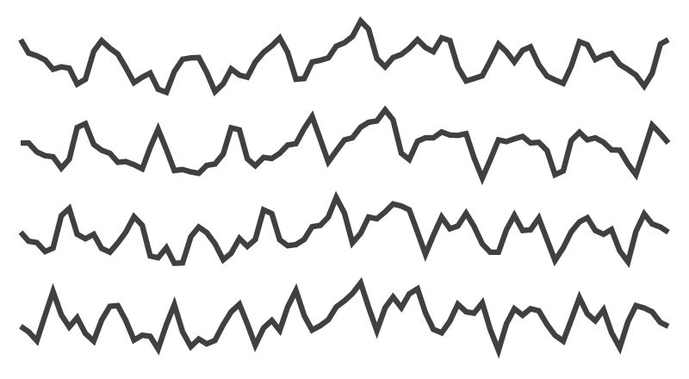
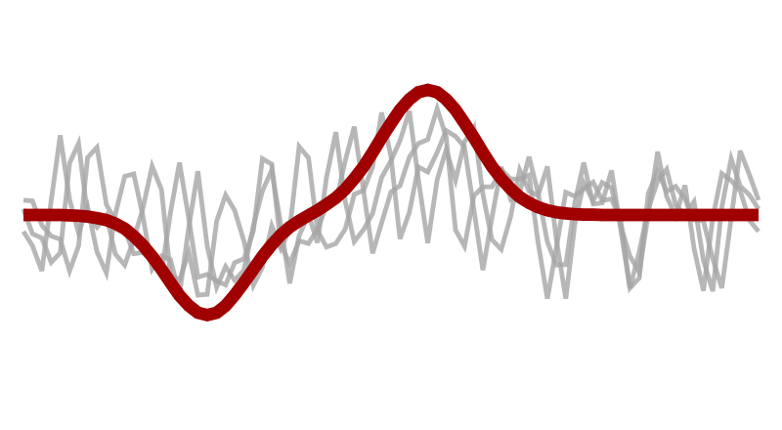
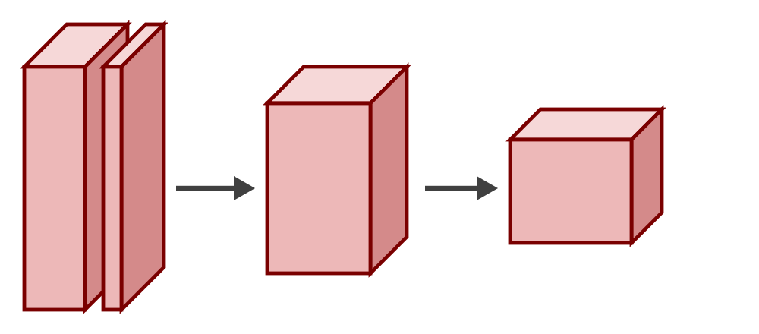
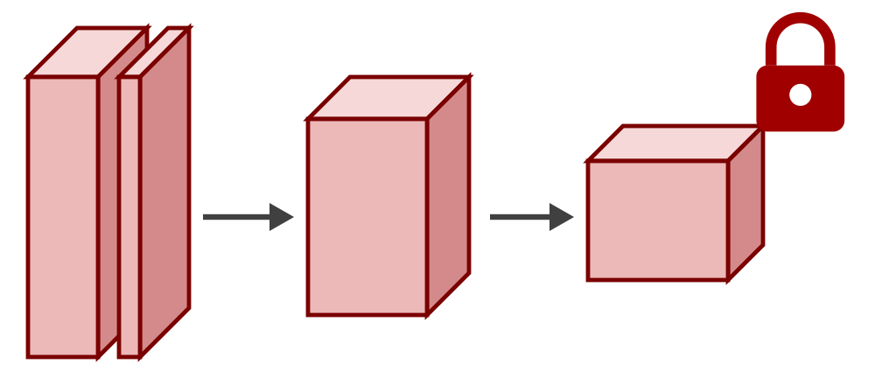
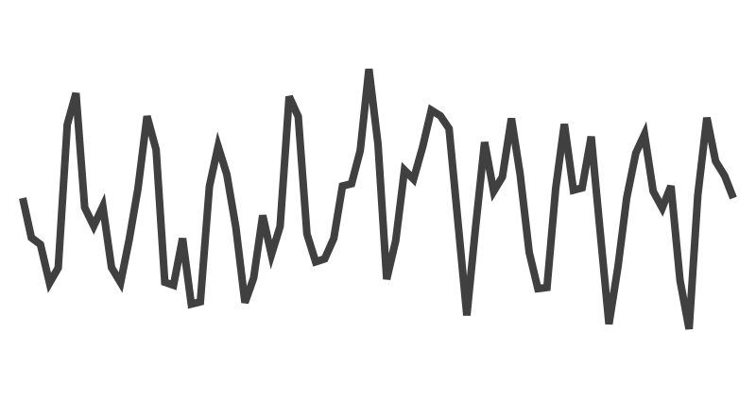
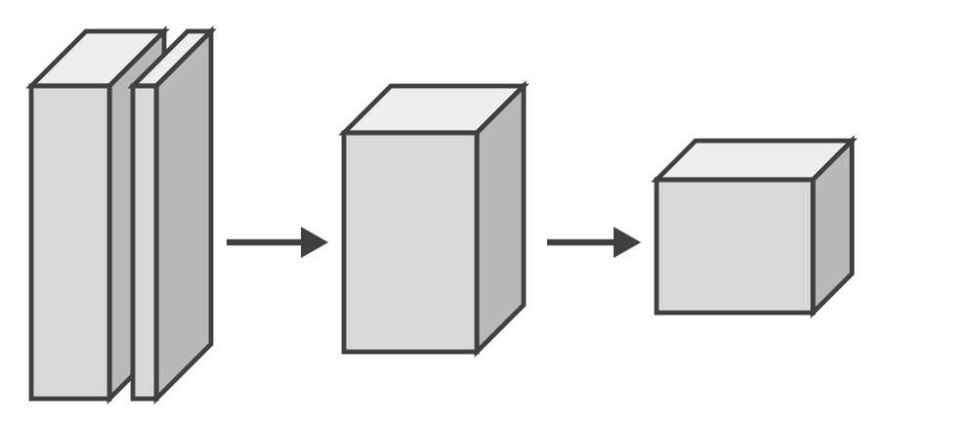
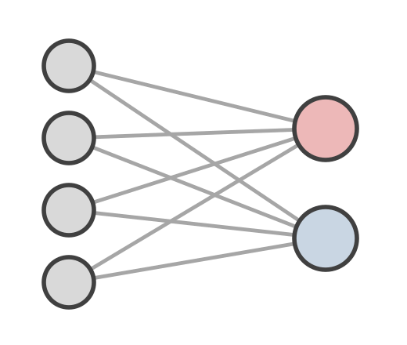
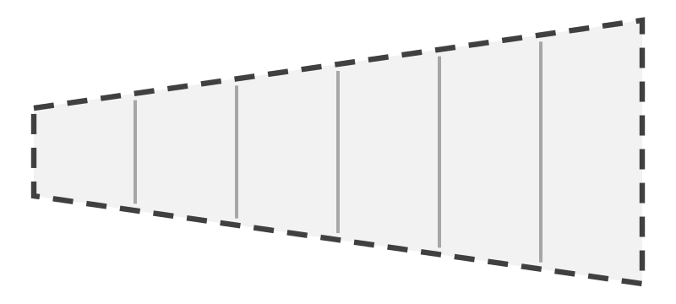
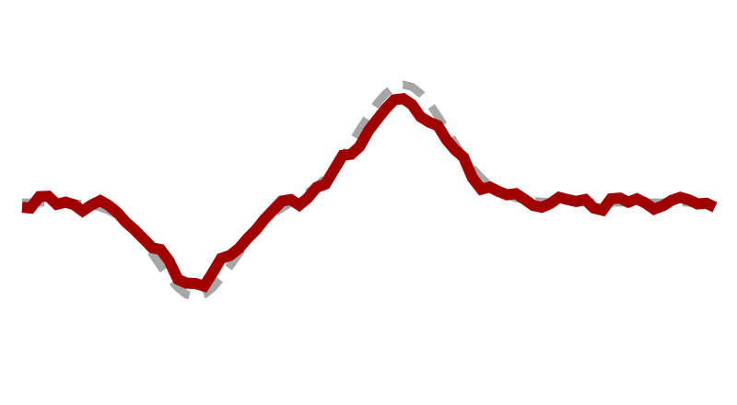
2 Research Progress and Stage Achievements
Chapter 1 · RED: learn from multi-trial averages during training; a plain EEGNet at inference
Stage 1 · Averaged-input teacher (training only)
1. Teacher on averages
Averaging the same group raises the SNR; the teacher learns the clean aVEP
2. Noise2Noise reconstruction
The target ā never contains x, so the student learns E[ERP | x]: only what one trial can recover
3. Teacher as critic
T judges the student's own reconstruction, so the target is always reachable
Inference
Only the student EEGNet is kept: same cost as the baseline
Research positioning
Chapter 1 · within-subject single-trial SNR
Averaging group
same subject, session, char., bit
k-trial average a
k ∈ {2, 3, 6}
Teacher EEGNet
trained on averages
Frozen teacher T
reused in Stage 2
Stage 2 · Student training on single trials
L_{CE}
label y
Single trial x
21 ch × 58 samples
EEGNet encoder
temporal → spatial → separable
Classifier
student logits
L = L_{CE} + λ₁ L_{N2N}
+ λ₂ L_{critic}
L_{N2N} = ‖x̂ − ā‖²
ā: group avg. without x
Linear ERP decoder
training only
Reconstruction x̂
λ₁ = 1, λ₂ = 0.5
Frozen teacher T
judges x̂
L_{critic}
CE(T(x̂), y) + KL
Notes:
~65 s. Stage 1, training only: a teacher EEGNet learns from k-trial averages, which have much higher SNR, then is frozen. Stage 2: the student sees single trials. Besides the label loss, a linear decoder reconstructs the ERP from the student's features and is trained against the average of the other trials in the same group; because that target never contains x, the best possible output is the expected ERP given x, i.e. only what is recoverable. The frozen teacher classifies this reconstruction and its verdict is distilled into the student. At test time only the EEGNet remains.

Slide 9
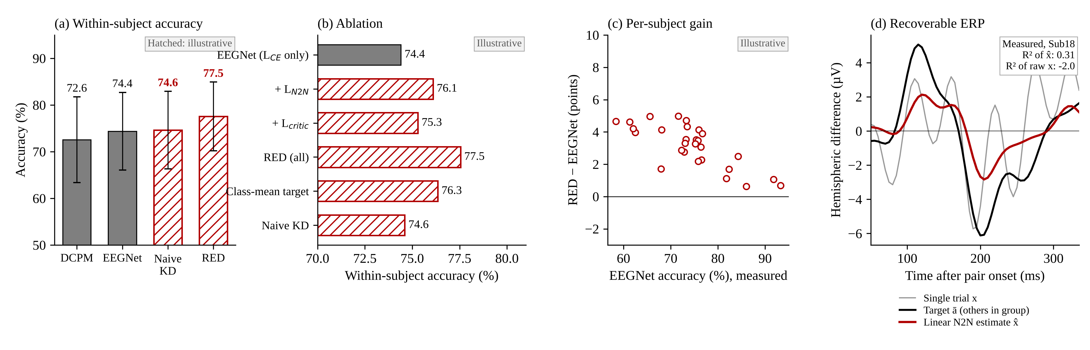
2 Research Progress and Stage Achievements
Chapter 1 · RED · Expected results (illustrative: experiments not yet run)
Expected: RED > EEGNet within subjects, both losses contribute, weak subjects gain most. Measured already: a linear N2N estimate recovers R² = 0.31 of the held-out group ERP (raw single trial: −2.0).
Grey solid bars and filled markers: measured (baselines, seed 0, 28 subjects; mirror r from the data). Red hatched bars, open markers and panels tagged "Illustrative": placeholder values showing how results will be reported, to be replaced by experimental results.
Notes:
~30 s. How Chapter 1 will be evaluated. (a) Within-subject accuracy against the measured baselines; the red bars are placeholders. (b) Ablation: each loss term on its own, the full method, and naive distillation, which we expect not to help. (c) Gain per subject. (d) is real: a simple linear Noise2Noise estimator, trained to predict the average of the other trials in the group, already recovers about 30 % of that held-out ERP from one trial, while the raw trial is a worse predictor than zero. This is the recoverable part RED is built to learn.

Slide 10
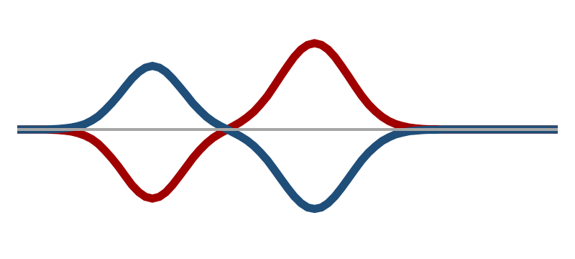
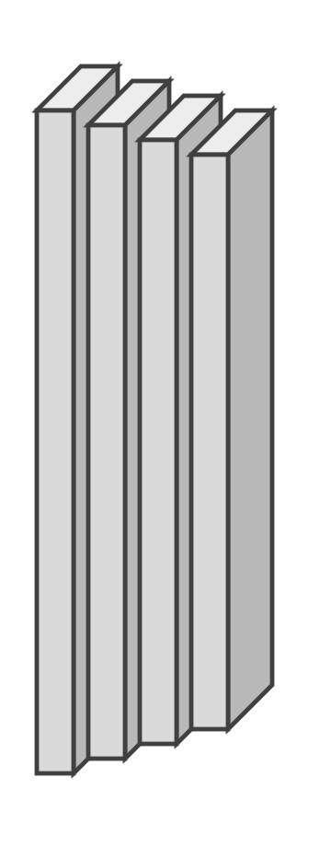
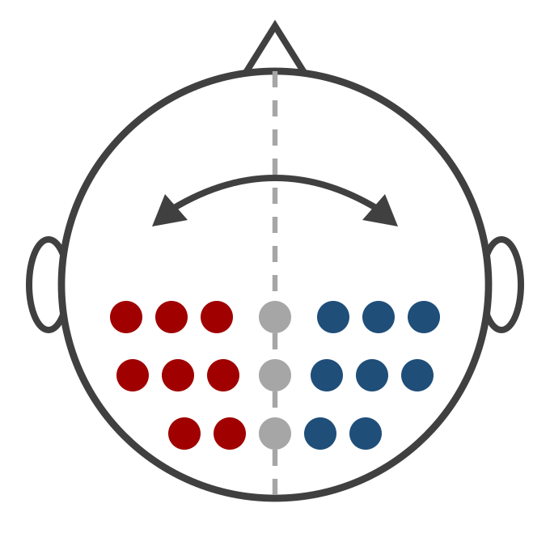
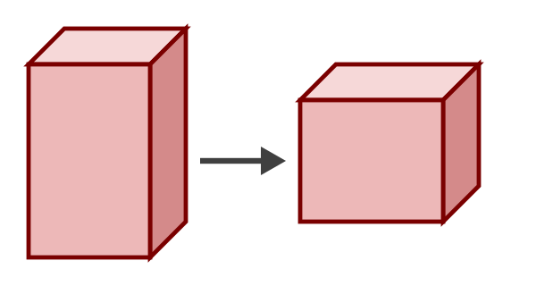
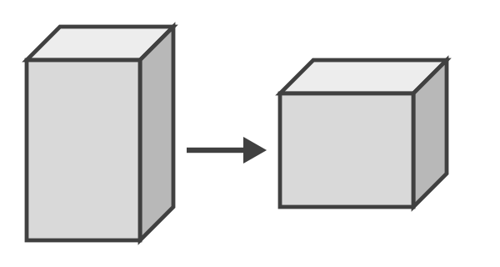
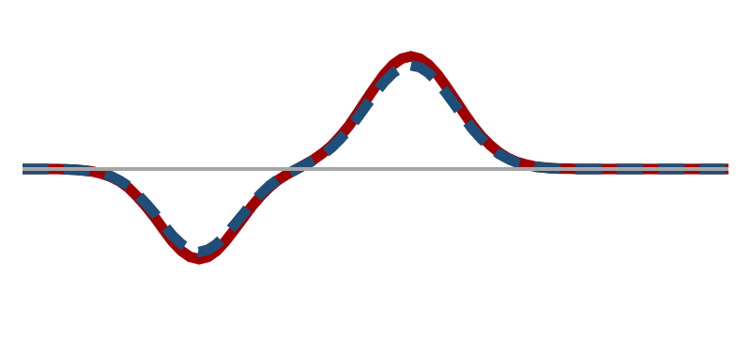
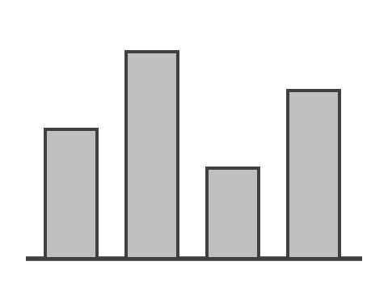
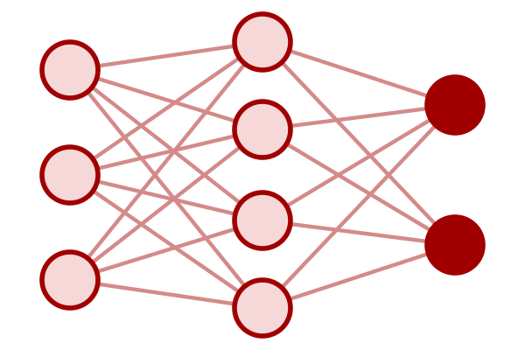
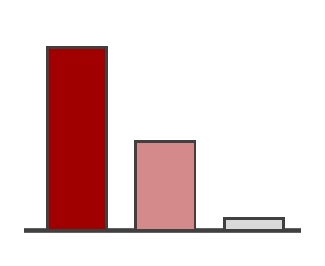
2 Research Progress and Stage Achievements
Chapter 2 · LR-MoE: experts organized by hemispheric symmetry and latency, chosen by a physiological router
Hemispheric decomposition
Expert families (× 3 latencies)
1. Hemispheric decomposition
Separates lateralized from shared activity; x_{a} does not depend on the common reference
2. Structured experts
Symmetry type × response latency, matching the observed subject differences
3. Physiological router
Interpretable descriptors pick experts per trial; no target labels needed
Training losses
CE + load balancing + mirror consistency + subject-coherent routing
Research positioning
Chapter 2 · cross-subject (LOSO) decoding
p(y | x)
Mirror-equivariant
logit(Mx) = −logit(x)
x_{a} = (x − Mx) / 2
lateralized
Hemisphere-dominant
L- or R-weighted
Σ
Single trial x
21 posterior channels
x_{s} = (x + Mx) / 2
shared + context
Symmetric / context
shared response (x_{s})
red left / blue right hemisphere
Shared
temporal conv
g
latency variants: ≈ 100 / 170 / 230 ms
Physiological router
Lateralization index · L/R power ratio
~10 Hz amplitude & phase · antisym./sym. energy
Small MLP
Soft top-2 weights g
Notes:
~65 s. Subjects differ in how symmetric and how fast their response is, so one model does not fit all. The mirror operator splits each trial into an antisymmetric, lateralized stream and a symmetric, shared stream. After a shared temporal convolution, three expert families process them: mirror-equivariant experts for strong lateralizers, hemisphere-dominant experts for asymmetric responders, and symmetric experts for the shared response, each with early, middle and late latency variants. A small router reads interpretable descriptors of the trial and gives soft top-2 weights to the experts. Test: leave-one-subject-out without target data.

Slide 11
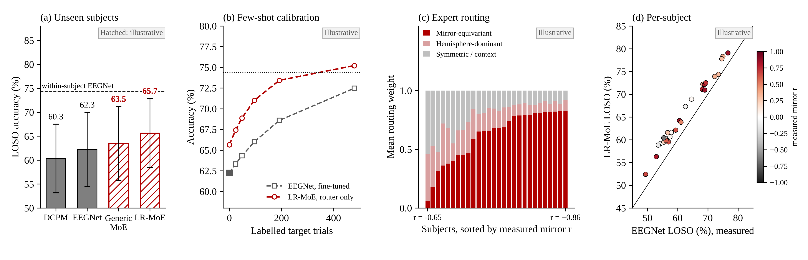
2 Research Progress and Stage Achievements
Chapter 2 · LR-MoE · Expected results (illustrative: experiments not yet run)
Expected: higher accuracy on unseen subjects, faster calibration, and routing that follows each subject's measured mirror symmetry; the largest gains for atypical subjects (low r).
Grey solid bars and filled markers: measured (baselines, seed 0, 28 subjects; mirror r from the data). Red hatched bars, open markers and panels tagged "Illustrative": placeholder values showing how results will be reported, to be replaced by experimental results.
Notes:
~30 s. How Chapter 2 will be evaluated. (a) Leave-one-subject-out accuracy against the measured baselines and a generic mixture of experts. (b) With a few labelled trials, tuning only the router should approach the within-subject level faster than fine-tuning EEGNet. (c) Routing weights per subject, sorted by the measured mirror correlation: strong lateralizers should use the mirror-equivariant experts. (d) Per-subject accuracy; points above the diagonal are improvements. All LR-MoE values here are placeholders.

