Slide 1

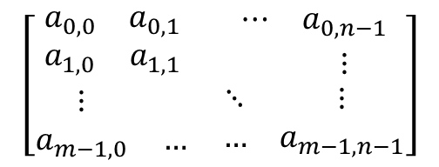

$$\left[\begin{matrix}\begin{matrix}a_{0,0} & a_{0,1} \\ a_{1,0} & a_{1,1}\end{matrix} & \begin{matrix}⋯ & a_{0,n−1} \\ & ⋮\end{matrix} \\ \begin{matrix}⋮ & \\ a_{m−1,0} & …\end{matrix} & \begin{matrix}⋱ & ⋮ \\ … & a_{m−1,n−1}\end{matrix}\end{matrix}\right]$$
$$m Rows$$
$$n Columns$$

Slide 2
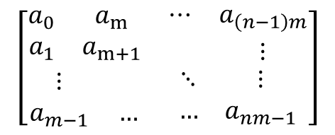

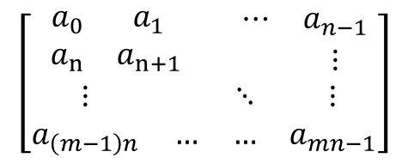






$$\left[\begin{matrix}\begin{matrix}a_{0,0} & a_{0,1} \\ a_{1,0} & a_{1,1}\end{matrix} & \begin{matrix}⋯ & a_{0,n−1} \\ & ⋮\end{matrix} \\ \begin{matrix}⋮ & \\ a_{m−1,0} & …\end{matrix} & \begin{matrix}⋱ & ⋮ \\ … & a_{m−1,n−1}\end{matrix}\end{matrix}\right]$$
$$\left[\begin{matrix}\begin{matrix}a_{0,0} & a_{0,1} \\ a_{1,0} & a_{1,1}\end{matrix} & \begin{matrix}⋯ & a_{0,n−1} \\ & ⋮\end{matrix} \\ \begin{matrix}⋮ & \\ a_{m−1,0} & …\end{matrix} & \begin{matrix}⋱ & ⋮ \\ … & a_{m−1,n−1}\end{matrix}\end{matrix}\right]$$
$$RowMajor$$
Col$Major$
$$\left[\begin{matrix}\begin{matrix}a_{0} & a_{1}\end{matrix} & \begin{matrix}⋯ & a_{l−1}\end{matrix}\end{matrix}\right]$$
$$\left[\begin{matrix}\begin{matrix}a_{0} & a_{1} \\ a_{n} & a_{n+1}\end{matrix} & \begin{matrix}⋯ & a_{n−1} \\ & ⋮\end{matrix} \\ \begin{matrix}⋮ & \\ a_{\left(m−1\right)n} & …\end{matrix} & \begin{matrix}⋱ & ⋮ \\ … & a_{mn−1}\end{matrix}\end{matrix}\right]$$
$$\left[\begin{matrix}\begin{matrix}a_{0} & a_{m} \\ a_{1} & a_{m+1}\end{matrix} & \begin{matrix}⋯ & a_{\left(n−1\right)m} \\ & ⋮\end{matrix} \\ \begin{matrix}⋮ & \\ a_{m−1} & …\end{matrix} & \begin{matrix}⋱ & ⋮ \\ … & a_{nm−1}\end{matrix}\end{matrix}\right]$$
$$RowMajor$$
Col$Major$

Slide 3
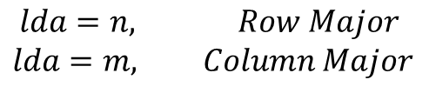
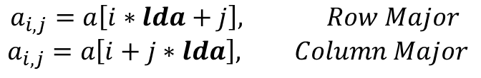
$$a_{i,j}=a\left[i∗lda+j\right], Row Major$$
$$a_{i,j}=a\left[i+j∗lda\right], Column Major$$
$$lda=n, Row Major$$
$$lda=m, Column Major$$

Slide 4


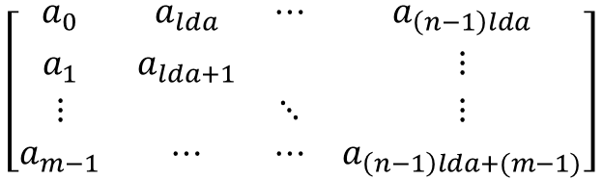
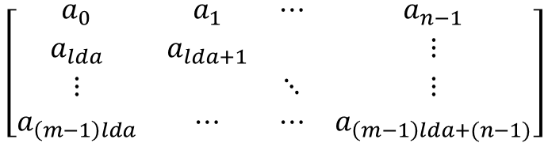
$$\left[\begin{matrix}a_{0} & a_{1} & ⋯ & a_{n−1} \\ a_{lda} & a_{lda+1} & & ⋮ \\ ⋮ & & ⋱ & ⋮ \\ a_{\left(m−1\right)lda} & ⋯ & ⋯ & a_{\left(m−1\right)lda+(n−1)}\end{matrix}\right]$$
$$\left[\begin{matrix}a_{0} & a_{lda} & ⋯ & a_{\left(n−1\right)lda} \\ a_{1} & a_{lda+1} & & ⋮ \\ ⋮ & & ⋱ & ⋮ \\ a_{m−1} & ⋯ & ⋯ & a_{\left(n−1\right)lda+(m−1)}\end{matrix}\right]$$
$$RowMajor$$
Col$Major$

