Slide 1
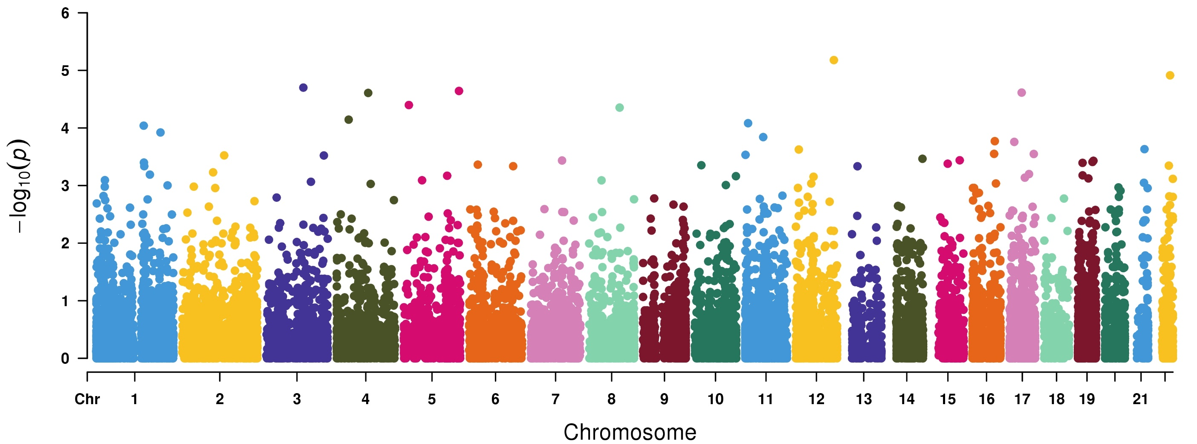
Genome-wide Robust SKAT-O based association study to identify Psoriasis Related Disorders of Colon associated genes in 50K UKBB exome-sequencing data
CCDC62
XRCC6
CD80
BANK1
DDX41
MED1
NIPAL2
PGLYRP3
ZNF143
FAM114A1
238 cases and 23,562 controls

