Slide 1
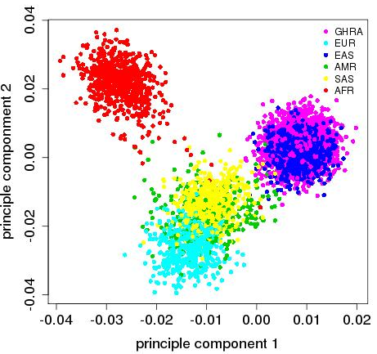
miRBase
Relase 22
N= 2,283 miRNA
dbSNP153
N= 40,602 SNPs
Gnomad v2.1.1
Asian100K
N= 9,907 SNPs
N= 2,879 SNPs
MAF>1%
N= 328 SNPs
N= 250 SNPs
243 SNPs
R²<0.8
4 pSNPs
225 SNPs
4 nSNPs

