Slide 1
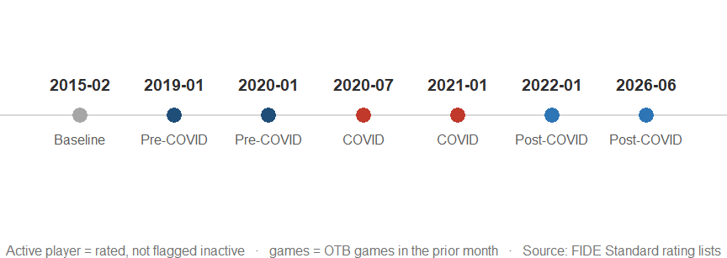
Did over-the-board chess recover after COVID-19?
FIDE Standard rating lists, 2015–2026
Honi Arora · 2162860 · arora.2162860@studenti.uniroma1.it

Slide 2
Online chess boomed in COVID — but FIDE only rates over-the-board play
• Lichess and Chess.com saw record growth during COVID lockdowns
• FIDE Standard ratings reflect only over-the-board (OTB) tournament games
• Question: did OTB tournament activity recover after COVID — or stay smaller for good?
Did over-the-board chess recover after COVID-19? — Honi Arora
2

Slide 3
Seven FIDE snapshots (2015–2026) span pre-, during-, and post-COVID periods
Did over-the-board chess recover after COVID-19? — Honi Arora
3

Slide 4
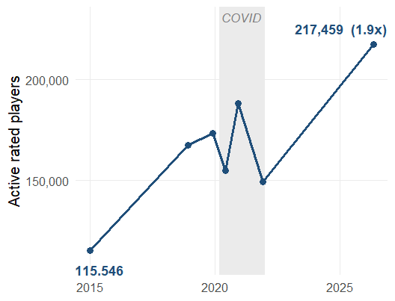
Active players grew ≈88% since 2015 — even through the COVID dip
• COVID-era dip (shaded) was brief — growth resumed right after
• 2026: 217,459 active players, vs 115,546 in 2015
• A bigger pool isn’t necessarily a healthier one — more on that shortly
Did over-the-board chess recover after COVID-19? — Honi Arora
4

Slide 5
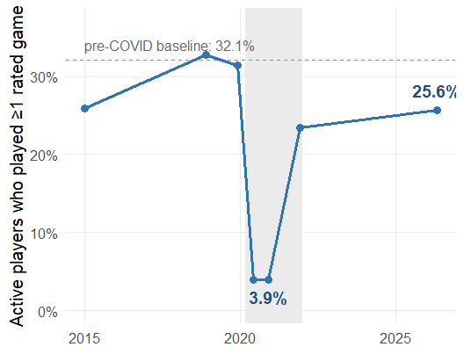
Participation collapsed during COVID, recovering only to ~25% by 2026
• Pre-COVID: 32.1% of active players played a rated game
• COVID trough: 3.9%
• 2026: 24.7% — partial recovery, not full
• chi²(2) = 90,418, p < .001, Cramér’s V = 0.29
Did over-the-board chess recover after COVID-19? — Honi Arora
5

Slide 6
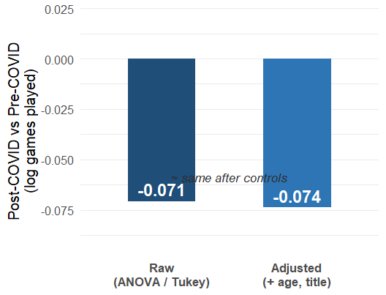
Controlling for age and title barely changes the COVID-era gap
• Post-COVID players play less than pre-COVID players (η² ≈ 0.07 — real, but modest)
• Adding age & title controls barely moves the gap: -0.071 → -0.074
• The participation gap isn’t explained by who kept playing
Did over-the-board chess recover after COVID-19? — Honi Arora
6

Slide 7
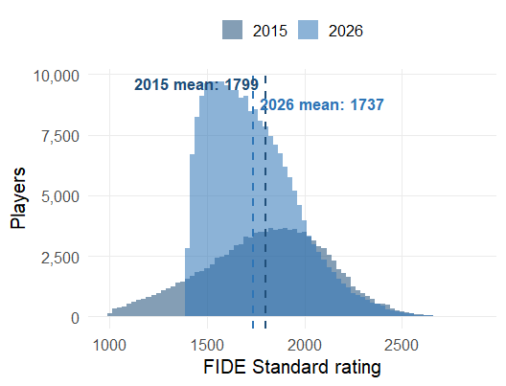
A bigger 2026 player pool comes with lower average ratings
• Mean rating: 1799 (2015) → 1737 (2026), Welch’s t-test p < .001
• Active pool: 115,546 → 217,459
• New, lower-rated players now make up a larger share of the pool
Did over-the-board chess recover after COVID-19? — Honi Arora
7

Slide 8
OTB chess recovered only partially — and the player base has changed
• Participation: 32.1% → 3.9% (COVID) → 24.7% (2026) — partial recovery
• Real, moderate effect (V = 0.29, η² = 0.07) — holds after controlling for age & title
• Pool nearly doubled (115,546 → 217,459) but mean rating fell (1799 → 1737)
• Bottom line: more people play, fewer play often — the player base has changed
Did over-the-board chess recover after COVID-19? — Honi Arora
8

