Slide 1

Did over-the-board chess recover after COVID-19?
Honi Arora · FIDE Master · 2162860
Bachelor's Degree in Applied Computer Science and Artificial Intelligence
Data Management And Analysis Unit 2
Sapienza
UNIVERSITÀ DI ROMA
Notes:
Title slide. Research question: did over-the-board chess recover after COVID-19? Thesis project for Data Management and Analysis, Sapienza.

Slide 2
MOTIVATION · 01
Online vs Over The Board Chess
30M
→
150M
Chess.com users grew five-fold from 2020 to 2023. Fast online formats came to dominate the market.
THE RESEARCH QUESTION
Has competitive chess recovered after COVID-19 and how has the player pool changed?
FIDE over-the-board play fell sharply
Official tournaments managed by the International Chess Federation were cancelled, and ratings show a steep drop through the period.
Did over-the-board chess recover after COVID-19? — Honi Arora
02
Notes:
Online chess boomed during lockdowns while over-the-board tournaments were cancelled. This sets up the research question.

Slide 3
MOTIVATION · 02
FIDE Ratings
FIDE
ELO RATING
OVER-THE-BOARD
Chess's governing body
Strength as a number
Played in person
Runs official over-the-board tournaments and maintains the world rating list.
Updated after every rated game — a win nudges it up, a loss down.
Real games at a physical board and tournament — not online. This study's focus.
THE ELO RATING SCALE
≈1000–1400
≈1400–1800
≈1800–2100
≈2100–2400
2500+
Beginner
Club player
Expert
Master · FM / IM
Grandmaster
Most rated players — and this study's average of ≈1750 — sit in the club-to-expert range.
Did over-the-board chess recover after COVID-19? — Honi Arora
03
Notes:
A quick primer for non-chess audiences: FIDE is the governing body, the Elo rating is a single strength number, over-the-board means in-person tournament play, and an active player is one rated and not flagged inactive. Most players sit between roughly 1400 and 2100.

Slide 4
DATA · 01
Data Preprocessing
2015-02
2019-01
2020-01
2020-07
2021-01
2022-01
2026-06
Baseline
Pre-COVID
Pre-COVID
COVID
COVID
Post-COVID
Post-COVID
COMBINED
CLEANED
ENRICHED
2,534,904
1,166,786 ~46%
1,166,786 × 15 colms
→
→
All 7 FIDE rating-list snapshots merged into one dataset of player records.
Removed Inactive players, those who had zero tournament games in past 12+ months.
Added COVID period, age, title status and monthly activity indicators
Source — FIDE Standard Rating Lists: official monthly records of every FIDE-rated player worldwide. (https://ratings.fide.com/download_lists.phtml)
Did over-the-board chess recover after COVID-19? — Honi Arora
04
Notes:
2.5 million raw records reduced to 1.17 million active rated players, then enriched into a 15-variable analysis dataset.

Slide 5
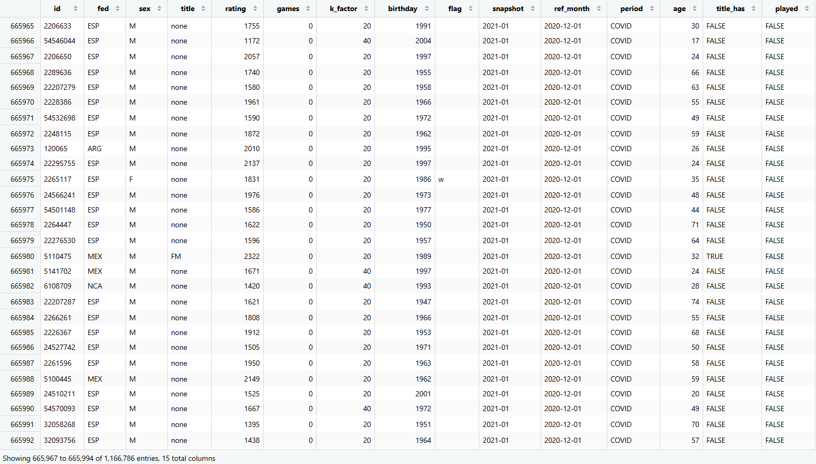
DATA · 02
The Final DataSet
SAMPLE OF THE CLEANED DATASET · 15 VARIABLES
Did over-the-board chess recover after COVID-19? — Honi Arora
05
Notes:
Source is FIDE Standard Rating Lists. Seven monthly snapshots span the baseline, pre-COVID, COVID and post-COVID periods.

Slide 6
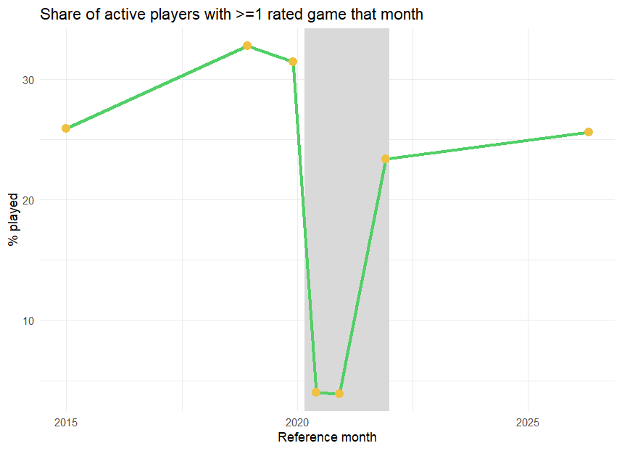
FINDING · 01
Participation collapse during COVID
Period | False | True
Pre-Covid | 231,657 (67.9%) | 109,493 (32.1%)
Covid | 329,715 (96.1%) | 13,539 (3.9%)
Post-Covid | 276,167 (75.3%) | 90,669 (24.7%)
χ² = 90,418 · p < .001 · Cramer's V = 0.29
A moderate association between period and tournament participation
Did over-the-board chess recover after COVID-19? — Honi Arora
06
Notes:
Share of active players who played a rated game collapsed from 32.1% pre-COVID to 3.9% during, recovering only to 24.7% by 2026. Chi-square 90,418, p<.001, Cramér's V 0.29.

Slide 7
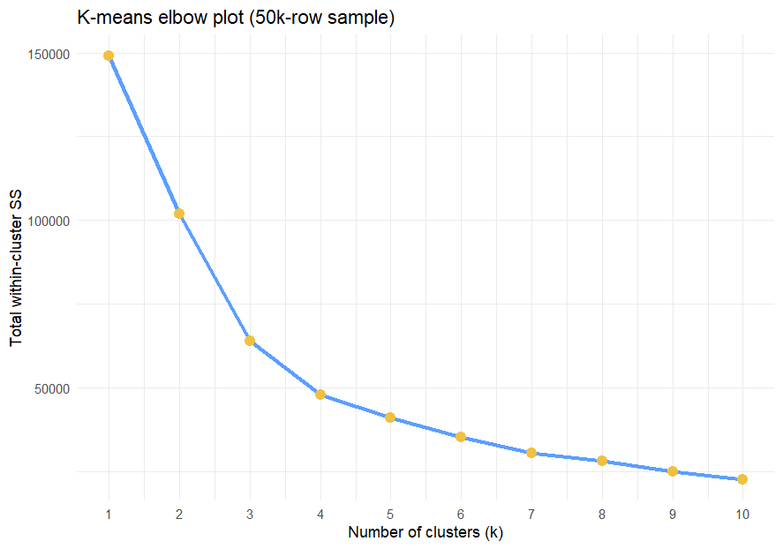
SEGMENTATION · 01
Elbow Plot for Determining Clusters
k = 4
a clear bend in the elbow curve
K-means groups players by similar rating, activity and age profiles.
These four clusters drive all subsequent player-segmentation analysis.
Did over-the-board chess recover after COVID-19? — Honi Arora
07
Notes:
K-means clustering on rating, activity and age. The elbow method shows a clear bend at k=4 — four meaningful player segments.

Slide 8
SEGMENTATION · 02
Four kinds of players
Young (Low-Activity)
Seniors (Low-Activity)
Regular Players
Strong (Low-Activity)
33% of players
28% of players
14% of players
26% of players
AVG. AGE
AVG. AGE
AVG. AGE
AVG. AGE
19
62
~33
~49
AVG. RATING
AVG. RATING
AVG. RATING
AVG. RATING
1372
1673
1689
2003
AVG. GAMES / MO
AVG. GAMES / MO
AVG. GAMES / MO
AVG. GAMES / MO
~0.3
~0.4
6.6
~0.7
Did over-the-board chess recover after COVID-19? — Honi Arora
08
Notes:
The four clusters: Inactive and Young, Inactive Seniors, Competitive Core, and Strong but Inactive. Only the Competitive Core drives most over-the-board participation.

Slide 9
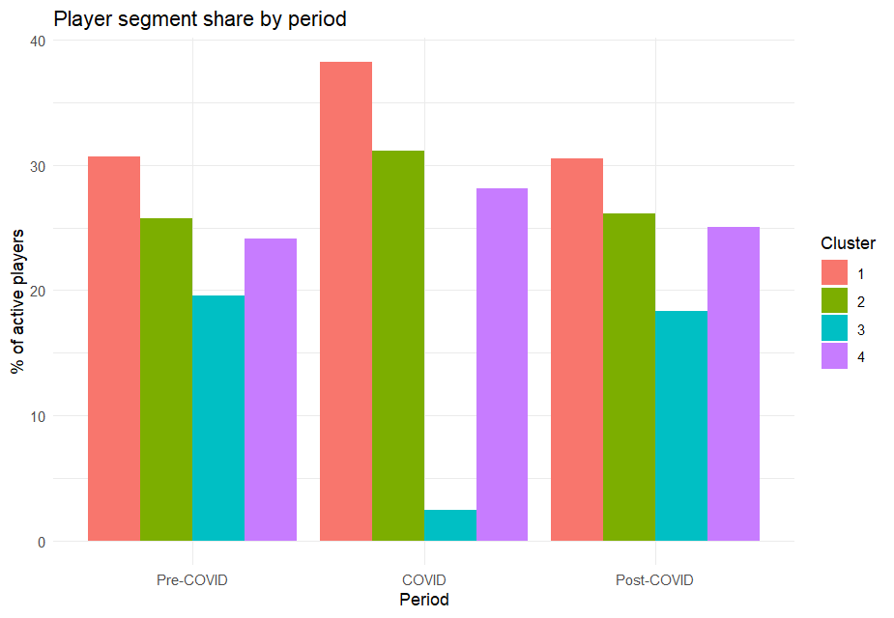
SEGMENTATION · 03
Cluster Graph
Tournament Regulars
Cluster 3 drops to roughly 2.5% of active players during COVID — then rebounds afterward.
The other three segments keep nearly the same share across all three periods.
Did over-the-board chess recover after COVID-19? — Honi Arora
09
Notes:
Segment share by period. The competitive core (cluster 3) nearly disappears during COVID and returns afterward, while the other three segments stay broadly stable.

Slide 10
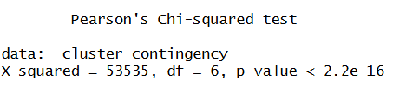
SEGMENTATION · 04
Were Clusters dependent on period?
LA-low activity
Period | Young (L.A.) | Seniors (L.A.) | Regulars | Strong (L.A.)
Pre-Covid | 103,225 30.7% | 86,535 25.7% | 65,903 19.6% | 81,084 24.1%
Covid | 129,812 38.3% | 105,625 31.1% | 8,331 2.5% | 95,555 28.2%
Post-Covid | 111,208 30.5% | 95,141 26.1% | 66,879 18.3% | 91,246 25.0%
PEARSON’S CHI-SQUARED TEST
χ² = 53,535
df = 6 · p-value < .001
Cramer’s V = 0.16 · moderate–weak
INTERPRETATION
Period and cluster membership are significantly associated (p < 0.001), but with a moderate-to-weak effect (Cramer’s V = 0.16).
Did over-the-board chess recover after COVID-19? — Honi Arora
10
Notes:
Segment share by period. The competitive core (cluster 3) nearly disappears during COVID and returns afterward, while the other three segments stay broadly stable.

Slide 11
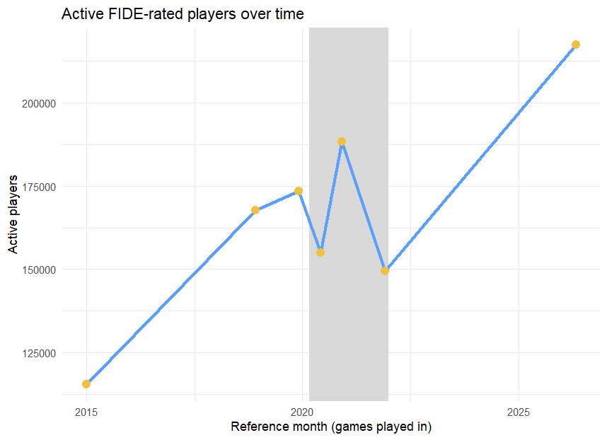
FINDING · 02
Growth of Active Players since 2015
115,546
217,459
→
active players, 2015 → 2026
≈ 88%
growth since 2015, even through the COVID dip
Active players are those with more than one rated tournament game per year. (Fide Handbook)
Did over-the-board chess recover after COVID-19? — Honi Arora
11
Notes:
Active players grew about 88% since 2015, even through the COVID dip — from 115,546 to 217,459.

Slide 12
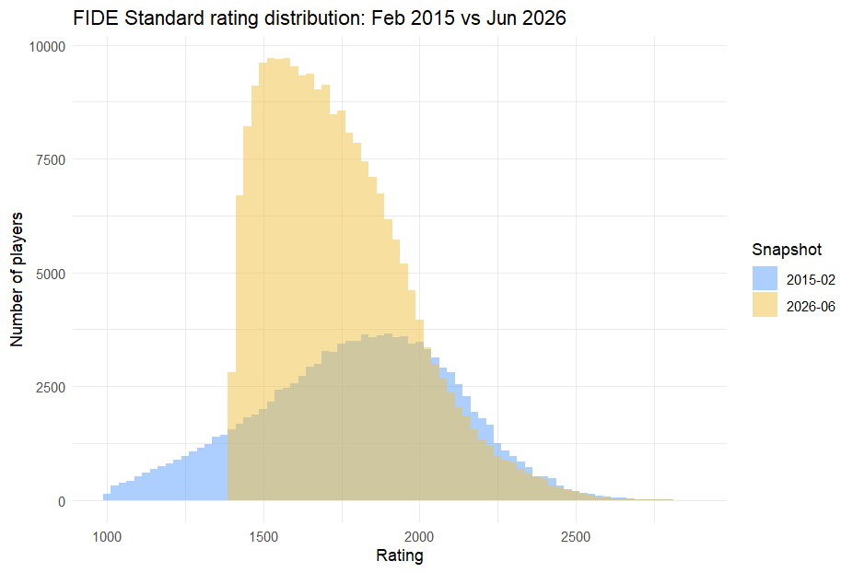
FINDING · 03
Player Rating Distribution
1799
1737
→
mean rating, 2015 → 2026 · SD (310 vs 224)
115,546
→
217,459
active pool nearly doubled
New, lower-rated players now make up a larger share of the pool.
Did over-the-board chess recover after COVID-19? — Honi Arora
12
Notes:
A bigger 2026 pool comes with lower average ratings. Mean rating falls from 1799 to 1737, Welch's t-test p<.001, as new lower-rated players join.

Slide 13
CONCLUSIONS
Conclusion
01 · PARTICIPATION
02 · POOL
03 · Clusters
−⅓
×2
86%
32% → 4% → 24%
116k → 217k players
Low Activity
Collapsed during COVID, only partly back by 2026.
Players nearly doubled, but average rating fell (1799 → 1737).
Only 14% compete in tournaments
regularly
BOTTOM LINE
OTB Chess grew in size, not in engagement — the post-COVID base is larger and more casual than before.
Did over-the-board chess recover after COVID-19? — Honi Arora
13
Notes:
Summary: participation collapsed then partially recovered; COVID had a real moderate effect; the pool nearly doubled while ratings fell; a structural shift toward casual players. Bottom line: chess grew in size, not engagement.

Slide 14
DATA MANAGEMENT & ANALYSIS · U2
Thank you for the attention.
Honi Arora · FIDE Master · 2162860
Sapienza University of Rome
Notes:
Thank you for the attention.

