Slide 1
Chess Piece Recognition:
Custom CNN vs YOLO
Honi Arora
Computer Vision & Deep Learning
Sapienza University of Rome

Slide 2
Table of contents
1
Problem & experimental design
2
Data pipeline
3
Models
4
Training & hyperparameter tuning
5
Results & analysis
6
Conclusions
Chess: Custom CNN vs YOLO — Honi Arora
2

Slide 3
Problem & experimental design
• Goal: recognize chess pieces from a board image; compare a small custom CNN classifier against YOLO detectors on accuracy, latency and compute.
• One shared synthetic dataset, processed into two views so both families see identical data:
View | Consumer | Unit | Labels
50×50 cell crops | Custom CNN | one board cell | 13 (empty + 12 pieces)
cell bounding boxes | YOLO (pico/n/s) | full board image | 12 piece classes
• Fair metric — “occupied-cell accuracy”: each YOLO detection is mapped to its grid cell; the top-confidence class per occupied cell is scored, putting detection on the CNN’s scale.
Chess: Custom CNN vs YOLO — Honi Arora
3

Slide 4
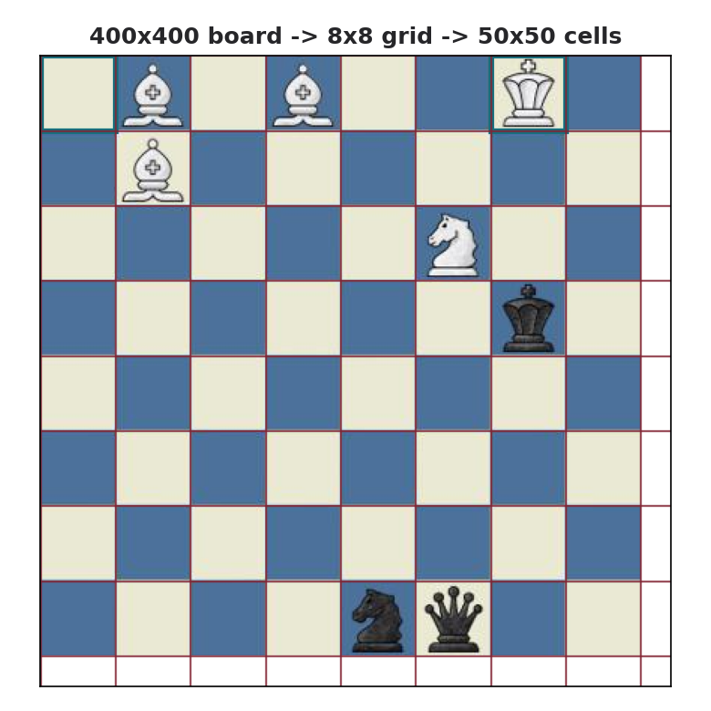
Data pipeline
• Source: koryakinp/chess-positions (Kaggle, CC0) — 100k rendered 400×400 boards; label = FEN in the filename; board fills the frame as a clean 8×8 grid (50×50 cells).
• FEN → 8×8 grid → 13-class index per cell (empty=0, white 1-6, black 7-12); occupied cells → YOLO cell-boxes (12-class).
• Working set: 20k train / 4k test boards.
• Class skew: 83% empty, kings 1/board, queens ~0.8%; balanced to ~429k crops (max_empty_ratio).
• Memmap crop cache: precompute (N,64,50,50,3) uint8 → training reads crops with zero JPEG re-decode.
• Kornia differentiable, GPU-batched augmentation (affine/jitter/noise/blur), strength is a tuned hyperparameter.
Chess: Custom CNN vs YOLO — Honi Arora
4

Slide 5
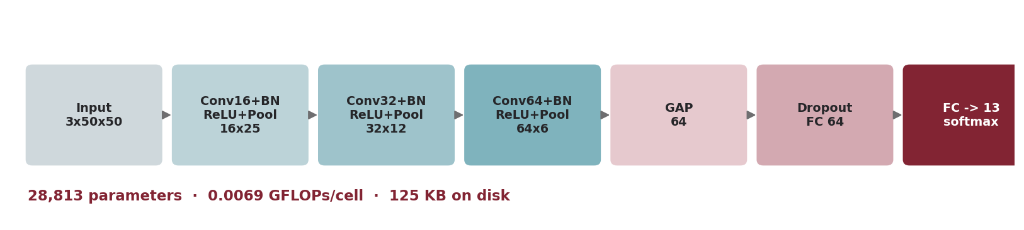
Models
YOLOv8 variants (trained on the same derived boxes):
Variant | Origin | Params | Note
yolo_pico | scaled YAML, from scratch | 184,300 | sub-nano stress test
yolov8n | pretrained (COCO) | 2,692,548 | standard nano
yolov8s | pretrained (COCO) | 9,843,604 | “big” model
Chess: Custom CNN vs YOLO — Honi Arora
5

Slide 6
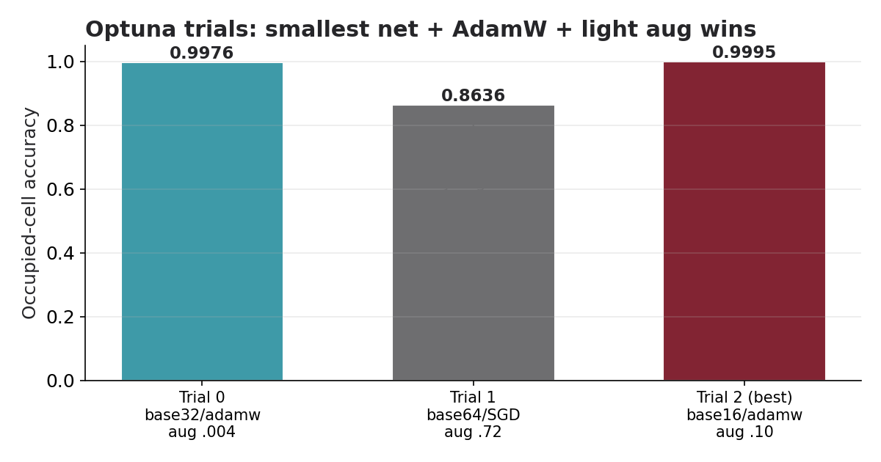
Hyperparameter tuning (CNN)
• Optuna study, SQLite storage (resumable), MedianPruner; each trial → a wandb run.
• Search space:
– lr, weight_decay (log); optimizer {adam/adamw/sgd}
– aug_strength 0–0.8; n_blocks 2–4; base_ch {16/32/64}
– fc_dim {64/128/256}; dropout 0–0.5; batch {128/256/512}
• Dual stop: target accuracy OR time budget; ETA predicted from a calibration mini-run.
• Insights: AdamW ≫ SGD; heavy augmentation hurts clean renders; the smallest net (28.8k params) won.
Chess: Custom CNN vs YOLO — Honi Arora
6

Slide 7
Training methodology
• Engineering: spec → plan → 19-task TDD build; per-task spec + code-quality review; 38 unit/smoke tests.
• Hardware-aware: RTX A4000 16 GB; 90% GPU-memory cap; monitored soft RAM guard (RLIMIT_AS breaks CUDA).
• CNN speed (measured): 0.0283 s/step → ~38 s/epoch → ~142 s per 6-epoch trial; target hit in 1 epoch.
• Two-phase tuning: target 0.995 was met instantly (trial 0) → raised to 0.999 to force real exploration.
• YOLO: imgsz 416, 12 epochs, 25% data fraction; n/s from COCO weights, pico from scratch; optimizer=auto (AdamW).
• Final CNN rebuilt from the best Optuna trial (FixedTrial), retrained, saved, pushed to Hugging Face.
Chess: Custom CNN vs YOLO — Honi Arora
7

Slide 8
Results — head-to-head
Model | Occ-acc | mAP@50-95 | Params | GFLOPs/bd | Lat ms/bd | Disk MB | Train s
custom_cnn ★ | 0.9996 | — | 28,813 | 0.442 | 0.514 | 0.125 | ~38
yolo_pico | 0.2073 | 0.255 | 184,300 | 0.236 | 5.491 | 0.567 | 260
yolov8n | 1.0000 | 0.995 | 2,692,548 | 1.469 | 4.346 | 5.594 | 537
yolov8s | 1.0000 | 0.995 | 9,843,604 | 4.985 | 6.067 | 19.918 | 734
• Pretrained YOLOs are perfect (grid-aligned boxes are trivial to localize); CNN trails by only 0.04 pp.
• CNN vs yolov8n: ~93× fewer params, ~8.5× lower latency, ~45× smaller — at ~equal accuracy.
• Pico (sub-nano, from scratch) collapses to 20.7% and is even slower than nano.
Chess: Custom CNN vs YOLO — Honi Arora
8

Slide 9
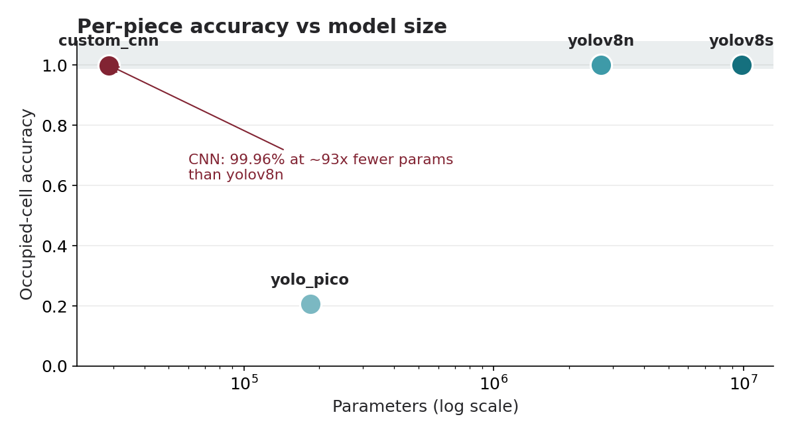
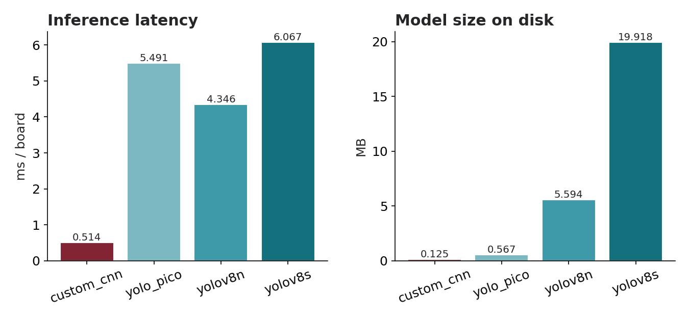
Results — accuracy vs cost
• Shrink the paradigm, not just the width: a tiny CNN classifier learns in 1 epoch; a tiny detector cannot.
Chess: Custom CNN vs YOLO — Honi Arora
9

Slide 10
Conclusions & recommendations
• On grid-croppable / embedded targets: ship the custom CNN — 99.96% at 125 KB and 0.5 ms/board.
• For robust real-photo recognition: yolov8n pretrained — perfect here, no board-cropping step, best generalization; yolov8s adds cost without accuracy.
• Do not train a sub-nano YOLO from scratch on small data.
• Trade-off: the CNN’s efficiency assumes an 8×8 grid (free from synthetic geometry); real boards need detection/perspective first — YOLO’s strength.
• Future work: real-photo test set (ChessReD2K), full-data YOLO + HPO sweep, board→FEN reconstruction.
Chess: Custom CNN vs YOLO — Honi Arora
10

Slide 11
Artifacts & reproducibility
• Code: github.com/Honi05/cvproject (TDD, 38 tests, PR #1).
• CNN model: huggingface.co/honi05/chess-piece-cnn
• YOLO models (pico/n/s): huggingface.co/honi05/chess-piece-yolo
• Derived dataset: huggingface.co/datasets/honi05/chess-positions-cv
• Experiment tracking: Weights & Biases — project chess-cnn-vs-yolo (Optuna trials + comparison).
• One command per stage: 01_build_data → 02_train_cnn → train_all_yolo → full_compare → push_artifacts.
Chess: Custom CNN vs YOLO — Honi Arora
11

Slide 12
References
• Dataset: P. Koryakin, “Chess Positions”, Kaggle (CC0).
– Jocher et al., Ultralytics YOLOv8.
– Akiba et al., “Optuna: A Next-generation Hyperparameter Optimization Framework”, KDD 2019.
– Riba et al., “Kornia: an Open Source Differentiable CV Library for PyTorch”, WACV 2020.
– Slides template: github.com/pietro-nardelli/sapienza-ppt-template (CC BY-NC-SA 4.0).
Chess: Custom CNN vs YOLO — Honi Arora
12

Slide 13
Thank you for the attention!

