Slide 1










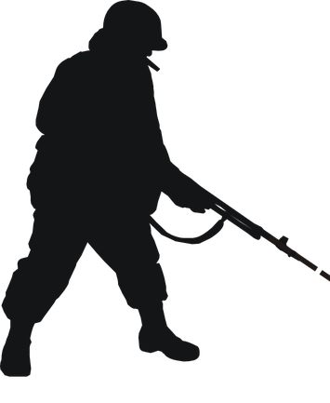


Slide 5
00
11
22
33
44
55
66
77
88
99

