Slide 1










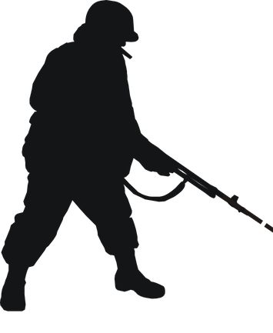


Slide 5
00
11
22
33
44
55
66
77
88
99
00
If roll was successful …
Superior Success
2x Superior Success
11
22
33
44
55
66
77
88
99
2x Superior Failure
Superior Failure
… if roll failed

Slide 6
You have credentials.
You don’t have credentials, but …
… you observe an authenticated user’s mesh traffic.
… you have >1h.
… you have 1 turn.
Attacker -30 if VPN
Attacker -30
Hacking Test
Attacker Infosec vs. Defender Firewall (or Infosec)
Get user-level access (Superior 1x: security, 2x: root).
Covert Status.
No Alert.
Can impersonate user.
Only one-way.
Covert Status.
Spotted Status.
Active Alert.
On Success
Hidden Status.
Covert Status.
Passive Alert.
Critical
System aware of discrepancies.
Passive Alert.
(If Defender succeeds on roll regardless of overall outcome.)
System aware of tampering.
No Access.
Passive Alert.
Failure

Slide 7
Upgrading Status
Complex Hacking action
Superior success upgrades 2x steps
Does not erase previous logs, but harder to locate attacker.
Hidden
System unaware. No Logs. +10 to subvert.
Covert
System aware. Does not consider threat.
Spotted
System considers threat. Launches CM. Active alert.
Downgrading Status
Critical failure during any Infosec causes Spotted.
Zero In (Infosec vs. Infosec) by system defender (-30 if attacker hidden). If successful causes Spotted.

Slide 8
Psi Chi
Psi Gamma
Simple
Opposed
Infection Rating 33+
“Increased Effect” push auto applied.
Infection Rating 66+
One free push effect applied (same each time).
Ranged sleight used in ...
Touch (+20), 2m (+10), 10m (±0),
12m (-10), 14m(-20), …
Target Type
Pods / Cyberbrains (-30)
Non-Human (up to -30 or impossible)
Psi Test
Target Full Defense (+30)
Success: Effects takes place.
Critical Success: Double Potency.
Critical Failure: 1D6 DV
Defender Critical Success: Lock Out
Defender success regardless of outcome: Aware of something.
Infection Test (if pushed)
Infection Test

Slide 9
If pushed Psi Chi: IM + 5 and 1D6 DV
If pushed Psi Gamma: IM x 2 and 1D6 DV
Raise Infection Rating (IR) by
Sleight’s Infection Modifier (IM)
Spending Moxie
1x: Avoid test if not pushed.
1x: Avoid DV if pushed.
2x: Avoid test and DV if pushed
Infection Test
(The ‘virus’ rolls, not the character)
Critical Failure: Virus loses grip until next recharge.
Failure: Nothing else happens.
Critical Success
Checkout (takes over in sleep) or
Interference (critical failure in future).
Success
Roll D6 (1+ per superior),
consult strain table.

